Slide 1
Breaking Down Silos to Foster a Culture of Data-Driven Decision Making
Michael Dillon, Associate Vice-Provost of Institutional Research, UMBC
Terry Fernandez, Senior Director, IT Customer Service, American University
Scott Krajewski, Director of IT, Augsburg College
“This presentation leaves copyright of the content to the presenter. Unless otherwise noted in the materials, uploaded content carries the Creative Commons Attribution-NonCommercial-ShareAlike license, which grants usage to the general public with the stipulated criteria.”

Slide 2
The Plan for Our Session
Act 1: Quick Independent Survey
Act 2: Presenter Perspectives
Act 3: Group Exercise

Slide 3
Audience Poll
Let’s take a moment to learn a little more about our colleagues in the room today.

Slide 4
A Quick Independent Survey
Please spend the next 5-10 minutes answering these two questions.
What are the key action(s) an institution should take to create a culture of data-driven decision making?
How would you rate your institution’s current level of maturity regarding data-driven decision making?
Record your answers on the survey form in front of you. Then, share your institutional ranking with the colleagues at your table.

Slide 5
How Do You Compare?
Results of the CDS 2014 Analytics Maturity Index - Average of All US Institutions
Notes:
Courtesy of Leah Lang, EDUCAUSE

Slide 6
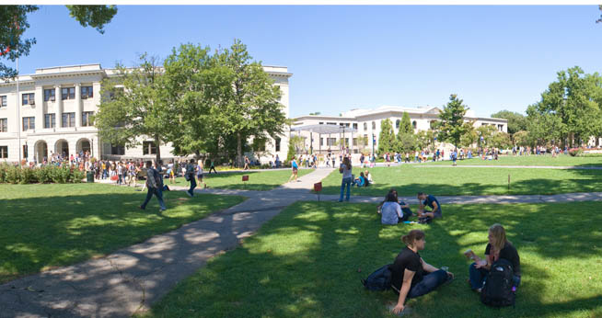
Expanding Use of Help Desk Ticketing System Across Campus
OIT & Campus Technology Partners
AU Central: Registrar, Financial Aid, & Student Accounts
Procurement & Contracts
Public
Safety
Human Resources
Undergrad. Academic Advisors for 2 Schools
Notes:
Evolution – and interplay between top down and organic Provost gets this info and thinks this cool, I want this from all
Academic Advising
How to use a ticketing system as a starting point
Becomes embedded in the culture of the institution
Institutional effectiveness and best practices

Slide 7
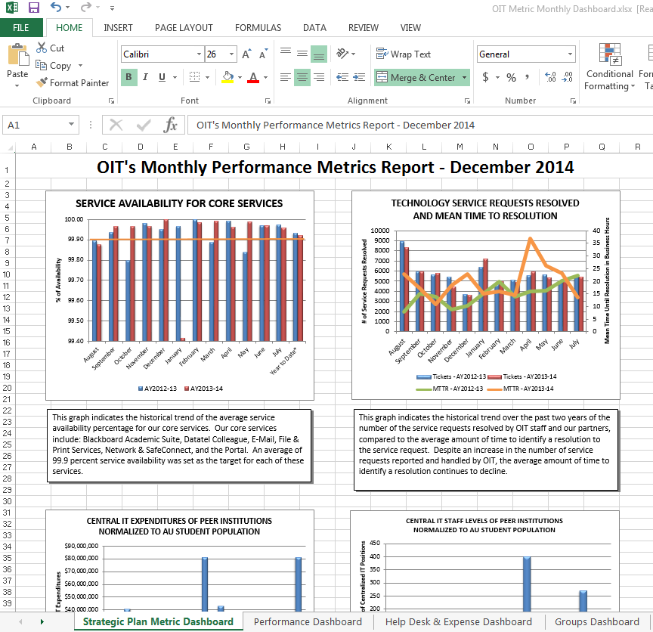
AU Office of Information Technology’s Compelling Business Need

Slide 8
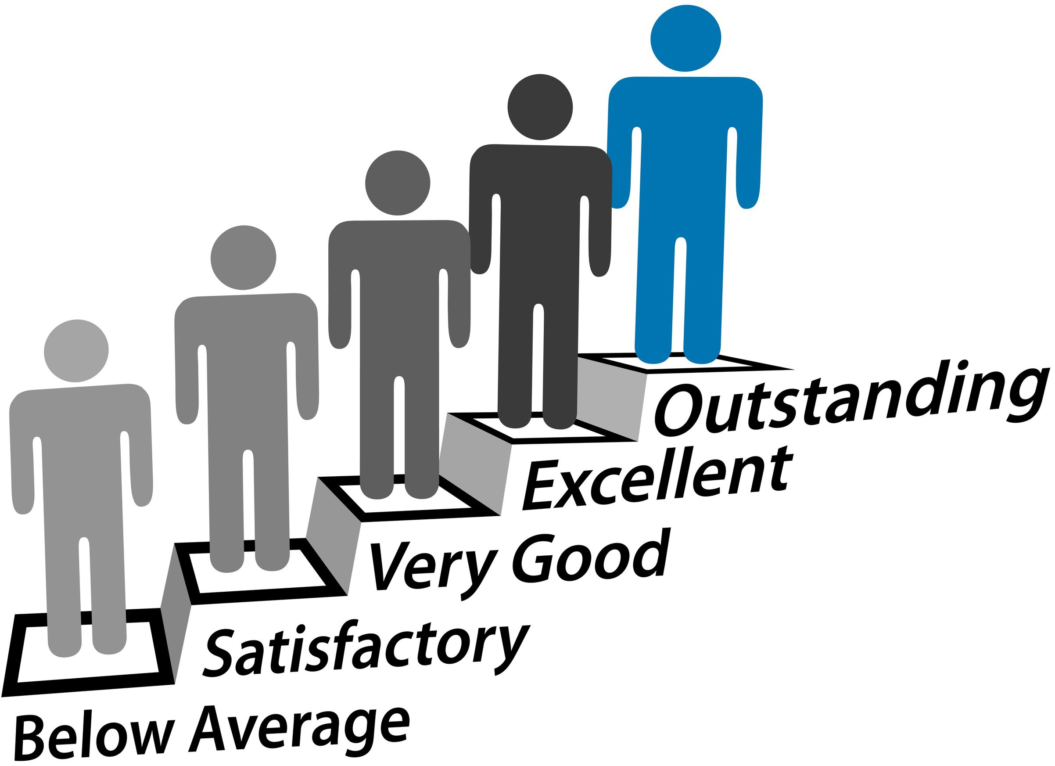
Has a compelling business need been identified?
Get IT (or IR) Out of the Middle
of Every Reporting Request
Improve Satisfaction/Performance
Gain Competitive Advantage/
Benchmark Against Peers
Notes:
There is a desire to:
Make more intelligent decisions faster
Use data from the past to benchmark against current performance
Monitor real-time performance to make changes in strategy at the most meaningful times
Predict future performance
Need to visually represent data
University leaders are acutely aware that buried in all their data is the secret sauce for competitive differentiation.
At AU, empowerment of campus power users and getting IT our of the middle of every reporting request, so they can focus on strategic initiatives.

Slide 9
Who is the champion to push for the right tools and make the tough decisions?
Top Down: President Kerwin for
Business Intelligence Program
Bottom Up: OIT Senior Leaders for Service
Management Dashboards Only
Notes:
A data warehouse / business intelligence initiative can rise organically from the bottom-up, gain momentum from the top-down, or both. AU has experienced both. They are expanding BI one domain at a time.

Slide 10
Is there a sound relationship established between IT, IR, and the business units?

Slide 11
Are there individuals within the business units with required key competencies?
Notes:
Are there individuals within the business units with required key competencies?
Someone that questions the status quo, a strong critical thinker.
Someone that understands the data domain and business needs.
Someone that can define the problem and narrow the analysis.
Someone with good communication and presentation skills.
Is there a culture of analysis in the business units, where they are relying on the data to make decisions?
Data is being collected.
Basic analytics are available, but often requires countless hours to create spreadsheets and reports.
Desire for self-service.

Slide 12
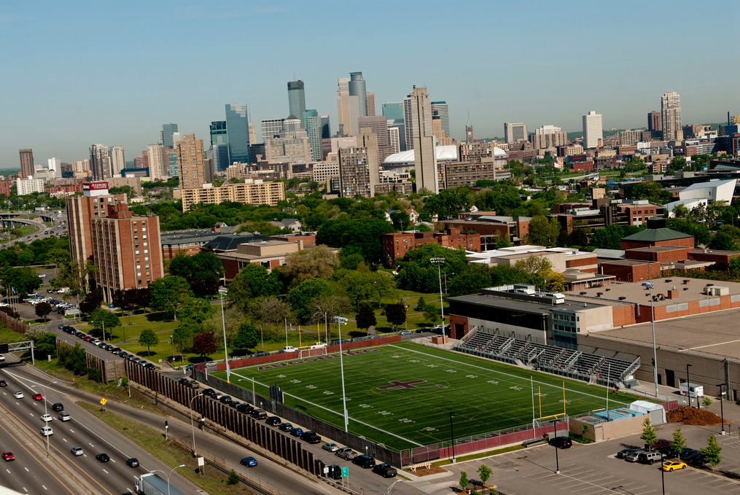
Notes:
institutional capacity

Slide 13
Notes:
president, new strategic plan

Slide 14
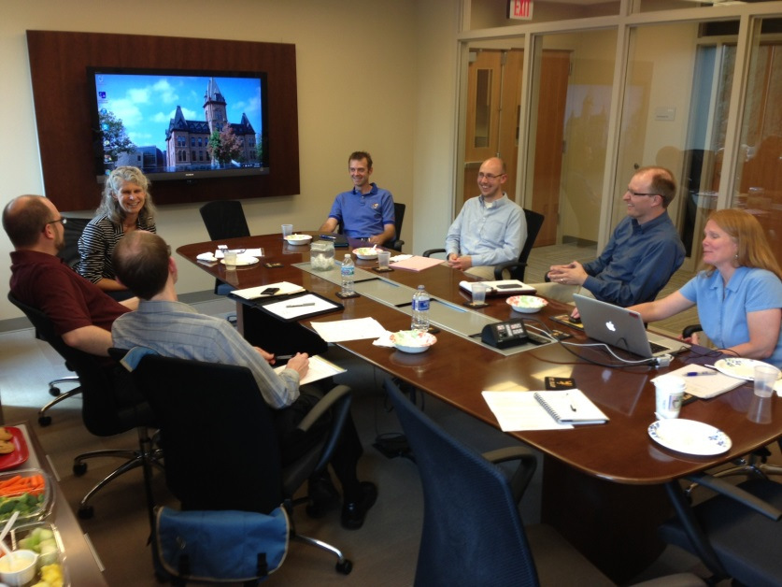
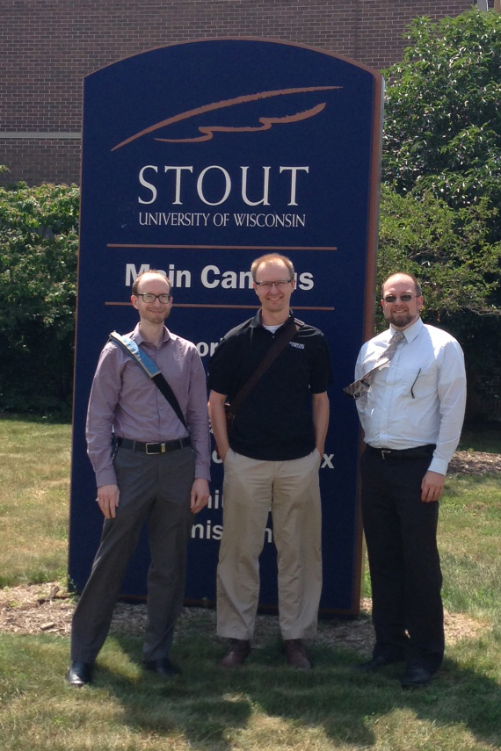
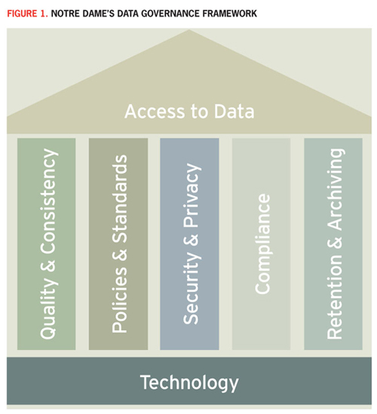
Notes:
community of practice, find models and visit, pick a few things and deliver, find out question looking to be answered

Slide 15
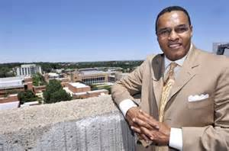
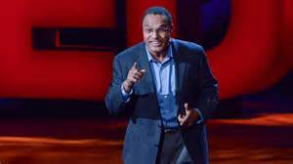
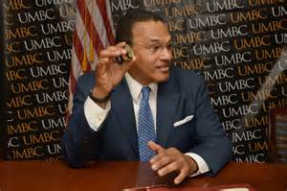
Notes:
I am from UMBC, a mid-sized research university located in Baltimore Maryland. Some have you may have seen our President Freeman Hrabowski speak. If you haven’t and have the opportunity to hear him speak please do so; he is a blast. And yes, it is fun to have someone like that as President.

Slide 16
Diagram Six The Lazy Analyst
The World
(Data)
Analyst
Clean Source
Data Cleaning
Questions
Answers
+
+
Error Checking
Decision
Maker
Questions
Data Warehouse
+
Answers
Notes:
I am from Institutional Research. Data Warehousing and Business Analytics can seem scaring to some IR folks. They may no longer be the trusted advisor of the leadership if the decision makers can get what they need from the warehouse without their assistance.

Slide 17
Degrees
Diagram Nine: An Extremely Simple Dynamic Model of a University
Reputation
Quality of Instruction
Quality/Quantity of Research
Quality of Student Cohort
Classes per Faculty
Hire/Retain Faculty
Students per Faculty
Grad
Rate
Gainful Employment
Enroll
Revenue
Endowment
Enrolled per Admit
Alumni Giving
Apps per Admit
Admit
Merit-based Aid
Apply
Notes:
Universities are complicated organisms. This is important to understand if you are thinking about tearing down silos within their environment. Changing the environment can be healthy, even reinvigorating, but it needs to be done with care.

Slide 18
How do I get buy-in?
Be the only game in town!
Notes:
UMBC has done relatively well in its efforts to date in enhancing strategic planning by creating a campus wide reporting environment One advantage is that we coordinated the implementation of our data warehouse solution with our People Soft Student Administration implementation. People needing reports had little choice but to use the new reporting solution.

Slide 19
Group Exercise
Please select one of the playing cards in the center of the table. Once everyone has their card, identify the role that you will be asked to play at EDUCAUSE University, based on the on-screen key.
Please note: the cards are for assignment purposes only and do not denote gender or organizational importance.

Slide 20
Role | Playing Card (any suit) | Role | Playing Card (any suit)
Academic Advisor |  | Head of Facilities
Academic Dean |  | Head of Human Resources
Chief Information Officer (or equivalent) |  | Head of Institutional Research
Dean of Students/ Student Affairs |  | University Registrar
Head of Enrollment

Slide 21
Quick Trade Opportunity
You have 30 seconds to trade cards/roles with a colleague.

Slide 22
Role | Playing Card (any suit) | Role | Playing Card (any suit)
Academic Advisor |  | Head of Facilities
Academic Dean |  | Head of Human Resources
Chief Information Officer (or equivalent) |  | Head of Institutional Research
Dean of Students/ Student Affairs |  | University Registrar
Head of Enrollment

Slide 23
Group Exercise Instructions
Congratulations! Each of you has been selected to serve on a cross-functional committee tasked with developing a strategy to create a data-driven culture of decision making at EDUCAUSE University.
Please read the brief description of your assigned role, as well as the key motivators unique to this role. Use this as your guide to try to think through the key components of a successful strategy, using a new lens or filter.

Slide 24
Group Exercise Instructions
Consider requirements for governance, infrastructure, data collection and reporting tools, process, expertise, and investment. You have been tasked with answering these three questions:
What are the characteristics of institutional readiness?
How would you ensure institutional buy-in?
What elements are needed for successful data collection and appropriate use?
Use the markers and paper at each table to organize your notes, as we will ask each group to share their strategy.

