Slide 1
Analytics in Higher EDUCATION:
Progress and Promise
Jacqueline Bichsel, PhD, and Susan Grajek, PhD
EDUCAUSE Center for Applied Research
June 2012

Slide 2
OBJECTIVES
Assess the current state of analytics in higher education.
Outline the challenges and barriers to using analytics.
Develop a maturity index to provide a common means of assessing progress in analytics.

Slide 3
Methodology
Two surveys
Seven focus groups
  IT and IR professionals from around the country
  EDUCAUSE members (N=214, 21% response rate)
  AIR members (N=125, 25% response rate)

Slide 4
The Current state of analytics

Slide 5
Analytics is a major priority
Analytics is a major institutional priority at 24% of higher education institutions
8–10% of AA, BA, and BA LA are not interested or not aware
Only true of 3–4% of MA and DR
What priority does your institution place on analytics? N = 255 (excluded “other”), EDU + AIR

Slide 6
Analytics is a major priority
Publics are leading, but are privates catching up?
What priority does your institution place on analytics? N = 275, EDU + AIR

Slide 7
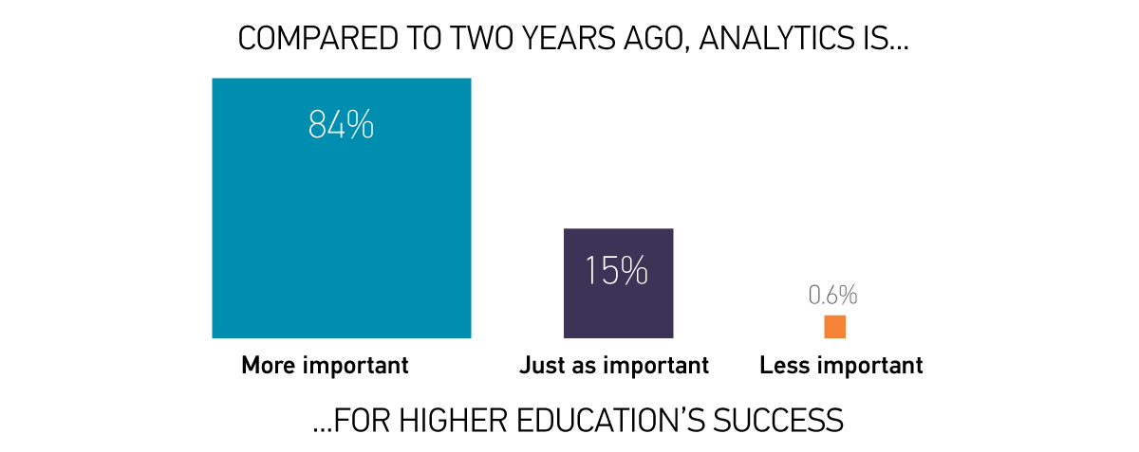
Analytics is a major priority
INSERT TYSON CHART 9
N = 339, EDU + AIR

Slide 8
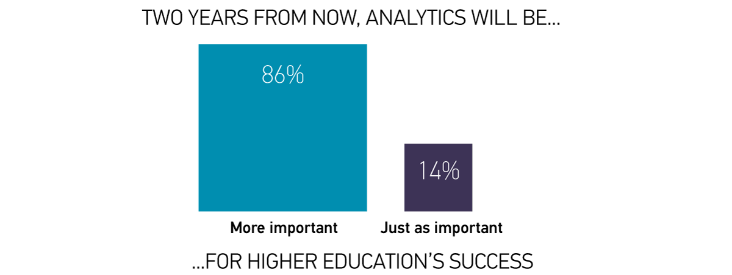
Analytics is a major priority
N = 339, EDU + AIR

Slide 9
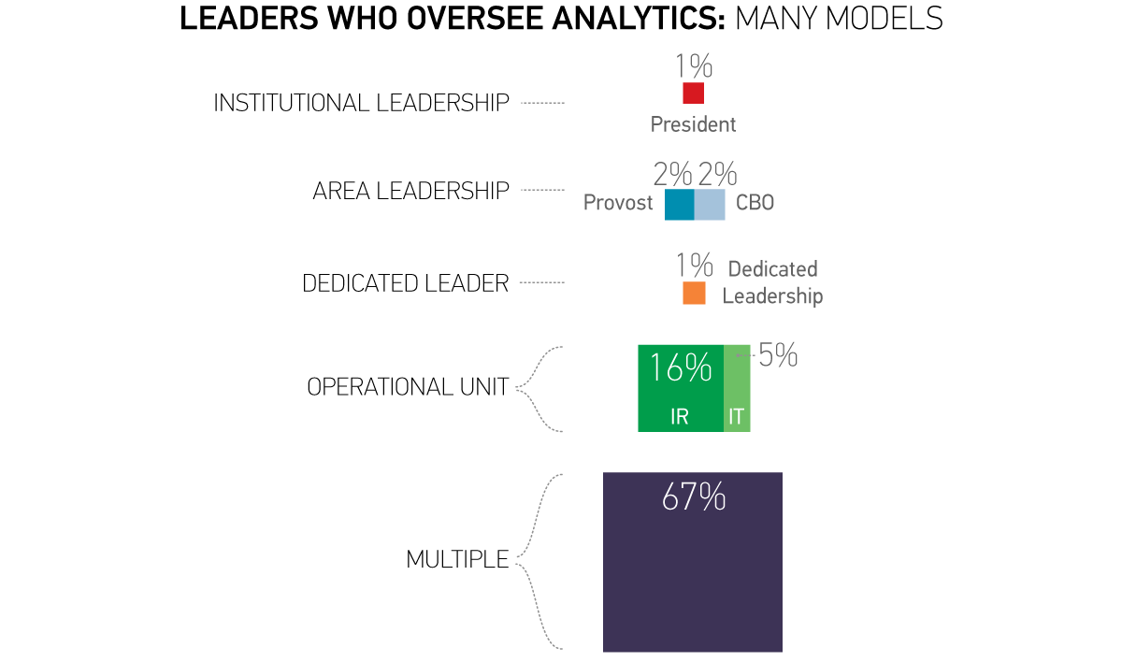
Leaders who oversee analytics: Many Models
INSERT TYSON CHART 1
Which leaders or areas oversee analytics at your institution?, N = 180,EDU ONLY

Slide 10
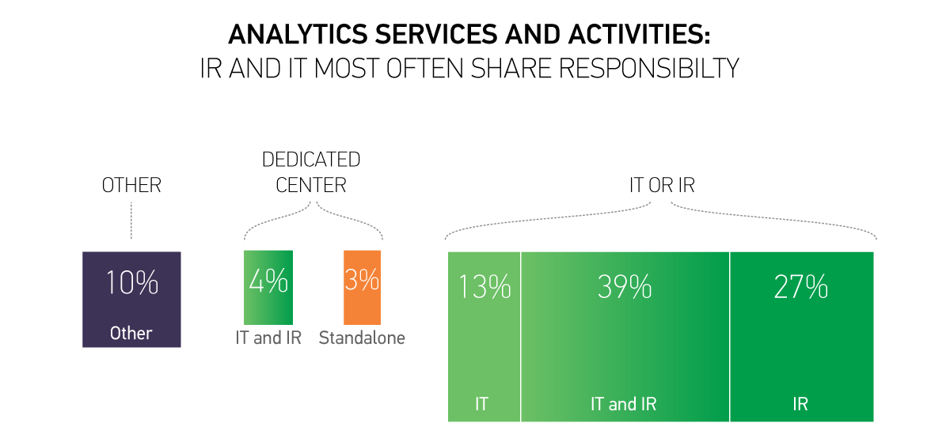
analytics services and activities:
IR and IT Most often Share Responsibilty
How are analytics services and activities delivered at your institution?, N = 180, EDU ONLY

Slide 11
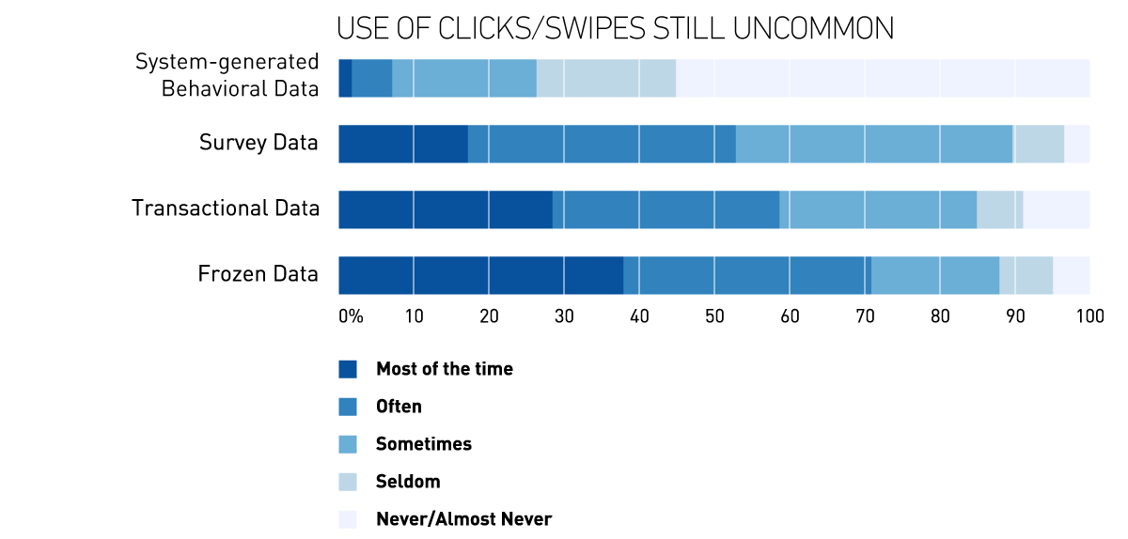
DATA USED FOR ANALYTICS
INSERT TYSON CHART 3
To what extent are the following types of data used in analytics activities? N = 180, EDU ONLY

Slide 12
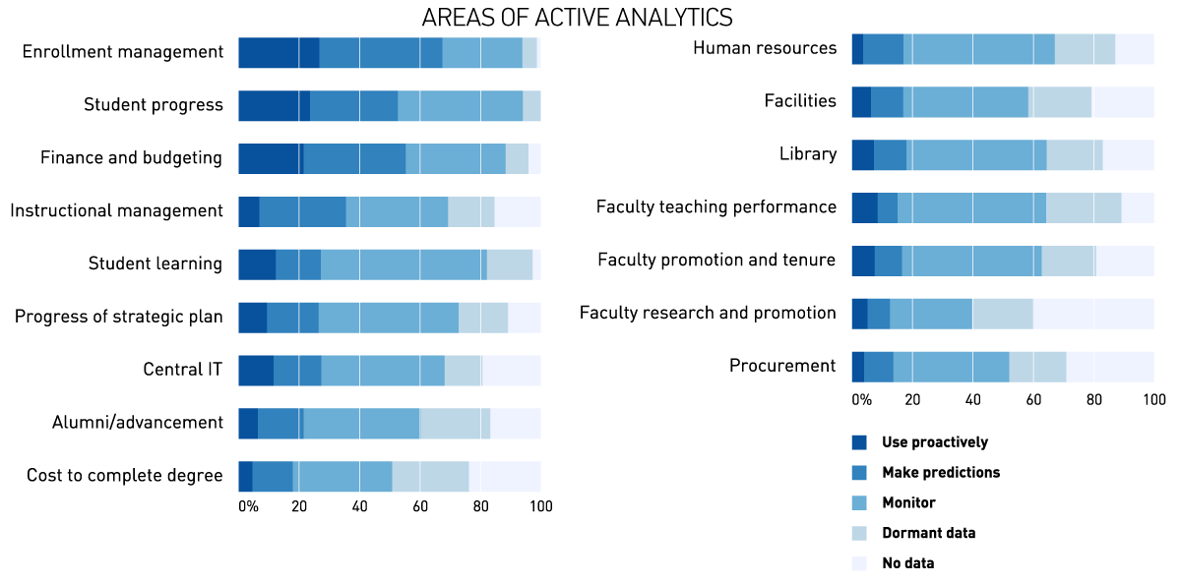
MOST ACTIVITY IN STUDENT and FINANCE AREAS, LEAST IN FACULTY
INSERT TYSON CHART 4
Provide your best estimate of how data are being used at your institution.; N = 339, EDU + AIR
Notes:
More than 50% of institutions are using data to make predictions or to be proactive.

Slide 13
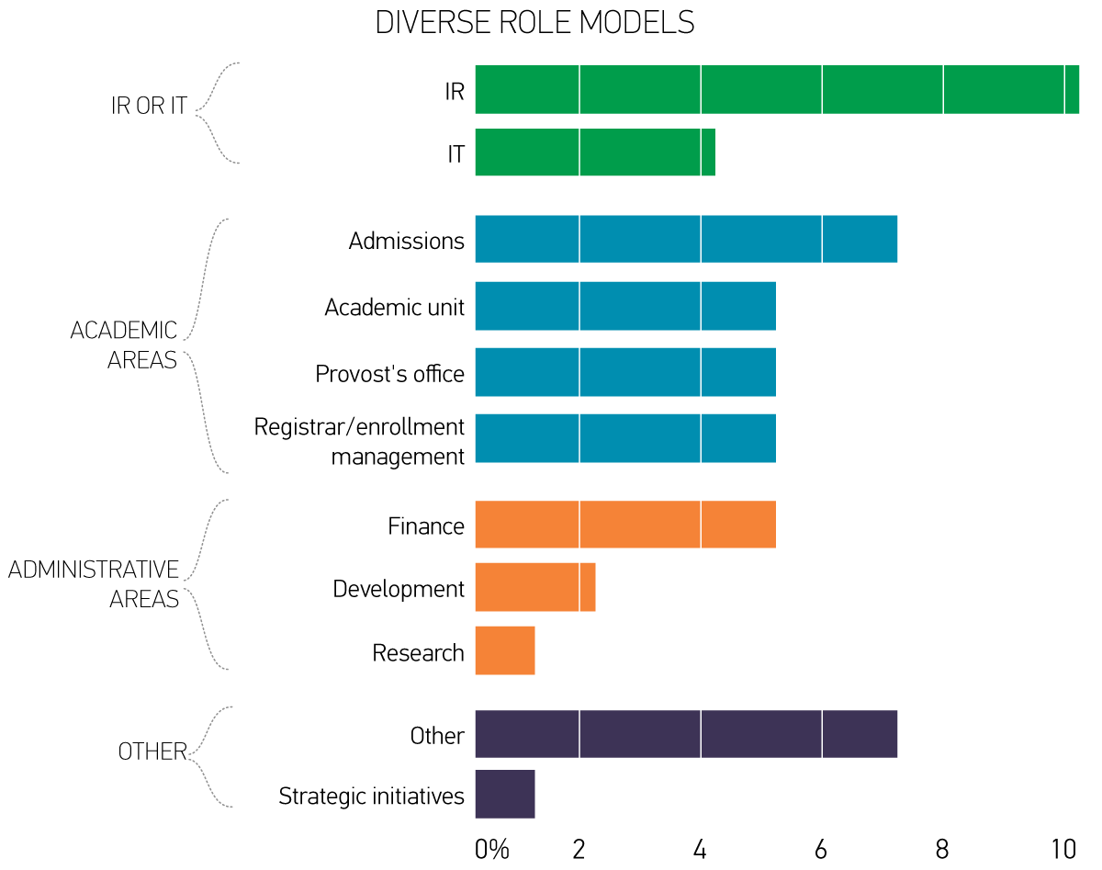
Specify the departments , units, or programs that are role models for analytics; EDU members only.

Slide 14
Opportunities, Challenges, and barriers

Slide 15
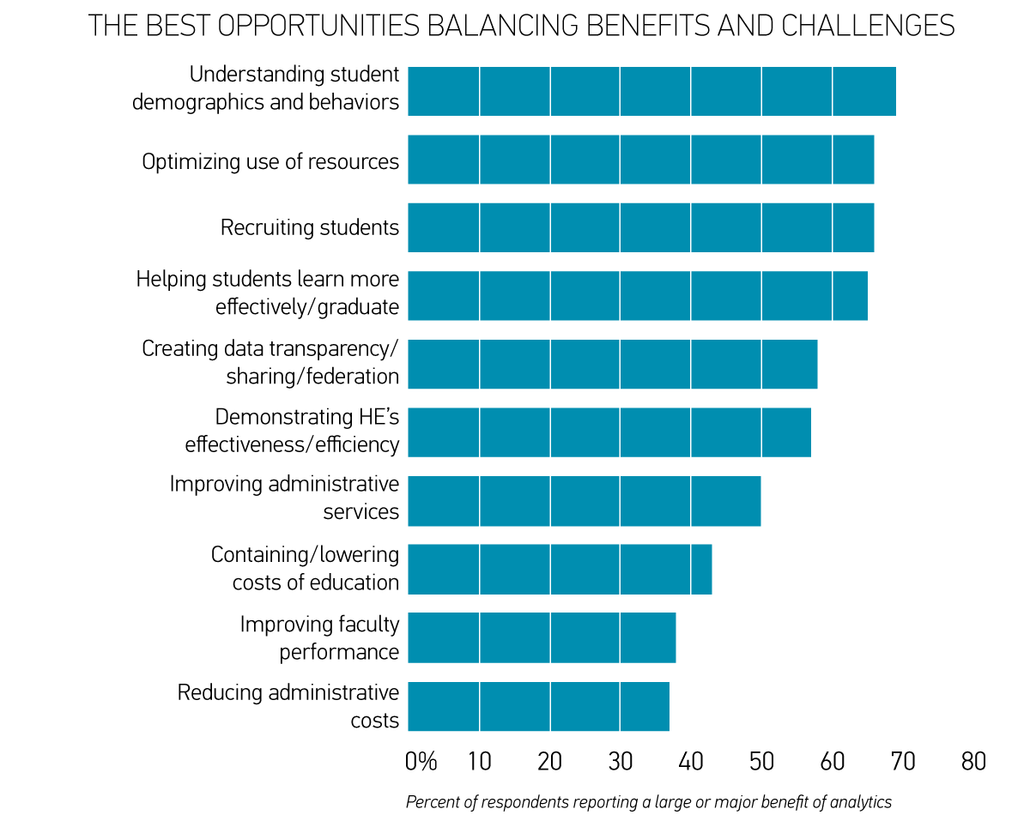
MORE OPTIMISM AROUND STUDENT AREAS THAN COST OR FACULTY
What are the potential benefits of analytics in addressing the following challenges?; N = 339, EDU + AIR

Slide 16
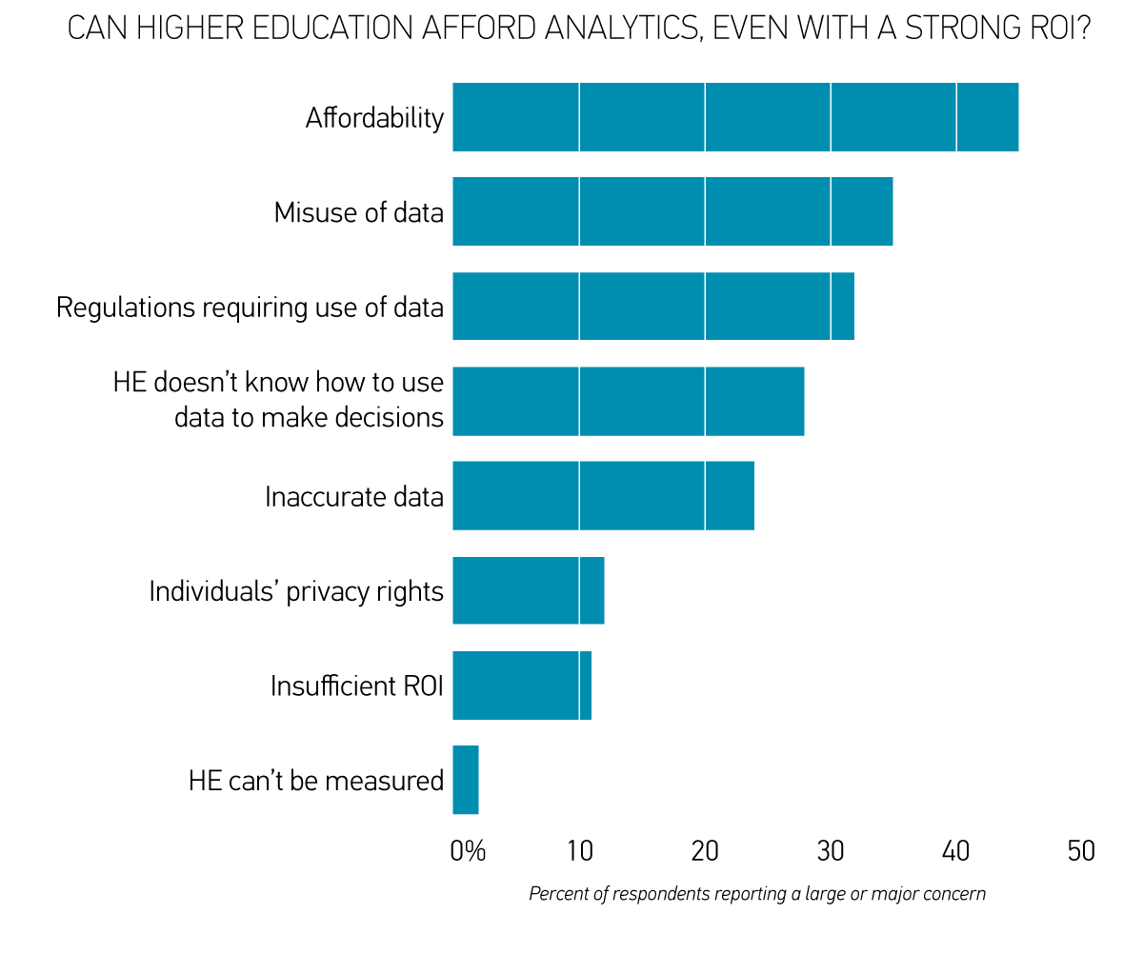
DATA AND AFFORDABILITY ARE THE BIGGEST CONCERNS
erwyrewgf
What are your concerns about the growing use of analytics in higher education?; N = 339, EDU + AIR

Slide 17
Maturity
What are the components of analytics, and how capable is higher education today?

Slide 18
ANALYTICS maturity in higher education has five components
CULTURE
  Committed leadership; culture accepts use of data to make decisions
DATA & TOOLS
  Clean, standardized data and reports; right tools and software
INVESTMENT
  Funding and staffing for analytics
  Derived from factor analysis of 21 items asking
  “To what extent are the following in place to enable your institution to make progress with analytics?”
N = 339, EDU + AIR

Slide 19
Five components of higher Education analytics maturity
EXPERTISE
  IR and/or business professionals with analytics training
INFRASTRUCTURE
  Storage capacity; IT professionals supporting analytics; policies regarding security and rights to data
WHERE DO WE STAND?

Slide 20
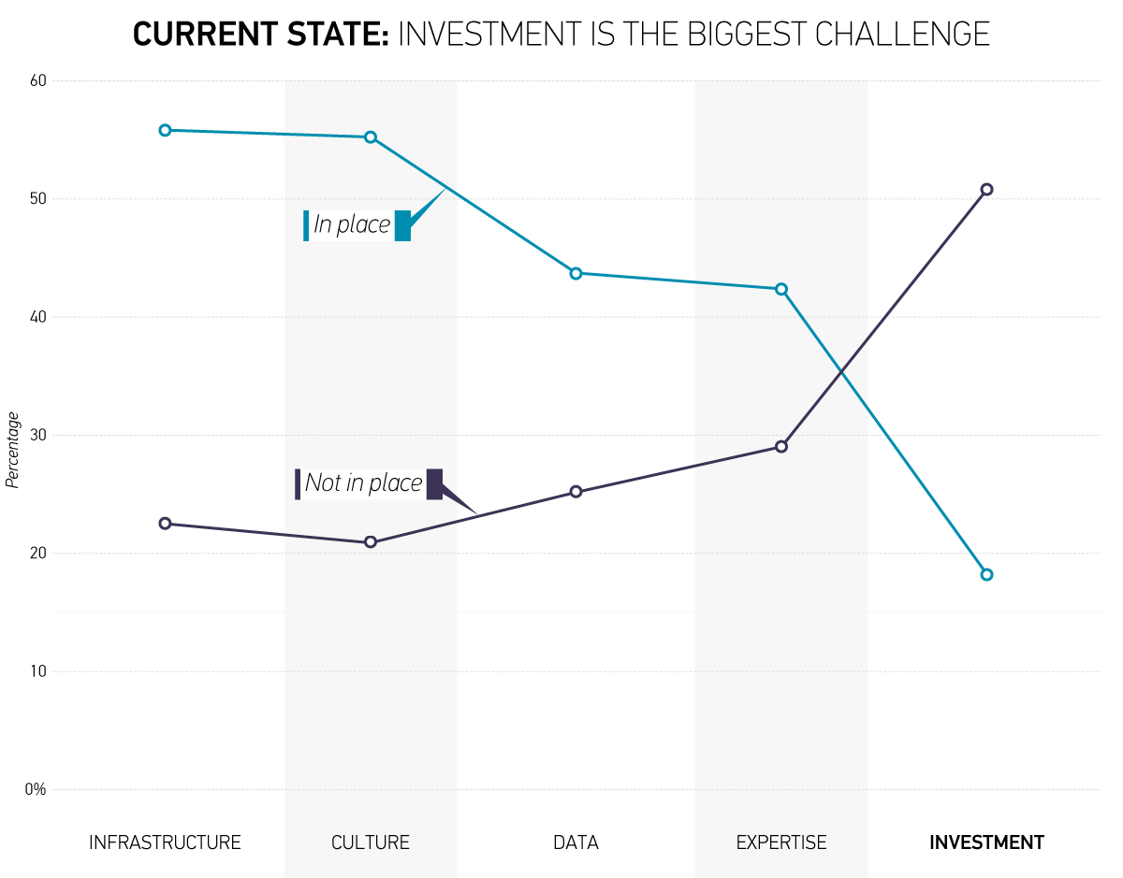
CURRENT STATE: INVESTMENT IS THE BIGGEST CHALLENGE

Slide 21
Once again, leadership is the magic ingredient
Senior leaders need to make analytics a priority
Institutions that place a higher priority on analytics are further ahead with
  Culture
  Investment
  Expertise
  Infrastructure
  …but not Data

Slide 22
NEXT STEPS WITH THIS STUDY
Examining Carnegie class, control, size.
  Still reviewing the data, but no clear differences found to date, except for size.
Analyzing focus group results for better context and insights.
Work on maturity index has just begun.
The final results will be released in August.

Slide 23
SUMMARY and final points
Analytics is widely viewed as important.
IR and IT are both critical partners.
  IT is more optimistic than IR regarding the potential of analytics.
  IT rates maturity higher on Culture and Infrastructure.
  IR rates maturity higher on Expertise.
  Preliminary focus group analysis suggests that great analytics programs have good communication between IR and IT.

Slide 24
Summary and final points
Analytics activities are occurring throughout institutions, but student and financial areas are the most active.
Least optimism that analytics can be used to lower HE costs…but promise is seen in optimizing resource usage.
The big challenge: How can higher education afford analytics?

