Slide 1
The Current State of Research Computing in Higher Education
Susan Grajek
ECAR Annual Meeting, Tempe, Arizona, January 2014

Slide 2
Research in Higher Education

Slide 3
Research is four things: brains with which to think, eyes with which to see, machines with which to measure and, fourth, money.
- Albert Szent-Gyorgyi

Slide 4
Amazing Growth
Growth from 1958 to 1968
Academic research and development +417%
Academic research expenditures+587%
Federally funded academic R&D +618%
Number of American research universities
1945
+
2000
Early 1960s
Source: National Research Council. Research Universities and the Future of America: Ten Breakthrough Actions Vital to Our Nation's Prosperity and Security. Washington, DC: The National Academies Press, 2012

Slide 5
US Leadership in Academic Research
35-40 of Top 50 Research Universities
~60% of Nobel Prize Winners since 1930s
More international students enroll in U.S. research universities than their counterparts elsewhere
Source: National Research Council. Research Universities and the Future of America: Ten Breakthrough Actions Vital to Our Nation's Prosperity and Security. Washington, DC: The National Academies Press, 2012

Slide 6
Contributions to the US Economy
MIT
4,000 MIT-related companies
1.1 million people employed
Annual world-wide sales of $232 billion
Equivalent to among the 40 largest economies in the world
Source: National Research Council. Research Universities and the Future of America: Ten Breakthrough Actions Vital to Our Nation's Prosperity and Security. Washington, DC: The National Academies Press, 2012
Notes:
The Massachusetts Institute of Technology (MIT) has reported that 4,000
MIT-related companies employ 1.1 million people and have annual
world sales of $232-billion—a little less than the gross domestic product
of South Africa and of Thailand, which would make MIT companies
among the 40 largest economies in the world

Slide 7
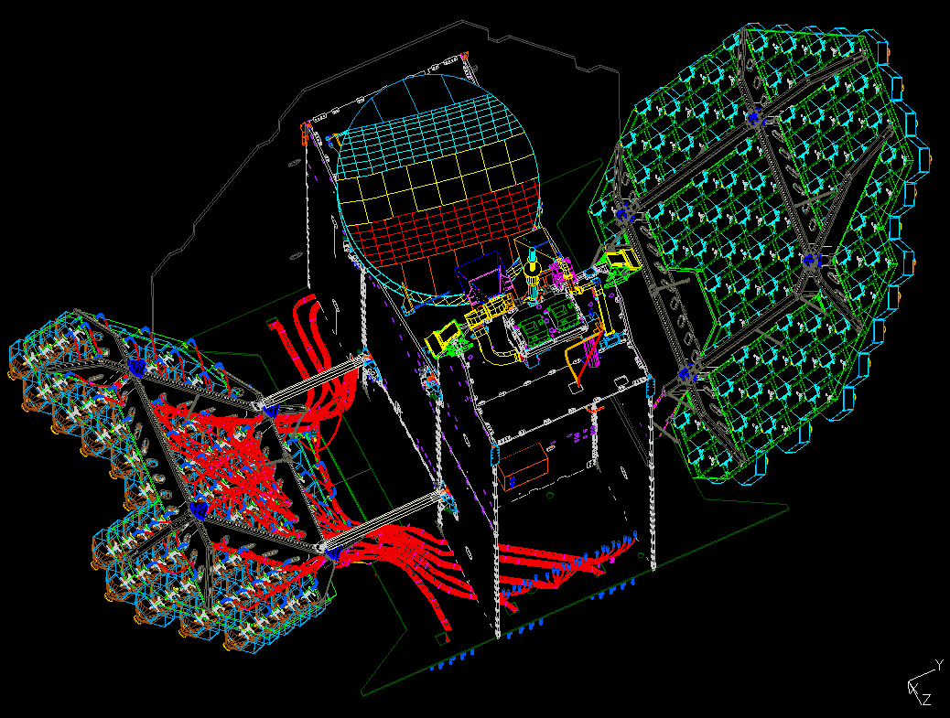
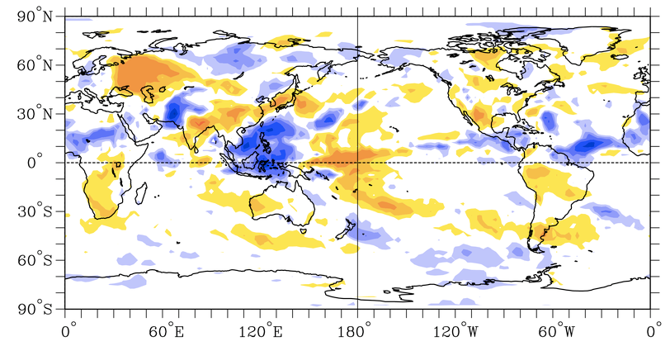
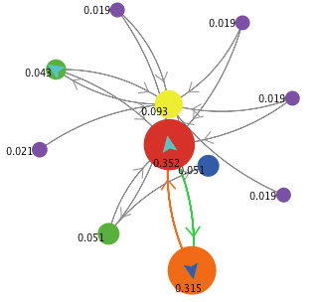

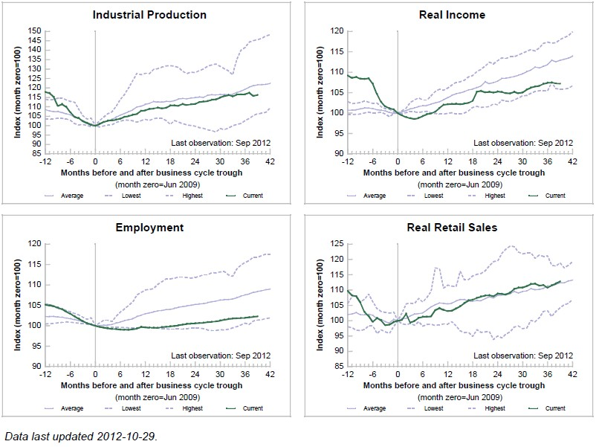
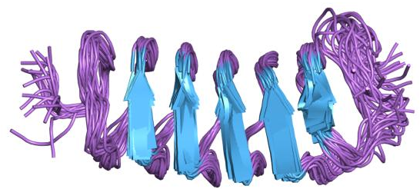


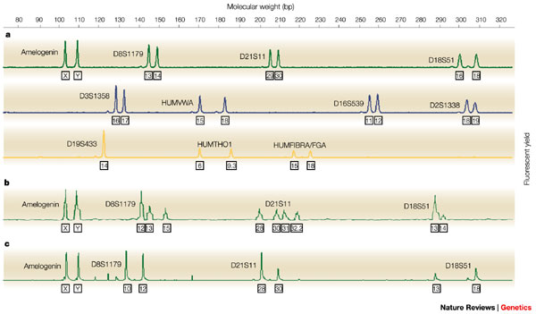
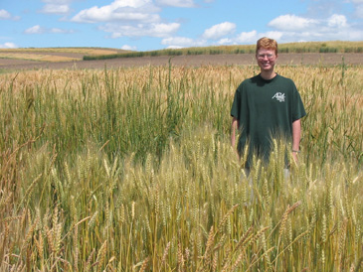

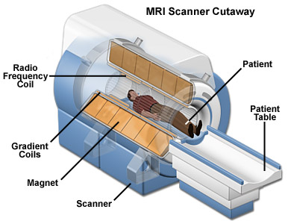
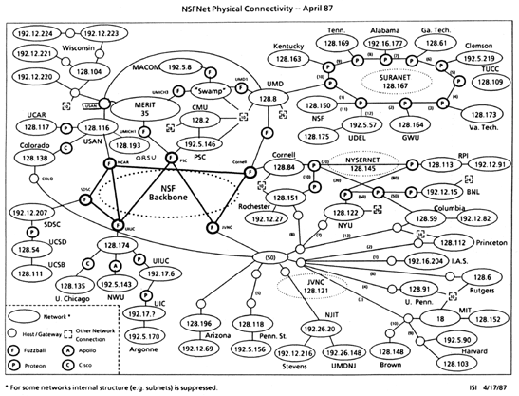
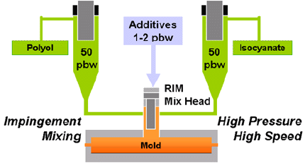
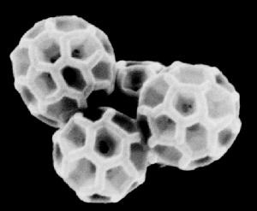
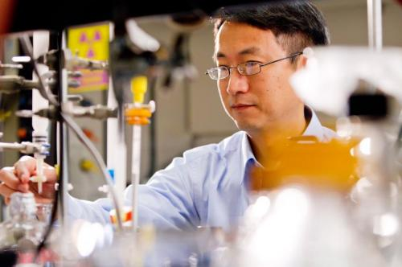
Sensational Products
Basic research has a 25 year pay-off: It takes that long to realize (and sometimes recognize) the potential of a break-through innovation.
Notes:
Bar code scanners
Computer-assisted design
Anti-freeze proteins used in ice cream, cosmetics, fish farming, and tissue transplants
Genetic plant research that has led to the development of new crops
Improved biofuels
The application of modified Buckeyballs in medicine and in building materials
Low-cost, low-energy use methods for obtaining clean drinking water
Improved understanding of business cycles and economic policies
Forensic DNA analysis
The development of revolutionary weather-sensing networks
MRI technology
Reaction injection molding that has led to lighter and more fuel-efficient automobiles
solid-state physics and ceramics/glass engineering essential to the optical fibers
The PageRank method that led to Google
NSFNET, the telecommunications that developed into the Internet
Cosmic microwave background radiation

Slide 8
Today
2012
“Our research universities are, today, the best in the world and an important resource for our nation, yet at the same time, they are in grave danger of not only losing their place of global leadership but of serious erosion in quality due to critical trends in public support.”
- National Research Council. Research Universities and the Future of America: Ten Breakthrough Actions Vital to Our Nation's Prosperity and Security., 2012
2007
“Having reviewed trends in the United States and abroad, the committee is deeply concerned that the scientific and technological building blocks critical to our economic leadership are eroding at a time when many other nations are gathering strength.”
- National Academy of Sciences, National Academy of Engineering, and Institute of Medicine, Rising Above the Gathering Storm: Energizing and Employing Americans for a Brighter Economic Future, 2007

Slide 9

What happened?

Slide 10
Government, businesses and higher education partnership weakens
Unstable and declining federal funding for university research
Cuts in state funding for higher education
Business and industry have largely dismantled the large corporate research laboratories that drove American industrial leadership
Concerns about academia’s track record in management, productivity, and cost efficiency
Increases in R&D funding in other countries
Source: National Research Council. Research Universities and the Future of America: Ten Breakthrough Actions Vital to Our Nation's Prosperity and Security. Washington, DC: The National Academies Press, 2012
Notes:
“While research efforts are increasing across the globe, top research remains
highly concentrated. A new indicator of research impact—measured by normalized
citations to academic publications across all disciplines—shows that 40 of the
world top 50 universities are located in the United States, with some US universities
excelling in a wide range of disciplines. Stanford University features among
the top 50 for all 16 subject areas, and 17 other US universities feature in the top
50 in at least 10 scientific fields.
“A more diverse picture emerges on a subject-by-subject basis. The United
States accounts for less than 25 of the top 50 universities in social sciences, a
field in which the United Kingdom plays a key role. The universities producing the
top-rated publications in the areas of earth sciences, environmental science and
pharmaceutics are more evenly spread across economies. Universities in Asia
are starting to emerge as leading research institutions: China has six in the top
50 in pharmacology, toxicology and pharmaceutics. The Hong Kong University
of Science and Technology is among the top universities in computer science,
engineering and chemistry.”

Slide 11
Increases in R&D funding in other countries
US Ranking on the Global Competiveness Index
World Economic Forum in 2013: #5
Location of top 50 universities
Other OECD includes other European, Australia, Canada, Israel, Japan, Korea, Mexico, and New Zealand
Non-OECD includes Brazil, China, Chinese Taipei, Hong Kong, China, India, Iran, Lithuania, Malaysia, Singapore, South Africa and Thailand
Source: Organisation for Economic Co-operation and Development, 2013
Notes:
Other OECD includes Australia, Canada, Israel, Japan, Korea, Mexico, New Zealand, Norway and Switzerland.
Other EU (and OECD) includes Austria, Belgium, the Czech Republic, Denmark, Finland, France, Germany, Greece, Ireland, Italy, the Netherlands, Poland, Portugal, Spain and Sweden.
Non-OECD includes Brazil, China, Chinese Taipei, Hong Kong, China, India, Iran, Lithuania, Malaysia, Singapore, South Africa and Thailand.

Slide 12
Location of top 50 universities by discipline areas
Other OECD includes other European, Australia, Canada, Israel, Japan, Korea, Mexico, and New Zealand
Non-OECD includes Brazil, China, Chinese Taipei, Hong Kong, China, India, Iran, Lithuania, Malaysia, Singapore, South Africa and Thailand
Source: Organisation for Economic Co-operation and Development, 2013
Notes:
Other OECD includes Australia, Canada, Israel, Japan, Korea, Mexico, New Zealand, Norway and Switzerland.
Other EU (and OECD) includes Austria, Belgium, the Czech Republic, Denmark, Finland, France, Germany, Greece, Ireland, Italy, the Netherlands, Poland, Portugal, Spain and Sweden.
Non-OECD includes Brazil, China, Chinese Taipei, Hong Kong, China, India, Iran, Lithuania, Malaysia, Singapore, South Africa and Thailand.

Slide 13
Operational challenges
Declining opportunities for new faculty
Underinvestment in campus infrastructure, particularly in cyberinfrastructure
Accumulating regulatory and reporting requirements
Research sponsors do not always pay the full costs of research
Increased competition for international students, researchers, and scholars
Source: National Research Council. Research Universities and the Future of America: Ten Breakthrough Actions Vital to Our Nation's Prosperity and Security. Washington, DC: The National Academies Press, 2012

Slide 14
But our Grand Challenges remain
Sources: Grand Challenges of Engineering, National Academy of Engineering, National Research Council, 2008. Social, Behavioral and Economic Research in the Federal Context, Report of the National Science and Technology Council Subcommittee on Social, Behavioral and Economic Sciences, January 2009

Slide 15
Research Computing

Slide 16
Staffing

Slide 17
IT FTE by IT domain
CDS2013 M1Q24
Notes:
Compare to gartner benchmark

Slide 18
How is your institution organized to support research?
departments independently provide research IT services
minimal resources
integrated set of research IT services
planning an integrated set of research IT services
CDS2013 M4Q1

Slide 19
Which unit is responsible for research computing?
CDS2013 M1Q6

Slide 20
Services

Slide 21
Consulting and support services Primarily central IT
CDS2013 M4Q2

Slide 22
Consulting and support services Primarily shared
CDS2013 M4Q2

Slide 23
Consulting and support services Primarily other unit
CDS2013 M4Q2

Slide 24
Consulting and support services Primarily not provided
CDS2013 M4Q2

Slide 25
Operational research services offered
Not assessed in 2011

Slide 26
Operational research services offered
Not assessed in 2011

Slide 27
Most common management models
Central IT
High-performance network provisioning within the institution (90%)
High-performance external network provisioning (80%)
Provision of data center facilities for academic units to operate their servers (67%)
Videoconferencing services (64%)
High-throughput computing services (43%)
High-performance computing services (43%)
Institutional grid computing services (34%)
System
Access to specialized scientific apparatus (e.g., telescope, sensor network, etc.) (68%)
Institutional grid computing services (34%)
Shared
Management of research servers owned by academic units (48%)
An integrated system of research-related services, sometimes known as cyberinfrastructure or support for e- science (45%)
Data management, storage and curation services (44%)

Slide 28
Outsourcing is uncommon
Most commonly outsourced services are:
High performance network provisioning (5.4%)
High throughput computing services (5.1%)
Institutional grid computing services (4.6%)
An integrated system of research-related services (4%)
Outsourcing is almost always to non-commercial services providers

Slide 29
Research computing practices

Slide 30
Number of research services offered related to CIO’s reporting relationship
Average number of research services offered
Who CIO Reports to

Slide 31
Expenditures

Slide 32
Percent spent by IT domain
CDS2013 M1Q16,19,20
Notes:
2.5% overall spent on outsourcing support

Slide 33
Central IT operating expenditures
CDS2013 M1Q16
Notes:
DR pub spending a little more proportionally on comm infrastructure
AA spending a little more on support

Slide 34
Central IT capital expenditures
CDS2013 M1Q16
Notes:
DR pub investing in comm infrastructure
DR priv investing in info systems
BA priv investing in enterprise infrastructure

Slide 35
Central IT capital vs. operating
CDS2013 M1Q13

Slide 36
IT expenditures by institutional mission
CDS2013 M1Q17
Notes:
Not enough data to do by CC

Slide 37
Percent of IT budget spent on research mission
Who CIO Reports to

Slide 38
Greater allocation of IT budget to research associated with more research services
Average number of research services: 11
% of IT Budget Spend on Research Mission
Average allocation to research: 4%
Number of research services and technologies

Slide 39
Relationship between research, administrative, and teaching spending
% of IT Budget Spend on Research Mission
Number of Research Services and Technologies

Slide 40
A Maturity Model for Research Computing

Slide 41
ECAR Research Computing Maturity Index
http://www.surveygizmo.com/s3/1125699/Research-Computing-Maturity-Index

Slide 42
Maturity: Infrastructure
We have appropriate bandwidth available for research computing.
We have adequate storage capacity for research computing
We have adequate processing capacity for current research computing needs.
We have adequate processing capacity for future research computing needs if demand increases.
We have adequate floorspace for research computing servers.
We have adequate power available for research computing.
We have adequate cooling available for research computing.
Our institution has a high-performance computing (HPC) system in place.
We provide specialized software/apparatus for research computing needs.

Slide 43
Maturity: Central IT involvement and service quality
Research computing is prominent in Central IT strategic plans.
Most of our Central IT staff are aware of the benefits of providing research computing services.
Central IT has regular communication with researchers regarding their research computing needs.
Central IT plays an integral part in providing research computing services on campus.
Central IT staff are frequently written into research grants to provide research computing services.
Central IT regularly communicates with researchers across campus regarding the research computing services that are available.
Central IT is proactive rather than reactive in responding to research computing requests.
The wait time for research computing consulting assistance is adequate.
The wait time for other research computing requests is adequate.

Slide 44
Maturity: Investment
At our institution, research computing is viewed strategically as an institutional-priority investment—where the benefits outweigh the costs—rather than as an expense or auxiliary item.
We have a funding model for research computing that works for our institution.
We have an adequate number of specialized central and/or distributed IT staff dedicated to providing research computing services.
IT staff across campus are provided ongoing training in the provision of research computing services.

Slide 45
Maturity: Culture
Administrative leaders at our institution place a high priority on research computing.
Researchers at our institution place a high priority on research computing.
Research computing at our institution is centrally managed.
Research computing at our institution is centrally planned.
Research computing services and technologies support a variety of academic disciplines at our institution.
At our institution, the researchers themselves (or their departments or units) are responsible for obtaining all their research computing needs.
Our institution has clear policies on research computing.
Faculty are generally satisfied with the provision of research computing technologies at our institution.
Faculty at our institution have incorporated data-intensive research into the curriculum.

Slide 46

If we knew what it was we were doing, it would not be called research, would it?
- Albert Einstein

Slide 47
Thank you!
Susan Grajek, Ph.D.

