Slide 1
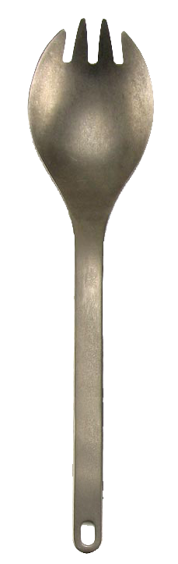

BETTER THAN REMOVING YOUR APPENDIX WITH A SPORK: DEVELOPING FACULTY RESEARCH PARTNERSHIPS
Dr. Gerry McCartney
Vice President for Information Technology and System CIO
Olga Oesterle England Professor of Information Technology
2014 ECAR Annual Meeting
Notes:
PHOTOS:
Left: Steele installation, May 5, 2008.
Center: Students using PAL wireless network.
Right: Steve Abel, assistant dean for clinical programs School of Pharmacy and Pharmaceutical Sciences Purdue University, works with third-year pharmacy students in an immersive 3-D virtual version of a pharmacy clean room. The students will soon be beginning their practicum year and working in real clean rooms, a transition the “flight simulator” is designed to make easier, and safer for patients.

Slide 2
OUR MISSION
Implement novel business models for the acquisition of computational infrastructure to support research

Slide 3
2007: BEFORE CLUSTER PROGRAM
Faculty purchase computers in a variety of platforms from multiple vendors
Research computers housed in closets, offices, labs and other spaces
Grad students support computers rather than focus on research
Inefficient utility usage
Wasted idle time cycles
Redundant infrastructures for scattered sites

Slide 4
2008: STEELE
A New, Collaborative Model
ITaP negotiates “bulk” research computer purchase
Existing central IT budget funds investment
Researchers buy nodes as needed/access other, idle nodes as available
Infrastructure/support provided centrally at no cost to researchers
Money-back guarantee

Slide 5
“I’d rather remove my appendix with a spork than let you people run my research computers.”

Slide 6
2008: STEELE
Results
12 early adopters increase to over 60 faculty
1,294 nodes purchased in 4 rounds
  $600 savings per node (40%)
  Collective institutional savings more than $750K
Ranking: 104 in Top 500; 3 in Big Ten
No one acted on money-back guarantee

Slide 7
  “ITaP completely took care of the purchasing, the negotiation with vendors, the installation. They completely maintain the cluster so my graduate students can be doing what they, and I, want them to be doing, which is research.”
  — Ashlie Martini
  associate professor of mechanical engineering,
  University of California Merced
  “In a time when you really need it, you can get what you paid for and possibly more, when available. And when you don’t need it, you share with others so they can benefit from the community investment.”
  — Gerhard Klimeck
  professor of electrical and computer engineering
  and Reilly Director of the Center for Predictive Materials and Devices
  (c-PRIMED) and the Network for Computational Nanotechnology (NCN)

Slide 8
2009: COATES
2010: ROSSMANN
2011: HANSEN
124 faculty from 54 departments
28,240 cores
Cost per GFLOP drops from $21.84 to $13.28
All TOP500-class supercomputers
Grant proposals redrafted to cover costs of computer cycles instead of computers

Slide 9
“You can’t look at 100 atoms and predict how a piece of aluminum is going to behave. Every atom, that’s a very simple thing. But the collective behavior becomes very complicated. As these clusters become more and more powerful, we can run larger and larger simulations.”
— Alejandro Strachan professor of materials engineering and deputy director of the National Nuclear Security Administration’s Center for the Prediction of Reliability, Integrity and Survivability of Microsystems (PRISM)

Slide 10
2012: CARTER
Plot Twist
Intel/HP approach Purdue with offer of pre-production, next generation hardware at a discount
Funded centrally
Researchers purchase nodes with the revenue earmarked for future clusters
Purdue’s first top 100 supercomputer

Slide 11
“We found that our Large Eddy Simulation (LES) code is about two times faster. We have already done a couple of production runs with 100 million grid points in an impressive turn-around time.”
— Gregory Blaisdell professor of aeronautics and astronautics engineering

Slide 12
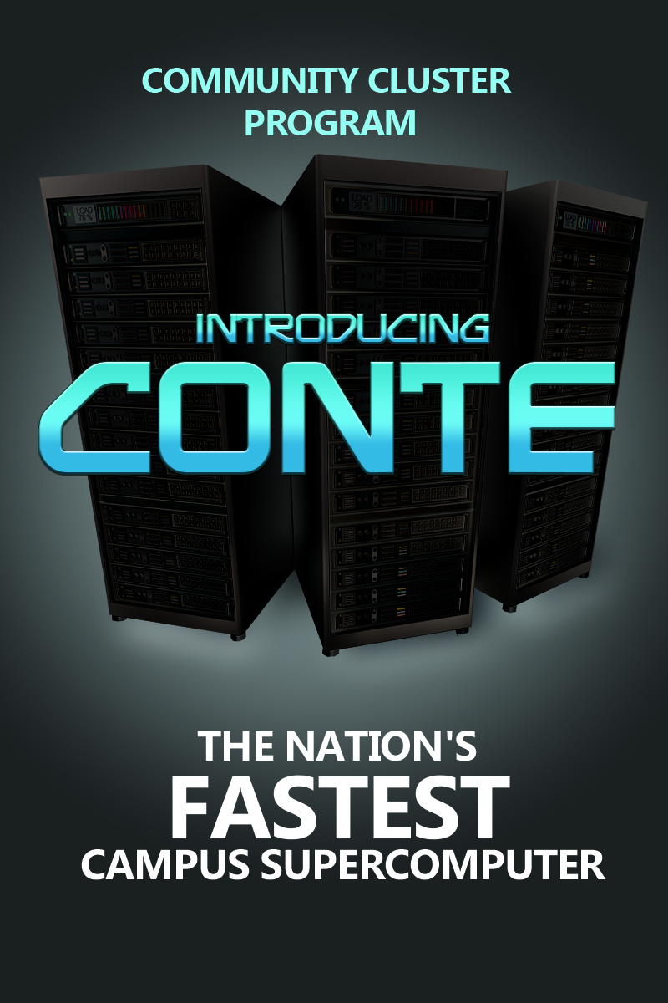
2013: CONTE
Intel/HP offer next generation chips with Phi accelerators
Max speed 943.38 teraflops
Peak performance 1.342 petaflops
580 nodes
78,880 processing cores (the most in a Purdue cluster to date)
Ranked 28th in TOP500 (June 2013 rankings)

Slide 13
“We've been running things on the Conte cluster that would have taken months to run in a day. It's been a huge enabling technology for us.”
— Charles Bouman
Showalter Professor of Electrical and Computer
Engineering and Biomedical Engineering and co-director of
the Purdue Magnetic Resonance Imaging (MRI) Facility
“For some of the tasks that we’re looking at, just running on single cores we estimated that my students would need a decade to graduate to run all their simulations. That’s why we’re very eager and dedicated users of high-performance computing clusters like Conte.”
— Peter Bermel
assistant professor of electrical and computer engineering

Slide 14
NUMBER OF
PRINCIPAL INVESTIGATORS
141
141
out of
160-200
160-200

Slide 15
SIX COMMUNITY CLUSTERS
STEELE
7,216 cores
Installed May 2008
Retired Nov. 2013
COATES
8,032 cores
Installed July 2009
24 departments
61 faculty
ROSSMANN
11,088 cores
Installed Sept. 2010
17 departments
37 faculty
$27.02 per GFLOP
$21.84 per GFLOP
$16.58 per GFLOP
HANSEN
9,120 cores
Installed Sept. 2011
13 departments
26 faculty
CARTER
CONTE
$13.28 per GFLOP
$10.52 per GFLOP
$2.86 per GFLOP
10,368 cores
Installed April 2012
26 departments
60 faculty
#175 on June 2013 Top 500
9,280 Xeon cores
(69,600 Xeon Phi cores)
Installed August 2013
14 departments
22 faculty (as of Dec. 2013)
#28 on June 2013 Top 500
Notes:
Updated November 2012

Slide 16
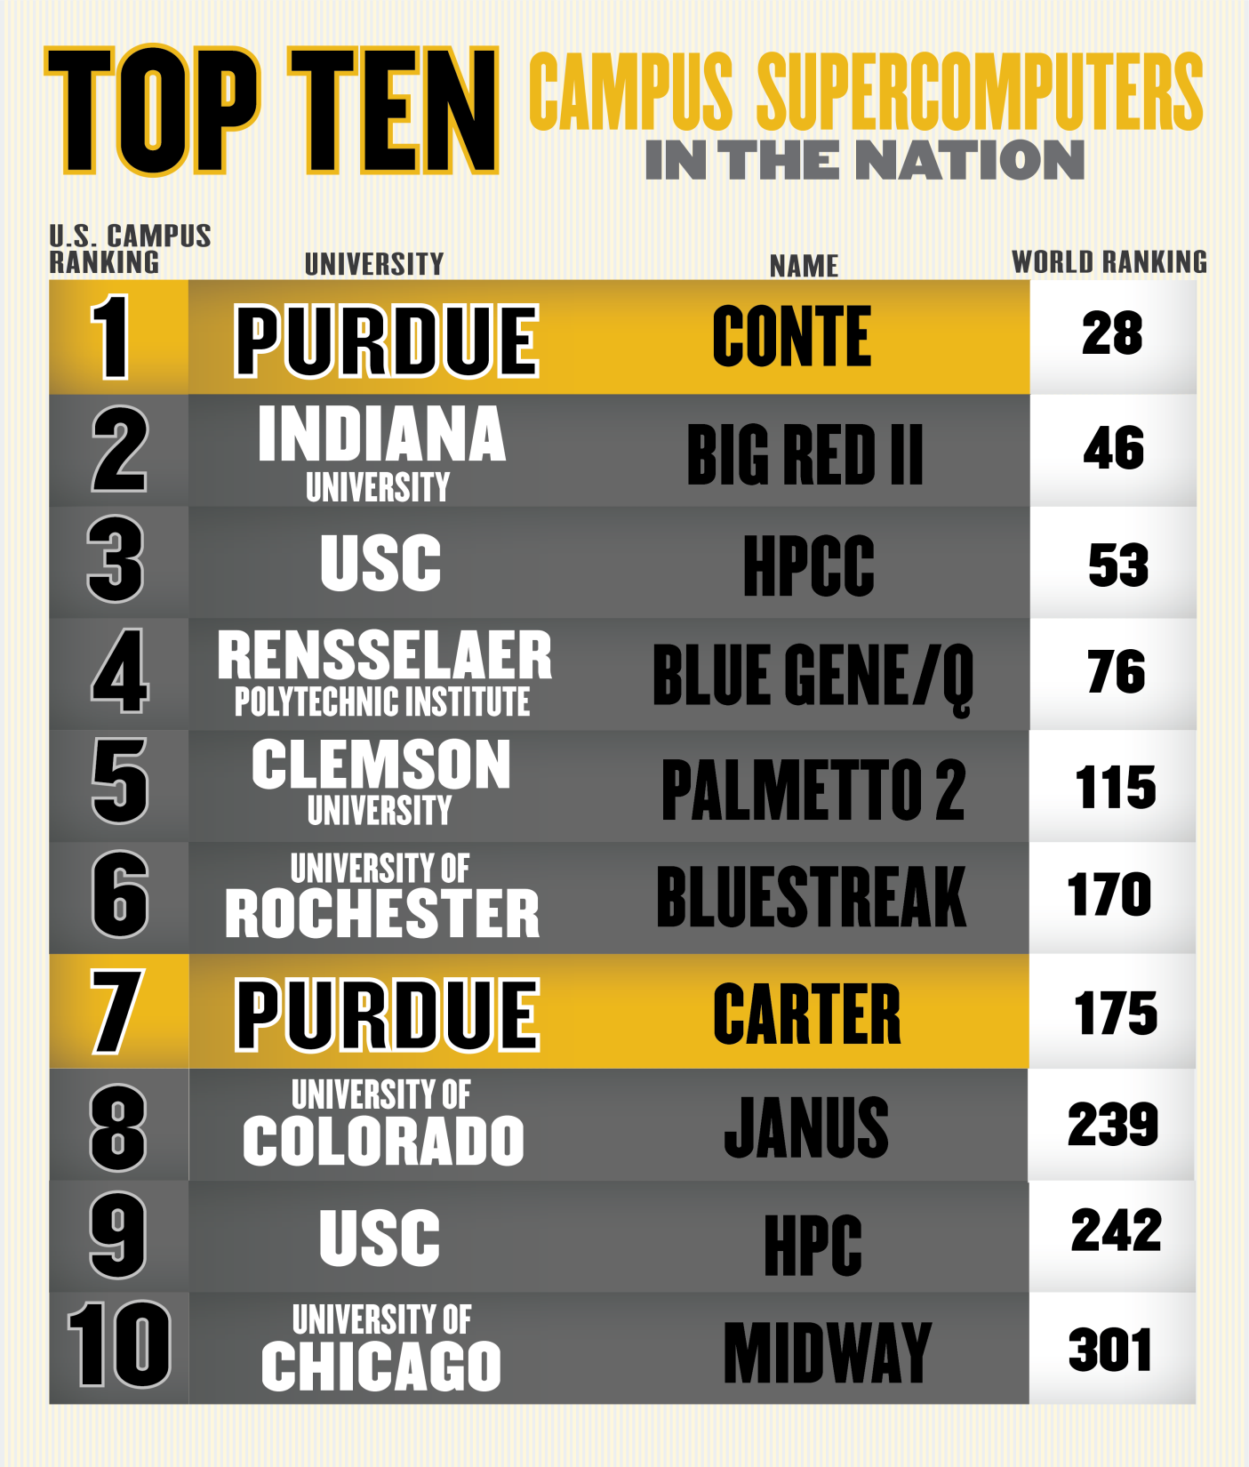
June 2013 Top 500

Slide 17
NORMALIZED PER CORE-HOUR COST

Slide 18
PERCENTAGE OF AWARDS TO HIGH-PERFORMANCE COMPUTING USERS
Millions
3%
5%
6%
9%
13%
10%
13%
19%
19%
20%
21%
24%
27%
26%
32%
33%
Notes:
2013—33%

Slide 19
OUR ACADEMIC PARTNERS
By Department | Cores
Physics | 8,984
Electrical and Computer Eng. | 8,920
Mechanical Engineering | 5,792
Aeronautics and Astronautics | 4,328
Earth & Atmospheric Sciences | 3,192
Chemistry | 1,792
Materials Engineering | 1,280
Chemical Engineering | 1,048
Biological Sciences | 1,024
Med. Chem./Molecular Pharm. | 960
Mathematics | 768
Biomedical Engineering | 640
Nuclear Engineering | 432
Statistics | 424
Civil Engineering | 416
Industrial and Physical Pharmacy | 384
By Department | Cores
Ag. and Biological Engineering | 344
Computer Science | 312
Commercial Partners | 304
College of Agriculture | 224
Agronomy | 160
Forestry and Natural Resources | 64
Computer and Information Tech. | 48
Health Sciences | 48
Animal Sciences | 32
Computer Graphics Technology | 32
Horticulture/Landscape Arch. | 32
Industrial Engineering | 32
Brian Lamb School of Comm. | 24
Management | 24
Agricultural Economics | 16
Entomology | 16

Slide 20




OUR FOUNDATIONAL IT PARTNERS
Purdue prefers to construct large business deals with a small handful of foundational partners. Together we advance technologies and define the curve of innovation for the higher education market.

Slide 21
MANAGEMENT, NOT MAGIC
Develop relationship with Sponsored Programs
Cultivate the early adopters
Respect your project managers
Establish operational credibility in central IT
  Do it—take the risk
  Do it well
Flex the business model
Don’t ask for money

Slide 22
“High-performance computing is critical for the modeling that we do as part of the National Nanotechnology Initiative. Without Purdue’s Community Clusters we would be severely handicapped. They provide ready, ample and cost-effective computing power without the burdens that come with operating a high-performance computing system yourself. All we have to think about is our research.”
— Mark Lundstrom
Don and Carol Scifres Distinguished Professor of Electrical and Computer Engineering and member of National Academy of Engineering

Slide 23
"I wouldn't have been elected to the National Academy of Sciences without these clusters. Having the clusters, we were able to set a very high standard that led a lot of people around the world to use our work as a benchmark, which is the kind of thing that gets the attention of the national academy."
— Joseph Francisco
William E. Moore Professor of Physical Chemistry,
member of the National Academy of Sciences and
past president of the American Chemical Society

Slide 24

@gerrymccartney

