Slide 1
Supervising Remote Faculty in Fully Online Programs
Ronald C. Thomas, Jr., Ed.D.
Associate Dean, Online Academics
Embry-Riddle Aeronautical University
Copyright Ronald C. Thomas, Jr., 2009. This work is the intellectual property of the author. Permission is granted for this material to be shared for non-commercial, educational purposes, provided that this copyright statement appears on the reproduced materials and notice is given that the copying is by permission of the author. To disseminate otherwise or to republish requires written permission from the author.

Slide 2
Presentation Objectives
Show the creation of the system at Florida State University
Show the expansion of the system at Embry-Riddle Aeronautical University
Give you a chance to try it out before considering it for adaptation

Slide 3

Online Learning at
Florida State University
2+2 Distance Learning Initiative (1999)
  Materials-based
  Mentor-supported
  Degree completion programs
Blackboard (Bb) course management system (CMS)
  Includes communication tools for one-to-one (email), one-to-many (discussion board), many-to-many (chat)

Slide 4
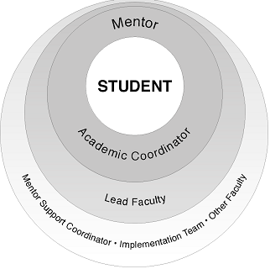
FSU’s Student Support Model

Slide 5
What Are the Mentor KSA’s?
Master’s degree (or higher) in relevant discipline
Enthusiasm! Must care about and enjoy relating to students
Active listener, have empathy with students
Take initiative in communications with students and maintain engagement
Accept monitoring and guidance of lead instructor
Must be highly organized and keep detailed records

Slide 6
What Comprised the Training?
Time with Distance Learning staff to learn online support, issues with adult students, referral resources at FSU
Time with discipline area faculty for collegial and instructional contact
Technical training with Blackboard CMS (face-to-face and online)

Slide 7
What Are the Duties of Mentors?
Completing Course Materials
Initiating and Maintaining Contact with Students
Responding in a Timely Manner
Facilitating Electronic Learning and Discussion Groups
Attending to Student Progress, Grading Assignments, and Reporting Grades
Communicating with Faculty

Slide 8
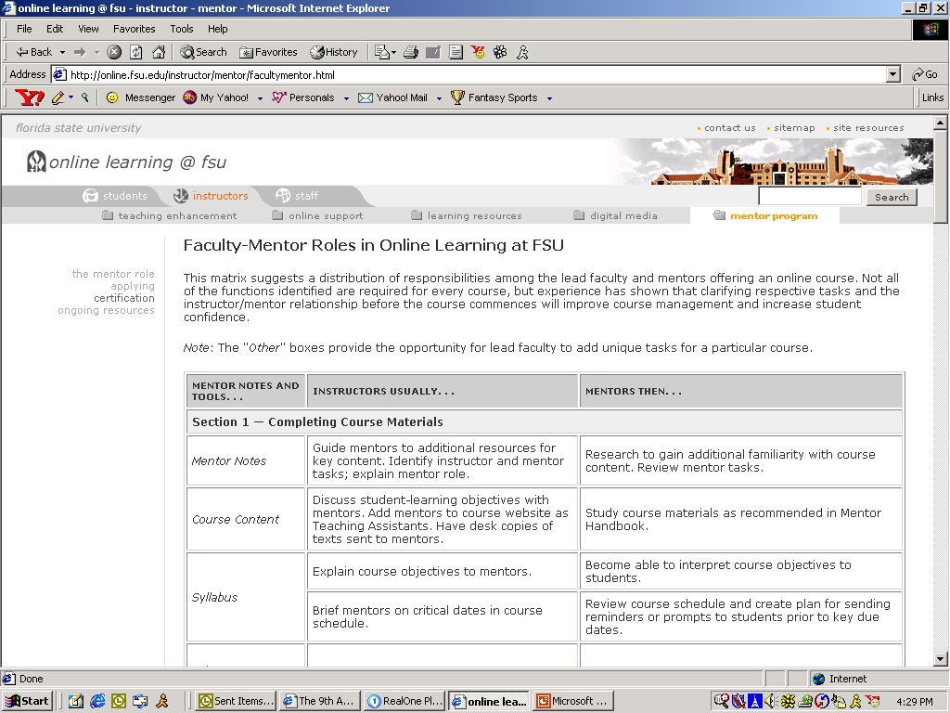

Slide 9

How Did FSU Support Mentors?
Implementation Coordinator
  Modeled engagement with mentors that mentors must develop with students, regular communication
  Ongoing training and development
    Mentor Team Website
    Audio-conferences
    Face-to-face meetings and focus groups

Slide 10
How Was the Model Evaluated?
Faculty evaluations – formal and informal
Student evaluations – formal surveys, voluntary telephone interviews
Student performance indicators
Dissemination of plan, processes and results for feedback from partners (Florida community colleges) and external audiences
Mentor performance reports *

Slide 11
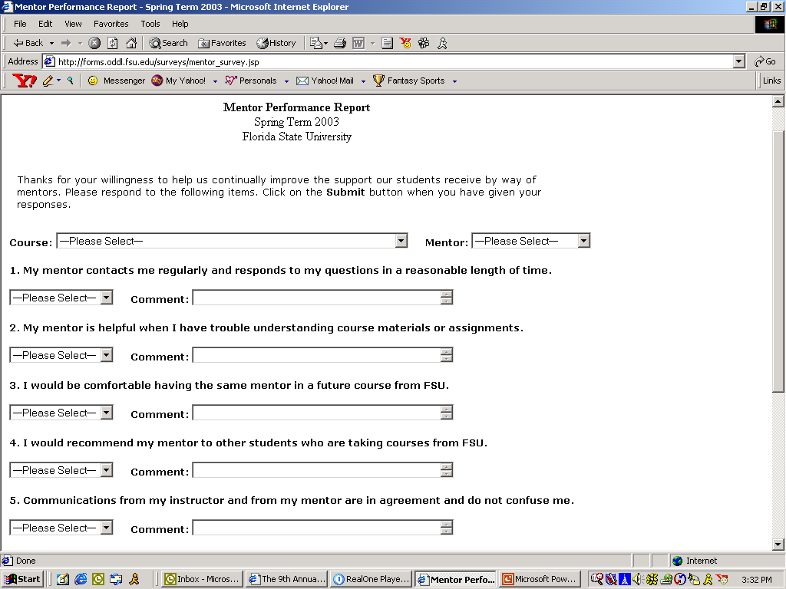

Slide 12
FSU Mentor Performance Reports
(Summer, 2001 - Summer, 2003)

Slide 13
Did Mentor Support Work at FSU?
Mentor-supported courses
  By the end of Summer, 2003, 118 courses with mentor support had been delivered
156 mentors formally trained, supporting four degree completion programs and one contract program*
  Computer and Information Sciences
  Information Studies
  Interdisciplinary Social Science
  Nursing (RN-BSN)

Slide 14

Student Performance Indicators
Completion Rate (through Summer, 2003) = 92%
Success Rate (completers earning a grade of C- or better) = 89%

Slide 15
Lessons Learned at FSU
Communication function is the most important and effective
  72% of responses in this area were positive
  21% of responses were neutral
  7% of responses were negative
Students report that clarification of materials & processes and encouragement are the two main contributions of mentor support

Slide 16
Implications for Teaching
Mentor support allowed scalability. To increase class size, add another mentor (at 20-25:1).
Non-traditional students with varying levels of computer skills, balancing their education against their jobs and family obligations, needed “High Touch” to go with High Tech.
Supporting faculty = supporting students. Mentors were conduits for two-way communications.

Slide 17

Online Learning at Embry-Riddle Aeronautical University
Analogous to the Worldwide Campus F2F curriculum, undergraduate and graduate
  Developed by full-time faculty, taught predominantly by adjuncts (over $5 million annual payroll)
  Comprises +/- 50% of campus enrollments (12,000+)
Blended, hybrid (webcast-F2F-online) and web-enhanced also supported

Slide 18
Online Faculty Development
Fully online instructor-led courses
Meet or exceed the SACS policy statement (12/06) on training for online faculty
Delivered in the same format as the credit courses the faculty will lead (immersive approach)

Slide 19
Current Course Series
  FACD 700/700L: Instructional Use of Blackboard with Lab
  FACD 701: Teaching at Embry-Riddle
  FACD 702: Supporting Online Learners
  FACD 703: Developing Online Course Materials
  Materials

Slide 20
Current Course Series
  FACD 700/700L: Instructional Use of Blackboard with Lab
  FACD 701: Teaching at Embry-Riddle
  FACD 702: Supporting Online Learners
  FACD 703: Developing Online Course Materials
  Materials

Slide 21
Current Course Series
  FACD 700/700L: Instructional Use of Blackboard with Lab
  FACD 701: Teaching at Embry-Riddle
  FACD 702: Supporting Online Learners
  FACD 703: Developing Online Course Materials
  Materials

Slide 22
Curriculum Matrix
FACD 700/700L | FACD 701 | FACD 702 | FACD 703
Announcements Faculty Profile | Orientation to ERAU Policies | Creating a Learning Contract | What Online Learning Is & Isn’t
Discussion Boards Email Usage | Preparing to Teach | Principles of Engagement | Online Course Design
Grade Center Tests and Surveys | Success in the Classroom | Facilitation Skills Online | Interactivity in Online Courses
Assignment Tool Turnitin.com | Introduction to Assessment | Advanced Discussion Mgmt. | Assessment in Online Courses
Group Collaboration Course Content Areas | Orientation to Aerospace* | Tools for Online Collaboration | ERAU’s Online Development Process
Summary and Evaluation | Reflection and Best Practices | Incorporating Assessment | Online Course Implementation
Course Management* |  | Final Reflections and Application | Reflections and Wrap-up

Slide 23
Curriculum Matrix
FACD 700/700L | FACD 701 | FACD 702 | FACD 703
Announcements Faculty Profile | Orientation to ERAU Policies | Creating a Learning Contract | What Online Learning Is & Isn’t
Discussion Boards Email Usage | Preparing to Teach | Principles of Engagement | Online Course Design
Grade Center Tests and Surveys | Success in the Classroom | Facilitation Skills Online | Interactivity in Online Courses
Assignment Tool Turnitin.com | Introduction to Assessment | Advanced Discussion Mgmt. | Assessment in Online Courses
Group Collaboration Course Content Areas | Orientation to Aerospace* | Tools for Online Collaboration | ERAU’s Online Development Process
Summary and Evaluation | Reflection and Best Practices | Incorporating Assessment | Online Course Implementation
Course Management* |  | Final Reflections and Application | Reflections and Wrap-up

Slide 24

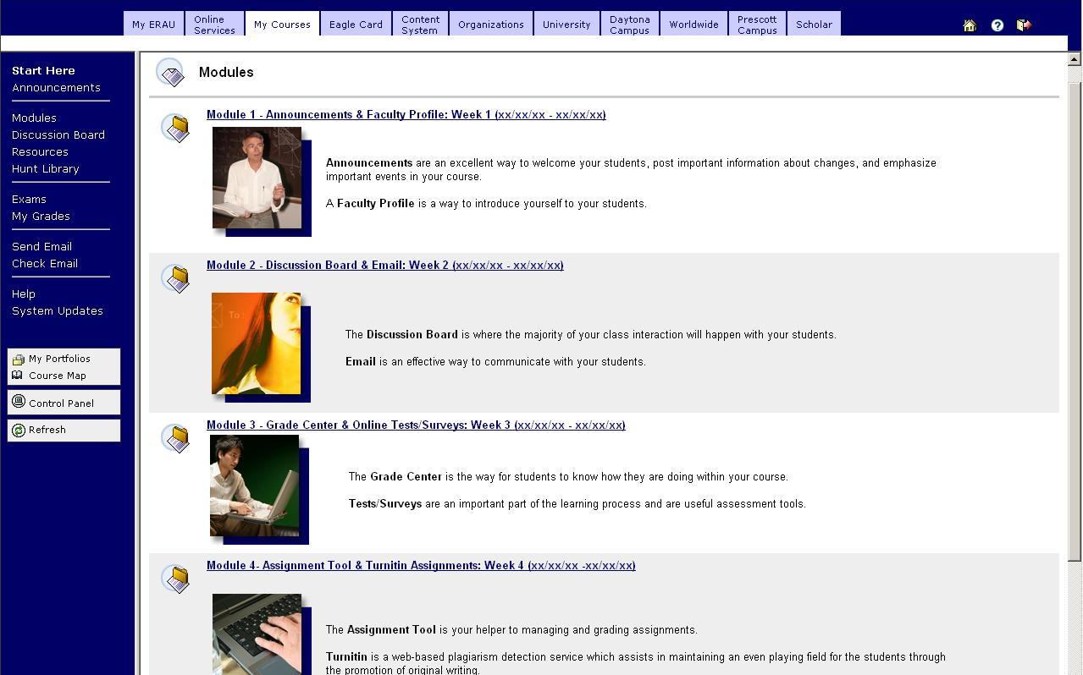

Slide 25
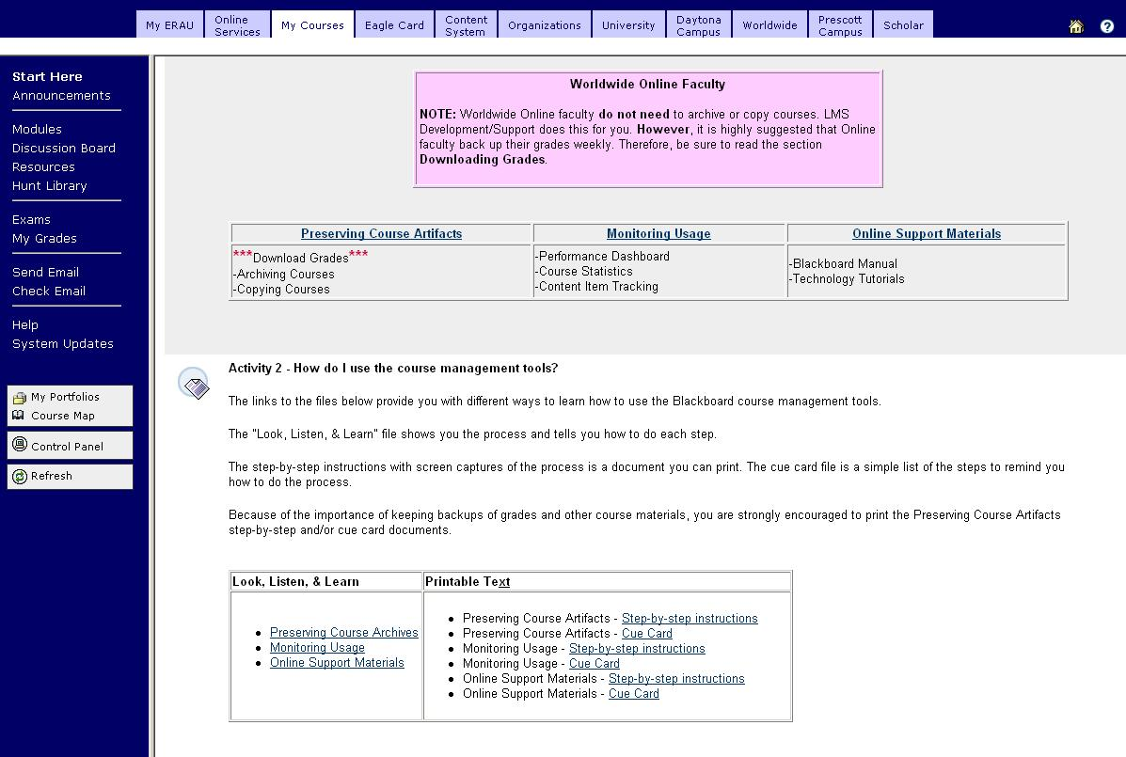

Slide 26

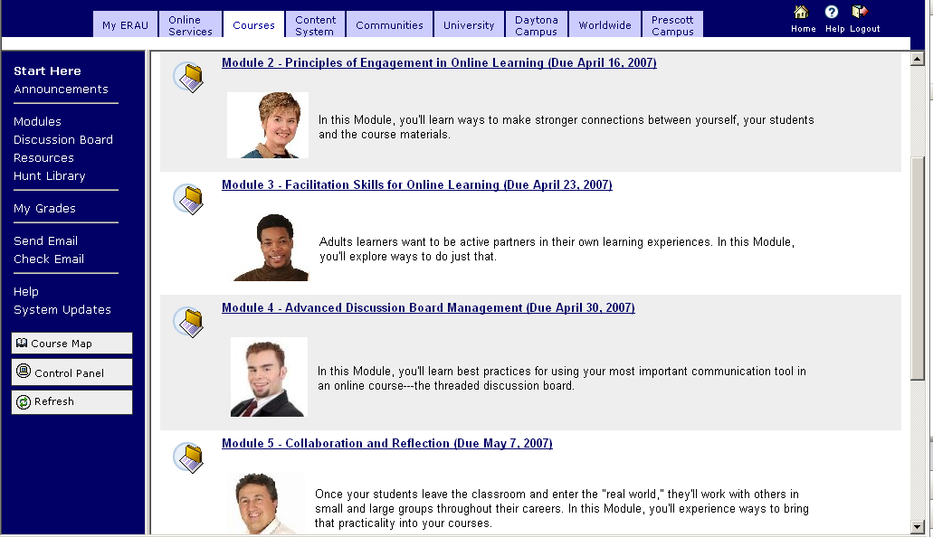

Slide 27
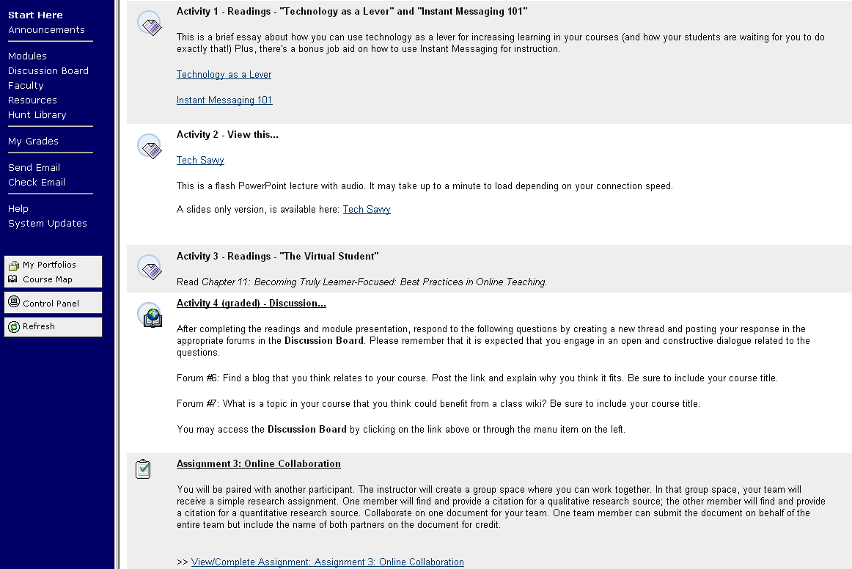

Slide 28
Supervision On-the-Job
Pre-employment
  Course developers and monitors (SMEs)
  Faculty course clearance application
  Contractual “Obligations and Expectations”

Slide 29
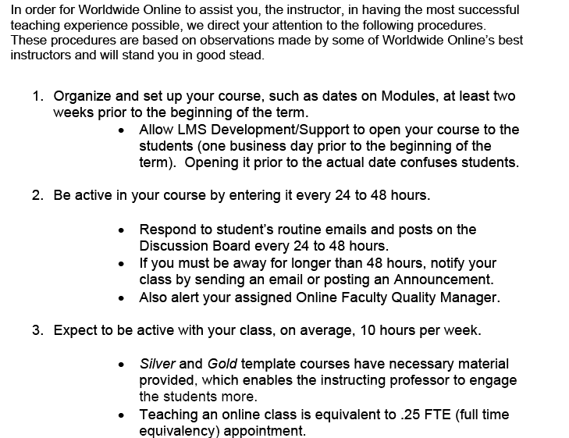

Slide 30
Supervision On-the-Job
After assignment
  Online Faculty Quality Managers
    (Also FACD instructors and online faculty themselves)
    Assigned by academic discipline
    “The Secret Shopper”

Slide 31
Online Course Reviews
Based on the Contract Documents (and the FACD course objectives)
Rotation weighted by exception:
  Every course gets a first-week QC sweep
  New instructor
  Revised course (esp. with major upgrades)
  Instructor with previous below par reviews
  Prompted by Online Query Form

Slide 32
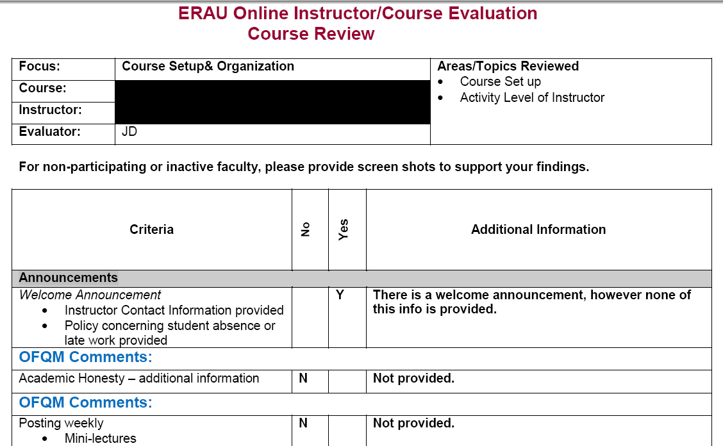

Slide 33
Online Query Forms
The “Trouble Ticket” from the field
  Initiated only by an advisor, not a student
  Could cover anything from a simple inquiry (alternate email for an instructor) to a major issue (grade appeals)
  Goes into a generic email account to be worked by an OFQM
  All cases are tracked until resolution

Slide 34
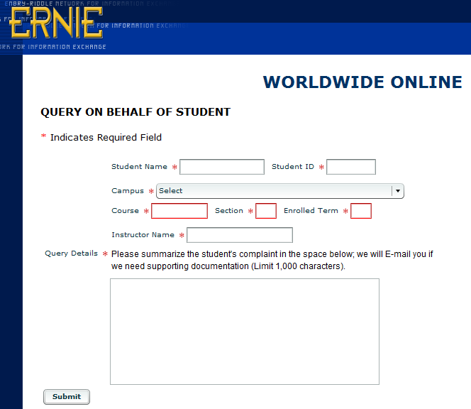

Slide 35
Additional New Initiatives
End-of-Course student evaluation restructured
  Separates identifies questions about course from questions about instructor
  Only asks students to rate observables
  Aligned to contractual job description and learning objectives of faculty training

Slide 36
Additional New Initiatives
Administrative elements added to faculty performance appraisal
  Turnaround time on contract offers
  Closure rate and time on incompletes
  Timely response to and number of queries
  Instances of posting grades late
  Unauthorized alteration of course content

Slide 37

Audience Participation

Slide 38
Dean-for-a-Day Scenario #1
On a routine first-week QC sweep, it is found that the course website’s colors, menu, buttons, and banner have been changed.
It’s not the first time that this instructor has done this.

Slide 39
Dean-for-a-Day Scenario #2
A few queries come in from an online course in which different students complain that they have not gotten grades back on papers they turned in weeks ago.
When the instructor is contacted, he says that he was very busy with his online courses for other colleges and fell behind in his ERAU work.

Slide 40
Dean-for-a-Day Scenario #3
ERAU policy states that computation error is the only grounds for grade appeal. A student alleges that a question on the online final exam was from an optional reading on the syllabus and should not be counted.
In reviewing the course, you find that other questions with outright factual errors.

Slide 41
Dean-for-a-Day Scenario #4
An online instructor does not log into his course for over three weeks. When contacted, he states that he went on vacation and that his students would be okay until he got back.
The instructor has a contract in place to teach in the next online term.

Slide 42
Future Goals
Online job-bidding board for assignments
  Rankings based on credentials, seniority, appraisals, evaluations, demerits
  De facto semi-annual contracts for adjuncts
Departmental Lead Faculty/Course Directors
  “Head coach” for online adjuncts
  Course developer and monitor as same professor

Slide 43
For more information:
Ronald C. Thomas, Jr., Ed.D.
Associate Dean, Online Academics Assistant Professor, Arts and Sciences Embry-Riddle Aeronautical University Worldwide Online
600 S. Clyde Morris Boulevard
Daytona Beach, Florida 32114-3990 386-947-5219 ronald.thomas@erau.edu

Slide 44
What did you think?
Your input is important to us!
Click on “Evaluate This Session” on the ELI Annual Meeting program page.

