Slide 1
CATS with Clickers
Using Learner Response Systems for Formative Assessments in the Classroom
EDUCAUSE Learning Initiative Annual Meeting January 2010

Slide 2
We are. . .
Charlotte Briggs, Ph.D.
    Director of the Office of Dental Education
    College of Dentistry
    University of Illinois at Chicago
    . . .Faculty development, teaching & learning
Deborah Keyek-Franssen, Ph.D.
    Director of Academic Technology
    University of Colorado at Boulder
    . . .Faculty support, development opportunities, shape IT

Slide 3
Please…
…return the clickers at the end of the session!

Slide 4
Who are you?
Faculty, including deans, academic officers
IT, including senior or support staff, CIOs
Librarians
Students
Other
Notes:
CLICKER QUESTION
Who are you?

Slide 5
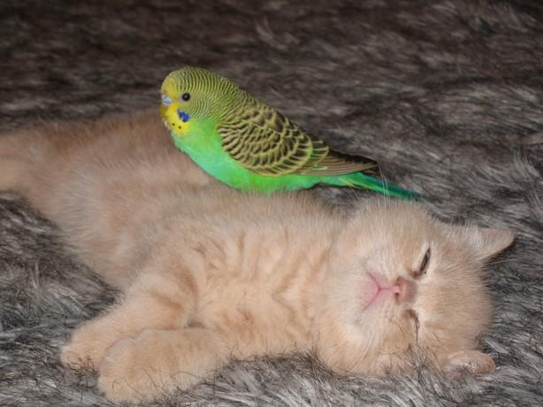
What’s it about?
Nope!
Not kitties!

Slide 6
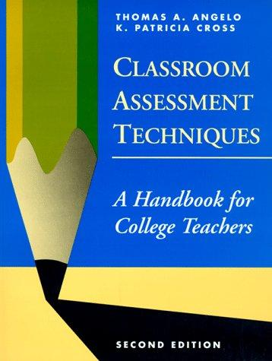
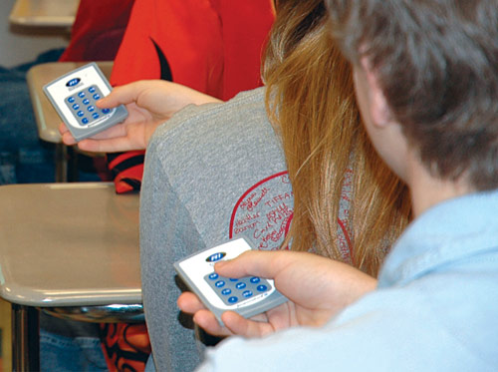
CATs with Clickers
Notes:
It’s about a well-tested set of activities for assessing how things are going in a class, called Classroom Assessment Techniques, or “CATs”. It’s a way to quickly get feedback about how things are going in a class so you can immediately make adjustments to improve teaching and learning, instead of having to wait until the next semester, as you would have to with only feedback from course evaluations.
And it’s about using clickers to conduct CATs.
You can think of this session as a suggestion for a new approach to doing CATs by using clickers to make them quicker and easier to perform.
Or you can think of it as an introduction to a valuable resource for those who are looking for educationally sound ideas for using clickers.

Slide 7
How much do you know about CATs?
Could have written the book myself
Have used CATs in my own teaching
Heard of them, but haven’t used them
Never heard of them
Actually, I know a lot about CATs: Garfield, Morris, Cheshire, Krazy…
Notes:
CLICKER SLIDE
Before we start, we’d like to get a sense of how much you already know about CATs and clickers, so we can make adjustments to meet your needs.

Slide 8
How much do you know about clickers?
Nothing
Seen them on “Who Wants to be a Millionaire”
Experience only as student/audience
Experience as instructor/presenter
Hey, I invented clickers
Notes:
CLICKER SLIDE

Slide 9
Assumptions about our audience
More familiar with clickers than with CATs
Seek pedagogical understanding of clicker use more than technical skills
Looking for faculty development ideas
Want approaches that work and are educationally sound
Understand the value of a good “cookbook”

Slide 10
Purpose
Introduce CATs to instructional technology community as a pedagogy that is:
  extensively-tested
  educationally effective
  enhanced by technology (clickers)

Slide 11
Objectives
Introduce concept and practice of “classroom assessment techniques” (CATs) as a means of formative assessment
Introduce Angelo and Cross’s Classroom Assessment Techniques
Demonstrate how clickers can be used to conduct many of Angelo and Cross’s CATs.
Provide a handout that lists 23 CATs that can be implemented with clickers
Notes:
Introduce ELI members to the concept and practice of “classroom assessment techniques” (CATs) as a means of formative assessment and continuous course improvement.
Introduce Angelo and Cross’s Classroom Assessment Techniques, a classic text in the teaching and learning literature.
Demonstrate how learner response systems (clickers) can be used to conduct many of Angelo and Cross’s CATs.
Provide a take-away handout that lists 23 CATs out of the 50 described in Classroom Assessment Techniques that can be implemented with clickers, and that describes suggested adaptations for clickers where required.

Slide 12
Rationale
Let instructional needs and good pedagogy drive technology use.
Instructional Goals
Good Pedagogy
Technology Use

Slide 13
So, really, what are CATs?
Quick, easy ways to get feedback from students about:
  Prior knowledge
  Preconceptions/misconceptions
  Opinions
  Understanding
  Confusion
  Satisfaction

Slide 14
You might already know some CATs. . .
Minute Paper
Muddiest Point
One Sentence Summary
Reading Rating Sheets
Chain Notes

Slide 15
A CAT starts with a teaching question
Do I need to review basic concepts?
Did students grasp the main points of lecture?
Notes:
A CAT starts with a teaching question. Deb: I’m teaching German 3025, “Antics of the German Romantics.” I know that most of my students have just taken “Introduction to German Literature” last semester. I know they covered German Romanticism, but I don’t know how much they actually remember about it. I’m asking myself this question: How much time do I need to review basic concepts of Romanticism before I move into more advanced topics that are the real focus of the course? So I’ve decided to use the “Background Knowledge Probe” CAT during my first class to find out.
Charlotte: I am teaching an upper level political science class about the US legal system, and have just given an introductory lecture on grand juries. I’ve planned my syllabus so that my next lecture is supposed to cover finer points about how grand juries vary in different states, but first I need to make sure that my students have a basic understanding of grand juries. So my teaching question is: Did my students grasp the main points in my introductory lecture on grand juries, or do I need to spend more time on the topic during the next class session? I’ve decided to use the “One Sentence Summary” CAT at the end of the lecture to find out.

Slide 16
Let’s try some CATs!
Background Knowledge Probe
One Sentence Summary
Notes:
Divide audience into 2 groups, and have each do one of the 2 CATs simultaneously. Depending on size of audience, we could have them work individually or in small groups. 3-5 minutes to do work + 3-5 minutes to debrief.

Slide 17
Let’s try some CATs!
Background Knowledge Probe
Notes:
GROUP A: You are students in German 3025, the highly popular “Antics of the German Romantics” course that you’ve looked forward to ever since you declared your German major. You took an introduction to German literature course last semester, during which you learned all about the great works and characteristics of major literary periods from medieval times to the present. Your professor doesn’t want to make assumptions about the knowledge from the previous course that you have brought with you, so she has developed the following Background Knowledge Probe CAT:
Please list as many characteristics of German Romanticism as you can.

Slide 18
Let’s try some CATs!
One Sentence Summary
Notes:
GROUP B: You are students in Political Science 345, “The History and Functions of Juries.” You have just listened to an introductory lecture on grand juries. Your professor wants to make sure you grasped the main points of the lecture, and so she has developed the following One Sentence Summary CAT to assess your understanding:
Working as quickly as you can, answer the questions “Who Does What to Whom, When, Where, How, and Why?” in relation to the following topic: Grand Juries. Then do your best to synthesize the answers to each of the seven WDWWWWHW questions into a single informative, grammatical, and long summary sentence.

Slide 19
Quick Debrief
Background Knowledge Probe
One Sentence Summary
Notes:
In a real class situation, there would be sufficient time to complete each CAT.
In a real class situation, you could do a bit of debriefing live, right after the students complete the CAT, to get a general sense of what people know or understand. You also get to take the responses home with you for deeper analysis and a better understanding of the proportions of the class that understood or didn’t understand the concept.

Slide 20
Why use CATs?

Slide 21

Monitor what student think or understand. . .
Notes:
The purpose of CATs is to gauge what students think or understand. . .
Do they already know anything about the material you’re going to cover?
What are their motivations for learning in your course?
Can they identify their learning goals?
Do they have an opinion about a topic?

Slide 22
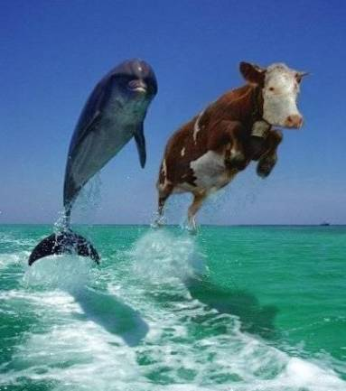
. . .and what they can do
Notes:
. . .or how far along they are at achieving course objectives for a particular skill or competency.
How well did they understand the material you just presented?
How well did they retain the material you presented in the last class?

Slide 23
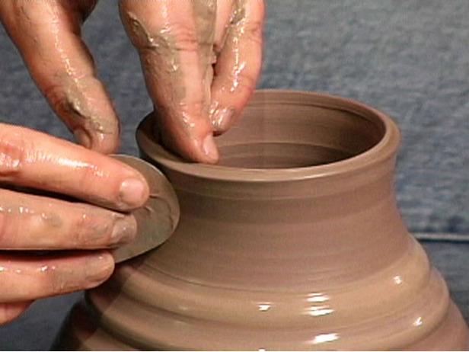
Formative
Notes:
And CATs are, by definition, used for “formative” assessment.
By “formative” we mean that the information that is gathered is used immediately as feedback to improve the course, as opposed to “summative” assessment, which refers to assessments that are used to make final decisions, such as what grade to give a student or whether an adjunct should be asked back.
Often when we talk about “formative assessment” we mean giving feedback to students to help them do better before they have to perform on a test for a grade.
In this case, CATs are formative assessments that gather information from students as feedback to the instructor about how he or she is doing and what could be done to make the learning process better.
The purpose CATs is to allow the instructor to shape—or reshape—the educational process by making adjustments while the course is going on…while it’s in motion.

Slide 24

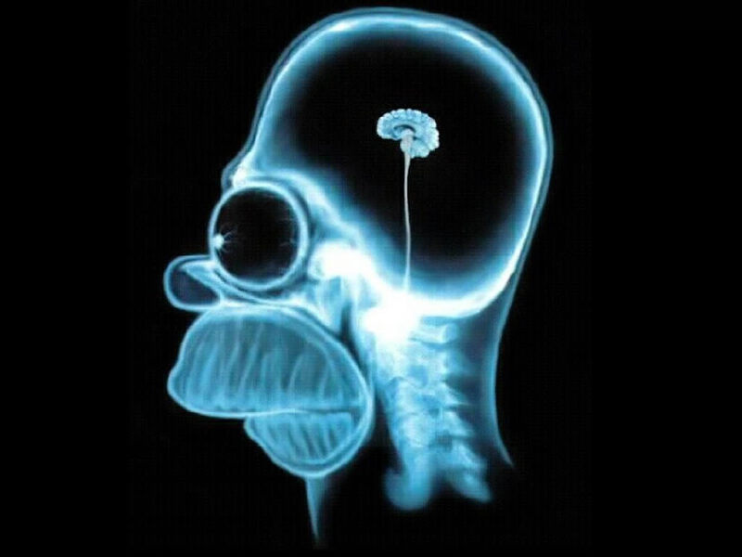
Challenge: We can seldom assess knowledge and needs before the course starts
Notes:
In an ideal world we would do a needs assessment of our learners before each course and design the course for that particular group of students, but it’s pretty rare that instructors get any information about their students other than their names before the start of a course. We might be able to tell a little bit about the demographics of the class from the roster, but we seldom know much about what courses or experiences they’ve already had, let alone what grades they received in a prior course, which may or may not correlate to the knowledge they’re bringing into your course.

Slide 25
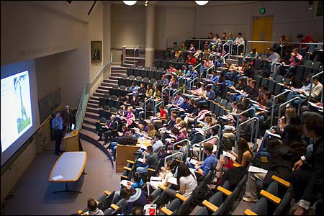

Challenge: Getting a handle on what’s going on in large classes
Notes:
…And when a class is large, it’s especially difficult to get to know students and to monitor what’s happening for them as the course progresses.

Slide 26

CATs help faculty know their students and monitor their learning better
Notes:
So CATs are ways to get “a closer perspective,” so to speak.

Slide 27
Angelo & Cross (1993)
Collected and tested CATs
Research & workshops nationwide
>5000 faculty
Sponsors: National Center for Research to Improve Postsecondary Teaching and Learning (NCRIPTAL), Harvard Graduate School of Education, Harvard Seminar on Assessment and grants by Ford and Pew
Notes:
NCRIPTAL was a federally funded project to identify effective teaching, learning and assessment practices at the college level, to conduct research to validate them, and to disseminate them more widely.
As part of that project, as well as several related grant funded initiatives, Angelo and Cross set out to identify effective ways that faculty members, essentially used informal research methods in the classroom, not necessarily so they could publish the results, but so they could improve the course.
After identifying a large number of CATs that faculty members around the US were already using, they conducted workshops with faculty to test the techniques and to disseminate them.

Slide 28
Angelo & Cross (1993)
50 CATs
Organized by purpose
Classroom Goals Inventory
Notes:
The result was a book published by NCRIPTAL in 1988 that compiled many of the most popular CATs that could be used in the widest variety of disciplines and classroom situations.
And then, a few years later, in 1993, Angelo and Cross, through Jossey-Bass, published this edition of the book, which very quickly gained respect and popularity in the teaching and learning community.
The book includes 50 CATs that are organized by their purpose—such as to gauge what students already know, or to determine how they feel about something, or to see if they understand an analytical framework well enough to apply it to a particular problem or example.
The book also includes an inventory by which faculty can explore the goals that they have for their students for a particular class, and compare them to the goals of other instructors at 2-yr and 4-yr institutions. The inventory is, itself, a very valuable faculty development tool, but not something we have time to talk about today.

Slide 29
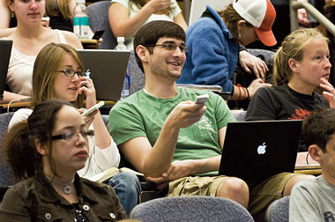
CATs w/ Clickers
√ Quicker
√ Easier
Notes:
The whole point of CATs is that they are quick and easy enough that they’re feasible to conduct even in a large or busy course.
As I started working with faculty who wanted to use clickers, I realized that many of the recommended uses of clickers would qualify as “classroom assessment techniques” so I decided to systematically review each of the 50 CATs in Angelo and Cross’s Classroom Assessment Techniques book to determine which could be conducted with clickers, which would make them even quicker and easier to carry out.
Using clickers makes the gathering of formative assessment data quicker, and makes the evaluation of it easier.
CATs just isn’t about the collection of data. There’s a feedback loop inherent in the process: you also evaluate the data and make necessary changes to your teaching based on your evaluation.

Slide 30
CATs with Clickers Table
13
“as is”
10
modified
23 CATs with clickers
Notes:
[Distribute table]
The table needs to be used with the book to be meaningful.
Left-hand column: name of CAT, organized into categories based on the purpose of the assessment. The names of the CATs and the categories are verbatim from Angelo & Cross.
Middle column: page number in Angelo & Cross where you’ll find the CAT
Right-hand column: My own adaptations to the CAT so it can be performed with clickers.
If the right-hand column is blank, it means the CAT can be performed with clickers without any modification.

Slide 31
Impact of Modifications
Tend to down-grade the complexity of the exercise, in itself, to a MCQ
Class discussion can restore depth
Instructors often get the most out of clickers when they are used to prompt discussion

Slide 32
CATs with clickers to try
Background Knowledge Probe
One Sentence Summary

Slide 33
Modified CAT with clickers
Background Knowledge Probe

Slide 34
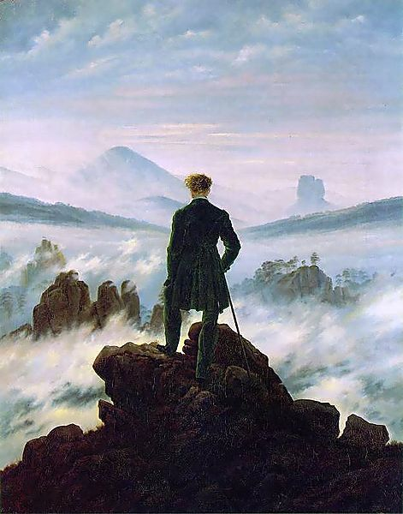
Which of the following is NOT a characteristic of Romanticism?
Attention to “the natural”
Valued “folk” literature, such as fairy tales
Had a strong geographical center in Düsseldorf
Referred to “the blue flower” as a central symbol for longing
Valued medieval literature and art.

Slide 35
Modified CAT with clickers
One Sentence Summary

Slide 36
Find the errors in WDWWWWHW
Who and Why
When and Where
How and Why
Who and How
Does What to Whom and How
Who: A grand jury is a panel of judges
Does What to Whom: that decides if someone should be charged with a crime
When: when the offense might be a felony carrying prison time
Where: in federal courts and most state courts
How: by listening to arguments by attorneys for both sides
Why: so common sense, community perspectives are part of the criminal justice system
Notes:
Grand Jury Clicker Question
Who: A grand jury is a panel of judges
Does What To Whom: that decides if someone should be charged with a crime
When: when the offense might be a felony carrying prison time
Where: in federal courts and most state courts
How: by listening to arguments by the prosecutor and defense attorney and deciding if evidence amounts to probable cause
Why: so that common sense perspectives of the community are part of the criminal justice system.
Find the errors in this one-sentence summary about the role of grand juries in bringing indictments.
a. Who and Why
b. When and Where
c. How and Why
d. Who and How
e. Does what to whom and How

Slide 37
Classroom Assessment Project Cycle
Plan
Implement
Respond

Slide 38
Classroom Assessment Project Cycle
Plan:
* Choose class
* Focus on goal/question
* Choose CAT

Slide 39
Classroom Assessment Project Cycle
Implement
* Teach
* Collect data
* Analyze data

Slide 40
Classroom Assessment Project Cycle
Respond
*Formulate response
* Communicate results, try out response
* Evaluate impact on T&L

Slide 41
Design a follow-up project
Plan
Implement
Respond

Slide 42
Resources
Thomas Angelo and K. Patricia Cross, Classroom Assessment Techniques
Derek Bruff, Teaching with Classroom Response Systems
Doug Duncan, Clickers in the Classroom

Slide 43
Questions or Comments?
Charlotte Briggs
clbriggs@uic.edu
Deborah Keyek-Franssen
deblkf@colorado.edu

