Slide 1
Transforming Digital Toys into Study Buddies: Using Mobile Devices to Engage Students
Berlin Fang
Feb 22, 2010

Slide 2

If Mobile learning is the answer, what is the question?

Slide 3
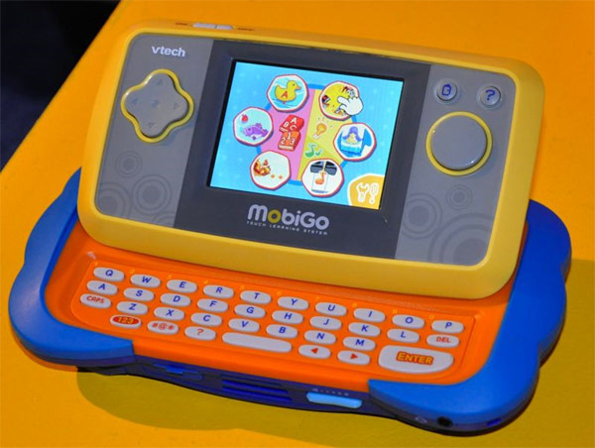
The ME-Generation
Mobile electronic

Slide 4

Mobile workforce

Slide 5


Slide 6
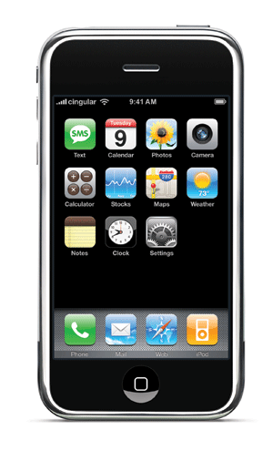
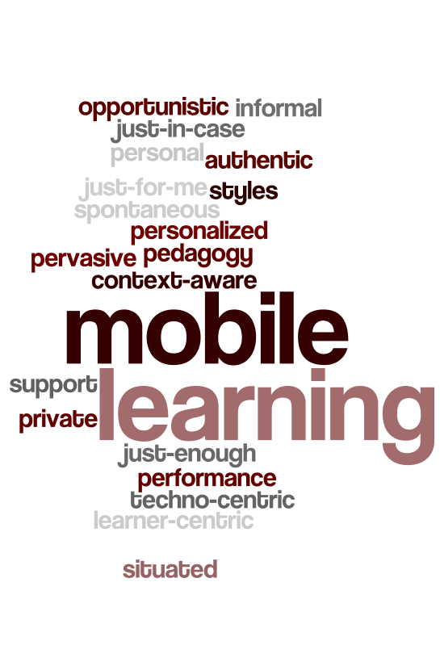


Slide 7
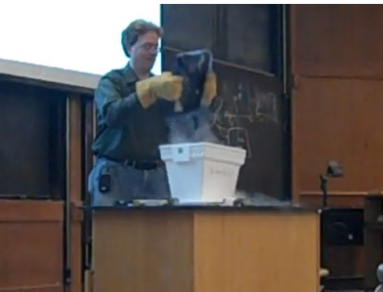
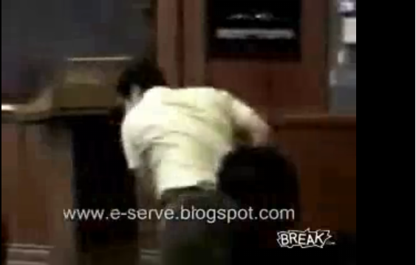
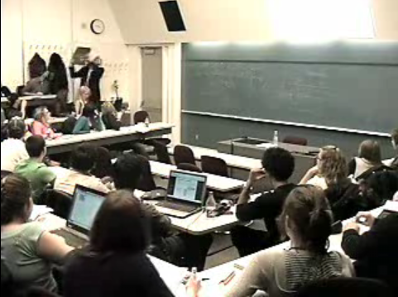
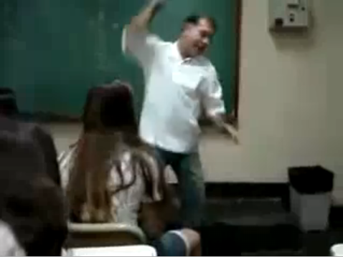
Professors vs. gadgets

Slide 8
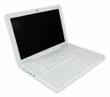

Ban or restrict?
Notes:
Poll
Does your institution ban mobile devices in your classroom?
Yes
No
Depends on the professor

Slide 9
Problems with Restrictive Approaches
“An Apple [the computer] a day keeps professors away” : Professor vs. Laptop?
“Innovator, early adopter, early majority, late majority, my professor”
“I don’t trust you can put learning in your own hands”

Slide 10
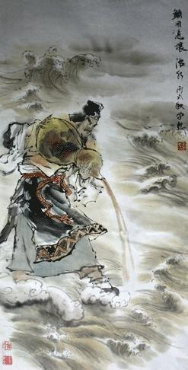
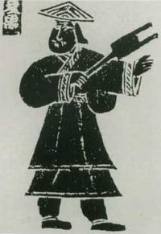

Contain or channel

Slide 11
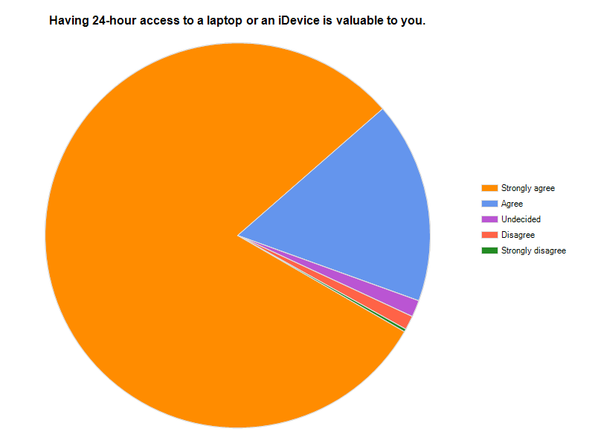
Academic Value for Students
97.% of our students (N=428) think that having a laptop is useful for them academicaly.

Slide 12
Anatomy of An Activity
Tool
Subject
Object
Outcome
Rule
Community
Division of Labor

Slide 13
Integration into the classroom
Motivate learners
Organize content
Be the model
Institute rules
Leverage tools
Evaluate results

Slide 14
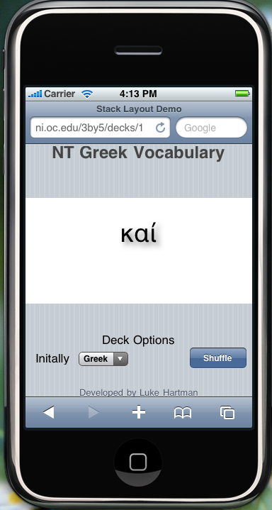
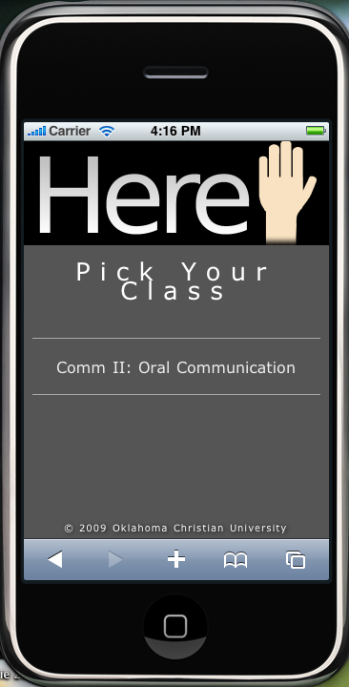
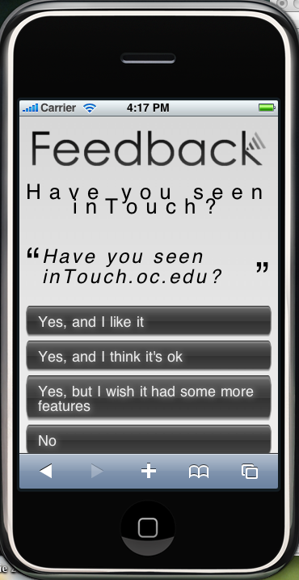
Enriching the class

Slide 15

Creating opportunities for collaboration
Notes:
Mobile technologies also make it easier for students to be communicating and collaborating with each other. Confucius said: whenever three people are walking together, there is bound to be one who can be the teacher of the two others. At OC we have quite a number of professors using wikis and increasingly, Google Docs as ways to collaborate. Students quote this increased collaboration as one of the main benefits of our mobile learning program.

Slide 16
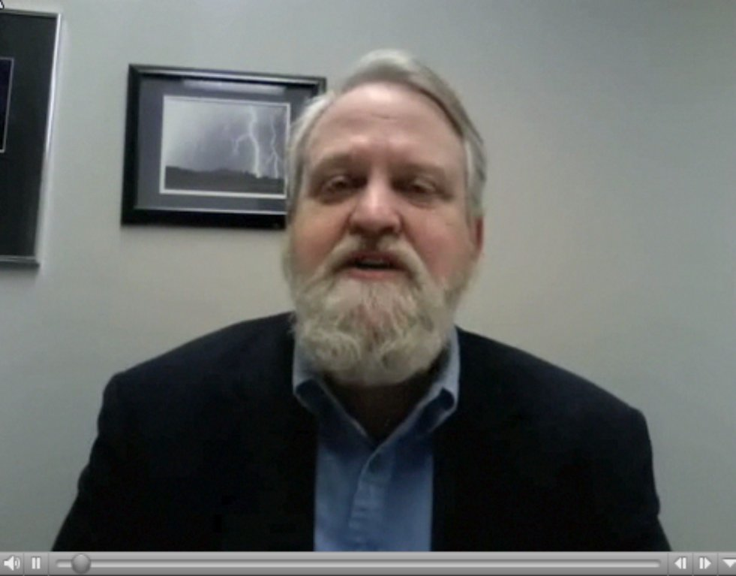
Extending the classroom:
“Blizzard Lecture”

Slide 17
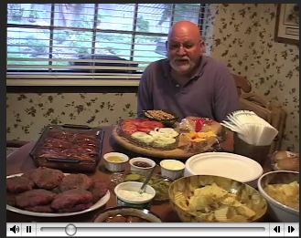
Extending the classroom:
“Food for thought”

Slide 18

Extending the classroom:
Mobile Rehearsal

Slide 19
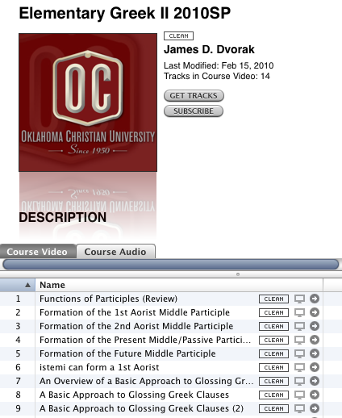

Extending the classroom:
Greek to go

Slide 20
References
Brown, J. (2010). Can You Hear Me Now? [Article]. T+D, 64(2), 28-30.
Li, J . (2007). Red Flag Canal Winding through Mountains (Photograph): People’s Net. Retrieved February 20, 2010, from http://unn.people.com.cn/GB/22220/68034/68083/84022/84023/6226587.html
Murph, D. (2010a). OU professor submerses laptop in liquid nitrogen, smashes it to prove a point. Engadget. Retrieved February 20, 2010, fromhttp://www.engadget.com/2010/02/21/ou-professor-submerses-laptop-in-liquid-nitrogen-smashes-it-to/5#comments
Murph, D. (2010b). VTech launches kid-friendly MobiGo handheld gaming system, Flip e-reader Retrieved February 20, 2010, from http://www.engadget.com/2010/02/18/vtech-launches-kid-friendly-mobigo-handheld-gaming-system-flip/
互动百科. (2010). Gun (鲧) Retrieved February 20, 2010, 2010, from http://www.hudong.com/wiki/%E9%B2%A7

Slide 21
THANK YOU
Berlin Fang
Oklahoma Christian University
Berlin.fang@oc.edu
(405)425-1858
http://ni.oc.edu, twitter: @berlinf

