Slide 1


Augmented Reality in a 4G World
Applications for Higher Education
February 15, 2011
Notes:
This presentation is primarily focused on augmented reality for Android mobile devices.

Slide 2
What is Augmented Reality?
A technology…and confluence of technologies
A field of research
A vision of future computing
An emerging commercial industry
A new medium for creative expression
Source: Gene Becker, Lightning Laboratories

Slide 3
Definition of AR
Augmented reality (AR) refers to the addition of a computer-assisted contextual layer of information over the real world, creating a reality that is enhanced or augmented.
ELI Horizon Report, February 2011
Trying to imagine how augmented reality will be used is like trying to forecast the future of the web in 1994.
The Economist Technology Quarterly, September 2009

Slide 4
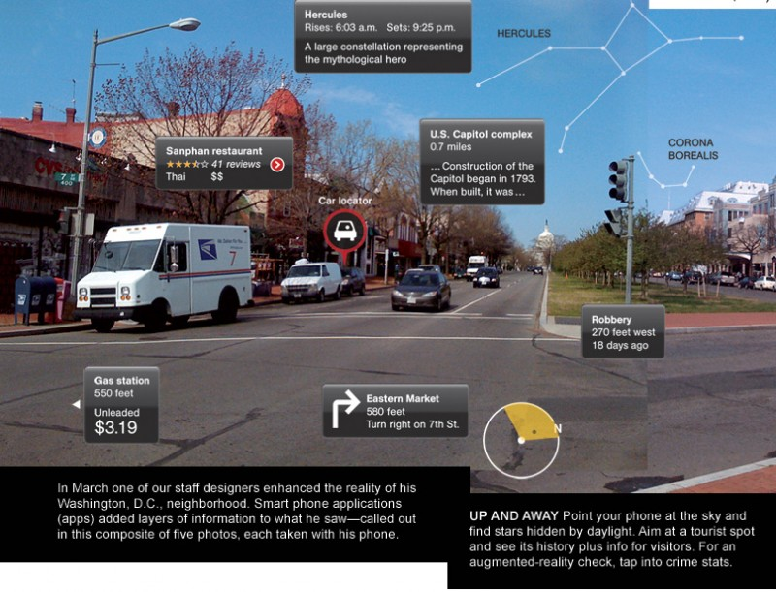
Definition of AR - Example
Source: http://www.vagabondish.com/

Slide 5
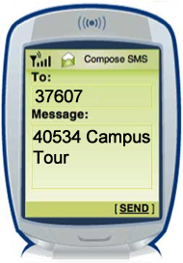
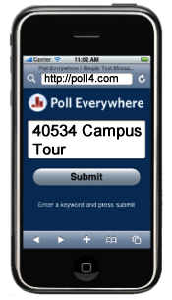
How Will Your Campus Use AR?
We will be running a Poll during this presentation and ask you to respond how you will be using AR on your campus. Three ways to respond:
Text
Web: poll4.com
Twitter
Tweet
@poll 40534 Campus Tour

Slide 6
What AR Applications Exist on the Market?
483 AR apps exist in the Apple Store out of 300,000+ total iOS apps
258 AR apps exist in the Android Market out of 130,000+ total Android apps
Browsers allow you to view augmented content – Junaio, Layar, and Wikitude World Browser
Editing tools allow you to augment your own reality – Tag What, Artags, and Sekai Camera
Educational tools help you learn by interacting with the environment around you – Google Goggles and Google Sky Map
Sources: AndroidZoom, Augmented Planet

Slide 7

Browser App Demo
Wikitude World Browser

Slide 8

Editing App Demo
Tag What

Slide 9

Educational App Demo
Google Sky Map

Slide 10
Are Current AR Apps Really AR?
No, not really
The biggest category of apps is AR browsers
They just use the device’s GPS and compass to determine where you are and which way you are facing
It is doing pretty much the same thing as Google Maps, except overlaid on a real-time digital video image
It is a good start, but there is still a lot of work to do to get to real AR

Slide 11
So, What Does a Real AR App Look Like?
It would have the ability to take advantage of contextually aware information
The user can tailor their interests and experience
the content based on their interests
It would have the ability to add content
The user can add, remove, or change the openness of
their content in the AR space
It would have the ability to immerse the user into the scene without the user being aware they were in the scene
The user can be tracked as an object amongst other
objects to become part of a seamless environment

Slide 12
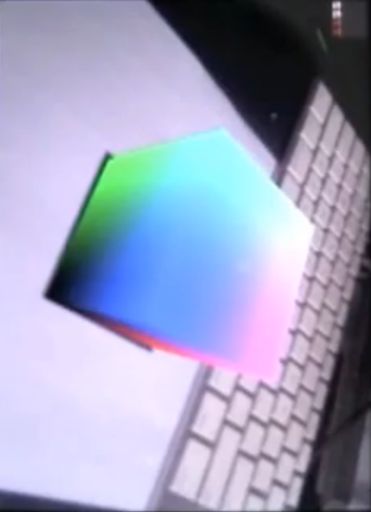
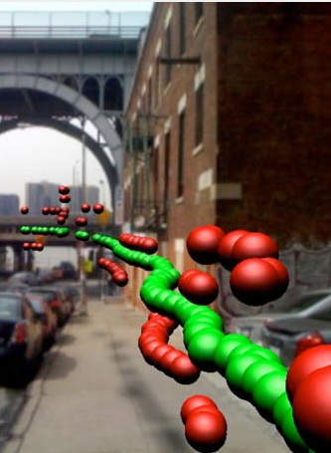
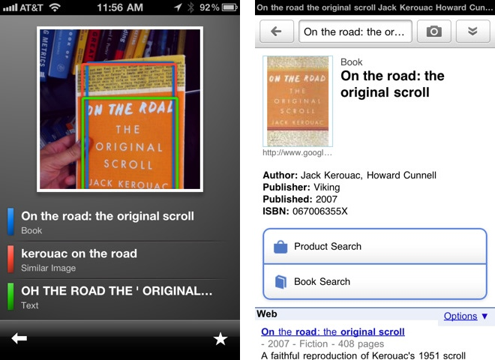

Types of AR
Marker-based (Visual Metaphor)
Markerless (Spatial Positioning/Gravimetric)
  Sensor dependent (i.e. GPS, compass, accelerometer)
  Natural feature/image recognition
Natural feature/
Image recognition
Marker
Sensor dependent

Slide 13
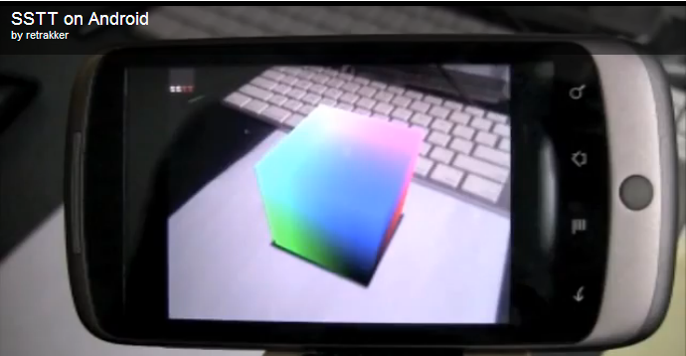
Marker-based Demo
SSTT 3D box demo with Galaxy Tab
Example
Screenshot
Marker

Slide 14
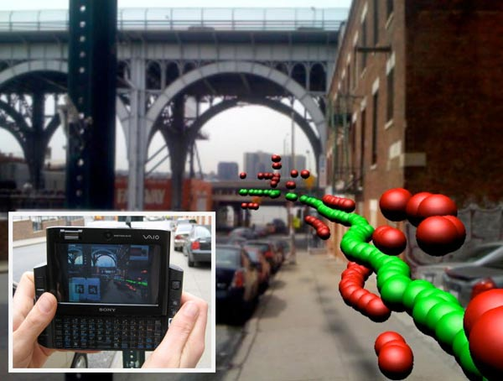
Sensor Dependent Example
Pollution visualized in Manhattan
Sean White and Steve Feiner of Columbia University developed an app that shows levels of carbon monoxide in Manhattan based on collected CO sensor data (red = locally sensed, green = remote EPA
sensor reading). The height of each ball reflects concentrations of the pollutant.
Source: http://cs.utsa.edu/~jpq/Site/teaching/uiu-f10/4.pdf

Slide 15

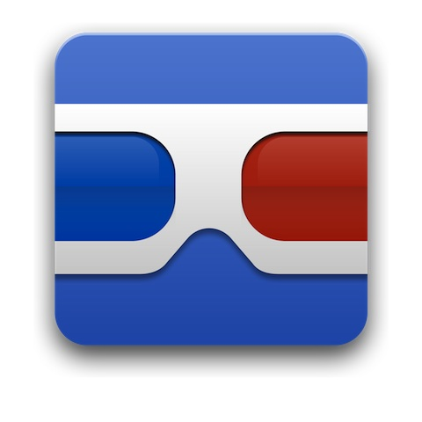
Image Recognition Demo
Google Goggles on the Samsung Transform

Slide 16
AR Limitations
Constrained audience
Immature technology
Complex app authoring
Limited use cases

Slide 17
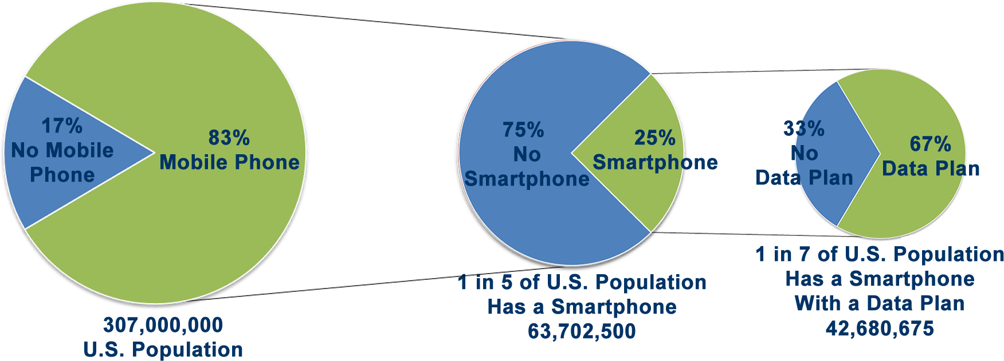
Constrained Audience
83% of U.S. population has a mobile phone
25% of those who have mobile phones have smartphones
67% of those with smartphones don’t have a data plan
That means only 1 in 7 of the U.S. population has the technical capability to access your AR application
Source: BillShrink, InfoWeek

Slide 18
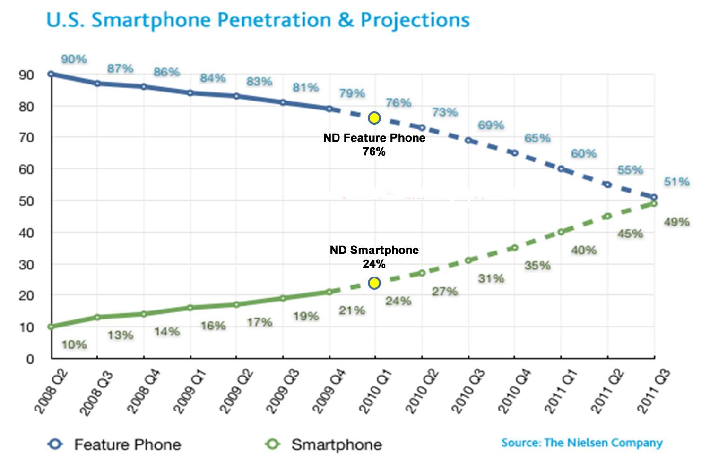
Smartphone Penetration at Notre Dame
Source: The Nielsen Company

Slide 19
Immature Technology
Sensor accuracy
GPS only accurate within 10 meters; accelerometer drifts
over time and can get confused
Indoor/relative positioning and object tracking
GPS needs clear line-of-sight to satellites; Skyhook
can place you by wi-fi triangularization
Graphics/screen size
Not well suited for outdoor use, low light situations, or
rapid movement/screen refresh events; small screen size
Quality and quantity of bandwidth
Network latency (~400 ms) causes many delays and errors
Battery/Power Usage
GPS, other sensors, and processor drain battery quickly

Slide 20
Complex App Authoring
Expensive to develop AR apps due to:
  No single standard/spec or AR engine
  Platform centric authoring required
    Android
      Too many versions to support: 1.5, 1.6, 2.0, 2.1, 2.2, 3.0
      Inconsistent applications across carriers
    iOS
      Apple reluctant to make all sensors available
      Unwilling to open up all hardware/software for AR development
    Open source
      Too many choices, no real leader (Gamaray, Mixare, openAR, Argon, KHARMA, ARToolKit, FLARToolKit, OpenMAR, ARML)
  Develop for web app or native app or both?
Too many options creates scalability and cost issues
Need an open, distributed, multi-user AR framework fully integrated with the Internet

Slide 21
Limited Use Cases
Conventional desktop UI environment doesn’t work
Windows, icons, menus, and pointing – six degrees of
freedom needed rather than 2D
Reliance on single-person, socially disconnected AR user experiences
Very few AR apps exist to socially connect people
Ergonomics – Unnatural physical position/point only
Having to hold up phone to view is awkward
Overload or over-reliance
UI must not overload user while also preventing the
user from over relying on the AR app such that they
miss important cues from the environment

Slide 22
Benefits of 4G
Higher potential bandwidth
Minimal latency
Better throughput
Better coverage/signal penetration
Simultaneous user support
Reliability
Interoperability

Slide 23

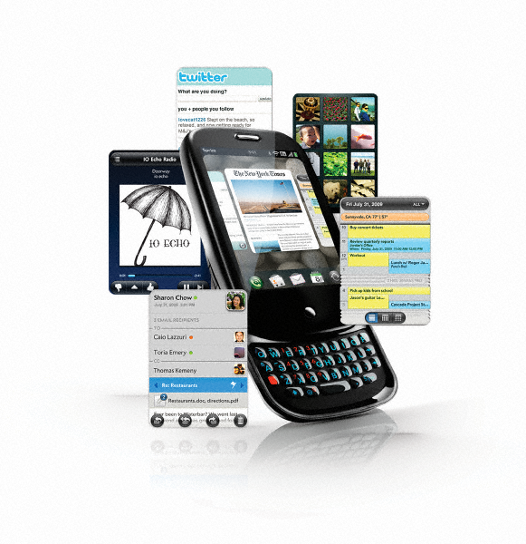
Mobile Data Traffic Growth
The Mobility Revolution = How People Work and Play
3G Traffic in Mature Markets to Increase 20 Fold by End of 2014
September 1, 2009
Machine to Machine (M2M)
Smartphone adoption
Embedded laptops and data card growth
Consumers adopting mobile apps
Enterprise mobility into every product, service, and process
4G
Source: Chetan Sharma Consulting

Slide 24
High Capacity Requires Spectrum
Expect no more than 22 MHz FDD per operator nationwide
700 MHz
60 MHz (1)
Most of these are allocated to voice
3G
85 MHz (1)
Extensive enough to deliver next generation broadband content & services
4G
198 MHz (1)
(2.5 Ghz)
(1) Spectrum band shared by multiple operators

Slide 25
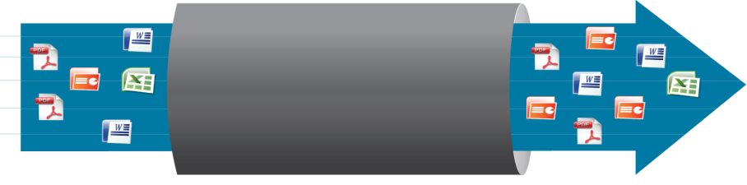
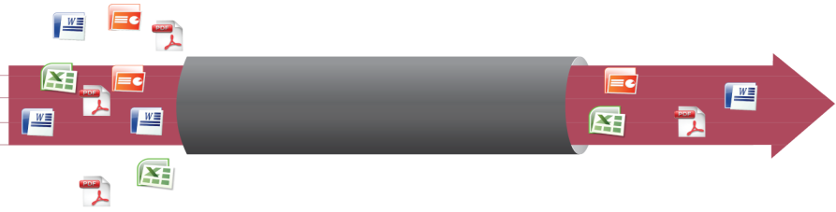
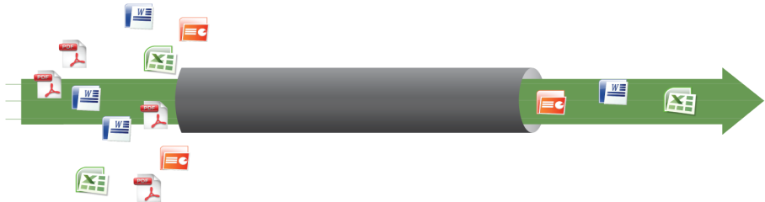

Sprint 4G Spectrum Advantage
With large spectrum holdings, Sprint offers faster speeds and serves more users, while competitors must choose between number of users versus high data rates. In summary: More Spectrum = Greater Capacity and Fewer Potential Bottlenecks for Customers
Spectrum Position in
Market for high speed data
Competitors Concern and
potential customer impacts…
“rapidly growing demand for bandwidth-intensive wireless services is placing excessive demands on current networks and spectrum . . . In order to migrate to LTE on a broad scale, wireless companies will need a “wide band of clean spectrum.”
– Colin S. Stretch, Counsel for AT&T Inc.
Comments of AT&T Inc., WT Docket No. 09-66, September 30, 2009
2.5 GHz
WiMAX
120 MHz
Sprint
“I'm not ready to put a number on it, but I'll say in the five-plus year timeframe, I'd like to have north of -- I'd like to be in a position where I could acquire north of 100 megahertz. “
– Bill Stone, Executive Director Network Strategy, Verizon Wireless
National Broadband Plan Workshop, Spectrum, September, 17 2009
700 MHz and AWS
30-46 MHz
Verizon
“We’re going to have to consider pricing structures that allow us to sell packages of bytes, and at the end of the day the concept of a flat-rate infinitely expandable service is unachievable.”
– Verizon Chief Technology Officer Dick Lynch
Metered Mobile Broadband
700 MHz
and AWS
12-24 MHz
AT&T
“AT&T CEO Randall Stephenson says wireless customers who are heavy Internet users will eventually pay more than those who use less.”
-MarketWatch March ,2010
Source: Macquarie, The Wireless 4G Evolution, November 2009

Slide 26
4G Compared to 3G
4G enables productivity with speeds up to 10 times faster than 3G
Sprint Download Speeds
Sprint Upload Speeds
10 Mbps
8 Mbps
6 Mbps
4 Mbps
2 Mbps
Peak
Up to 10 Mbps
Downloads up to 10x faster
than 3G
8 Mbps
6 Mbps
4 Mbps
2 Mbps
Average
3-6 Mbps
600-1400 Kbps
Peak
Up to 1 Mbps
Sprint 4G
Sprint 3G
Sprint 4G
Sprint 3G

Slide 27
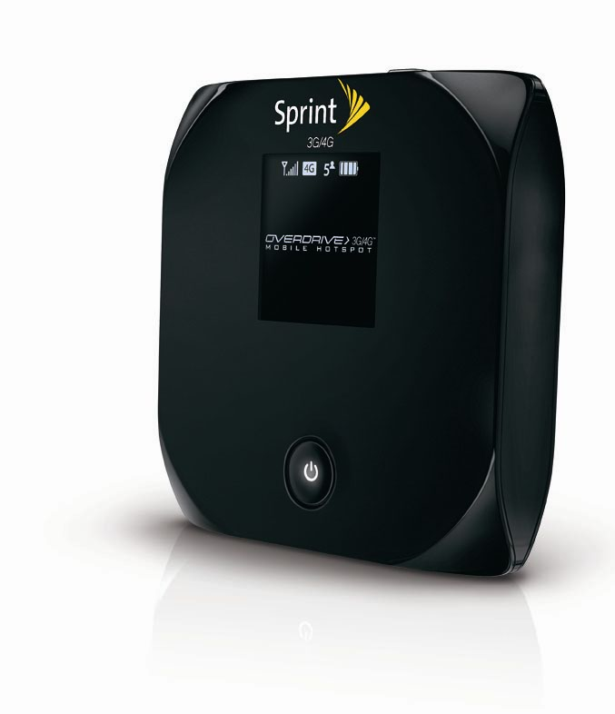
4G Can Complement or Replace Wi-fi
4G shares much in common with typical public WiFi…
high bandwidth and performance
broadly supported by IT, Computer and Consumer Electronics companies
superb technologies for embedding low-cost radio chipsets
…but overcomes some challenges businesses/institutions experience with WiFi
Sprint 4G
Wide area coverage (Anywhere on the Campus)
Mobility (walking, riding, exercising)
No capacity constraints
Full security (FERPA)
Dedicated spectrum (no interference)

Slide 28
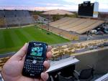

















Core Enablers
4G and Custom Network Solutions
Mobile Learning
Convergence
Stadium
Coverage
Street-level
Research
Center
Covered Parking
Campus Safety
Courtyard
Lecture
Hall
Operations
Premise Applications
Subway
Admin
Buildings
Library
Underground
Coverage
Residence Halls
Green Campus Sustainability

Slide 29
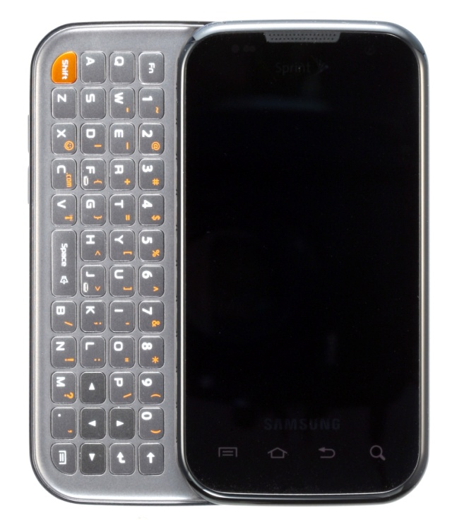
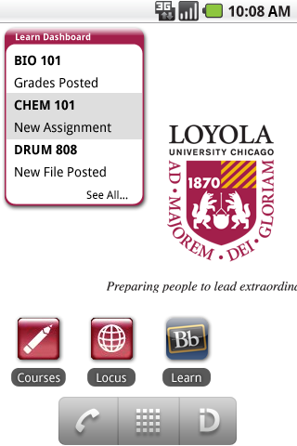
The Sprint Id Opportunity in Education
Sprint ID lets users, on select Sprint devices, get a feature-packed bundle of digital content (apps, widgets, ringers, wallpapers and more) all at once in a single download to build a total personalized experience for their phone.
Campus administrators can take advantage of Sprint Id to create unique, branded campus experiences that foster community building and engagement ; while leveraging the existing resources at their disposal.
Through a variety of experience packets, universities can extend their campus reach, build affinity, and provide access to key, campus resources.

Slide 30
Can AR Take Advantage of 4G?
Unfortunately, not right now
The limitations of the device, both hardware and software means we cannot fully take advantage of 4G yet
As the devices mature, you will see more and more AR apps becoming true AR apps where they take advantage of:
  Cloud-based content/data flows from sensors
  Mashups
  Shared augmented realities
  Registration and display of virtual objects

Slide 31
Today’s Smartphone AR Limitations
Sensor accuracy (GPS, compass, etc.)
Display (small screen)
Form factor/appearance (ergonomics)
Weight of device
Battery life
Processor speed and battery usage
Outdoor use (weather, sunlight)
Cost
Memory/storage capacity

Slide 32
Are there any 4G AR Apps Available Now?
No, but there are other 4G apps available
Current 4G apps take advantage of higher speeds and specialize in transferring large files that you wouldn't want to download over a 3G network
Here are some of the winners of Sprint’s 4G app challenge in 2010
  NASAImages – this image app gives users access to large, high-quality pictures
  Say What? – this gaming app requires reliable connectivity and low latency to be played properly
  MediaFly – this is a video and radio streaming app that detects when there's a 4G connection nearby and it can switch to that and provide more high-quality videos and a less blocky experience

Slide 33
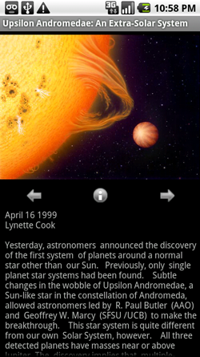
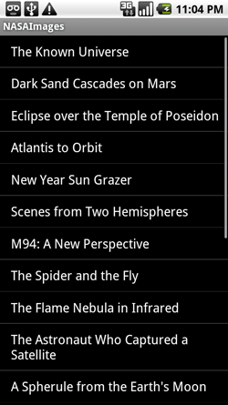
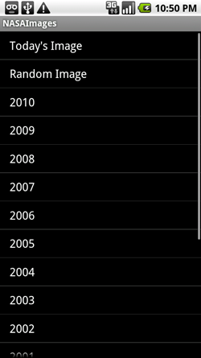
NASAImages Demo
NASAImages – this image app gives users access to large, high-quality pictures

Slide 34
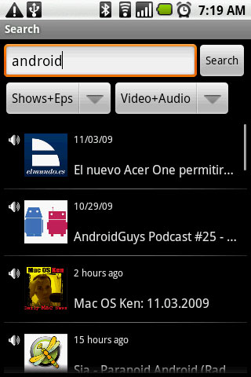
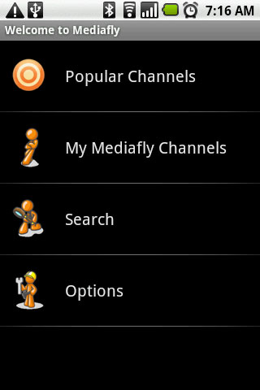
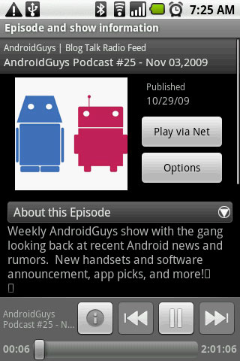
MediaFly Demo
MediaFly – this is a video and radio streaming app

Slide 35
AR Now and in the Future
Now | Future
“Point” interaction | Live, interactive experience
Involvement of limited senses in apps | Multi-sensed apps
Single, individual viewer experience | Multi-user, collaborative, social experience
Local, fixed content | Cloud-based contextual data integration
AR engine fragmentation | Common AR engine across all platforms

Slide 36
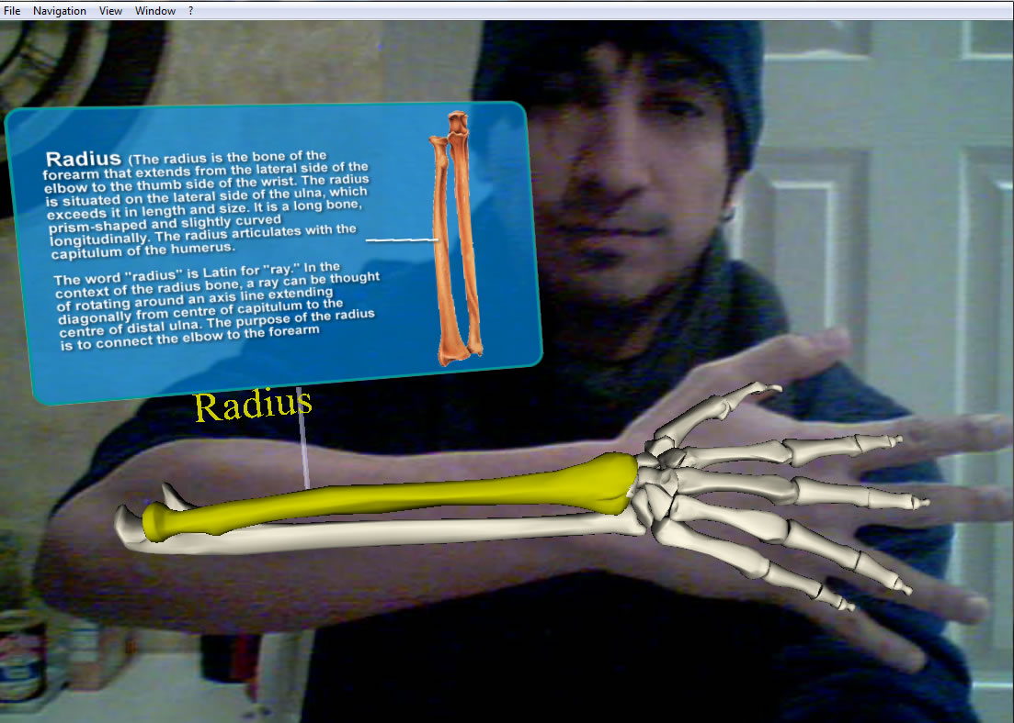
Health Instruction/Knowledge Database
Example
Screenshot
Source: http://technoccult.net/archives/2010/01/11/augmented-reality-medical-app/

Slide 37

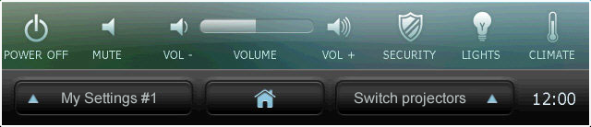
Classroom Control Concept
When the professor walks into their classroom, their mobile phone senses they are in the room and pops up a virtual control panel for them to control all aspects of the classroom with hand gestures such as turning the projector on, setting the room volume, changing the light settings, etc.

Slide 38

Roman Forum Example

Slide 39
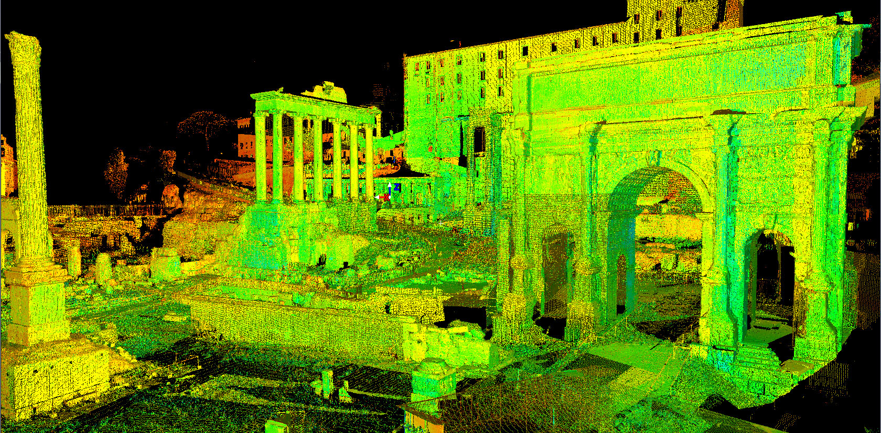
Arch of Septimius Severus

Slide 40
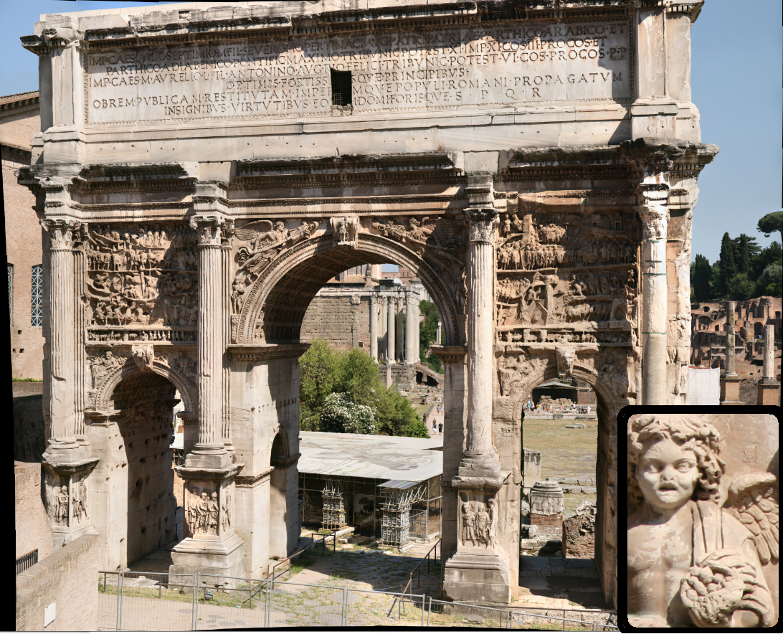
Roman Forum Example

Slide 41
Roman Forum Augmented Example
To the Emperor septimus severus , Son of Marcus, Pius, Pertinax, Pater Patriae, Parthicus Arabicus,Parthicus Adiabenicus, Pontifex Maximus, having held the tribunician power 11 times, acclaimed emperor 11 times, Consul 3 times, Proconsul,and Emperor Marcus Aurelius (caracalla), Son of Lucius, Antoninus, Augustus Pius, Felix, having held the auspicious tribunician power 6 times, Consul, Proconsul, Pater Patriae, Highest and Strongest Princes for having restored the State and enlarged the Empire of the Roman people, by their visible strengths at home and abroad, the Senate and People of Rome [made this]

Slide 42
Show Poll Results
Show Poll results for “How will your campus be using AR”

Slide 43
Questions?

Slide 44
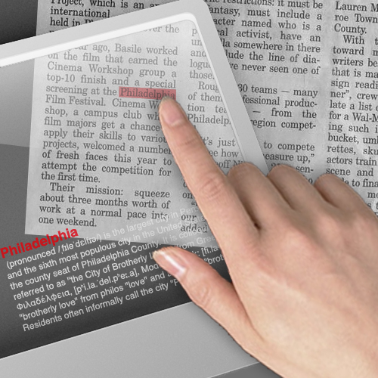
Higher Education AR Example #1

Slide 45
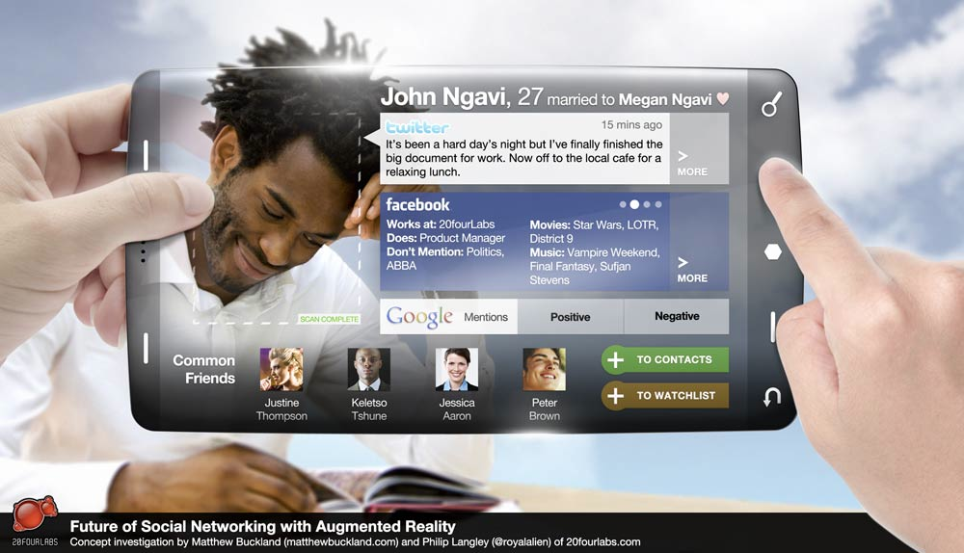
Higher Education AR Example #2

Slide 46
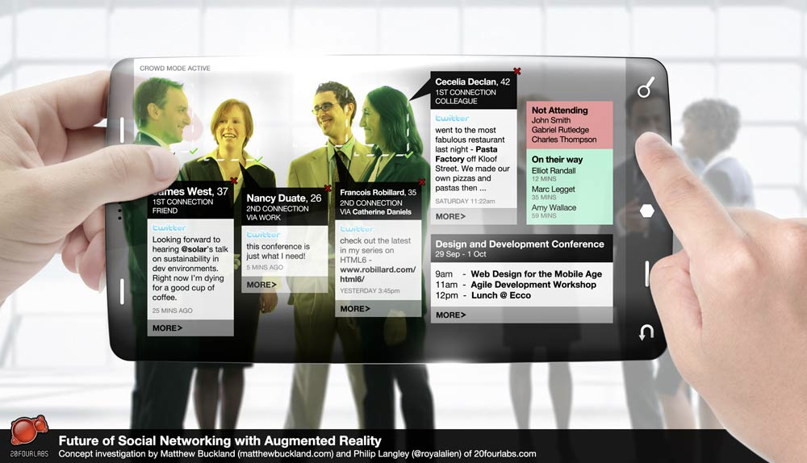
Higher Education AR Example #3

