Slide 1
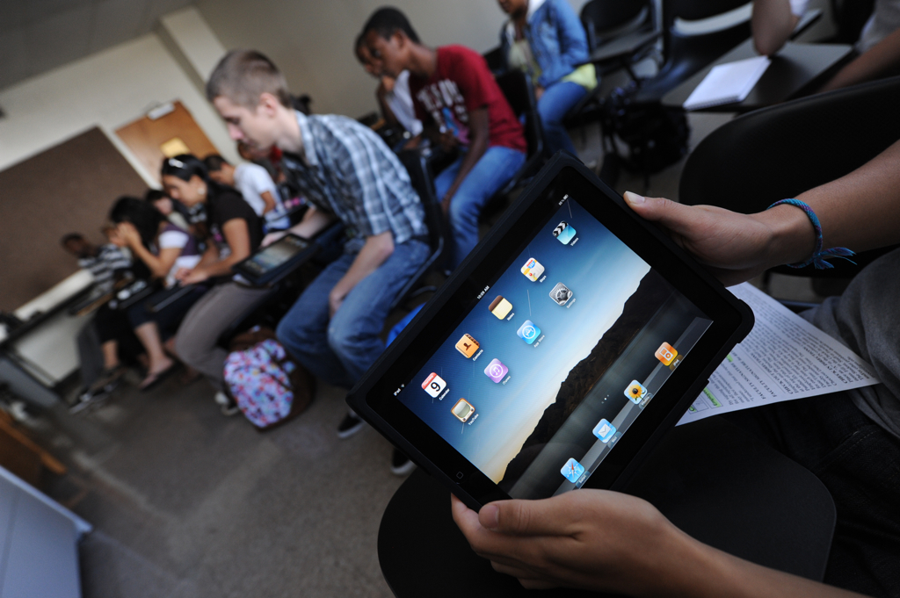
You can get there from here!
Strategies for Planning Academic iPad Initiatives
Notes:
Julian

Slide 2
About Us…
Trish Nolde
  Director, Language Acquisition Resource Center
Joe Horne
  Manager, Instructional Design Services
Julian Allen
  Director, Professional Services
Notes:
Julian

Slide 3


Share with Others!
Wireless
Network: EDUCAUSEAIR
Password: ELI_2012
On Twitter
This Seminar: #ELI12_SEM04
ELI 2012: #ELI12
Notes:
Julian: Feel free to ask questions! Just raise your hand.

Slide 4
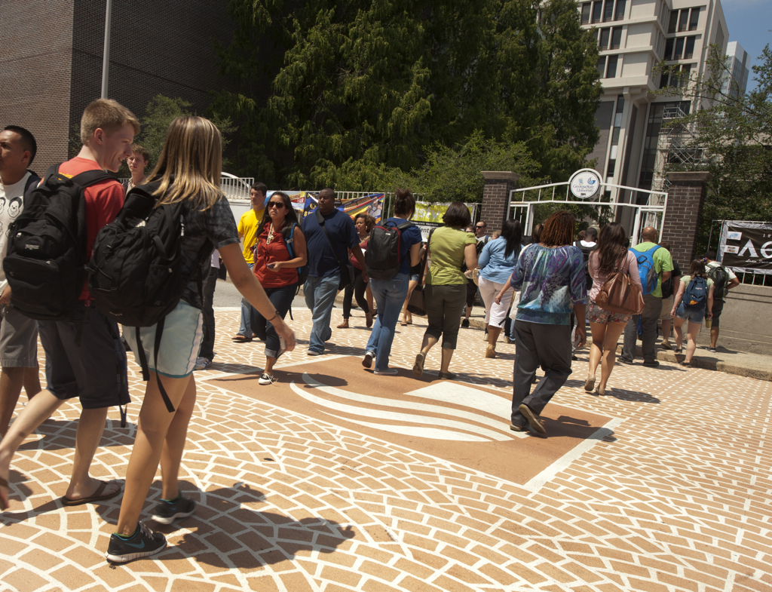
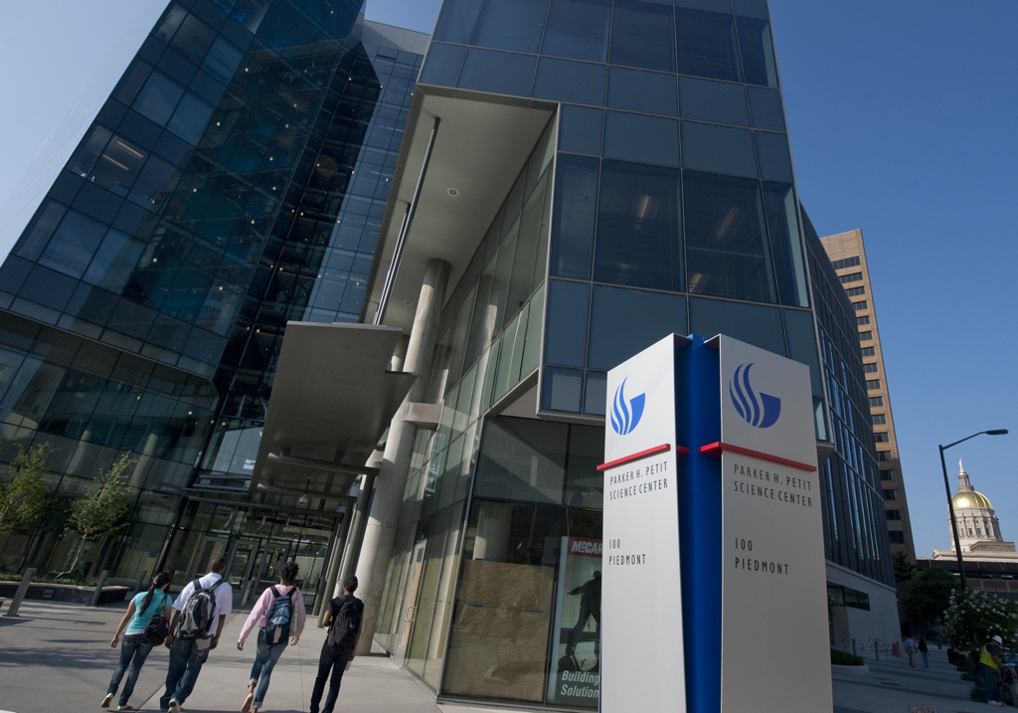
About Georgia State University
Founded in 1913
(we’re counting down to 100!)
32,000 students
(graduate and undergraduate)
1150 faculty
250 degree programs across
8 colleges
Notes:
Julian

Slide 5
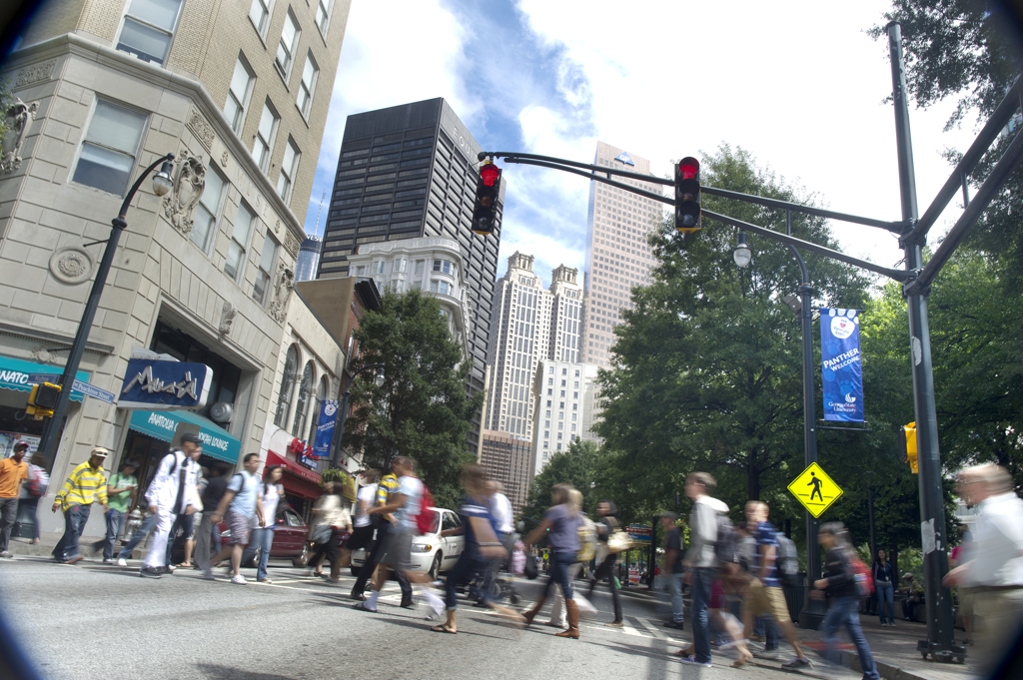
About Georgia State University
Located in the heart of downtown Atlanta
Notes:
Julian

Slide 6
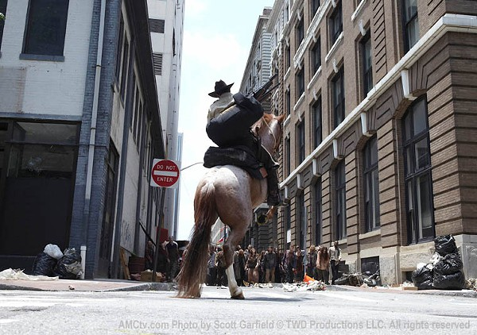
About Georgia State University
GSU: Home of the Walking Dead
Notes:
Julian

Slide 7
About You?
?
?
?
?
?
?
Notes:
Joe

Slide 8
What you told us…
Most have small scale experience or personal experience with mobile learning
A few schools have their own
app(s), but most do not
Half have official deployment of mobile technologies to various groups
Notes:
Joe

Slide 9


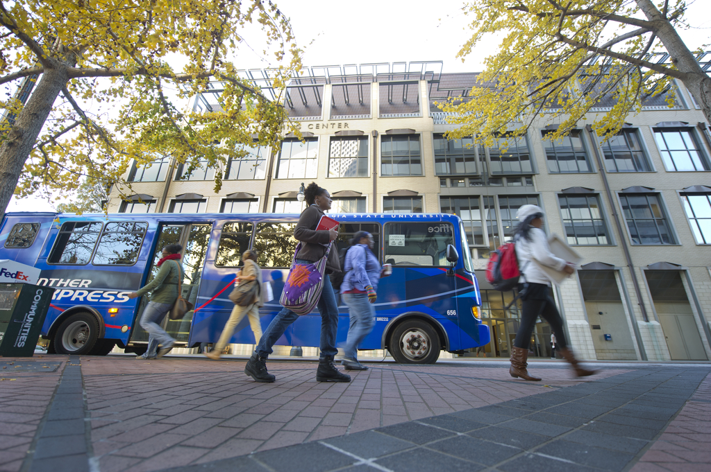
Mobile Learning
How do we define Mobile Learning
at GSU?
Notes:
Joe: Ask question about IT arrangement… do you have a mobile initiatives group

Slide 10

What are iPads best used for?
Consumption v/s Creation
Notes:
Joe

Slide 11
Group Activity
Is mobile learning the right choice?
Using the Appropriateness Instrument, assess your institution’s needs related to mobile technology.
Discuss your findings with others at your table.
Notes:
Joe

Slide 12
Group Activity
70+ Mobile is the way to go!
40-69 Maybe mobile, maybe not.
<40 Probably look elsewhere.
Notes:
Joe

Slide 13
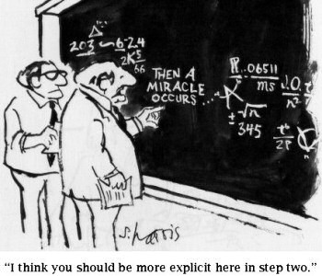
Somewhere between great ideas and great implementations…
Notes:
Trish: Emphasis is not on 100 cool things you can do with ipads in your classes, but how to get iPad INTO your classes.

Slide 14
Deployment Models
Course
Deployment
Program
Deployment
Staff and Faculty
Deployment
Event
Deployment
Notes:
Trish

Slide 15
Course Deployment
A bank of devices is deployed to a specific class or course.
One per student plus faculty member
A very structured, specific deployment
Can be customized to particular class or course requirements
Notes:
Trish

Slide 16
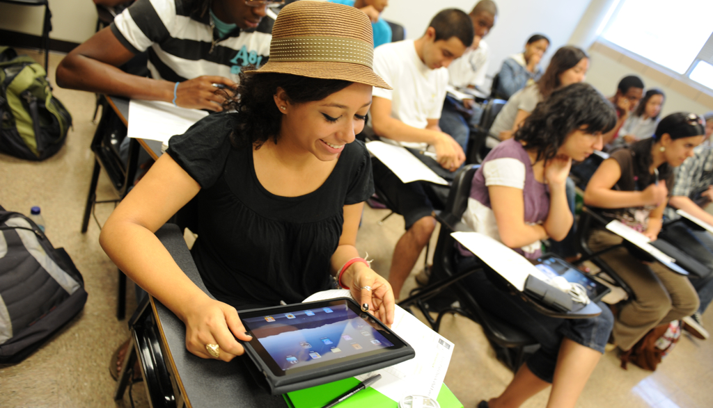
Course Deployment
SPAN 3305: Spanish Literature Survey
Notes:
Trish

Slide 17
Course deployment:
Spanish 3305
Second language literature survey
25 students
Concept mapping, planning for writing, annotated reading, video poems
Notes:
Trish

Slide 18
Course deployment:
Challenges & Solutions
Challenges:
  Curriculum redesign
  Discipline-specific app identification and research
  App purchase and installation decisions
  Semester-long commitment
Solutions:
  Close cooperation between the issuing agency and the course instructor
  Self-selected faculty often translates into greater buy-in
Notes:
Trish

Slide 19
Program Deployment
Deployment across an entire program
Can involve a diverse range of courses and technical requirements
Faculty are often not self-selected but are assigned
Notes:
Joe

Slide 20
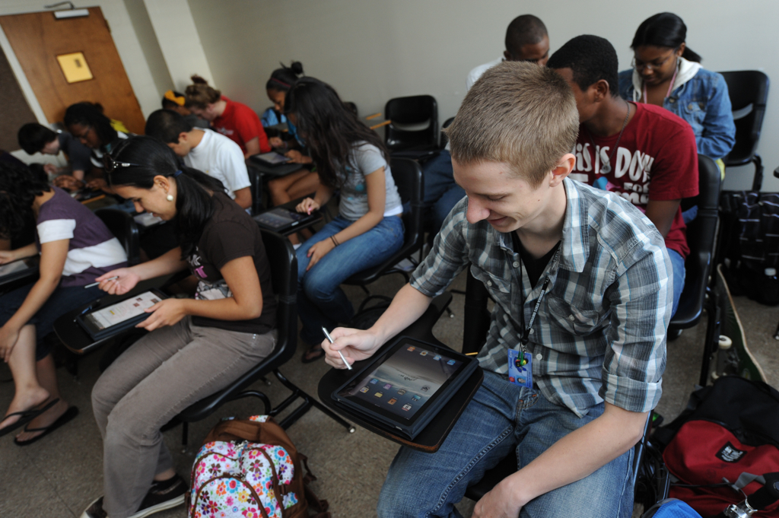
Program Deployment:
Freshman Learning Communitites
FLC: Freshman Learning Community
Notes:
Joe

Slide 21
What is an FLC?
75 cohorts of 25 students
Grouped around a common interest
Take all courses together
Half of all incoming freshman participate
Transition from high-school to college model of learning
Notes:
Joe

Slide 22
Program Deployment:
Challenges & Solutions
Challenges:
  Large number of faculty and students to train
  Classroom wireless problems
  High faculty turn-over
Solutions:
  Just-In-Time training for students upon deployment
  Upgrade Wireless where possible, re-assign rooms for better connectivity
  Create common mobile-enhanced curriculum
Notes:
Joe

Slide 23
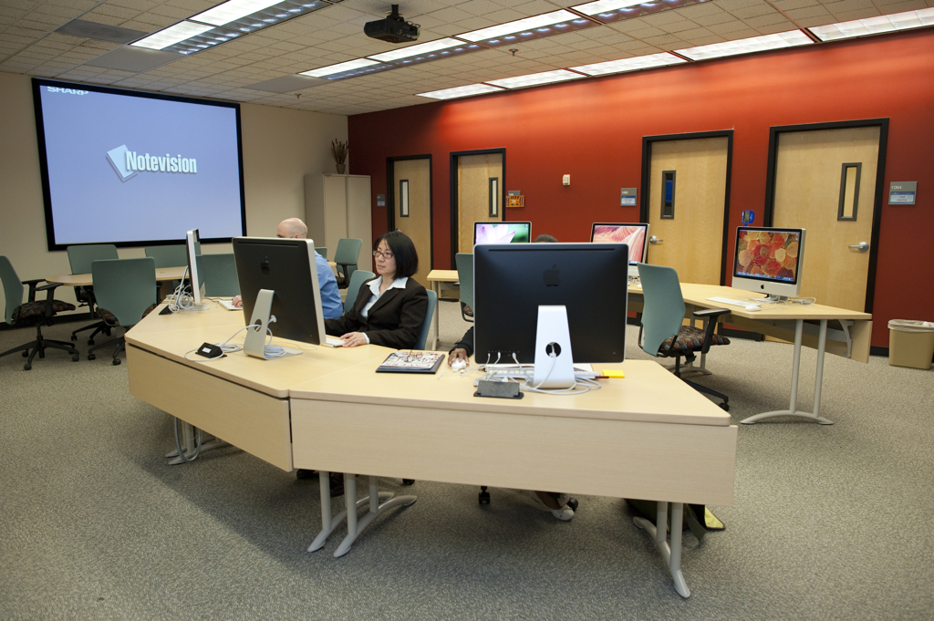

Staff and Faculty Deployment
Check-out program:
  Campus-wide availability
  Departmental availability
Notes:
Joe

Slide 24
Staff and Faculty Deployment:
Challenges & Solutions
Challenges:
  Inventory – can’t keep them in stock
  Getting data off the device
  I need to use this at a conference tomorrow – can you teach me?
Solutions:
  Be vigilant in getting things returned
  Remind them to take their data – or help them get their content off
  Flexible, easy support for travellers
Notes:
Joe

Slide 25
Event Deployment
One-time or repeated event
Short period of time
Quick turn-around
Limited and controlled geographic area
Notes:
Julian

Slide 26
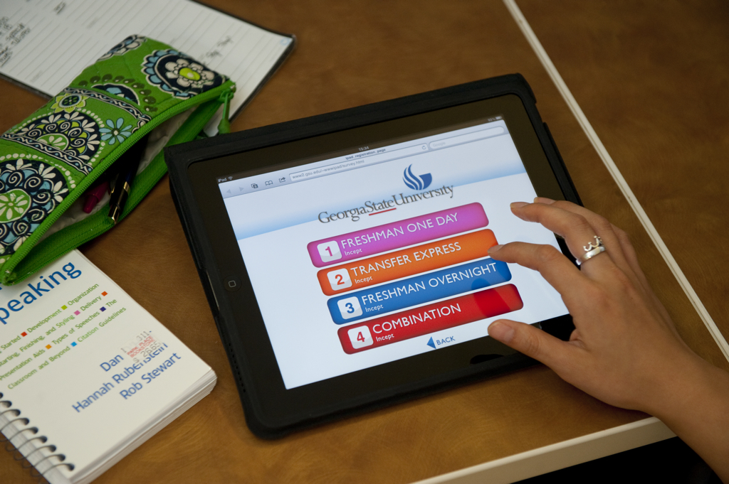
Event Deployment
Incept:
GSU’s Freshman Orientation
Notes:
Julian

Slide 27
Event Deployment:
Orientation and Registration
Most incoming first-year and transfer students
Facilitated quick, efficient registration
“Coolness factor”
Free up computer labs, normally reserved for event
Great use of iPads when not deployed in academic programs
Notes:
Julian

Slide 28
Event Deployment:
Challenges & Solutions
Challenges:
  Rapid, Repeated Deployment
  High Wireless Network Load
Solutions:
  Re-image nightly
  Used Charging/Re-imaging carts
  Vastly increased network capacity
Notes:
Julian

Slide 29
Any Questions?

Slide 30
Let’s take a break!

Slide 31
Group Activity
Share your story…
Working with your colleagues at your table, identify the types of deployments currently underway at your school.
Identify common challenges, and suggest solutions.
Notes:
Julian

Slide 32
Considerations
Legal
Support
Security
Infrastructure
Notes:
Julian

Slide 33
Deployment Models
Course
Deployment
L
Program
Deployment
L
S
S
S
S
I
I
Staff and Faculty
Deployment
L
Event
Deployment
L
S
S
S
S
I
I
Notes:
Julian

Slide 34
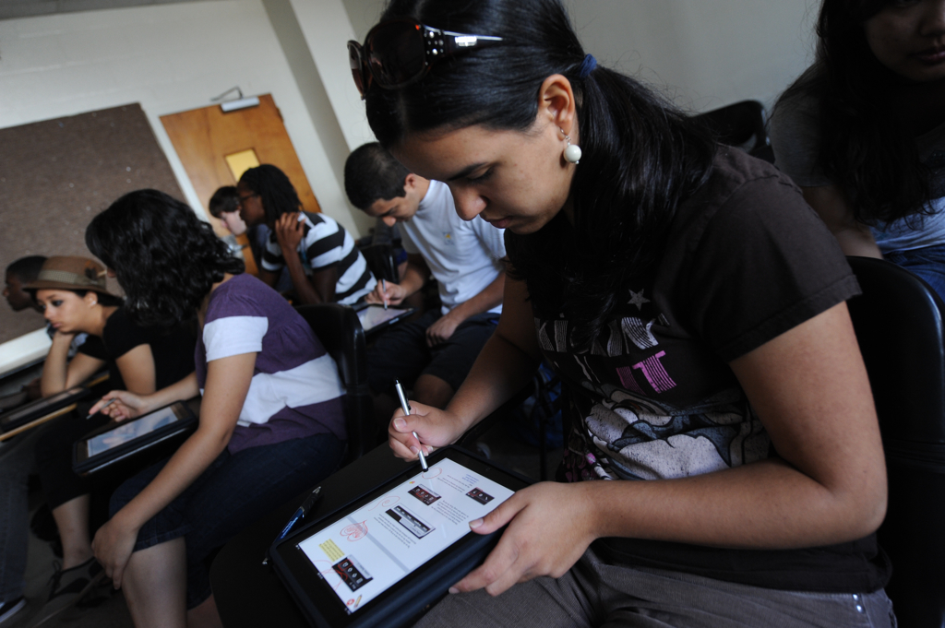
Legal Considerations:
Ownership
Who’s iPad is it anyway?
Notes:
Julian

Slide 35
Legal Considerations:
Ownership
It’s Mine!
University Owned
v/s
Individually Owned
No!
It’s Mine!
Notes:
Julian

Slide 36
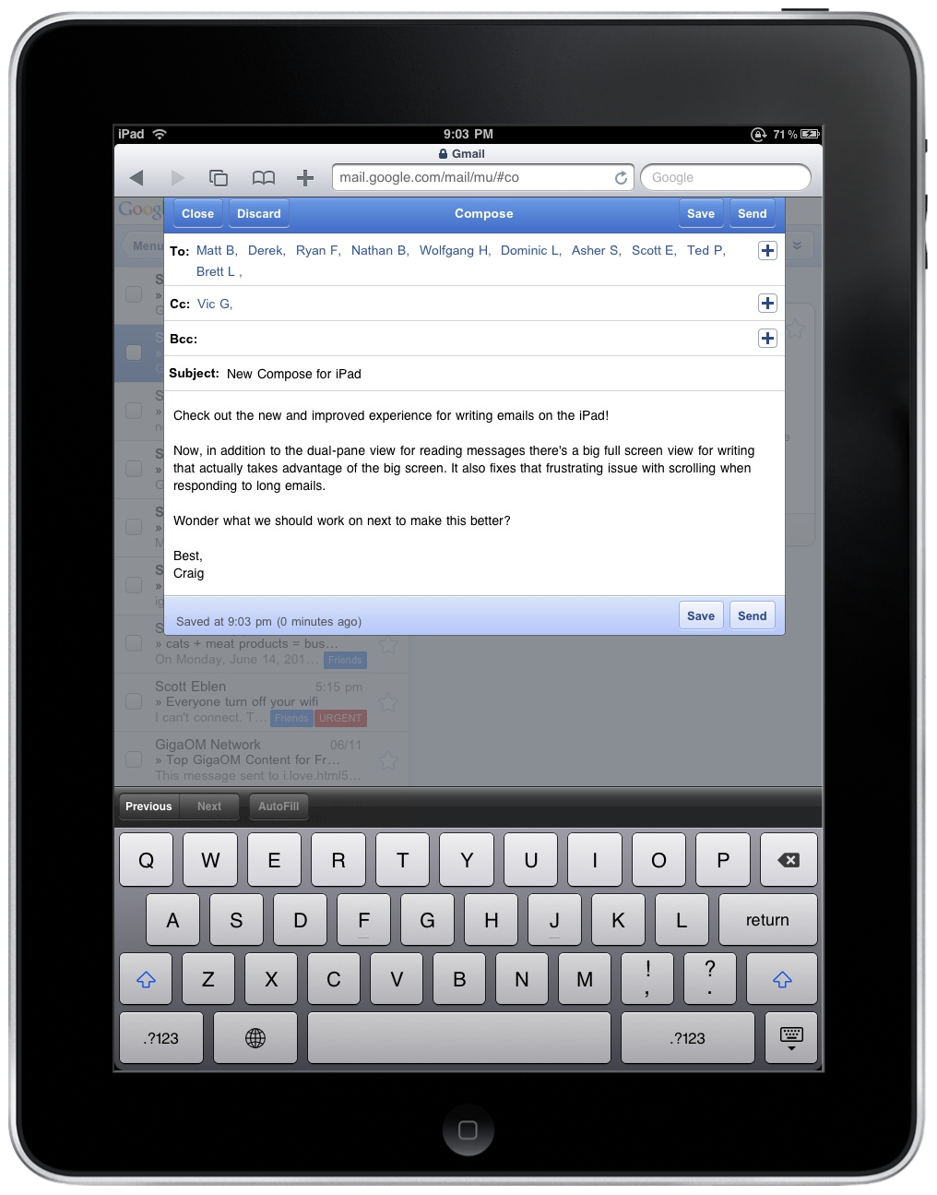
Legal Considerations:
Ownership - Device
University Owned:
  Checkout (Day, Week, Semester, Year)
  Lease (Option to purchase at end of term)
Student Owned:
  Student Provided
  University “Gift” (included in tuition or fees)
What are the legal and financial restrictions of each at your university?
Notes:
Julian

Slide 37
Legal Considerations:
Ownership
In just one month…



November 30, 2011
December 31, 2011
Notes:
Julian

Slide 38
Legal Considerations:
Ownership - Device
University Owned:
  Checkout (Day, Week, Semester, Year)
  Lease (Option to purchase at end of term)
Student Owned:
  Student Provided
  University “Gift” (included in tuition)
What are the legal and financial restrictions of each at your university?
Notes:
Julian

Slide 39
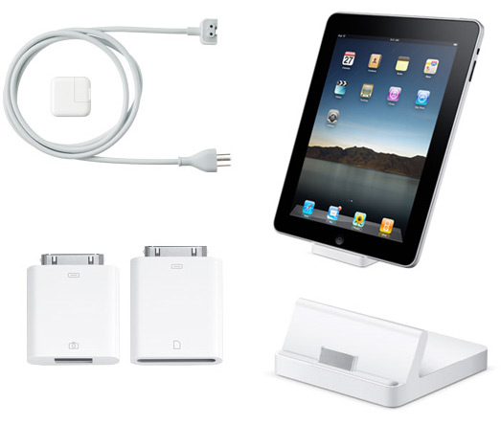
Legal Considerations:
Ownership - Accessories
What about the accessories (keyboards, stylus, cover, earphones)?
If University supplies...
Owned by university
If student supplies...

Slide 40
Legal Considerations:
Loss – It Happens
What happens when the iPads or accessories aren’t returned?
  (damaged, stolen, lost, dog ate my iPad…)
  User pays replacement fee… OR
  Students: Grades Held, Registration Held
  Faculty/Staff: Wages Garnished
Notes:
Julian

Slide 41
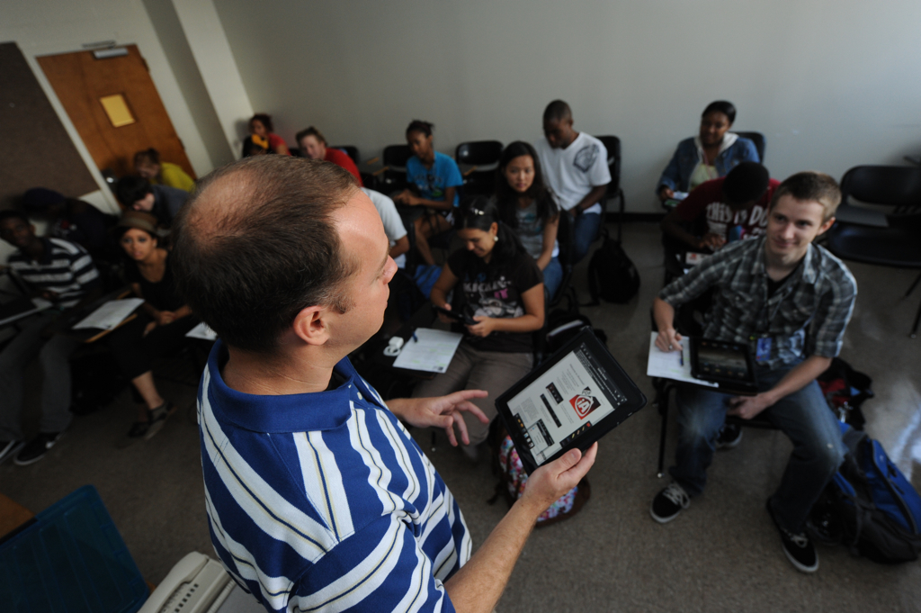
Support Considerations
What should your
support model look like?
Notes:
Trish

Slide 42
Support Considerations
Who
What
When
Where
How
Notes:
These decisions are highly individualized based on the institution, the support center, the size of the deployment and the anticipated support needs. 1 WHO is going to be providing the support? Center? Vendor? Instructor? WHO is going to be receiving support? Students and Instructor? Will they have separate support resources? 2. WHAT kind of support will they receive? Initial setup / routine / emergency only / specific function? 3. WHEN will this support be available? Set schedule / 24-7 / appt only / walk-up? 4. WHERE will they come to receive support? Genius bar / computer lab / training center/ personal office space? What kind of space limitions may affect access to support? 5. HOW will the support be provided? Face to face / online tutorials / printed materials / training seminars / online chat? The best and more flexible support models probably includes a blend of all these options, depending upon your institutional needs.

Slide 43
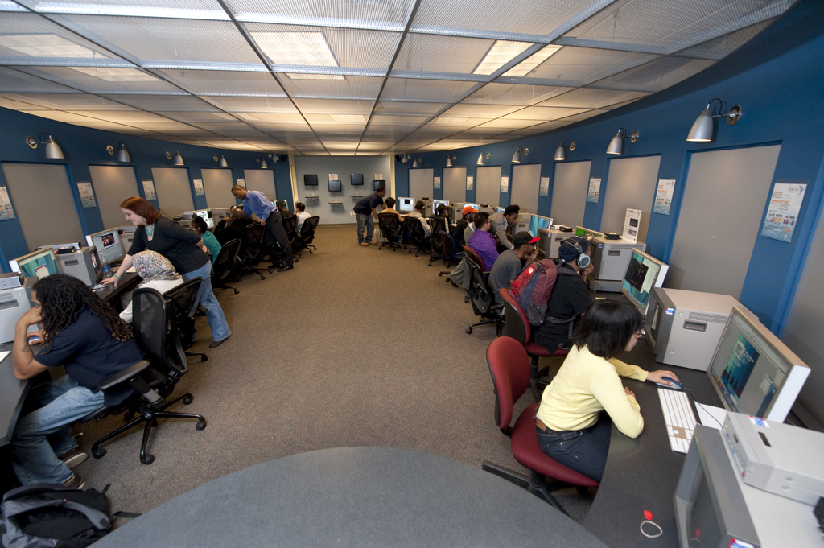
Support Considerations:
For Students
Walk-in Help
Peer Mentoring
Online resources
  University-provided
  Other web resources
iPad & Software Training
Notes:
Trish

Slide 44
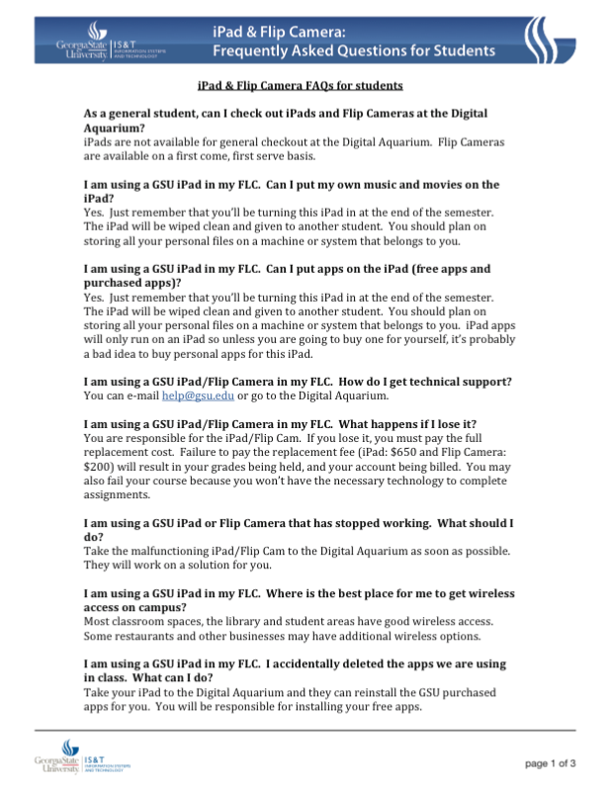
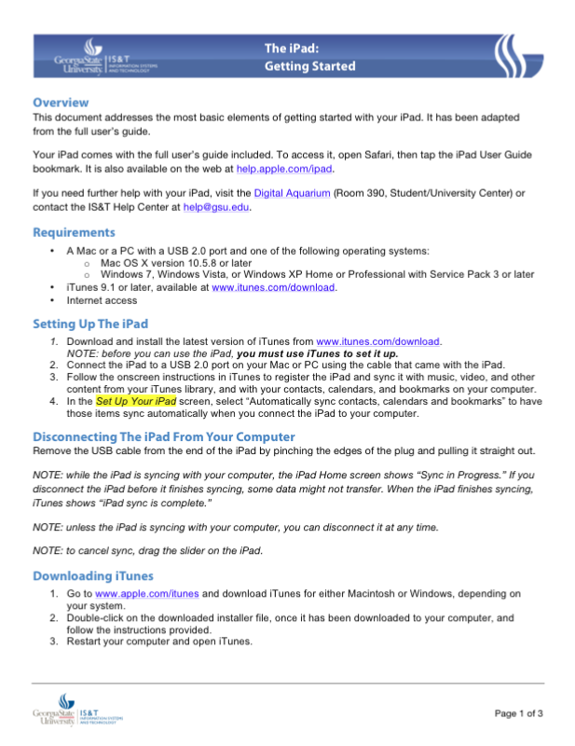
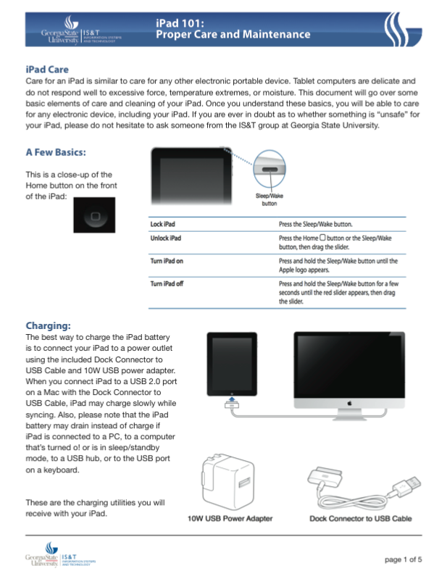
Support Considerations
Notes:
Trish

Slide 45
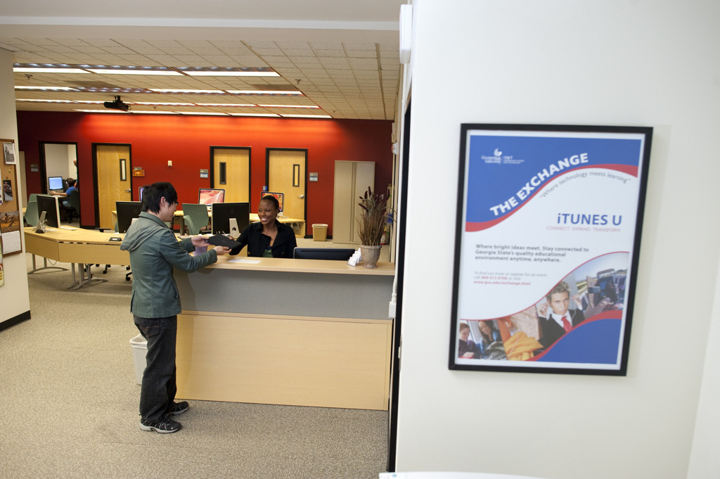
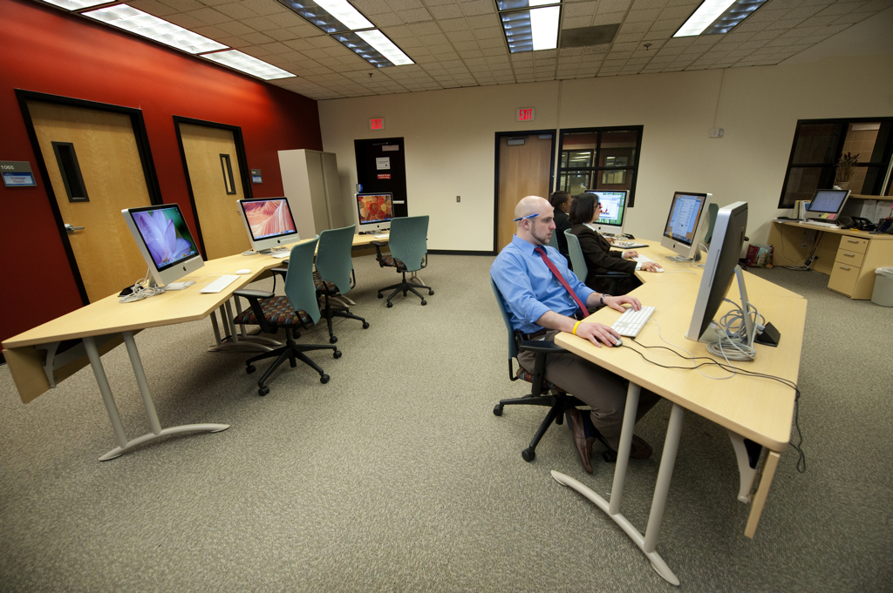
Support Considerations:
For Faculty
Walk-in Help
Course Development
Application Selection
Teaching Community
Online resources
  University-provided
  Other web resources
Notes:
Joe – mention the App Selection Tool handout

Slide 46
Security Considerations
Is sharing devices safe?
Malware in Apps, on the web
Confidential or sensitive information
Notes:
Julian – story about faculty wanting their devices “cleaned”

Slide 47
Security Considerations:
Personal Data
How do we keep personal data, well, personal?
Re-image each device between users (for iPads with purchased Apps for special configuration)
Factory Restore (for iPads without purchased Apps)
Notes:
Julian

Slide 48
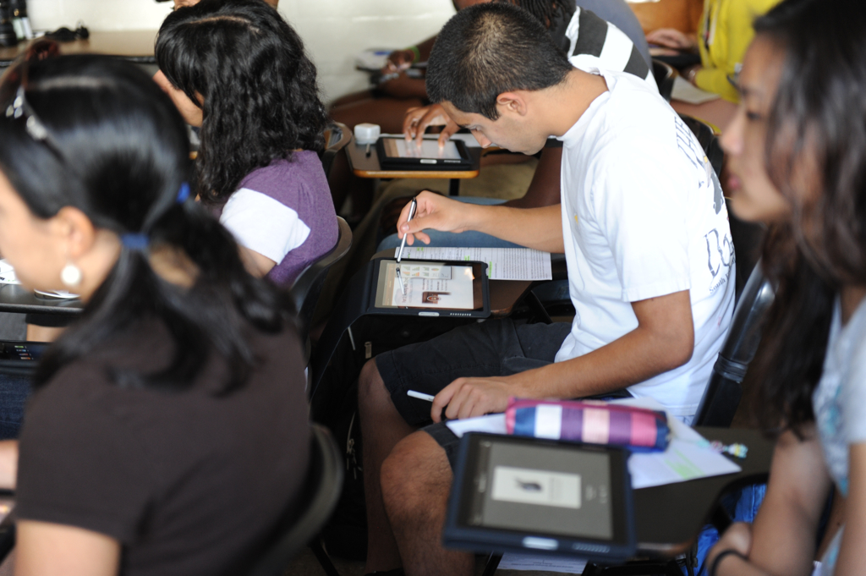
Infrastructure Considerations
Is your network ready?
Notes:
Julian

Slide 49
Infrastructure Considerations:
Wireless Network
What we did:
Installed 802.11n wireless networks in 16 of our 51 campus buildings and outdoor centers
170 classrooms upgraded
802.1X for continuous access
Over 1300 access points installed; 1000 more on the way
Spent approximately $2.5M
over 3 years
Notes:
Julian

Slide 50
Infrastructure Considerations:
Campus Systems
Student Systems
  Access Portal
  Registration (Banner)
Learning Management
  WebCT Vista, moving to Desire 2 Learn
Email
  Client setup
  Mobile-Makeover Day
Websites
  Mobile-ready
  Video & interactive content
Notes:
Julian

Slide 51
What is readiness?
readiness [ˈrɛdɪnɪs] n
  the state of being ready or prepared, as for use or action
Collins English Dictionary
Notes:
Trish

Slide 52









Are we ready?
Devices
Centers
Faculty
Students
Readiness
Notes:
Trish

Slide 53

Devices: Ready to Deploy
Inspected • Inventoried • Imaged
Notes:
Do they all work? Are all their parts included? Inventoried means that the serial numbers are recorded, entered into whatever checkout system that you have, do you need barcodes? Do you have barcode technology? Do you have a custom image you want to provide? Maybe so if you have specific apps or VM applications. If not, at the minimum you need to be sure that the devices are updated with the current OS.

Slide 54
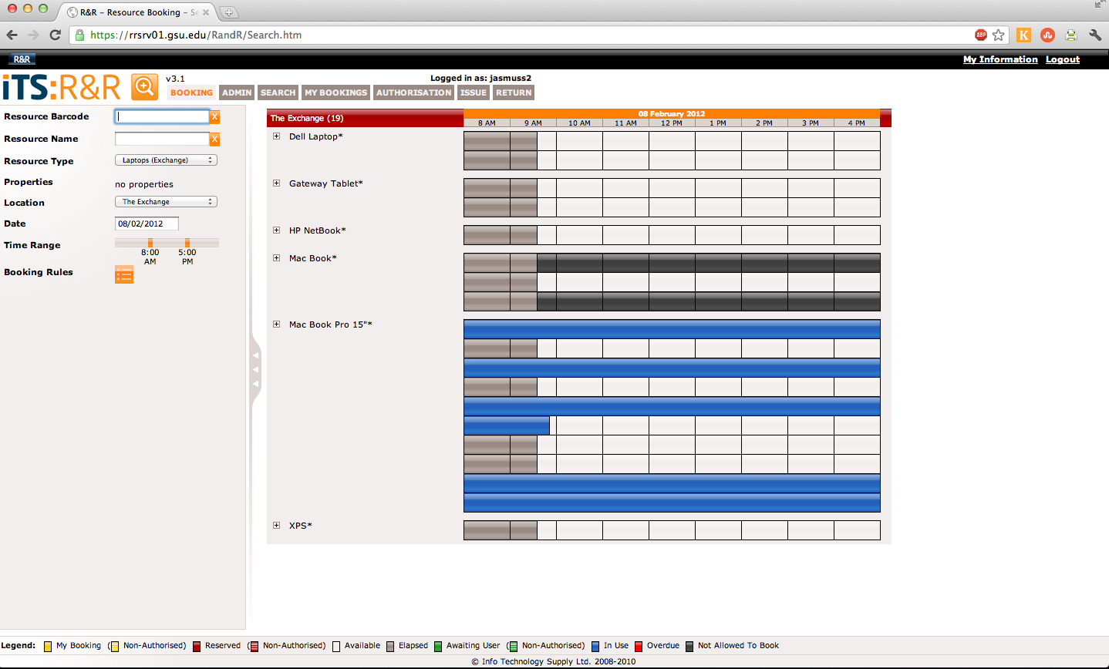
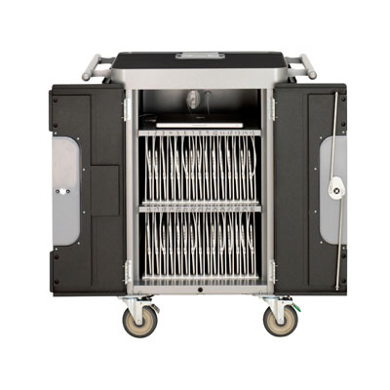
Devices: Ready to Deploy
Carts: Great for recharging and re-imaging
R&R: Our checkout system
LARC check out

Slide 55
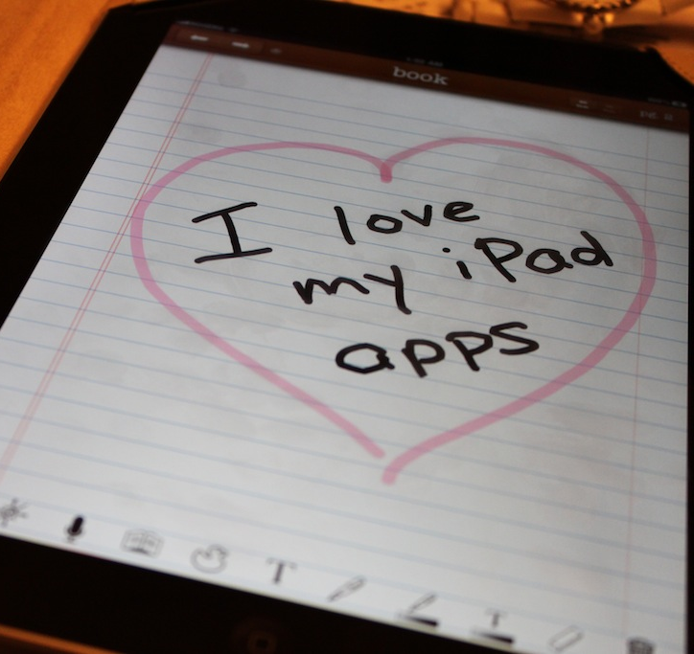
Devices: Ready to Deploy
Apple Volume Licensing:
  Shall we say…. Challenging?
  Not designed for
  ease of use
Gifting is problematic
These are personal devices, designed for the enterprise

Slide 56
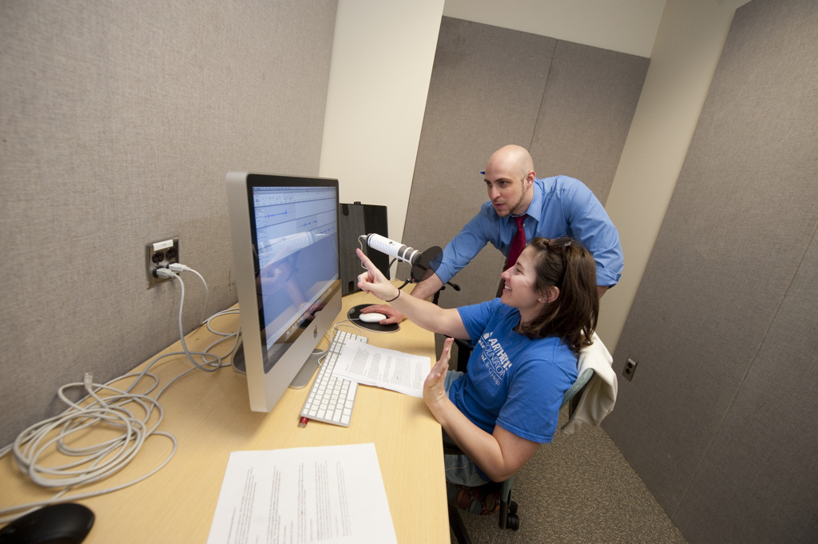
Centers: Ready to Support
Trained in support
Tested on procedures
Equipped for success
Notes:
Training is ongoing from semester to semester, particularly as student employees move and functionality of the devices changes. New OS, new features, new apps may require training updates. Testing on procedures can be formative or summative, but now is not the time to find out that your support employees don’t understand the policies in place. Equipped for success: support employees are given access to whatever resources they require: job aids, help sheets, video training resources. If needed and/or possible, consider dedicating a support employee to the project and loaning them a device for themselves.

Slide 57

Faculty: Ready to Engage
Comfortable with the device
Understanding of the limitations and benefits
Curriculum adaptations
Notes:
As early as possible, put a device in the hands of the faculty member so that they are not learning the device at the same time their students are. It is important that the faculty member demonstrate basic proficiency in the use of the device so that they can model for the students. During this time of exploration faculty will begin to discover potential limitations to the use of the device and should be encouraged to look for work-arounds. Some software apps don’t function on mobile devices in the same way they do on personal computers. Curriculum adaptations may be necessary with regards to communication channels, content creation, student deliverables, etc. We can’t just add technology requirements on top of existing traditional course requirements: students will see right through that. This is an excellent opportunity for faculty to begin to work with instructional designers on campus or with other technology-adopting faculty members.

Slide 58
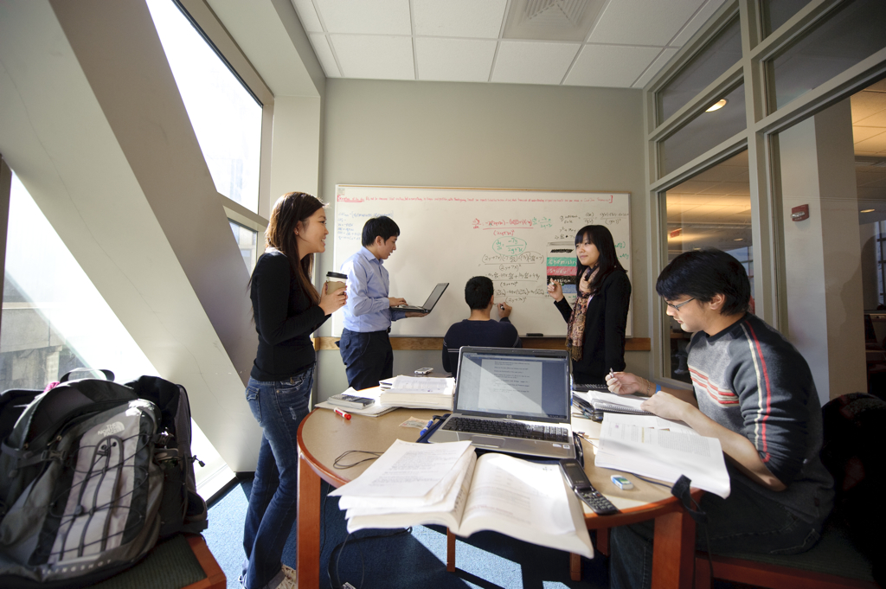
Faculty: Ready to Engage
Training + Time
Trials
Teamwork
Notes:
Trish

Slide 59


Students: Ready to Learn
Comfortable with the device
Committed to its use
Cognizant of the purpose
Know how to find help
Notes:
Trish

Slide 60
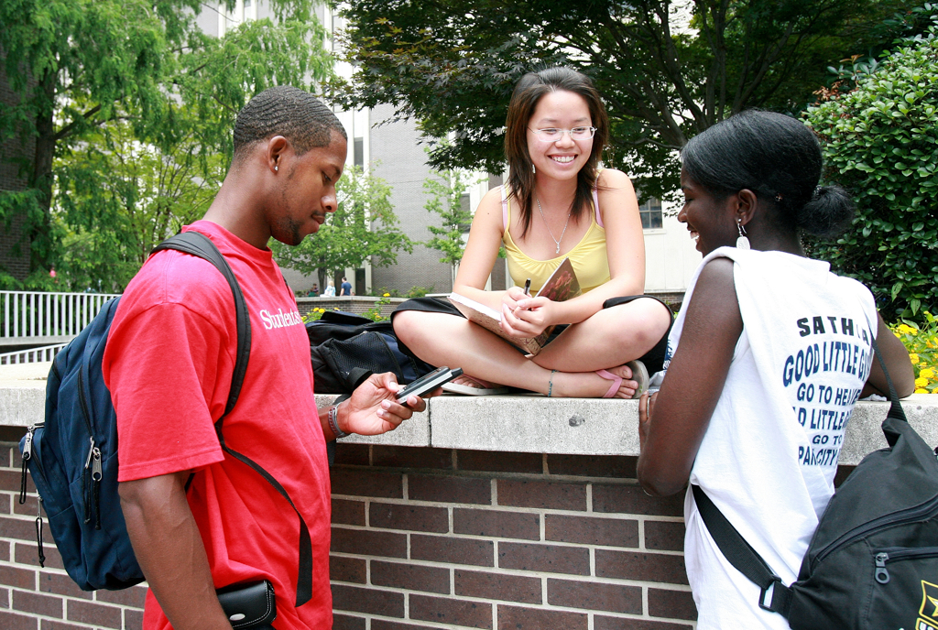

Students: Ready to Learn
Community
Community
Community
Community
Notes:
Trish

Slide 61
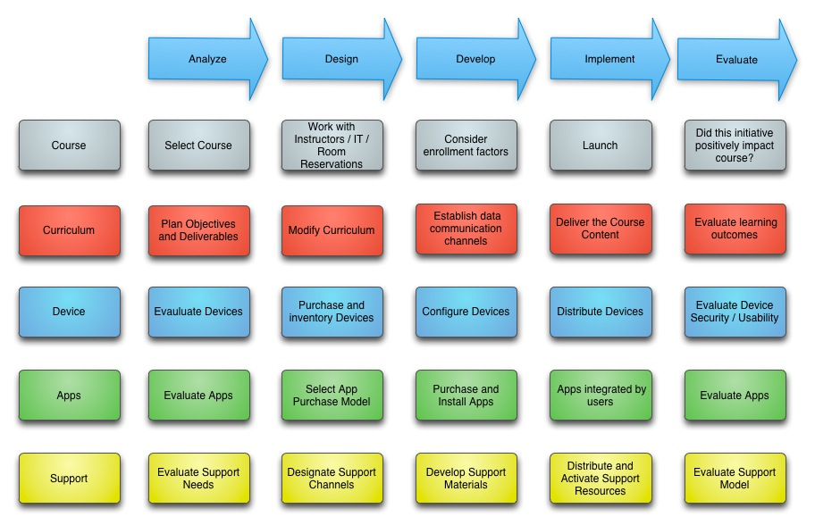
Bringing it all together…
Using the ADDIE Model for iPads

Slide 62





Like a well-oiled machine?
Faculty
Centers
Students
Devices

Slide 63
Any Questions?

Slide 64
Group Activity
Your table will be assigned as one of the following:
Devices Centers
Faculty Students
Brainstorm your ideas and create a list of three creative solutions to readiness challenges for your respective group.
Notes:
Julian

Slide 65
Group Activity
What are the challenges inherent to your group?
How might these challenges be addressed?
Notes:
Julian

Slide 66

Moving Forward
Where are we going next?

Slide 67
Personal Devices
Allow the user to manage their own device
Decide how you want to handle faculty purchase and reimbursement
Should students bring their own or should we supply one

Slide 68
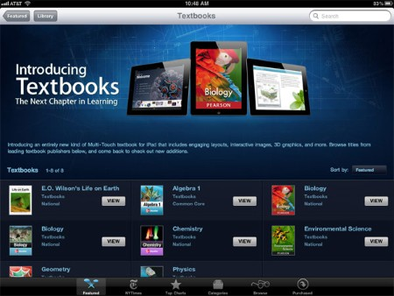

iBooks 2 & iBooks Author
Notes:
Joe

Slide 69

iTunes U App
A New LMS
Integration into existing courses?
Access to password protected content?
Notes:
Joe

Slide 70
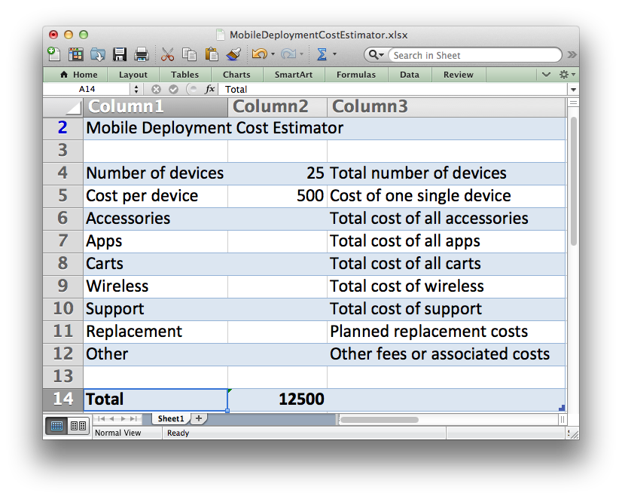
Economics of Mobile Learning
Replacement program
  Missing 50 adapters
  Missing 10%
  of Flip Cams
$2.5 million dollars on wireless costs
Download the evaluator
Notes:
Joe

Slide 71
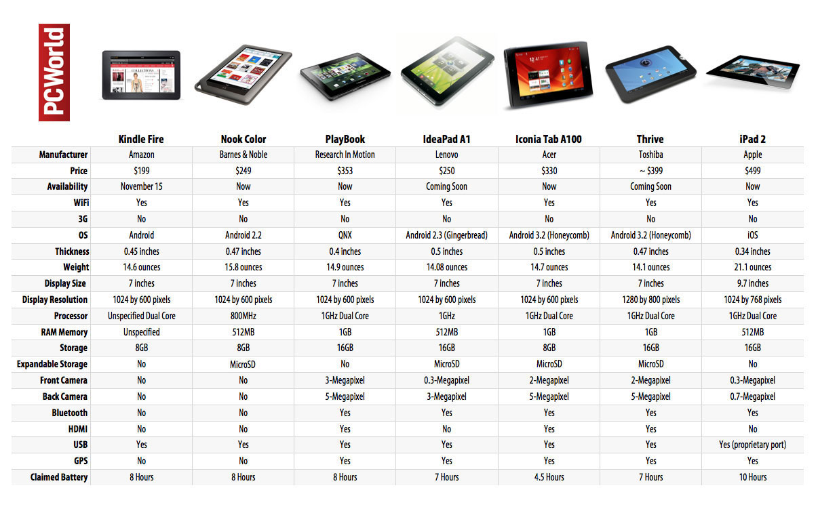
Mobile Competition
http://www.pcworld.com/article/240746/amazons_kindle_fire_tablet_vs_the_competition_spec_showdown.html
Notes:
Joe

Slide 72
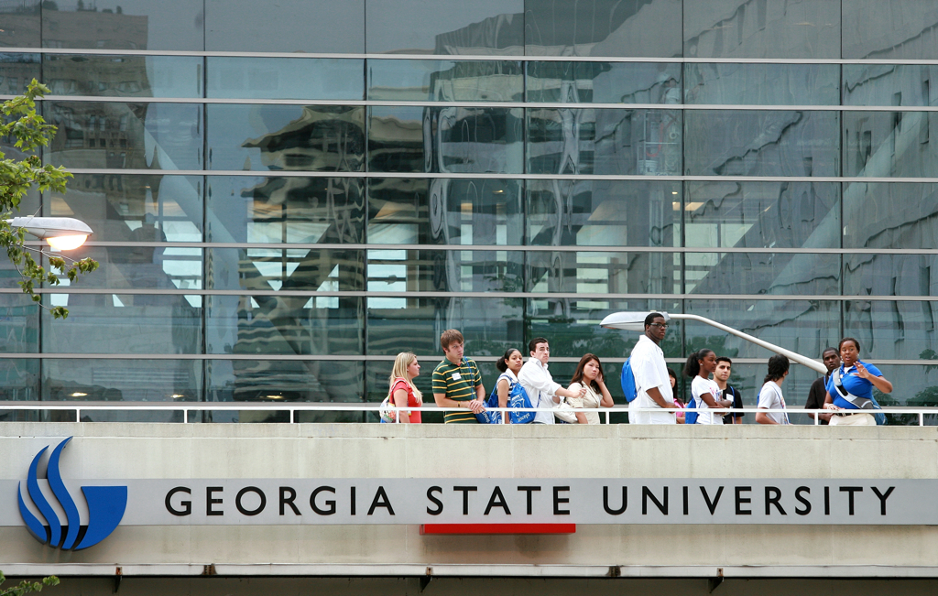
Creating Campus Community
Centralize Initiatives
iPad Meetups
Center for Instructional Innovation
Make connections,
work together,
share resources
User groups

Slide 73
Any Questions?

Slide 74
Contact Us!
pnolde@gsu.edu
jphorne@gsu.edu
joallen@gsu.edu

Slide 75
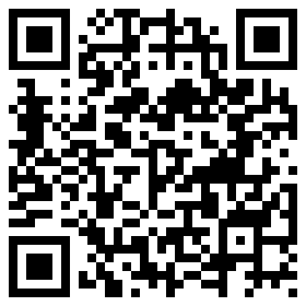
Evaluate Us!
http://www.educause.edu/ELI12/Program/SEM04
Notes:
Joe

