Slide 1
Setting the Stage for Success: A Discussion of Insights from the MISO Survey
ELI 2012 Annual Meeting
February 15, 2012
Austin, Texas

Slide 2
About the MISO Survey
Web-based quantitative survey launched in 2005
MISO: Measuring Information Service Outcomes
Measures the effectiveness of library and computing services in higher education
Focuses on faculty, undergraduates, and staff
Respondents since 2005 (includes 2012 to date)
15,519 faculty, 28,302 undergraduates, 22,635 staff
misosurvey.org

Slide 3
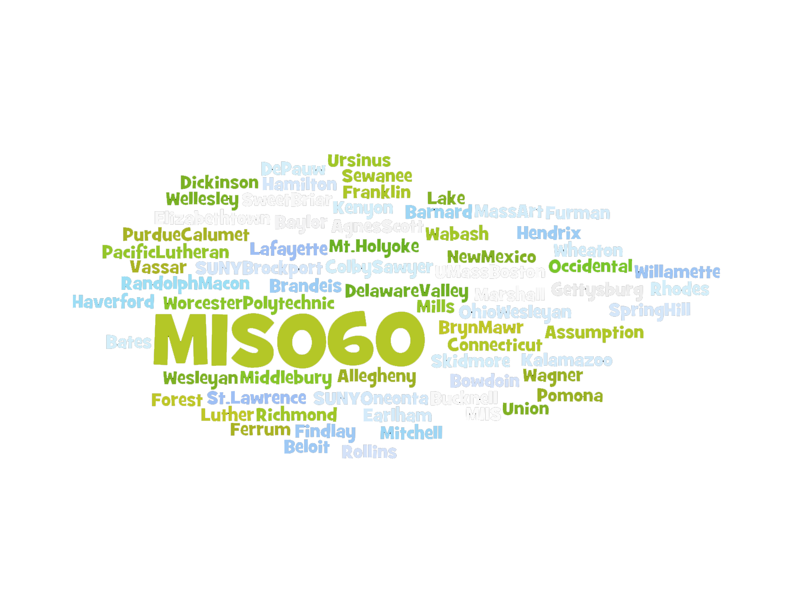
Participating Institutions
misosurvey.org

Slide 4
MISO Survey Team
David Consiglio, Bryn Mawr College (Principal Investigator)
Laurie Allen, Haverford College
Neal Baker, Earlham College
Kevin Creamer, University of Richmond
Katherine Furlong, Lafayette College
Gentry Holbert, Spring Hill College
Joshua Wilson, Brandeis University
Jean Lacovara, MISO Survey staff
misosurvey.org

Slide 5
MISO Measures
Library and technology services
Frequency of Use, Importance, and Satisfaction
Communicating with campus constituents
Skill level of constituents and interest in learning
Software and tools used
Demographics about constituents
misosurvey.org

Slide 6
Why is MISO different?
Thoroughly tested, evolving instrument
Exceptionally strong response rates
2011:
Faculty – 55.8%
Students – 55.3%
Staff – 51.8%
Comparable results
Results permit statistical tests, custom comparisons
misosurvey.org

Slide 7
The MISO Survey Workbook
Trends and Comparisons

Slide 8
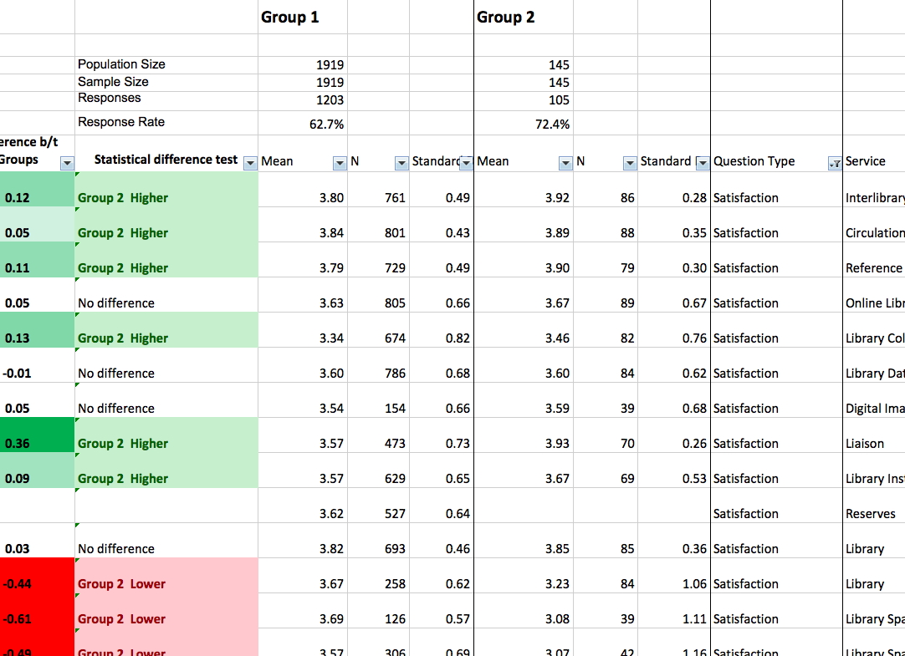

Slide 9
Supporting Innovation

Slide 10
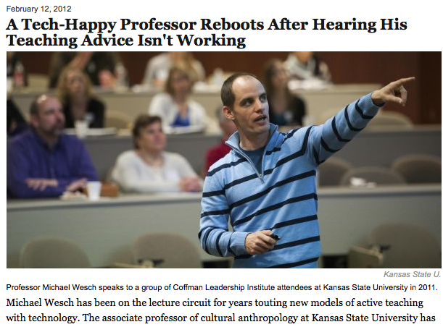

Slide 11
Maslow’s Hierarchy of Needs
misosurvey.org

Slide 12
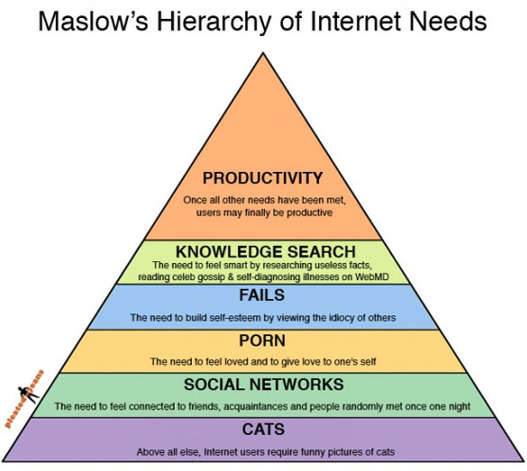

Slide 13
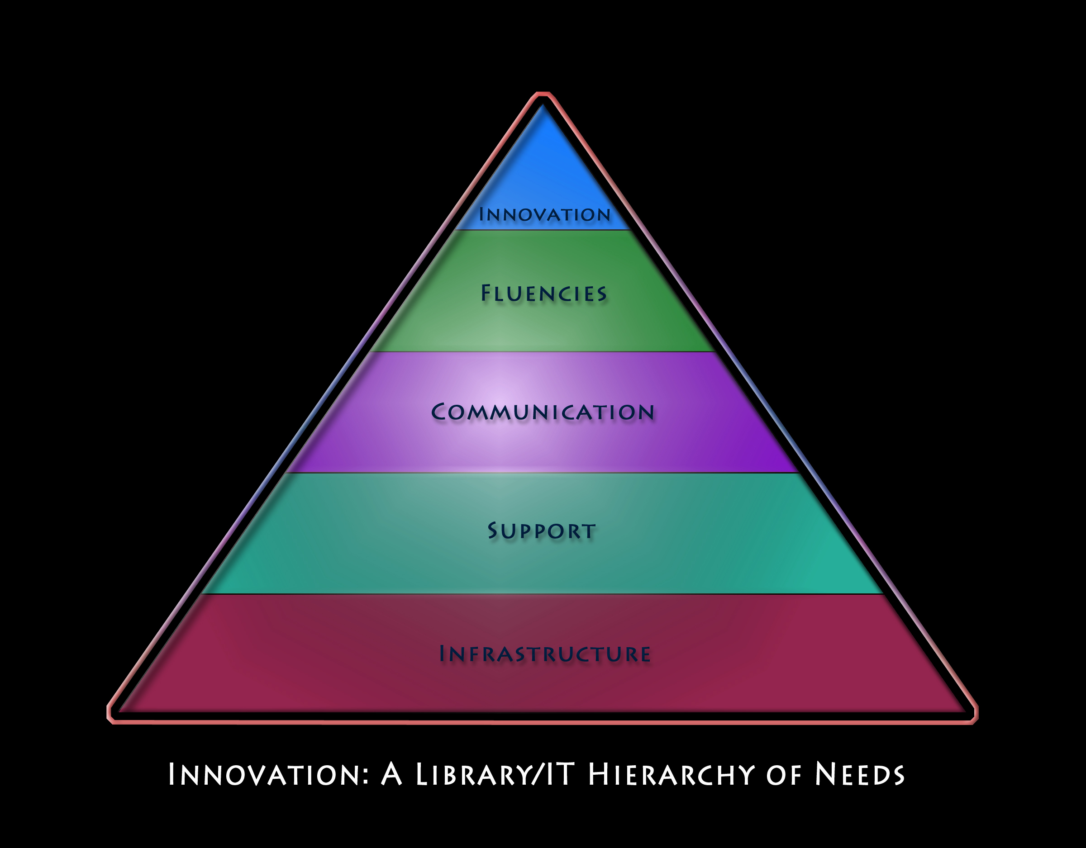
misosurvey.org

Slide 14
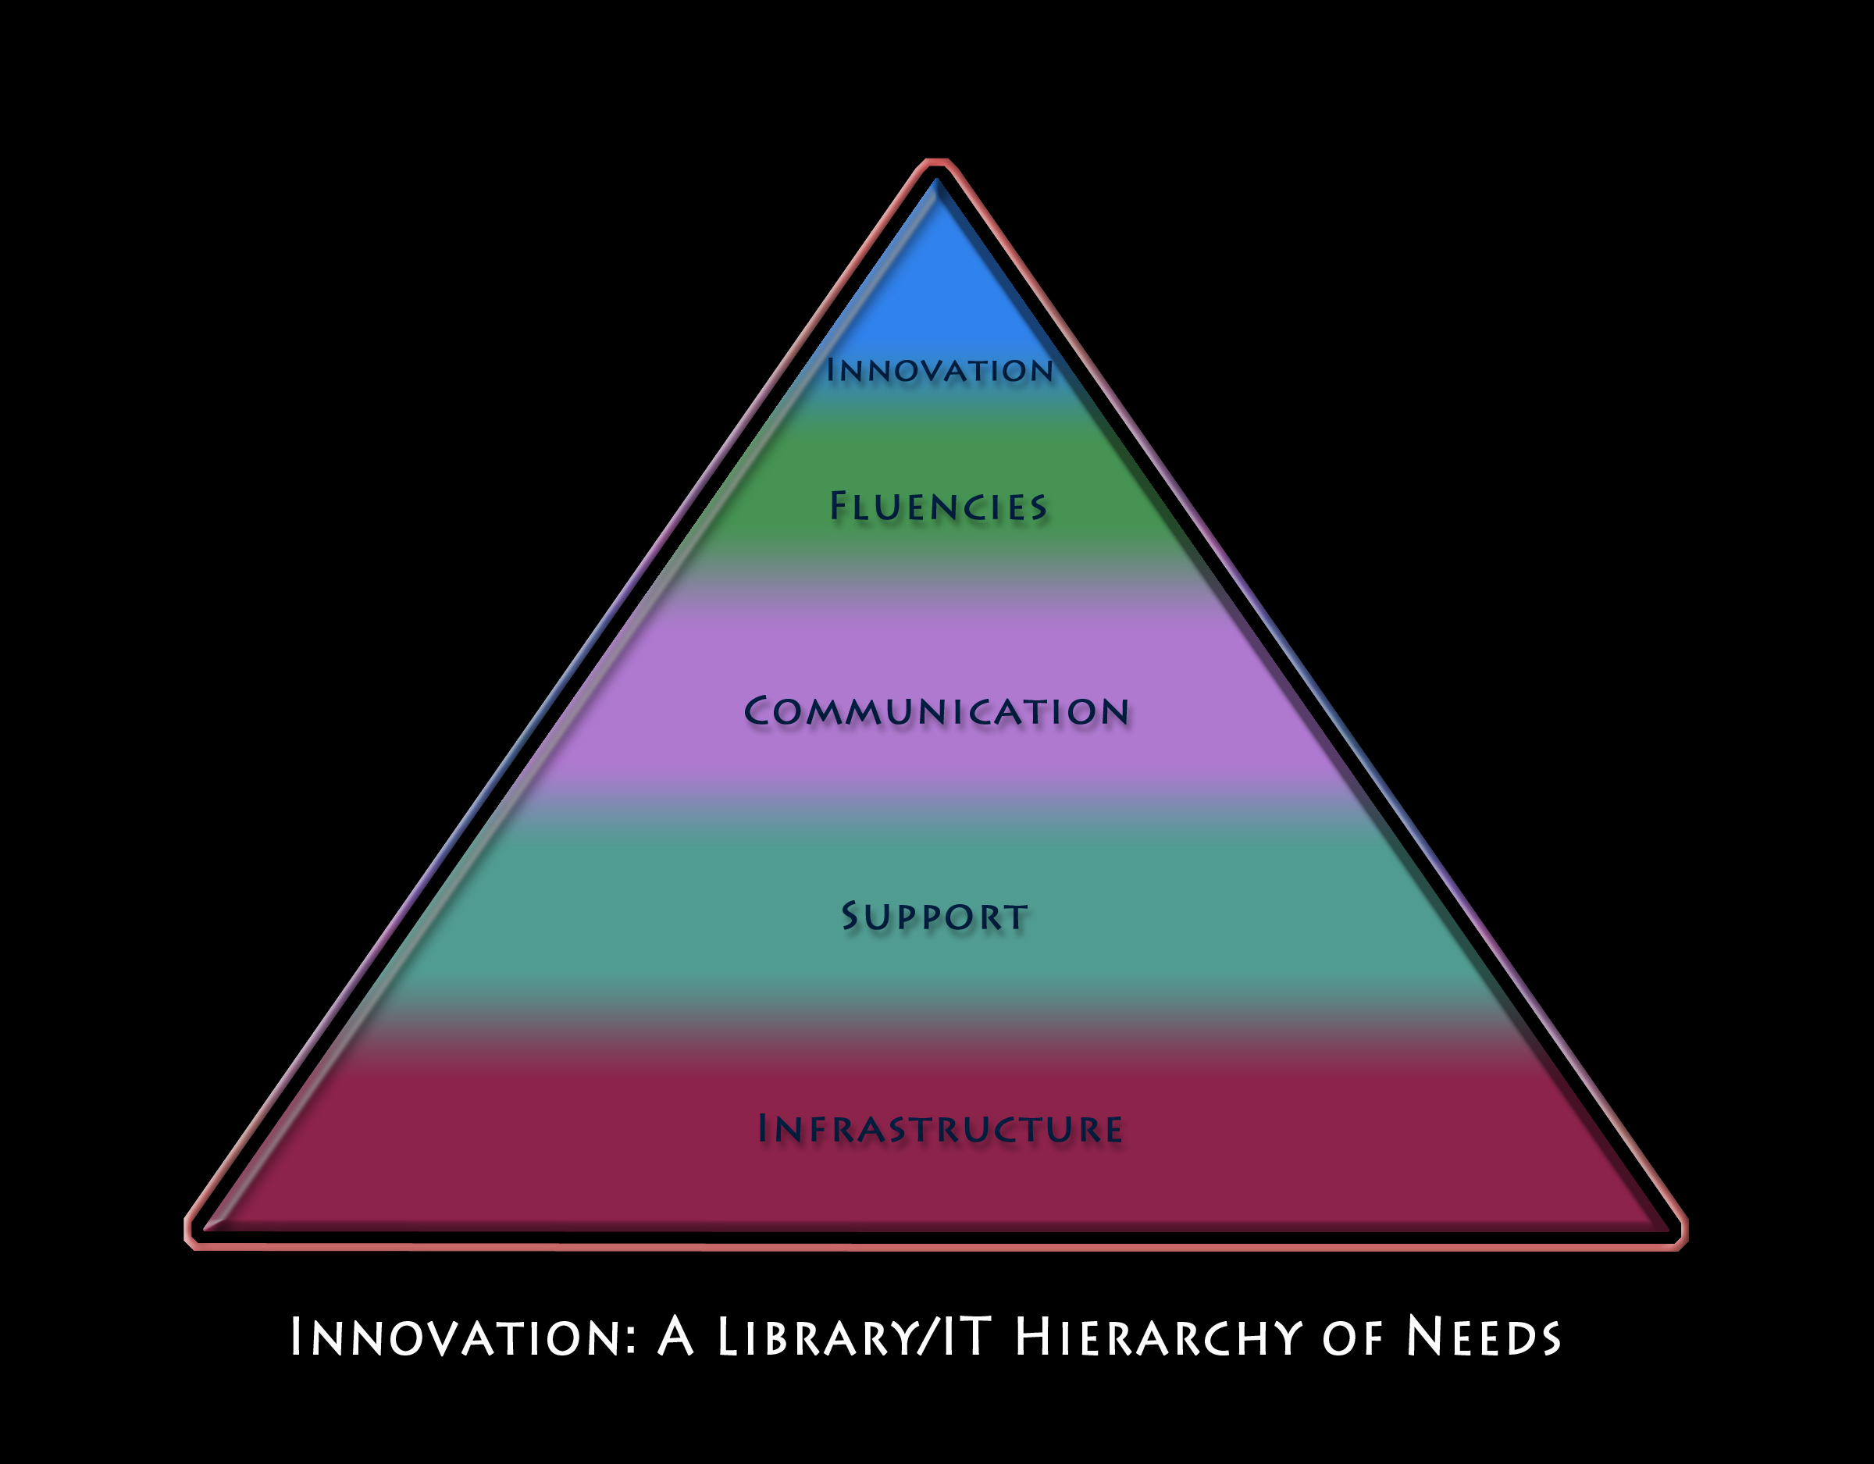
misosurvey.org

Slide 15
Satisfied

Slide 16
Satisfied Innovators: Infrastructure
Course Management System
Technology in Meeting Spaces / Classrooms
Wireless Availability & Performance
Network Stability & Speed
Off-Campus Access
Library & Help Desk Schedules
Library Collections & Databases
Quiet & Group Study Spaces in the Library
Campus Computing Labs
Desktop / Laptop Computer Replacement
misosurvey.org

Slide 17
Satisfied Innovators: Support
Help Desk
Support: Tech in Meeting Spaces / Classrooms
Time it Takes to Solve Classroom Technology Problems
Instructional Technology Support
Library Research Instruction
Library Liaison / Contact
Library Reference Services
Library Circulation Services
Support: Specialized Computer Needs
misosurvey.org

Slide 18
Satisfied Innovators: Communication
Computing & Library Web Sites
Status Information on Computing Problems
Your Input into Library Issues That Affect You
Your Input into Computing Issues That Affect You
Informed: Privacy Issues Related to Technology
Informed: Fair Use and Copyright
Informed: Available Library Services
Informed: Scheduled System Downtime
misosurvey.org

Slide 19
Fluencies: Higher Interest in Learning for ‘Satisfied Innovators’
Interest: Instant Messaging
Interest: Course Management System
Interest: Library Databases
Interest: Database Software
Interest: Presentation Software
Interest: Web Authoring Software
Interest: Graphics Software
Interest: Audio/Video Editing Software
Interest: Math or Statistics Software
Interest: Operating System
Interest: Backing Up Data
Interest: Avoiding Computer Problems
Interest: Solving Computer Problems
misosurvey.org

Slide 20
Differences in Skills
Somewhat Satisfied Innovators
Satisfied Innovators
E-mail
Search Engines
Word, Spreadsheet, & Presentation Software
Math or Statistics Software
Backing Up Data
Operating System
Privacy Issues
Copyright & Fair Use
Instant Messaging
ERP Self Service & Data Administration
Course Management System
Avoiding Computer Problems

Slide 21
Fluencies: No Difference in Skills
Voicemail
Technology in Meeting Spaces / Classrooms
Online Library Catalog
Library Databases
Database Software
Web Authoring Software
Graphics Software
Audio / Video Editing Software
Social Software (wiki, blog)
Solving Computer Problems
misosurvey.org

Slide 22
Importance and Satisfaction by Age
Faculty
misosurvey.org

Slide 24
Satisfied
Somewhat
Satisfied
Somewhat
Dissatisfied

Slide 25
Very Important
Important
Somewhat Important

Slide 28
Wireless Access / Availability
Course Management System
Borrowing Laptops
ERP Self Service
Library Liaison
Library Databases
Technology Instruction
Off-Campus Access
Tech in Meeting Spaces / Classrooms
Support: Tech in Meeting Spaces / Classrooms
Help Desk
Interlibrary Loan
Importance
Library Reference Services
Satisfaction
misosurvey.org

Slide 29
Service Attributes
For Help Desk, Reference, and Circulation Services:
Reliability
Responsiveness
Knowledge
Friendliness
How much do each of these attributes predict overall satisfaction with a service?
misosurvey.org

Slide 30
23.5%
13.0%
12.8%
8.4%
10.9%
5.6%
8.1%
5.4%
19.4%
6.8%
17.7%
12.3%
13.8%
4.5%
1.3%

Slide 31
Thank You.
Visit our web site: http://misosurvey.org/
E-mail: survey@misosurvey.org
ECAR Research Bulletin: “Measuring Information Services Outcomes with the MISO Survey” --now available

