Slide 1
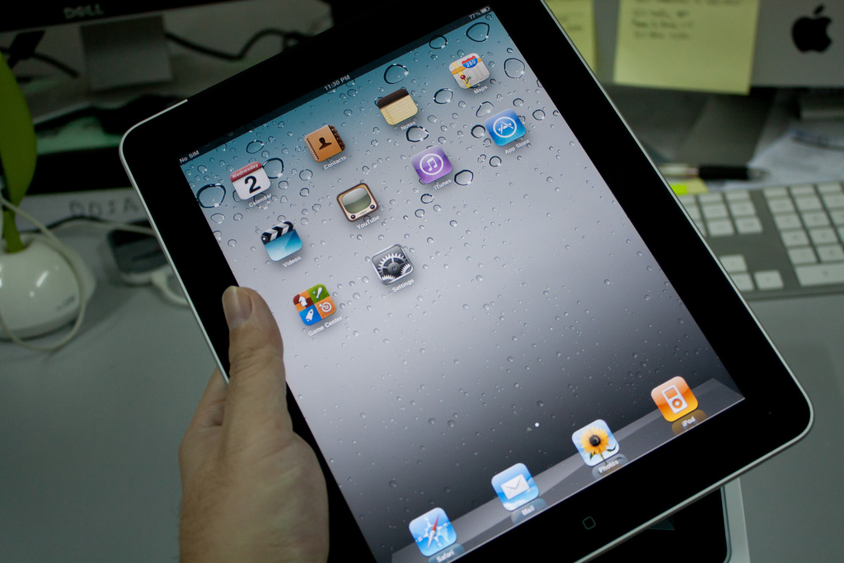
Instant Surveying with a Tablet
Jennifer Jones & Bryan Sinclair
Georgia State University Library
Photo by liewcf (CC BY-SA 2.0), http://www.flickr.com/photos/liewcf/5492116190/

Slide 2
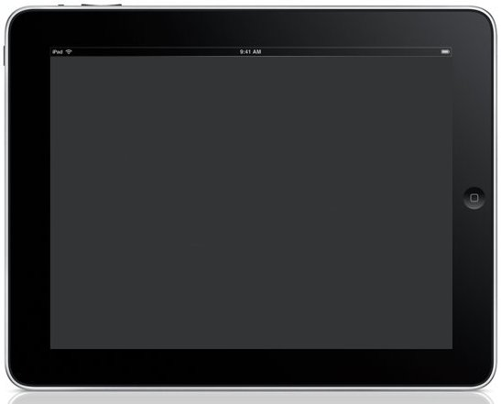
Background
Notes:
Assessment of student preferences, perceptions, and satisfaction is an ongoing challenge, because students don’t want to complete surveys and they don’t show up for scheduled focus groups and interviews.
Surveys administered too frequently leave the population with survey fatigue.

Slide 3
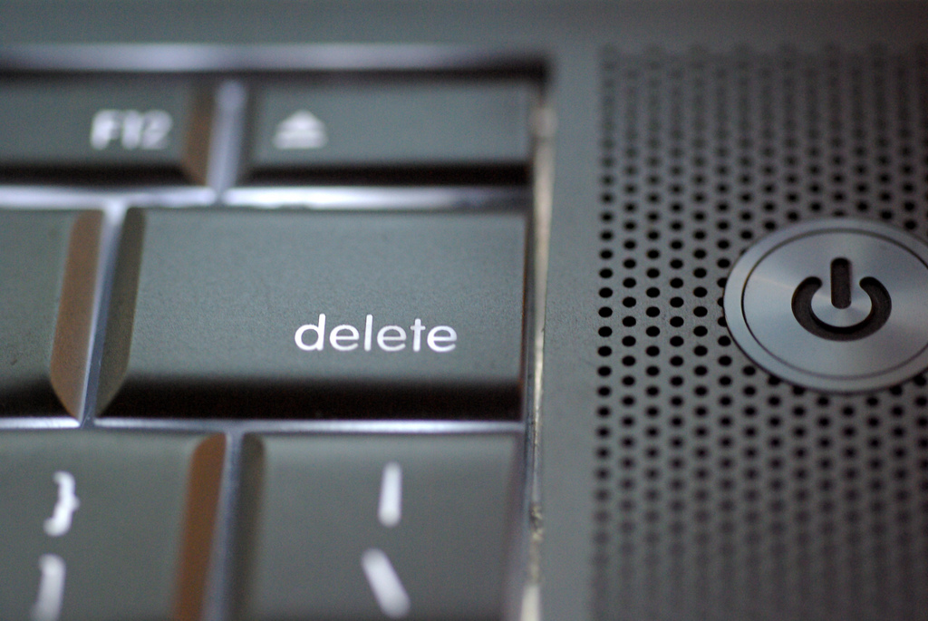
Photo by Dave King - http://www.flickr.com/photos/djking/ (Creative Commons license: some rights reserved)
Notes:
Surveys on paper or sent via email are easy to delete.
We needed a method that allowed us to gather student feedback while avoiding these issues.
10 iPads from IS&T
Decided to pilot using the iPads as data collection devices

Slide 4
Benefits

Slide 5
Photo by Mark Nockleby - http://www.flickr.com/photos/nocklebeast/ (Creative Commons license: some rights reserved)
Notes:
Man on the street/student on the quad method - or the “guerrilla” method of approaching unsuspecting students and asking them to complete a survey
Beats the clipboard and pencil approach—
Porability makes it easy to meet subjects where they are
Software enables automatic compilation of results

Slide 6
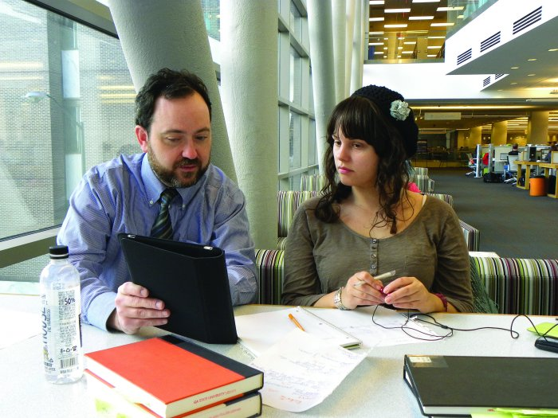
Photo by Christian Steinmetz, GSU Library
Notes:
Tablets are handheld devices, but still large enough for the sharing of information. Laptop too large. Smartphone too small.

Slide 7
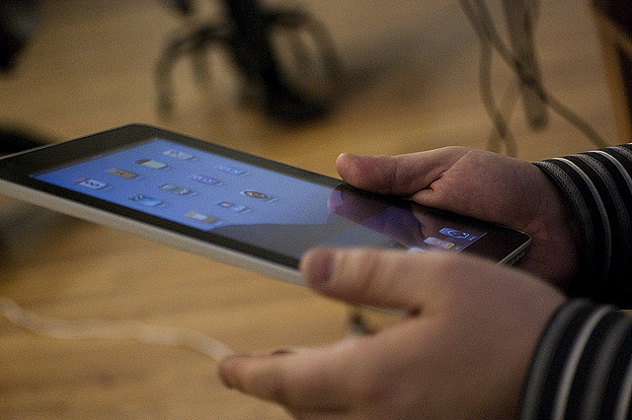
Photo by Pete Prodoehl - http://www.flickr.com/photos/raster/ (Creative Commons license: some rights reserved)
Notes:
The iPad Factor – students are drawn to new devices and like the tactile, hands-on aspect
The Face-to-Face Factor – would student be more willing to complete a survey when asked in person?

Slide 8
Methodologies
Notes:
To test the iPads as data collection devices:
Students in the library buildings during regular business hours
2 one-question surveys
93% and 89% response rates
Then worked with Social Media Task Force, which was formed to look at how to use social media to create an informed, involved patron community
Incept – survey incoming students during their lunch break about their social media usage and preferences
No incentives
Definitely saw evidence of the iPad factor and the face-to-face factor

Slide 9
Apps/Software

Slide 10
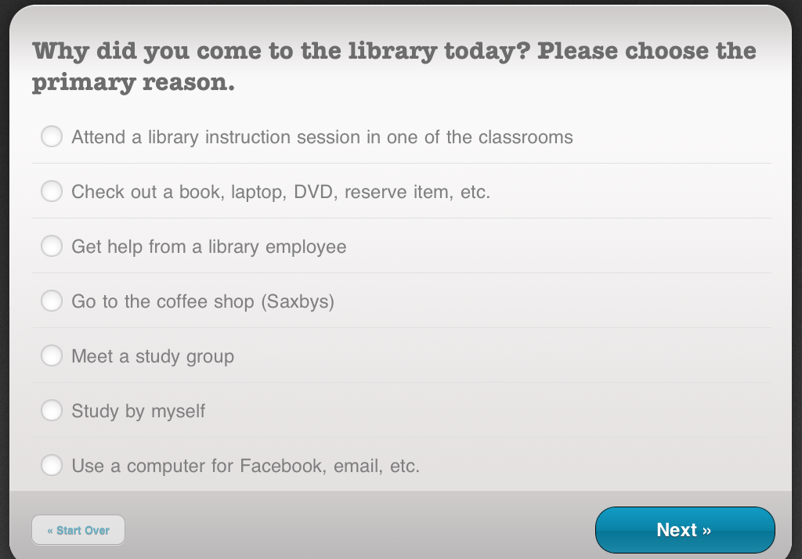
Notes:
Polldaddy
Linked to a web-based Polldaddy account
Benefit- collects responses offline
Benefit- optimized for the screen
Drawback- because it’s optimized, no zooming
Drawback- free version of Polldaddy account does not allow for export of data collected

Slide 11
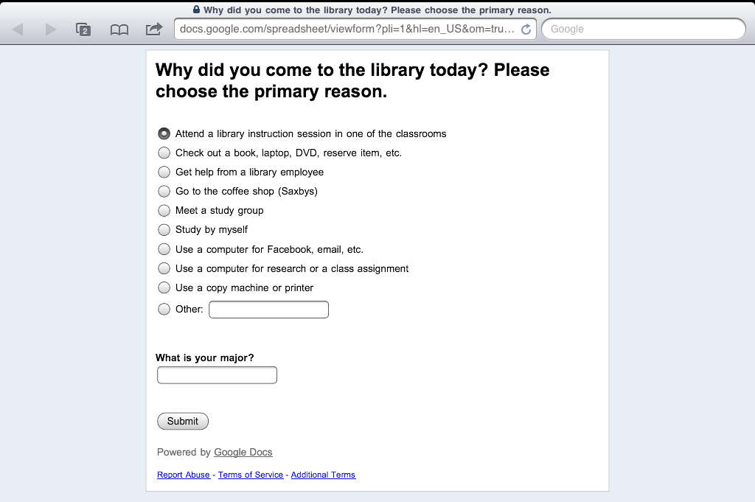
Notes:
Google Forms
Benefit- Google Docs – free
Benefit- allows for large numbers of responses
Benefit- Stores data in Google spreadsheet; easy to manipulate the data
Drawback- requires internet connection

Slide 12
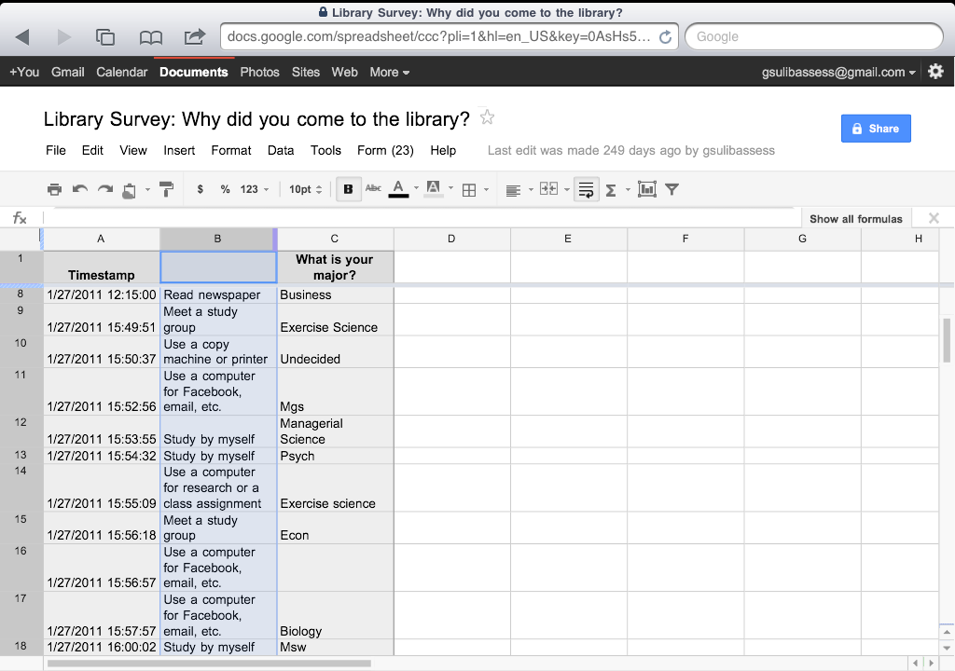
Notes:
Spreadsheet side of Google Forms

Slide 13
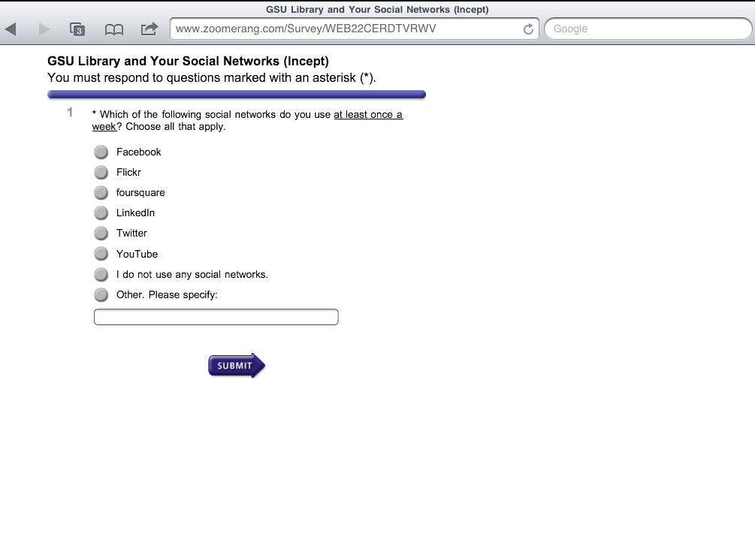
Notes:
Zoomerang
Benefit – displays well
Benefit- many options within the paid subscription (and even the free account)
Drawback- requires internet connection. This is not an app, but a web page accessed through Safari

Slide 14
Polldaddy for iOS | Free app Collects results offline A few display issues Free version: 200 responses/month Free version: no data export
Google Forms | Within Google Docs High response limit Wifi required
Zoomerang | Wifi required Free version: 100 responses/survey

Slide 15
Lessons Learned
Notes:
Know your wifi reliability. Certain times of day might mean slower response times and connectivity issues.
Keep it short. This method does not lend itself to lengthy surveys.
Approaching individual students seemed more effective than approaching students in groups.
Using tablets does not replace any other assessment methods (except maybe the clipboard); just something you can add to your assessment toolkit.

Slide 16
Future Projects
Notes:
A few things we are considering . . .

Slide 17
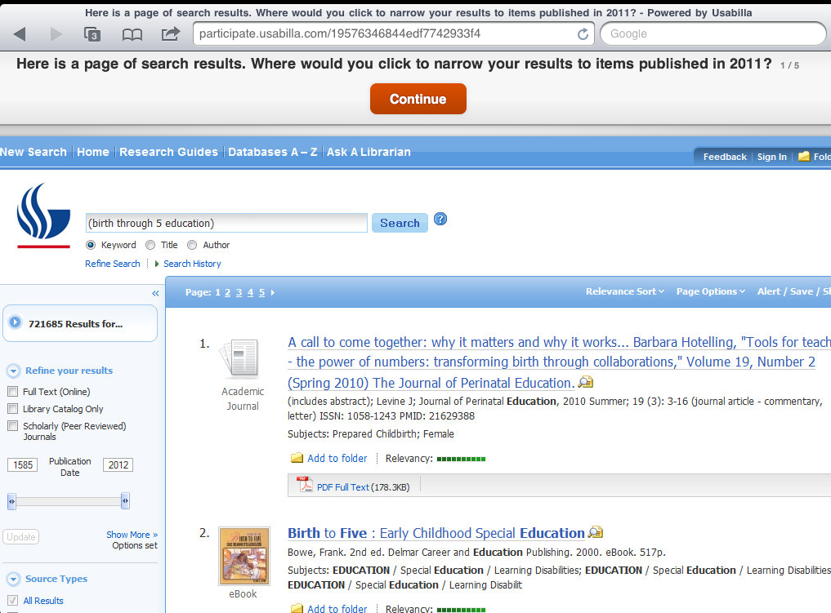
Notes:
Walk-up usability studies on our Special Collections & Archives website redesign and mobile website with Usabilla software
Usabilla presents a question and a screen capture or live web page. The user taps on the screen to answer the question.

Slide 18
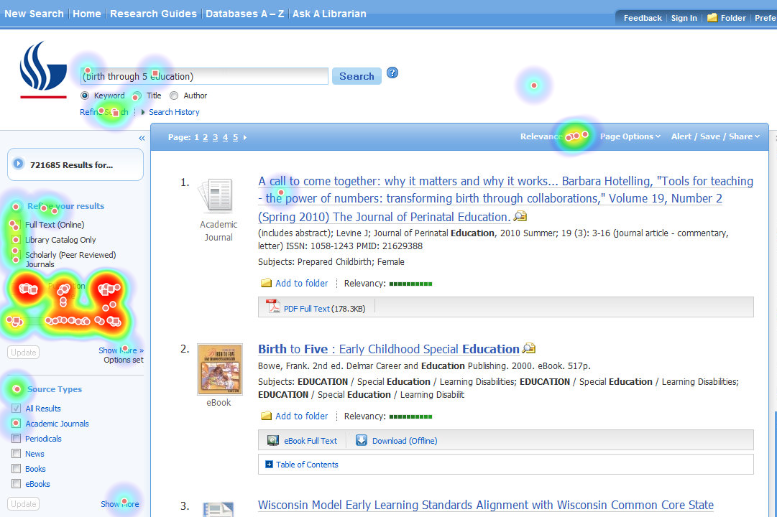
Notes:
Usabilla generates a heat map based on screen taps

Slide 19
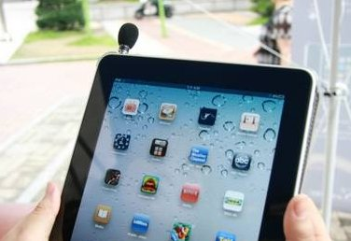
Notes:
Additional plans:
Collect data based on observational studies. Already have performed a series of observations on whether and how students are using the white boards in the group study rooms to help inform whether we should purchase some portable, digital white boards
Interviews with students that include audio and video
Recently consulted with another academic library that plans to use our pilot methodology to gather data to help validate results from their LibQUAL survey (LibQUAL is the library service quality survey managed by the Association of Research Libraries)

Slide 20
Thanks.

