Slide 1

Changing Perspective:
Using student voices to
advance learning technology
Kyle Bowen, Purdue University
Eden Dahlstrom, EDUCAUSE

Slide 2
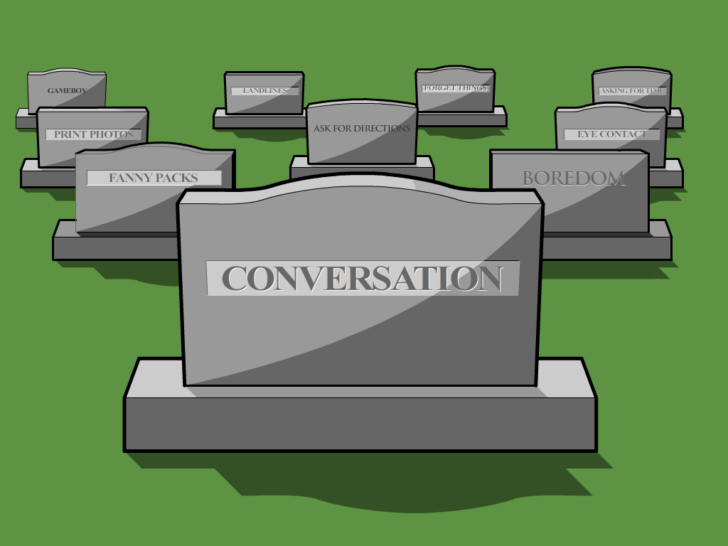

Slide 3


Slide 4


Slide 5


Slide 6


Slide 7


Slide 8
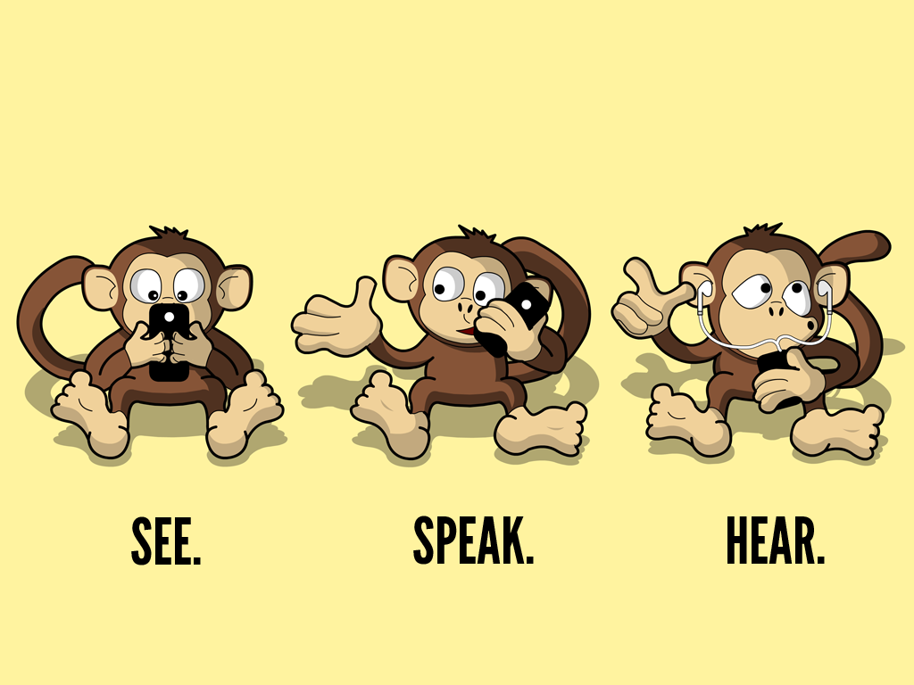

Slide 9
Knowing Thy Student –
the ECAR Story

Slide 10
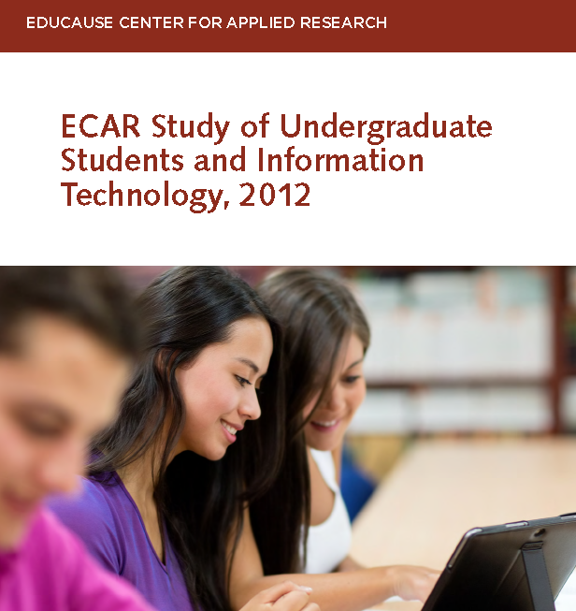
Notes:
For 2012:
Eden Dahlstrom, Principal Investigator EDUCAUSE
Charles Dziuban, University of Central Florida
JD Walker, University of Minnesota
And new for 2013:
Glenda Morgan, University of Illinois at Urbana-Champaign
Kate Hellweg, Research Associate EDUCAUSE

Slide 11
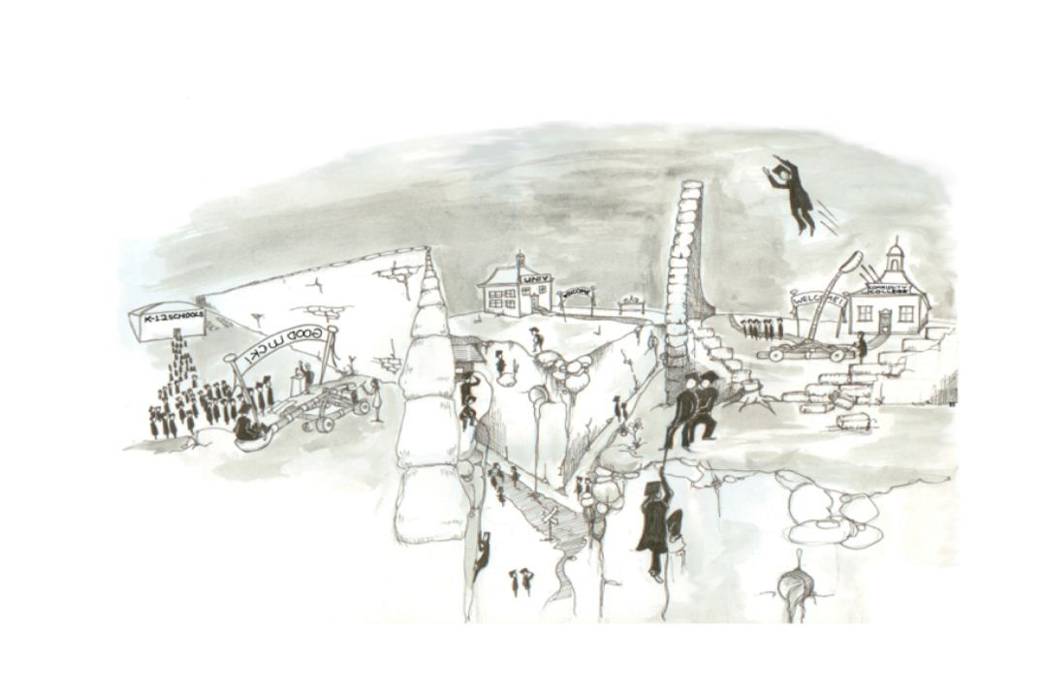

Slide 12
Student engagement…
…through blending learning environments and infusing technology
Notes:
Section preface:
Technology is important to students in terms of how they access course materials and how instructors use technology to engage them in the learning process. Students prefer courses with some online components and they expect their instructors to seamlessly integrate technology in their pedagogical practices. It is important to students that their instructors know how to use technology to facilitate and support learning, and the majority of students said that their instructors use technology effectively. Students shared the types of technology they want instructors to use more of, such as open educational resources and game-based learning. Given the resources needed for instructors to change their curriculum and pedagogy, listening to what students say about new or different technologies to integrate into the learning environment could be a wise investment.

Slide 13
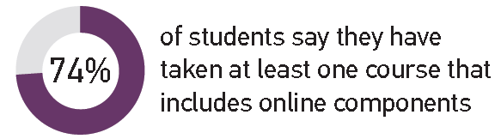
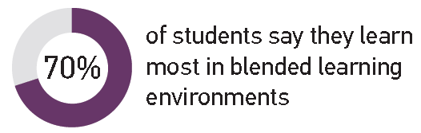
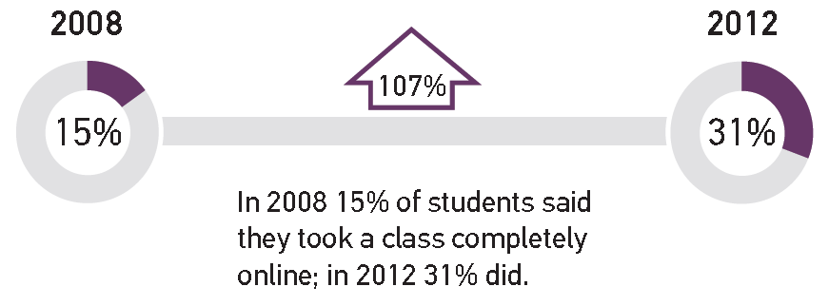
Blended Learning Environments Are the Norm
And Online-
Only Course Experiences Are Up
Notes:
Figure 1 –
Learn Most:
Blended learning environment preference is universal across C-classes.
Non North-American countries have the highest rate (82%) for preferring blended learning environments
AA institution students have highest rate (12%) for preferring completely online courses
Online Components:
82% of students at DR Public institutions tell us they take blended courses; the highest for any C-class.
-
Online Only:
Highest for AA-institution students (39%); lowest for DR Priv (8%
Can = 22%; non-North Am = 12%

Slide 14
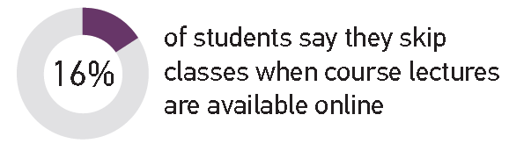
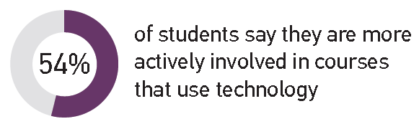
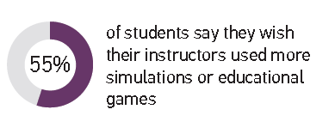
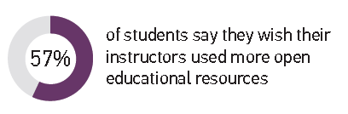
Technology Engages Students
Engagement Winners
Notes:
Re: engagement
67% say technology helps them feel connected to what’s going on at the institution
Undergrads have a comfort level with technology
But more technology doesn’t translate to more connectedness – the same percentage of students reported tech makes them feel connected to other inn 2012 as in 2011 yet there has been continued proliferation of mobile devices which are today’s tools for “connectedness”
Re: Engagement Winners
OER –
57% of students wishing their instructors used freely available course content MORE is up from 2011 when only 19% said so
The emergence of freely available content is part of the way open solutions are changing the game of higher ed
GBL
NMC Horizon report of 2012 pegs GBL as a mid-term horizon (2-3 yrs out) before seeing widespread adoption. SS findings support this
Caution: educational games can require tech skills of instructors and students beyond those typically epxected for general perp for a course

Slide 15
BYO technology…
…is prolific and diverse
Notes:
Section Preface:
The ownership rates of technological devices among students continues to proliferate. Nearly all students own a laptop, and more students in 2012 than in previous years own handheld mobile devices such as tablets, smartphones, and e-readers. There is diversity in brands and operating systems among these devices, and consequently there is growing need for device neutrality of apps designed for these mobile technologies. Striking a balance between device-neutral apps and apps that are optimized for specific mobile platforms is tricky but critical in the bring-your-own-device era.

Slide 16
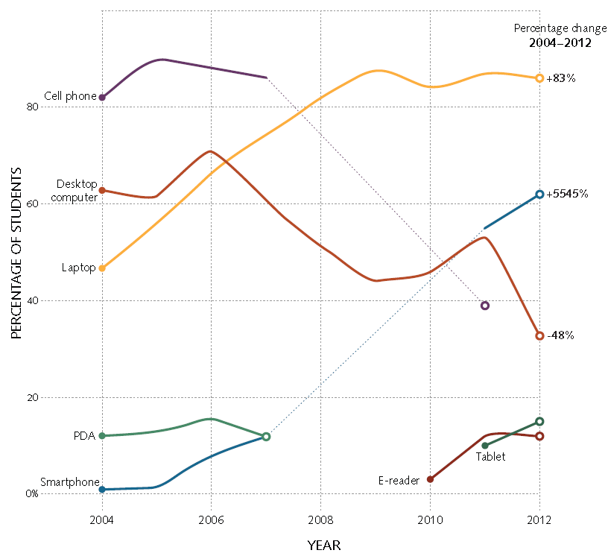
Trend Toward Mobility
Trend Toward Mobility
Smartphones replaced feature phones
WOW!
teehee

Slide 17

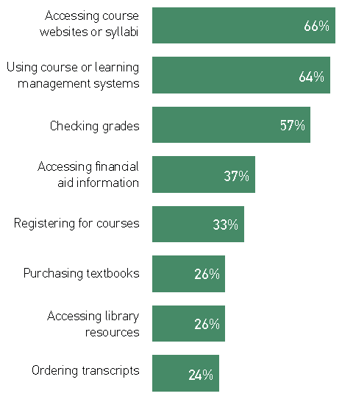
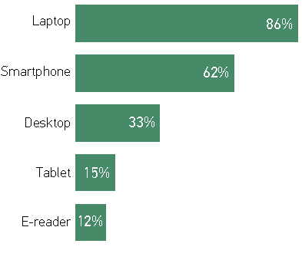
Extreme Mobility Still Supplemental
Important to do from
a mobile device
Own device
Use device for academic purposes
Notes:
Time will tell if mobile devices are additive or will replace another technology. Tablets are notably good consumption tools but still somewhat awkward tools for production.
Use Device for Academics
e-reader 6%, Tablet 12%, Desktop Computer 56%, Smartphone 42%, Laptop 91%
Own Device e-reader 12%, Tablet 15%, Desktop Computer 33%, Smartphone 62%, Laptop 86%
No surprises this year for device ownership.
86% own a laptop
Highest among younger students and students attending four-year colleges/universities
62% own smartphones
Up from 55% in 2011
Nearly twice as many in 2012 than in 2011 said they use these for academic purposes (67% and 37%, respectively)
Pew says 46% of adults own a smartphone, and it is on the rise
15% own tablets…12% own e-readers…according to Pew 19% of adults own these items
Greatest in non-north American countries
Chasm between desktop ownership (33%) and percent who say they use one (56%) – suggesting institutionally-provisioned desktops are still popular. Why?
Fast/reliable internet connection?
Designated workspace/?
Specialty hardware/software access?
Access free/low cost printing??

Slide 18
Prolific and Diverse BYO Technology
Notes:
Laptops (86%)–
Mac market share higher at 4-yr institutions, especially doctoral institutions
More Macs at Canadian institutions
Smartphones (62%)
Not stat sig diffs
Tablets/E-readers (15%/12%) –
No stat sig diffs by age, gender, class standing, or C-class
Message:
@ most institutions, enough students use both to warrant supporting both platforms for academics.

Slide 19
Using technology…
…to evoke strong, positive responses from students
Notes:
Section Preface:
Students value technology in the academic environment, and the vast majority say that technology helps them achieve their academic outcomes and prepares them for the future. Technologies such as laptops, printers, and USB thumb drives top the list for the most important devices, and technology infrastructure such as the library website and course or learning management systems are among the institutions’ technology resources that students use the most. In terms of student use, the three types of resources that grew the most over the last year were e-portfolios, web-based citation tools, and e-books.
Despite the availability of new technology and integration of existing technology into “the classroom,” students’ interest in having more technology skills or training by far exceeds their interest in having new, more, or “better” technology. Using technology for academics for most undergraduates is more about using existing technologies better and less about adopting innovative technologies.

Slide 20
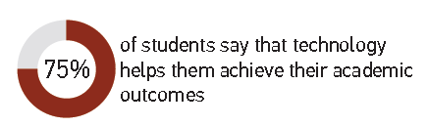

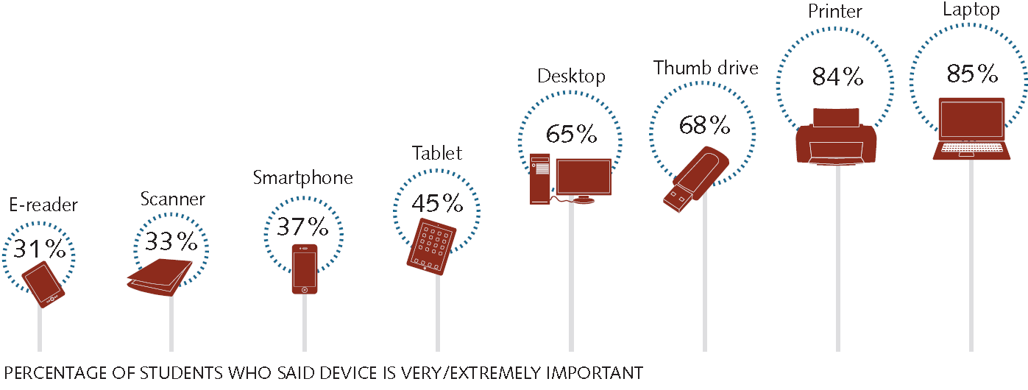
Technology Commendations
Importance of various devices to academic success
Notes:
Tech has a democratizing effect
By providing access to info on demand
The effect can be harnessed when “access to info” is streamlined THEORETICALLY creating a scenario where students have more time to “use the info”
75% say tech helps them achieve their ac outcomes, 75% say it preps them for future ed plans, 63% say it prepares them for the workforce
Winning tech trifecta:
Laptops – to produce
Printers – review and submit
Thumb drives – to transport and share

Slide 21
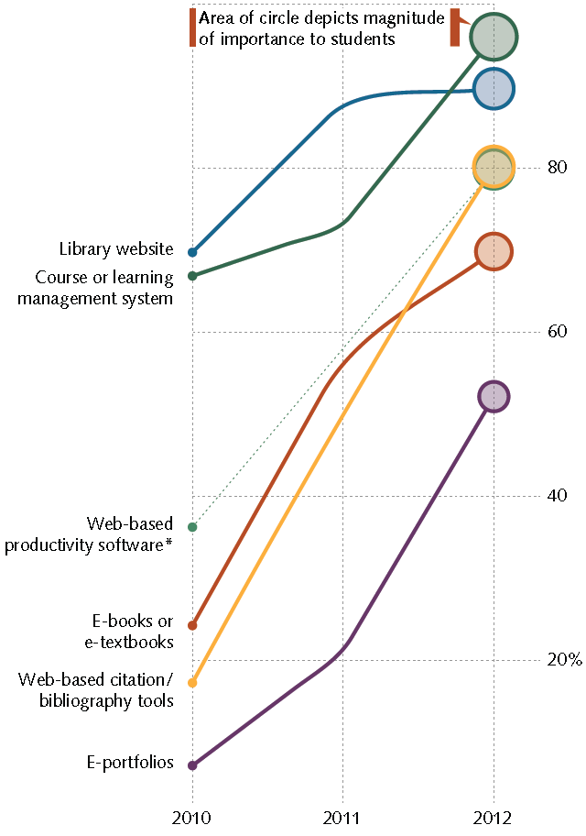
Beyond Devices
Comparing 2012 to 2010
7 times as many students used e-portfolios
Percentage of students who use the resource
5 times as many students used web-based citation/bib tools
3 times as many students used e-books or e-textbooks
Notes:
Basic technologies still have the greatest impact on student success.
Like textbooks and chalkboards, an institutions library website and CMS/LMS are the baseline resources students expect to encounter in most of their courses
Re: EBOOKS and Texts: the 2011 Horizon report predicted widespread adoption in 1-year or less. Trends here support this.
However, interestingly: the three emerging items (e-portfolios, web-based citation, and e-books) are at the bottom of the importance list. Could be a latent effect – with exposure/use will come the value/importance increase

Slide 22
Tech Literacy Isn’t Innate
Percentage saying they agree/strongly agree that they are prepared to use technology upon entering college/university
Percentage saying it is very/extremely important to be better skilled or trained at using technology
Percentage saying most/all instructors provide adequate technology training
Notes:
Figure 9. Importance to Academic Success (% very or extremely important) – for all, not just among owners

Slide 23
Listening to students…
…about how best to connect with them
Notes:
Section Preface:
Social networks are more about socializing with friends than succeeding academically, and students prefer it this way. Most students prefer to keep their academic and social lives separate. E-mail is the preferred method of communication with instructors while on-demand interactive communication methods (i.e., texting, instant messaging, online chatting) are commonly used among students to interact with one another. These on-demand communication methods increased the most from 2011 to 2012 in terms of what students wished their instructors used more often.

Slide 24
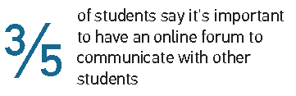
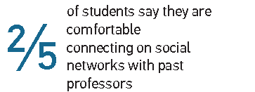
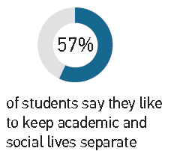
Communication Mode Selectivity
Social networking
with other students?
Social
networking
with current instructors?
Notes:
The separation of academics and social lives appears to be specific to students’ disinterest in connecting with instructors on social networks.
Friending current and former instructors is still taboo
Big take-away: even though students use a technology regularly as part of their everyday life, it does not necessarily mean they want that same technology integrated into their academic lives

Slide 25
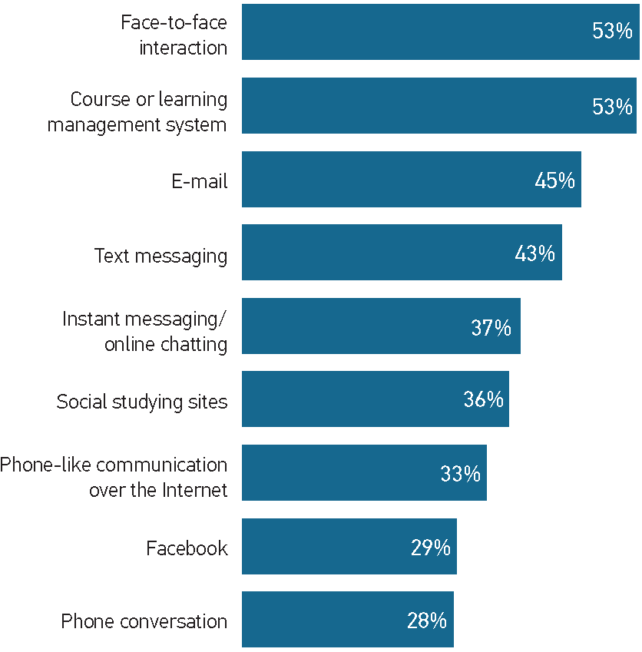
Students Say: Use These More
21% •
27% •
Percentage
change
from
2011
to
2012
28% •
20% •
24% •
Notes:
Students want to interact with instructors using direct forms of interaction (f2f, email) and the cms/LMS
Even students for who have taken online courses 8 out of 10 say F2F interaction is very/extremely important
Don’t know if they consider f2f as physically f2f or f2f 1:1 interaction remotely
Email provides a passive, but highly documentable way to connect with instructors
Email topped this list in 2011…didn’t ask about F2F

Slide 26
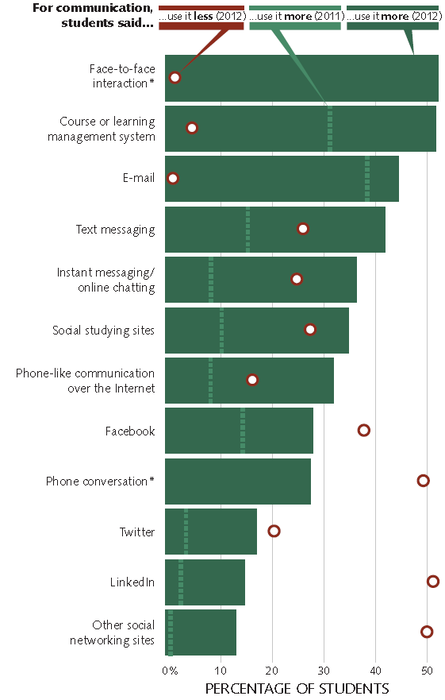
Students Also
Say…
21. Instructors: | Use it more | Use it less | 2011 use it more data | % diff use it more in 2012 than 2011
Open educational resources | 57% | 10% | 19% | 38%
Simulations or educational games | 55% | 13% | 15% | 40%
Course or learning management system | 49% | 5% | 32% | 17%
E-books or e-textbooks | 47% | 16% | 31% | 16%
Web-based videos | 46% | 11% | 18% | 28%
Video-sharing websites | 46% | 10% | 18% | 28%
Podcasts and webcasts | 43% | 19% | 17% | 26%
Tag/bookmark/'like' article or info online | 39% | 18% | 15% | 24%
Online multi-user computer games | 38% | 25% | 6% | 32%
Online forums or bulletin boards | 38% | 16% | 21% | 17%
Web-based productivity software | 37% | 9% | -- | --
Locally installed productivity software | 35% | 4% | -- | --
Wikis | 34% | 21% | 13% | 21%
Web-based music | 33% | 21% | 5% | 28%
Photo-sharing websites | 33% | 21% | 4% | 29%
Blogs | 27% | 30% | 14% | 13%
E-portfolios | 25% | 26% | 6% | 19%
…Use Some of These Less
Notes:
Use this as a communication mode MORE in 2012 SS
Use this as a communication mode MORE in 2011 SS
Use this as a communication mode LESS in 2012 SS

Slide 27


Slide 28
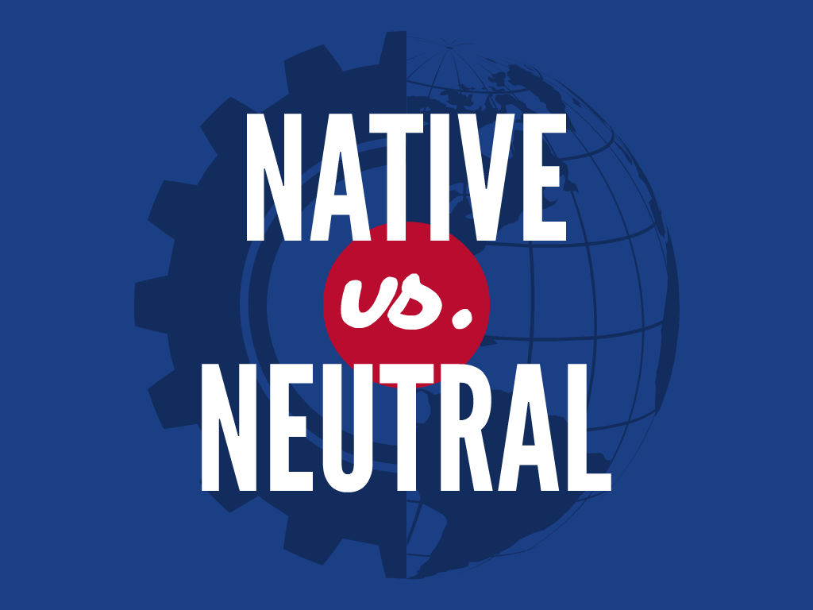

Slide 29

70%
EASY TO USE

Slide 30
70%
FASTER

Slide 31

25%
REGULAR
WEBSITE
25%
NO PREFERENCE

Slide 32
ANDROID
84%
iPHONE
Mobile OS

Slide 33
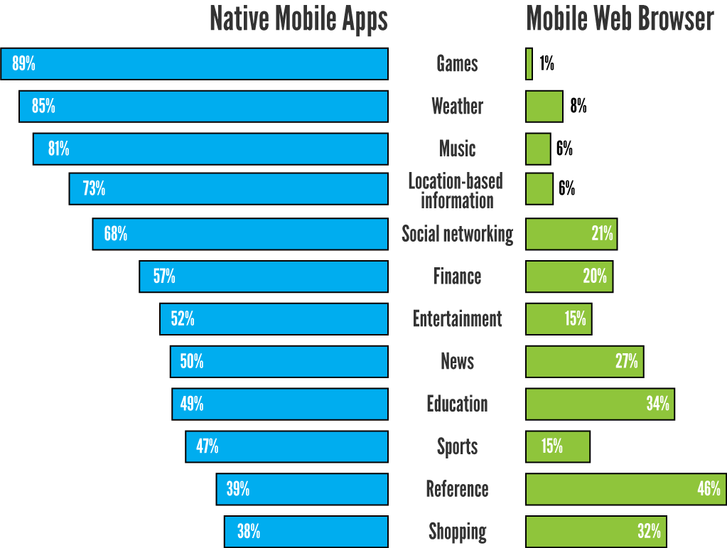

Slide 34
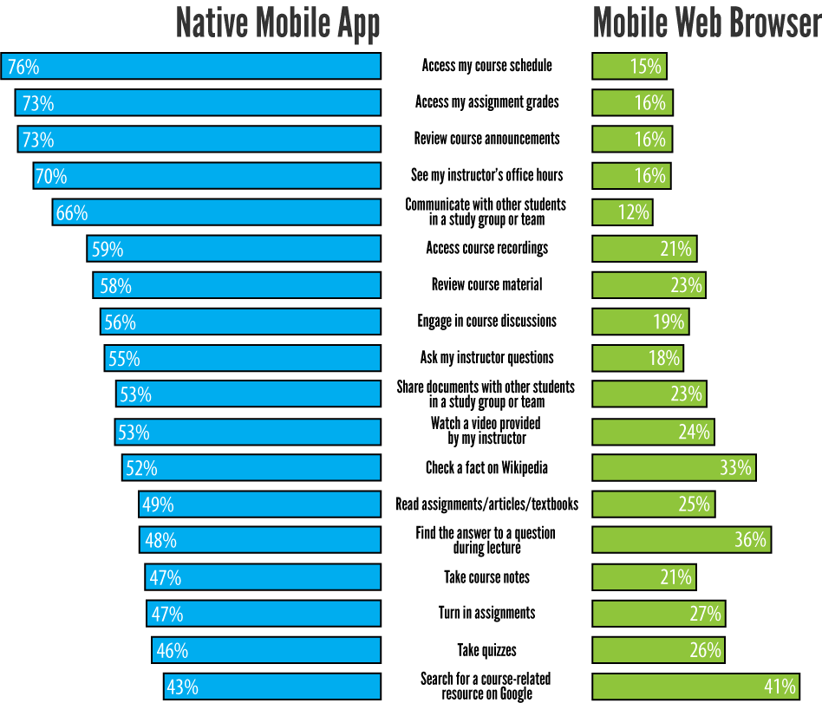

Slide 35
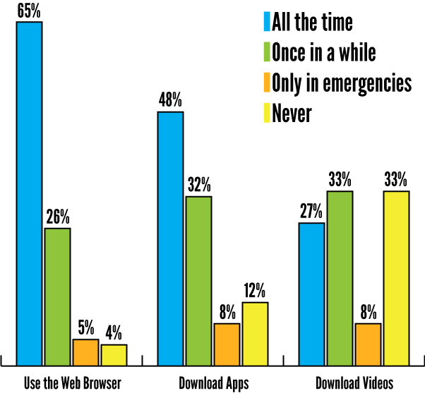

Slide 36
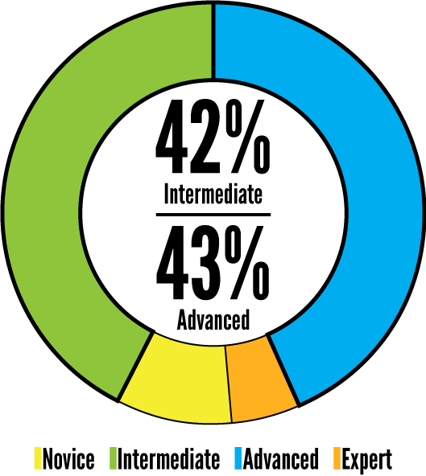

Slide 37
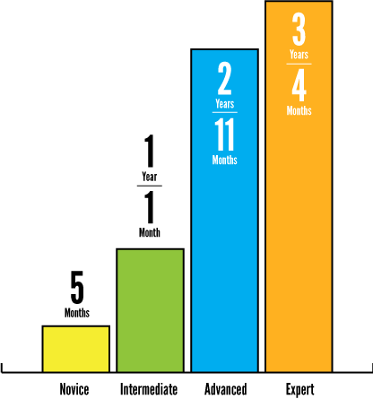

Slide 38
MOBILE DEVELOPMENT ISSUES
Notes:
Cross-platform stuff
Anyone who watches the syfy channel on Saturday mornings knows that When you take one awesome thing and combine it with another awesome thing
You usually get something twice as awesome.
NEXT SLIDE

Slide 39

Notes:
-For example dino shark and sharktopus
-Half shark, half octopus, all killer!
-not really the case with development for 2 mobile platforms with 2 different Uis
NEXT SLIDE

Slide 40

Notes:
I give you Appleroid man!

Slide 41
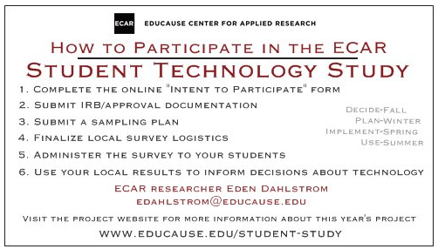
What Can YOU Do?
Do recon on the Student Study Website: www.educause.edu/student-study
Complete the online “intent to participate” form
Submit IRB/approval documentation
Submit a sampling plan
Finalize local survey logistics
Administer the survey to your students
Use your local results to inform decisions

Slide 42
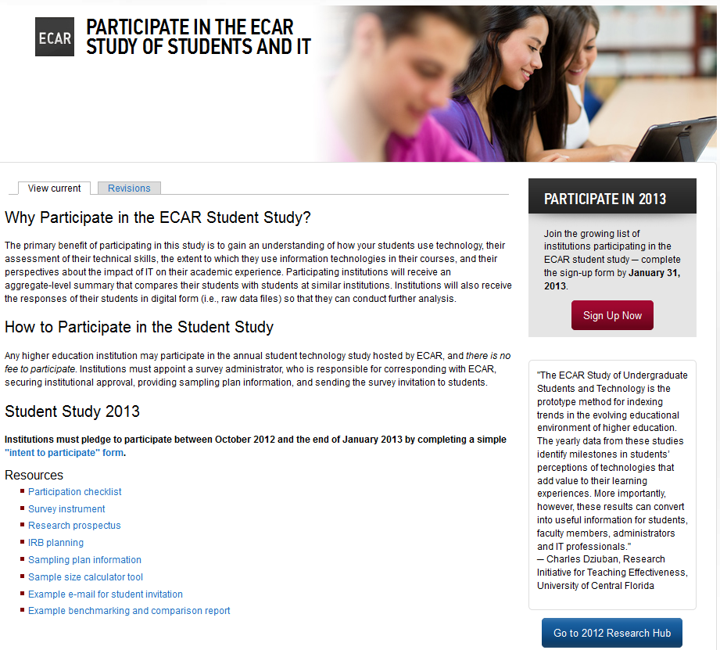

Slide 43
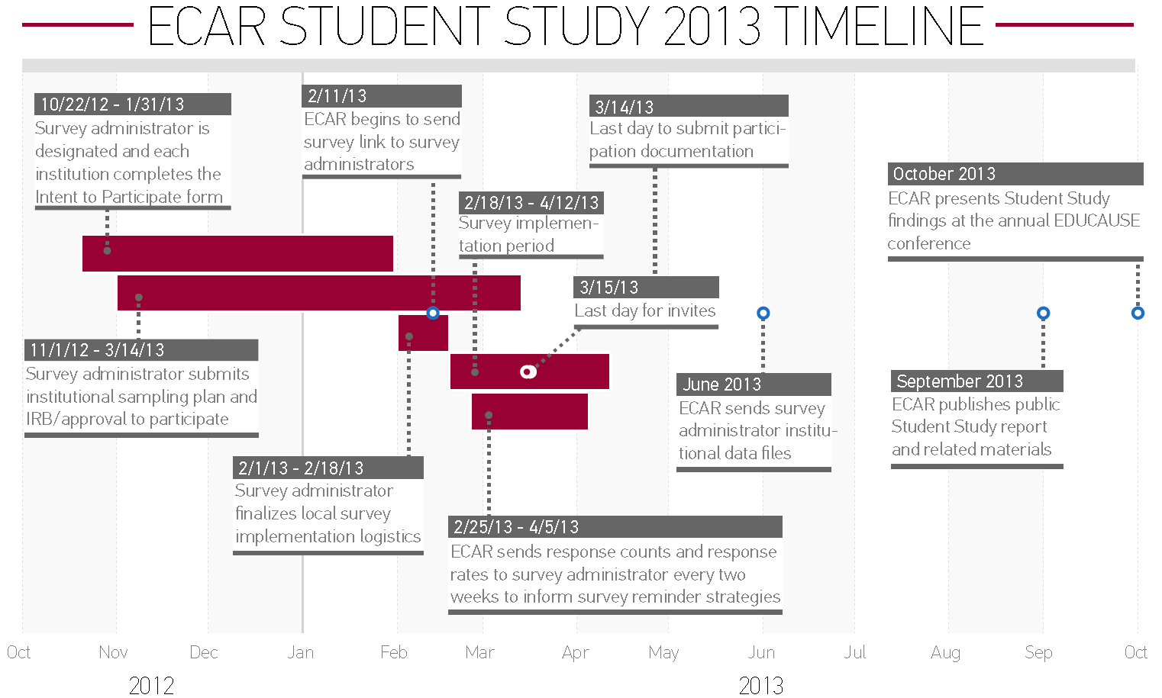
Participate in the Student Study
You Are Here

