Slide 1
Diving Deep into Data: Motivations, Perceptions, and Learning in Minnesota MOOCs D. Christopher Brooks, Ph.D. J.D. Walker, Ph.D. EDUCAUSE Learning Initiative Annual Meeting 4 February 2014

Slide 2
The Day of the MOOC
Notes:
W

Slide 3
MOOCs at Minnesota: Background
Offered 5 MOOCs in summer 2013:
Statistical Molecular Thermodynamics
Social Epidemiology
Health Informatics
Global Food Systems/Sustainability
Canine Theriogenology
Total nominal enrollment: 71,029
Notes:
W

Slide 4
Why Researching MOOCs Is Hard
Students not very motivated
Very diverse student population
Lack of information on students’ background, aptitude, pre-course knowledge, etc.
Notes:
W

Slide 5
Researching MOOCs Anyway: Design and Methods
Research questions:
Time & effort
Student characteristics
Student outcomes
Data sources:
Time & effort diaries
Faculty interviews
Pre and post surveys
Coursera data
Notes:
Time & Effort: Faculty, TAs, & Staff
Student Characteristics: Demographics, motivations/reasons for enrolling; prior experience with MOOCs; hours available to work; problems with MOOCs; obstacles to completion; course, instructor, and experience evaluation; in some cases, measures of aptitude; etc.
Student Outcomes: Self-reported intent & completion

Slide 6
Instructor and TA Self-Reported Effort in Hours
 | Planning | Executing | Total
Statistical Molecular Thermodynamics
Sustainability & Food Systems
Interprofessional Health Care Informatics
Social Epidemiology
Canine Theriogenology for Dog Enthusiasts
Unidentified & TAs
TOTAL
AVERAGE

Slide 7
Instructor and TA Self-Reported Effort in Hours
 | Planning | Executing | Total
Statistical Molecular Thermodynamics | 207.50
Sustainability & Food Systems | 272.50
Interprofessional Health Care Informatics | 263.00
Social Epidemiology | 114.50
Canine Theriogenology for Dog Enthusiasts | 19.92
Unidentified & TAs | 234.95
TOTAL | 1,112.37
AVERAGE | 222.47
Notes:
PLANNING: Learning about MOOCs, course and instructional design, creating written content, creating media content, creating assignments and assessments, and outreach (media and advertising)
WEEKS: 5.6/course
DAYS: 27.8/course

Slide 8
Instructor and TA Self-Reported Effort in Hours
 | Planning | Executing
Statistical Molecular Thermodynamics | 207.50 | 205.50
Sustainability & Food Systems | 272.50 | 157.50
Interprofessional Health Care Informatics | 263.00 | 56.00
Social Epidemiology | 114.50 | 74.50
Canine Theriogenology for Dog Enthusiasts | 19.92 | 52.35
Unidentified & TAs | 234.95 | 242.00
TOTAL | 1,112.37 | 787.85
AVERAGE | 222.47 | 157.57
Notes:
EXECUTING: Monitoring, Planning, Participating, and Grading
WEEKS: 3.9/course
DAYS: 19.7/course

Slide 9
Instructor and TA Self-Reported Effort in Hours
 | Planning | Executing | Total
Statistical Molecular Thermodynamics | 207.50 | 205.50 | 413.00
Sustainability & Food Systems | 272.50 | 157.50 | 430.00
Interprofessional Health Care Informatics | 263.00 | 56.00 | 319.00
Social Epidemiology | 114.50 | 74.50 | 189.00
Canine Theriogenology for Dog Enthusiasts | 19.92 | 52.35 | 72.27
Unidentified & TAs | 234.95 | 242.00 | 476.95
TOTAL | 1,112.37 | 787.85 | 1,900.22
AVERAGE | 222.47 | 157.57 | 380.04
Notes:
WEEKS: 9.5/course
DAYS: 47.5/course
STAFF: 1704.5 hours (42.6 weeks or 213.1 days)
TOTAL: 3604.7 hours or 720.9 hours/course

Slide 10
The Faculty Experience: Overview
Personal Satisfaction
Student & Professional Connections
Despite considerable effort
Despite low completion rates
Keeping Things Fresh
Think about Teaching
Despite the public debate
Broad Reach
Professional Satisfaction
Notes:
Despite the considerable effort they invested in designing, creating, and teaching the MOOCs, all of the faculty expressed high levels of personal satisfaction as a result of the experience. They all singled out the broad reach of their courses, including both the extremely large number of students they touched and the wide geographical scope of their audience. Low completion rates were not surprising and faculty tended to focus on the connections they made with students and other professionals in their field. Commenting on the general excitement surrounding the newness of the phenomena as well as all of the national debate concerning them, one instructor said, “Even if this is not the next wave of transformative experience, still, it’s a good adjutating experience to keep us mixing, and thinking and playing.”

Slide 11
The Faculty Experience: The MOOC Idea
Global Outreach
Social Justice
Edutainment
Community Building
Best Interactive Textbook
Notes:
Faculty varied in their conceptions of the MOOCs. The terms “global outreach,” “social justice,” “edutainment,” “community building,” and “best interactive textbook” were used to describe their views of what a MOOC ultimately represented. All agreed that whatever service the MOOC provided, it increased the value of the University brand and their own standing. One instructor explained, “You want your own scientific scholarly reputation to be great and you want it to be great in a great institution.”

Slide 12
The Faculty Experience: Beyond the MOOC
BIG IDEAS
Student-Centered
Discussion & Activities
Brief Lecture
Notes:
In terms of a lasting impact, several instructors suggested that teaching MOOCs has altered how they would teach in both online and face-to-face courses. Several mentioned that they had a renewed appreciation for brevity in lectures and that they now ask themselves, “Do I need to say all this stuff?” or can the time in class and online be more productively used for discussion and for approaches that grow directly from student inquiry. Others reminded themselves of the importance of bringing forward both the big ideas of a course and its entertaining aspects right from the start in order to “build community” and engender trust for more difficult discussions. With a MOOC, one instructor commented, one has to build “a grand entrance to a course.”

Slide 13
The Faculty Experience: Effort and Evaluation
Peer Review
Not a book
Not an article
Not a discovery
Not a patent
Notes:
Several faculty wondered aloud about how the university will eventually report faculty effort with MOOCs. One instructor commented: “It’s not a book or a scientific publication. It’s not a patent. But yet I’ve reached 20,000 students, most of whom said, ‘Wow you’ve changed my life in some small way.’ How does that fit in our grading of one another, our peer review system? And that will be a fun thing to watch unfold.”

Slide 14
The Faculty Experience: International Audience
Culture
Methods
Standards
Notes:
Several faculty wondered aloud about how the university will eventually report faculty effort with MOOCs. One instructor commented: “It’s not a book or a scientific publication. It’s not a patent. But yet I’ve reached 20,000 students, most of whom said, ‘Wow you’ve changed my life in some small way.’ How does that fit in our grading of one another, our peer review system? And that will be a fun thing to watch unfold.”

Slide 15
Reasons for Enrolling: Individual Questions and Factor Analysis
This subject is relevant to my academic field of study
This class teaches skills that will help my job/career
Because this course is offered by a prestigious university
I think taking this course will be fun and enjoyable
I am not geographically close to educational institutions
Traditional courses are too expensive
I was interested in taking a course with this professor
This course is offered by the University of Minnesota
General interest in the topic
To help me decide whether to take further college/university classes
To make professional connections
To obtain a badge or certification that will be useful to me professionally
Total variance explained: 64.55%
(Eigenvalues in parentheses)
University-related reasons
(3.929)
Access-related reasons
(1.475)
Professional reasons
(1.312)
Enjoyment-related reasons
(1.029)
Notes:
W

Slide 16
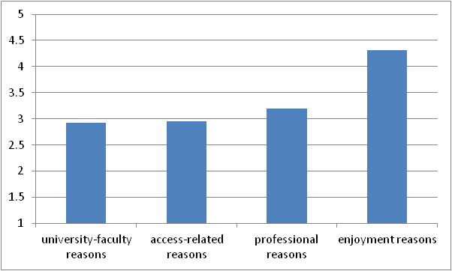
Reasons for Enrolling: Overall Mean Ratings
Notes:
W

Slide 17
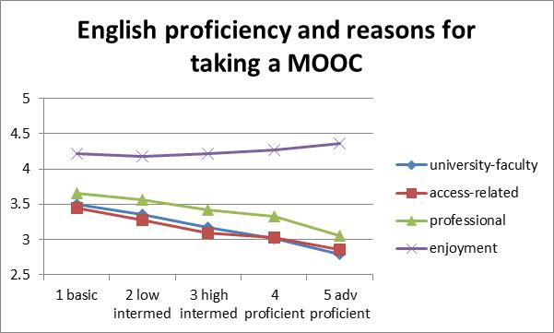
Reasons for Enrolling
Notes:
W

Slide 18
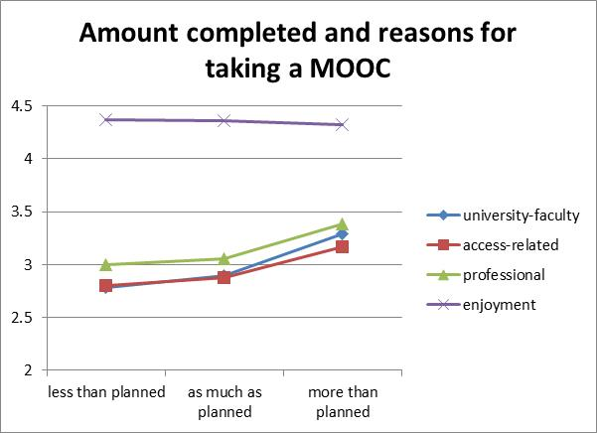
Reasons for Enrolling
Notes:
W

Slide 19
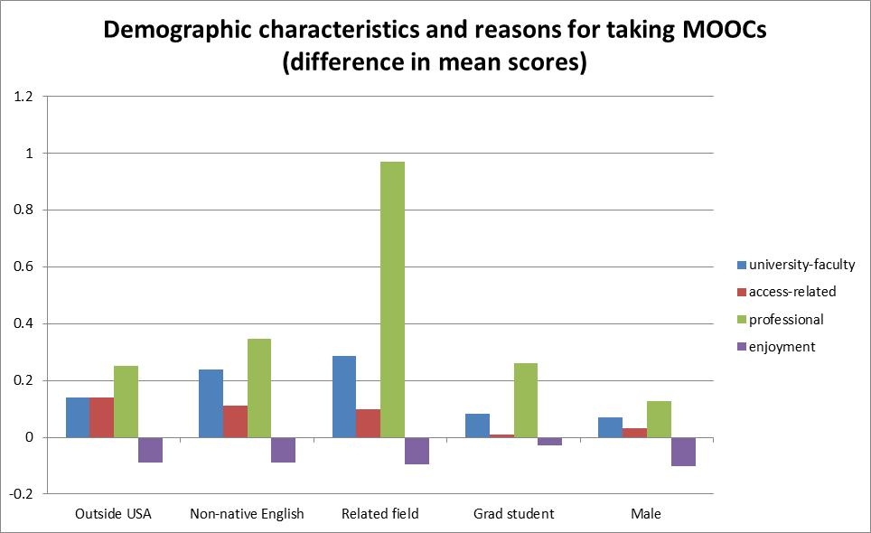
Reasons for Enrolling
Notes:
W

Slide 20
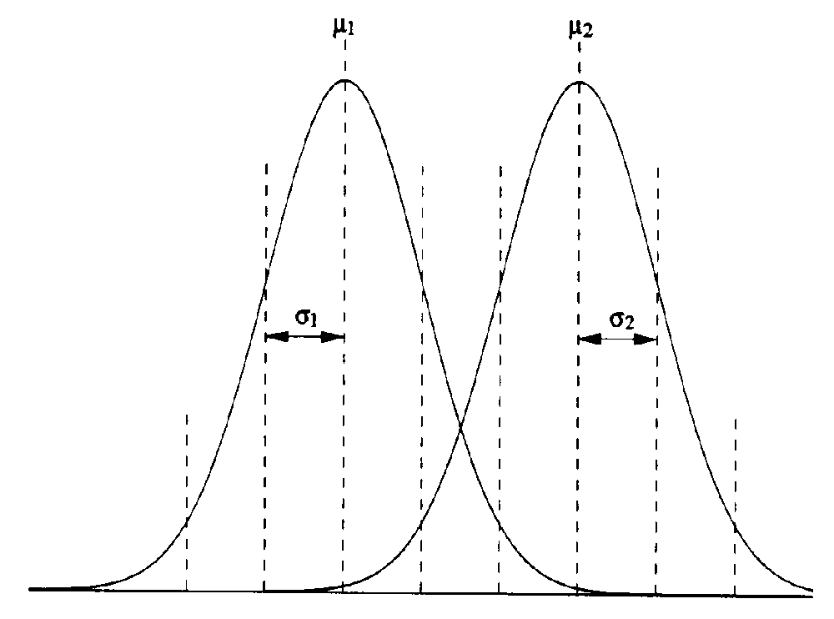
Two Populations of Students
Strivers: outside US, male, younger, non-native English, work/study in same field, professional reasons
Grazers: inside US, older, native English, complete less, enjoyment reasons
Notes:
W

Slide 21
Predicting Success: Models of Student- versus Instructor-Defined Completion
 |  | Intent | Self-Reported | 50% Completed | Total Points
Reasons for Enrolling | University
 | Professional
 | Access
 | Enjoyment
Demographics | English Proficiency
 | Location: USA
 | Age
 | Sex
Obstacles to Completion | Tech Unfamiliar
 | Connection Problems
 | Computer Problems
 | Time Zone Issues
 | Family Issues
 | Work Issues
Intent
Self-Reported

Slide 22
Predicting Success: Models of Student- versus Instructor-Defined Completion
 |  | Intent | Self-Reported | 50% Completed | Total Points
Reasons for Enrolling | University | +
 | Professional | +
 | Access | +
 | Enjoyment | +
Demographics | English Proficiency | +
 | Location: USA | 0
 | Age | –
 | Sex | 0
Obstacles to Completion | Tech Unfamiliar
 | Connection Problems
 | Computer Problems
 | Time Zone Issues
 | Family Issues
 | Work Issues
Intent
Self-Reported

Slide 23
Predicting Success: Models of Student- versus Instructor-Defined Completion
 |  | Intent | Self-Reported | 50% Completed | Total Points
Reasons for Enrolling | University | +
 | Professional | +
 | Access | +
 | Enjoyment | +
Demographics | English Proficiency | +
 | Location: USA | 0
 | Age | –
 | Sex | 0
Obstacles to Completion | Tech Unfamiliar
 | Connection Problems
 | Computer Problems
 | Time Zone Issues
 | Family Issues
 | Work Issues
Intent
Self-Reported

Slide 24
Predicting Success: Models of Student- versus Instructor-Defined Completion
 |  | Intent | Self-Reported | 50% Completed | Total Points
Reasons for Enrolling | University | +
 | Professional | +
 | Access | +
 | Enjoyment | +
Demographics | English Proficiency | +
 | Location: USA | 0
 | Age | –
 | Sex | 0
Obstacles to Completion | Tech Unfamiliar
 | Connection Problems
 | Computer Problems
 | Time Zone Issues
 | Family Issues
 | Work Issues
Intent
Self-Reported

Slide 25
Predicting Success: Models of Student- versus Instructor-Defined Completion
 |  | Intent | Self-Reported | 50% Completed | Total Points
Reasons for Enrolling | University | + | +
 | Professional | + | 0
 | Access | + | 0
 | Enjoyment | + | 0
Demographics | English Proficiency | + | -
 | Location: USA | 0 | +
 | Age | – | 0
 | Sex | 0 | 0
Obstacles to Completion | Tech Unfamiliar |  | 0
 | Connection Problems |  | +
 | Computer Problems |  | 0
 | Time Zone Issues |  | 0
 | Family Issues |  | 0
 | Work Issues |  | 0
Intent |  |  | 0
Self-Reported

Slide 26
Predicting Success: Models of Student- versus Instructor-Defined Completion
 |  | Intent | Self-Reported | 50% Completed | Total Points
Reasons for Enrolling | University | + | +
 | Professional | + | 0
 | Access | + | 0
 | Enjoyment | + | 0
Demographics | English Proficiency | + | -
 | Location: USA | 0 | +
 | Age | – | 0
 | Sex | 0 | 0
Obstacles to Completion | Tech Unfamiliar |  | 0
 | Connection Problems |  | +
 | Computer Problems |  | 0
 | Time Zone Issues |  | 0
 | Family Issues |  | 0
 | Work Issues |  | 0
Intent |  |  | 0
Self-Reported

Slide 27
Predicting Success: Models of Student- versus Instructor-Defined Completion
 |  | Intent | Self-Reported | 50% Completed | Total Points
Reasons for Enrolling | University | + | +
 | Professional | + | 0
 | Access | + | 0
 | Enjoyment | + | 0
Demographics | English Proficiency | + | -
 | Location: USA | 0 | +
 | Age | – | 0
 | Sex | 0 | 0
Obstacles to Completion | Tech Unfamiliar |  | 0
 | Connection Problems |  | +
 | Computer Problems |  | 0
 | Time Zone Issues |  | 0
 | Family Issues |  | 0
 | Work Issues |  | 0
Intent |  |  | 0
Self-Reported

Slide 28
Predicting Success: Models of Student- versus Instructor-Defined Completion
 |  | Intent | Self-Reported | 50% Completed | Total Points
Reasons for Enrolling | University | + | + | +
 | Professional | + | 0 | 0
 | Access | + | 0 | 0
 | Enjoyment | + | 0 | 0
Demographics | English Proficiency | + | - | 0
 | Location: USA | 0 | + | -
 | Age | – | 0 | -
 | Sex | 0 | 0 | 0
Obstacles to Completion | Tech Unfamiliar |  | 0 | 0
 | Connection Problems |  | + | 0
 | Computer Problems |  | 0 | 0
 | Time Zone Issues |  | 0 | 0
 | Family Issues |  | 0 | -
 | Work Issues |  | 0 | -
Intent |  |  | 0 | +
Self-Reported

Slide 29
Predicting Success: Models of Student- versus Instructor-Defined Completion
 |  | Intent | Self-Reported | 50% Completed | Total Points
Reasons for Enrolling | University | + | + | +
 | Professional | + | 0 | 0
 | Access | + | 0 | 0
 | Enjoyment | + | 0 | 0
Demographics | English Proficiency | + | - | 0
 | Location: USA | 0 | + | -
 | Age | – | 0 | -
 | Sex | 0 | 0 | 0
Obstacles to Completion | Tech Unfamiliar |  | 0 | 0
 | Connection Problems |  | + | 0
 | Computer Problems |  | 0 | 0
 | Time Zone Issues |  | 0 | 0
 | Family Issues |  | 0 | -
 | Work Issues |  | 0 | -
Intent |  |  | 0 | +
Self-Reported

Slide 30
Predicting Success: Models of Student- versus Instructor-Defined Completion
 |  | Intent | Self-Reported | 50% Completed | Total Points
Reasons for Enrolling | University | + | + | +
 | Professional | + | 0 | 0
 | Access | + | 0 | 0
 | Enjoyment | + | 0 | 0
Demographics | English Proficiency | + | - | 0
 | Location: USA | 0 | + | -
 | Age | – | 0 | -
 | Sex | 0 | 0 | 0
Obstacles to Completion | Tech Unfamiliar |  | 0 | 0
 | Connection Problems |  | + | 0
 | Computer Problems |  | 0 | 0
 | Time Zone Issues |  | 0 | 0
 | Family Issues |  | 0 | -
 | Work Issues |  | 0 | -
Intent |  |  | 0 | +
Self-Reported

Slide 31
Predicting Success: Models of Student- versus Instructor-Defined Completion
 |  | Intent | Self-Reported | 50% Completed | Total Points
Reasons for Enrolling | University | + | + | + | 0
 | Professional | + | 0 | 0 | 0
 | Access | + | 0 | 0 | 0
 | Enjoyment | + | 0 | 0 | 0
Demographics | English Proficiency | + | - | 0 | +
 | Location: USA | 0 | + | - | 0
 | Age | – | 0 | - | 0
 | Sex | 0 | 0 | 0 | -
Obstacles to Completion | Tech Unfamiliar |  | 0 | 0 | -
 | Connection Problems |  | + | 0 | -
 | Computer Problems |  | 0 | 0 | 0
 | Time Zone Issues |  | 0 | 0 | 0
 | Family Issues |  | 0 | - | -
 | Work Issues |  | 0 | - | -
Intent |  |  | 0 | + | +
Self-Reported |  |  |  |  | +

Slide 32
Predicting Success: Models of Student- versus Instructor-Defined Completion
 |  | Intent | Self-Reported | 50% Completed | Total Points
Reasons for Enrolling | University | + | + | + | 0
 | Professional | + | 0 | 0 | 0
 | Access | + | 0 | 0 | 0
 | Enjoyment | + | 0 | 0 | 0
Demographics | English Proficiency | + | - | 0 | +
 | Location: USA | 0 | + | - | 0
 | Age | – | 0 | - | 0
 | Sex | 0 | 0 | 0 | -
Obstacles to Completion | Tech Unfamiliar |  | 0 | 0 | -
 | Connection Problems |  | + | 0 | -
 | Computer Problems |  | 0 | 0 | 0
 | Time Zone Issues |  | 0 | 0 | 0
 | Family Issues |  | 0 | - | -
 | Work Issues |  | 0 | - | -
Intent |  |  | 0 | + | +
Self-Reported |  |  |  |  | +

Slide 33
Predicting Success: Models of Student- versus Instructor-Defined Completion
 |  | Intent | Self-Reported | 50% Completed | Total Points
Reasons for Enrolling | University | + | + | + | 0
 | Professional | + | 0 | 0 | 0
 | Access | + | 0 | 0 | 0
 | Enjoyment | + | 0 | 0 | 0
Demographics | English Proficiency | + | - | 0 | +
 | Location: USA | 0 | + | - | 0
 | Age | – | 0 | - | 0
 | Sex | 0 | 0 | 0 | -
Obstacles to Completion | Tech Unfamiliar |  | 0 | 0 | -
 | Connection Problems |  | + | 0 | -
 | Computer Problems |  | 0 | 0 | 0
 | Time Zone Issues |  | 0 | 0 | 0
 | Family Issues |  | 0 | - | -
 | Work Issues |  | 0 | - | -
Intent |  |  | 0 | + | +
Self-Reported |  |  |  |  | +

Slide 34
Predicting Success: Models of Student- versus Instructor-Defined Completion
 |  | Intent | Self-Reported | 50% Completed | Total Points
Reasons for Enrolling | University | + | + | + | 0
 | Professional | + | 0 | 0 | 0
 | Access | + | 0 | 0 | 0
 | Enjoyment | + | 0 | 0 | 0
Demographics | English Proficiency | + | - | 0 | +
 | Location: USA | 0 | + | - | 0
 | Age | – | 0 | - | 0
 | Sex | 0 | 0 | 0 | -
Obstacles to Completion | Tech Unfamiliar |  | 0 | 0 | -
 | Connection Problems |  | + | 0 | -
 | Computer Problems |  | 0 | 0 | 0
 | Time Zone Issues |  | 0 | 0 | 0
 | Family Issues |  | 0 | - | -
 | Work Issues |  | 0 | - | -
Intent |  |  | 0 | + | +
Self-Reported |  |  |  |  | +

Slide 35
Predicting Success: Models of Student- versus Instructor-Defined Completion
 |  | Intent | Self-Reported | 50% Completed | Total Points
Reasons for Enrolling | University | + | + | + | 0
 | Professional | + | 0 | 0 | 0
 | Access | + | 0 | 0 | 0
 | Enjoyment | + | 0 | 0 | 0
Demographics | English Proficiency | + | - | 0 | +
 | Location: USA | 0 | + | - | 0
 | Age | – | 0 | - | 0
 | Sex | 0 | 0 | 0 | -
Obstacles to Completion | Tech Unfamiliar |  | 0 | 0 | -
 | Connection Problems |  | + | 0 | -
 | Computer Problems |  | 0 | 0 | 0
 | Time Zone Issues |  | 0 | 0 | 0
 | Family Issues |  | 0 | - | -
 | Work Issues |  | 0 | - | -
Intent |  |  | 0 | + | +
Self-Reported |  |  |  |  | +

Slide 36
Predicting Success: Models of Student- versus Instructor-Defined Completion
 |  | Intent | Self-Reported | 50% Completed | Total Points
Reasons for Enrolling | University | + | + | + | 0
 | Professional | + | 0 | 0 | 0
 | Access | + | 0 | 0 | 0
 | Enjoyment | + | 0 | 0 | 0
Demographics | English Proficiency | + | - | 0 | +
 | Location: USA | 0 | + | - | 0
 | Age | – | 0 | - | 0
 | Sex | 0 | 0 | 0 | -
Obstacles to Completion | Tech Unfamiliar |  | 0 | 0 | -
 | Connection Problems |  | + | 0 | -
 | Computer Problems |  | 0 | 0 | 0
 | Time Zone Issues |  | 0 | 0 | 0
 | Family Issues |  | 0 | - | -
 | Work Issues |  | 0 | - | -
Intent |  |  | 0 | + | +
Self-Reported |  |  |  |  | +

Slide 37
Learning in MOOCs:
A Hybrid Model
Computer science MOOC, fall 2013, Professor Joseph Konstan
Compared hybrid course (face-to-face plus MOOC) and fully online course (MOOC only)
Pre- and post-course knowledge test
Results:
students can learn in a MOOC!
and learning gains are evenly distributed
but they learn more with a face-to-face component
More details at ACM Learning@Scale conference, March 4-5, Atlanta. http://learningatscale.acm.org/
Notes:
W

Slide 38
Questions?

Slide 39
Diving Deep into Data: MOOCs at Minnesota
Thanks!
http://z.umn.edu/research
D. Christopher Brooks, Ph.D. (cbrooks@educause.edu)
J.D. Walker, Ph.D. (jdwalker@umn.edu)

