Slide 1

ELI Beta Release Announcement
Megan Marler
Joe Moreau
Lisa Stephens
Jim Twetten
Clare van den Blink
Notes:
Really excited to announce the availability of FLEXspace for Beta Testing.
If you attended our presentation last year at ELI, we hope you’ll be as excited as we are with the progress.
The goal of today’s presentation is to get you into the system, so you have a chance to kick the tires, and take FLEXspace for a test drive. We only have 45 minutes, so I’ll start with a couple of questions and then introduce the team.
QUESTION: how many of you brought laptops today?
FLEXspace is built on a platform that will be mobile device friendly this summer, but for the beta test period, you’ll need to use a laptop or desktop to access the system. You should receive everything you need during this demo to take this back to your campus and get started with uploading your learning spaces.
We’ll reinforce this point throughout the presentation, but obviously the only rule of engagement for a beta rollout is to be tolerant of tweaking and Be willing to provide feedback through the 3-5 question survey as many times as you would like. If you don’t need to provide your contact information, but it would be useful if we need to follow up with more questions.
Let me back up and introduce the team –
Lisa Stephens (Project Lead) Sr. Strategist, Academic Innovation
Megan Marler (ARTstor) Strategist - Director, Strategic Services
Joe Moreau (Sponsor Lead) Vice Chancellor and Chief Technology Officer – Foothill Danza CC
Jim Twetten (CCUMC/Tech Integration) Dir. Academic Technology – Iowa State
Susan Brower, part of the CCUMC team is going to be roving with a camera to capture your reactions – this video is for internal use only, it will not be posted anywhere. Please don’t be shy with sharing if you see Susan’s camera looking over your shoulder!
There are a number of other key players who couldn’t be with us today, who are listed at the end of the presentation.

Slide 2







Founding Partners
Notes:
Just a little quick background for those of you who might be new to FLEXspace
It’s a unique collaboration among founding institutional partners – we all have skin in the game, and formed a Core Team, now functioning as an interim board.

Slide 3
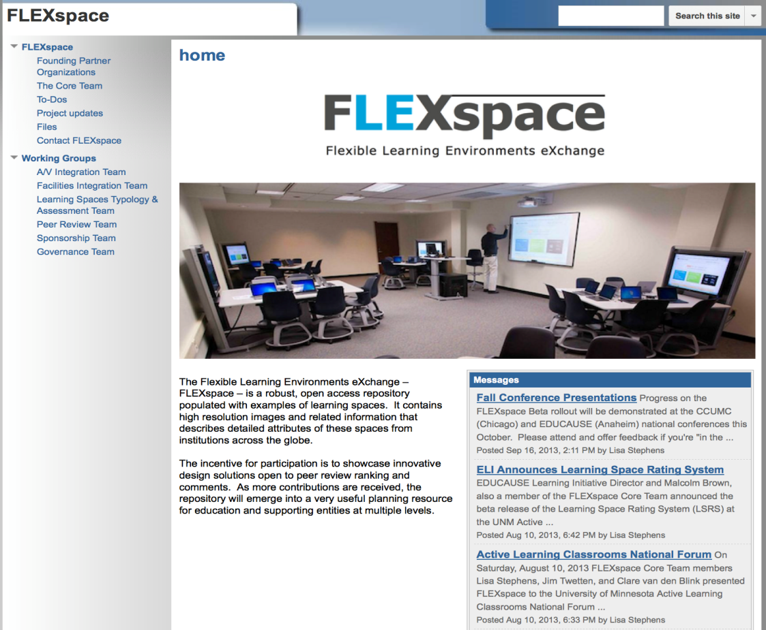
https://sites.google.com/site/flexspacedev/
Website
Search on
“FLEXspace”
or
EDUCAUSE
Archives
Notes:
The FLEXspace story and many past presentations are available in EDUCAUSE conference archives, or the FLEXspace informational website – and we encourage you to look there for more details like the business and sponsorship plans.

Slide 4
Vision
A robust, searchable, open access learning space repository that is able to be peer-reviewed.
In discussions with several sponsors to ensure this remains free as a service to the education and not-for-profit community
Notes:
The vision is to create a robust, highly searchable open access learning space repository that can be peer reviewed.
Joe has been meeting with potential non-competing sponsors to support the production rollout, he’d be happy to respond to questions while roving around.
In terms of peer review, our friends at MERLOT have requested a critical mass of 500 records in order to begin designing the assessment rubrics, and of course as we talk more with the LSRS team, that may influence the development path as well.

Slide 5

Community Value
Share and monitor best practices
Create common understanding across disciplines and knowledge domains
Support agile renovation cycles
Synergy with other national efforts
  Learning Space Rating System (conceptual inputs/ratings)
  FLEXspace (concrete exemplars)
Notes:
The key community value of FLEXspace is sharing best practices.
We’re convinced that by creating three separate domains to gather information from the perspective of faculty, instructional technology support and facilities design and support expertise we’ll help promote a common understanding across the learning space eco-system.
We also know that renovation cycles need to be increasingly agile, and respond to increased demand for digital content capture for a variety of applications.
Both the Learning Space Rating System and FLEXspace are now in Beta, and in many ways are two sides of the same coin. We anticipate communication will be “ramping up” among these efforts during the beta phase of each project.
Also during Beta, we have experts providing external review to assist with assessment of the tool.
Both the LSRS and FLEXspace teams are very excited to have been interviewed by Campus Technologies Magazine – we think it will be in their March issue, and you’ll see increased information coming out from EDUCAUSE, SCUP and other publishing points.

Slide 6
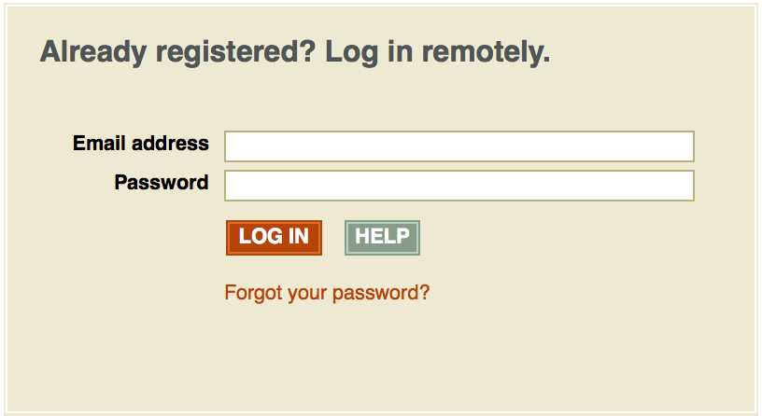
Viewing Environment
http://library.demo.artstor.org
beta001@flexspace.org
Password: artstor1

Slide 7
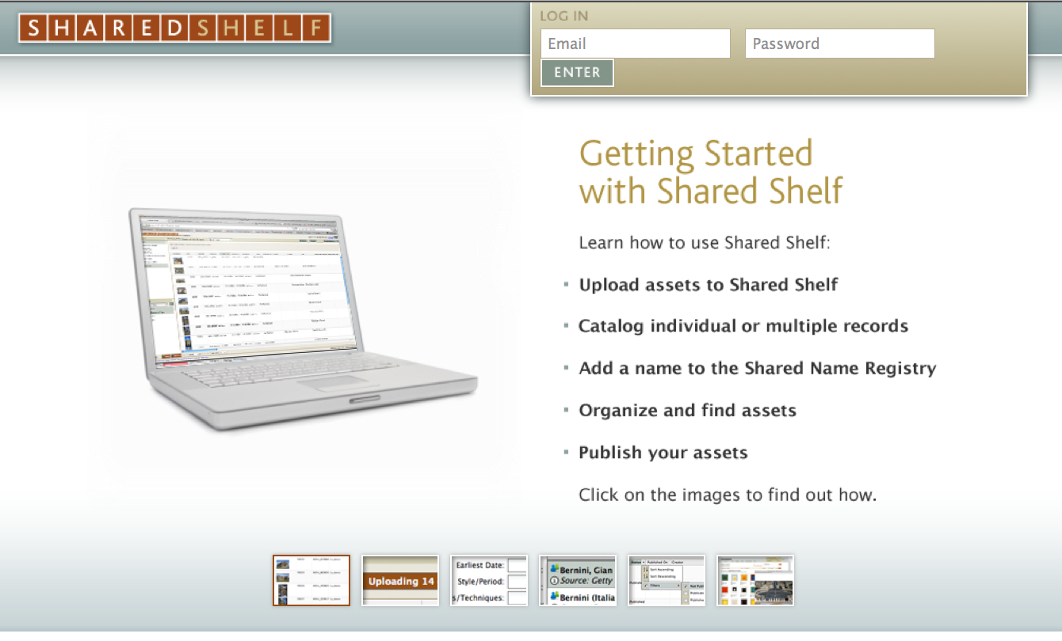
Upload Environment
http://catalog.sharedshelf.demo.artstor.org
beta001@flexspace.org
Password: artstor1

Slide 8
Live Demonstration Goal
beta001@flexspace.org
Password: artstor1
Looking for “first impressions” – be honest!
Open Dialog – shout out questions are fine.
Do you have what you need to take this back and share with your colleagues?
Based on first impressions, how might we improve what you see?
  T
Notes:
To get the demo started and walk you through, we need “hands up” again of who has laptops to follow along in the demo.
Count OFF – as soon as you have your number, use the top 2 lines to login.
This is for today only – you’ll need to request an account from ARTstor through their support link to get a real account after today.
We are specifically looking for ideas based on “first impressions” – and capturing that on video so we can review it later.

Slide 9
Core Team & Interim Board
Malcolm Brown - Director, EDUCAUSE Learning Initiative
Terry Calhoun - Director, Media Relations and Publications – SCUP
Carey Hatch - Associate Provost, Academic Technology - SUNY System Administration
Gerry Hanley - Sr. Director, Academic Tech. Svcs; California State Univ. – Office of Chancellor
Mark McCallister - Associate Director, Academic Technology, University of Florida
Joseph Moreau - Vice Chancellor, Foothill-DeAnza Community College District
Kim Scalzo - Director, SUNY Center for Professional Development
Brad Snyder - Technical Services Coordinator, SUNY Cortland
Lisa Stephens - Sr. Strategist, Academic Innovation - SUNY (Project Lead)
Jim Twetten - Director, Academic Technologies - Iowa State University
Clare van den Blink - Director, Academic Technologies – Cornell University
Notes:
(Lisa wrap up - 2 min) – Full Listing of the Core Team collaborating on this effort

Slide 10
Taxonomy Review & Contributors
Learning and Assessment
Clare van den Blink –Cornell U. (Core Lead)
Doug Willen – Swarthmore College
Joan Lippincott – Coalition Network Info.
Linda Kendall Knox – U. Michigan
Dana Gierdowski – U. North Carolina
Technology Integration
Brad Snyder – SUNY Cortland (Core Lead)
Charles Minihan – Emory University
Beth Fellendorf –U. at Buffalo
Lori Swinney – U. North Dakota
Mark McCallister – Univ. of Florida
John Pfeffer – U. at Buffalo
Jim Twetten – Iowa State University
FLEXspace Identity Design
Laurie Yarnes – U. at Buffalo
Facilities Integration
Terry Calhoun – SCUP (Core Lead)
Claire Turcotte – SCUP
Ira Fink - Ira Fink and Associates
Persis Rickes - Rickes Associates Inc.
Shirley Dugdale - Dugdale Strategy, LLC
Scott Shader – U. Mass Med School - Worcester
Valarie Avalone - Monroe CC (SUNY)
Daniel K.Paulien - Paulien & Associates, Inc.
Fran Gast - RI School Design (RISD) Ret.
Ludmilla Pavlova-Gillham –U. Mass - Amherst
Lennie Scott-Webber - Steelcase Inc.
Michael Hites – U. Illinois
Notes:
(Lisa)
This is not an exhaustive list, but it represents the key people who have reviewed and refined the original project into the three taxonomies.

Slide 11
Contributors
Original SUNY FACT² Task Group – Innovative Instruction Space Repository (2011)
David Lavallee, SUNY Executive Vice Chancellor & Provost, (Sponsor)
Joseph Moreau, Chief Technology Officer, Oswego, Chair
Lisa Stephens, Associate Director of Academic Services, U. Buffalo (FACT² Chair)
Joan Getman, Sr. Strategist for Learning Technologies, Cornell
Greg Bronson, Project Lead - Cornell
Graham Glynn, Assistant Provost, Stony Brook
Wayne Jones, Chemistry Department Chair, Binghamton
Mark McBride, Instructional Support, Buffalo State College
Mary Jo Orzech, Director of Libraries, Brockport
Joe Smith, Director of Educational Communications, Upstate Medical
Leanne Washauer, Associate Professor of English, Suffolk County CC
Emily Trapp, Director of Instructional Media Services, New Paltz (EdTOA)
Mitch Fields, Assistant Director of Capital Program Management, SCUF
Geoff Hamburg, Capital Program Manager SCUF
Jeffrey Bartkovich, Vice President of Educational Technology Services, Monroe CC
Shihong "Steve" Chen, Chief Information Officer, Hudson Valley CC
Notes:
(Lisa) – Acknowledging the original team that launched the SUNY proof of concept effort, many of whom are still actively involved.

Slide 12
ELI Core Team Contacts
Lisa Stephens (Project Lead) Lisa.Stephens@suny.edu
Terry Calhoun (SCUP - Facilities) Terry.Calhoun@scup.org
Gerry Hanley (MERLOT - Peer Review) ghanley@calstate.edu
Megan Marler (ARTstor) Megan.Marler@ARTstor.org
Joe Moreau (Sponsor Lead) moreaujoseph@fhda.edu
Jim Twetten (CCUMC/Tech Integration) jtwetten@iastate.edu
Clare van den Blink (Learning/Assessment) cv36@cornell.edu
Malcolm Brown (ELI Advisory) mbrown@educause.edu
Notes:
Entire Team needs to jump in for Q&A

