Slide 1
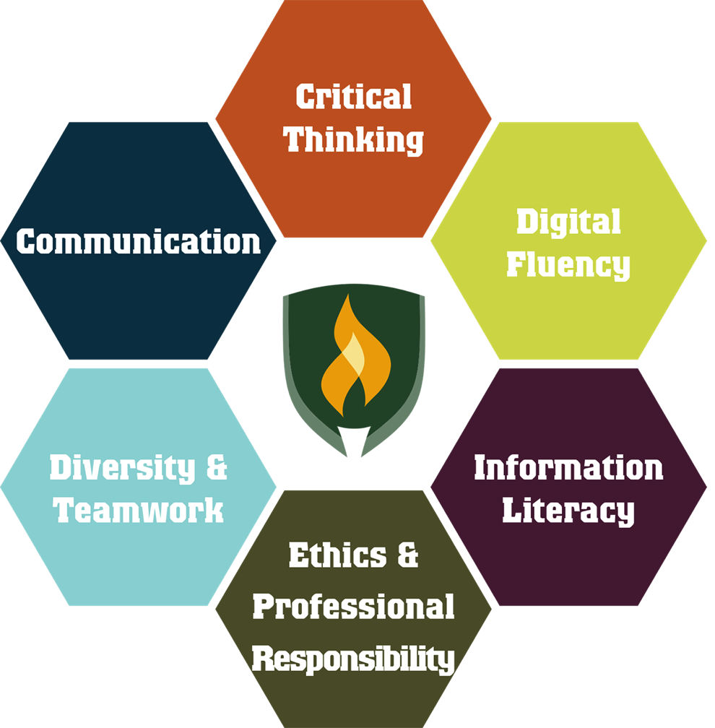
Rasmussen’s Transferrable Skills
Notes:
Focus on lifelong learning & authentic workplace activities
These skills lay the foundation for any credential
As part of the HLC Assessment Academy Project, the six skills were chosen after
conducting an extensive literature review;
receiving formal feedback from nearly 100 advisory board members;
gathering substantial input from nearly 400 faculty members across the College.
Critical Thinking
Improving thinking, including problem‐solving and creativity, by applying intellectual standards such as clarity, precision, logic, and reflection.
Digital Fluency
Effectively employing and understanding digital tools to express ideas in appropriate contexts.
Information Literacy
Recognizing when information is needed and possessing the ability to locate, evaluate, and use effectively needed information.
Communication
Displaying capability in writing, reading, and oral communication; understanding of non‐verbal language.
Diversity
& Teamwork
Demonstrating awareness and empathy while working collaboratively with people of diverse backgrounds and perspectives.
Ethics & Professional Responsibility
Understanding and exhibiting principles of conduct and professional behavior which impact a greater good in the world and workplace. Understanding and applying ethical and professional principles of conduct.

Slide 2
Industry
Authentic, project-based assessments
Subject Matter
Transferrable Skills Summit
Define TS outcomes
Develop competencies
Curriculum
Corresponding rubrics
Design
Faculty
Notes:
Interdisciplinary collaboration
Increased focus on teaching and learning
Decreased focus on being an assessment expert and ensuring validity and reliability in creating authentic assessments

Slide 3
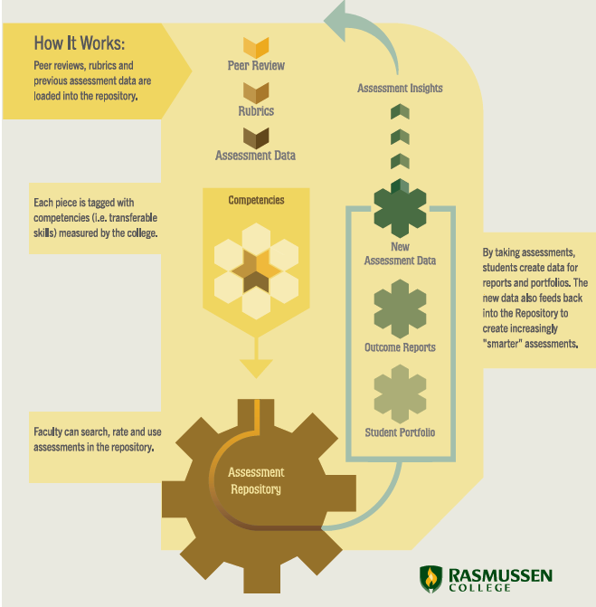
Notes:
Peer Reviewed Assessment Repository
Faculty and industry experts are involved in the Transferrable Skills Summit
Authentic project-based assessments are created for teach Transferrable Skill
Students demonstrate mastery in each Transferrable Skill
On-going quarterly evaluation of the assessment data

