Slide 1

The Sensible Application of Learning Technologies in space designs
Bryan Lewis
Gerry Starsia

Slide 2
Learning Modes
Poll Question: What method of instruction leads to the most retention of information (choose one)?
  Reading about an activity
  Hearing about an activity
  Participating in an activity
  Simulating an activity
  Watching an activity

Slide 3
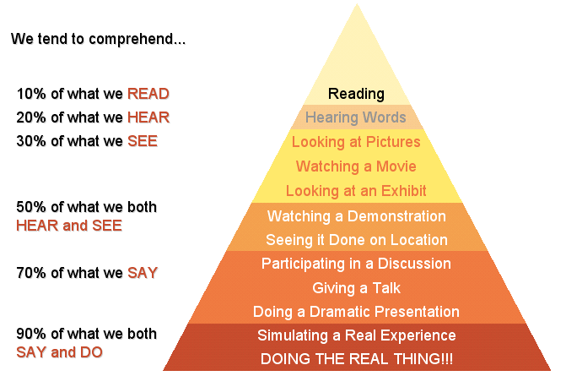
Instructional Goal – Comprehension

Slide 4
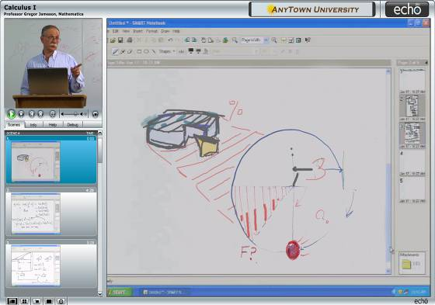
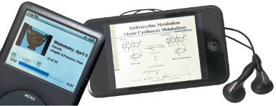
Learning Technology Trends
Podcast - audio only
Enhanced Podcast - audio & JPEG visuals
Vodcast - audio & full-motion video of course visuals
Rich Media - browser-based rich media player with indexing, navigation, resizing, closed captioning support
We determine the percentage of the area by calculating how
Full-motion course visuals

Slide 5
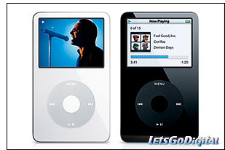
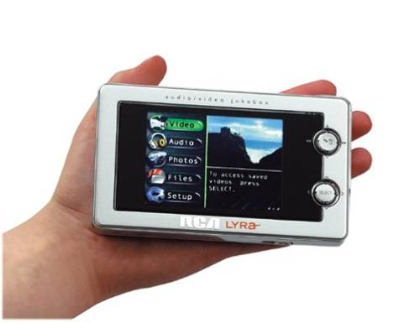

Learning Technologies
Notes:
Trickles to every curriculum area
Tech and non-tech - most hybrid. Puzzle with tech to research, create solution, present
Real world scenarios

Slide 6
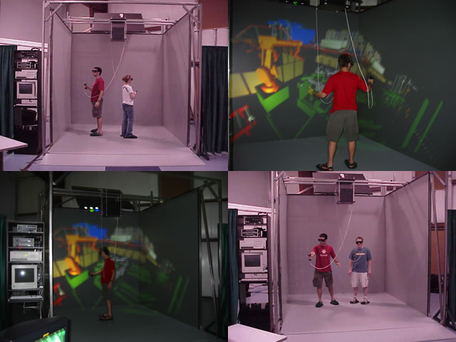
Learning Caves
Notes:
SIMULATION – hard sciences
3D projection getting cheap

Slide 7
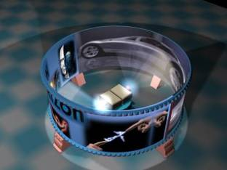
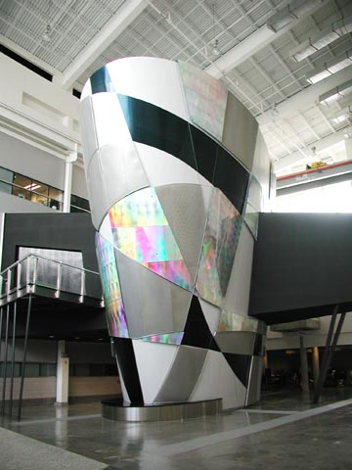
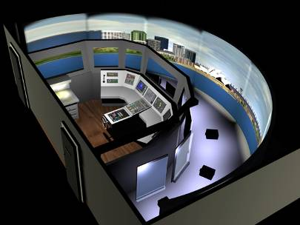
Video Simulation Surrounds

Slide 8
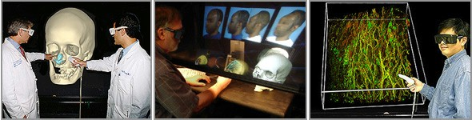
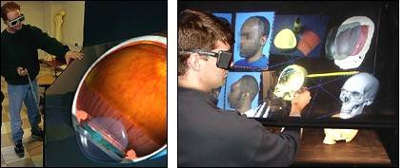

Learning Simulations
Notes:
3D comes to the desktop – some 3D monitors without glasses

Slide 9
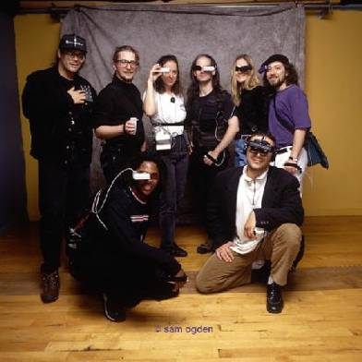
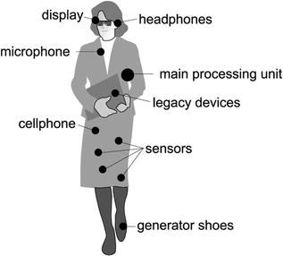
Sensory Technologies
Wearable Computing

Slide 10
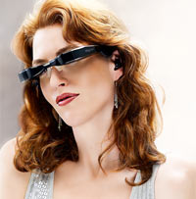
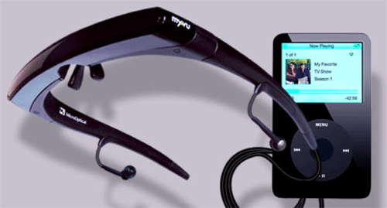

Wearable Technologies
Notes:
Myvu’s creator, claims its glasses create a viewing experience equivalent to a 27-inch display watched at about two meters. My own experience was pretty consistent with that claim, although with only 320 x 240 resolution, the pixel lines were clearly visible (imagine a 27-inch TV at half resolution, and you get the idea.) Despite the lower resolution, the image the Myvu produces is crystal clear and sharp. $299

Slide 11
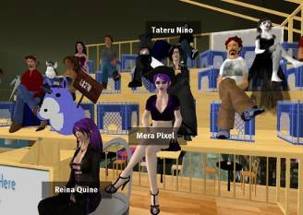
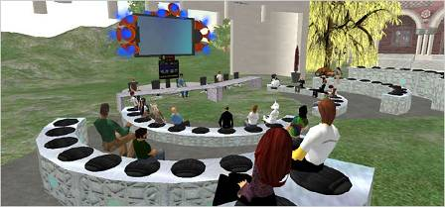

Learning Technologies
On-line 3D virtual world based on avatars
Learn, explore, meet other residents, socialize, participate in group activities, create and trade virtual property and services from one another
5.5 million accounts on Second Life
Virtual Worlds
Notes:
While virtual worlds have some application in the learning environment, how much do we devote? Are they a leading or following learning enabler?
In their book The Media Equation, Cliff Nass and Byron Reeves revealed through a series of experiments that people treat media in exactly the same way they treat reality. From this astounding finding we can begin to understand why massive multiuser virtual environments have become so popular. People are, by nature, social and desire a broad variety of interaction with other people.
Leveraging some of the most interesting aspects of these online computer games such as fantasy, choice, and customization (Cordova & Lepper, 1996; Lepper & Malone, 1987) we can begin to extrapolate how the classroom of the future may differ from what we have today.

Slide 12
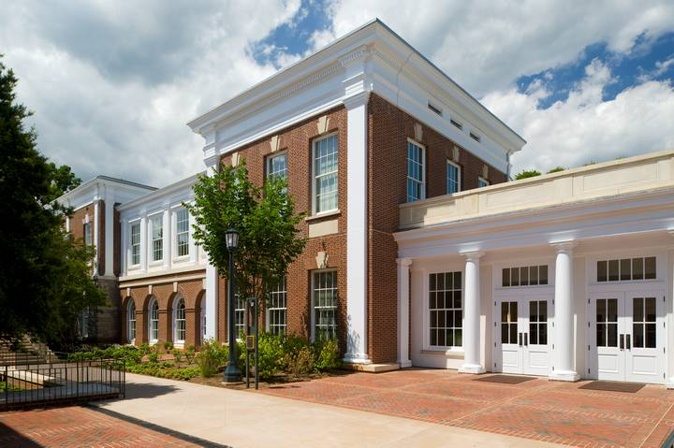
Instructional space planning and technology– A Case Study

Slide 13
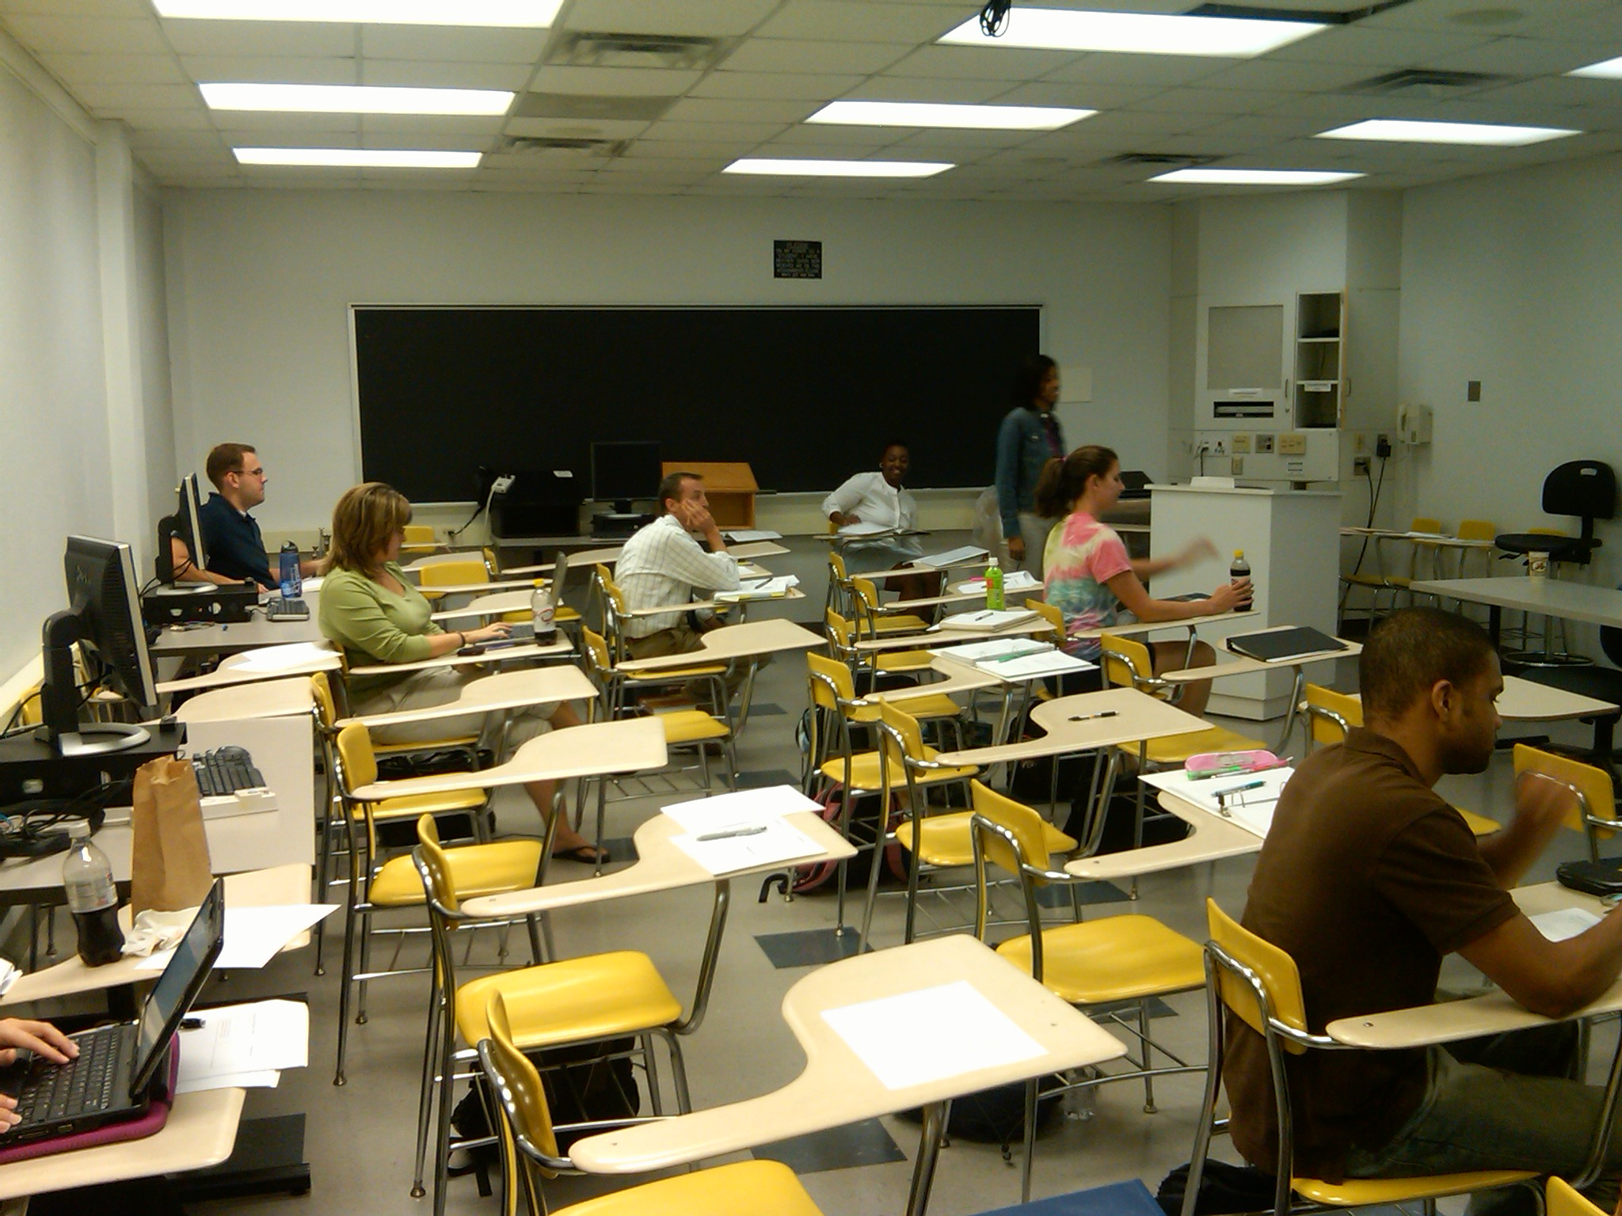
Classroom Configuration to Avoid
Seeking to Avoid

Slide 14
Case Method Instruction
Insert FP JPEG here
Notes:
Very quick example – shown for <10 seconds
How do we design spaces and use technology to enhance business school learning? Case methodology
Tiering (any case room)
Flxibility (260)

Slide 15
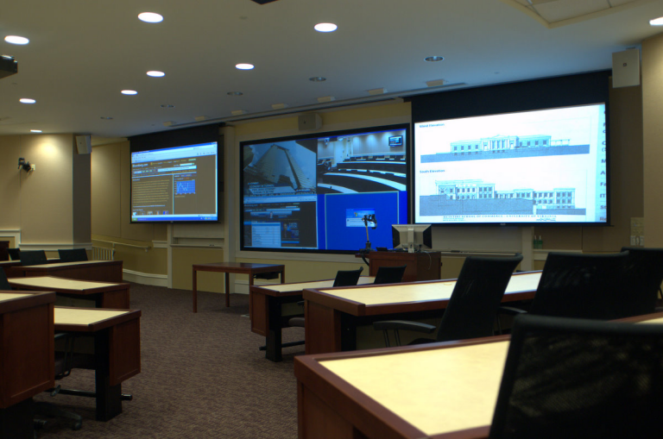
Case Method Delivered
Case Method Classroom
Notes:
15

Slide 16
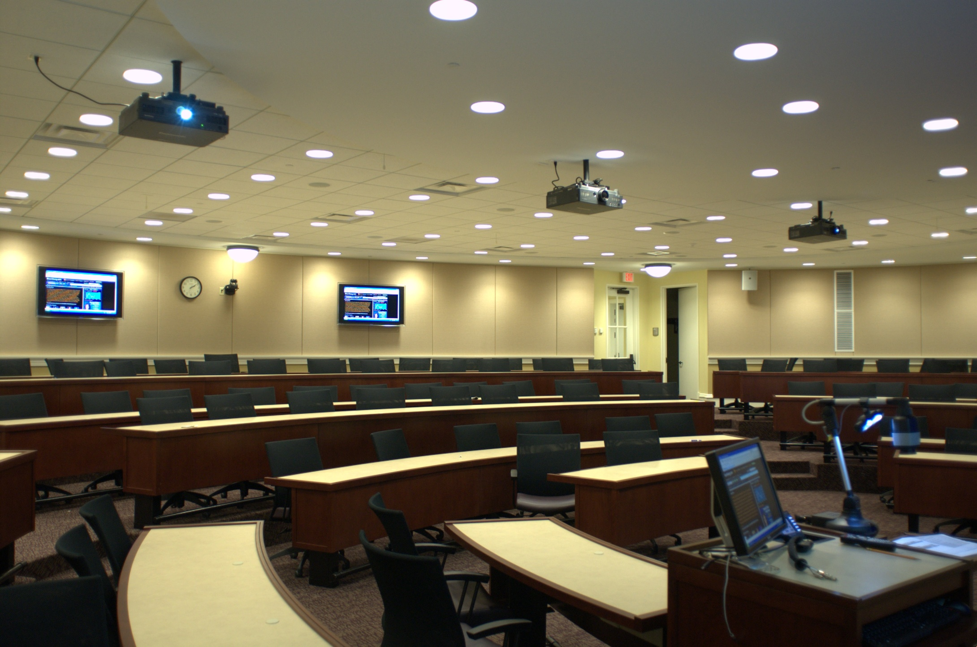
Case Method Classroom
Case Method Classroom

Slide 17
Conference Room
Insert plan 5 JPEG here
Notes:
Very quick example – shown for <10 seconds

Slide 18
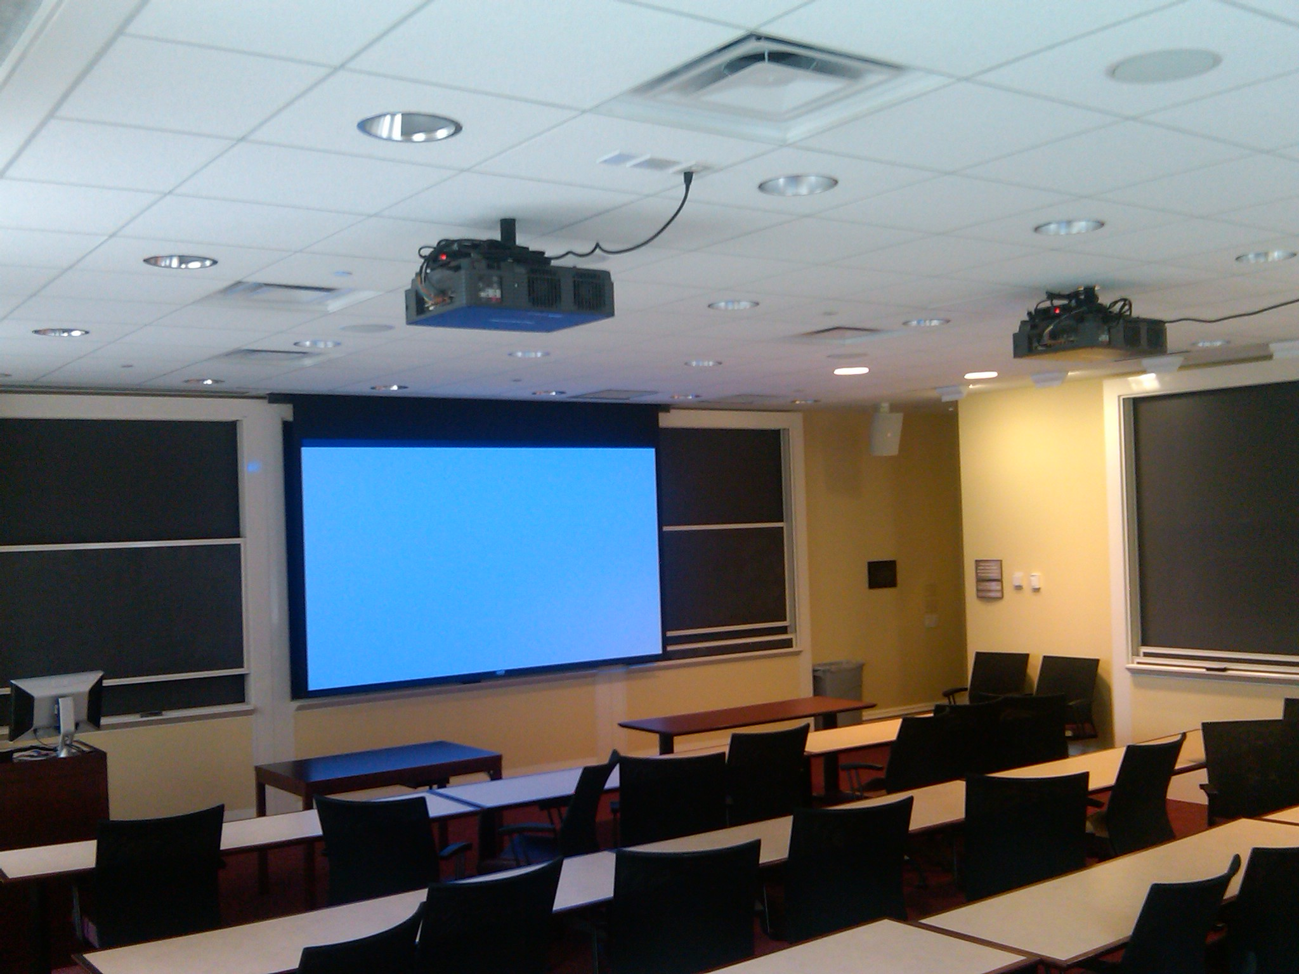
Flat Floor Classroom
“Flexibility”
Flat Floor Classroom

Slide 19
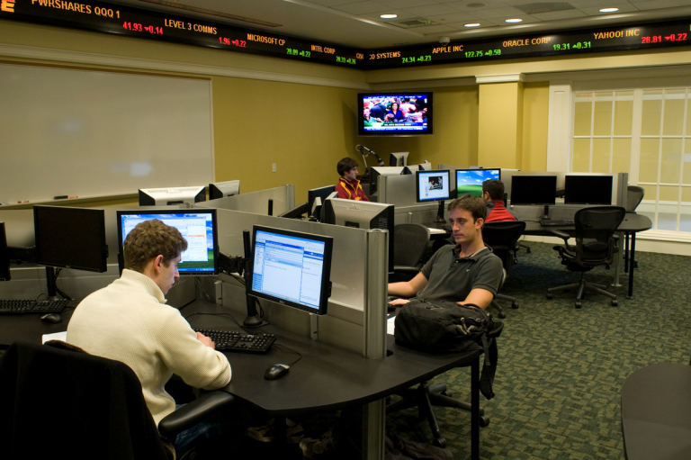
Financial Trading Center
Financial Trading Center
Notes:
THESE ARE THE KINDS OF SPACES WE WANTED…
THIS IS WHAT WE HAVE…
19

Slide 20
Conference Room

Slide 21
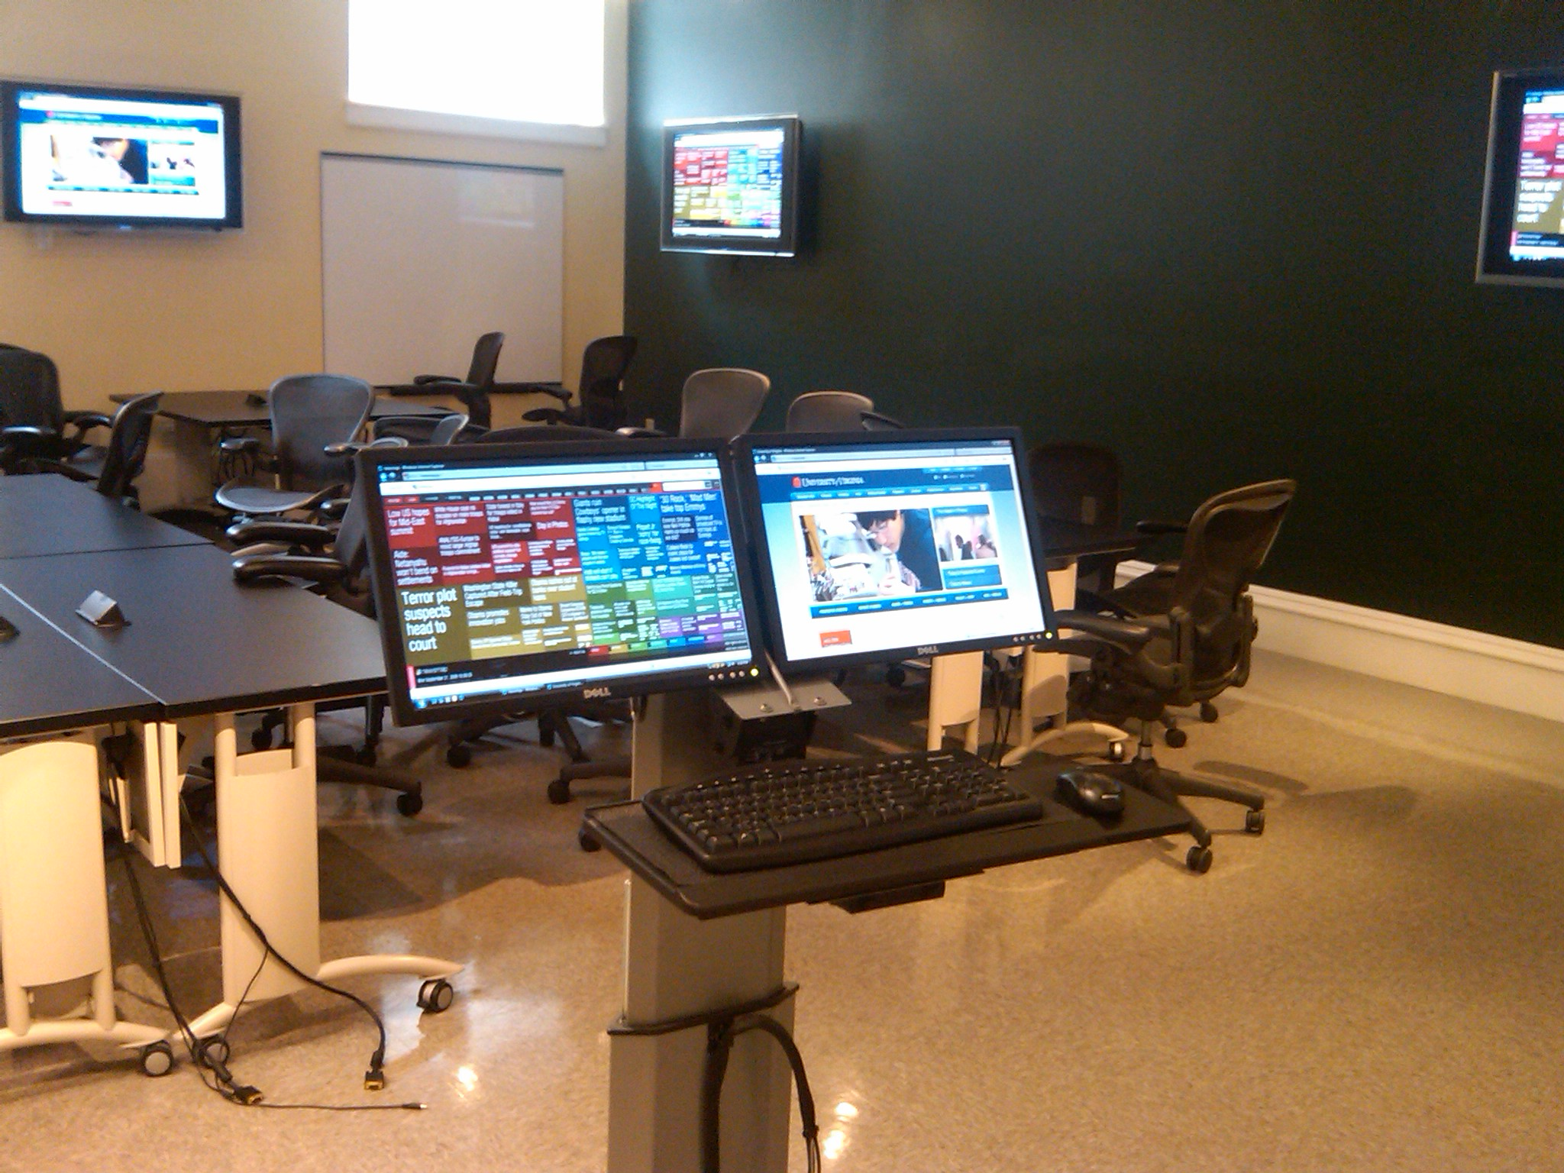
Emerging Technologies Lab
Flexible Lab Space
Emerging Technologies Lab

Slide 22
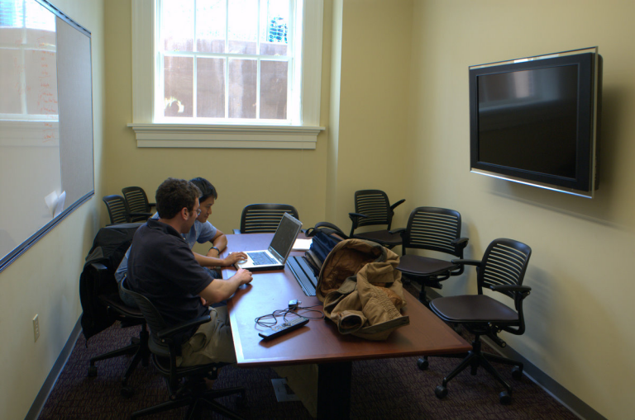
Group Study Rooms
Group Study Rooms
Notes:
46” Sony TV; laptop connection video, power, ethernet,, wireless
22

Slide 23
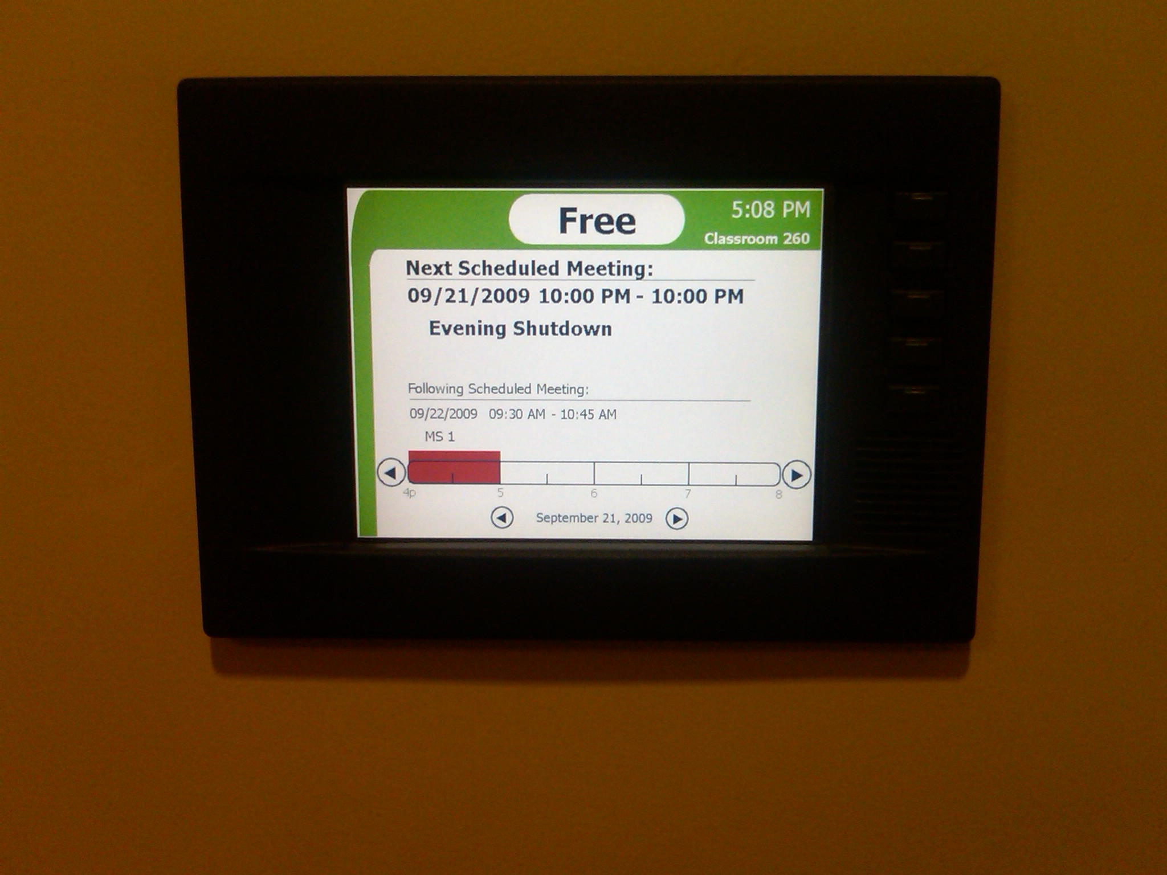
Room Scheduling Panel
Room Scheduling Panel

Slide 24
Lessons learned
Never too many group study rooms
Demand-based instructional space choices
Flat floor rooms provide the max flexibility
Demand-based technology choices (vtc)
Invest in infrastructure
Invest in core video and audio technologies (high quality image and sound replication)

Slide 25
Future Design Considerations
Classroom w/integrated group study rooms
Multipurpose group study rooms
Furniture tiers vs. constructed space
Designing spaces for both residential and distance education

Slide 26
Questions?
Gerald Starsia is the associate dean for administration at the McIntire School of Commerce (gs2t@comm.virginia.edu)
Bryan Lewis is the director of enterprise systems at the McIntire School of Commerce (brl6m@comm.virginia.edu)
For more information about the Rouss / Robertson Project (www.educause.edu/library/EQM0912)

