Slide 1

Executve Oversight &
Accountability
Dwight Fischer, Asst. Vice President & CIO
Dalhousie University
Halifax, Nova Scotia
Alternative Titles Considered...
  The Black Hole of IT
  Getting Administrators to Pay Attention
  The Overloaded and Overwhelmed IT Shop
  How to Control Runaway IT Costs?

Slide 2
Two Perspectives
Executives
  Need to
    be engaged
    assert leadership
    make decisions
    align IT with business
    ask questions
    question assumptions
    troubleshoot
    understand new tech means change management
    steer the process, sponsor the projects
    hold IT leaders accountable
IT Leadership
  Needs to
    align IT to org goals & objectives
    demonstrate project & portfolio management
    present at executive level
    educate the organization
    speak in lay terms
    synthesize concepts
    demonstrate good project management oversight
    hold self and IT organization accountable
Notes:
Venus & Mars

Slide 3
Agenda
Oversight of major IT projects
Cost containment
Alignment of IT with organizational goals
Managing the change process
Good decision making structure
Project portfolio management
Role of Executives and IT Leadership in strategic oversight!
This will be half presentation, half discussion

Slide 4
Presenter
Assistant Vice President & CIO at Dalhousie University
    Currently leading Web Overhaul project
    Managing the expectations and oversight of new exec team
Led major projects on three campuses of the University System of New Hampshire
    Keene State College
    University of New Hampshire
    Plymouth State University
Presenter and course instructor for project management in NERCOMP and U. of Phoenix
Notes:
Recent migration to Atlantic Canada

Slide 5
Project management is about managing change
New technologies introduce change…
    At the infrastructure level
    At the user level
    At the organizational level
Good organizations recognize this and put change management procedures in place around new technologies.

Slide 6
Project Portfolio Management
Developing good project charters
Project steering and sponsorship
Identifying projects
  Proposed, in queue, in progress, completed
Track resource allocation
Decision-making process
Communication

Slide 7
Project Portfolio Management
“Set of business processes that, when consistently applied, enables organizations to plan and control technology investments.” ECAR, 2006

Slide 8

How many view technology

Slide 9

The Real Cost of Technology

Slide 10
The Cost of IT
Direct Costs
Hardware
Applications
Middleware
Consulting Services
Training
Additional infrastructure
Indirect Costs
Time and effort
Opportunity cost
Goodwill and patience
Staff morale
User aggravation
TRUST
Ability to get people to engage in future projects

Slide 11
Message to Executives
IT serves the institution
You need to be engaged
Decisions need to be made
Do not be bamboozled by IT and jargon
Make your IT leader make you understand
There is no such thing as a one-time technology cost
Explore alternatives…outsource, contract, etc.

Slide 12
IT Leaders
Understand the priorities of your organization
Avoid letting technology set the course
Write and speak to the executive level
Understand that execs have a thousand other things on their plates. You have their attention for 15 minutes (on a good day)
A good Gantt chart is worth a thousand words
Notes:
Understand that many academic leaders have gotten to their role without an formal management training. They also play by very different rules in the academic governance model. What we are discussing here is different.

Slide 13
Containing Costs
Good project charters
  Who, what, why, when and where
Infuse project management methodology
Follow schedules and troubleshoot
Manage the portfolio of projects
Hold organizational leaders accountable
Hold vendors accountable
Use opportunities to inform campus constituents (tell ‘em, tell ‘em, tell ‘em…)

Slide 14
Risk Management
Risk
  Poor project priorities
  Too many projects, too few get completed
  Major projects without good management can cost institution thousands, if not millions
  Scope creep
  Culture of de-central authority challenges central decision-making
  Lack of accountability
  Demoralized staff
Notes:
Staff need to know there is clear scope, priorities, leadership, decision making, and sponsorship. If they know that is there, they will go to great lengths to make the project happen.

Slide 15
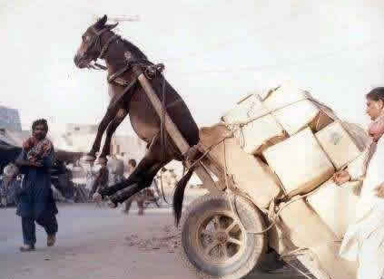
IT Overload

Slide 16
Decision Making
Develop rapid decision-making structure specifically for the project
  Project schedules, critical paths and business cycles all require ability to make decisions quickly
  This is not consensus or full-representation decision-making
  Gather & vet information, but make decisions in a timely, transparent way
  Allow teams to make decisions
  Document decisions
        Failure to make decisions are decisions in and of themselves…with consequences in cost

Slide 17
Prepare for Decisions
Concise, informative write-up
  What is the core issue?
  What is at stake?
  What are the costs?
    Human
    $$$, short- and long-term
    Other
  How will this impact other projects?
  What are the options?
  Why decision required now, or when?
  What if no decision is made?
  Who else needs to be present?

Slide 18
Support the Decision Making
Once you make decisions, stick to them
If you need to revisit them with new information, do so, but judiciously

Slide 19
Again…
“Set of business processes that, when consistently applied, enables organizations to plan and control technology investments.” ECAR, 2006

Slide 20
Questions
www.educause.edu/library /ERB0614
dwight.fischer@dal.ca
Copyright Dwight Fischer 2009. This work is the intellectual property of the author. Permission is granted for this material to be shared for non-commercial, educational purposes, provided that this copyright statement appears on the reproduced materials and notice is given that the copying is by permission of the author. To disseminate otherwise or to republish requires written permission from the author.

Slide 21
Additional slides not covered in presentation

Slide 22
Why Project Management?
Today’s complex environments require ongoing implementations
Project management is a method and mindset…a disciplined approach to managing chaos
Project management provides a framework for working amidst persistent change
Notes:
Business applications in an academic setting
Mulit million dollar business

Slide 23
Project Management is Change
Project methodology is really about managing change
  Change in current practices
  Developing new practices
  Getting people to change their behaviors
    How they do their work
    How they work together
    How they get the work of the project done
    Avoidance of paving the cowpaths
PM is a mindset, a discipline, that can help your organization increase effectiveness and put order to chaos

Slide 24
Highlights of Portfolio Management (ECAR 2006)
Investment
Communication
Accountability
Awareness

Slide 25
Proposing Projects
Establish process
  Application form
  Use project charters
  Assign resources on team to assist in development
    Process alone will weed some out
  Make sure process is documented, understood and adhered to

Slide 26
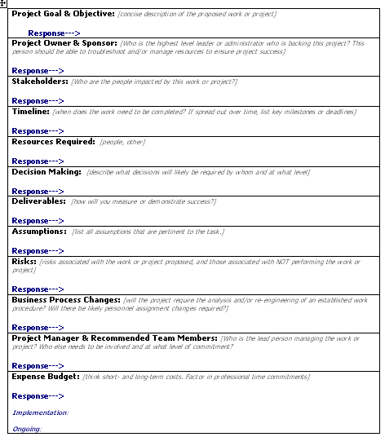
Project Charter
Handout
Who
What
Where
Why
When

Slide 27
Project Charter
Project Goal & Objective
Sponsor
Stakeholders
Timeline
Resources required
Deliverables
Decision making
Assumptions
Risks
Business process changes
Project manager
Project team
Budget
Signatures

Slide 28
Executive Oversight
Get right people at the table
  VPs
  CIO
  Key directors
Designees OK, but not the uninformed
The show must go on
  Driven by costs, by external pressures
  No decision is a decision
Team leadership required
Team needs to be well-defined and managed

Slide 29
Why Projects Fail
Failure to align project with organizational objectives
Poor scope
Unrealistic expectations
Lack of executive sponsorship
Inability to move beyond individual and personality conflicts
Politics
Lack of project management skills
Notes:
Pole the audience for examples
Big Dig
Project Fresh
What constitutes at successful project?
NOTE: I have removed all references to the word ‘business’ That seems a negative connotation to many, particularly in academic circles.
EXAMPLE of POOR SCOPE: Let’s put in a new card reader system

Slide 30
Why Projects Succeed!
Project Sponsorship at executive level
Good project charter
Avoidance of the scope creep
Strong project management
The right mix of team players
Good decision making structure
Good communication
Team members are working toward common goals
Good project portfolio management
Notes:
Good Charter includes good scope!
Put people in charge who have skills in leading and managing projects.

Slide 31
Portfolio Management:
Executive Level Requirement!
Key administrators need to understand their role in technology oversight
This is more about strategy than technology
Technology is expensive, short- and long-term
Portfolio management should be aligned with academic and enrollment strategy of your institution

Slide 32
Portfolio Management Concerns (ECAR 2006)
What work is being requested?
How is work assigned?
Standardize flow of requests
Do people understand the process?
What is value of proposed project to the organization?
What is the cost, short- and long-term, of support?
What will it take to do it right?
Who has to be involved?

Slide 33
Role of Sponsor
Communication
Leadership
Political support

Slide 34
Triple Constraint
Scope/quality
Resources
Risk?
Time
Notes:
Identify all your constraints
Develop these in the charter
Add a fourth constraint…RISK…use example of Y2k ….WHAT IS THE RISK OF NOT ACTING?
ARE some constraints more important than others
Y2K
Federal regulation
Upgrades
limited resources, but significant goals…Mojo College
Legal requirement

Slide 35
Playing to Different Players
The Hoverer
The Absenteeist
The Divergererer
The Overwhelmed
The Deer in Headlights
The Detailer
The Meddler
The Luddite

Slide 36
Presentation Skills
Identify individuals with communication skills and ability to translate complex technology in lay terms
Avoid PowerPoint overkill: simple is better
Identify and present the big-picture questions that need to be answered
Simple pictures say thousands of words

Slide 37
Assumptions
Opportunity to put it all out there
  Challenges facing the project
  Implications
  Organizational history
  Political implications
  Impact to traditional power
  Requirements of decision-making
Write down what cannot be said
  Keep it objective
Notes:
Share assumptions in Data Center move
in Library move
In ERP implementation

Slide 38
Assumptions (Example)
See example project charter in folder

Slide 39
Decision-making process
Types of decisions
  Urgent
  Transformative
  Priorities
  Personnel assignments
  Major costs

Slide 40
Structure Decisions at Meeting
Make sure meetings are well led
Agenda is clear
  Save the FYI, you can always distribute that otherwise
  Your time with execs needs to be tight
  1-3 issues max
  Make sure timeline is clear

Slide 41
Selecting Project Managers

Slide 42

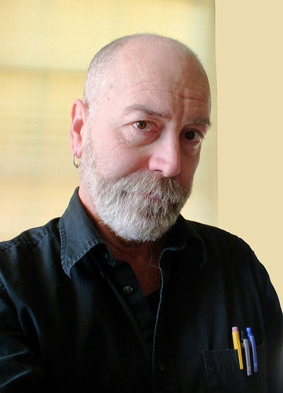

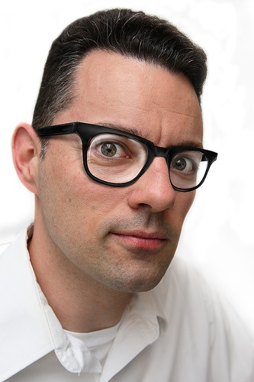


Your real project managers

