Slide 1
Pervasive Mobility
Jim Trietsch
Chief Operations Planning Officer
Abilene Christian University

Slide 2

Copyright, James W. Trietsch, 2009. This work is the intellectual property of the author. Permission is granted for this material to be shared for non-commercial, educational purposes, provided that this copyright statement appears on the reproduced materials and notice is given that the copying is by permission of the author. To disseminate otherwise or to republish requires written permission from the author.

Slide 3
The Promise

Slide 4
ACU at a Glance
Abilene, TX
Private, masters level
4800 students from all states and 60 countries
200 faculty members
14 online masters programs

Slide 5
Timeline
January 2007 – iPhone announced
June 2007 – Apple executive briefing
July 2007 – first iPhones at ACU
September 2007 – faculty research proposals
February 2008 – ACU announcement
August 2008 – Freshmen receive iPhones or iPod Touches
February 2009 – ConnectEd summit – 412 attendees representing 144 organizations

Slide 6
Quick Facts
All incoming freshmen had a choice of iPhone or iPod Touch
Rollout weekend – 615 iPhones, 342 iPod Touches
28 AT&T, 7 Apple, 70 ACU employees
30 min/phone to activate
100% signed agreement to pay full retail if devices were lost/stolen. 90% later thought it was “ridiculous”

Slide 7
Quick Facts
12 reported that if the iPhone or iPod Touch falls into a small round porcelain or large square fiberglass container of water, it does not float!
181% increase in wireless access points added in residence halls
1468 wireless devices registered
Hart Auditorium – 75 students vs. 300

Slide 8
Quick Facts
103 teachers reported using the attendance application to take roll
1001 – average daily user sessions in Fall semester
135 (98%) faculty members attended classes
800 mentions in newspapers, magazine, publications, blogs, and broadcast media.

Slide 9
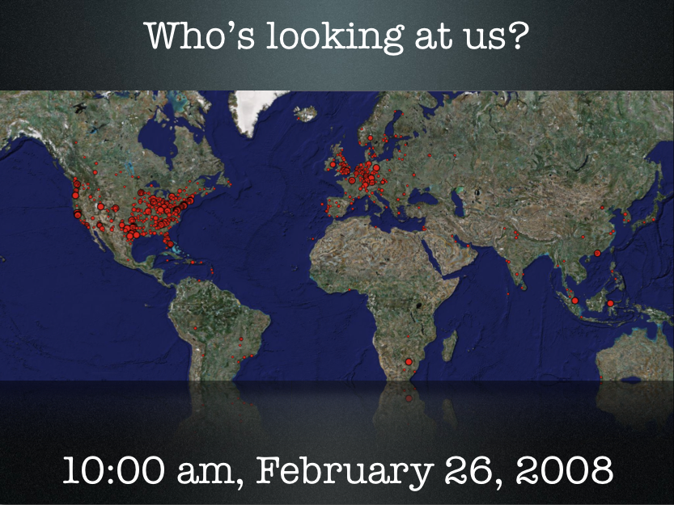

Slide 10

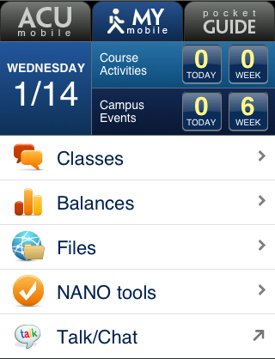
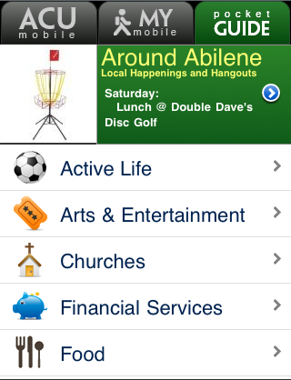
Connecting to ACU Connecting to learning Connecting to Abilene
Building tools: m.acu.edu framework

Slide 11
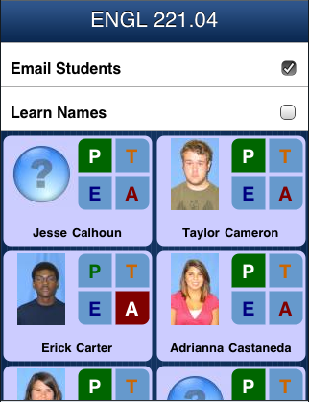
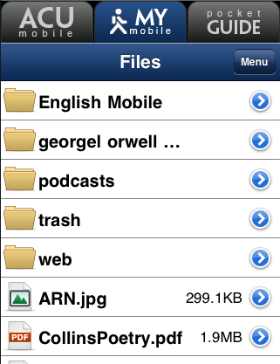
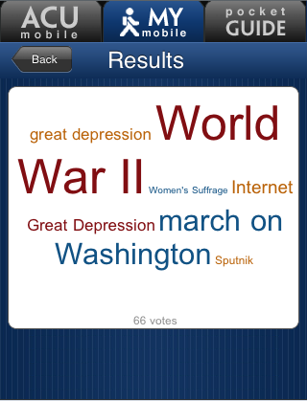
103 faculty for 230 classes Learning materials anywhere 49 faculty for 422 polls
Tools for connecting, teaching, learning

Slide 12
Survey of 177 FR and Upperclassmen

Slide 14
What did you think?
Your input is important to us!
Click on “Evaluate This Session” on the Enterprise 2009 program page.

