Slide 1
Controlling the Higher Ed Enterprise
(for Less Than $5B)
Brad Wheeler
Vice President for IT and CIO, Dean, & Professor
Indiana University
© Brad Wheeler, Creative Commons Attribution 3.0

Slide 2
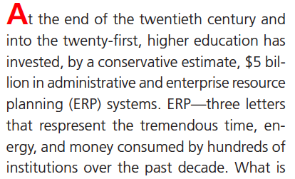

“The Promise and Performance for Enterprise Systems for H.E.”
Kvavik & Katz, ECAR, 2002

Slide 3
Why?
42% Replace Aging Systems
17% Improve Services
13% Integrate the Enterprise
“The Promise and Performance for Enterprise Systems for H.E.”
Kvavik & Katz, ECAR, 2002

Slide 4
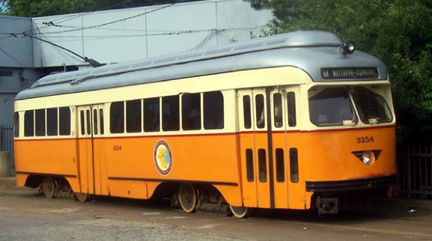

“Leading an IT Enterprise that is out of Control” Greg Jackson
1) The Realm of IT Control is Changing…
Servers
To the Cloud
Networks
To the Carriers
Devices
To Personal
2) Higher Ed Must Focus on Solving the Right Strategic Problems

Slide 5
The Economic Context for Higher Ed has Changed
$5 Billion
for ERP
$??
History
Future
1995
2020
2010

Slide 6
As the Internet drives down coordination and distribution costs at an unprecedented scale worldwide, colleges and universities have the deep cultural values and scale to change the game to our advantage.
The question is….do we have the will to do so?

Slide 7
Changing the Game

Slide 8
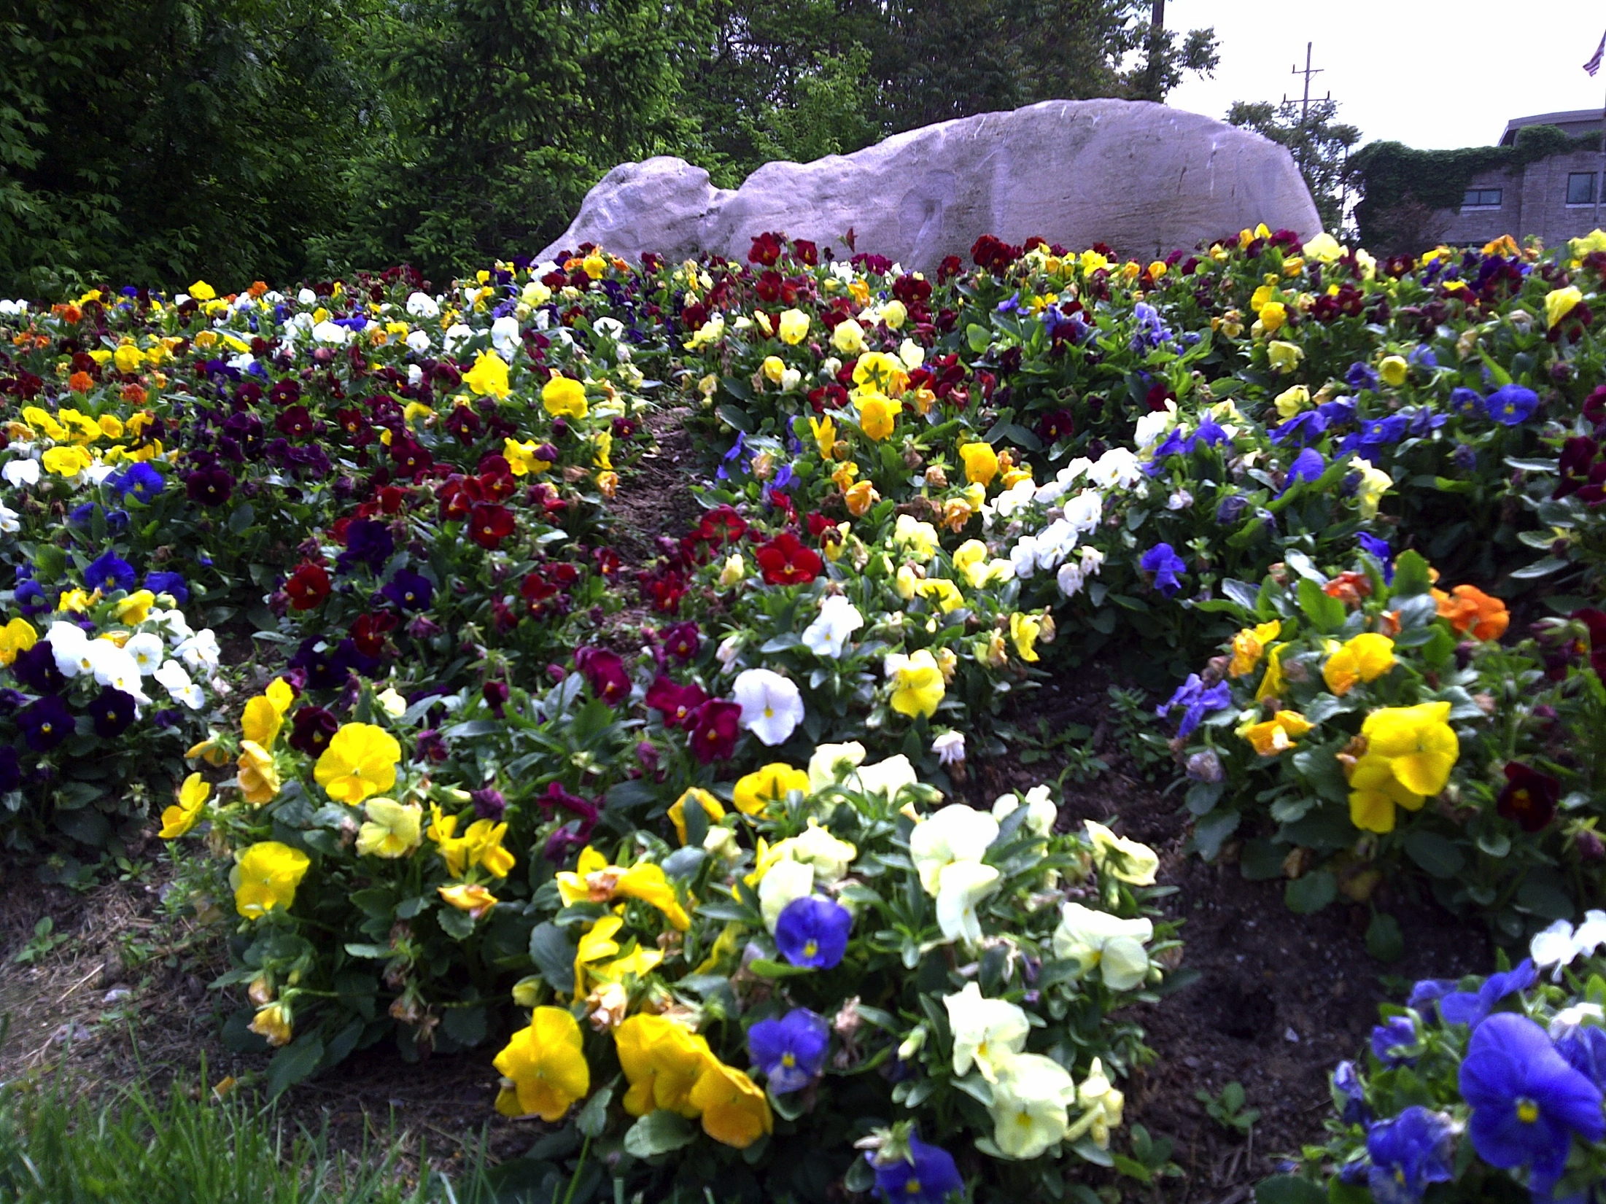

Slide 9


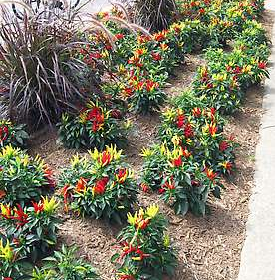
“Putting the BLOOM in Bloomington”
The Herald-Times, July 29, 2007
H-T: What’s this I hear about the nursery? Are all the flowers and plants on campus grown there?
Emily Thickstun | Herald-Times
Emily Thickstun | Herald-Times
Emily Thickstun | Herald-Times

Slide 10
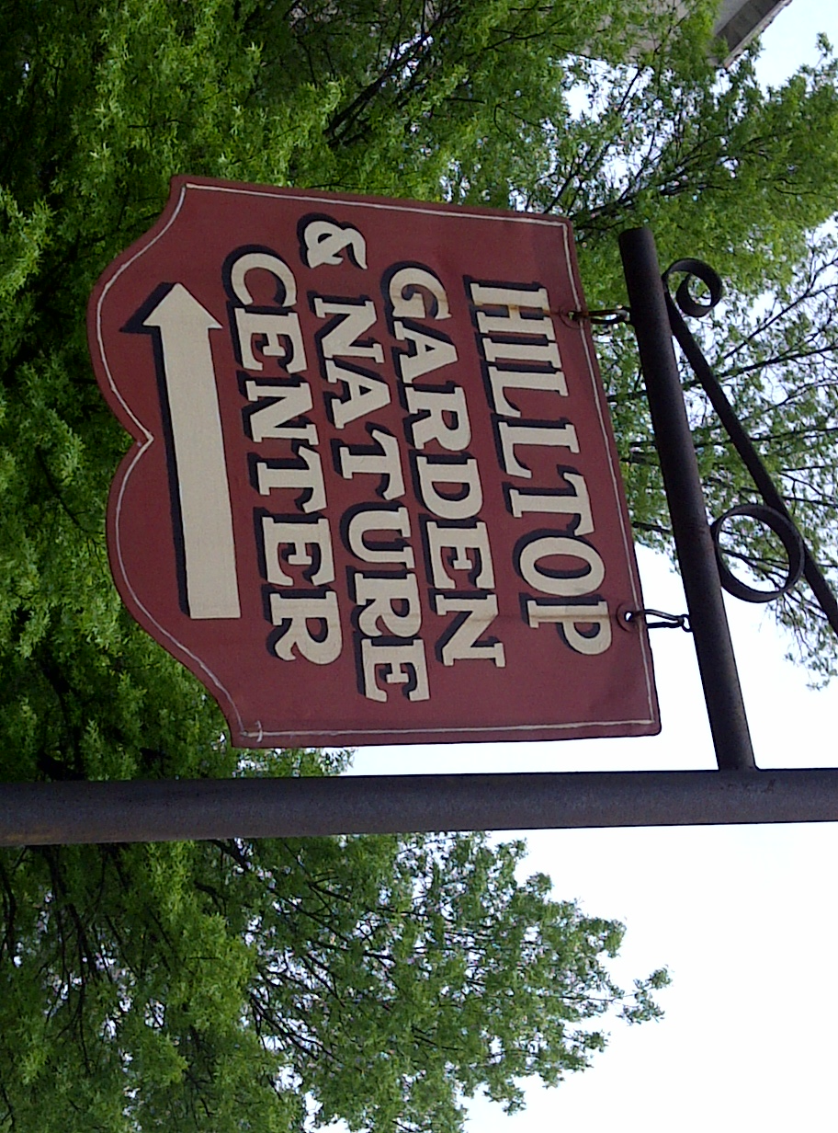

Slide 11
“We think the flowers we grow in our four greenhouses are better than any you can purchase. We plant in a 4-inch pot and in some cases even larger planters. So we already have a very nice plant when it hits the bed. We are using composted soil that really gives the plant a good growing media.
We are using “layers” of plants that as they grow really give layers of nice color in addition to nice height. Remember that these are annual flowers, which are all planted now so there is nothing in the greenhouses. We do grow approximately 10,000 mums which are lined out within the nursery. The best time to see all the color in the greenhouses is late April.”

Slide 12

Market-based Solution to Achieve a Goal

Slide 13
In the Game…Scale Matters

Slide 14
Problem:
Higher Education lacks a suitable structural capacity for [agile] collaborative action …at scale.
Answer:
Higher Ed must become more sophisticated in choosing our (1) games for aggregation and (2) means for self-coordinating industry resources.

Slide 15

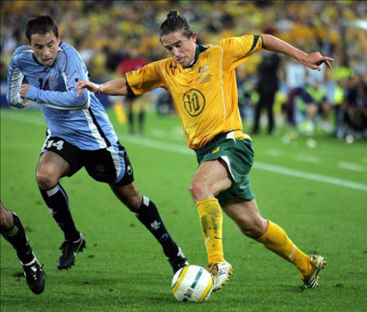
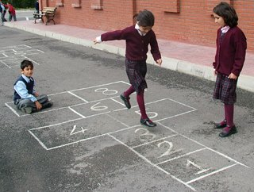
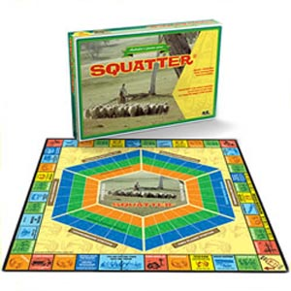

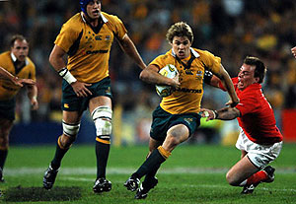
Games are Fun…

Slide 16
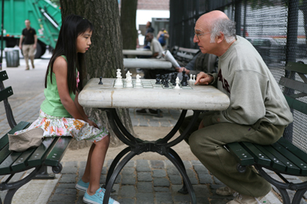
Games have Participants
Participants vary in Skill
http://www.cbc.ca/gfx/images/arts/photos/2009/06/25/whatever-works-chess-392.jpg

Slide 17
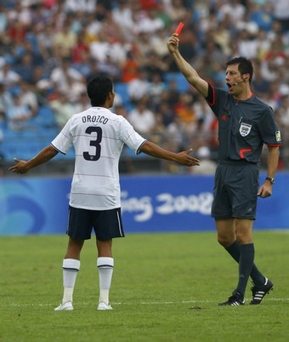
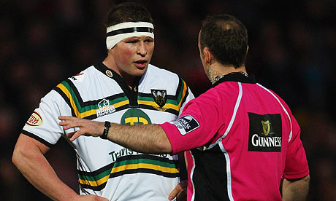



Games have Rules…

Slide 18
We Don’t Like It When People Don’t Play by the Rules of the Game
^
Spirit of the

Slide 19
And…

Slide 20
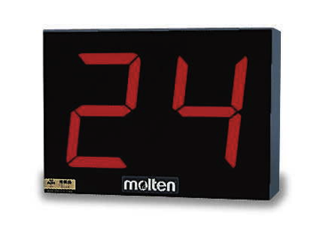
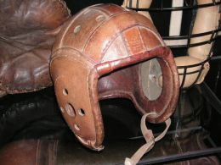
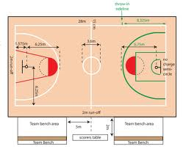

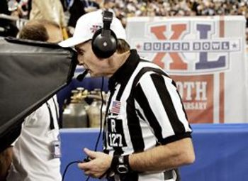
the Rules Sometimes Change…
http://www.dsr.wa.gov.au/basketballdimensions

Slide 21
So…

Slide 22
What are the Rules of the Higher Ed IT Game?

Slide 23
Rule #1: Research and Education Become More Technologically Intensive
Higher Ed Must Play. No Passes Allowed

Slide 24
Rule #2:
IT Imposes Inescapable
Costs
Requirements
Marketing
Implementation
Maintenance
Design
Evaluation
Integration
Upgrades
Development
Acquisition
Training
(Repeat)
Testing
Support

Slide 25
Sources $
Uses $
DIRECT
Investment in
Research & Education
Government
Tuition
Grants
Philanthropy
INDIRECT
+ Enabling
Other?
IT
- Leaks

Slide 26
Rule #3:
IT is a Game of Scale
Rewards (profits/savings) accrue to scale
Winners
Losers

Slide 27
Therefore
#1 HE is increasingly IT dependent
#2 IT cost $ (our job)
#3 Scale is advantageous
Question:
How does Higher Ed get Scale?
Answer: Via Aggregation

Slide 28

Aggregator Needed
What is the game for Aggregation? How can H.E. play?

Slide 29
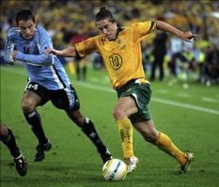
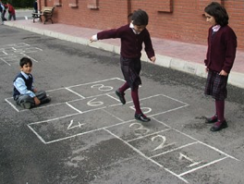

Which Aggregator Game to Play?
How to Achieve Scale?
Market of sellers and buyers (Commercial)?
  Products, offers, terms, roles, contracts
Virtual Hierarchy (Center of Excellence)?
  Institution is aggregator/service provider
Consortium?
  Shared governance for service provision

Slide 30

Are the Rules the Same for Each Game?
No…

Slide 31
A) The Game of Buyers and Sellers…The Market

Slide 32
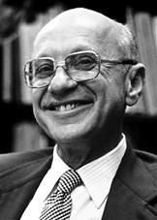
“…there is one and only one social responsibility of business–to use it resources and engage in activities designed to increase its profits so long as it stays within the rules of the game, which is to say, engages in open and free competition without deception or fraud."
Milton Friedman
Nobel Laureate
The New York Times Magazine, September 13, 1970

Slide 33

The Commercial Model Plays Shrewdly
“Greed is Good”
Winners (usually) seek and achieve scale

Slide 34
Scholarly Communications
Example: The Market Game Over 20 Years

Slide 36
Notes:
This graph shows that even though the price of expenditures skyrocketed, we kept buying. Good example of co-dependence.

Slide 37
Supply Side Aggregates…
Buy Side Fragments…
Pricing Outcome…?
100% Predictable
Market Game Conclusion:

Slide 38
Commercial Supply Side is not the Problem
In the market game…

Slide 39
Market Game is a Values Conflict
By the Rules of the Game:
It is the responsibility of commercial firms is to transfer our money to their shareholders.
Our responsibility is to efficiently procure the services while minimizing our life-cycle costs.
How to affect the Rules of the Game?

Slide 40
http://www.cbc.ca/gfx/images/arts/photos/2009/06/25/whatever-works-chess-392.jpg

Slide 41
B) The “Hierarchy” Game:
The Higher Ed Store
In Corporate Speak:
A Center of Excellence

Slide 42
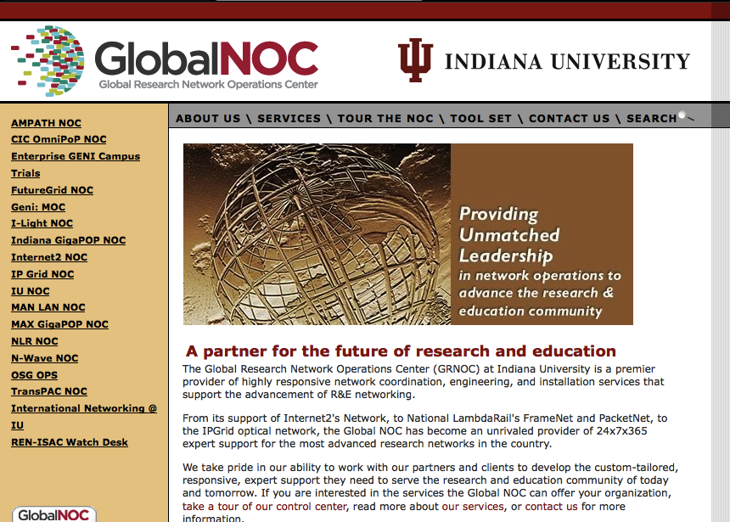

Slide 43
Hierarchy Game can Match Values
Higher Ed Institution(s) is/are the provider(s)
Money (mostly) stays in higher ed
Risks
How to affect the Rules of the Game?

Slide 44
C) The Consortium Game:
Formal coalitions, collaborations, partnerships

Slide 45
Higher Ed Collaboration
2004
Can higher ed capture economies of scale in software creation and maintenance? The $100 Million question…
Lifecycle
System
Costs/
Effectiveness
Solo
Capturing Industry Leverage:
Learning how to partner
Synchronizing institutional
investments
IT architecture discipline
Creating effective consortia
Common licensing!!
Functional
Partnership
Dysfunctional
Partnership
?
Number Participating

Slide 46
“Collaboration is not the same as
cooperation. Collaboration requires
alignment around a common goal.
Collaboration is about doing
something together. Collaboration
only lasts as long as the alignment
around common purpose lasts.”
James Hilton, U. of Virginia

Slide 47
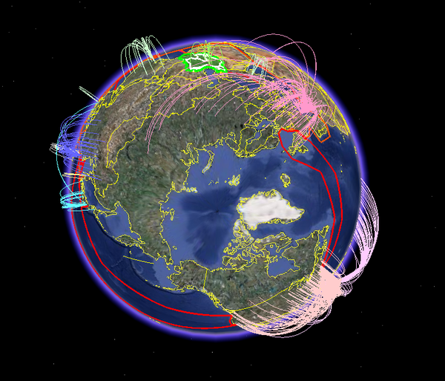


Collaboration at Scale is Possible
The Internet Reduces Coordination Costs

Slide 48
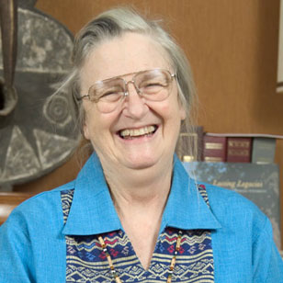
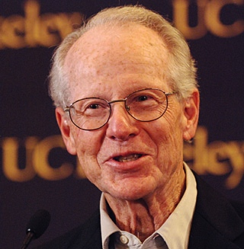
2009 Nobel Prize in Economics
“…challenged the conventional wisdom that common property is poorly managed and should be either regulated by central authorities or privatized.”
Elinor Ostrom
“…focuses on the problem of regulating transactions that are not covered by detailed contracts or legal rules. He has argued that markets and firms (hierarchies) should be seen as alternative governance structures that differ in how they resolve conflicts of interest.”
Oliver Williamson

Slide 49







Meta-university Collaborations
(Just to name a few…)
c
c
c
c
c
PUBLIC
KNOWLEDGE
PROJECT
Books
Journals
Textbooks
Learning
Administrative
Very real lessons and insights from the past decade.
Rules of the game created FOR higher education’s values

Slide 50

Collaboration at Scale Example

Slide 51
Kuali Member Institutions
1. Australian National University
2. Boston University
3. Boston College
4. Bradley University
5. Brock University
6. Brown University
7. California State University – Office of the Chancellor
8. Carnegie Mellon University
9. Colorado State University
10. Cornell University
11. Duke University
12. Indiana University
13. Indiana University Foundation
14. Iowa State University
15. Lehigh University
16. Marist College
17. Massachusetts Institute of Technology
18. Michigan State University
19. NACUBO
20. Naval Postgraduate School
21. North Carolina State University
22. North West University (South Africa)
23. Ontario College of Art and Design
24. Pennsylvania State University
25. Research Foundation of the City of New York
26. San Joaquin Delta Community College
27. The University of Arizona
28. Triangle Research Libraries Network
29. Tufts University
30. Tulane University
31. University of British Columbia
32. University of California- President's Office
33. University of California-Berkeley
34. University of California-Davis
35. University of California-Irvine
36. University of California-Santa Barbara
37. University of California-San Diego
38. University of Chicago
39. University of Connecticut
40. University of Florida
41. University of Illinois
42. University of Hawaii
43. University of Maryland
44. University of Pennsylvania
45. University of Southern California
46. University of Toronto
47. University of Virginia
48. University of Washington
49. West Virginia University

Slide 52
Community Ecosystem
Open Licensing
Software
Producers
Software
Consumers
Commercial
Support

Slide 53
Typical Project Stages
Discussion
Incubation
Build
Enhance
What?
Investors
Board
Sustain
Who?
Functional
Council
Scope
Common
Need
Technical
Team
Plan
Integrate
When?
Timeline
Expand?

Slide 54
Kuali Secret Sauce?... Values
Valued
Collaboration
(participate)
Lightweight
Coordination
(few immutables)
Severable
Property
(walkaway)

Slide 55










Kuali Commercial Affiliates
Notes:
We have two new Commercial Affiliates: Sciquest and VivanTech. Sciquest brings expertise in eprocurement and plan on assisting the KFS project with creating linkages between KFS and shopping carts within Sciquest. VivanTech brings expertise in developing custom financial information systems, and has been assisting some of the Kuali partners in their implementation planning for KFS. We welcome these 2 new CA’s.

Slide 56
Changing the Game…?
…Control the Rules!

Slide 57
Which Game? What Rules?
Market of sellers and buyers (Commercial)
  Products, offers, terms, roles, contracts
Virtual Hierarchy (Center of Excellence)
  Institution is aggregator/service provider
Consortium
  Shared governance for service provision

Slide 58
Assessing the Aggregation Games
GAME | Values | Control/Power | Execution
Market | Conflict | Sellers | Proven
Hierarchy | Aligned… but… | Institution | Mixed
Consortium | Aligned Coopetition | Members | Fledgling

Slide 59

Changing the Game…?
Behavior Changes Required

Slide 60
1) Above-campus Mindset
Local optimization is
suboptimization

Slide 61

Above Campus Services
Shaping the Promise of Cloud Computing for Higher Education by Brad Wheeler and Shelton Waggener
Illustration by Randy Lyhus ©2009
EDUCAUSE Review, Nov/Dec 2009

Slide 62
2) Solutions as Paths
Not Just Products
“Some of us have seen fortunes slip through our hands as we learned how to implement these kinds of systems in universities;”
MIT, Cambridge, February 2000.
“Mitigating the Risks of Big Systems”
NACUBO Business Officer Magazine
July-August 2007

Slide 63


Slide 64

Licensing Cost or Price Models?
$$$
$$
Licensing & Support Costs
$
Number of Students, Faculty, Staff, etc.

Slide 65
3) End ‘Murdered by the Matrix’
Procurement Dance
 | Product 1 | Product 2 | Product 3
Feature X | -1 | +2 | -2.4723
Feature Y | +2.7 | -.5 | +2.1111
Feature Z | N/A | +1 | +2.4722
 | 1.7 | 2.5 | +2.111

Slide 66
Asserting An Offer to Buy
Request for Proposals
New Financial System Needed
Qualified Offers Must Not Exceed Following Terms:
Fully-paid up, unmetered license, perpetual use
Less than $100,000, paid upon go-live.
10 Year maintenance/support agreement
Not to exceed $50,000 per year for 10 years…
Up to 2,000 consulting hours @ $130 per
Additional 1,000 hours @ $100
Additional 1,000 hours @ $60 per

Slide 67
Conclusion:
Problem:
Higher Education lacks a suitable structural capacity for [agile] collaborative action …at scale.
Answer:
Higher Ed must become more sophisticated in choosing our (1) games for aggregation and (2) means for self-coordinating industry resources.

Slide 69
Controlling the Higher Ed Enterprise
(for Less Than $5B)
Brad Wheeler
Vice President for IT and CIO, Dean, & Professor
Indiana University
© Brad Wheeler, Creative Commons Attribution 3.0

Slide 70
Student
$
M1…M2…M3
Rice
$
R1 .1 .2
R2
Research
$
R1
R2x..
R3
Financial
$
R1
R2
R3
R4 .1 .2 .3
2004 2005 2006 2007 2008 2009 2010 2011 2012

Slide 71
People
$
R1
Library
$
R1
R2
Ready (SaaS)
$
R1
R2
Student
$
M1…M2…M3
Rice
$
R1 .1 .2
R2
Research
$
R1
R2x..
R3
Financial
$
R1
R2
R3
R4 ….1 .2
2004 2005 2006 2007 2008 2009 2010 2011 2012

Slide 72
Fair Questions…
(Circa 2004)

Slide 73
1. Can disparate institutions agree on software design?
 Yes

Slide 74
2. Can distributed development teams code enterprise scale quality software?
 Yes

Slide 75
3. What about commercial support?


Slide 76
4. Will it work?
 Yes

Slide 77
5. Will it really cost less to implement and sustain?
 Yes….(and soon to be) Yes

Slide 78
6. Is the community model extensible to other needs?
 Definitely Yes

Slide 79
… Another Question

Slide 80
How many faculty lines and scholarships did that decision cost you over a community source path?
?

Slide 81
Kuali Foundation & Projects
By GAAP Accounting:
  $800K in annual cash dues to foundation
  $11M in total annual revenue (project MOUs)
  $28M in foundation net assets (project MOUs)
People:
5 foundation staff
1,040 on Kuali All Hands list
591 on project boards, councils, committees
12 Commercial Affiliates, 50 Institutions

