Slide 1


A Path to the Community Cloud
Making Above Campuses Services a Reality
Elizabeth Van Gordon – vgordon@iu.edu
Dennis Cromwell – dcromwel@iu.edu
Rob Lowden – rlowden@iu.edu
© Copyright Van Gordon, Cromwell, Lowden, 2011. This work is the intellectual property of the authors. Permission is granted for this material to be shared for non-commercial, educational purposes, provided that this copyright statement appears on the reproduced materials and notice is given that the copying is by permission of authors. To disseminate otherwise or to republish requires written permission from one of the authors.

Slide 2
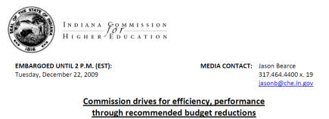
Indiana Commission for
Higher Education
Operating Efficiency Guidelines
Streamline administrative structure and personnel functions, including the elimination of redundant or unnecessary positions.
Expand joint purchasing agreements with other Indiana institutions, particularly in the areas of health insurance and energy.
Review the institution’s contribution to employee retirement and health care plans, and seek alignment with the private sector.
Explore options for consolidating and/or outsourcing all back‐office and non‐academic operations, including payroll, purchasing, marketing and technology.
Consider partnerships with non‐higher education entities, including the state, K‐12 school districts, and city/county governments, to achieve economies of scale and eliminate duplication.

Slide 3

“Indiana University’s core information technology plays an absolutely essential part in the university’s education and research mission”
Michael A. McRobbie
Indiana University President
Michael A. McRobbie
Indiana University President

Slide 4
“…Moreover, through IU’s management of the I-Light
Optical Fiber Network, the new Data Center is as valuable to every IU campus as it is to Bloomington. It hosts IU’s internal ‘Cloud’ of storage and virtualized servers that are available on-demand as needed. This means that schools and departments can reclaim much-needed physical space that was once devoted to departmental and research systems...”
Michael A. McRobbie
Indiana University President

Slide 5

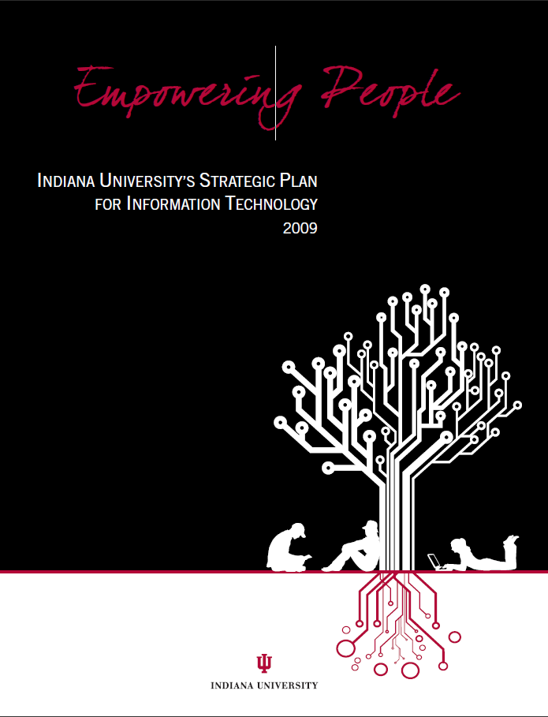
Bradley C. Wheeler
Vice President for Information Technology and CIO
Action 7: IU should maintain and refresh its IT infrastructure by consolidating enterprise-scale (multi-campus) services for software systems, server and data hosting, networks, backup, messaging, support services, and training, while also enabling innovative departmental-scale technology services provided at the edge.

Slide 6
Making the
Business Case
Hardware
  On demand expansion
  Reduced downtime during maintenance
Staffing
Facility
  Security
  Fire safety
  Maintenance
  Utilities
Business continuity

Slide 7
CDW Video

Slide 8
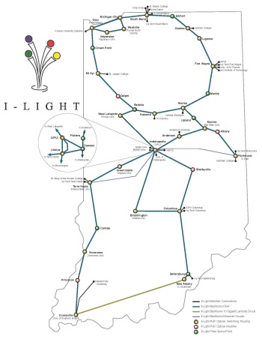
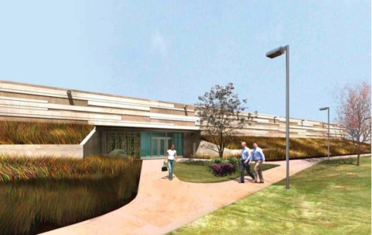
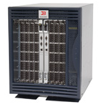
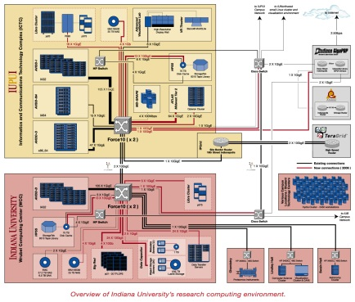
Technical Requirements
Robust data center
High capacity network
Consolidated storage
and virtual servers
Excellent DR capability

Slide 9
Technical Requirements
Robust data center
High capacity network
Robust data center
Consolidated storage
and virtual servers
Excellent DR capability

Slide 10
Technical Requirements
Robust data center
High capacity network
Consolidated storage
and virtual servers
Excellent DR capability
High capacity network

Slide 11
Technical Requirements
Robust data center
High capacity network
Consolidated storage
and virtual servers
Excellent DR capability
Excellent DR capability

Slide 12
Technical Requirements
Robust data center
High capacity network
Consolidated storage
and virtual servers
Excellent DR capability
Consolidated storage
and virtual servers

Slide 13
Technical Requirements
Security
Identity Management
Leveraged services
Accounting
Customer facing interface

Slide 14
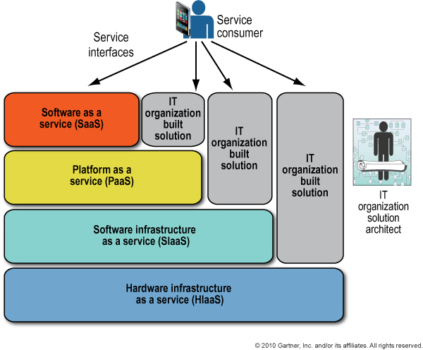
Review of type of
Cloud Services
Notes:
Infrastructure as a Service (IaaS)
Hardware IaaS
Software IaaS
Platform as a Service (PaaS)
Software as a Service (SaaS)
A very traditional look at cloud computing. All of these models have value. The virtualized data center is primarily looking at the bottom layers of this stack. They key is that it enables the top layers of the stack.

Slide 15
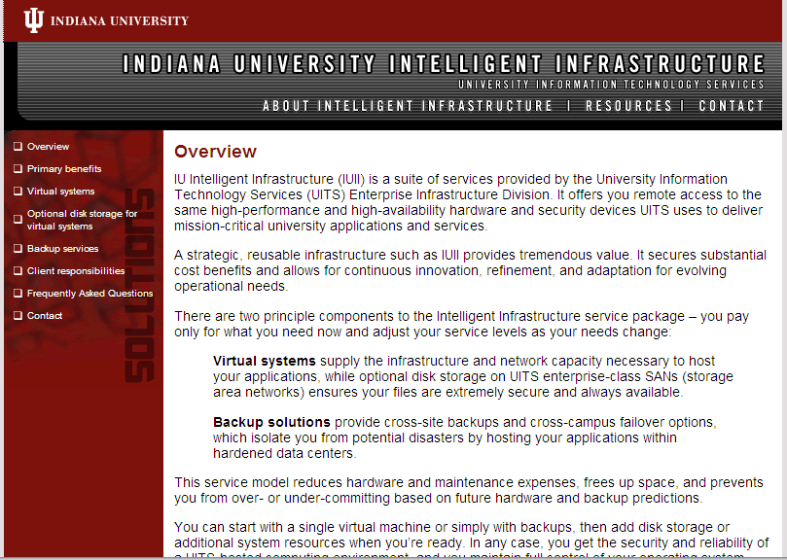
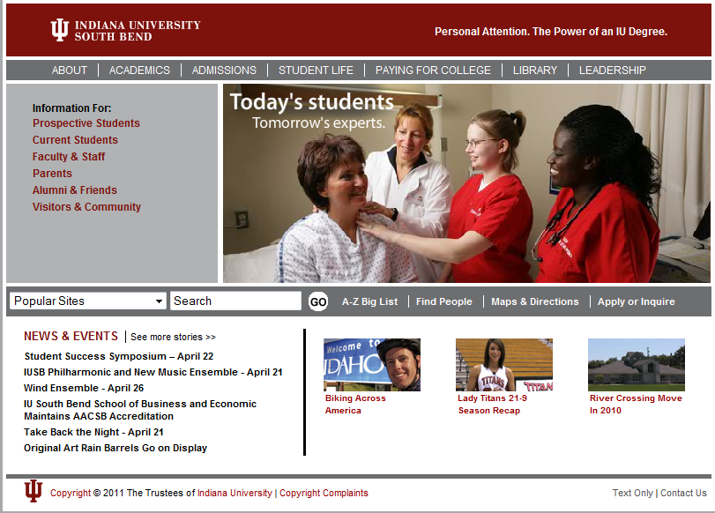
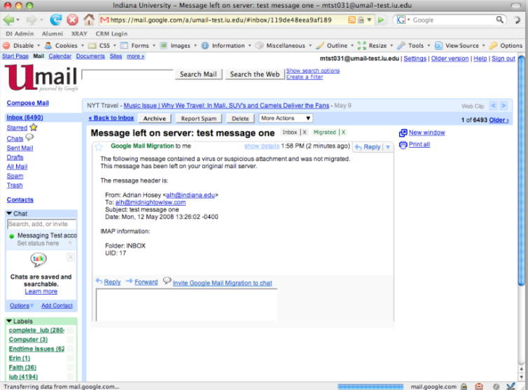
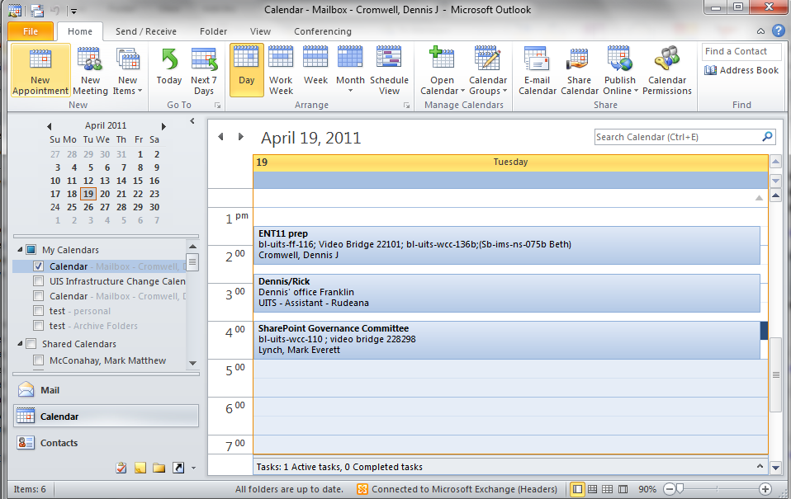
Examples of Services
IaaS
PaaS
SaaS
SaaS

Slide 16
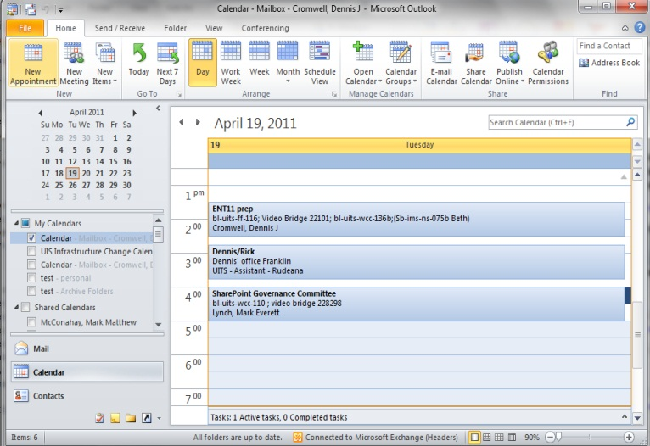
Examples of Services
IaaS
PaaS
IaaS
SaaS
SaaS

Slide 17
Examples of Services
IaaS
PaaS
PaaS
SaaS
SaaS

Slide 18
Examples of Services
IaaS
PaaS
SaaS
SaaS
SaaS

Slide 19
Examples of Services
IaaS
PaaS
SaaS
SaaS
SaaS

Slide 20

Barriers
Budgeting in higher ed does not always look at true TCO
Expenses
Electricity Costs
Building Costs
How much is space worth?
Saving a fraction of an FTE is not really a savings
CapEx vs. OpEx
Notes:
Budget -> Where is the budget, and where are the expenses
Staff depth (Small shops may only have a single jack of all trades and not true technical depth / redundancy)

Slide 21

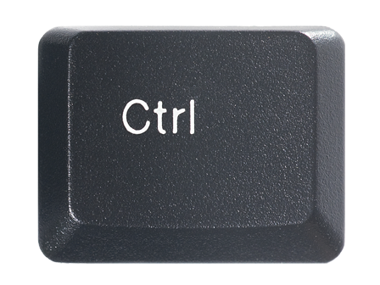
Cultural Barriers
Control is a Perception and Trust is Hard
vs.
Notes:
Sometimes there are valid reasons a unit does not want to give up “control”
Generally the level of control is not an real issue, but a perceived one.
The issue is really one of trust

Slide 22
New Business Models
New customer service and marketing models
Dealing with geographic distance and multiple time zones
Defining service level expectations

Slide 23
A Path to the Community Cloud
Making Above Campuses Services a Reality
Elizabeth Van Gordon – vgordon@iu.edu
Dennis Cromwell – dcromwel@iu.edu
Rob Lowden – rlowden@iu.edu
© Copyright Van Gordon, Cromwell, Lowden, 2011. This work is the intellectual property of the authors. Permission is granted for this material to be shared for non-commercial, educational purposes, provided that this copyright statement appears on the reproduced materials and notice is given that the copying is by permission of authors. To disseminate otherwise or to republish requires written permission from one of the authors.

