Slide 1
Effective Implementation of IT Governance: From Top to Bottom
Terry Nikkel / Janice El-Bayoumi
University of New Brunswick
Lyne Bouchard
University of Sherbrooke
May 2012
Copyright Terry Nikkel, Janice El-Bayoumi, Lyne Bouchard, 2012. This work is the intellectual property of the authors. Permission is granted for this material to be shared for non-commercial, educational purposes, provided that this copyright statement appears on the reproduced materials and notice is given that the copying is by permission of the authors. To disseminate otherwise or to republish requires written permission from the author.

Slide 2
demystifying COBIT: the UNB experience
Terry Nikkel / Janice El-Bayoumi
University of New Brunswick

Slide 3
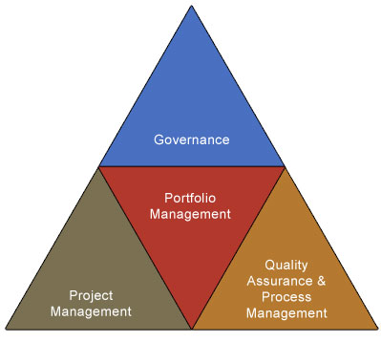
UNB’s IT Framework

Slide 4

Practical USE of COBIT for process Improvement
Notes:
Context: - no image
No formal l experience in Quality Assurance or Process Management
No previous QA or Process Mgt positions at UNB, or at peer institutions throughout the region
Lengthy IT experience including 10 years as Director of Client Services responsible for all customer facing services – staff of about 30, in this and other roles led numerous process and quality improvement initiatives
Received training in COBIT IT Governance early in position – provided theory, not practical
Currently approaching 2nd year in the position
What is a process: - mosaic image
Confusion with policy, procedures and similar terms:
Definition: A collection of related, structured policies, standards, procedures, guidelines, best practices, templates, activities or tasks that produce a specific service, product or goal

Slide 5
COBIT OvervIEW
Business Goals
IT Goals
IT Processes
Process Objectives
Objective Practices
Practices Value and Risk
Notes:
COBIT Processes (version 4):
34 Process covering all aspects of IT
Each process can be evaluated in a 6 tier maturity model running from Non-existent to optimized – examples: Define the information architecture, Manage changes, Ensure continuous services, Monitor and evaluate IT performance, Provide IT governance
Each processes includes objectives and each objective includes practices needed to meet objective (COBIT Control Practices)
Processes also identify IT goal supported – risk and value drivers – very useful for managing up (making the case for improvement) and managing down (connecting the dots for people affected)
Why improve processes?
COBIT tells you why by identifying value and risk drivers for each process as well as the IT goals each process supports
Organization improvement in the following areas: Effectiveness, Efficiency, Confidentiality, Integrity, Availability, Compliance, Reliability

Slide 6
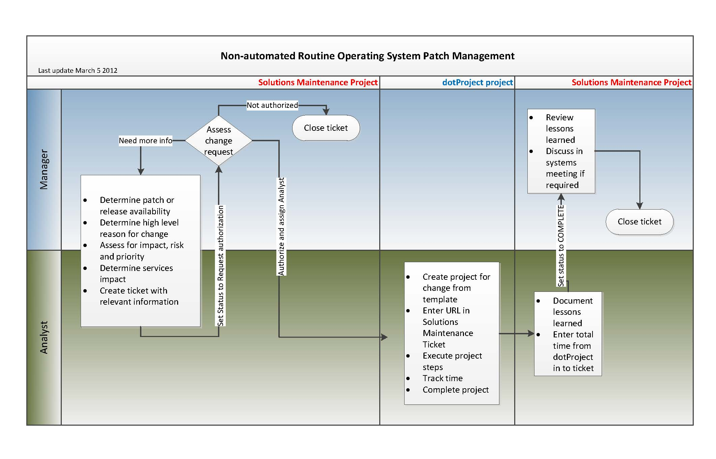
Example: AI6 Manage Change
Supports 4 IT Goals
Contains 6 Objectives
1 Objective: Assessment, prioritization, authorization
6 Value and Risk Drivers
4 Practices
Notes:
Example using 1 process: - to illustrate the various parts – will also use Change Management as an example throughout
4 IT Goals supported
Define how business functional and control requirements are translated into effective and efficient operation
Reduce solution and services defects and work
Ensure minimum business impact in the event of an IT service disruption or change
Maintain the integrity of information and processing infrastructure
6 Objectives
Change standards and procedures
Impact assessment, prioritization and authorization
Emergency changes
Change status tracking and reporting
Change closure and documentation
Why: Drivers/Risks related to impact assessment, authorization, prioritization objective
Efficient and effective assessment
Formally defined change impact expectations based on business risk and performance measurement
Consistent change procedure
Reduction in unintended side effects
Reduction in adverse effects on infrastructure capacity and performance
Changes prioritized
How: Practices related to impact assessment, prioritization objective
Create method to request changes
Ensure all changes go through change request method
Categorize requested changes (Infrastructure, OS, networks etc.)
Prioritize changes – based on business/technical needs, considering legal, regulatory, contractual

Slide 7


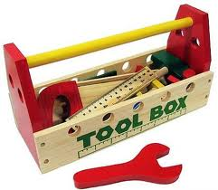
Getting started
Notes:
Identifying process improvement priorities
Who should be involved – Leadership (AVP, Directors)
High level understanding of COBIT
High level understanding of maturity model
Drivers: Will vary with organization. Ours included:
Audit recommendations
Pain points
Long standing issues
Maturity assessments
Downsizing – need to work better/smarter
Agility requirements
Tool: COBIT Quick Start
ID’s key process and objectives (useful)
Helps with maturity assessment (somewhat useful)
Includes some RACI components (considered in benchmarking)
Includes some metrics (considered these)

Slide 8
Moving forward
Review
Benchmark
Implement Plan
Set Improvement Target
Develop Plan
Notes:
Framework for improving specific processes
Benchmark
Maturity Assessment tool provided by COBIT not useful for me
Is it always needed?
Simple or complex
Benchmarking tool provided by COBIT not helpful for me
Examples:
Change management: decided on my own based on Auditor’s recommendation and personal existing knowledge
Information Architecture: management team identified particular objective to work on, benchmarking exercise was enterprise-wide
Monitor and Evaluate IT Performance: management team identified particular objective to work on and AVP suggested tool to use for benchmarking, management team heavily involved in developing measures
Set improvement goal
Change management: determined improvement goal on my own and had it confirmed by Manager
Information Architecture: improved goal recommended by enterprise-wide ad-hoc committee, confirmed by AVP
Monitor and Evaluate IT Performance: management team heavily involved in developing measures
Develop plan to reach goal
Change management: determined improvement goal on my own and had it confirmed by Manager
Information Architecture: final decision will be through University Management Council
Monitor and Evaluate IT Performance: developed by QA, authorized by AVP
Implement plan – all driven by QA
Change management: 50% QA - team participation and work
Information Architecture: 90% QA work, initiative committee formed with appropriate membership outside ITS
Monitor and Evaluate IT Performance: 90% QA, with input from designates and other admin/PR support
Iterative improvement – worked in to goals or procedures for all three.
What is success,
how will it be measured,
who will do it,
when/how often
Review soon after implementation, long term – max is 3 years.
QA follow-up critical to success

Slide 9











Lessons Learned
Notes:
Management support - Don’t bother starting without it – from all levels
Process learning - Be prepared to send the leader on professional development in particular processes. In some processes, expertise exists within – but can you access it? You have to know something about the process you are improving.
Theory to practice – COBIT provides theory, professional development provides theory. The trick is turning theory to practice
Target scope – Watch the scope of the improvement. The bigger it is – the longer it takes. Not everything can be long-term
Who does the work – The most successful improvements have been those in which I did most of the work, and tried to ease the load on others. People are busy and they don’t see immediate results of improvement work.
Overcoming resistance – know your audience; listen to them; involve them when possible; connect to the dots (value and risk).
Deadlines – nothing happens without deadlines – use short-term and long-term as appropriate
Ownership/Accountability – this idea new in ITS. Assign accountability for each process, procedure, standard. Resist pressure to assume accountability yourself
Build in regular review – key to iterative improvement; frequent in the beginning, after the kinks are out – best practice says every 3 years max
Follow-up – all is lost without this step
Reassess priorities with management – at minimum annually

Slide 10
Tips for Newbies
To start - find something to keep them busy
Provide the framework to work within. Send them to COBIT training
Find someone whose done it to give practical advice

Slide 11
Processes Worked in the last year
Define the information architecture
Manage IT human resources
Manage change
Install and accredit solutions and changes
Ensure continuous services
Monitor and evaluate IT performance

Slide 12
IT Governance at the Board Level
Lyne Bouchard, Ph.D., ICD.D.
May 17, 2012

Slide 13
Have you ever participated in a board meeting?
More than twice per year
Once or twice per year
Never, rarely

Slide 14
How did you find your discussions with board members?
Positive and productive
Neutral – a formality
If only I did not have to do it!

Slide 15
Would you say that most board members simply do not get IT?
Yes
No

Slide 16
Boards and IT – Thesis
It is true that most board members want to have as little to do with IT as possible
But IT departments encourage them in thinking this way
Therefore, to address this issue, the IT department has to change how it works with boards

Slide 17
Board members vs. managers
Mr. C: Prove to me that you are managing well!
Mrs B: Prove to me that your project is a good project!
Mr. A: I have a great project!

Slide 18
When IT is the problem
IT managers task their specialists to define and conduct activities and projects
Specialists come back to managers to validate their work
Their viewpoint is one of content
Most managers take the content prepared by their specialists, often in the form of a presentation document, and simply forward it to the board
Therefore, bringing board members to focus on content
Rather than on management and governance
The information needed by board members is often different from the one prepared by specialists, even when one has to approve a project

Slide 19
IT Strategic Planning
Example
The IS Strategic Plan Outline
Executive Summary
I. Introduction/Preface
II. The Enterprise Business Strategy Review
III. IS Progress and Opportunities
Current Assessment of the IS Organization
External Factors for IT Planning
Resources Available
IV. IS Department Strategies, Initiatives and Projects
Selected Projects Supporting the Initiatives
Summary of Allocation of Resources
Timeline for Projects
Appendix: Major project descriptions, benefits and costs, and relative evaluation
Typical Strategic Plan Outline used to discuss IT with business people
Source: Gartner, “Developing an Outline for Strategic IS Plans”, 2002

Slide 20
IT Strategic Planning
Example
CIOs should rather engage a conversation with their boards around three questions
How is IT used to support the University’s strategies
Understand – IT as support
How could our strategies change if we were to use technologies differently?
Envision – IT as an enabler or show stopper
What are other universities doing? Other types of organizations?
Compare – Make it obvious

Slide 21
Balanced ScorEcards
Example
Are infrastructures meeting expectations?
Answer: 99,9% availability
?

Slide 22
Balanced ScorEcards that work FOR Boards
Example
Are infrastructures meeting expectations?
Networks
Servers
Phone system
Email
X
X
X
X
X = current situation
Metrics selected to appear in a balanced scorecard depend on what is important to each organization. These metrics are not numerous and should be represented so that they do not need to be explained (translated). Balanced scorecards are tools to engage a conversation.

Slide 23
Examples of risks to be followed by boards members
Example
Risks | Questions
Business operations | What happens to our operations if our technologies stop working?
Finance | How do we finance IT in the short term and in the long term? Will we be able to afford today’s IT spendings in the future?
Implementation | How are our projects doing?
IT operations | Are our infrastructures meeting expectations?
Information protection | Are we exposed?
Competencies | Do we have enough IT specialists with the right competencies?
Suppliers | How is it going with respect to our IT suppliers?
Regulatory | Are we meeting our legal obligations?

Slide 24
Specific investments’ analysis
IT must engage a conversation with the board on:
The nature of the project – what is it all about?
Why do we need this?
Link with the organization’s strategy?
How much will this cost and can we afford it?
How long before we implement and start to see benefits?
What are the risks and how will me manage them?
How will organizational change be tackled?
Who worked on this, who approved it?
For board members, the question is not whether this is a good project. Why would you bother bringing a project to the board if it is not a good one?
The question is whether the IT department is in control and can deliver the project with success. You need to demonstrate this to the board.

Slide 25
Conclusion
IT needs to engage a conversation with board members

Slide 26
THANK YOU

