Slide 1
Moving Your Library to the Cloud
(…and other “cumulus” successes)
Param Bedi, VP, Library and Information Technology
Mark Yerger, Director of Enterprise Systems
In Collaboration with Carrie Rampp, Director of Library Services
Bucknell University
May 2012

Slide 2
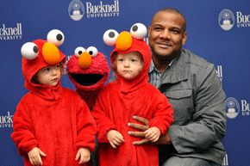
Quick overview of Bucknell
Bucknell University
  Located in rural Lewisburg, PA
  Largest liberal arts university in U.S., founded 1846
  3400 undergraduates, 150 graduate students
  350 faculty, 50 majors
  Elmo creator Kevin Clash, Bucknell Forum
  "Creativity: Beyond the Box" speaker series
  Organization – Library & Information Technology
  Merged with approximately 85 staff, nearly 25 directly related to the library
  One University library, approximately 810,000 physical volumes
  Approximately $3m materials budget
  Receive more than 90% of materials shelf-ready

Slide 3

“Cloud” Strategy @ Bucknell
Evaluate the case for each project
  What is the overall value?
  What are the risks and tradeoffs?
    Application and Data Security
    Enterprise Risk Management
  Back out Strategy
    What is it?
    Do we need one?
Reinvest savings on strategic initiatives

Slide 4

Key Successes
Library – WorldShare Management Services
E-mail – Google Apps
Purchasing – eProcurement
E-billing - TouchNet
LMS - Moodle

Slide 5
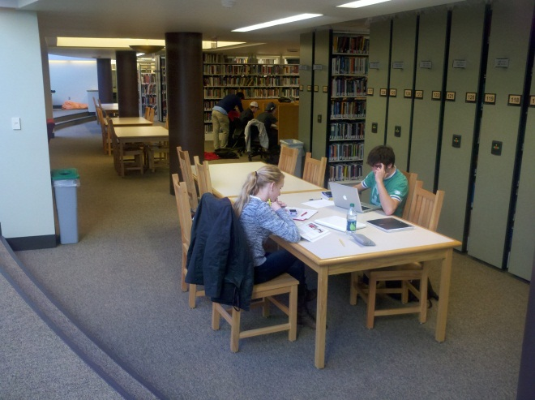
Case In Point: Library
OCLC WorldShare Management Services
Savings
  A LOT of $$
  Staff time (approaching 2 FTEs to date)
  Far less duplicated work/effort
MOST IMPORTANT:
  WorldCAT integration – One source
  Even closer to our goal of one-stop discovery
  One stream for patron-driven
  acquisitions/inter-library loan
What will we cover?
  Our path to implementation
  Bucknell perspective, a little insight into each major system module
  What comes next

Slide 6

Case In Point: Library
How did we get here?
OCLC
  Nonprofit, membership, computer library service & research org
  Dedicated to furthering public access to the world’s information and reducing information costs.
  More than 72,000 libraries in 170 countries and territories around the world have used OCLC services to locate, acquire, catalog, lend and preserve library materials.
3 most commonly asked questions
    How did you make this decision?
    What is the cloud?
    Why not open source?
  Positively received by the community

Slide 7

In the beginning…
July 2010 - Invited by OCLC to participate in the early-adopter program for WMS
Internal discussions focused on…
    Privacy and data security
    OCLC Business plan
    Cost/Benefit analysis
    What’s the back-up plan?
    SLA

Slide 8
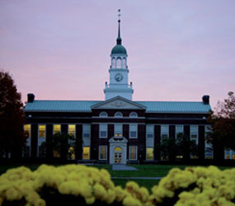
Then, there’s the contract…
Show Stoppers
  University counsel and OCLC counsel negotiation
  CAS implementation for authentication
  Support for Summon feed
  Go Live date – prior to June 30th, 2011
  Bertrand Library

Slide 9
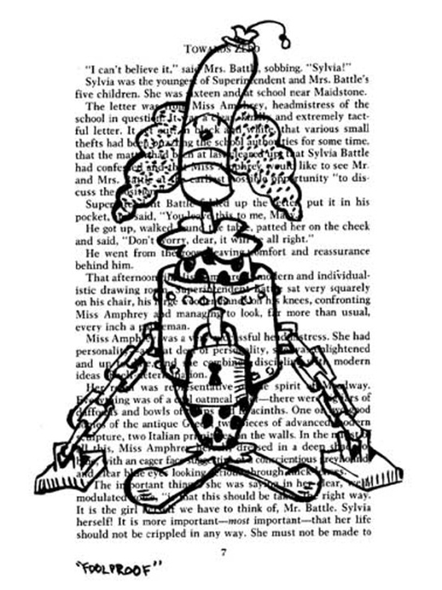
Getting started…
Cohort Group (8 other libraries)
  Weekly online meetings (3-4 hrs/wk)
  Assignments
  Presentations
Local task-force
  Weekly meetings
  Filled out many, many forms…
Artist John Kovaleski, panel from “Unbound”

Slide 10
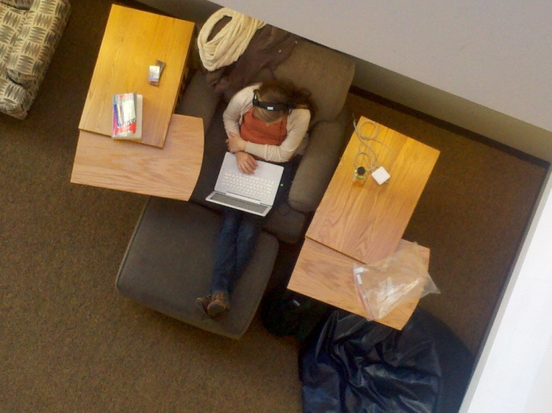
Timeline
March 2011 -- Bibliographic Data
  8 files of 90,000 records each
    Ceased shipments of all new materials, except for RUSH
    Created a (manageable) backlog of several thousand titles
May 2011 -- Patron Data
  Ceased adding new patrons
June 2011 -- Circulation Transaction Data
  Manual circulations for a couple of weeks
June 13 – WENT LIVE!!!
  Loaded manual circs from spreadsheet

Slide 11
Immediately after go-live
Cataloging and Circulation had exception reports and other migration issues to clean-up – which were mostly done by the middle of August
Verify…
  Bib records, patron records, circulation transactions, holdings
  CAS Authentication (Single-sign on)-Available in July 2011
On to module by module….

Slide 12
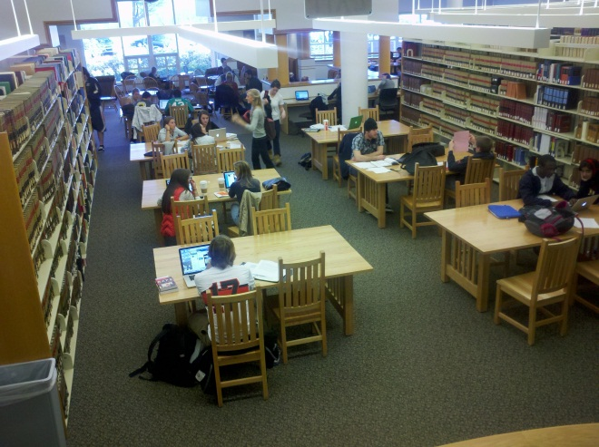
Circulation
Module fairly basic, but evolving
Reserves module very new at time of go-live
Limited reports

Slide 13
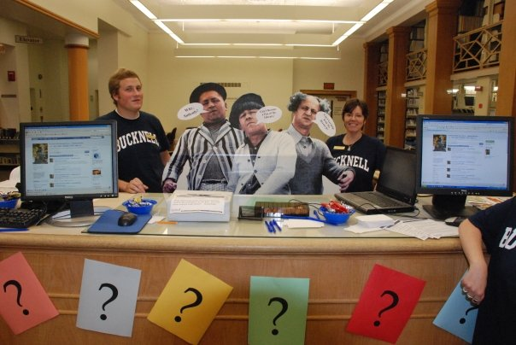
Acquisitions
Use WorldShare acquisitions
only for rush orders, items
requested through Get-It.
Catalogers need not do anything
with items ordered through acquisition module as OCLC local holding record is automatically created.

Slide 14
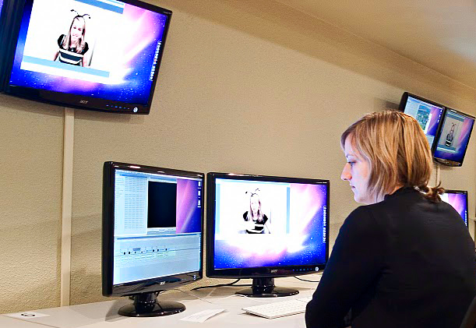
Collection Development
Patron Driven Acquisitions
  Get-It button in WorldCat allows us to make buy/borrow decisions immediately
  Knowledge Base
12-seat FinalCut/Apple Xsan video editing lab in library

Slide 15
Cataloging
Changed from YBP to OCLC WorldCat Cataloging partners
  Receive 90% of materials shelf-ready
  Bucknell symbol and OCLC local holdings record created by WorldCat Cataloging partners—Means most of what we get goes straight to the shelves upon arriving.
  Huge savings -- $$$$
  Since June 2011, 20% fewer books for original cataloging/cataloging review
    Accepting additional levels of cataloging
No more redundant work
  However, we can’t slack with brief records any more
No need to maintain local records – share our work with everyone
Cataloging DVDs is a little more cumbersome—short term
  No call number browse
  Limited information on hit-lists

Slide 16
Costs/ Savings
We have saved A LOT of $$$.
Indirect costs – servers, staff time, new staff opportunities
We expected an increase in ILL activity, but we have not – in fact, it’s gone down
Consolidation of services from OCLC: (Summon, A-Z list, etc.)

Slide 17
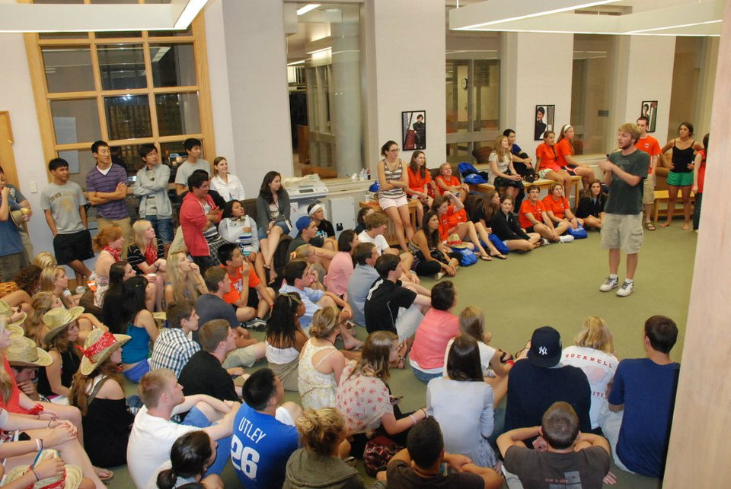
Looking forward to…
Improved and customizable notices (May 2012)
Self-check (May 2012)
Reports
Plan to eliminate:
Serials Solutions, A-Z list
Summon
Maybe, 12 months…ILLiad
First year students participate in the library’s late-night orientation program.

Slide 18


Other Cloud Moves:
Google Apps
Significant annual savings (includes staff reallocation)

Slide 19
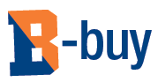

Other Cloud Moves:
eProcurement
Projected to save 5% to 15% of typical “procurement” spend.

Slide 20

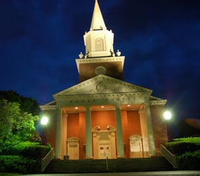
Open source
Significant annual license savings starting in 2013
Equal or better performance than legacy

Slide 21
Link to Progress On the Ground
Funded Projects and Reallocation of Resources
L&IT had no additional staff since 2008
Budgets have been flat since 2008
Academic:
  Academic Video Lab
  Geographic Information Services (GIS)
  Double our Instructional Technology (ITEC) team
  No cuts in online databases
  Upgraded technology in 70 classroom and labs
  Summer Technology Faculty Workshops
  Faculty Course Development Grants

Slide 22
Link to Progress On the Ground
Funded Projects and Reallocation of Resources
Academic and Administrative
  Mobile Technology
  Kaltura: Video Management
Administrative
  Business Intelligence
  Document Imaging
  SciQuest – eProcurement
  Concur Travel and Expense System
  TouchNet B-bill and payment

Slide 23
Thanks for your attention!
Other info:
  Param Bedi: param.bedi@bucknell.edu
  Mark Yerger: mark.yerger@bucknell.edu
  WebEx playback for WorldShare event
  http://tinyurl.com/jan2012WorldshareWebEx

