Slide 1
A Business Intelligence Journey: Lessons Learned
Sharon E. Blanton, Ph.D.
Associate Vice President & CIO
Portland State University
May 16, 2012
Copyright Sharon E. Blanton 2012. This work is the intellectual property of the author. Permission is granted for this material to be shared for non-commercial, educational purposes, provided that this copyright statement appears on the reproduced materials and notice is given that the copying is by permission of the author. To disseminate otherwise or to republish requires written permission from the author.

Slide 2
DM1 DM2
Successes & Challenges
Lessons Learned
Next Steps
Agenda

Slide 3
DM1 -> DM2
Legacy System
Disconnected collection of data and reports from multiple disparate sources
Client based tool with ad hoc and scripted queries
Limited data modeling and design
Caused multiple inefficiencies
Generated inconsistent results
Project Origin
Examined university’s problems and created questions
Looked for a tool to answer the questions
Notes:
Hummingbird BI Query, nightly transactional data dumps, extensive use of Excel, SQL
How much $ would we save if we left all vacancies open until the end of the year?
How low does the state support of the university have to go for it to no longer be worthwhile to accept the funds and regulations?
How would our budget model need to change if we were no longer a state agency?

Slide 4
DM1
DM1 -> DM2
PSU’s Solution
Six months of research and discovery
Initial Goals: Software solution partner vs. provider; Transparency; Accessibility; Ease of use; Timely; Analytics (not just reporting)
What should Business Intelligence look like at PSU?
  Organizational Capability to organize, access, and analyze information to understand the business to improve decisions and manage performance, while spanning people, processes, and technology.
“Take-action analytics” based on history and forecasts using ODS, EDW, & Cognos
“single version of the truth”
Creation of centralized BI Team
Notes:
Called many other institutions, relied on Gartner, local partners

Slide 5
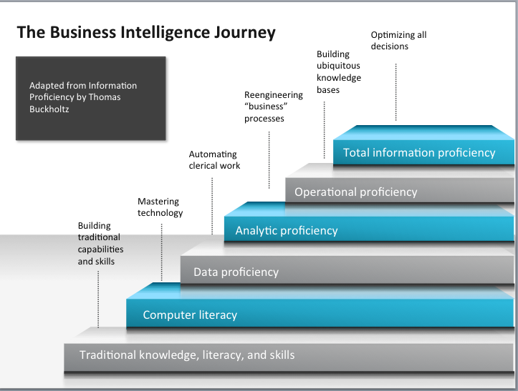

Slide 6
DM1 -> DM2
DataMASTER
Data Management and Analytics
For Strategic, Timely, Education Reporting
Notes:
Create centralized BI Team

Slide 7
DM1 -> DM2
Core Project Objectives
Collaboration through effective communication
Reconciliation of definitions and meanings
Alignment of information needs with leadership and university goals
Accessibility to data for a wide range of technical abilities
Empowering users through the use of appropriate technology
Fostering education and communication of the complexities of business intelligence
Enhance value to the institution’s functional areas (business)
Align to institution’s strategic goals and objectives
Engage key executive stakeholders and address priority functional areas

Slide 8
DM1 -> DM2
Guiding Principles
Access and Delivery
  Support a culture of fact-based management to drive decisions, actions and outcome.
  Create and maintain an environment of open information access.
  Provide an environment that is easy to use, understand and easily accessed.
Evolving Process
  Support alignment with university goals and measures.
  Encourage solutions that can be leveraged across business units.
  Maintain a consistent level of service and availability of information while migrating to the new system.
  Implement a process that supports expedient change, communication and education.
  Promote continuous process improvement.
Governance
  Decisions based on changing core objectives.
  Pursue governance with cooperation and collaboration.
  Maintain an environment of transparency and information sharing.
  Seek collaboration and engagement from across the university.
  Balance university-wide requirements with unique department and school requirements.
  Maintain responsible stewardship of university resources.

Slide 9
DM1 -> DM2
Original Identified Success Factors and Risks
Essential to the success of the initiative:
  Executive sponsorship
  Availability of funding and qualified staff
  Data quality
  Alignment with PSU's core objectives of education, research, and service
  Satisfy the broad information needs of the university
  Availability of subject matter experts
  Provisions for BI education for functional and technical professionals
  Acceptance of a phased and iterative development approach
Additional risks:
  Resistance to change
  Lack of commitment and support
  Insufficient time and resources

Slide 10
DM1 -> DM2
New methodology driven workshops
“Information Opportunity Portfolio”
Driven by functional business questions, business processes, and information needs
Emphasis on three driving questions for performance measures:
How are we doing? (scorecards & dashboards)
Why? (reporting & analytics)
What should we be doing? (planning, forecasting, and analytics)
Focus on the information sweet spots for rapid and continuous information deployment. Craft a framework to identify the sweet spots into a matrix of:
Functional domain
Subjects
Metrics
Hierarchy of dimensions
Notes:
Key decision – will not simply migrate/recreate existing reports
Reference: Three driving questions – Boyer, J., Frank, B., Green, B., Harris, T., Van De Vanter, K. (2010). Business intelligence strategy: A practical guide for achieving BI excellence. IBM Corporation.

Slide 11
DM1 -> DM2
Evaluate and determine priorities
Level of effort and difficulty which might include criteria such as cross-functional, data availability, calculation complexity considerations.
Organizational importance which might include criteria such as action-ability, materiality, and tactical vs. strategic considerations.
Scope BI projects according to the subjects and priorities.

Slide 12
DM1 -> DM2
Discover
Information discovery
Define
Project Charter
Design
Technical Specification
Business process assessment
Project proposal and approval
Project Plan
Functional Specification
Process changes identified
Business rules
Modeling
Data and application integration design
Architecture definition
Proof of concept as needed for high risk deliverables
Visual Design
Report mock up with user input
Develop
Transformation of design
Report development
Data import and export development
Unit test development
Deployment to “sandbox” for user preview of solution
Deploy
Test dev, test, production environments using manual and automated processes
Performance testing
User acceptance testing
Training and knowledge transfer

Slide 13
DM1 -> DM2
2010
12/2009 – Tool Selected
Jan
Feb
March
April
May
June
July
Aug
Sep
Oct
Nov
Dec
DM1
Launched
Procure/Install Infrastructure
Steering Committee
Finance Project
Team
Student
Project
Team
HR Project
Team
Finance Report
Writer
BI Team
Manager
ETL
Analyst
Project
Manager
Cognos Training

Slide 14
DM1 -> DM2
2011
Jan
Feb
March
April
May
June
July
Aug
Sep
Oct
Nov
Dec
SIG
Consultants
Student
Report
Writer
HR
Report
Writer
Cognos
Administrator
Query Studio Training
Lost
Project
Manager
Support
Coordinator
Retired
Finance & OIRP Phase Kick-Offs

Slide 15
DM1 -> DM2
2012
Jan
Feb
March
April
May
June
July
Aug
Sep
Oct
Nov
Dec
Hiring
Freeze
BI
Query Sunset
Hiring
Freeze
DM2 Launched
Official Access
Request Process
New Project Manager
Lost Team
Manager
Intro to Cognos Training
OAA, Dean’s Phase, and Advancment Phase Kick-Offs
HR Phase Kick-Off
OAA, Dean’s, and Advancement Phase Kick-Offs
EMSA Phase Kick-Off

Slide 16

DataMASTER2

Slide 17
DM1 -> DM2
What’s new in Phase 2:
New infusion of cash
Restructured governance
Empowered more functional users
Acquired more assistance from consultants
Developed much more agile approach

Slide 18
Successes and Challenges
Successes
Everyone has heard of DataMASTER
Faster reporting
Discovery of shadow systems
Cross functional collaboration and knowledge transfer
Expanded thinking and better questions
Increased efficiencies
Increased collaboration throughout Oregon University System
Uncovered shadow systems

Slide 19
Successes and Challenges
Challenges
The usual FUD
Learning curve
Holding back the reigns
New unit development
Challenges

Slide 20
BI Team Organization History
Successes and Challenges
Existing
New
Vacant
IT Director
1/3 Report Writer
Support Coordinator
ETL Data Analyst
Consultant
Team Lead
CIO
Project Manager
IT Director
1/3 Report Writer
Support Coordinator
ETL Data Analyst
Cognos Admin
Team Lead
CIO
Project Manager
1. 4/10-3/11
2. 4/11-8/11
CIO
3/3 Report Writers
Vacant Support Coordinator
ETL Data Analyst
Cognos Admin
Vacant Director/Team Lead
New Project Manager
CIO
3/3 Report Writers
Support Coordinator
ETL Data Analyst
Cognos Admin
Team Lead
Project Manager
3. 9/11-12/11
4. 1/12-Current

Slide 21
Lessons Learned
Lesson #1: BI projects run by IT tend to fail
Plan

Slide 22
Lessons Learned
Lesson #2:
Project sponsorship can’t be in name only

Slide 23
Lessons Learned
Lesson #3: Project management must adjust to the customers involved
TEAM
WORK

Slide 24

Lessons Learned
No matter how much customers
dislike a legacy system,
they will dislike change more
Lesson #4

Slide 25
Lessons Learned
Lesson #5:
Appropriate governance has everything to do with project success
BEFORE: Advisory Group
Very large groups
Many group members were unneeded
Confusion caused by lack of clearly defined purpose
Requested to explore unlimited amount of business questions and isolate most pressing questions to the university
Questions were to drive design & creation of reports
Questions were intended to be exploratory and most remained unanswered causing frustration among group members
AFTER: Work Groups
Group members are to be involved as needed
Small, more efficient groups
Purpose is well defined
Task oriented instead of advisory

Slide 26
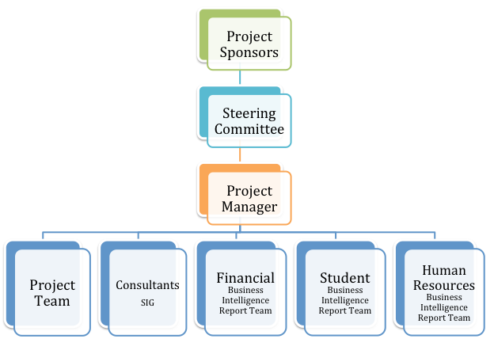
BI Team Manager
BI Team
ETL Analyst
Report Writers
Cognos Admin
Support Coordinator
Lessons Learned

Slide 27
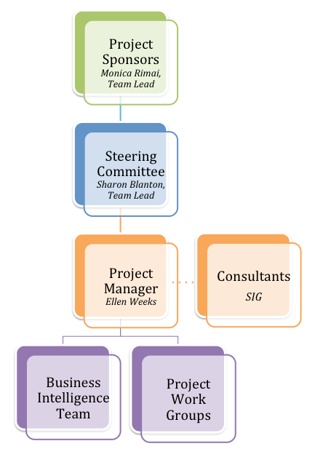
Lessons Learned

Slide 28

Lessons Learned
Lesson #6:
Overwhelming process
can lead to
underwhelming results.

Slide 29

Lessons Learned
Lesson #7:
A BI project can foster amazing cross campus collaboration and knowledge transfer
Notes:
Great discovery of shadow systems

Slide 30
Lessons Learned
Lesson #8:
A mission critical project should be managed by someone with deep and broad institutional knowledge and relationships

Slide 31

Lessons Learned
Lesson #9:
New tools expose need for new policy

Slide 32
Next Steps
Continue Training
Continue Culture Shift
Hire Support Coordinator
Hire BI Director
Expand Development Access in Measured Manner
Populate EDW
Sunset BI Query
DM2

Slide 33

For more information please visit: https://sites.google.com/a/pdx.edu/dm2/
Sharon E. Blanton, Ph.D.
Associate Vice President & CIO
Portland State University
sblanton@pdx.edu
503-725-9144

