Slide 1

Navigating the Clouds with an Enterprise IT Strategy
The importance of understanding risks in strategic innovations
Clayton Burton
Jason Long
Fred Miller

Slide 2

Agenda (and obligatory cloud picture)
IT Strategic Planning and the Cloud
The Role of Various Cloud Models
Identity Management
Shibboleth in Detail
Lessons Learned
Future considerations

Slide 3
About you?
Interested more in security, strategy, or cloud apps?
Have a strategic plan the addresses cloud services?
Cloud Services for email/calendar?
Other types of cloud services?
Single sign-on solutions?
Using Internet2 Net+ services?
Have a strategy for cloud and BYOD?

Slide 4
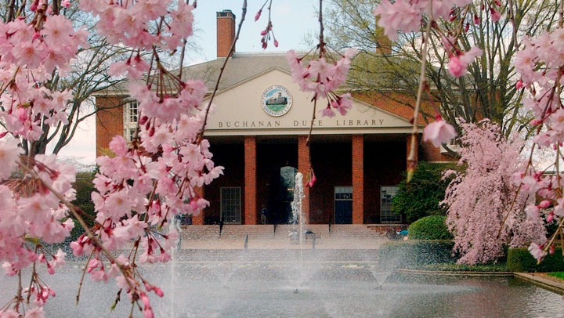
About Furman University
Private liberal arts university
750 acres campus in Greenville, South Carolina
2650 undergraduates
96% live on-campus
Division 1 athletics

Slide 5
Furman’s IT Strategic Plans
2007
  II.24.2 Establish an efficient central system that serves as the information window to Furman University
    Implement Single Sign-On
2011
  2. Champion scalable information technology innovations and best practices.
    Enable efficient operations using appropriate vendor, cloud, and open source solutions.
Notes:
The 2007 IT Strategic Plan was over 50 pages long. Among it’s long list of goals was a tactic to “implement single sign-on”
Our 2011 IT Strategic Plan was much more concise. We stated our vision as
“…providing the campus community with a digital information environment that reflects and advances the high quality of Furman’s academic program and physical campus.”
The Five main goals of the 2011 plan:
1. Establish a new IT Service Center as the nexus of technology support excellence.
2. Champion scalable information technology innovations and best practices.
3. Improve enterprise information systems functionality and usability.
4. Establish a state-of-the art system and processes for digital media distribution.
5. Provide a robust, consistent, and reliable campus network infrastructure.
You can download the plan from here: http://www2.furman.edu/sites/ITS/About/Pages/ITSReports.aspx

Slide 6
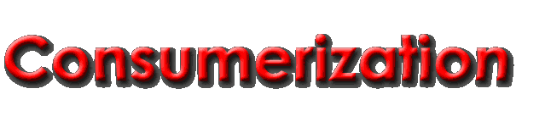
Industry
Govt. / Legal
Consumers
Higher Ed Institution
Consortia
Foundations
Notes:
This is a concept map of major economic forces affecting higher education
Your higher education institution in shown at the center, acted upon, and with, the government, foundations, consortia, industry, and, of course, consumers.
There are consumers on our own campus who are contributing to the decisions we make.
More and more we're seeing industry marketing directly to these on-campus consumers, and then these consumers are coming to IT with their expectations for IT services.
It used to be that people on campus would come to IT and say "we'd like a new service, what should we do?" Now we are seeing these consumers, the people on our campus, saying "Here is what we want to do - make it work." They've already selected a solution.

Slide 7
Affecting institutions’ strategy
Strategic
Operational
 | Consumerization | Digitization (Information Architecture)
Innovation
Collaboration
Communication
Service
Notes:
Is consumerization affecting your institution's strategy?
At Furman we believe it is. Devices and services are being developed for the consumer, and people want to use these devices and services to do their work.
At the same time, the University has been driving a strategy to digitize the way it does business. The choices we make for the University's information architecture (the digitization of our business processes) increasingly needs to be prepared for innovations arising from the industry to consumer space.

Slide 8
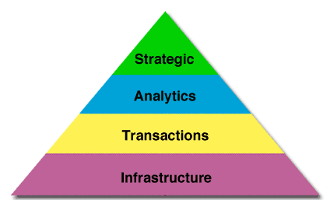

Investing in an IT project portfolio
Notes:
This model was adapted from work done by the MIT Center for Information Systems Research.
The MIT CISR notes that across all IT organization, not just higher ed, that typically 85% of projects are for “keeping the lights on”. The remaining 15% of projects are strategic initiatives intended to advance the digitization of the business. Better IT organizations can push this ration from 85/15 to 80/20.
This pyramid shows the relative dollars of an IT project portfolio. Most investment will be in infrastructure and transaction systems.
What we tell our IT Governance at Furman is to think of IT projects as an investment portfolio. Just like a financial investment portfolio, if all you make are conservative investments, you won’t achieve the same level of return as organizations that include some risk in their portfolio. We see our investment in strategic IT projects as where we are taking risks to advance the University’s business.

Slide 9
Innovation within the IT Portfolio
Strategic Innovations
Infrastructure
Analytics
Transaction Processing
Increasing Risk
Adapted from Ross and Weil, IT Savvy: What Top Executives Must Know to Go from Pain to Gain, Harvard Business Press, 2009, fig. 3-2.
Notes:
Possible discussion of « categories of risk »
Will as many as 50% of strategic innovations fail?

Slide 10

Consumerization & cloud services
IT as a partner, not competitor
Technology contract approvals
Compliance reviews
Leadership agreement on a platform approach
Post-implementation reviews
Notes:
Furman University policy requires that the CIO approve all contracts for technology purchases, leases, or services.
This policy helps us work with departments as a partner to help them make the best decisions for the University’s information architecture. It also allows us to check contracts for compliance with regulations such as HIPAA, PCI-DSS, FERPA, and others. BTW- Furman is PCI SAQ B compliant – no credit card information is stored on computers on Furman’s campus; nor are there dedicated terminals used for credit card transactions on our campus network.
We have also used our IT Governance process to get our campus leadership to agree that a digital platform that can be used across campus is a better approach than using disparate systems for individual departments.
Finally, Furman has begun process to review projects after their implementation. This “post implementation review” helps us determine whether the original objectives of the project were met, and what others steps we should take to improve the digital platform under review.

Slide 11




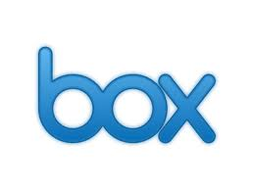
Vision: One place for all your Furman stuff...
more...
Notes:
This is a very simple way of describing how we are working to unify campus access to disparate cloud systems using single sign-on from within our campus porta.

Slide 12
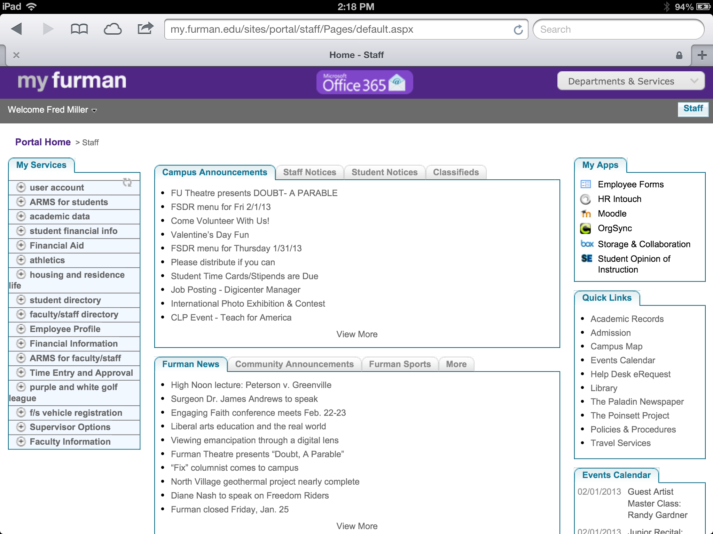
Notes:
While we know our portal still needs usability improvements, this is how the portal looked back in February. We’ve recently added single sign-on access to our MyFurman portal.
Note: not all Furman’s cloud solutions are available from with MyFurman, just the ones with single-sign on access. (e.g. our PCI-DSS 3rd party payment solutions.)

Slide 13
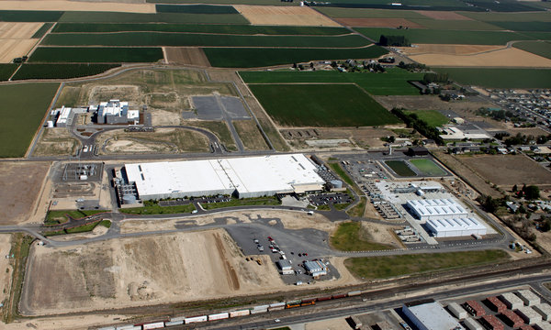
Models of cloud services & risks
Software As A Service: “Cloud As A Kit”
Infrastructure As A Service: “Pay As You Go”
Collaboration Opportunities
Notes:
Photo is of a Microsoft data center in Washington, from NY Times article, September 24, 2012.

Slide 14
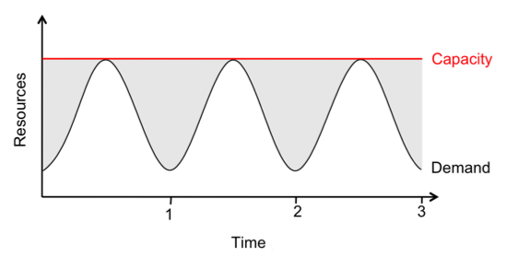
SaaS – “Cloud as a Kit”
Over 40 Software-As-A-Service contracts
  Event scheduling
  PCI-DSS solutions
  Admission
  OrgSync
  More
Office 365
Box
Risks?
Notes:
Diagram notes that in the traditional server model, you needed to size the server for maximum capacity.
SaaS cloud vendors typically sell their services at a single price, very similar to what you would expect to pay using the old on-premise model. However, many of the SaaS vendors are using other vendors cloud solutions to deliver their services.

Slide 15
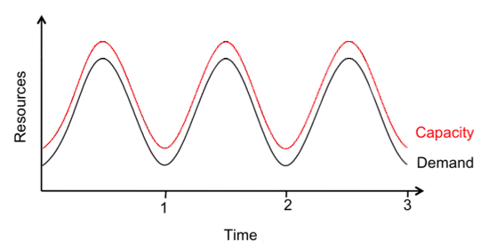
IaaS - “Pay as You Go”
Amazon, Moodle & Mobile
Notes:
Vendors use the IaaS “Pay As You Go” model to only use as many server resources as they need.
Furman has begun using Amazon for cloud services, too. We now host a Moodle instance on Amazon. We also host our edge.furman.edu mobile platform on Amazon.

Slide 16
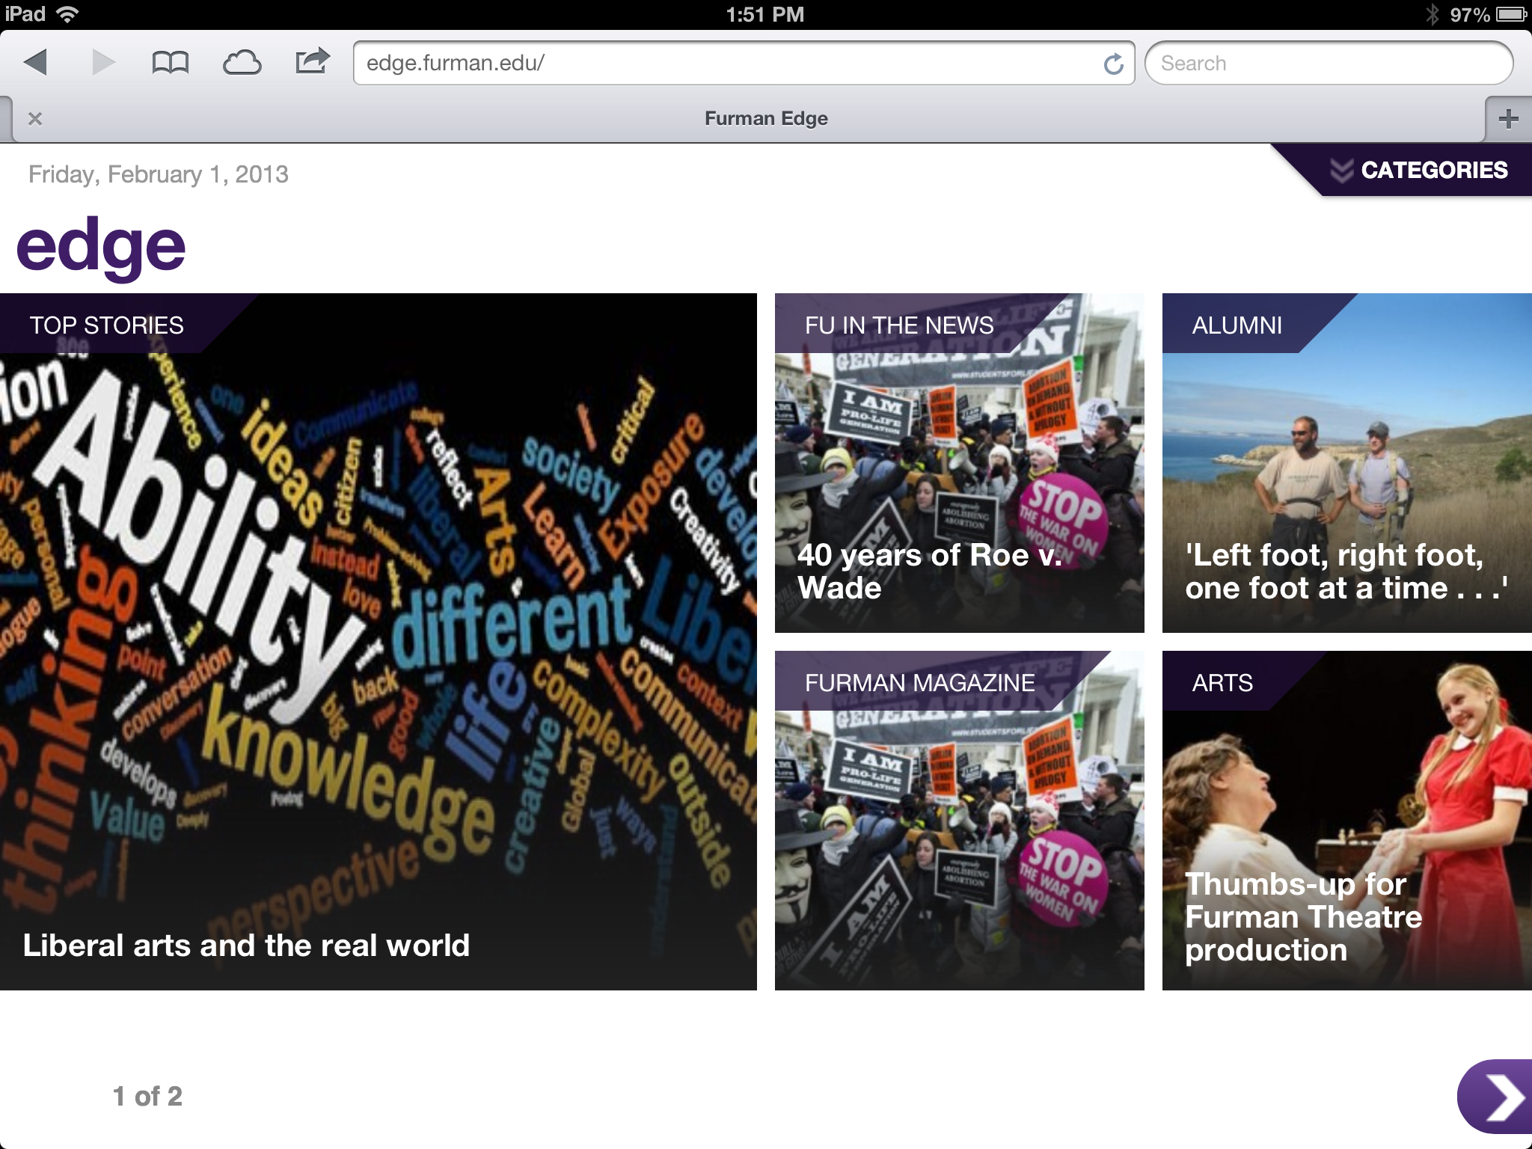
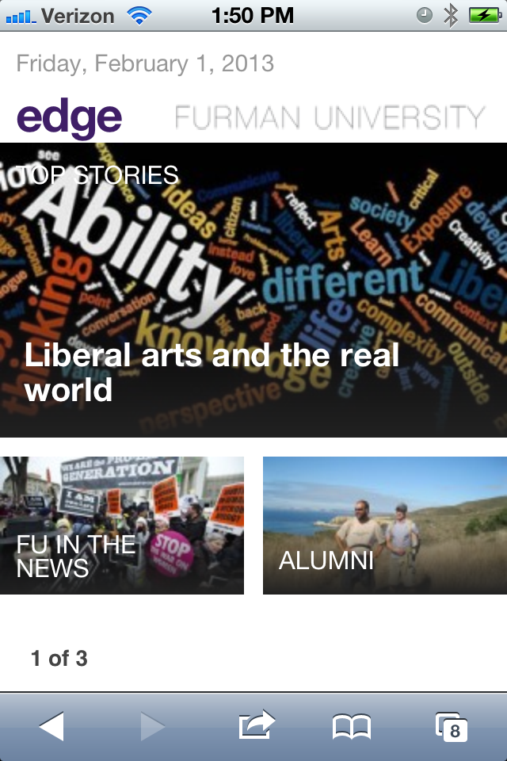
edge.furman.edu
Notes:
Check out http://edge.furman.edu
While it looks like a responsive web application that resizes to present Furman news and digital content to the web, tablets, and smartphones, it’s also the heart of our new digital platform.
Running on Amazon servers we can scale up server resources as needed. We use open source Wordpress software, and some custom design work, not only to present our mobile content, but it’s also designed to provide news content to our university web site, and digital signs on campus.

Slide 17

Identity management
Identity strategy: provisioning and de-provisioning
The university portal: when is single sign-on appropriate
Shibboleth and federated identity
One place for "all your campus stuff"
Risks? Costs?
Notes:
Now we’re going to do a deeper dive into how identity management is at the heart of Furman’s cloud strategy.

Slide 18
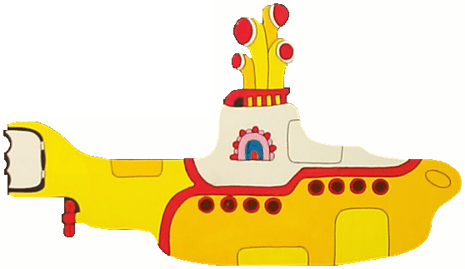
One identity, infinite services
Motivations
Consumerization-driven services expected
Excellent usability: fewer passwords; fewer URLs
Provisioning and removing user access easier
3rd party services never see passwords
Notes:
Transition: leadership perspective vs. SSO specific, Furman specific, and details specific to our choices
Can log into CNN through Facebook
Portal centralization
Auto-provisioning is key
Giant targets like Box or Microsoft being compromised doesn’t get all your data
The big benefit to the way we do identity management is that our vendors never see Furman passwords. That way, like compartments in a submarine, if one vendor’s information is compromised, information from other vendors remains secure.

Slide 19

One password, infinite access
Risks
Too much access: one password for (almost) everything
Log out confusion possible
Possible critical failure point
Social engineering weakness
Less direct control
Notes:
Same password you use to reserve a room also shows your salary information
Architecture weakness; can keep help from being received or given
Although once logged in, if the server is down the service continues
One well-placed phishing email can really hurt
Working with vendors and contracts instead of employees and systems

Slide 20




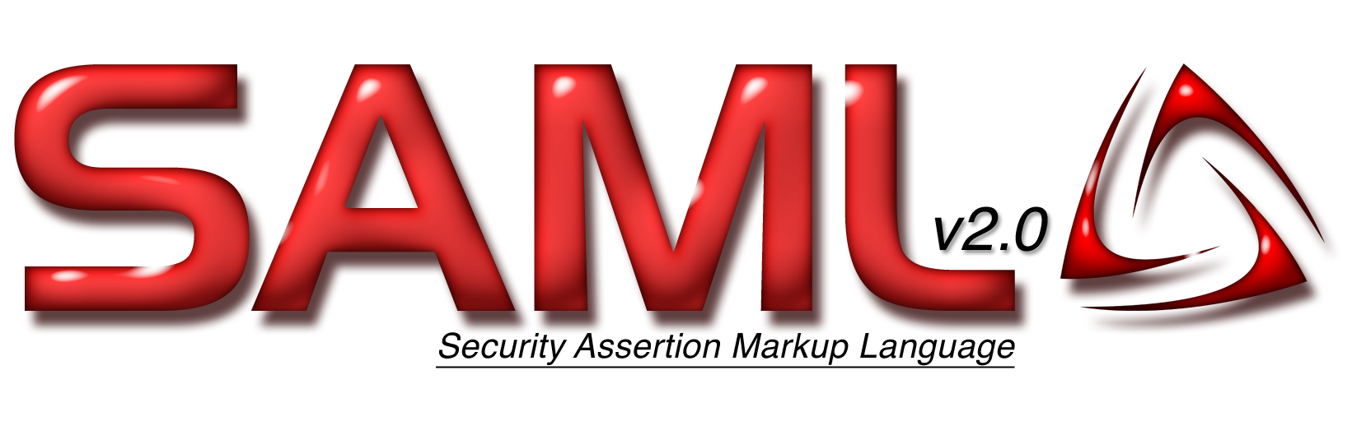

SSO choices
Interdependent, overlapping, standard-resistant choices
Not just services you know you will have
Complex decisions made quickly with limited information
Notes:
Not all are separate choices; standard “resistant” meaning standards are developing but are not industry-wide
Industry marketing to departments directly, glossing over the IT details

Slide 21

Additional considerations
Moving from managing systems to managing services
  TRUST
Consultants vs. training
Wide net vs. standardizing support
Total cost of architecture
  Redundancy
  Staffing: anchoring the cloud
Notes:
Potentially different way of thinking for staff
Clean and quick but expensive to create and extend vs. slow and potentially messy with a high initial soft cost but hopefully low cost to extend
Wider support means greater flexibility when adding services, but more total support required
You can’t outsource “bringing it all together” – someone still has to manage all the anchors

Slide 22
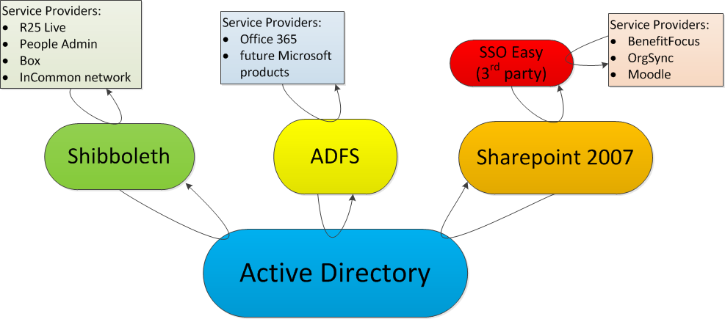
Our current SSO setup
Notes:
Messy
Created quickly and organically as needs arose and as we were learning

Slide 23
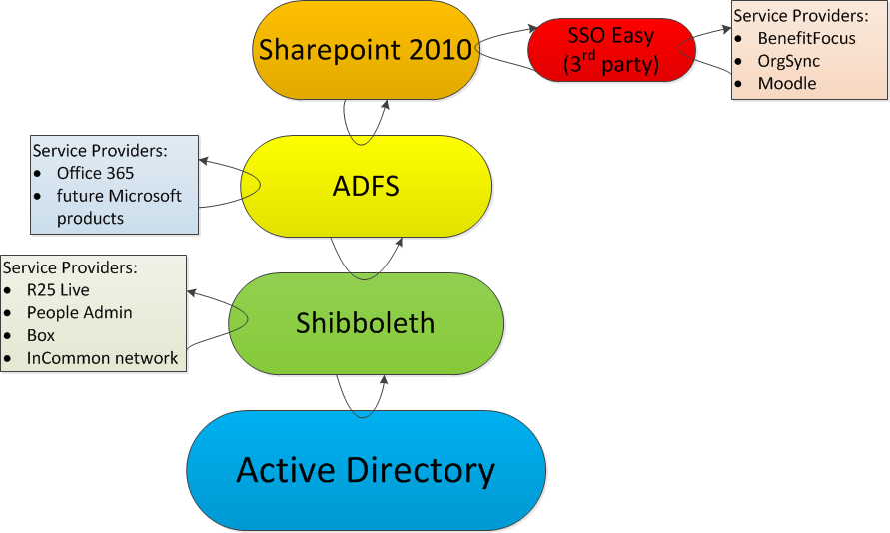
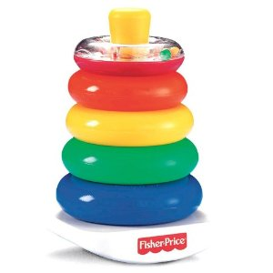
Future SSO setup
Notes:
So simple a child could understand it ☺
Key difference: Sharepoint 2010
Most important slide we’ve shown

Slide 24
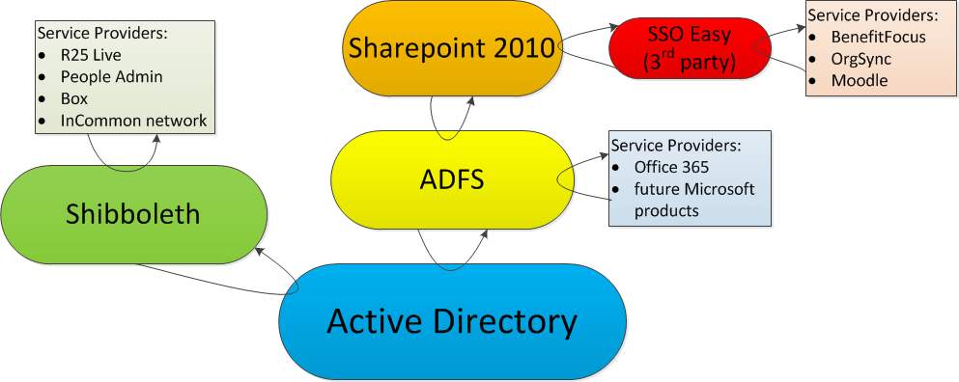
Intermediate step
Notes:
Shibboleth can be inserted later

Slide 25
Furman’s choices
SSO Easy for speed of deployment
Fischer International consulted for Shibboleth installation
Consolidation of architecture in phases
Redundancy of key systems
Moving to shibboleth standard and in-house support
Notes:
You can pay someone to handle it all for you – either SSO connections, Shibboleth SP control, or both
Architecture is fairly well-documented online
Our ADFS setup is currently robust and risk is well-mitigated; Shibboleth needs the same
In-house support through Shibboleth gives us control, better knowledge, and controls costs; also to support the InCommon federation
Transition: Shibboleth in more detail

Slide 26

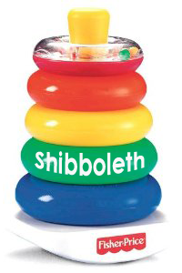
Where do Shibboleths come from?

Slide 27

SAML
Security Services Technical Committee (SSTC)
3 versions:
  v1.0 in 2002
  v1.1 in 2003
  v2.0 in 2005 (most recent version as of Apr 2013)
Notes:
SAML is a very mature stancard

Slide 28
SAML's building blocks
SAML Core: the data that's transmitted
  assertions, requests, responses
Bindings: how the data's transmitted
  ie: SOAP, HTTP POST, HTTP Redirect (GET)
Profiles: describe use cases in detail

Slide 29
SAML 2.0 Profiles
SSO Profiles
  Web Browser SSO Profile
  Enhanced Client or Proxy (ECP) Profile
  Identity Provider Discovery Profile
  Single Logout Profile
  Name Identifier Management Profile
Artifact Resolution Profile
Assertion Query/Request Profile
Name Identifier Mapping Profile
SAML Attribute Profiles
Notes:
The web browser SSO profile is most important

Slide 30
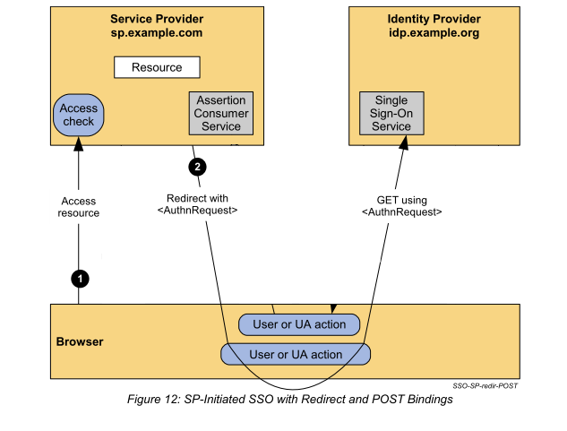
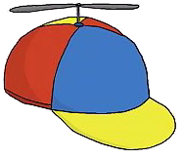
SAML Flowchart Phase 1
You request a resource
Notes:
Note the idp.example.org in this example is on Furman’s campus

Slide 31
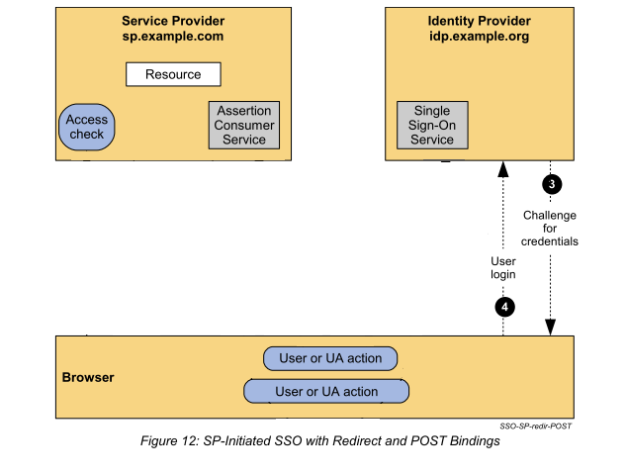
SAML Flowchart Phase 2
Login if you haven't already
Here's the login!
(the Single sign-on)

Slide 32
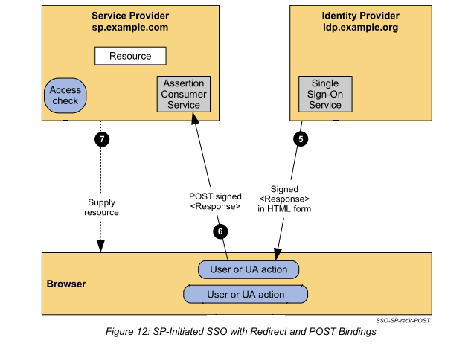
SAML Flowchart Phase 3
You get the resource

Slide 33
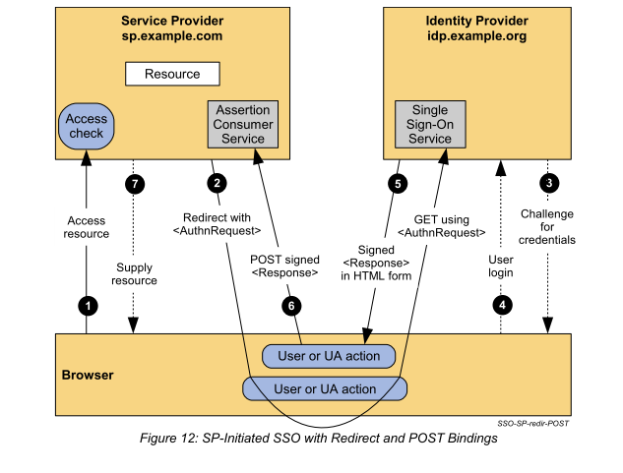
SAML Flowchart (complete) from Oasis SAML v2 Technical Overview PDF

Slide 34
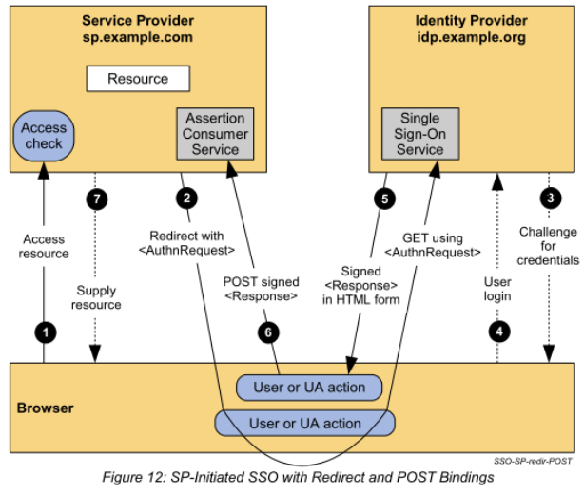
WAYF?
Where Are You From?
aka "Discovery"
How the SP knows which IdP
inherent in the URL,
  ie: furman.SP.com
passed in the URL
ie: SP.com/furman
SAML 2.0 IdP Discovery Protocol
Just ask!

Slide 35
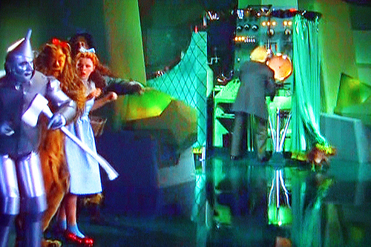
SAML Metadata
Don't mind me! I'm just the Metadata!
usually maintained by your Federation
adds security
  SPs and IdPs specified
  certificates
more maintainable
  configuration stored in one place
simplifies process of adding SPs

Slide 36
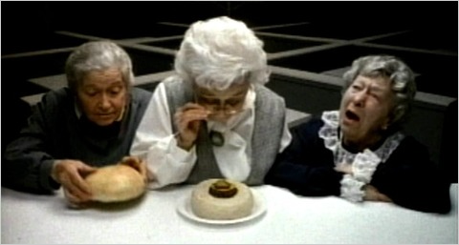
Where's the Metadata?
For InCommon:
  https://wayf.incommonfederation.org/InCommon/InCommon-metadata.xml
  About 6 MB
  Take care to configure servers properly using HTTPS!

Slide 37
Additional Considerations
Service Logout vs. Session Logout
  see SAML 2.0 Single Logout protocol and profile
Shibboleth IdP Clustering
  Internet2 recommends Terracotta
  Stateless Clustering: requires customization
  Active-Passive redundant servers
Notes:
We handle getting users to understand session logout as an education challenge.

Slide 38
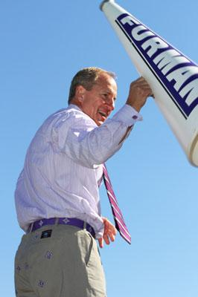
Lessons learned
Identify risks
Educate the community
Manage Change
Leadership support key
TRUST
Notes:
What is the cloud?
Security

Slide 39

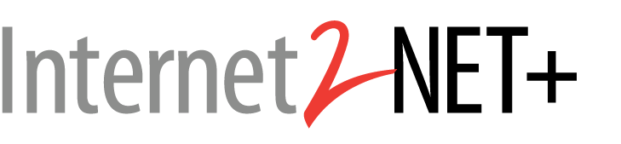
Challenges & opportunities
More Mobile
Virtualization
Data center in the cloud
More collaborations
When to partner?
Notes:
We’re considering the new Net+ Cloud VOIP solution

Slide 40
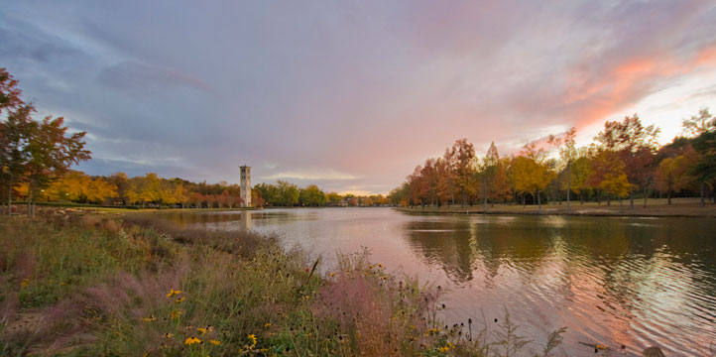
Thanks
  “Above the Clouds: A Berkeley View of Cloud Computing”
  http://radlab.cs.berkeley.edu/publication/285
  Shibboleth documentation
  https://wiki.shibboleth.net/confluence/display/SHIB2/Home
  More about Shibboleth
  http://shibboleth.net
Notes:
Thanks! Here are some links to additional resources

