Slide 1

Providing Private Cloud Services to Support HIPAA Compliance Dennis Cromwell – Associate Vice President of Enterprise Infrastructure at Indiana University John Weakley – Director Enterprise Infrastructure at Indiana University
April 18, 2013

Slide 2
Health Insurance Portability and Accountability Act
HIPAA legislation 1996 implemented 2003
Privacy Rule
Security Rule
What is PHI?
https://kb.iu.edu/data/ayyz.html
No such thing as HIPAA compliance
Basically, self asserted alignment
Covered Entities (CE)
Business Associate (BA)
Hybrid – concept of organization that deals with covered and uncovered HIPAA components
ie: IU data center hosting, where we are neither the CE or BA but hosting systems for a CE or a BA

Slide 3
HIPAA Privacy Rule
The Privacy Rule “applies to health plans, health care clearinghouses, and to any health care provider who transmits health information in electronic form” DHS.
It protects “individually identifiable health information held or transmitted by a covered entity or its business associate, in any form or media, whether electronic, paper, or oral”.
Notes:
As an IT provider, we are really not worried about the privacy world
University only worries about this at point if health care delivery (clinics, hospitals, etc.)

Slide 4
The Security Rule IT – Security rule rules!
The Security Rule requires 1. administrative,
Technical safeguards to
Ensure the confidentiality, integrity, and availability of all e-PHI they create, receive, maintain or transmit;
Identify and protect against reasonably anticipated threats to the security or integrity of the information;
Protect against reasonably anticipated, impermissible uses or disclosures;
Ensure compliance by their workforce; and
Provide a means for managing risk in an ongoing fashion.

Slide 5
HIPAA Terms
Covered Entity
Business Associate
health plans, health care clearinghouses, and health care providers that transmit health information
Receive ePHI from a Covered Entity, or may create or obtain PHI from other parties for use on behalf of Covered Entity.
A person or entity that performs certain functions or activities that involve the use or disclosure of PHI on behalf of, or provides services to, a covered entity.
Hybrid Function
uses or discloses ePHI for only a part of its business operations.

Slide 6
HITECH – Stricter Enforcement
2009 HITECH enactment
Stricter penalties
Penalties
Civil and criminal
Maximum penalty $1.5 million and 10 years in prison
Think about it …prison, personal penalties.

Slide 7
Health Insurance Portability and Accountability Act Scope
Take a moment to ask yourself where do you have data at your institution that might fall under HIPAA scope?

Slide 8
IU Departments Impacted by HIPAA
School of Medicine – multiple locations around the state.
School of Nursing
Allied Health
School of Education
School of Social Work
School of Optometry
And many more……
School of Dentistry
Speech and Hearing Department
Human Resources (Health Plan)
Student Health Center
Psychology Department
Research Administration

Slide 9




Business Associates
Hospitals and Clinics
Indiana University
Vendors and Service
Suppliers

Slide 10
Where BA comes into play…..
Financial Management Services
Healthy IU
Allied Health
Internal Audit
Cyclotron
University Counsel
IT Services (UITS)
Research Administration
Student Health Center
School of Nursing
School of Medicine

Slide 11
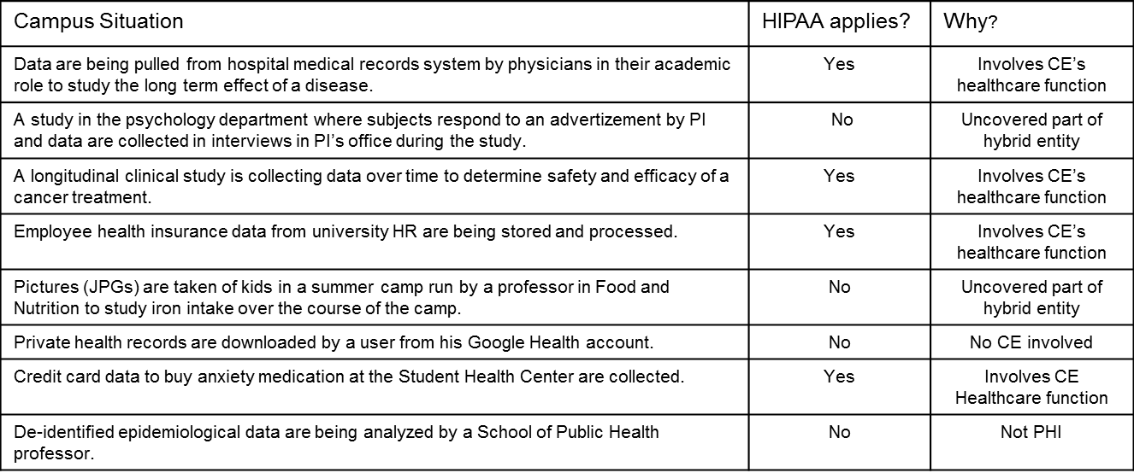
What is/isn’t Covered by HIPAA …basically, if no healthcare component then not PHI

Slide 12
HIPPA @ Indiana University
Research Computing Biomedical
Form Research HIPAA Team
Include Enterprise Infrastructure Team
Form HIPAA Governance Team
Disbanded HIPAA RT Governance Team
Form University HIPAA Compliance function
2008
2009
2010
2011
2012
2013

Slide 13
Why start with research ?
Massive data storage and super computers
Life sciences large research component
Beyond departmental scope and capability
Increasing regulatory and compliance complexity
IU Research IT able to apply research processes to medical research data needs and technologies
60% Indiana University research efforts lends to healthcare

Slide 14
HIPAA Alignment
WHY?

Slide 15
HIPAA Alignment Process (HOW?)
Get buy-in
Assign ownership
Form partnerships
Document everything
Assess risk
Create & execute risk management plan
Retain external consultant
Perform gap analysis
Fill gaps
Get official blessing & advertise

Slide 16
HIPAA Aligned Services @ IU
SaaS
PaaS
IaaS

Slide 17
HIPAA Control Stack
Users
Administrators
Controls needed to manage all layers of the stack needed for each HIPAA aligned service
Applications
Interfaces
Software
Platform
Infrastructure

Slide 18
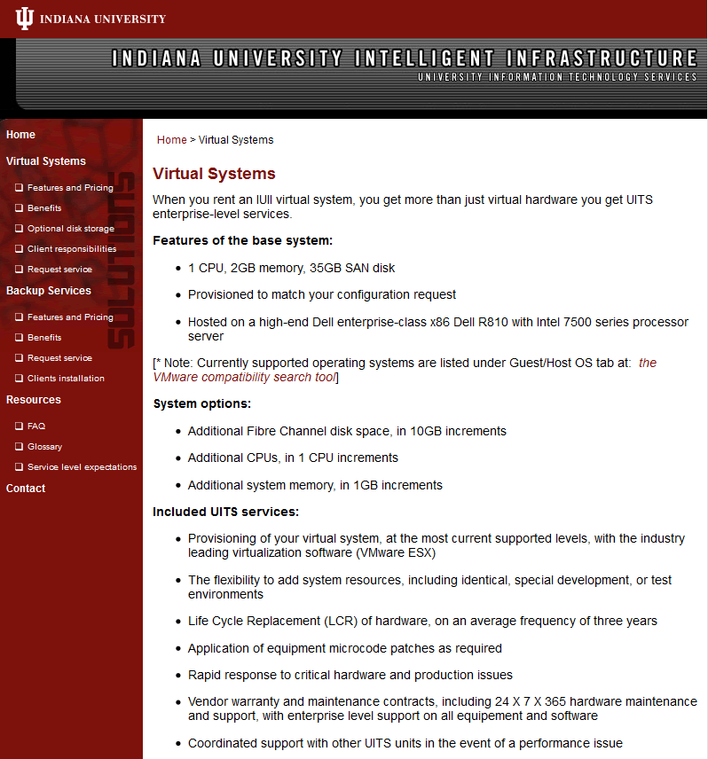
Infrastructure as a Service
Data Center Co-location
Provide rack space, cooling, power in secure hardened data center
Virtual Systems
Provide robust, cost effective, energy-efficient virtual, secure servers within a cloud environment
Registered Envelope Service
Data loss prevention appliance (Ironport) to encrypt email containing sensitive data

Slide 19

Platform as a Service
SMART Services@ Indiana University
Enterprise system and database administration for
health care and health care research providers
HIPPA aligned service
IU Healthcare affiliates supported:
Regenstrief Institute – advanced healthcare research
Indiana CTSI – Clinical and Translational Sciences Institute
Hoosier Oncology Group – cancer research

Slide 20
Software as a Service
REDCap - Research Electronic Data Capture
Easy-to-use database management tool for capturing, using and sharing of research data
Alfresco Share
Online collaboration and data sharing tool includes safe, fast and secure large file sharing
Slashtmp
Share data via a web interface, for files that are too large to send via email
Sharepoint
HIPAA aligned Microsoft Sharepoint services

Slide 21

Indiana University Data Center Service
Firewalls
ACL’s
VLAN Segments
IP Zones
Site to site VPN
Encryption at rest
Encryption in transit
Biometric access security
Standard Operating Procedures
F5 Tornado Proof

Slide 22
Benefits to HIPAA Alignment at Indiana University
Research Grants
Clinical Practices
NIH
Healthcare Research
Quality of Care Studies
IU School of Medicine Affiliates
Student Enrollment
Partnership with IU Health
Advances in Medical Education

Slide 23
Benefits – Before and After
Item | Before | After
Number of biomedical user accounts | 10 | 2,800
Volume of biomedical data store | 2TB | 500TB
Use of computing cycles |  | 1 MSUs
Number of database | 4 | 700
RC services for biomedical users | 2 | 10
Number of major NIH grants we are part of | 1 | 6
Number of Healthcare Affiliates | 0 | 4
Number of FTE’s funded by these grants | 0 | 4

Slide 24
HIPAA 2.0
HIPAA in the Cloud
Vendors must sign BAA
Private, HIPAA-aligned clouds?
Some are moving forward, with vendors such as Microsoft, Firehost, LogicWorks, Amazon WS, etc.
HIPAA compliant messaging
Social media and HIPAA

Slide 25
Conclusions
It is possible to become HIPAA aligned? YES!
Is it worth the expense? YES!
It builds a foundation & culture of security
It creates a set of resources to align with other regulations
If you build it, they will come.

Slide 26
Q/A
Where do you go from here?

Slide 27


Resources
The HIPAA Security Rule
http://www.hhs.gov/ocr/privacy/hipaa/administrative/securityrule/index.html
NIST 800-66: Guide to Implementing the HIPAA Security Rule
http://csrc.nist.gov/publications/nistpubs/800-66-Rev1/SP-800-66-Revision1.pdf
NIST 800-53: Recommended Security Controls
http://csrc.nist.gov/publications/nistpubs/800-53-Rev3/sp800-53-rev3-final_updated-errata_05-01-2010.pdf
NIST 800-53A: Guide for Assessing Security Controls
http://csrc.nist.gov/publications/nistpubs/800-53A-rev1/sp800-53A-rev1-final.pdf
FIPS 200: Federal Systems Minimum Security Requirements
http://csrc.nist.gov/publications/fips/fips200/FIPS-200-final-march.pdf
NIST HSR Toolkit
http://scap.nist.gov/hipaa/
Significant contribution of material from:
Bill Barnett Ph.D. - Director, Science Community Tools
Anurag Shankar Ph.D. - Principal Project Analyst, UITS/IU School of Medicine
Indiana University

