Slide 1
What's Your Carbon Footprint? Sustainability and Green IT Initiatives That Make a Difference
MARC
January 8, 2009

Slide 2
A Hot Topic, but
What are we talking about?
Is “sustainability” a current fad or truly significant?
Notes:
Ambiguity in language
n Discuss “sustainability”, “climate change”, “green”
*General agreement that significant climate change is occuring----the debate as such is the effect of human activity on climate change.
*Refer to the Intergovernmental Panel on Climate Change

Slide 3
Sustainability, Green, Climate Change, Green House Gases…
Wide ranging, and overlapping, vocabulary
  “Sustainable”: Human systems have less impact on ecological systems
  “Green”: Focused on efficient use of resources
  “Climate Change”: Focused on reducing emission of Greenhouse Gases

Slide 4
“What does this mean for society? A vast majority of climate scientists agree with the IPCC consensus that Earth will warm along with increasing greenhouse gases. However, the effects will be far more varied than a simple and uniform warming over the entire planet, because heating also alters the water cycle, among other changes. As a result, some regions will become considerably hotter or cooler, or wetter or drier, than others.”
http://www.ncar.ucar.edu/research/climate/future.php

Slide 5
Role of HE in Sustainability Initiatives
Research
Education of coming generations and community at large
Operations

Slide 6
My Context for Engagement
American College and University President’s Climate Commitment*
Chancellor’s Initiative
Governor’s Initiative
All 13 University System of Maryland Institutions Signed Commitment
*http://www.presidentsclimatecommitment.org/

Slide 7
Who Do Campus Leaders Turn To For Operational Sustainability?
Physical Plant
Capital Planning
Question To Be Asked
  What is the role of the IT organization??

Slide 8
Study for an ECAR
Research Bulletin*
All Maryland institutions where President signed commitment
  Plus University of Penn.
  19 in all
Hour long interview with CIO
Survey
  What initiatives
  Barriers
  Most important
*not an ECAR Research Study

Slide 9
Main Foci
Policy
  E.g. teleworking
Practice
  E.g. buying energy star hardware
Technology
  E.g. Virtualization

Slide 10
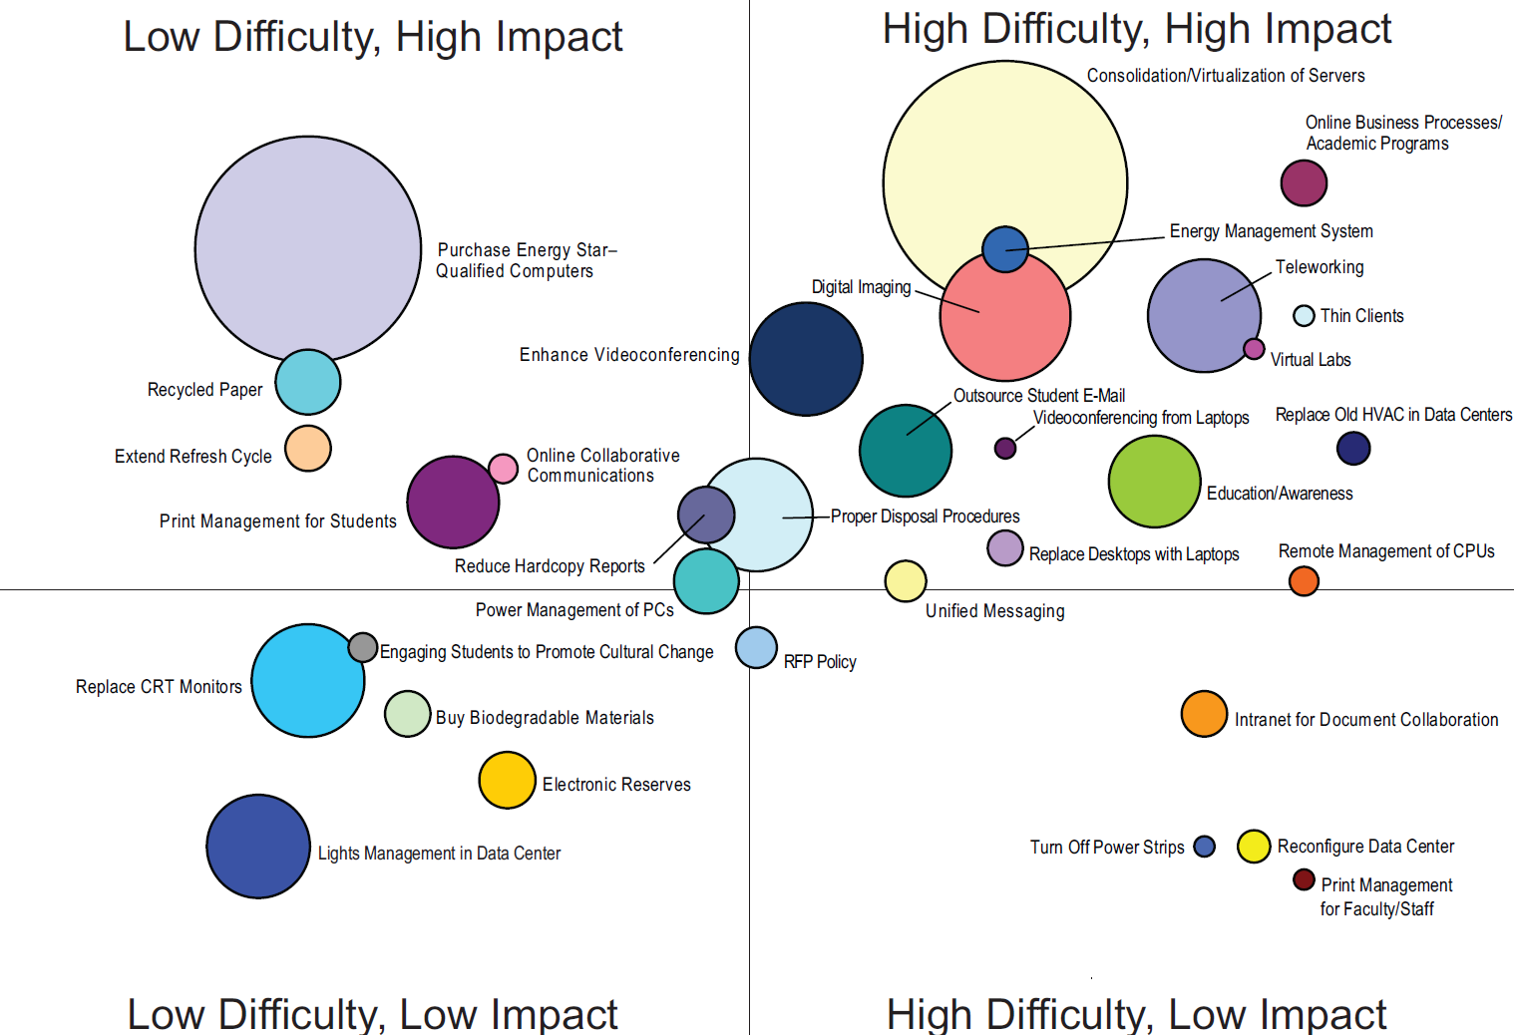

Slide 11
General Threads
IT unit operations
  Focus on Data Center
IT operations around campus
  Desktops
  Distributed servers
IT in support of other initiatives
  Teleworking
  Online classes
  Online business processes

Slide 12
IT Initiatives Making a Difference
Philadelphia University
Undergraduate and graduate programs
Six schools
3,400 total student head count
2,850 total undergrads
1,250 resident
110 acre campus
Programs include engineering, industrial design, architecture, and sustainable design

Slide 13
Students Drive the Shift to Sustainability
Engineering, industrial design, architecture, and sustainable design students
Asked hard questions
Obvious topics
Several obscure
Distinct focus on recycling
Bicycle program
Philly CarShare site
Consumption measurement /competitions

Slide 14
A Campus-Wide Sustainability Committee
Students,faculty, and staff membership
Two members of OIR are committee members
Broad range of green issues
Many involving technology
Recycling
Disposal
Energy consumption
Opportunities were abundant, direct and indirect

Slide 15
IT Involvement and Action
Identified low difficulty, low impact
Electronic reserves (in place prior to green inits.)
All-in-one PCs with LCD monitors (since 2001)
Quickly moved to low difficulty, high impact
Recycled paper, letterhead, and toner cartridges
Print management and quotas (since 2003)
Elimination of printed directories, documentation
Energy Star purchases
Solar-powered emergency phones (planned)

Slide 16
IT Involvement and Action
Focused on high difficulty, high impact activities
Outsourcing services
Student email, CMS
Reduces our carbon footprint
Disposal techniques and practices
Render farm
Unified messaging
Replace aging voicemail system
Reduces our carbon footprint

Slide 17
IT Involvement and Action
Focused on high difficulty, high impact activities
Outsourced telephone services
Reduces our carbon footprint (cooling and HVAC)
Data Center power generation
Multiple purpose
Synergy and opportunity
Close/consolidate labs
Relocate computing resources
Library, Student Center, Residence Halls
Potential for energy savings
Reduction in shuttle van schedule
Safety benefits

Slide 18
IT Involvement and Action - Next Stages
Student Suggestions
Focused on education
Consumption/conservation
Paper saving (micro)
Student technology ownership
Presents additional need to conserve/educate
Opportunities to partner and address needs
Printers
Large LCD TVs
Gaming

Slide 19
IT Initiatives Making a Difference
Focus on conservation
Continuously educate and communicate
Identify areas of synergy
Participate in campus green committees
Solicit suggestions and participation
Report and publicize results

Slide 20

Penn Green IT
MARC
January 8, 2009

Slide 21
Penn Landscape
University of Pennsylvania
Philadelphia, PA
24,107 students
  includes graduate/professional students and undergrads
20,381 staff and faculty
750+ staff with IT-related jobs
Responsibilities, decision making and funding are highly decentralized

Slide 22
Collaboration & Communication
Green Teams sprouting up all over campus in different schools/centers—Green IT and beyond
IT participation planned in Recylemania 2009 events
Green IT a regular topic of discussion at annual Penn IT staff event

Slide 23
Collaboration & Communication
Cross-campus working group of IT staff created last Spring to make Green IT recommendations—documented work online
  Data Centers and Servers
  Desktops and End Users
Developed a Green IT web site, focused on what actions end users can take to green up their computing practices
  http://www.upenn.edu/computing/greenit/
  Communications blitz imminent

Slide 24
6 Areas of Focus for End Users
Green Purchasing
Reducing Electricity Consumption
Appropriate E-Waste Disposal
Batteries, Batteries, Batteries
Smart Printing
Other Green Work Practices

Slide 25
Focus on Purchasing
Consider buying small form factor or all-in-one desktops.
Purchase new displays every other computer replacement cycle, instead of every cycle—although do replace those CRTs.
Do not buy a bigger monitor than you need.
Purchase desktops that are Energy Star 4.0-compliant.
Consider purchasing solid-state drives instead of traditional hard drive technologies in order to reduce power consumption.
Notes:
Almost all current desktops can achieve basic Energy Star compliance, but less than 25% currently comply with the more stringent Energy Star 4.0.

Slide 26
Focus on Purchasing
Purchase multiple pieces of equipment from the same vendor at the same time to reduce cost and carbon footprint associated with multiple shipments.
Request fewer manuals and copies of drivers/installation media when placing bulk equipment orders.
Work with vendors when placing bulk equipment orders to receive them without individual packaging.
Notes:
Almost all current desktops can achieve basic Energy Star compliance, but less than 25% currently comply with the more stringent Energy Star 4.0.

Slide 27
Focus on Reducing Electricity
Shut down computers at the end of work days or work sessions.
Turn off unused monitors, printers, and other peripheral equipment, even when computers cannot be turned off.
Invest in a Smart Strip, a power strip which shuts off electricity to other outlets on the strip when a device connected to the "master" outlet is powered off.
Set your monitors to enter an energy-saving "sleep" mode after a specified period of inactivity.
Do not use screen savers.
Turn down the brightness setting of monitors and laptop displays.

Slide 28
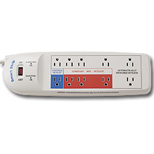
My Favorite Eco Gadget…
Smart Strip
Retails $30-$40

Slide 29
Focus on E-Waste Disposal
Work with IT Support to make sure all data is securely wiped from your hard drive, before sending computers to be donated or recycled.
Choose a reputable e-waste recycler who will make sure the devices are disposed of properly.
Donate old equipment to give your computer a second life.
Use vendor recycling programs. Programs are available through Dell, Apple, HP, and Lenovo.
Participate in municipal hazardous waste collection days

Slide 30
Focus on Battery Devices
Do not overcharge batteries.
Unplug power adapters when they are not in use.
Recycle your old cell phone by donating them.
  Make sure that you wipe it clean of all of your personal data before recycling.
Use rechargeable instead of disposable batteries.
  Disposable alkaline batteries can take a lot more energy to produce than they provide.
  Fewer batteries used can reduce the amount of lead, mercury, and other heavy metals from leaking into the water supply.
Dispose of all batteries properly. Penn’s Office of Environmental Health and Radiation Safety recycles batteries or use national non-profit like Call2Recycle Program.

Slide 31
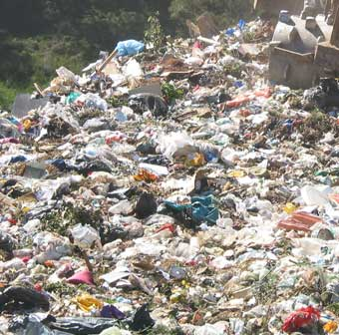
Paper, paper, everywhere…
Paper accounts for more than 40% of a typical landfill's contents, according to the EPA's web site.

Slide 32
Focus on Printing
Print as little as possible.
Distribute documents electronically.
Reduce font size and margin size to reduce paper usage.
Print on both sides of the page whenever possible and appropriate.
Set your printer to draft/ink-saving mode when you don't require high-quality printing.
Use Ecofont to save ink.
Print in black-and-white when color is not required.
Use recycled paper.
Save discarded paper to be used as scratch paper.
Place well-marked paper recycling bins near printers, copiers, and doors.
Recycle depleted toner cartridges.
Notes:
Bookstore has a toner cartridge recycling

Slide 33

Ecofont by SPRANQ, Netherlands
Reported to use up to 20% less ink
Suggested font size 9 or 10 pt.

Slide 34
Focus on Work Practices
Use E-Fax instead of a traditional fax.
Utilize instant messaging (IM).
Explore online collaboration tools and document stores, like wikis and content managers.
Use all the features of available teaching tools, like Blackboard, etc.
Conduct meetings through video conferencing or teleconferencing especially when traveling is far away and costly.
Promote flexible work arrangements which include teleworking.

Slide 35
Penn (and Wharton!) Green IT
MARC
January 8, 2009

Slide 36
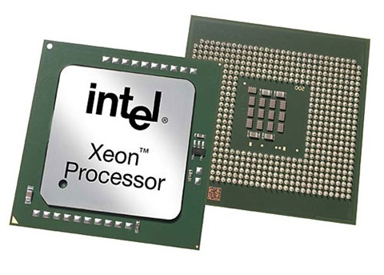
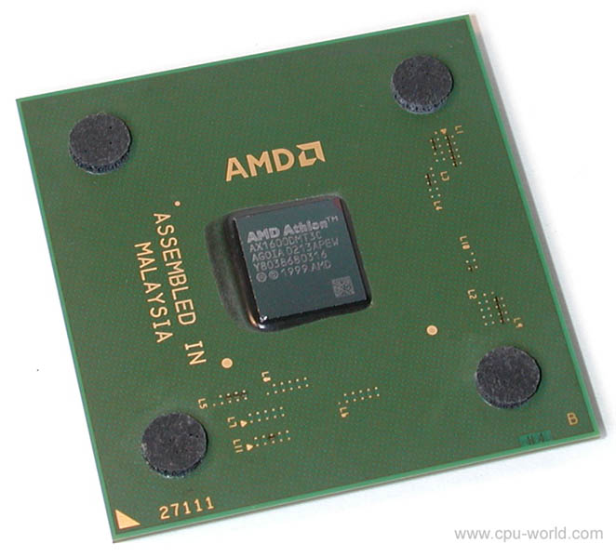
Focus on Servers
Low-voltage CPUs

Slide 37
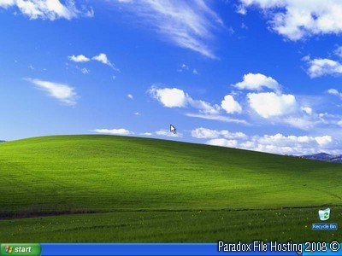
Focus on Servers
Extend your server life

Slide 38
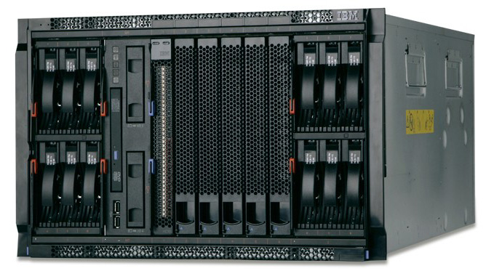
Focus on Servers
Rack-dense Form-factor

Slide 39
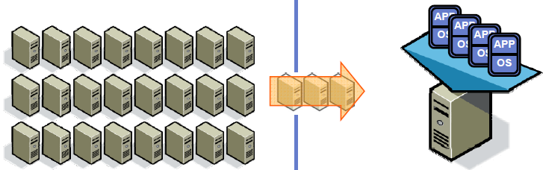
Focus on Servers
Consolidate & Virtualize

Slide 40
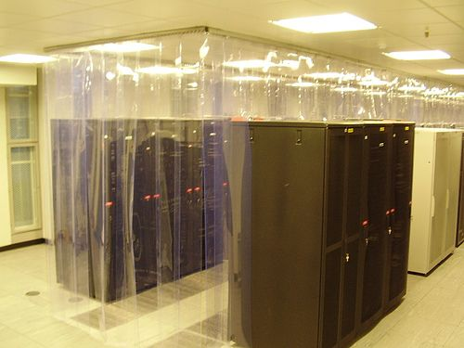
Focus on Data Centers
Hot aisle & Cold aisle

Slide 41
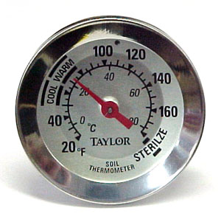

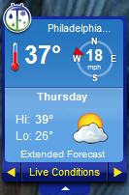
Focus on Data Centers
Free Cooling and Raise Setpoints

Slide 42


Focus on Data Centers
208V (480V?) & 3-phase

Slide 43
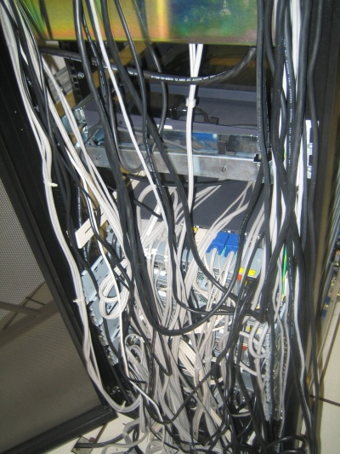
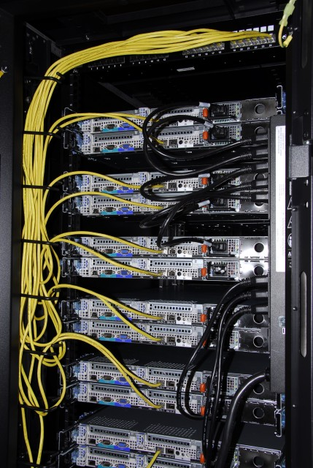
Focus on Data Centers
Racking and Cabling

Slide 44

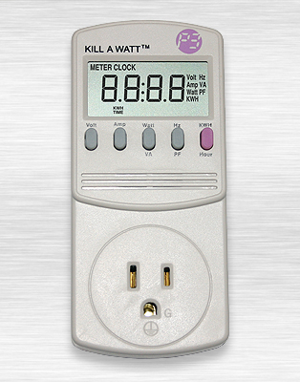
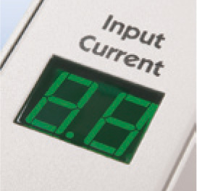
Focus on Data Centers
Monitor, Meter, Report, Analyze

Slide 45
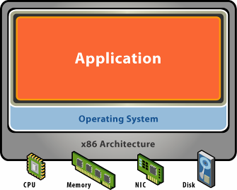
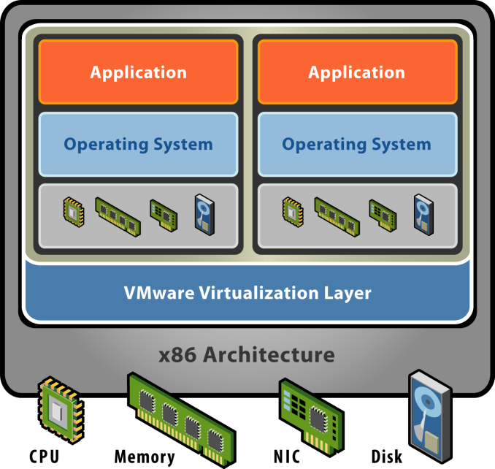
Focus on Virtualization
What is it?

Slide 46
Focus on Virtualization
Server Virtualization
25 Blades and 200 VMs

Slide 47



Focus on Virtualization
Storage Virtualization

Slide 48
Questions to Take Back to Your Campus
Has your institution made any enterprise climate commitments?
  If not, why not?
  If so, have you engaged in a baseline assessment of energy use?
    You need to know where you are
    You do what you measure
What initiatives do you have underway that have climate change impact?
  Note they may not have been initiated with climate change in mind.

Slide 49
Recall the 3 operational areas---policy, practice, technology
  What can your campus do in each area?
  What is the role of the IT organization in supporting these activities?
Can you form alliances with other campus units in effecting operational changes?

Slide 50
How can you get leadership from the top to relay message that this is important and may take resources?
What are the cultural barriers on your campus that might need to be addressed moving forward?

Slide 51
Continue the Conversation
dspicer@usmd.edu
cepullj@philau.edu
amyp@upenn.edu
guamaniac@wharton.upenn.edu
@guamaniac on twitter

