Slide 1
Enterprise Storage at Seton Hall University
Matt Stevenson – IT Architect
Seton Hall University
stevenma@shu.edu

Slide 2

About Seton Hall University
Located in South Orange NJ
Approx 12,000 Students/Faculty/Staff
Main campus and Law School

Slide 3
Enterprise Storage Focus
Part of a larger virtualization effort
“Virtualize Everything”
  Servers
  Desktops
  Network
  Storage
All storage is using “storage virtualization”

Slide 4
What is storage virtualization?
Layer residing between the host (server, desktop, etc) and the physical storage array (out of band or in band)
Manipulates physical array(s) to overcome array limitations (maximum LUNs, number of partitions, replication, mirroring, heterogeneous storage environments)
Platform is usually one of the following:
  Stand alone appliances
  Included in the physical array
  Storage switch based

Slide 5
History 2004 / 2005
In 2004 SHU had stand alone servers and various disk islands
Most storage was direct attached
Standard “1U” rack servers, one per application

Slide 6
Architectural Changes (1)
Implement SAN
  Reduce dependency on direct attached disk
  Provide more centralized management of disk
Reduce server sprawl
  Research virtualization technology
Focus on Blade technology
  Smaller size, power, and cabling requirements

Slide 7
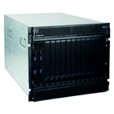
Architectural Changes (2)
IBM Blade Center Technology
  Modular design
  Includes Network, Storage Switch, and Management in single chassis
  Lower power requirements for servers
  70 Servers per rack
  Boot from SAN for no moving parts on blades

Slide 8
Architectural Changes (3)
Implement SAN
Reduce server sprawl
Focus on Blade technology
All led to:
  Requirement for Storage Virtualization

Slide 9
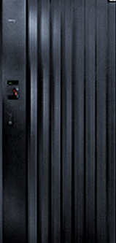
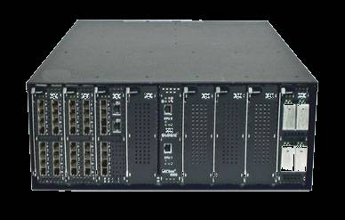
Storage (SAN)
SAN Storage
  IBM DS8000
  StorageTek Flex380
  Sun 6140
SAN Infrastructure
  qLogic SANBox 9000 (Blades)
    Up to 256 Ports (2/4/8G + 10G ready)
    Ability to expand SAN to other buildings/long distance (DR, etc)

Slide 10
Storage Virtualization (1) - Logical
  Server
  SAN Switch
  Virtualization
  Storage
Blade 1
Blade 2
Blade 3
Blade 4
SAN Switch 1
SAN Switch 2
IPStor 1
IPStor 2
IBM
DS8000
Sun
Flex380

Slide 11
Storage Virtualization (2) - Software
FalconStor IPStor software (v5)
  “Virtualizes” all storage, allows resize, assign/remove on the fly
  Allows mirroring/physical disk moves with no downtime (between multiple physical storage units)
  Single “pane of glass” management for all storage
  Freedom from vendor limitations (LUNs, sizes, etc)
  Snapshots of live data possible

Slide 12
Storage Virtualization (3)
FalconStor IPStor software (v5)
  In-band solution
  Active/Active cluster
  Single software interface for all management (Linux/Windows) via Java web start launcher
  Clients available for snapshots for Oracle, Notes/Exchange, SQL Server, etc

Slide 13
Storage Virtualization (4)
Tasks for administrators:
  Mirror data (Upgrades, backups)
  Move data
  Add additional storage from selected tier
  Provision new servers

Slide 14
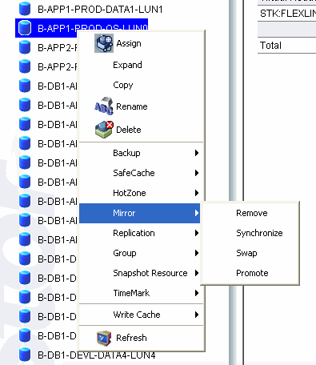
Storage Virtualization (5)
Mirror Command
  Move data
  “Swap” mirrors
  “Promote” mirror to primary storage
Moving storage from one array to another

Slide 15
Migrating storage between Arrays (1)
Step 1
- Mirror Data
Old Array (Primary)
New Array (Secondary)
Mirror Data
Step 2
- Swap Primary/Secondary
Old Array
(Secondary)
New Array (Primary)
Mirror Data

Slide 16
Migrating storage between Arrays (2)
Step 3
- “Promote” Mirrors
Old Array (Secondary)
New Array (Primary)
Break Mirror
Step 4
- Remove Old Storage
Old Array
New Array

Slide 17
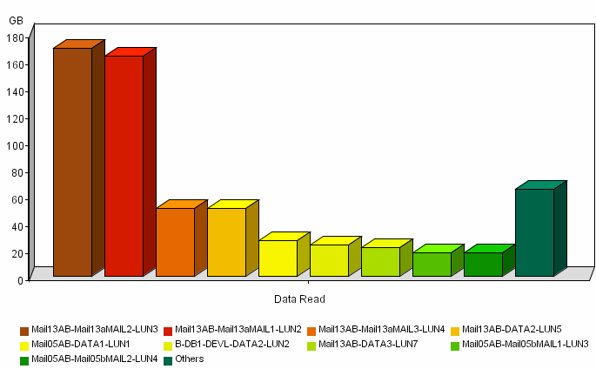
Additional Features
Replication
“Hot Zone”
Snapshots
Reports

Slide 18
System Performance
Applications currently utilizing storage virtualization – 100+ server clients
  Lotus Domino (campus wide)
  Sungard Banner (Approx 12 instances with multiple add-ons)
  File/Print services (campus wide)
  Content management system
  Luminis Portal
  VMWare ESX Servers

Slide 19
Storage Virtualization Sample Configuration
Banner ERP System

Slide 20
Storage Virtualization and Banner (1)
Banner Hardware and Operating Systems
Hardware (Application and DB servers)
  IBM LS21 AMD Opteron Dual Core, Dual Processor blade
  8GB RAM
  4Gb Fiber Channel HBA, Boot from SAN
  Dual GigE Ethernet
Operating System
  RedHat Enterprise Linux AS 3.0 – Update 9 (32Bit)

Slide 21
Storage Virtualization and Banner (2)
Production Banner layout
Prod App Server #1
Prod App Server #2
Banner Prod DB #1
Storage Virtualization
DS8000
Storage
Flex380
Storage
Data Mirrored

Slide 22
Storage Virtualization and Banner (3)
Banner DB Layout
Virtual Disk Mount Point
  32GB OS Filesystems
  32GB /u00/app/oracle
  100GB /u00/archive
  120GB /u00/backup
  30GB /u00/oradata
  100GB /u01/oradata
  32GB /u02/oradata
  32GB /app/sct
Banner App Server Layout
Virtual Disk Mount Point
  32GB OS Filesystems
  32GB /u00/app

Slide 23
Storage Virtualization and Banner (4)
Storage Virtualization Banner tasks
  Mirror Data
    Specific virtual disks or entire system
  Monitor performance
    Read/Write usage of specific virtual disks or entire system
  Resize virtual disks and filesystems when necessary
    RHEL AS 3.0 requires offline filesystem resize
    Online resize available in RHEL AS 4.0+

Slide 24
Storage Virtualization - Review
Single pane of glass for administration
Migration between physical disk arrays is a non-issue
Simplification means no full time storage administrator necessary
Avoid Single Point of Failure
Storage Virtualization Banner usage is no different than any other system

Slide 25
Questions
Matt Stevenson – IT Architect
Seton Hall University
stevenma@shu.edu

