Slide 1
Enterprise Storage at the Institute for Advanced Study
Jonathan Peele – Computer Mgr ITG
Institute for Advanced Study
jmpeele@ias.edu

Slide 2

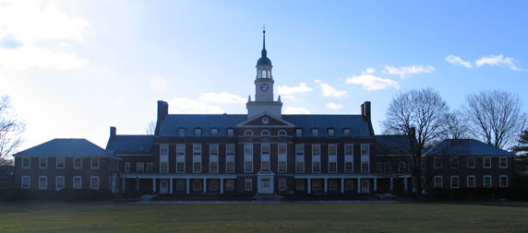
About IAS
Located in Princeton, NJ
Approx 400 Members/Faculty/Staff
Four schools, administration and many programs
  School of Historical Studies - School of Mathematics
  School of Natural Sciences - School of Social Science
IT
  Three computing support groups
  Networking and DB Integration
http://www.ias.edu

Slide 3
Enterprise Storage

Slide 4
Storage Background
Each computing group maintains its own storage devices
Schools have different storage requirements
Many servers are connected to storage resources within each computing group
Storage backups are created on hard drives, tapes or redundant filers
Offsite backups are stored on a variety of media
Notes:
Each group doing its own thing in terms of providing storage and backing up their storage
Schools had different types of data to backup
Administrative departments had different storage and retention requirements

Slide 5
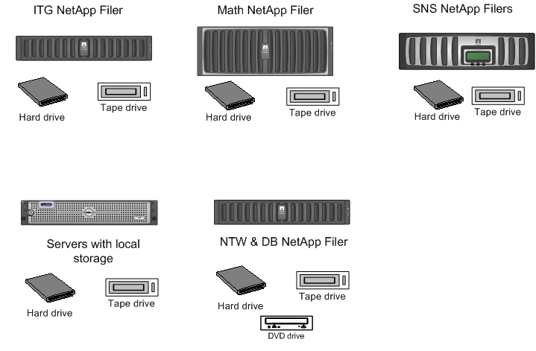
Storage Layout
Notes:
Redo slide with netapps from schools

Slide 6
Goals for Enterprise Storage
Increase storage resources
Consolidate storage
Effortless backups
Quick disaster recovery on multiple levels
Provide a home for storage needed by new campus-wide services
Streamline the process for capturing data for offsite storage

Slide 7
Requirements
Scalable and reliable with fault tolerance
Accessible from different types of platforms
Easy-to-use administration interface

Slide 8
Solution
Based on our requirements, we chose a 85T NetApp FAS3040 with a Sun StorageTek SL48 tape library

Slide 9
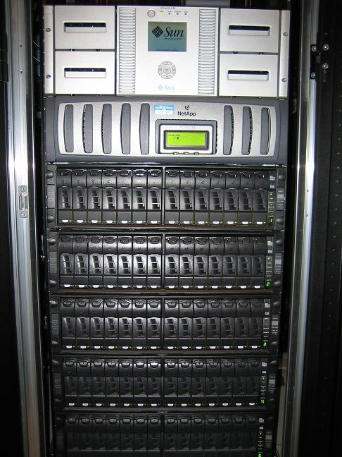
NetApp FAS3040 with tape library

Slide 10
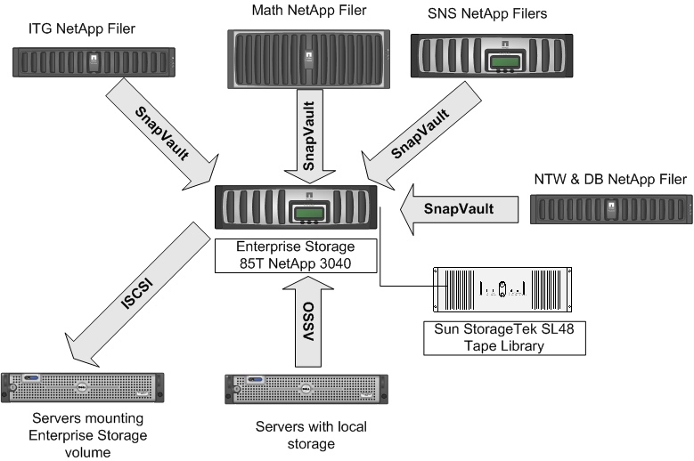
Centralized Enterprise Storage
Notes:
Redo slide with netapps from schools

Slide 11
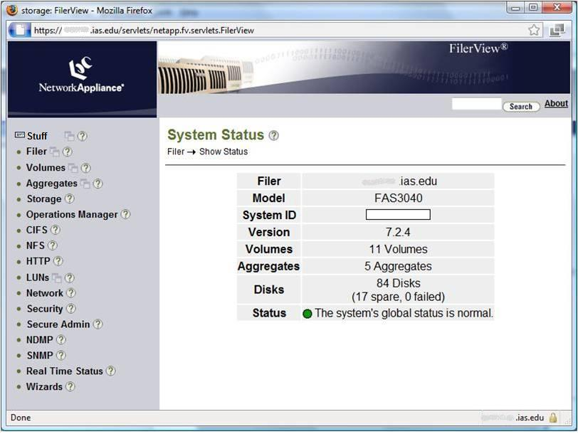
Administration Interface

Slide 12
IAS Storage - Review
Flexible and expandable storage
Saved money over individual NetApp purchases
Provide fast Disk-to-Disk backup for servers using Open System SnapVault.
Centralized backup and recovery for many storage systems on campus
Standardized storage media for offsite backups
IT staff in all computing groups can administer the device.

Slide 13
Contact Information
Jonathan Peele – Computer Mgr ITG
Institute for Advanced Study
jmpeele@ias.edu

