Slide 1
The Hows and Whys of a wireless WPA2/802.1X network
Presenters:
Kevin Koster, Founder and Technical Lead at Cloudpath Networks
Mike Courtney, Network Engineer at Washington and Lee University

Slide 2

Company:
  Headquartered in Denver
  Domain Expertise in Wireless & 802.1X
Focus:
  Simplify Adoption of Standards-based Network Security in Diverse Environments
Benefits of Working With Cloudpath:
  Responsive & Proactive Support
  Shared Knowledge

Slide 3



XpressConnect™ Customers
> 100 Universities > 1 Million Students

Slide 4









XpressConnect™ Capabilities
Comprehensive On-Ramping Tool
  Perform Network Configuration
  Resolve Software Conflicts Affecting Wireless
  Minimize User Errors
  Install Network-Related Software (NAC Agents, Pharos, etc)
  Verify Association, Authentication & DHCP Success
Wireless & Wired 802.1X Networks
Cross-Platform Support

Slide 5
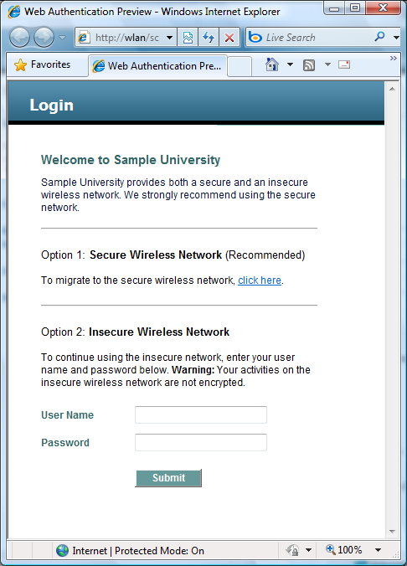

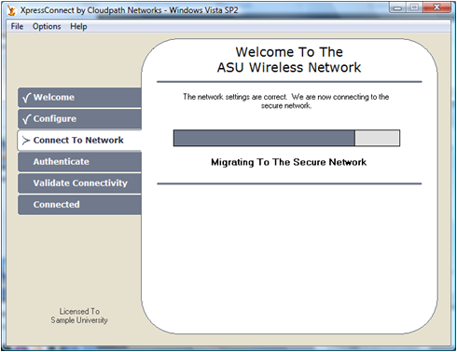
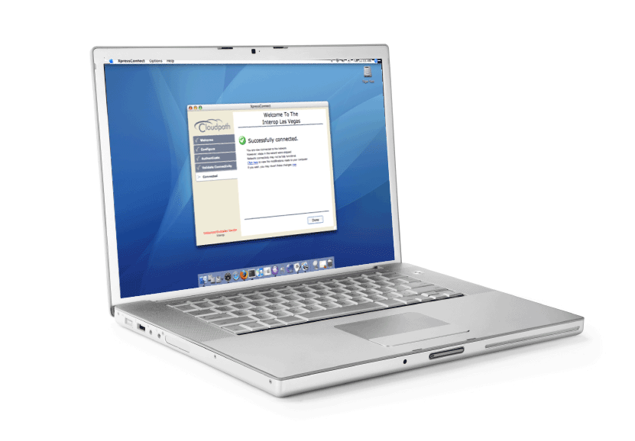
Student Experience – Day 1
univ-open
univ-secure
1
3
2

Slide 6
Student Experience – Day 2+
univ-open
univ-secure
1

Slide 7
Presentation summary
1. Provide a history of wireless networking at WLU
2. Describe the goals of our WPA2/802.1X project
3. Discuss the technologies that implemented those goals
4. The "gotchas" that we hadn't anticipated.

Slide 8
Opening questions
1. How many of you are currently running a WPA2/802.1X wireless network?
2. How many people are currently evaluating a WPA2/802.1X wireless solution?
3. What are you looking to get out of this presentation?

Slide 9
WLU Overview
Washington and Lee University is a top 15 liberal arts university and a top 25 law school located in Lexington, Virginia.
There are approximately 2,200 undergraduate and law students, 250 academic staff members, and 550 professional staff members.

Slide 10
Wireless History
5 Open/Guest SSIDs
3 WPA/802.1X SSIDs
3 Wireless Vendors
2008/09
4 Open/Guest SSIDs (50% Users)
2 WPA/802.1X SSIDs (50% Users)
2 Wireless Vendors
2009/10
1 Open/Guest SSID
1 WPA2/802.1X SSID (>90% Users)
1 Wireless Vendor
Target

Slide 11
New wireless goals
1. A single-vendor wireless solution.
2. A unified SSID schema that would be available to students and staff on- and off-campus.
3. A one-touch software solution to configure WPA2/802.1X for all our staff and student devices.

Slide 12
New wireless goals, cont.
4. Role-based access for students, staff, guests, and MAC authenticated devices.
5. 90%+ of our users on the secure WPA2/802.1X network.
6. To shift the day-to-day operations of the wireless network from Tier-3 and Tier-2 support to our Tier-1 / Help Desk staff.

Slide 13
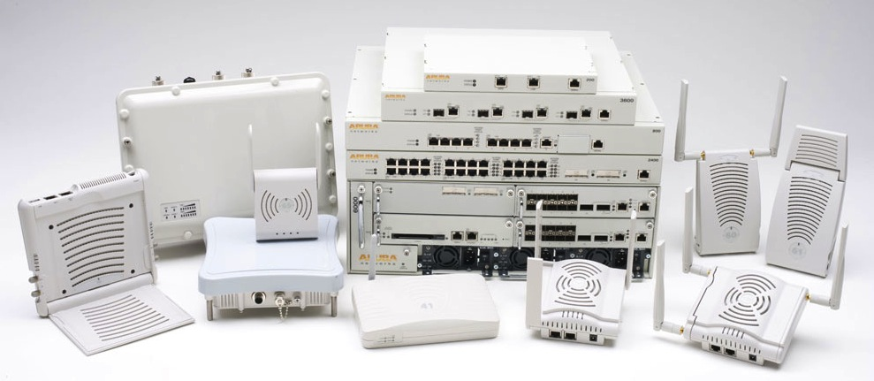
1. Single vendor solution
We chose Aruba Networks for our wireless network
We have deployed 6 wireless controllers and 455 Aruba access points in a single master, 5 local configuration

Slide 14
1. Single vendor solution
Very intuitive GUI and a “Cisco / Brocade” ish CLI
2.4Ghz and 5Ghz 802.11n solution
It takes less than a minute to turn up an entire building
Airwave Management tool is very impressive
Very responsive TAC and sales engineering staff

Slide 15
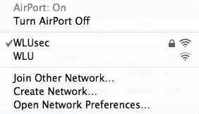
2. Unified SSID schema
We now have two wireless SSIDs on the campus:

Slide 16
2. Unified SSID schema, cont.
WLUsec - WPA2/802.1X - using EAP-PEAP/MSCHAPv2 that authenticates against Microsoft Windows 2008 server running NPS / RADIUS.
WLU – open network that can authenticate AD credentials via LDAP, a guest account, a campus sponsored account, or can provide MAC authentication.

Slide 17
3. WPA2/802.1X software
We chose XpressConnect from Cloudpath Networks
This is the key to our WPA2/802.1X implementation. XpressConnect is a web-based solution that allows students and staff to self-configure their devices.
We have an off-campus and on-campus deployment. (web ASP script on Windows 2008 IIS server)

Slide 18
3. WPA2/802.1X soft., cont.
1. XpressConnect is a quasi-NAC that can be packaged Cloudpath as an IIS, Apache, CD image, or a USB image.
2. It configures Windows XP, Vista, 7, Mac 10.4 - 10.6, Ubuntu 9+, iOS iPods and iPads, Android 2.1+ devices.
3. It saved us an unbelievable amounts of software development hours.

Slide 19
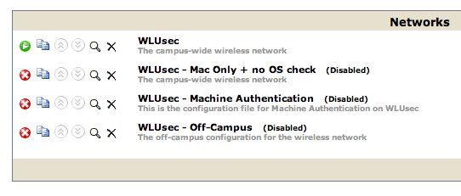
3. WPA2/802.1X soft., cont.

Slide 20

3. WPA2/802.1X soft., cont.

Slide 21
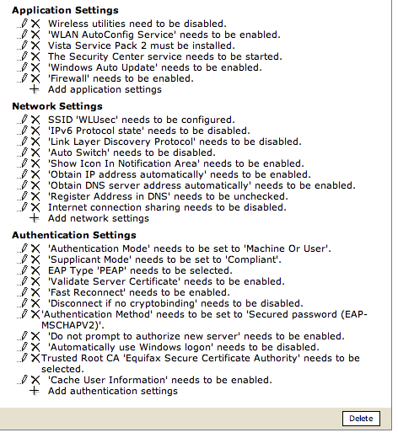
3. WPA2/802.1X soft., cont.

Slide 22
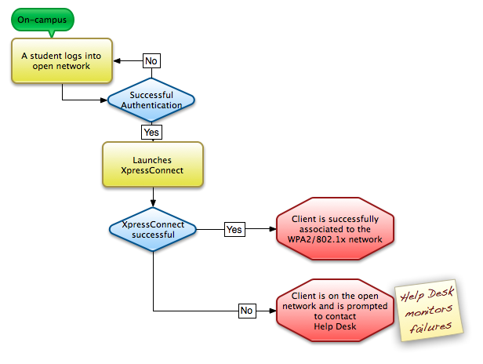
3. WPA2/802.1X soft., cont.

Slide 23
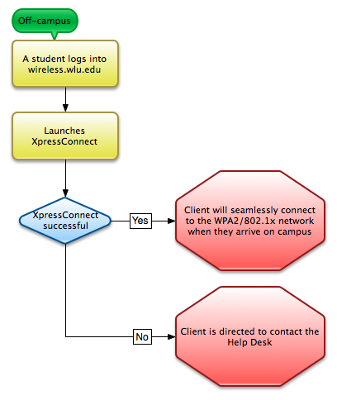
WPA2/802.1X software, cont.

Slide 24
4. Role-based user access
Users derive their security roles via RADIUS, for the WPA2/802.1X network, and LDAP, for the open network
User devices are authenticated via MAC addresses within the Aruba user database.
We can push stateful firewall changes to entire classes of users with a few lines of code or a couple of mouse clicks.

Slide 25
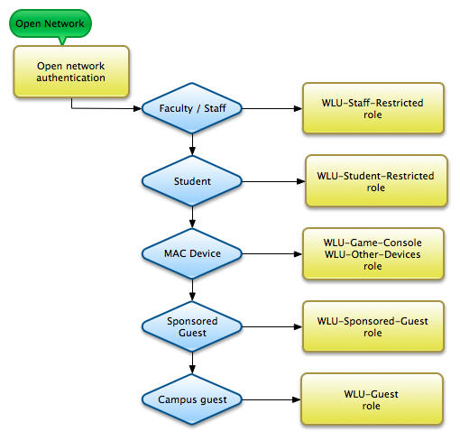
4. Role-based user access, cont.

Slide 26
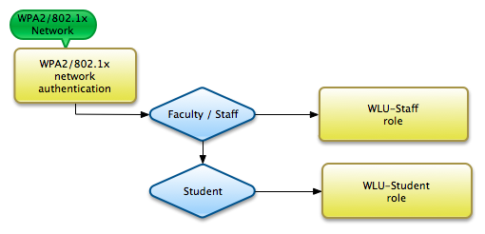
4. Role-based user access, cont.

Slide 27
5. Increasing WPA2 usage
Students expect wireless throughout the entire campus.
That being said, they’ll keep logging into portals over and over and over again…
The question became: "How are we going to force students to use the secure network?”

Slide 28
5. Increasing WPA2 usage, cont.
Answer: stateful firewall “fun restrictions” on “-Restricted” roles
We blocked the following sites on the open network:
  Facebook
  Hulu
  Pandora
  MySpace
  ESPN
  Youtube

Slide 29
5. Current WPA2/802.1X usage
Goal 90%
50%
99%
96%

Slide 30
6. Tier-1 / Help Desk support
The wireless network had been a “black box” for our Tier-1 / Help Desk staff in previous years.
They now have read-only access to Airwave – Aruba’s vendor-neutral wireless management system.
We had staff training to interpret the data in Airwave.
Help Desk staff provisions and creates sponsored guests.

Slide 31
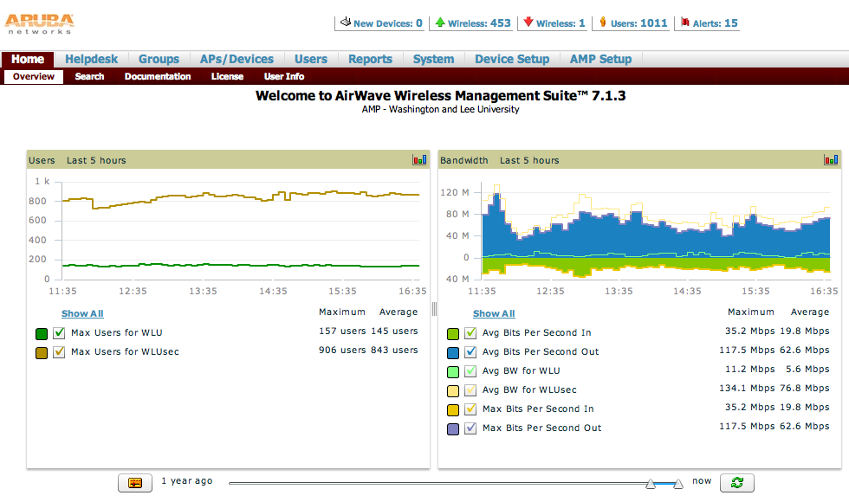
6. Tier-1 / Help Desk support

Slide 32
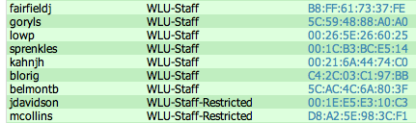
6. Tier-1 / Help Desk support

Slide 33
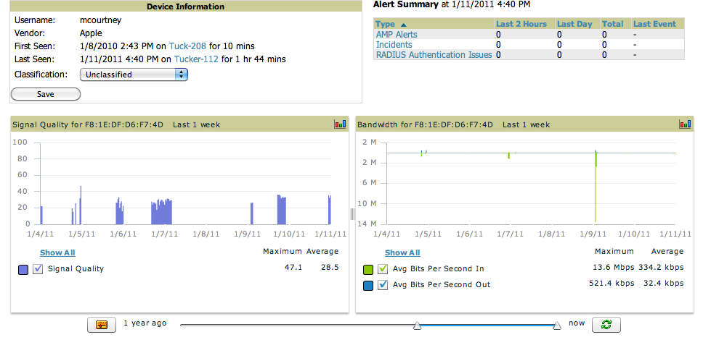
6. Tier-1 / Help Desk support

Slide 34
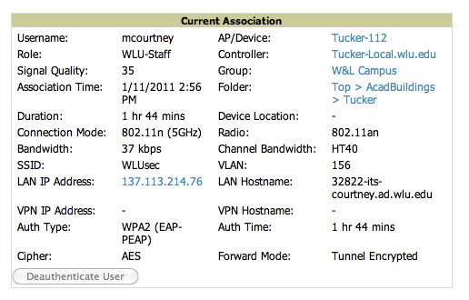
6. Tier-1 / Help Desk support

Slide 35
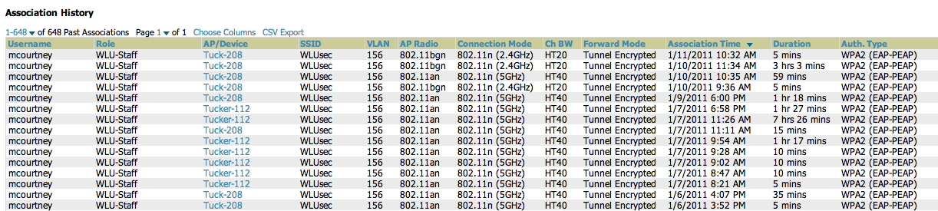
6. Tier-1 / Help Desk support

Slide 36
Successful deployment!
We were able to meet all of our stated goals!
But…
There’s no such thing as a canned WPA2/802.1X deployment… we ran into some “gotchas”…

Slide 37

“Gotchas”
1. Not all wireless 802.1X devices are the same…

Slide 38
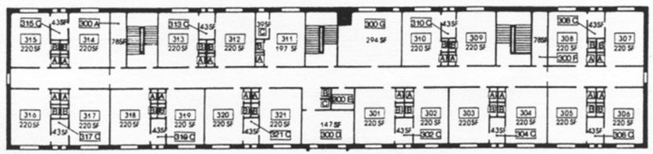
“Gotchas,” cont.
2. A one-to-one replacement of older wireless equipment may lead to problems.
  Hallway deployment of APs may cause problems.
  Apple devices tend to "cling" to 5Ghz

Slide 39
Conclusion
An WPA2/802.1X network is an achievable goal!
96% of students and 99% of staff use WPA2/802.1X
There’s always more work to do…

Slide 40
Contact
Kevin Koster
Founder and Technical Lead – Cloudpath Networks kevin@cloudpath.net
Mike Courtney
Network Engineer – Washington and Lee University mcourtney@wlu.edu

