Slide 1
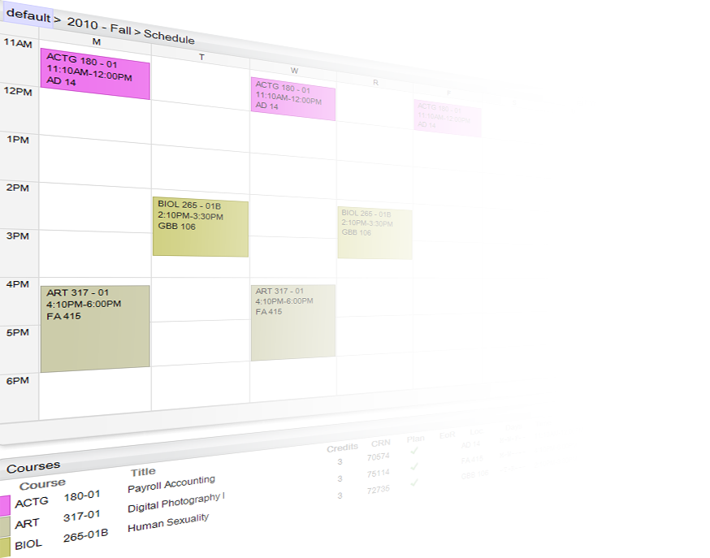

Academic Planner
Loey Knapp, Associate CIO, Technology Support Services
Sharon O’Hare, Executive Director, Office for Student Success
EDUCAUSE Mid-Atlantic Regional Conference
January 13, 2011

Slide 2



The Goal:
Student Engagement & Retention
Tools for Effective Academic
Decision Making
Comprehensive Academic Planning

Slide 3

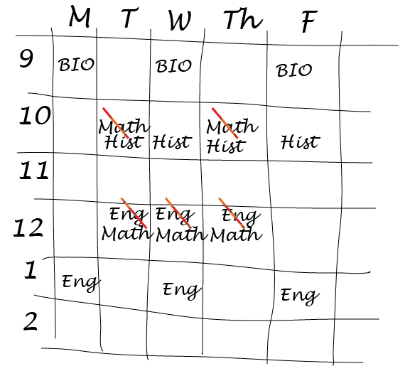
Course Catalog
2007
ERP
-Transcript
-Open Seats
Course listings
Course schedules
Piece of Paper

Slide 4

Course Catalog
2007
ERP
-Transcript
-Open Seats
Course listings
Course schedules
Piece of Paper
Review paper
with advisor
Registration

Slide 5

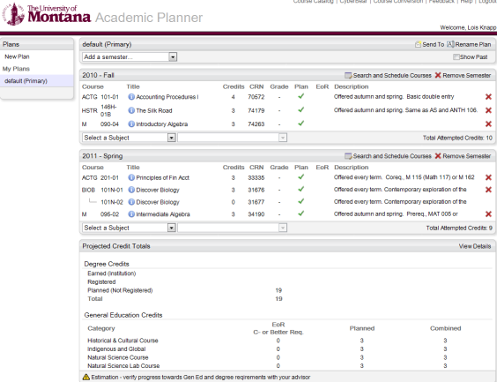
2010
Transcript
Course listings
Course schedules
Open seats
‘virtual piece of paper’
Academic
Planner
V1, 2
Registration
Review plan
Digital Plan

Slide 6
Live Demonstration

Slide 7
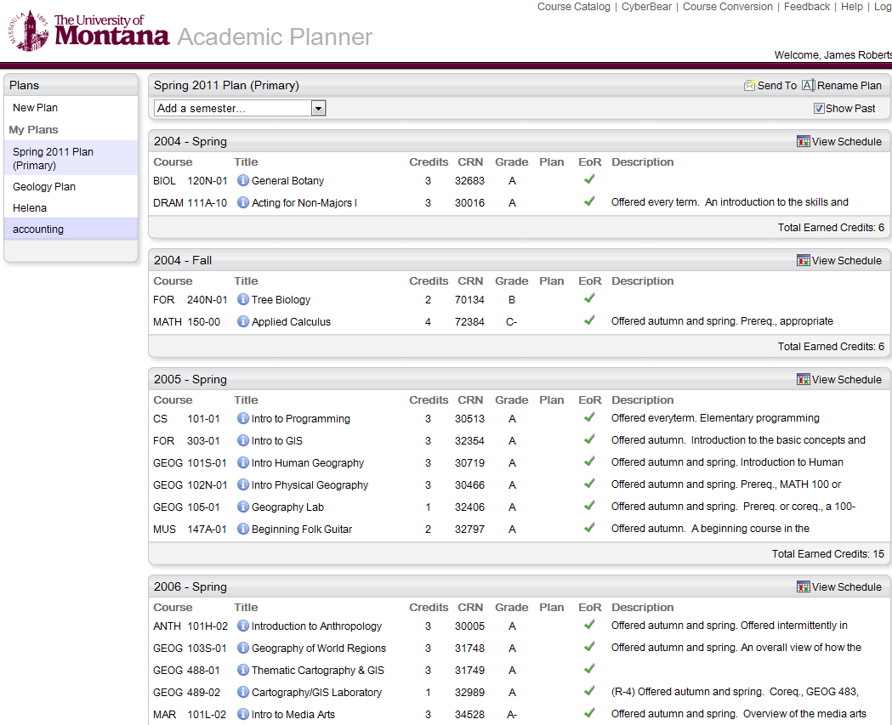

Slide 8
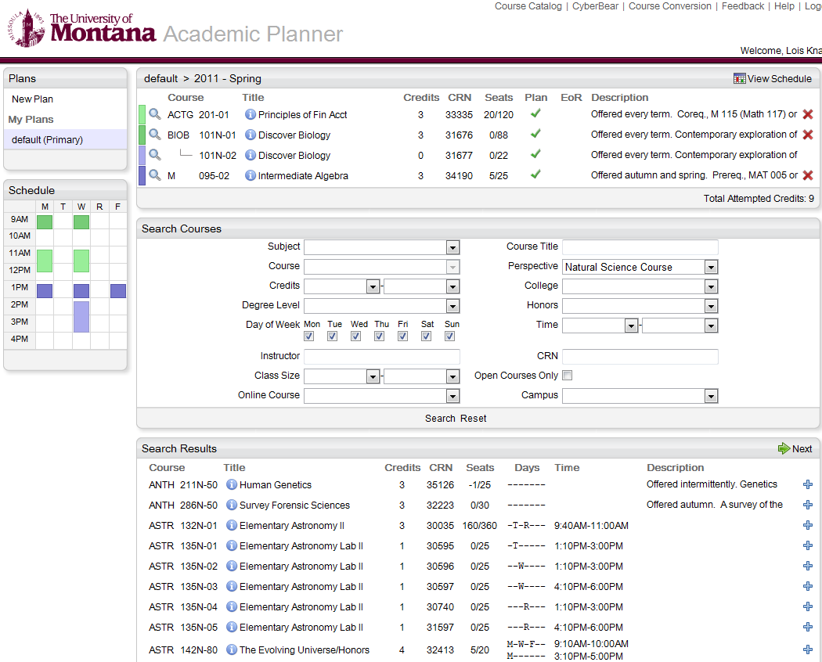

Slide 9
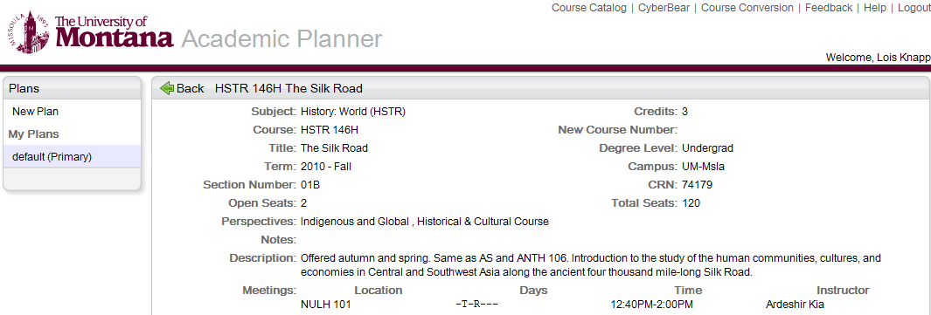

Slide 10
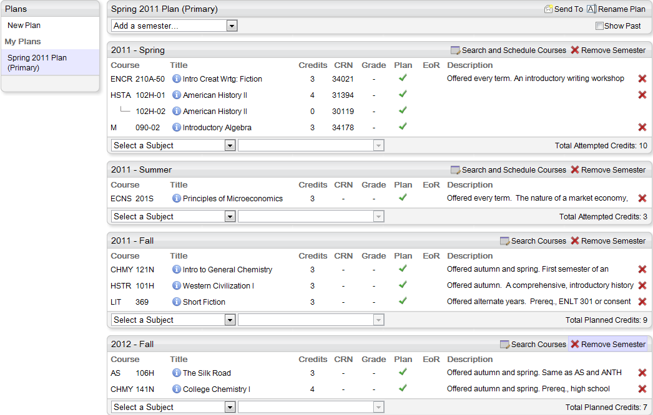

Slide 11
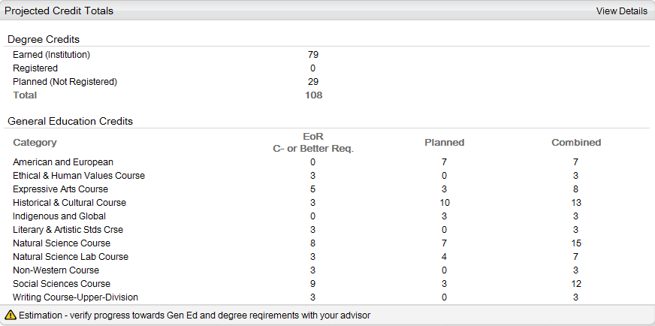

Slide 12
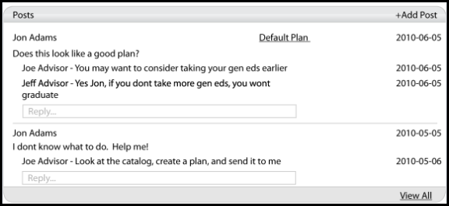
2011
Academic
Planner
V3
- Advising forum
Registration
Posts

Slide 13
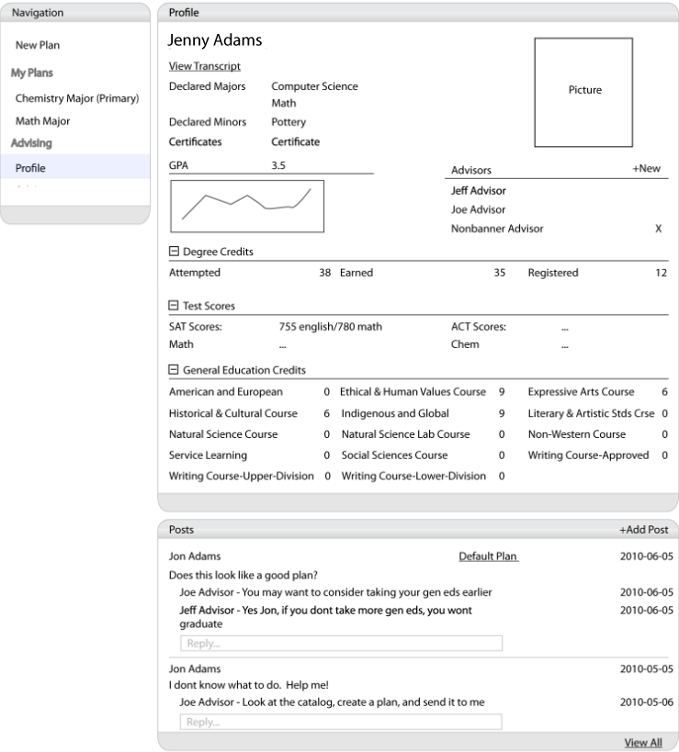
Student
View

Slide 14
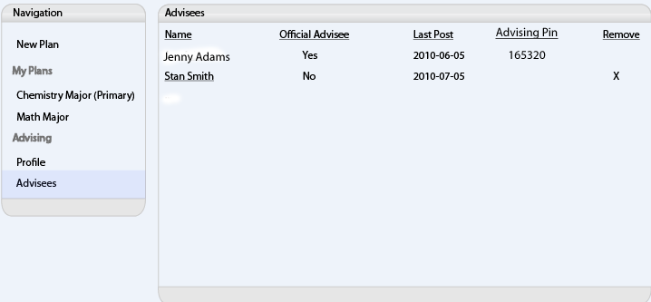

Advisor View

Slide 15
Where has this led?
A lot of student planning activities
  V1 (no marketing): 6,000 plans
  V2 (some marketing): 13,000 plans
Additional tools
  Course search on main UM web page
Additional uses
  Freshman pre-registration

Slide 16
Academic Application: Freshmen Pre-registration
Used by UM’s academic advisors to build schedules for new freshmen BEFORE summer Orientations
2010

Slide 17
Why pre-register freshmen?
Increase Freshmen retention
Ensure freshmen get off to a strong start enrolled in courses appropriate for their major AND college readiness
Increase freshmen engagement with college by guaranteeing enrollment in course(s) that interest them
Create equity - all freshmen have same access to courses

Slide 18
How did we do it?
We collected information
From | Information
Academic Departments | Core Courses for the First Semester
Incoming Freshmen | Their answers to questions on their major’s Academic Interest Questionnaire
 | Placement Test Scores
 | ACT/SAT scores
 | AP Coursework

Slide 19
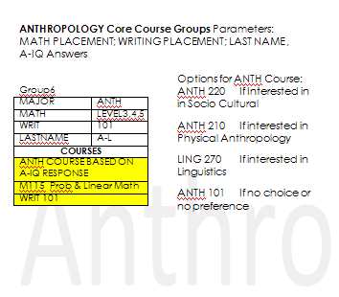
Departments defined the courses for their majors

Slide 20
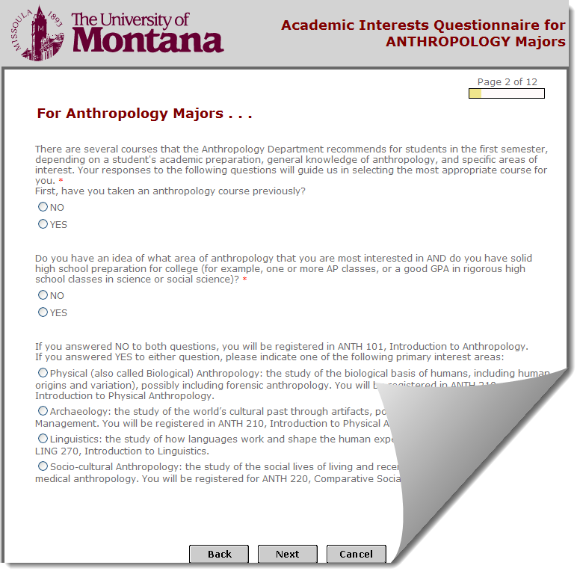
Student’s A-IQ answers told us what courses to select

Slide 21
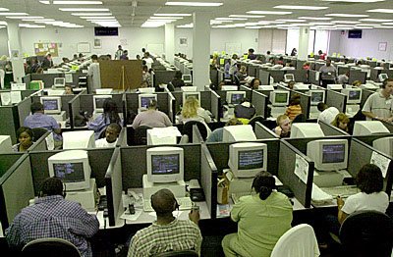

Advisors built schedules for 1600 incoming Freshmen . . .
3 weeks in June
. . . using Academic Planner

Slide 22
Live Demonstration

Slide 23
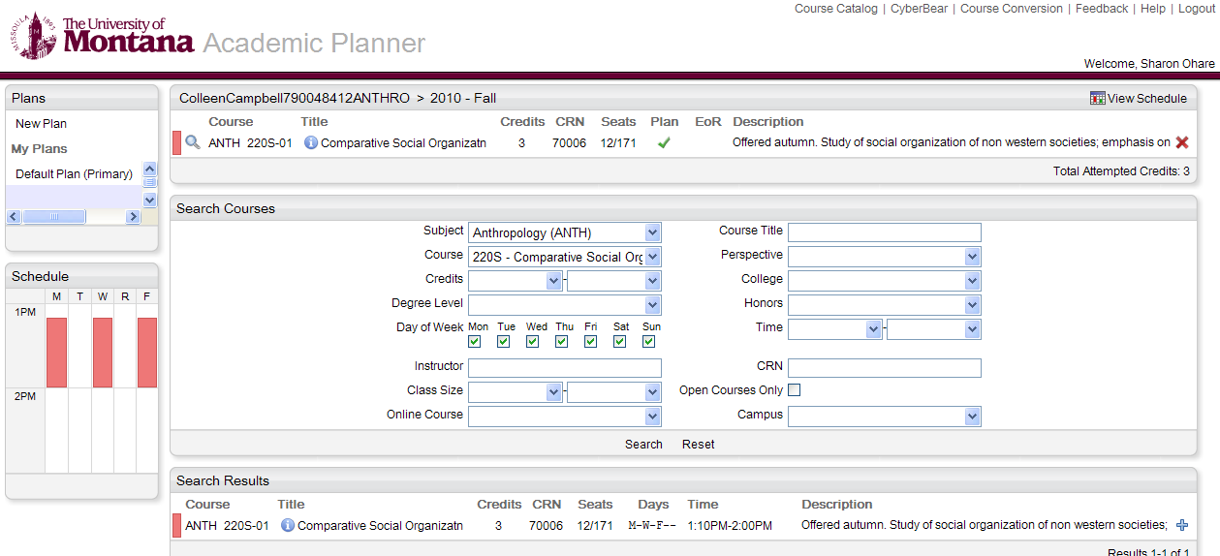

Slide 24
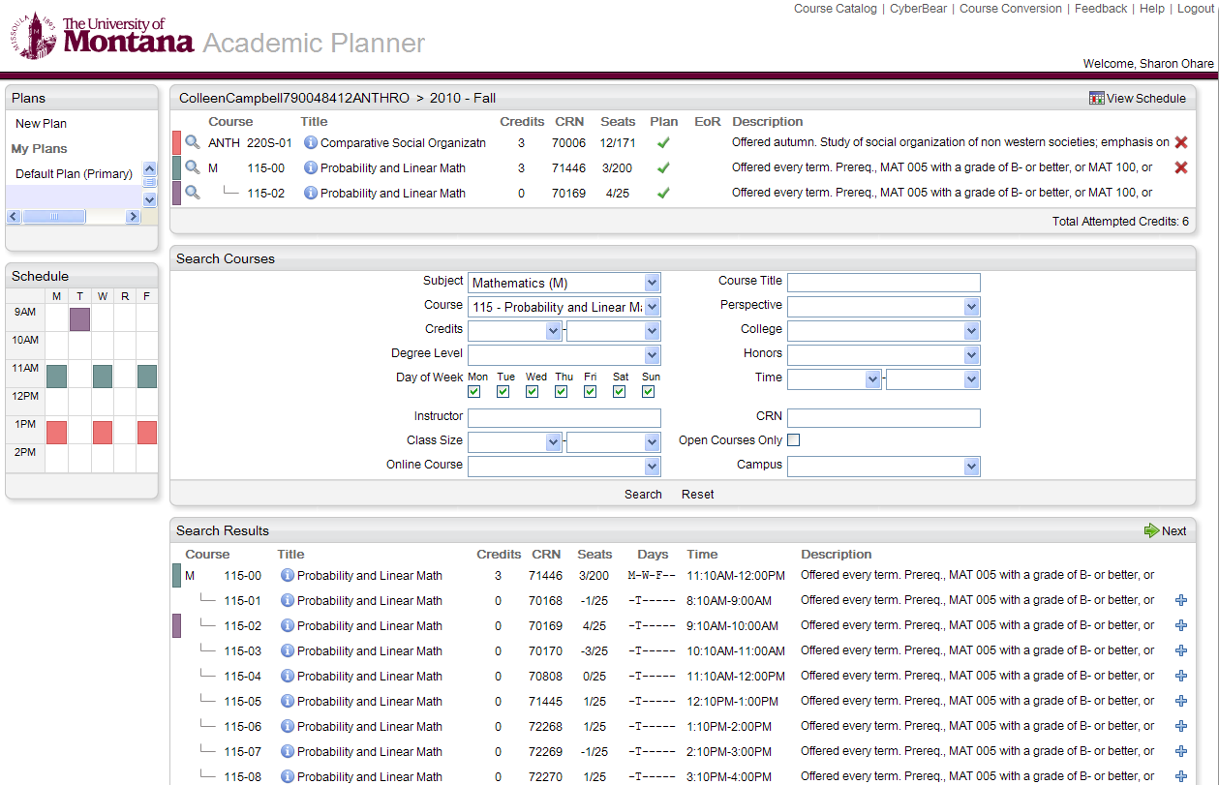

Slide 25
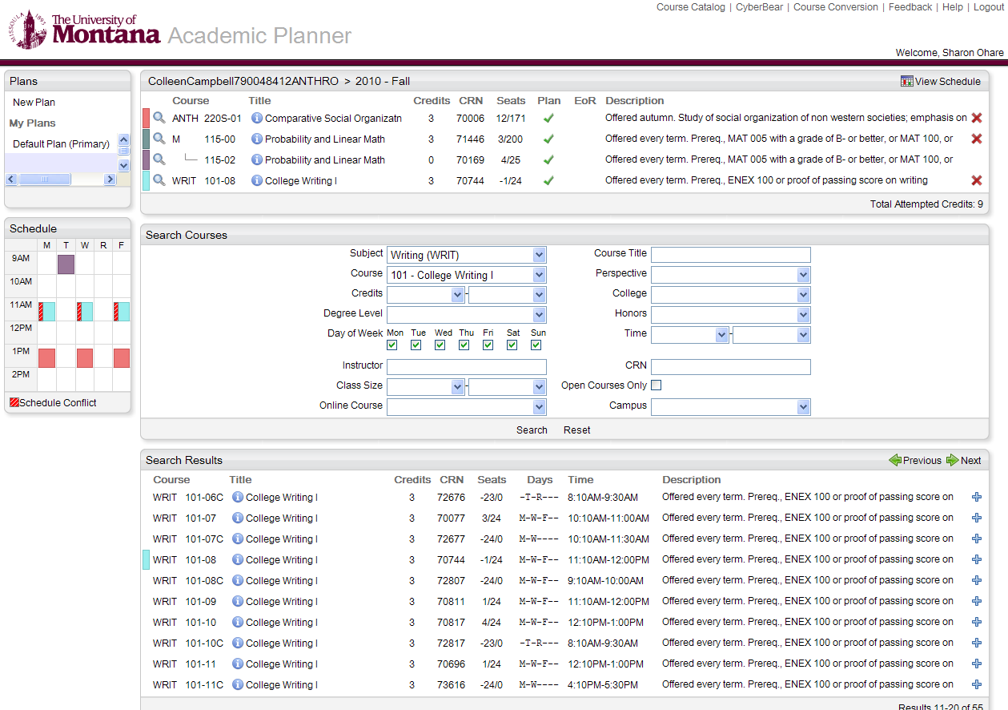
Schedule Conflict

Slide 26
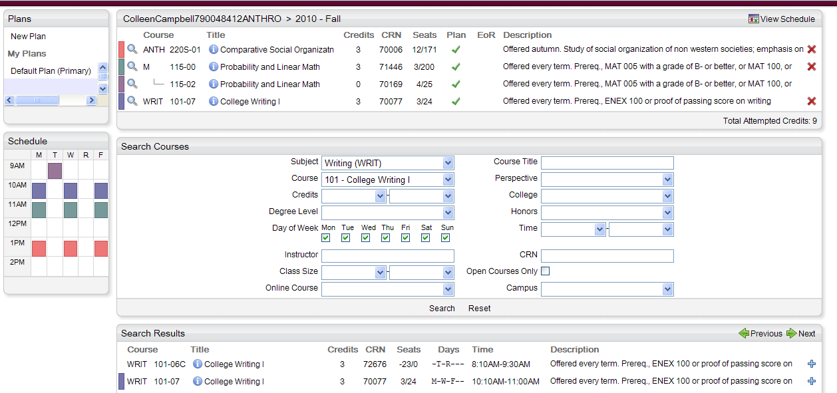
Conflict
Removed

Slide 27
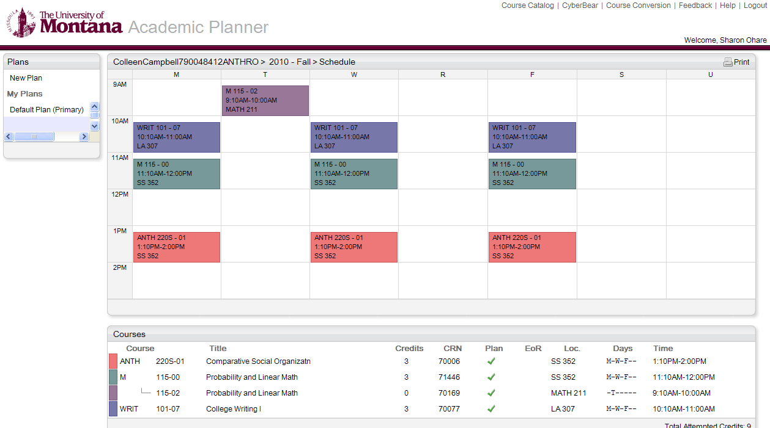

Slide 28
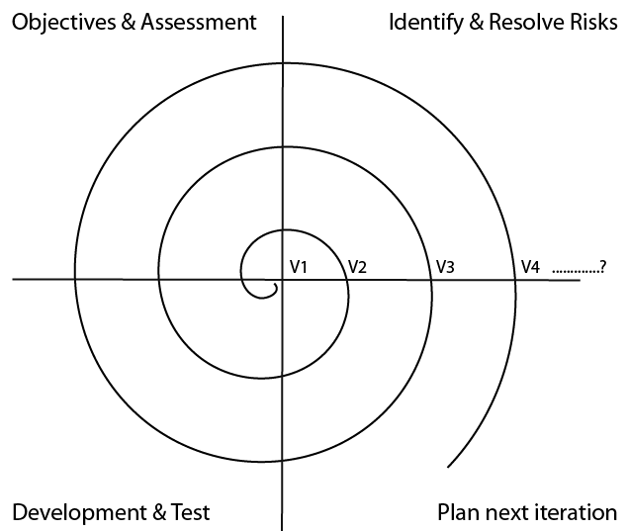

Slide 29

Where should we go?
Partners
Partners
Partners
Would this be of value to your university?
Do you have an equivalent tool in use?
Would you be interested in partnering?
Would you use this if it were open source?

Slide 30
The Presenters
Dr. Loey Knapp
  Associate Chief Information Officer, Technology Support Services
  University of Montana
  Loey.knapp@umontana.edu
  406-243-6309
Ms. Sharon O’Hare
  Executive Director, Office for Student Success
  University of Montana
  Sharon1.ohare@umontana.edu
  406-243-5672

Slide 31
Academic Planner Technical Specifications
Server Side
- Java / Spring / Hibernate
User Interface
- GWT (UI written in Java, compiled to Javascript)
Security
- Spring Security
- CAS single sign on
ERP (Banner) Access
- JDBC / Oracle stored procedures
Running on
- Redhat
- Apache Tomcat
- Oracle 10g

