Slide 1

Getting our Heads in the Game
Becoming Strategic Partners
January 14, 2011
Jason Hoerr Gena Howard
Andy Hoster Gene Spencer

Slide 2
Copyright
Copyright Jason Hoerr, Andy Hoster, Gena Howard and Gene Spencer, 2011. This work is the intellectual property of the authors. Permission is granted for this material to be shared for non-commercial, educational purposes, provided that this copyright statement appears on the reproduced materials and notice is given that the copying is by permission of the author. To disseminate otherwise or to republish requires written permission from the author.

Slide 3
Presenters Background
Andy Hoster
  14 Years of service to Albright
  Systems Administrator
Gena Howard
  11+Years of service to Albright
  Applications Support Manager
Jason Hoerr
  14 Years of service to Albright
  Network and PC Support Manager
Gene Spencer
  1.5 Years of service to Albright College
  Acting Director of IT Services
Notes:
Jason

Slide 4
Under Utilized & One-sided Partnerships
Opportunities Limited
Reported to CFO
Original State
Budget Primary Consideration
Deferred Maintenance
Notes:
Jason

Slide 5
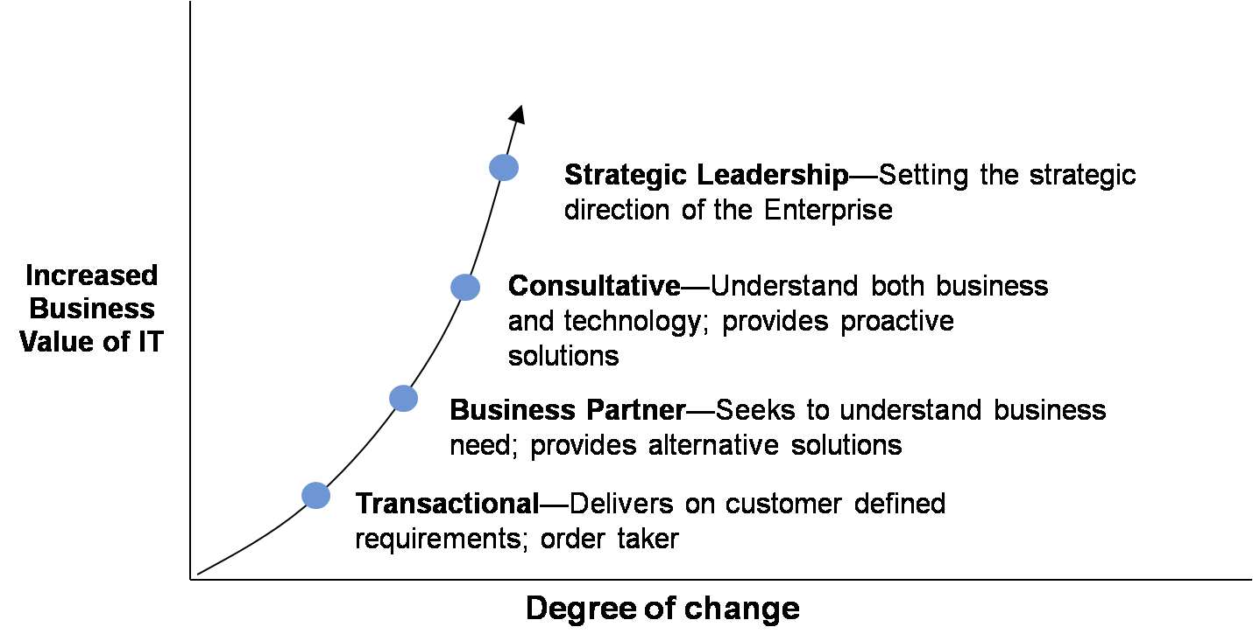
The IT Value-Curve
Credit: Gartner Research
Notes:
Gene

Slide 6
The IT Value-Curve
“Thanks for fixing my laptop”
Credit: Gartner Research
Notes:
Gene

Slide 7
The IT Value-Curve
“Thanks for automating that process”
Credit: Gartner Research
Notes:
Gene

Slide 8
The IT Value-Curve
“Thanks for addressing my needs”
Credit: Gartner Research
Notes:
Gene

Slide 9
The IT Value-Curve
“Thanks for thinking & acting strategically”
Credit: Gartner Research
Notes:
Gene

Slide 10
The IT Value-Curve
Our Institutional Capabilities
Our Technical Capabilities
Credit: Gartner Research
Notes:
Gene

Slide 11
The Reporting Relationship for IT
President
VP Academic Affairs
VP Financial Affairs
VP IT
VP some other sort
Notes:
Gene

Slide 12
The Reporting Relationship for IT
President
VP Academic Affairs
VP Financial Affairs
VP IT
VP some other sort
IT as an Academic Enabler:
Signals importance to Academic Mission
Clarifies priorities
Creates opportunities for better relationships with academics
Notes:
Gene

Slide 13
The Reporting Relationship for IT
President
VP Academic Affairs
VP Financial Affairs
VP IT
VP some other sort
IT as a strategic asset:
Critical resources and assets
Enabling institutional success
Alignment with the mission
Notes:
Gene

Slide 14
The Reporting Relationship for IT
President
VP Academic Affairs
VP Financial Affairs
VP IT
VP of some other sort
Responding to Crises
Highly Reactive
Deferred
Maintenance
IT as a Cost Center:
Focus on transactional services
Low cost, “easy” solutions
Economics drive decisions
Keep Services
Running
Relationships!!!
Notes:
Gene

Slide 15
The Reporting Relationship for IT
President
VP Academic Affairs
VP IT
VP some other sort
Provost
as Advocate
Decisions Made
in Context
Support College
Wide Priorities
IT as an Academic Enabler:
Signals importance to Academic Mission
Clarifies priorities
Creates opportunities for better relationships with academics
It’s About
Opportunities
Notes:
Provost as Advocate
Decisions made in Context
Support College-Wide Priorities
It’s about opportunities

Slide 16


It’s About partnerships
We need $X and Y Months to accomplish this goal the Right Way.
Great! Give us your best estimate, so that Strategic Planning can be more accurate.
ITS ← → Senior Leadership
First, ask for what you really need
Notes:
How many of you have this kind of relationship with your senior leadership, or have seen things happen this way?
In our case, we needed to do 2 steps: change our reporting relationship, as we said, and then set up this kind of dialogue with that executive. (provost / cfo)

Slide 17
It’s not About the past
Not asking “The Right Question”
It’s not About Technology
A “Solution Looking for a Problem”
It’s not About us
A Departmental Perspective
IT’S ABOUT ALL OF US
An Institutional Perspective
Notes:
If your first question is about money, bad decisions will result.
Recommended vs. minimum network infrastructure upgrade ($18k vs. $100k)
Too much or too little
Can’t build trust in asking for the right resources when that never happens

Slide 18
Strategic Partners
To be seen as a Strategic Partner…
We need to first think of ourselves as a partner!!!
Advancement/ Fund Raising
Library
President’s Senior Staff
Student Government Association
Trustees
Faculty
Notes:
Some examples of groups we needed to reach out for…
- Library (collaborate on creating a better classroom experience (including tech in Science Center)
- Advancement/Fund Raising (collaborate on preparations for a new campus campaign)
- Student Government Association (collaborate on their key initiative – student wireless)
- Trustees (fulfill their desire to create student wireless and to show them we could
- President’s Senior Staff (to help them see that we were on their side, trying to accomplish their goals AND that we were willing to be honest with them to both see the challenges and reap the opportunities

Slide 19




Key external partners
We developed stronger (and new) relationships with key external partners:
(our hosting partner)
(Moodle hosting partner)
(copier/MFD partner)
(Wireless vendor)
Notes:
We have lots of partners, but we decided to create stronger relationships with those who could do stuff better/cheaper/faster than we could ourselves

Slide 20

Strategic Conversations
We're trying to retrain ourselves to ask our users what they want instead of telling them what they want
Going through a structured process of asking individual departments what they’ll need in 3-5 years.

Slide 21

Strategic Conversations
How does technology improve or facilitate your experience at Albright today?
What part of your current experience could be significantly improved with the help of technology?

Slide 22
Strategic Conversations
How do you imagine the impact of technology changing for you over the next 3-4 years?
How does the use of technology affect others with whom you collaborate? How should it?

Slide 23
Strategic Conversations
If you had a magic wand with which you could improve one element of how technology supports your experience, what would you change?

Slide 24

Strategic conversations
What do we get from these conversations?
A chance to understand real needs
Possibility of finding “low hanging fruit” (quick win)
Themes to combine into a strategic plan
A sense within the community that we are being strategic
Better relationships

Slide 25
Change
The ability to evolve originated within our department
Partnership
Relationships matter from Departments to Individuals
Solutions
Understand, assist and be proactive
Value
Trusted, appreciated, engaged
Things we value
Notes:
Jason

Slide 26


Living in possibility
“What assumption am I making,
that I am not aware I am making,
that gives me what I see?”
“What might I now invent,
that I haven’t yet invented, that
would give me other choices?”
(The Art of Possibility, Sept. 2000, ISBN-13: 978-0142001103)
Notes:
Jason

Slide 27

Questions and Conversation?

Slide 28

Solution

Slide 29
Contacts:
Jason Hoerr – jhoerr@alb.edu
Gena Howard – ghoward@alb.edu
Andy Hoster – ahoster@alb.edu
Gene Spencer – gspencer@alb.edu

Slide 30
THANK YOU!

