Slide 1
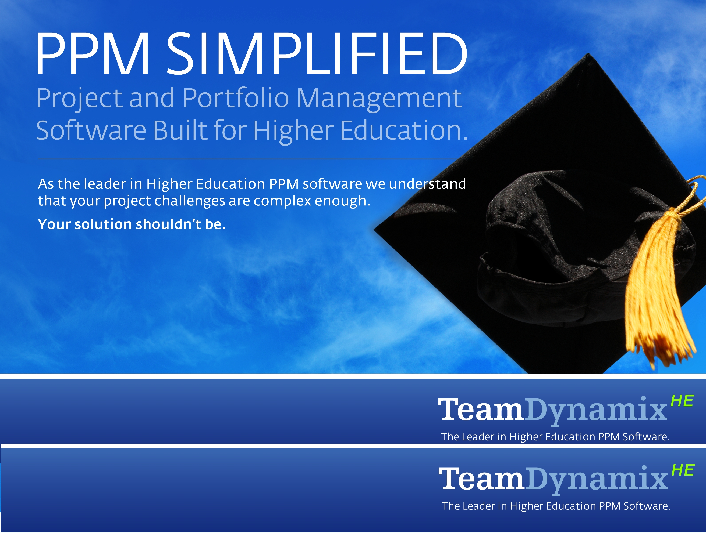

TeamDynamix Overview
TeamDynamix provide Higher Education specific Project and Portfolio Management solutions (PPM). TeamDynamix software and services adhere to a simple and proven higher education specific PPM deployment approach.
Bridging the gap between stakeholder expectations and reality through effective IT governance and management practices
Educause Mid-Atlantic Conference 2012
Highlights
Built specifically to support the evolution of the Higher Ed PMO
Embedded Higher Ed best practices (ECAR/Spellings)
Higher Education implementation approach (PEMM)
Intuitive solutions

Slide 2


Agenda
Managing Stakeholder Expectations while Delivering Quality Services at Carnegie Mellon University
Industry Best Practices
Discussion and Questions
www.TeamDynamixHE.com
2
Educause Mid-Atlantic Conference - 1/11/2012

Slide 3
Agenda
Managing Stakeholder Expectations while Delivering Quality Services at Carnegie Mellon University
Industry Best Practices
Discussion and Questions
www.TeamDynamixHE.com
3
Educause Mid-Atlantic Conference - 1/11/2012

Slide 4
Top-Ten IT Issues, 2011
According to Educause 2011 Current Issues Committee
1. Funding IT 2. Administrative/ERP/Information Systems 3. Teaching and Learning with Technology 4. Security 5. Mobile Technologies 6. Agility/Adaptability/Responsiveness 7. Governance, Portfolio/Project Management 8. Infrastructure/Cyberinfrastructure 9. Disaster Recovery / Business Continuity 10. Strategic Planning
http://www.educause.edu/EDUCAUSE+Review/EDUCAUSEReviewMagazineVolume46/TopTenITIssues2011/228654
www.TeamDynamixHE.com
4
Educause Mid-Atlantic Conference - 1/11/2012

Slide 5

Expectations of IT versus Delivery of IT Services
www.TeamDynamixHE.com
5
Educause Mid-Atlantic Conference - 1/11/2012

Slide 6
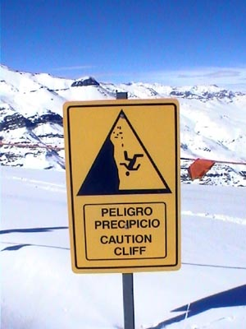
IT Demand versus IT Budget Availability
www.TeamDynamixHE.com
6
Educause Mid-Atlantic Conference - 1/11/2012

Slide 7
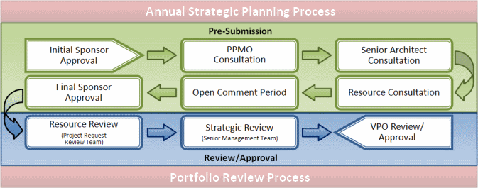
Carnegie Mellon: Solution - IT Planning
www.TeamDynamixHE.com
7
Educause Mid-Atlantic Conference - 1/11/2012

Slide 8
Carnegie Mellon: Governance
Executive Level:
President’s Office Advisory Board (Every 5 yrs)
Executive Steering Committee on Computing (ESCC)
Working Sub Teams from ESCC on Initiatives
Computing Facilities Group
Faculty Senate
Administrative Leaders Group
www.TeamDynamixHE.com
8
Educause Mid-Atlantic Conference - 1/11/2012

Slide 9
Carnegie Mellon: President’s Office Advisory Board
Outside review of operations by appointed committee by the President of the university
Occurs every 5 years
Includes leaders from industry, Higher Ed IT, and our Board of Trustees
Report is owned by the President’s Office
Relevant/Necessary information is shared with Computing Services
www.TeamDynamixHE.com
9
Educause Mid-Atlantic Conference - 1/11/2012

Slide 10
Carnegie Mellon: ESCC
Advisory Body to the Vice Provost and CIO Office
Consists of all the Vice President’s and (3) three College Deans
Sub Teams typically include distributed and functional IT Directors
Meet monthly to review and recommend priority on portfolio of work
Also a key opportunity to educate the campus on the work we do and challenges IT Faces
www.TeamDynamixHE.com
10
Educause Mid-Atlantic Conference - 1/11/2012

Slide 11
Carnegie Mellon: Computer Facilities Group
Chaired by the Vice Provost for Computing/CIO
Distributed IT Group Leaders with significant IT operations
Advisory group that provided feedback and input on our central and distributed IT plans
Includes groups such as the School of Computer Science, Software Engineering Institute, & Electrical Computer Engineering
www.TeamDynamixHE.com
11
Educause Mid-Atlantic Conference - 1/11/2012

Slide 12
Carnegie Mellon: Faculty Senate & ALG
Faculty Senate
Tenured and elected Faculty from across campus
Meets regularly but only has IT updates upon request or need
Administrative Leaders Group
Chaired by the CFO
Meets monthly
Includes business/functional organization leaders
www.TeamDynamixHE.com
12
Educause Mid-Atlantic Conference - 1/11/2012

Slide 13
Carnegie Mellon: Additional Governance
Directorate/Departmental Level:
Service/Department-based Advisory Groups
Department Computing Forum
Student Advisory Council
Computer Steering Committee
Customer Relationship Management
*Considering Adopting an IT Ambassador Program in the future for departments and students
www.TeamDynamixHE.com
13
Educause Mid-Atlantic Conference - 1/11/2012

Slide 14
Carnegie Mellon: What has Helped?
Continuously Improving Portfolio/Project Management:
Project Submission Process
Open Comment Period for Project Submissions
Project Request Review Team (PRRT)
Better Reporting and Transparency:
TeamDynamix Portfolio Analysis Reports
Technical Commitments Document
Directorate Operational Roadmap
www.TeamDynamixHE.com
14
Educause Mid-Atlantic Conference - 1/11/2012

Slide 15
Carnegie Mellon: We Didn’t Get Here Overnight
www.TeamDynamixHE.com
15
Educause Mid-Atlantic Conference - 1/11/2012

Slide 16
Expectation Management @ Carnegie Mellon
Maturity
Best Practice
Confident Competence
Awareness
2011
2010
Seat of the pants
2009
Portfolio Management as Standard Operating Procedure (SOP)
ESCC with Visibility and Input into our Organization and our Projects, Resources, and Priorities
Cross Directorate Collaboration and Vetting Projects using Transparency and Review Processes
Continuous Ongoing Project Submission and Review Electronically
Monthly Portfolio Review from the Vice Provost for Computing Office
Start of Budget and Resource Inclusion in Project Submissions via TeamDynamix
2008
Introduction of Electronic Portfolio Planning (TeamDynamix)
Internal Portfolio Management and Project Submission Process
Sequencing of Work via Technical Commitments
Development of Detailed Project Charters and Portfolio Vetting at the Central Computing Management Team Level
Disclosure of Projects via Technical Commitments
2007
2006
Centralized Coordination of 1 page charters
Re-adoption of ESCC and Creation of the Technical Commitments Document
Distributed Portfolio of Projects

Slide 17
Carnegie Mellon: Submitting Requests (Then)
www.TeamDynamixHE.com
17
Educause Mid-Atlantic Conference - 1/11/2012

Slide 18
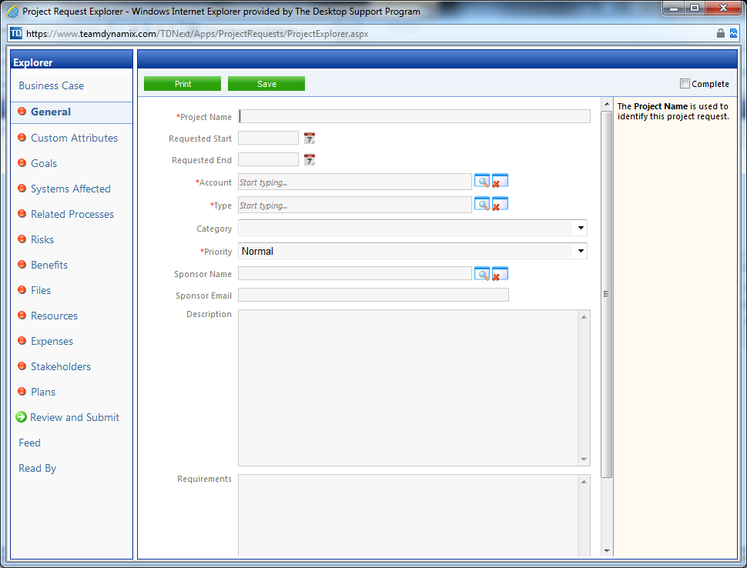
Carnegie Mellon: Submitting Requests (Now)
www.TeamDynamixHE.com
18
Educause Mid-Atlantic Conference - 1/11/2012

Slide 19
Carnegie Mellon: Portfolio Reporting (Then)
19
Educause Mid-Atlantic Conference - 1/11/2012

Slide 20
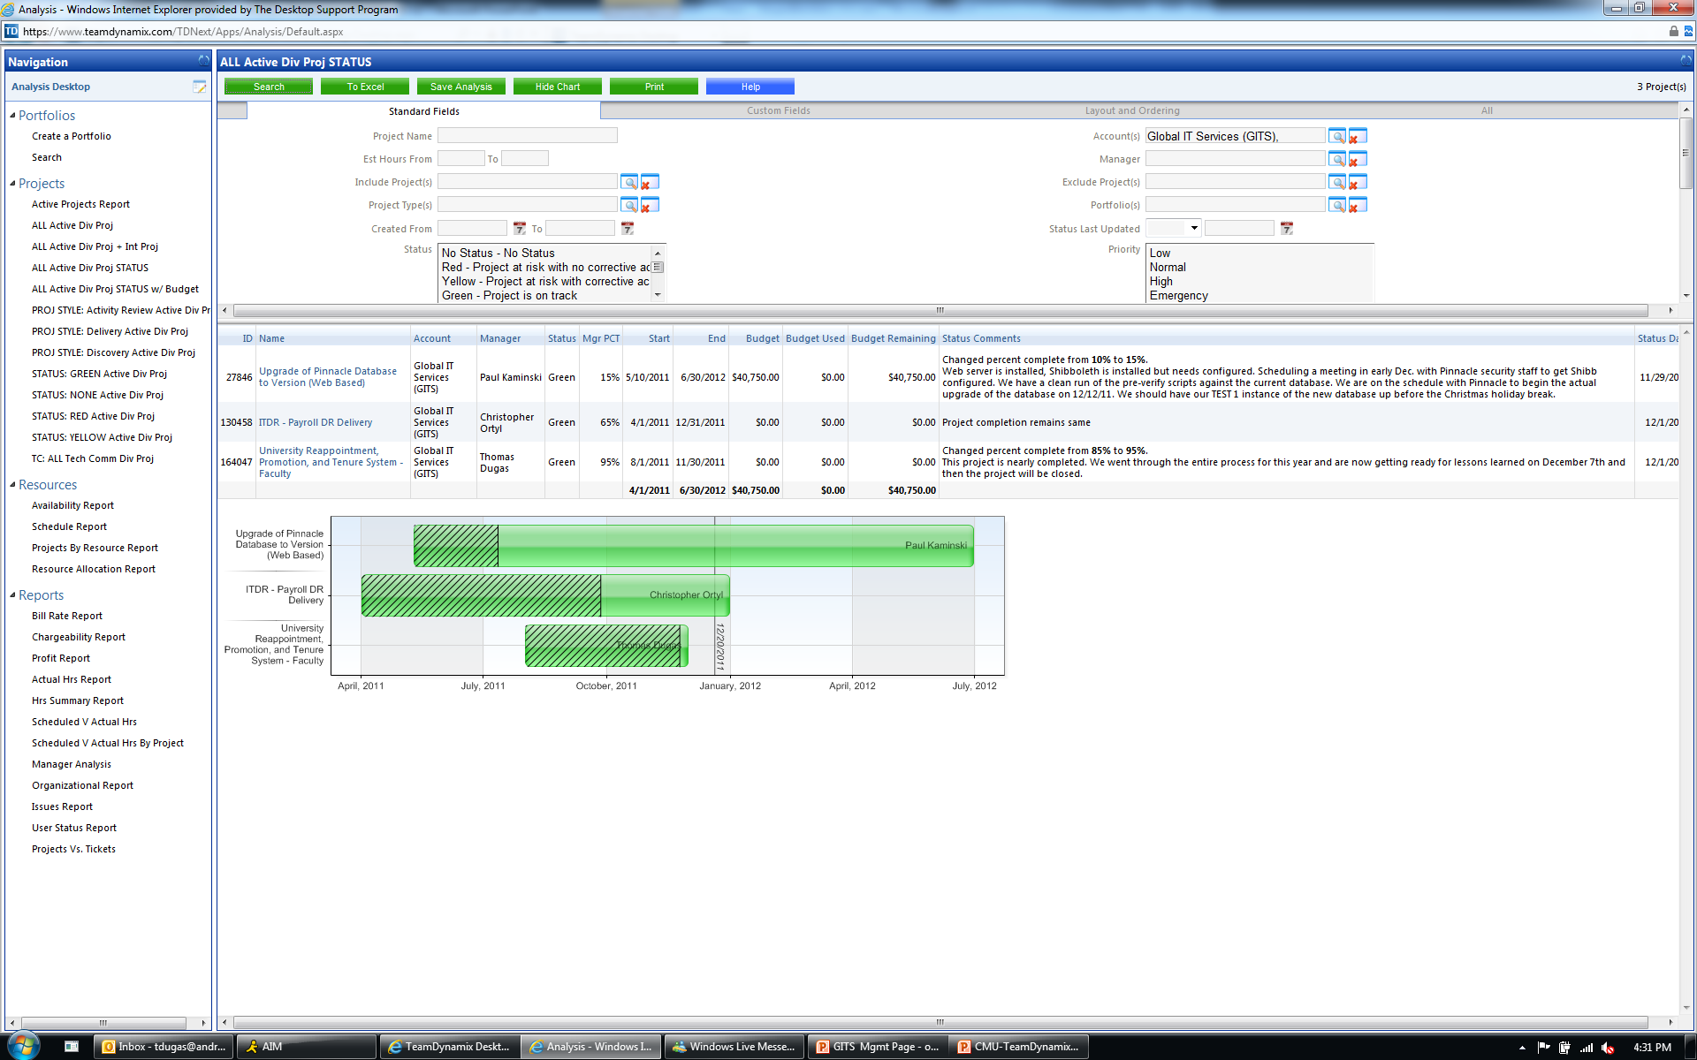
Carnegie Mellon: Portfolio Reporting (Now)
20
Educause Mid-Atlantic Conference - 1/11/2012

Slide 21
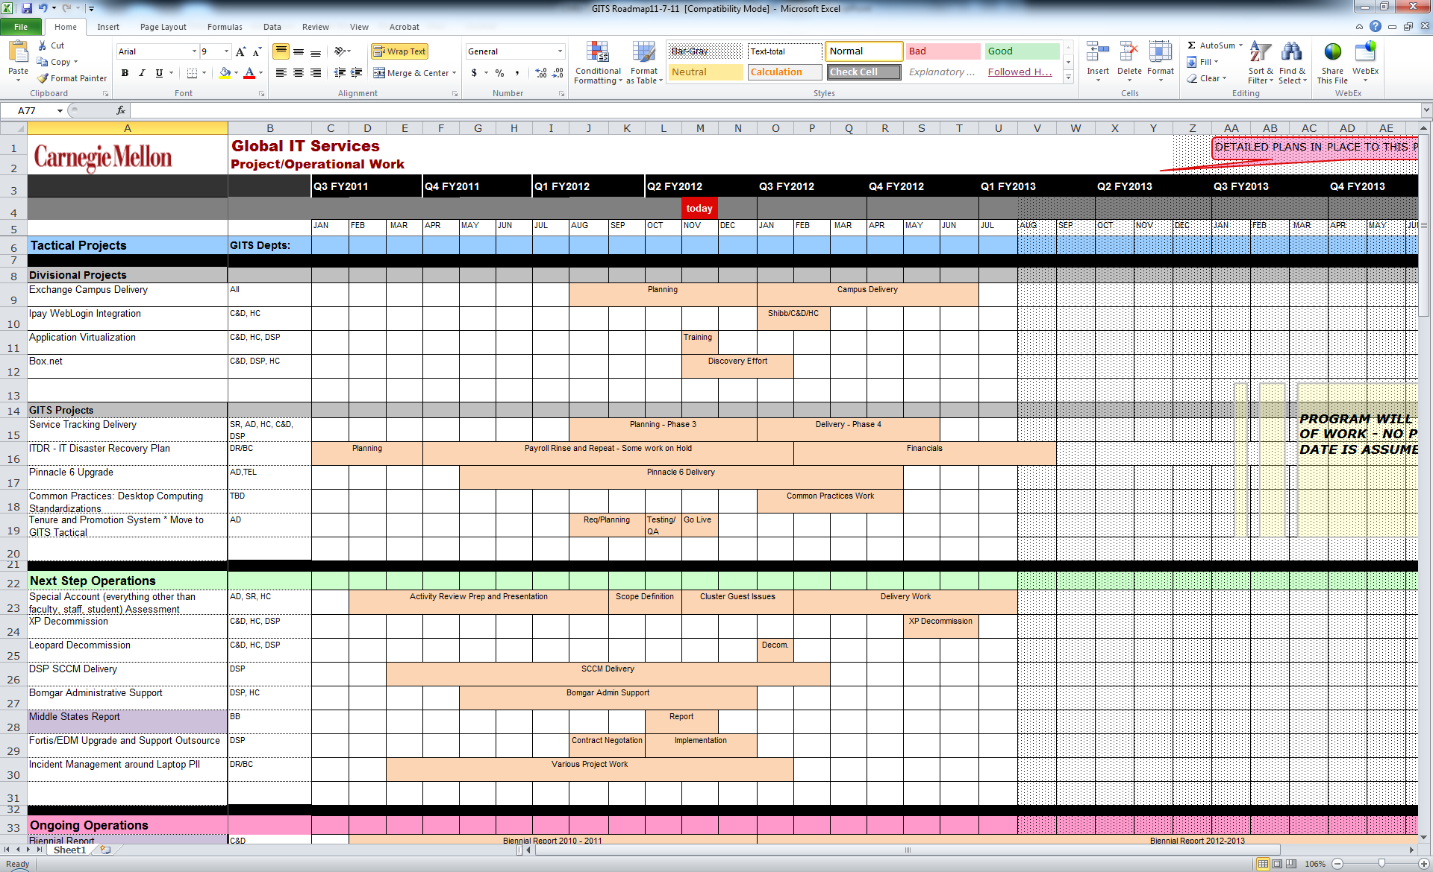
Carnegie Mellon: Stripy Sheets (Technical Commitments and Directorate Roadmap)
21
Educause Mid-Atlantic Conference - 1/11/2012

Slide 22
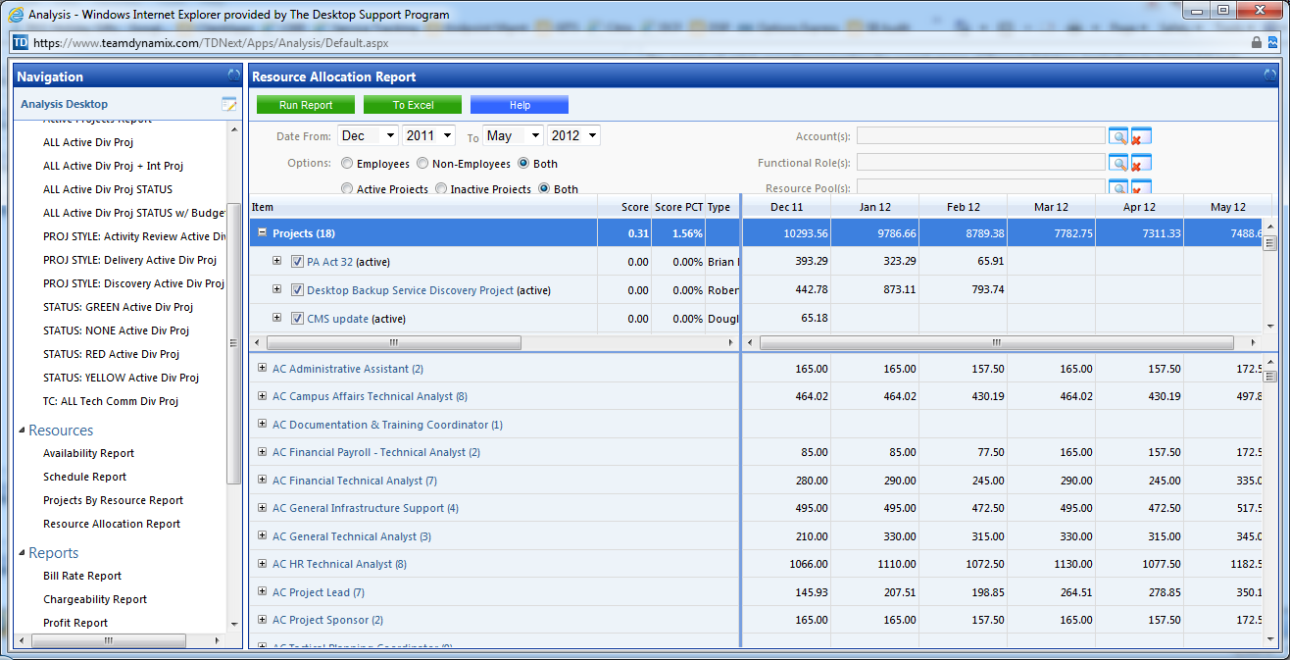
Carnegie Mellon: Next Up – Resources!
www.TeamDynamixHE.com
22
Educause Mid-Atlantic Conference - 1/11/2012

Slide 23
Carnegie Mellon: Summary
Key Items to Consider for Expectation Management and IT Governance
Tell your story though your IT portfolio
Establish advisory bodies with key stakeholders
Create communication opportunities throughout the IT organization with the community
Be Transparent and open wherever possible
www.TeamDynamixHE.com
23
Educause Mid-Atlantic Conference - 1/11/2012

Slide 24
Agenda
Managing Stakeholder Expectations while Delivering Quality Services at Carnegie Mellon University
Industry Best Practices
Discussion and Questions
www.TeamDynamixHE.com
24
Educause Mid-Atlantic Conference - 1/11/2012

Slide 25
Industry Best Practices Agenda
TeamDynamixHE overview
Impacts of the “New Normal” driving IT Governance
Higher education IT Governance best practices
Proven first steps

Slide 26
TeamDynamixHE Overview
“To enable college and university IT organizations to achieve their business objectives through products and services that foster operational excellence and exceed expectations”
www.TeamDynamixHE.com

Slide 27



















Client Sample
www.TeamDynamixHE.com

Slide 28
TeamDynamixHE Overview
Key Attributes
Have helped more institutions succeed with PPM than any other vendor
Offer the only extensive Higher Education specific library of PPM implementation templates
Product Governance: TeamDynamixHE Advisory Council (TAC)
Higher Ed Governance/PPM Community: TDHE Community
Proven Higher Ed implementation approach (PEMM)
www.TeamDynamixHE.com

Slide 29
Higher Education Trends: The “New Normal”
Budgets are tight. IT leadership needs to balance cost cutting with providing service to customers.
IT is under fire. IT leadership needs to find objective ways to negotiate schedules and demonstrate workloads and deliver results.
www.TeamDynamixHE.com

Slide 30
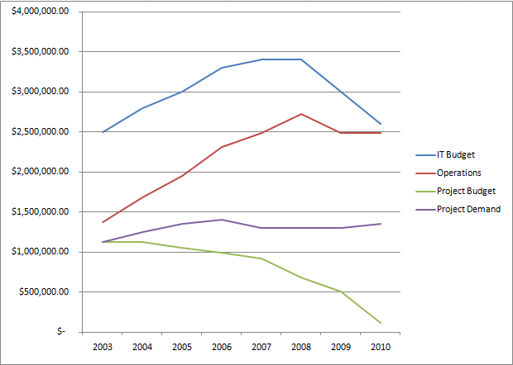
www.TeamDynamixHE.com
Notes:
For visual learners here is a chart

Slide 31
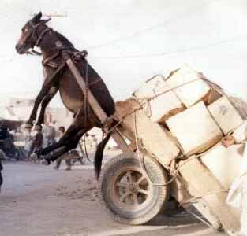
The Typical Result.
www.TeamDynamixHE.com
Notes:
Dwight Fischer

Slide 32
Trends in HE IT Governance: Focus Areas
Educating Stakeholders: Telling IT’s Story (the whole story)
Central management of demand
Shift of macro level decision making to the customer (governance committee)
Setting and managing reasonable expectations and objectively negotiating schedules
Improving execution
www.TeamDynamixHE.com
Notes:
This won’t be rocket science to you but these points are worthy of investigation.
-These points may seem off topic for some of you but they are interrelated
-We won’t be discussing improving execution as it is not directly related

Slide 33
Educating Stakeholders: Telling IT’s Story
Increase stakeholders’ understanding of the status of work they requested
Increase stakeholders understanding of how IT work supports their objectives and measures (services)
Increase stakeholders’ understanding of how IT supports the organization (services & portfolio)
Increase stakeholder’s understanding of IT’s constraints
www.TeamDynamixHE.com
Notes:
First need to help stakeholders understand IT because many time they do not. Quantity and type of work, Constraints, future commitments, current priorities.
. Factual data increases credibility
-This may be the first step or building the committees and centralizing demand management may be the first step. It will depend on the culture and pains at your institution
-services are articulated from the perspective of the customer. How they consume services (a deep subject in and of itself)

Slide 34
Telling IT’s Story: Basic Required Data
Skill set inventory (high level)
Key services inventory (services provided to stakeholder groups)
Work inventory by customer
Operational (keep the lights on)
Project work
Who is working on what for how long employing which skill sets? (high level)
Align work with key services & portfolio
Request inventory with required skill sets and duration (future/requested commitments)
www.TeamDynamixHE.com
Notes:
Transition to articulating services and portfolios. Stakeholders don’t know what virtualization can bring but they do know what reducing operations costs by 15% means. This can be tracked in a PPM tool or in excel. Can be managed by an individual and small staff minimizing the need for change. Maturity and budget should dictate which.
Tom mentioned the use of portfolios as a key communication tool

Slide 35
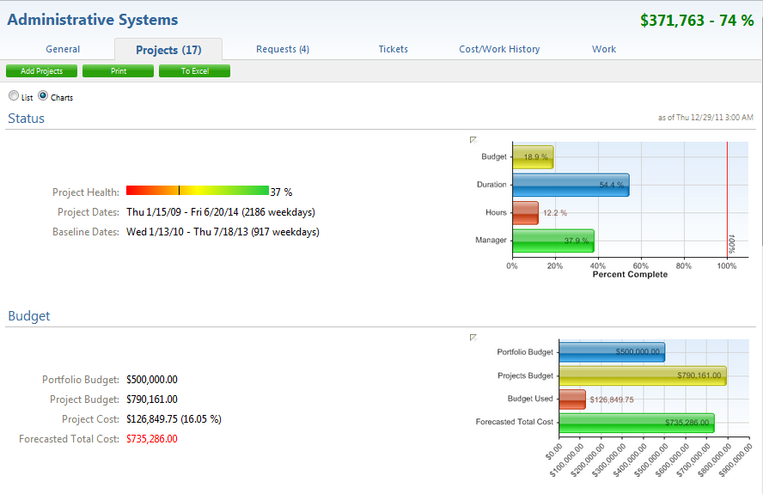
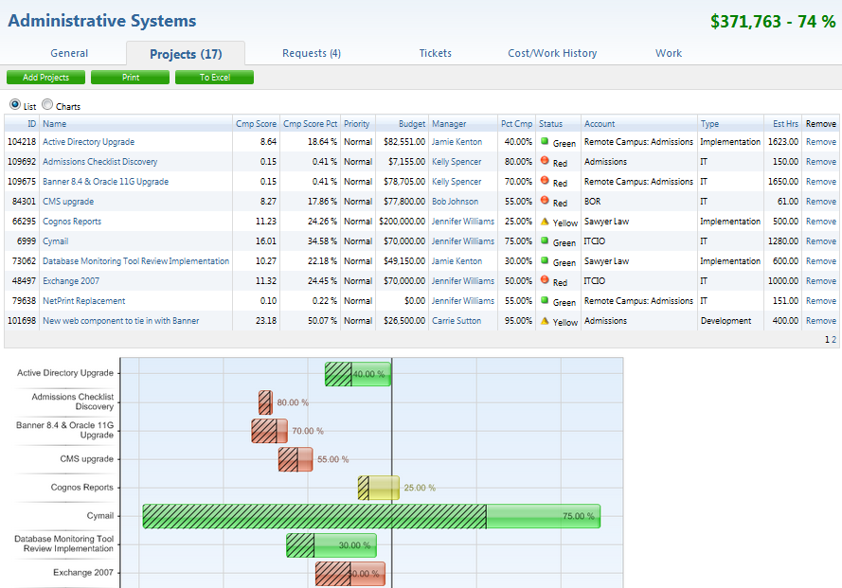
Reporting Example: The Portfolio View
www.TeamDynamixHE.com
Notes:
-Tom mentioned that the portfolio is critical for communication. We agree.
-Don’t need tools to report. Could use excel or PowerPoint. Doesn’t need to be task level
-Use the concept of a grouping of projects for different audiences. Portfolio, Department specific. One size does not fit all when it comes to marketing IT.

Slide 36
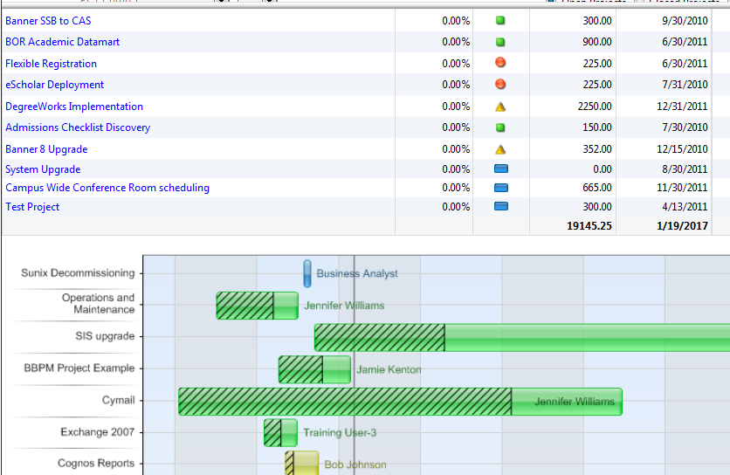
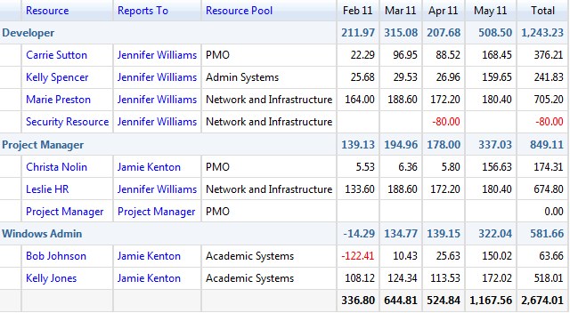
Reporting Example: Workload and Constraints
www.TeamDynamixHE.com
Notes:
Don’t need tools to report. Could use excel or PowerPoint. Doesn’t need to be task level

Slide 37
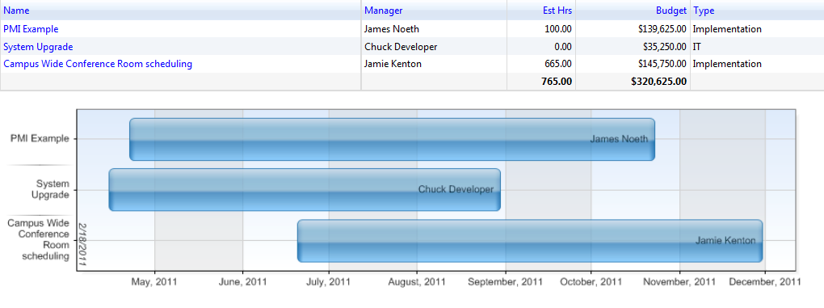
Reporting Example: Upcoming Commitments
www.TeamDynamixHE.com
Notes:
Educate stakeholders about future commitments so the expectation is set that resources are scarce in the future.
-With these reports we begin the education process. The process of building understanding and then support.

Slide 38
www.TeamDynamixHE.com
Notes:
Do you remember the operational work line?

Slide 39
Effectively Telling the Whole Story
Resource consumption and work activities are multi dimensional
Projects
“Smaller than a Project” Work
Incidents
All consume resources and drive costs
Required to fully explain constraints and demands
Including all dimensions in reporting increases credibility
Especially helpful when negotiating/justifying IT budgets
www.TeamDynamixHE.com
Notes:
An emerging trend that we see picking up steam
-ITSM constructs apply here
-Moving away from thinking about projects and then “other stuff” and moving towards looking at service delivery and the tools required to manage both
-some of you may have thought this was missing from the earlier section
-This may be as simple as creating high level representation of the operational demands being placed on IT

Slide 40



The “Demand and Resource Consumption Collage”
Projects
Operations
Operations
Incidents
Projects
Operations
Projects
Incidents
Incidents
Notes:
Sometimes a visual gives us new perspectives. This visual depicts the complexity of each of your resources workload. It makes sense that reporting one dimension would be only telling part of the story. Now obviously resources aren’t weighted evenly between the categories. Need a great way to consolidate work of your people. Something we’re seeing our clients do.

Slide 41
Telling the Whole Story: Basic Required Data
Builds upon basic requirements already presented
Work inventory by category
“Smaller than a project” work activities
Incidents (if within scope)
Formal service portfolio
Added complexity
Requires more process rigor
Clear definitions of services and catalog items
Automation tools highly beneficial
www.TeamDynamixHE.com
Notes:
The granularity required will largely be dictated by reporting needs. Build your process or configure your tool to handle added complexity.

Slide 42
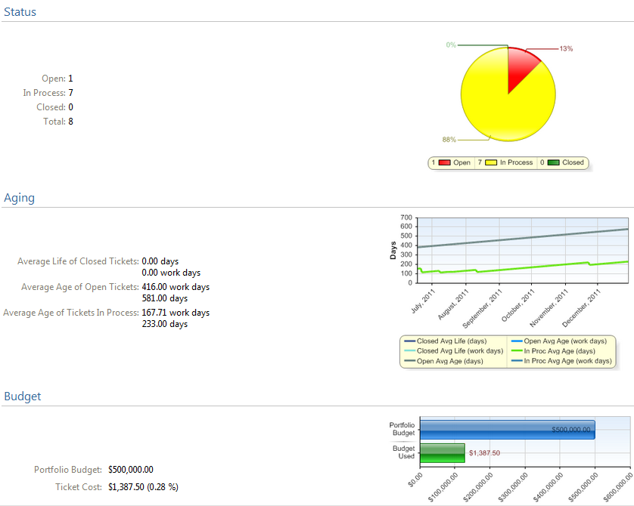
Reporting Example: The Portfolio View with Operational Work
Notes:
Don’t need tools to report. Could use excel or PowerPoint.

Slide 43
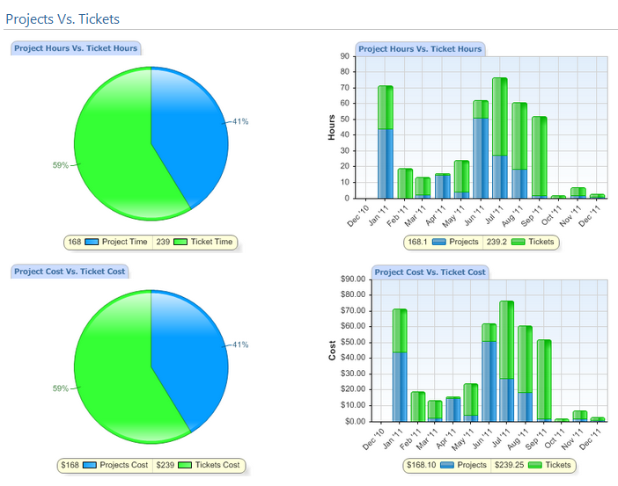
Reporting Example: Projects vs. Operational Work
Notes:
Don’t need tools to report. Could use excel or PowerPoint. Doesn’t need to be task level

Slide 44
Shift in Decision Making: Governance Committees (abbreviated)
Many structures (worthy of several presentations!)
Points Requiring Majority Agreement (and/or executive requirement)
Scope of decision making power
Structure of meetings
Frequency of meetings
Information to be prepared for meetings (by whom/when)
Portfolio/Service structure?
Agreement creates buy in & self regulation (removing burden from IT)
www.TeamDynamixHE.com
Notes:
These are the very basic key success factors. If it’s not possible to assemble a true governance committee then assemble a committee strictly for the purpose of educating stakeholders. From that foundation we see schools interject suggestions guiding leadership towards accepting or even better suggesting a governance structure.
-If you’d like more information please see me after the presentation

Slide 45
Central Management of Demand
Required for effective resource management
Clearly define how work is requested
Word doc
Email
Online form
PPM tool
Napkin and crayon
Clearly define the data required for work requests
Educate requesters about the value of centralized request process
Educate requesters thoroughly about the process requests will follow (they fear the “black hole” of IT)
Train. Train. Train.
www.TeamDynamixHE.com

Slide 46
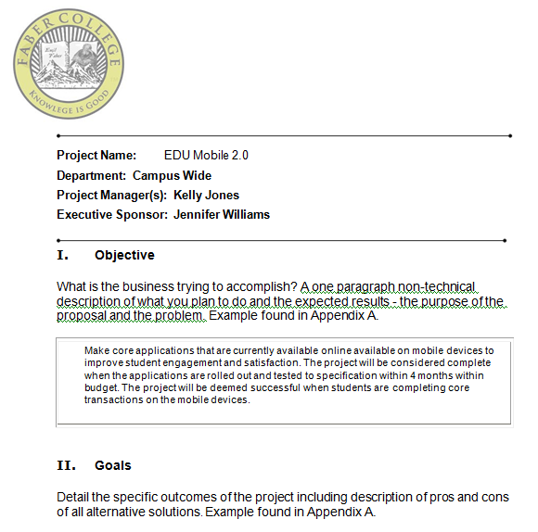
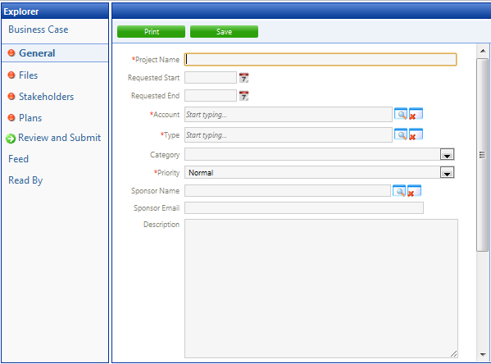
Example: Request Forms
Notes:
Could be automated or could be a word document
-leverage templates there are a lot of them out there that have been proven.

Slide 47
Setting and Managing Stakeholder Expectations
Clearly communicate commitments and constraints
Help stakeholders understand the impacts of priority changes
Clearly and factually present the roadblocks to completing requested work
Give Stakeholders objective and tenable choices to make
Timing
Prioritization
Reprioritization
Clearly communicate when work is slated to begin, what the stakeholder’s role is and when work is slated to be completed
Resource adjustments
Budget adjustments
Scope adjustments
www.TeamDynamixHE.com
Notes:
We have already laid a solid foundation by educating stakeholders and establishing guidelines for how work requests are processed. Negotiation and expectation is now easier to facilitate and more successful.

Slide 48
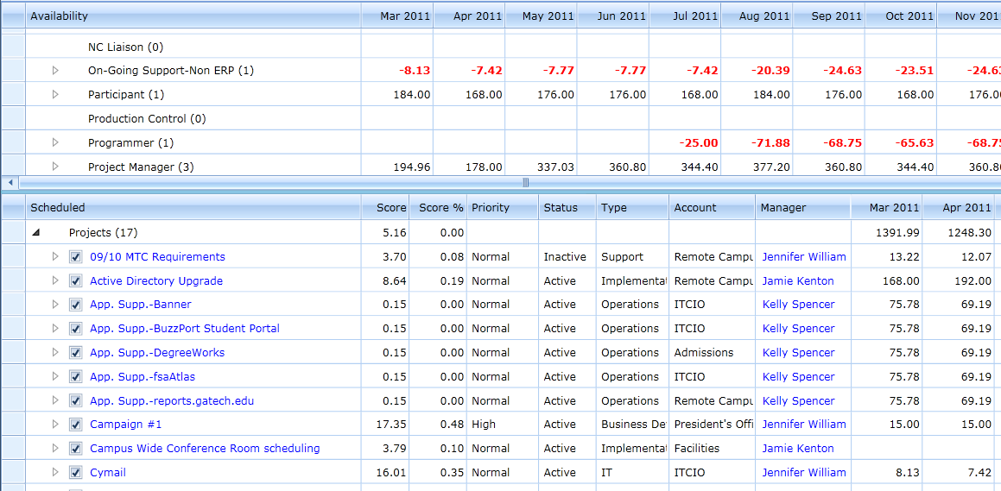
Reporting Example: Impacts of Priority Changes
www.TeamDynamixHE.com
Notes:
Helps explain choices

Slide 49
Proven First Steps
#1: Secure executive support
Identify and prioritize key pains (tackle them first)
Identify the MINIMUM amount of process/tool necessary to address key pains (digestible bites)
Spend time planning for change (cultural change mgmt.)
Communicate regularly (Marketing-frequency and format)
Leverage all stars to create change
Promote successes (marketing creates leverage)
REPEAT!
www.TeamDynamixHE.com
Notes:
Easier said than done. This is what we help clients do.
Much like CMU’s approach
-

Slide 50
IT Governance: Delivers Results
“TDHE has given IT leadership tools to understand capacity when making commitments and to clearly articulate constraints to stakeholders to set reasonable and achievable expectations.”
-Johnson County Community College
www.TeamDynamixHE.com

Slide 51
Agenda
Managing Stakeholder Expectations while Delivering Quality Services at Carnegie Mellon University
Industry Best Practices
Discussion and Questions
www.TeamDynamixHE.com
51
Educause Mid-Atlantic Conference - 1/11/2012

Slide 52
TeamDynamix Overview
TeamDynamix provide Higher Education specific Project and Portfolio Management solutions (PPM). TeamDynamix software and services adhere to a simple and proven higher education specific PPM deployment approach.
Highlights
Built specifically to support the evolution of the Higher Ed PMO
Embedded Higher Ed best practices (ECAR/Spellings)
Higher Education implementation approach (PEMM)
Intuitive solutions
Questions?
Tom Dugas
tdugas@andrew.cmu.edu
Andrew Graf
agraf@teamdynamixhe.com

