Slide 1
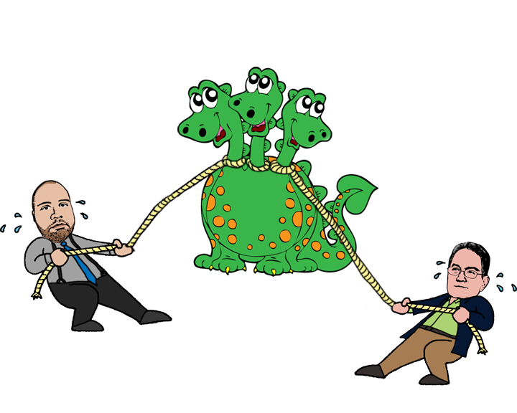

How AtTask and Loyola Slayed the Work Management Beast
Scott Sax
Associate Director, PMO Loyola University Maryland
Ty Kiisel
Manager, Social Outreach AtTask
Notes:
Quick introductions about us
Presentation not a sales pitch. – industry expert and case study.

Slide 2
Agenda
Project Management & Work Management
Loyola’s story
The Paradigm Shift
Notes:
Agenda of what to expect from our presentation

Slide 3
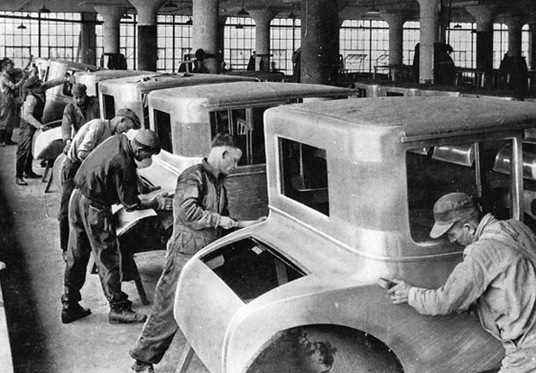

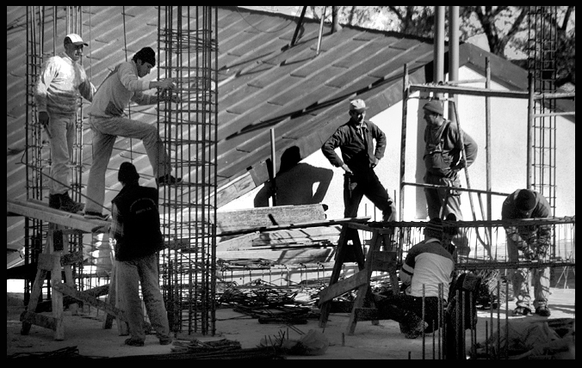
The Roots of Project Management
Notes:
Go through roots of PM

Slide 4
Gartner Predicts:
“By 2014, organizations will invest 30% less time and money in traditional IT project management than in 2010.”
Audrey Apfel
Managing Vice President and
Gartner Fellow Emeritus
February 24, 2010
Notes:
Gartner prediction

Slide 5
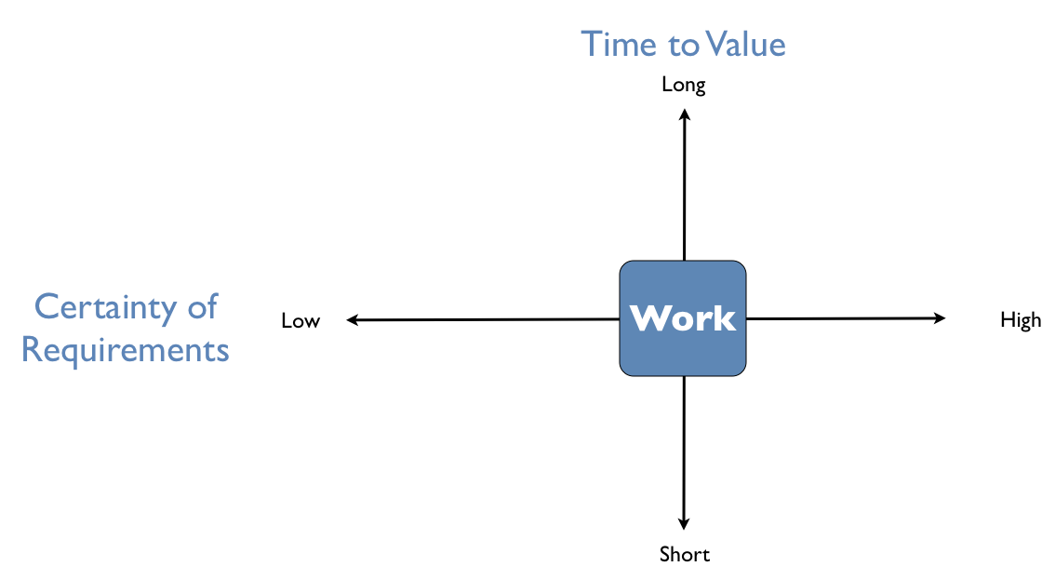
Is it really a project?
Iterative
Approaches
Programs &
Traditional Projects
“Change
Operations”
Repeatable Projects
& Managed Work
Audrey Apfel
“Be Prepared for the Future of
Program and Portfolio Management”
February 24, 2011
Notes:
Type of work…..

Slide 6
Is there a better way to get work done?
Notes:
Kind of ask rhetorical to audience. Sax to interrupt, “glad you asked that…let me tell you about Loyola’s story….”

Slide 7
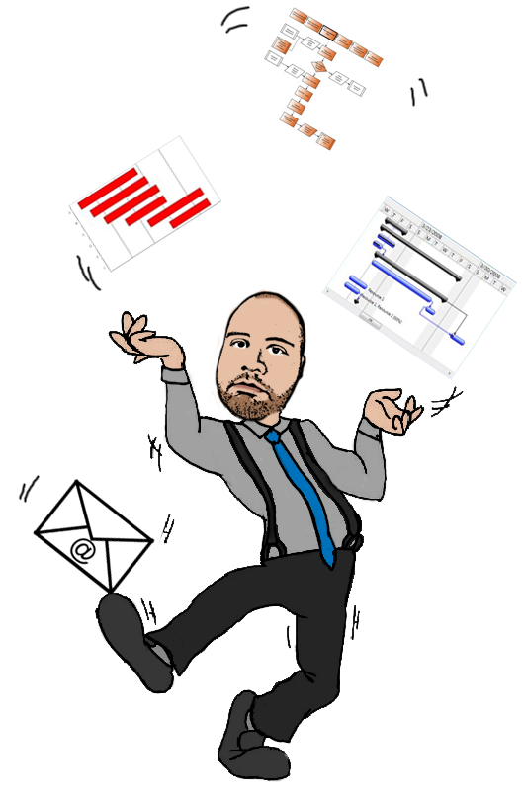

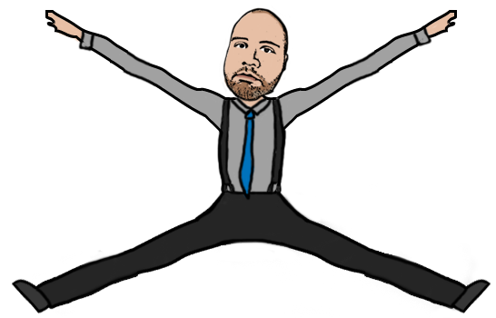
Loyola’s Story
Competing priorities
Not enough time
Too many projects at once
Resources stretched thin
Notes:
Like many, we had too many projects, competing priorities, not enough time, and not enough resources

Slide 8
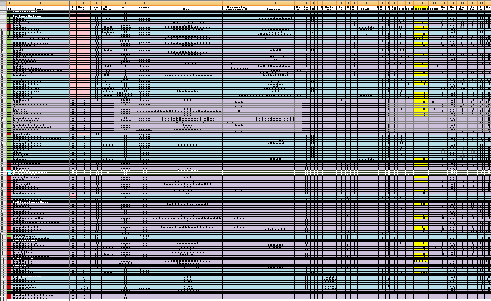
The Project Portfolio
Notes:
35 columns
130 rows
5 worksheets
Versioning – a nightmare

Slide 9



8 hours in the work day
A Person’s time divided by:
Operational Work
Overhead Work
Project Work
Notes:
A person’s typical day broken into 3 types of work…
Operational – things like ticket support, fixing things that break, patch work
Overhead work –just stuff…answering emails, ad hoc conversations, department meetings
Project Work – structured, scheduled work with specific start and end
3 headed monster
Ty – forrester report.
What do we do?

Slide 10
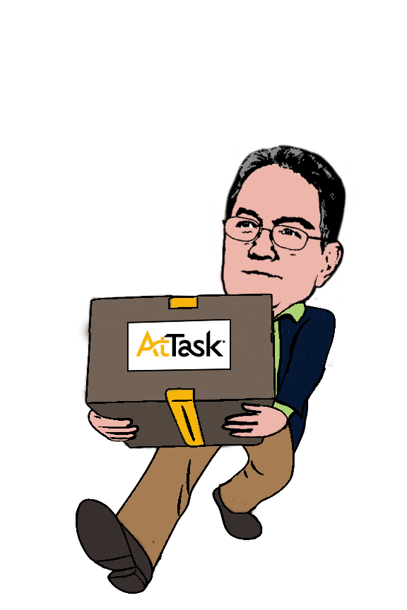
Here comes AtTask!
Notes:
AtTask to the rescue.
PPM system
Help us manage work, and not just project work.
Helps us manage our portfolio of projects
Helps us manage our resource allocations capacity.
Helps give executives and managers insight into the work we do
Things we needed it to do….
So how do we use AtTask?

Slide 11
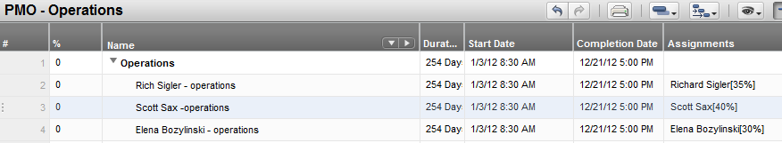

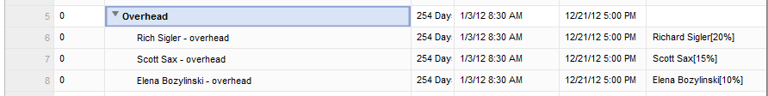


Estimating Time
Notes:
Every person’s day is different, 3 headed monster is different for everyone.
Created an allocation tracking project.
Estimated operational time (add blue)
Estimated over head time (add orange)
This is done for every person in department

Slide 12
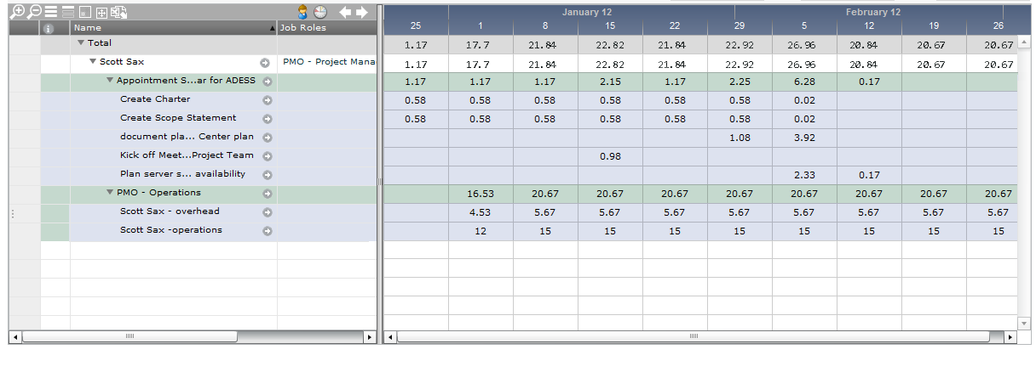

Project Time
Notes:
What’s left? The time they are available for project time.
We use a user utilization search that shows all of the person’s hours that they have allocated, and lets us drill down to see what’s taking up their time

Slide 13
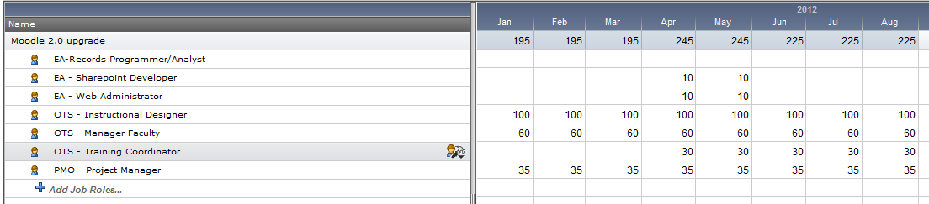
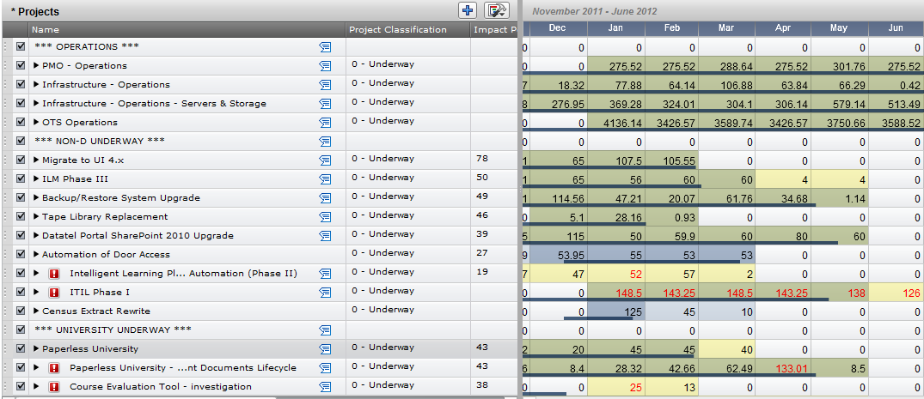
Resource Estimating
Notes:
We have a governance process in place that brings all project requests into central place where they get ran through a scorecard to determine the classification of project and also an impact score which we use for the priority of the project.
Every project then gets resources estimated, how much time a resource will be needed for the project and when.
We then add all our projects into the capacity planner, in order according to their classification and impact score, with our operations and overhead allocation tracking projects first, and then we can see where we have issues with not enough resources.

Slide 14
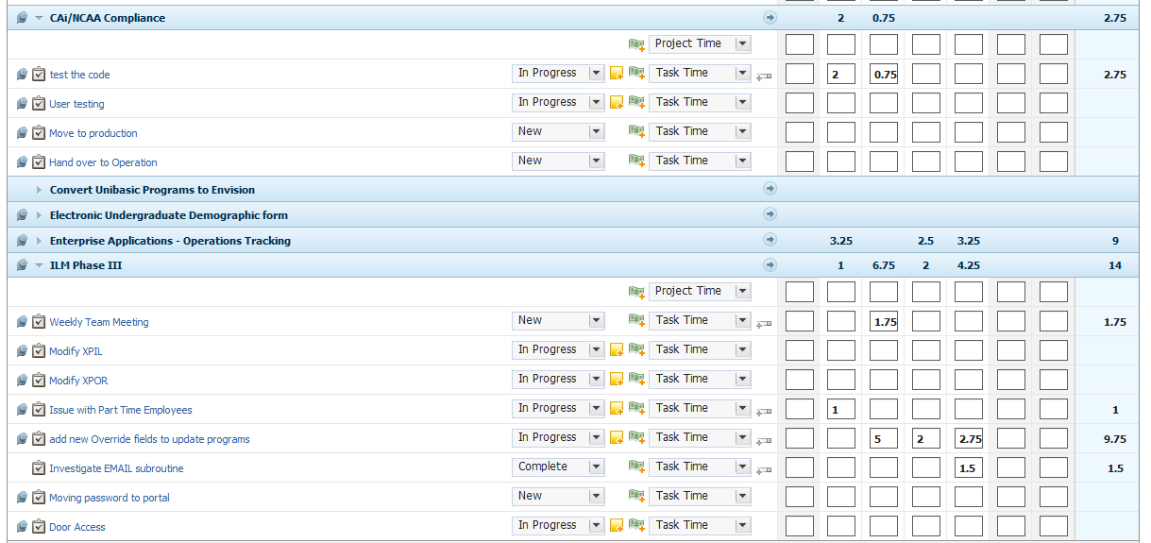
Tracking Time
Notes:
People are tracking their work on the tasks that they are assigned.
Visibility into all work going on, not just projects lets better allocation of resource.
Used for planned vs actual, better time estimating in future.
We are also in process of rolling out ITIL framework, and people will be able to track time against services from our service catalogue as well as other stuff that they may be doing, giving us closer estimates for their operational and overhead time
Long process to get all of this information, and wasn’t easy…..adoption was key…had to get buy in from everyone…
Had to show reasons why we were doing things, we understood what they were going through, everything that they were doing was to become more efficient, less projects at a time, less stress for them, etc.

Slide 15

Paradigm Shift
Seeing the same information in a different way
Notes:
Successfully implementing is just a tool…there is a mind set that needs to happen….
Ty – that’s really great Scott. You’ve done a great job of figuring out how much stuff can you really be taking in at any given time. To audience - that’s only half of the battle.
There really needs to be a paradigm shift…..

Slide 16
It’s About People
Command-and-Control Management Methodologies Aren’t Effective
Project information that’s untrustworthy
An overly structured work environment people dislike
Frustrated project teams whose work often goes unrecognized
Players or Pawns?
Notes:
Focusing on team members…..

Slide 17




It’s About People
Key Drivers to Team Member Engagement
I’m empowered to do what I do best
I have the tools I need to do my work right
I’m recognized for my contributions
I know what’s expected of me
Notes:
What team members want….
Scott to Ty – absolutely! We’re doing this at Loyola too! Let me show you….

Slide 18
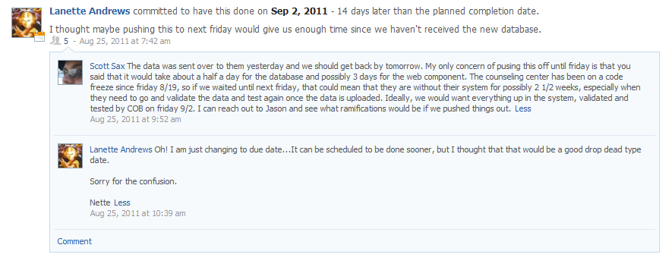
It’s About People
Sense of Ownership
Accountability
Commitment
Better Communication
Notes:
Take this clip…..a team member changed the planned completion date of a task assigned to her. She was able to use the system to communicate her needs, have a documented conversation about the change, gained a sense of ownership of her task because it was on her terms now, which also was better accountability to make sure it was going to get done. It also showed that she was committed
Ty – excellent!
You see, work management is more then just your projects

Slide 19
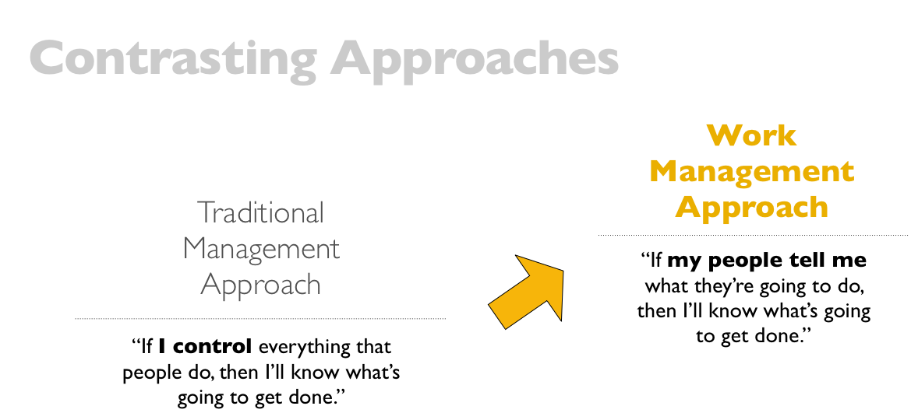
Notes:
Lets look at some traditional approaches and the work management approach….

Slide 20
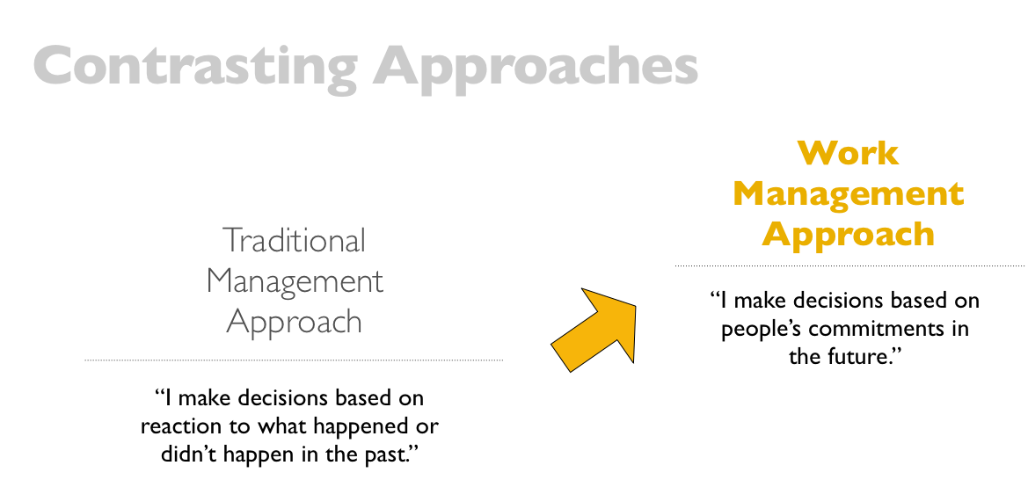

Slide 21
Democratized Work
Maximum buy-in
Promotes Involvement
Effective Collaboration
Empowers self-direction
Increases innovation and creativity

Slide 22
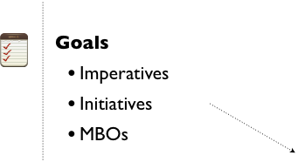

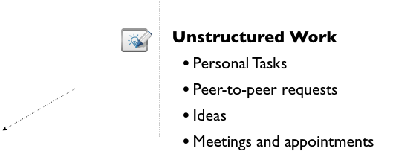
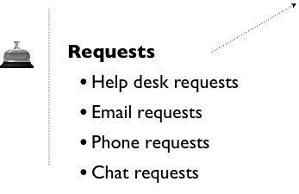
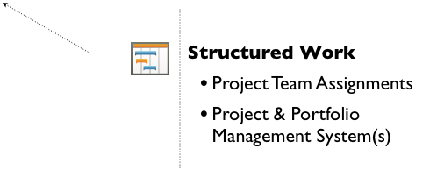
Work Management: Order out of Chaos
Notes:
Briefly talk each point, clicking brings new point in.

Slide 23
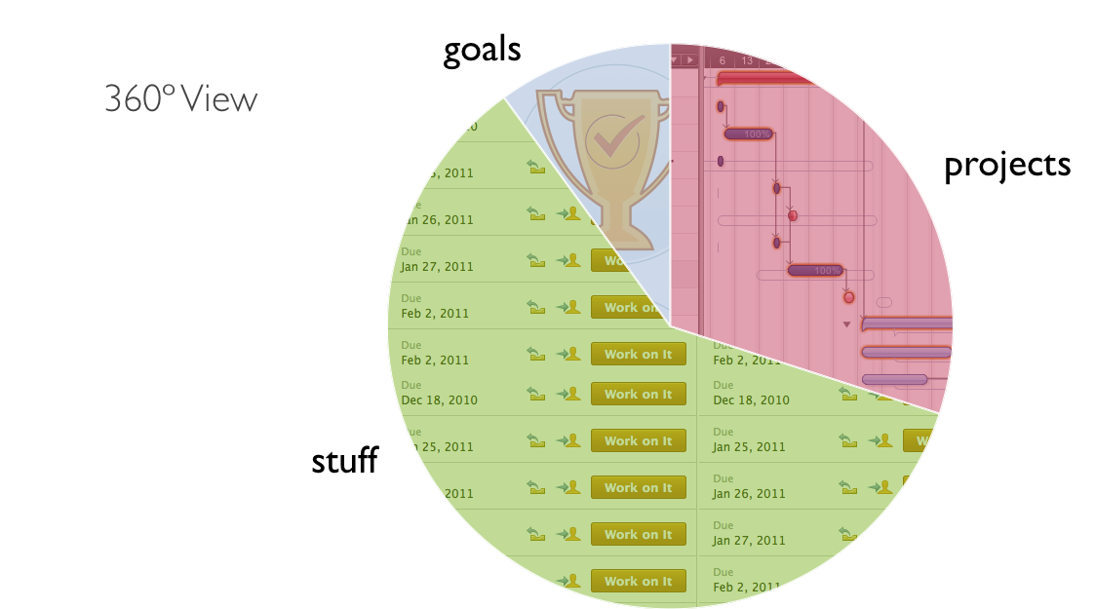
Work Management
Notes:
……here’s 360 degree view of it all….

Slide 24
Questions?
Scott Sax
Associate Director, PMO
Loyola University Maryland
sssax@loyola.edu
Ty Kiisel
Manager, Social Outreach
AtTask, Inc.
Ty.kiisel@attask.com

