Slide 1
Leverage the cloud +
Leverage in-house + Improve security =
Save Money
James G. Leoni
Assoc. Vice President & Deputy CIO
University of Maryland - CITS
jleoni@umaryland.edu
Joe Mancuso
Director Infrastructure Services
University of Maryland - CITS
jmancuso@umaryland.edu
Matt Riedel
Lead Systems Administrator
University of Maryland - CITS
mriedel@umaryland.edu

Slide 2

UM – The Founding Campus
Baltimore campus of the University of Maryland founded in 1807
Seven professional and graduate schools; we have very few undergrads
Close affiliation with UM Medical Center & UM BioPark

Slide 3

Center for Information Technology Services
Is the central information technology organization for the University
Develops and maintains mission-critical information systems and technologies
Maintains the network infrastructure as well as telecommunications

Slide 4

What is this session about?
Ties together many issues:
  Moving to the cloud
  Security of existing in-house systems
  Leveraging existing technology to meet new demands
Challenges we faced
Our implementation process
A live demo sending an encrypted email

Slide 5
Who may be interested in this session?
Those considering cloud email services
Those wanting to secure in-house email services
Those interested in data loss prevention and encryption to meet compliance issues

Slide 6

Background
Needed to replace our student email system
Considered both an in-house & cloud
Students overwhelming desire for Google
Notes:
Describe current system: Open Source, single point of failure, inability to get downtime, etc.
Solutions considered: Zimbra, GAE, revamp current setup
Mention Student Survey

Slide 7
Actual Student Quotes
“Your mail is irrelevant. Everyone I know simply forwards incoming messages to Gmail.”
“Switch to Google Apps for Education, I beg you.”
“As long as we can continue to bypass it and forward to Gmail, I'm content. If we were to have to start using it, I would suggest the school change applications - to Google apps.”
“At this point, I can't even remember how to get into the student email. I just have it all forward to my gmail account.”

Slide 8
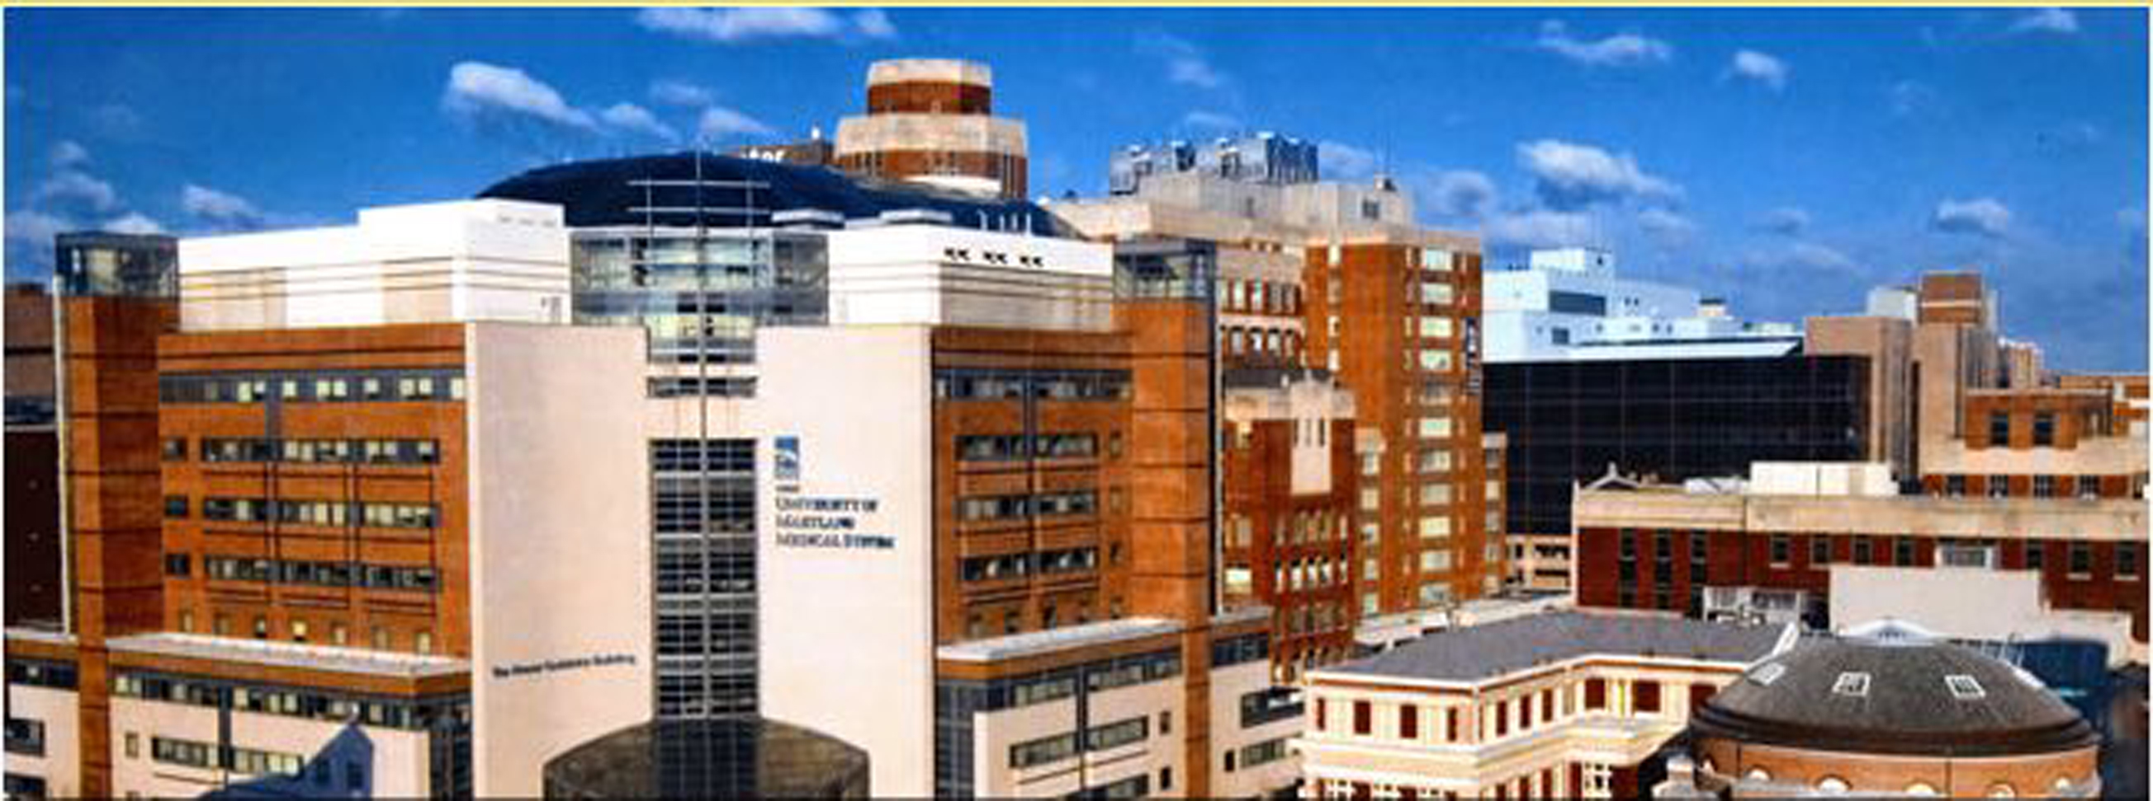
Decision to move to GAE
Aging infrastructure, costly replacement
We proceeded conservatively
GAE has been available for years
Notes:
Current setup was supposed to only be a temporary fix. It allowed us to buy time while we got other pieces in order.
First serious foray was Fall 2009 (?). We engaged each school individually to hear the concerns of their technical leaders.
By then, many universities had already switched or were planning to switch.

Slide 9

Hard to resist…
Home Brewed
Google
Total control/Total responsibility | Subject to local issues
Inferior user experience | H/W refresh cycle monster
Unfamiliar | Expensive!
Robust | Omnipresent
Feature-rich | Proven
Familiar | Free!
Notes:
Even with the deepest pockets, it would be hard to provide a solution that matches Google’s offerings.
Students already know and were using Google anyway.
Google provided additional levels of functionality, along with continual improvement.

Slide 10

Migration Tips
Due diligence
  Get your house in order
  Plan for the worst, hope for the best
Be flexible, but not a pushover
  Avoid 100 chefs in the kitchen
Notes:
Ask who in the room has already made the switch.
Despite your best efforts, nothing is as smooth as you hope it will be. There will be resistance to anything new, try not to let the loud and uninformed control the debate.
It’s important to hear peoples’ needs out, but at a certain point it’s impossible to accommodate every single desire. Stick to your core plans as best as possible, but if something can be done to help out a group and it doesn’t throw you off track, you should accommodate that.

Slide 11
Migration Tips
Consider using Single Sign-On (SSO)
  Pros & Cons
Remove dependency on legacy systems
Get your Identity Mgt. team involved early
Consider a pilot group – SGA?
Rollout plan
  Phased/Opt-In or All-at-Once?
Notes:
SSO: Unified logins for web only. Local logins still needed for Mobile and IMAP/POP access, if you’re going to enable it. This either means separate logins, or somehow syncing your campus credentials with GAE.
Clean up mail routing prior to moving any mailboxes. If you can, move mail routing to the outer edges of your campus domain.
Talk to your Identity management team to ensure that your plans fit with the capabilities of your ID infrastructure. Work closely with this team as you move forward, you’ll probably find that current IDM business practices will need altering.
Make sure to create a pilot group representative of the users you plan on hosting in GAE. In our case, since it’s a student system, we went to the SGA. This allowed us to get representatives from all the schools involved in testing. For us, more than anything, they helped us find flaws in our migration processes that we were able to fix prior to going live.
Rollout: We chose a hybrid approach. We had a six month window where students could migrate their mail on their own time. Then we had a hard cutover on October 1, 2011. At this point, only accounts were created; no mail was automatically moved. Students still have the ability to log into the migration tool and “finish” moving their mail. We plan on keeping that option around at least through the current Spring semester.

Slide 12
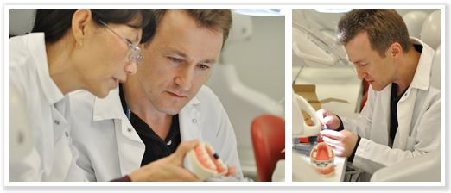

The HIPAA Dilemma
How do we provide students with the cloud based services they are asking for and at the same time provide secure communications required for HIPPA compliance?

Slide 13
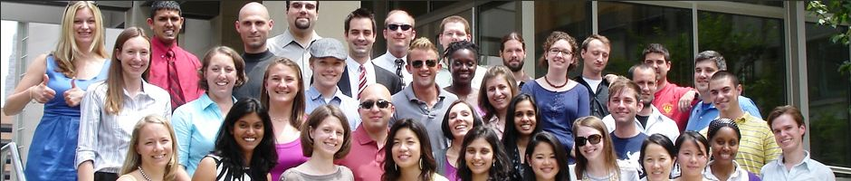
Migrating student email to GAE raised compliance concerns
Highlighted the need for better controls and secure email communications
  Not only for students but also for faculty and staff
Existing policies and practices for secure email vary greatly across campus

Slide 14
Laying the Foundation
Fall 2008 - CITS deployed Cisco IronPort appliances at the perimeter of the campus network processing all inbound traffic
Summer 2010 - CITS worked with the campus admins getting all outbound email through the IronPort appliances
Spring 2011 – TLS “preferred” encryption enabled
Summer 2011 - Data Loss Prevention (DLP) and Encryption deployed
  Provides a technical solution that can couple with UM campus policies and practices to ensure compliance with HIPAA, FERPA, etc…

Slide 15
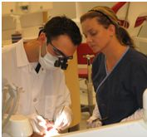
What is Data Loss Prevention?
DLP detects inappropriate content in outbound email messages
Based upon your policies you can take action; block or encrypt the message, warn the sender, notify someone else about the violation
Messages sent from the campus, including GAE, can be scanned for compliance and encrypted to ensure data is protected

Slide 16

Benefits beyond Securing GAE
We leveraged our investment in existing technology which proved cost effective
In addition to securing student email where appropriate, we could also secure staff and faculty email across a variety of email systems

Slide 17
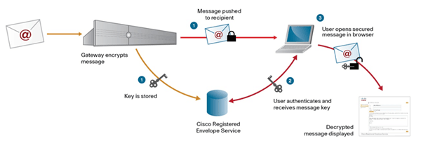

Slide 18
Demo!

Slide 19

Lessons Learned
Deploying cloud services forced us to consider how we could also improve our existing internal practices
Had to re-think our existing IT systems in a changing landscape
  Tough budgets
  Increasing student demands
  Growing compliance awareness

Slide 20

Lessons Learned
Deploying our email security solution at the network perimeter provided greater flexibility
We were able to protect a variety of systems and entities with different requirements
Choosing cloud based solutions is not an either/or decision

Slide 21

Questions & Discussion

Slide 22
Thank You
James G. Leoni
Assoc. Vice President & Deputy CIO
University of Maryland - CITS
jleoni@umaryland.edu
Joe Mancuso
Director Infrastructure Services
University of Maryland - CITS
jmancuso@umaryland.edu
Matt Riedel
Lead Systems Administrator
University of Maryland - CITS
mriedel@umaryland.edu

