Slide 1
EDUCAUSE Research Findings: CIOs, undergraduates, mobile devices,
IT organizations…and more
Pam Arroway, EDUCAUSE
Mid-Atlantic Regional Conference
January 2012

Slide 2
EDUCAUSE Center for Applied Research
Established in 2001 to provide
research-based evidence to
support effective decision making
in higher education.
Nearly 500 colleges and universities
subscribe to ECAR.

Slide 3
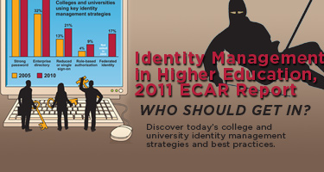
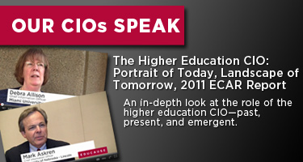


2011 Major Research Studies
Notes:
Identity Management in Higher Education (June 2011)
The Higher Education CIO: Portrait of today, Landscape of Tomorrow (October 2011)
ECAR National Study of Undergraduate Students and Information Technology, 2011 (October 2011)
Mobile IT in Higher Education (December 2011)

Slide 4

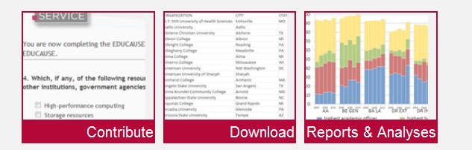
http://www.educause.edu/coredata
Notes:
The EDUCAUSE Core Data Service has been providing comparative data on IT in higher education since 2002, thanks to the dedicated contributions of over 800 institutions annually. The 2011 service was substantially redesigned to provide new interfaces for data entry and reporting, and new and expanded content. For 2012, we continue to refine content and will release a reporting/analytics tool.

Slide 5
http://www.educause.edu/ecaridm1101
All study materials are now publicly available.
Notes:
ECAR’s 2011 study of identity management in higher education updates our 2005 research on that topic and extends our work into the domain of federated identity. In 2010, invitations were sent to all EDUCAUSE member institutions. Responses were received from 323 higher education institutions in the U.S. and Canada. In addition, interviews were conducted with 55 IT leaders at 43 institutions.
Bottomline: Higher education has made substantial progress in the last five years, but many institutions are still struggling to deliver the full benefits of IdM. Institutions that report the greatest success have invested in all infrastructure aspects—technical, administrative, and political--required for identity management.

Slide 6
Identity Management Study
In 2010, a survey was sent to EDUCAUSE members
  323 institutions in the US and Canada responded
Interviews with 55 IT leaders at 43 institutions.
Higher education has made substantial progress in the last five years, but many institutions are still struggling to deliver the full benefits of IdM.
Institutions that report the greatest success have invested in all infrastructure aspects—technical, administrative, and political--required for identity management.

Slide 7
Five Core Identity
Management Elements
The greatest motivator
for engaging in identity management is
security and privacy.
Enterprise
Directory
Authentication
Reduced
or
Single
Sign-On
Role-Based
Authentication
Federated
Identity
Notes:
Authentication: are you who you say you are?
Enterprise Directory: single authoritative repository of information about IT resources and users
Reduced or single sign-on: Keeping the number of usernames and passwords needed manageable
Role-based authentication: Users with different roles have different access
Federated identity: Use locally assigned credentials to access remote resources (at another institution)
Other motivators: enhanced user services, regulatory compliance, position the institution for implementation of federated identity

Slide 8
Identity Management Capability Score
*Scale: 1 = very low, 2 = low, 3 = medium, 4 = high, 5 = very high
Notes:
Capability score was calculated only for respondents who answered all 14 capability questions. (Questions 3.1-3.14 on the survey instrument.)
The 14 items include things like immediately enable all authorized services for a new user , immediately change authorized services for a user who changes roles , reduced or single sign-on, strong authentication.
Responses were on a scale of 1-5, 1=capability is very low, 5=capability is very high.
Each institution’s average score over the 14 items is their capability score.
Mean capability score increased significantly from 2005 to 2010. (p=0.014)
Mean capability scores in 2010 did not differ significantly across Carnegie classes, size of institution or institutional control (public/private).

Slide 9
Identity Policies and Practices
+26%
+19%
+29%
Notes:
Between 2005 and 2010, use of strong passwords rose 25% and banning use of unencrypted passwords doubled.
Passwords remain the primary authentication method. (over kerberos, PKI certificate or hardware token, biometrics)
(sample size is about 125; margin of error is about 9%; so a difference of about 18% is stat signif)

Slide 10
Institutions with fully operational implementations reported better IdM outcomes:
Getting expected value from IdM projects
Meeting expectations about cost savings from IdM projects
Reported capability to engage in IdM projects
Notes:
Institutions engaged in automated role-based authorization projects grew 37% to 47%.
Stage of Implementation of Automated Role-Based Authorization (2010), by Carnegie Class (N=268)
Fully Operational Implementation: DR = 14% MA = 11% BA Liberal Arts = 6% BA Other = 0% AA = 8%
Significance = 0.002; Eta = 0.276
Stage of Implementation of Automated Role-Based Authorization (2010), by Institution Size (FTE Students)
Fully Operational Implementation: 1 – 4,000 FTE = 6% 4,001 – 15,000 FTE = 11% More than 15,000 FTE = 12%
Significance = 0.005; Eta = 0.236

Slide 11
57%
Demand for cloud computing in the coming year will increase the need for federated ID solutions.
29%
18%
12%
8%
Notes:
Stage of Implementation of Federated Identity, by Carnegie Class (N=268)
Significance = 0.000; Eta = 0.455
DR (N = 87)
Not Currently Planned but won’t Planned to start Implementation Partially Fully
Considering Evaluating start within next 12 months within the next 12 months in progress Operational Operational
6% 18% 3% 15% 15% 16% 26%
MA (N = 83)
Not Currently Planned but won’t Planned to start Implementation Partially Fully
Considering Evaluating start within next 12 months within the next 12 months in progress Operational Operational
34% 30% 2% 5% 8% 11% 10%
BA Liberal Arts (N = 34)
Not Currently Planned but won’t Planned to start Implementation Partially Fully
Considering Evaluating start within next 12 months within the next 12 months in progress Operational Operational
21% 44% 6% 12% 0% 6% 12%
BA Other (N = 25)
Not Currently Planned but won’t Planned to start Implementation Partially Fully
Considering Evaluating start within next 12 months within the next 12 months in progress Operational Operational
32% 44% 8% 4% 4% 4% 4%
AA (N = 39)
Not Currently Planned but won’t Planned to start Implementation Partially Fully
Considering Evaluating start within next 12 months within the next 12 months in progress Operational Operational
43% 33% 8% 8% 5% 0% 3%
Over the next 12 months, demand for cloud computing resources will increase need for federated identity services (N=321)
Strongly agree, 11%
Agree, 43%
Neutral, 29%
Disagree, 12%
Strongly disagree, 6%

Slide 12
http://www.educause.edu/ECAR/TheHigherEducationCIOPortraito/236114
Full report publicly available in March 2012.
Notes:
The EDUCAUSE Center for Applied Research (ECAR) conducted a survey and follow-up interviews in 2010 and 2011 with questions about the IT workforce and leadership, expanding on similar ECAR studies published in 2004 and 2008. The study and this slide deck also draw on the 2005–2009 EDUCAUSE Core Data Service (CDS) and the 2006–2011 EDUCAUSE Current Issues Surveys.

Slide 13
IT Workforce and Leadership Study
30,000 individuals in the EDUCAUSE database were invited to respond
Responses were received from 3,400 people from more than 1,000 institutions.
  368 senior IT leaders (whom we refer to as CIOs)
  545 CIO “aspirants”
  2,487 other IT staff who do not aspire to be CIOs
Report also used Core Data Service

Slide 14
Higher Education CIOs Are
Doing More
Standard functions reporting to the CIO include user support, administrative information systems, network infrastructure, data center operations, IT security and policy, and telephony.
From 2005 to 2009, half of institutions reported adding more official functions to the central IT organization.
IT planning and budgeting activities have significantly increased in central IT.
Notes:
Source: 2005–2009 EDUCAUSE Core Data Survey IT Organization, Staffing and Planning, Question 3: What functions report to or are included in the responsibilities of the highest ranking information technology administrator/officer on your campus?
“Standard” functions (selected by over 90% of all institutions) were user support/desktop computing, administrative information systems, network infrastructure, data center operations, and IT security and policy, with telephony not too far behind at 87%.
Over the period 2005–2009, more than half of institutions reported adding more functions to those responsibilities, while 21% reported reductions (28% reported no change). The most commonly added function was IT planning and budgeting, which was added by 27% of institutions, with 87% of doctoral institutions now reporting this function under the CIO but only 55% of BA GEN schools doing so.

Slide 15
The CIO is No Longer in the “IT Box”
The CIO position is more strategically oriented.
Half of CIOs selected IT funding as one of the top-five issues they spend time on.
CIOs cited the importance of being able to communicate, think strategically, influence, negotiate, and manage relationships.
CIOs must know how to introduce a new technology, as well as which ones to introduce.
Notes:
Source: EDUCAUSE Current Issues Survey 2011, Question 3: Which issues are you, as an IT leader or administrator, spending most of your time addressing? Check up to five [5] issues.
Every CIO respondent (100%) to the 2011 ECAR study indicated that communications skills are important to the job (high or very high), while only 31% put technical proficiency in the same category. Being prepared to take on the job of CIO isn’t just about skills. It is also about broad-based organizational background and understanding.

Slide 16
In Next Six Years, 31% of CIOs Plan to Retire or Leave Higher Education
n = 368
Notes:
Source: 2011 ECAR Workforce Survey
Question 1.26: How much longer do you plan to remain at your current institution?
Question 1.27: How much longer do you plan to remain in higher education?
Question 1.28: At what age do you plan to retire?
Question 1.3: What is your age?
Key Finding: 31% of current CIOs expect to retire or leave higher education within the next six years; 52% in 10 years.
Among the 368 CIOs reporting their plans in the current ECAR study, 42% plan to stay in higher education for at least the next six years, and 31% expect to retire (22%) or leave higher education (9%) over that time. The 2011 ECAR study also found that 52% of higher education CIOs plan to retire or leave higher education within the next 10 years, similar to findings in other surveys.
There is also some indication that the baby-boom generation will be working longer overall. Recent economic conditions have caused workers across many sectors to consider postponing retirement, and higher education CIOs are no exception. Pew Research found in 2009 that among workers in general 50–64 years old, average expected retirement age was 66, approximately four years later than for current retirees. In the year prior to the study, more than half (52%) of people in this age bracket had considered delaying retirement. An additional 16% said that they never plan to quit working.

Slide 17
Results Suggest a Sufficient Supply of Aspirants in Coming Years
Notes:
Source: 2011 ECAR Workforce Survey
Question 1.27: How much longer do you plan to remain in higher education?
Question 1.28: At what age do you plan to retire?
Question 1.3: What is your age?
Question 5.10: Do you aspire to a CIO position in higher education (institution’s senior-most IT leader)?
Question 1.8: What best describes your current IT position?
Key Finding: Of the 368 CIOs in the sample, 113 individuals plan to vacate that position within six years; while 420 individuals identified themselves as CIO aspirants who will be ready within six years; 44% of these aspirants are already in executive non-CIO positions.
These numbers suggest that there will be roughly four higher education candidates for each open CIO position. At the same time, some CIOs come from outside higher education—currently that proportion is about one-fourth. Factoring non–higher education candidates into the projection, one might expect there to be five or more total candidates for each open CIO position. Even with the additional openings created when CIOs move to other institutions or leave for non-retirement-related reasons, our results strongly suggest that there will be a sufficient supply of CIO candidates over the coming years.

Slide 18
A Culture of Succession Planning is Needed Within Higher Education
74% of CIOs come from within higher education. Roughly half of those from within the institution.
Only 31% of CIOs indicated that they are held responsible for identifying a successor.
  However, 64% of CIOs have identified a successor.
Aspirants who are being groomed for the CIO position are more optimistic about job opportunities.
  However, less than one-third of staff selected mentoring as a top factor in their professional growth.
Notes:
Source: 2011 ECAR Workforce Survey
Question 1.15: In what type of organization/institution was your most recent previous position?
Question 5.3: Which of the following describes your role in your previous position?
Question 5.4: Please indicate your level of agreement with the following statements about succession planning for your position. (a) I am held accountable by my supervisor for developing my successor. (b) I have identified one or more individuals within my organization who could succeed me now. (c) My successor is likely to be recruited from within the institution.
Question 5.12: Please indicate your level of agreement with the following statements. (a) I have sufficient opportunities to develop the skills I will need to become a CIO. (b) I believe there will be a sufficient number of CIO job openings in higher education for me to become a CIO within my desired time frame. (c) My manager/supervisor is helping to groom me as a future CIO. (d) To become a CIO, I will need to leave my current institution.
Question 2.3: Which of the following contribute most significantly to your professional growth and development? Select up to three.

Slide 19
http://www.educause.edu/Resources/ECARNationalStudyofUndergradua/238012
All study materials are publicly available.
Notes:
The ECAR study of undergraduate students and information technology sheds lights on how information technology affects the college experience. ECAR has conducted this annual study since 2004, and though students' ownership and utilization of technology changes from year to year, students consistently rely upon their instructors and institutions to meet their technology expectations and needs. The 2011 study differs from past studies in that the questionnaire was reengineered and responses were gathered from a nationally representative sample of 3,000 students in 1,179 colleges and universities.

Slide 20
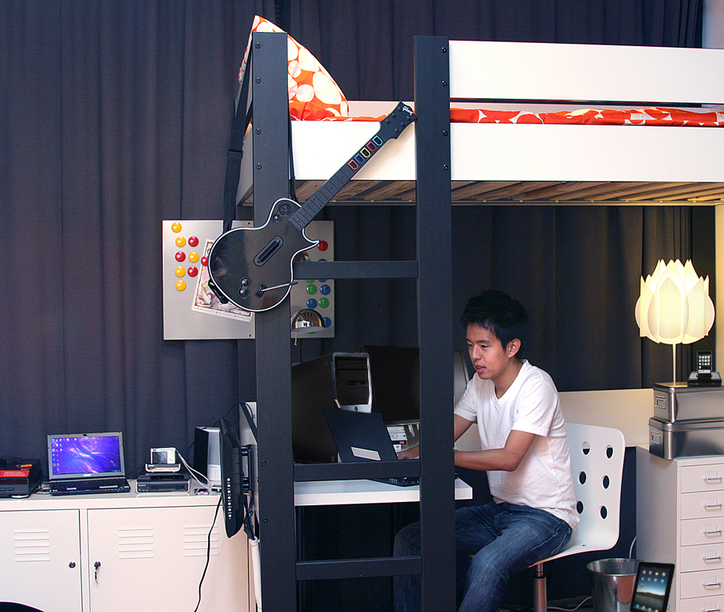

…they prefer small, mobile ones.
Students own many different devices...
Technology Ownership
Technology | Students Own
Laptop | 87%
Printer | 81%
DVD Player | 75%
USB Thumbdrive | 70%
Wi-Fi* | 67%
Stationary gaming device | 66%
iPod | 62%
HDTV | 56%
Smartphone | 55%
Digital Camera | 55%
Webcam | 55%
Desktop Computer | 53%
Handheld Gaming Device | 38%
Netbook | 11%
iPad | 8%
1
6
2
3
4
5
6
7
8
9
5
10
7
12
11
12
11
13
14
10
14
1
2
4
15
3
*Likely interpreted by the respondent as having access to Wi-Fi
8
9
13
Traditional age college students (18-24) and those from households of $100K+ own more technology than their counterparts.
15
Notes:
…PREFER SMALL, MOBILE DEVICES
Students are still attached to “standard issue” technology. A majority of students own a printer (81%), a DVD player (75%), a stationary gaming device (66%), an HDTV (56%), and a desktop computer (53%).
Graphic depicts 15 of the 34 devices that students were asked about owning.
Trends – 2010 Student Study: 84% own laptops, 46% own desktops, 13% own netbooks

Slide 21
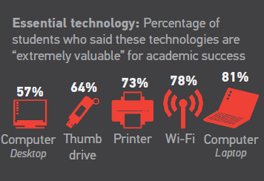
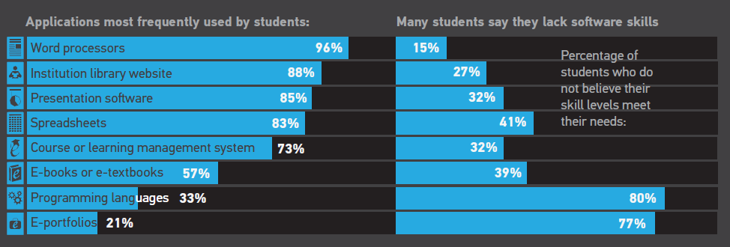
Students Rely on Traditional Devices…
…and Core Software

Slide 22
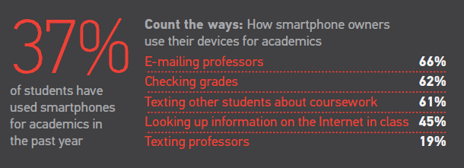
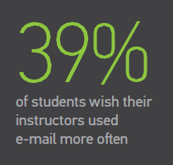
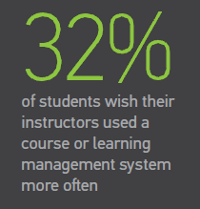
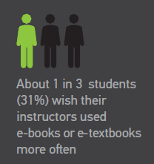
Students Recognize the Major Benefits of Technology
…they use their smartphones for academics
…they value anytime,
anywhere access
Value of Technology for Academic Success
Percent Responding “Extremely Valuable”
…they wish their instructors
used technology more often
Wi-Fi access is
key to student success, and students want access from everywhere
on campus.
Notes:
Students value software/program basics for academics. Longitudinal data will provide insight into which of the these technologies are waxing and which are waning in terms of value to students.

Slide 23
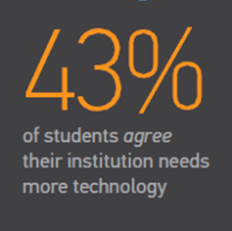
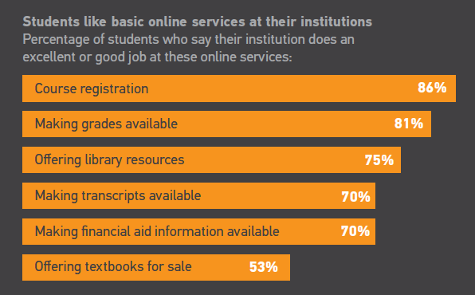
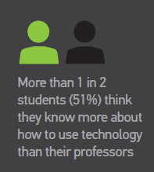
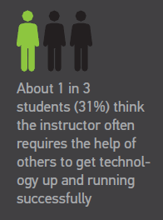
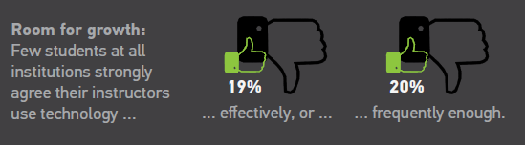
Students Report Uneven
Perceptions of Technology
Institutions provide these services well…
…but students
want more
technology
…I know more than my teachers
PD opportunities for faculty…
Notes:
Overall, students say their instructors use presentation devices effectively, but devices that inspire interactivity and participation, not so much.
Students report that projectors, Wi-Fi, laptops, desktops, and document cameras or digital overhead projectors are devices that instructors use “extremely effectively” to teach, mentor, or communicate—and these are generally the technologies that students also value highly. More personal technologies, such as e-readers, iPads, smartphones, and student response systems (clickers) are not used as effectively, students say. That students do not consider student response systems as more effectively used is notable, given that this technology is designed specifically for instructional support, as opposed to other, general-purpose devices.
Successful teaching with technology is like a coin, with obverse and reverse sides together constituting the whole. Successful instructors combine technology (obverse) with targeted pedagogical activities (reverse). Managing diverse technologies and weaving them all into a coordinated pedagogy is a challenging business requiring diverse expertise. As demonstrated by students’ lackluster response to student response systems (clickers), there are opportunities to inspire student participation and interactivity with existing technology, but the technology by itself isn't sufficient and doesn't guarantee successful learning outcomes.
Instructors at associate’s colleges and other two-year programs are significantly less likely to use a wide variety of technologies in class, students say. Devices that instructors at two or more other institutional types are significantly more likely to use than associate’s college instructors include laptops, projectors, Wi-Fi, student response systems, document cameras, USB thumb drives, interactive whiteboards, smartphones, webcams, iPads, and digital and Flip video cameras.
Notably, however, for the technologies that associate’s college instructors do use, students say those instructors often use those technologies more effectively. These include desktop computers, laptop computers, webcams, scanners, printers, projectors, and interactive whiteboards. In fact, instructors at other institution types do not use any devices more effectively than associate’s college instructors do, according to students.

Slide 24
Students Juggle Communication Tools
Students are comfortable communicating with other students on Facebook about academics
They prefer email for instructors

Slide 25
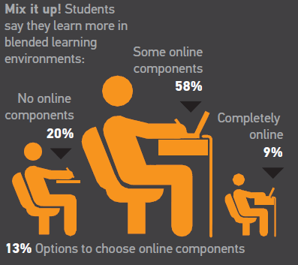
Students Prefer…
…courses with online components…
Preferred Learning Environment
…and say they learn more
in blended courses
Nearly 80% prefer blended environments

Slide 26
http://www.educause.edu/Resources/MobileITinHigherEducation2011R/238470
Full report publicly available in May 2012.
Notes:
The ECAR mobile IT study gathered quantitative and qualitative data from a representative sample of 209 higher education institutions.

Slide 27
ECAR Mobile IT Study
925 EDUCAUSE members were invited to respond
  Roughly half of EDUCAUSE members invited
  Stratified across Carnegie classes
Responses were received from 209 institutions
  Overall response rate of 23%

Slide 28
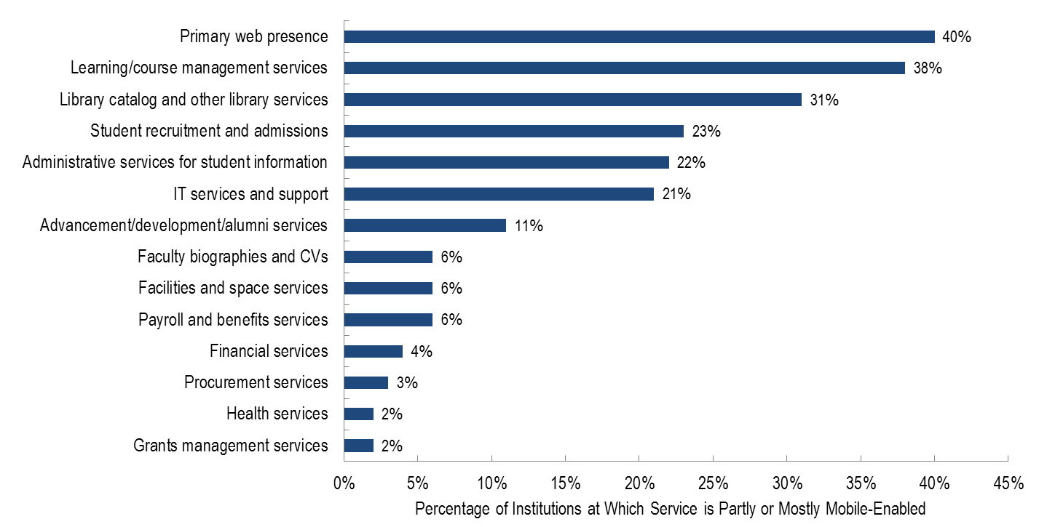
Student- and Public-Facing Services Are Enabled First
Services focused on staff are
languishing, relative to
student-focused services.
Notes:
Right click chart and select “Edit Data…” to view data pertinent to this slide.
The highest priority services were also those whose mobile enablement was furthest along, suggesting reasonable alignment of priority and activity. Note that five of the top six items are student-facing. Our experience suggests that the sixth item in order of mean priority and enablement, IT services and support, is often available to faculty, staff, and students alike. The remaining items on the list, with the exception of health services, are more administrative in their focus.

Slide 29
Maturity for Mobile-Enablement
MAINSTREAM
None
TRANSITIONING TO MAINSTREAM
Primary web presence
Learning/course management services
Mainstream
In transition
Administrative services for student information
Student recruitment and admissions
Transitioning to Mainstream
EXPERIMENTAL
Library catalog and other library services
IT services and support
Administrative services for student information
Student recruitment and admissions
Advancement/development/ alumni services
Experimental
Emergent
Main public- and
student-facing services
EMERGENT
Library, IT, and
key constituent services
Faculty biographies and CVs
Facilities and space services
Payroll and benefits services
Financial services
Procurement services
Health services (institutional health center)
Grants management services
Peripheral services for faculty and students
Notes:
Right click chart in bottom right corner and select “Edit data…” to see details and statistics.
None of the services, applications, and websites we asked about appears to have entered the “mainstream” in mobile form. The institution’s main web presence and its LMS/CMS are closest, as they transition out of the experimental stage. Student- and public-facing items dominate the experimental category, reflecting their higher priority. More purely administrative services (largely serving institutional employees) dominate the emergent category.

Slide 30
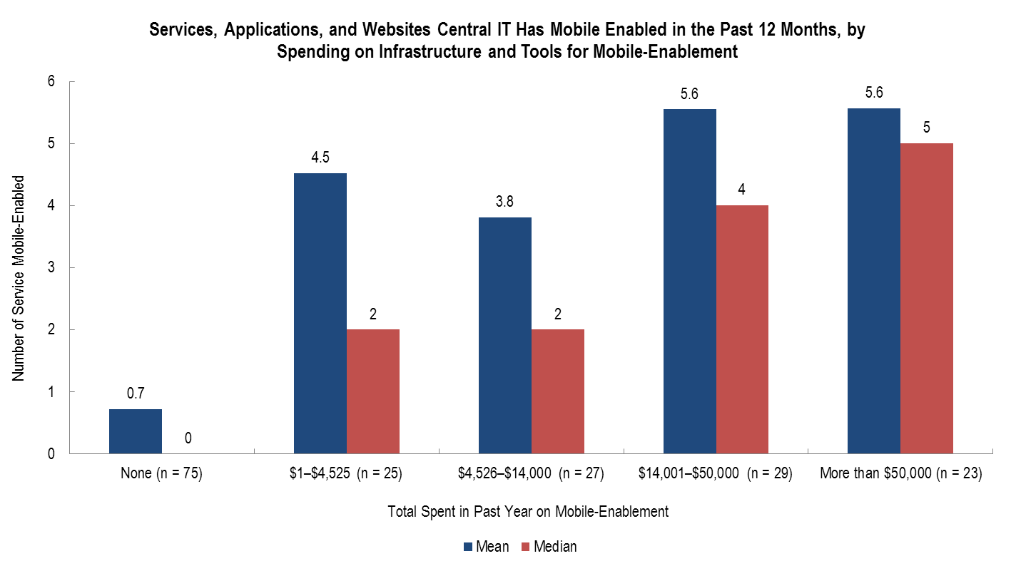
On Average, More Mobile Enablement Occurs Where Central IT Spends More On It
It costs roughly $5k to mobile-enable a service
Notes:
Outlying data points exaggerate most means, but median number of items mobile-enabled follows a regular pattern of increase as spending increases. Spending on infrastructure and tools for mobile enablement and the number of staff working on that task, taken together, explain about half of the overall variation in number of items enabled.
One-fifth of institutions have zero FTEs assigned to mobile-enablement.
The largest proportion have between 1 and 2 FTEs working on mobile-enablement.
DR institutions have the highest staffing levels ~4 FTE.

Slide 31
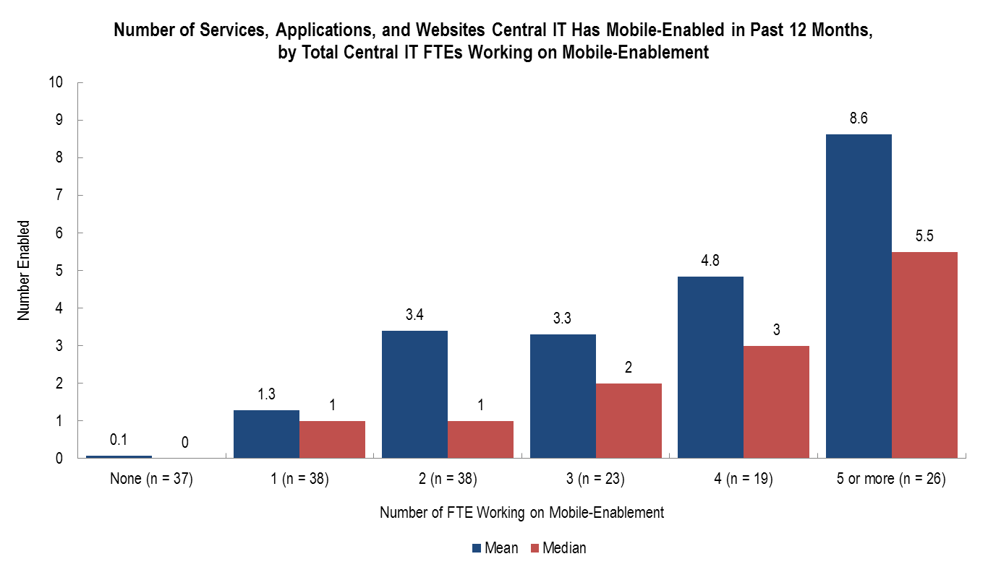
More Staff Working on Mobile-Enablement
Results in Greater Progress
Who Is in Charge of Mobile-Enablement?
Notes:
The number of staff assigned to mobile enablement is significantly associated with our best quantitative measure of mobile IT progress, the number of institutional services, applications, and websites enabled. As with other factors, productivity varies substantially within each FTE category, so median number of items enabled may be a more predictive measure than the
What more can we say about enablement and staffing?
One-fifth of institutions have zero FTEs assigned to mobile-enablement
The largest proportion have between 1 and 2 FTEs working on mobile-enablement
DR institutions have the highest staffing levels ~4 FTE
mean.
Who is in charge of mobile enablement?
For the 14 service areas we asked about, central IT has primary responsibility for mobile-enablement for more than 6 areas, on average.
Institutions with smaller staffs and budgets said they are looking to vendors to take a larger role in mobile development.

Slide 32
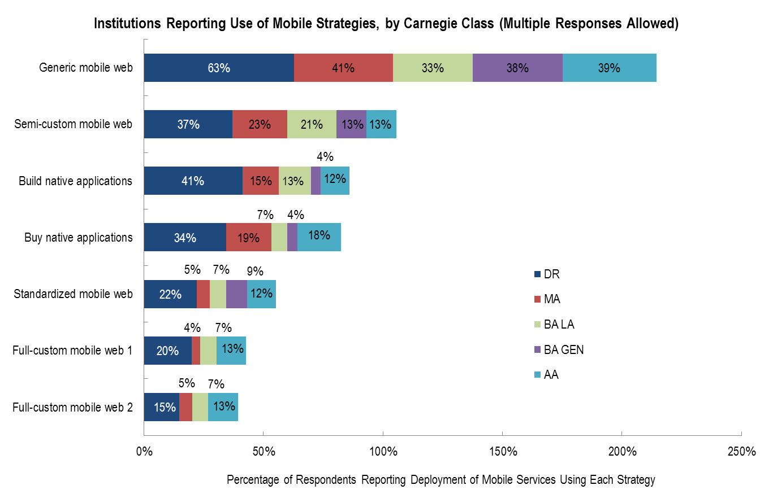
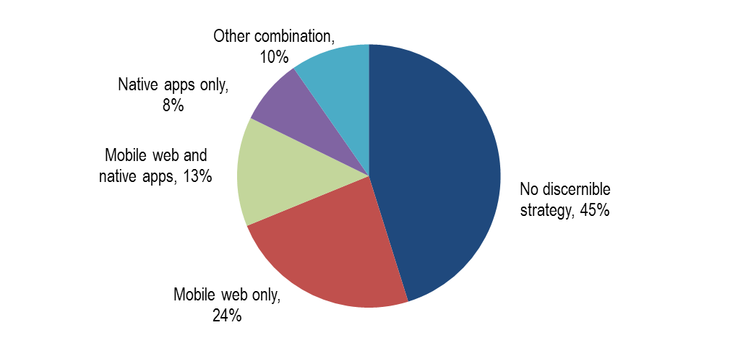
Most Activity is in Generic Mobile Web
Pattern of Inactivity is Reflected in
Development Strategy
Notes:
Right click chart and select “Edit Data…” to view data pertinent to this slide.
There are many ways to mobile-enable services, and we found wide variation in the adoption of various strategies. This slide shows the proportion of each Carnegie class that reported sparse or broad deployment of seven strategies—i.e., the proportion that were actually putting the technologies to use at the time of our survey. All classes made substantial use of generic mobile web technologies. Interestingly, native applications, whether built or bought, were in more frequent use than any of the more sophisticated browser-based mobile web technologies.
Pattern of Development Strategy:
When we organized development strategies into three groups—mobile web, native apps, and mobile frameworks—close to half of respondents appear not to be pursuing any of these strategies.
Large percentages seem to be focusing on mobile web only or a combination of this and native apps.
Adoption of mobile frameworks remains low.

Slide 33
Respondents Broadly Support Collaborations
Notes:
Right click charts and select “Edit Data…” to view data pertinent to this slide.
Interest in cross-institutional IT collaborations runs high. Most respondents are in favor of them, feel they would be a successful model for developing and maintaining applications, believe they could save higher education significant sums of money. Nearly 8 in 10 say they might even accept functional compromises in order to realize the benefits of collaborative solutions. Overall, the prospects for cross-institutional collaborations to develop mobile applications look very good.

Slide 34
http://www.educause.edu/coredata
Notes:
The following slides are a smattering of results from the 2011 Core Data Service. More details can be found in the collection of reports and analyses on the Core Data web site.

Slide 35
Centralized IT Funding per Student FTE, Adjusted for Inflation 2006–2010
US Dollars per Student FTE
2006
2008
2010
2006
2008
2010
2006
2008
2010
2006
2008
2010
2006
2008
2010
2006
2008
2010
Note: Bottom of bar = 25th percentile, line in bar = 50th percentile/median, top of bar = 75th percentile.
Notes:
Student FTEs (from IPEDS)
Total of all “Last FY actuals” sub-items for Module 1, Question 28. Central IT funding amounts, in US dollars (USD), that central IT (a) received in the last FY (FY 2009–2010) and (b) has budgeted for the current FY (FY 2010–2011) from each funding category.

Slide 36
Deployment Maturity: Teaching & Learning Technologies
MAINSTREAM
Document management tools
Hybrid courses
E-learning (wholly online courses)
Distance learning with local instructor and remote students
Mainstream
In transition
Interactive learning
Collaboration tools (e.g., Google Apps, Sharepoint)
Blogs
Transitioning to Mainstream
TRANSITIONING TO MAINSTREAM
Facebook
Distance learning with local students and remote instructor
E-portfolios
Learning objects
Lecture capture
Wikis
E-books
Simulation
Experimental
Content management
EXPERIMENTAL
Instruction
Mobile applications
E-textbooks
Twitter
Open content
Gaming
Social media
Content
Innovative learning
Notes:
The 21 teaching and learning technologies listed are in varying stages of deployment, as measured on the following scale: deployed broadly, deployed sparsely, in planning, experimenting/considering, considered; not pursued, and no discussion to date. Only one technology, document management tools, is broadly deployed in as many as half (51%) of institutions. One-third of the technologies are broadly deployed in more than one-quarter of institutions: Document management tools (51%), hybrid courses (43%), e-learning (wholly online courses) (35%), distance learning: local instructor and remote students (34%), collaboration tools (e.g., Google Apps, SharePoint) (29%), interactive learning (29%), and an information literacy requirement (28%). For all the talk about using technology to improve and innovate with teaching, most institutions are doing little more than experimenting with such technologies as Facebook, mobile apps for learning, simulations, e-textbooks, Twitter, open content and gaming. None is broadly deployed at more than 10% of institutions. Gaming and open content are deployed in the fewest number of institutions.

Slide 37
E-Mail
Reasons for Outsourcing
Reduce costs
Increase storage
Access to additional applications
Outsourcing Student E-Mail
58% of U.S. institutions are outsourcing student e-mail
  65% of AA institutions
  39% of BA institutions
16% have plans to outsource
Notes:
Over half of US institutions (58%) are outsourcing student e-mail. Outsourcing varies significantly by type of institution, with associate’s institutions most likely to be outsourcing e-mail (65%) and bachelor’s institutions least likely (39%)
A very small percentage are outsourcing staff and faculty e-mail (7%).
An additional 16% have plans to outsource, and almost none are planning to insource
Multiple factors drove outsourcing of student e-mail, although cost (savings or avoidance—increased storage) was the leading motivator
The potential to move to integrated suites of applications provided by outsourcers was also a strong factor for most outsourcing institutions.
Of those institutions who outsource email, more institutions outsource to Google any other option, with Microsoft as the dominant alternative

Slide 38

Deeper dive into selected portions of CDS
September: Connecting Student Data from ECAR and CDS
January: Funding Model Archetypes
February: IT Expenses
Future: Help desk practices, IT security practices, Cyberinfrastructure update

Slide 39
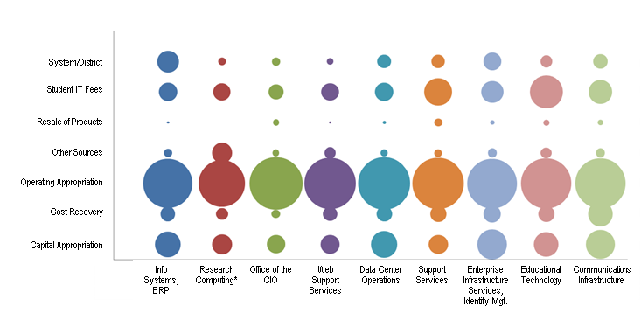
Funding Sources by IT Function
System/District
Student IT Fees
Resale of Products
Other Sources
Operating Approp.
Cost Recovery
Capital Approp.
Identity Mgmt.
Web Support Serv.
Support Services
Educational Tech.
Research Computing
Data Center Oper.
Info Systems, ERP
Office of the CIO
Comm. Infrastructure
Notes:
Area of the bubble is proportional to the percentage of institutions who are providing the service who use the specified source. Of those institutions with an ERP, a very large percentage use operating appropriations to fund this service; very few use resale of products.

Slide 40
Other Popular Research Bulletins
“How Are Students Actually Using IT? An Ethnographic Study” (Nov. 2011)
“From Learning Commons to Learning Outcomes: Assessing Collaborative Services and Spaces” (Sept. 2011)
“Evaluating IT and Library Services with the MISO Survey” (Jul. 2011)
“Clickers in the Classroom: Transforming Students into Active Learners” (Jul. 2011)
“Doing Academic Analytics Right: Intelligent Answers to Simple Questions” (Feb. 2011)

Slide 41
ECAR 2012 Research Agenda
2012 ECAR study of students and information technology
Cross-institutional collaborations and shared services
Analytics readiness and needs assessment
Service catalogs
Benchmarking user satisfaction
Research computing: key performance indicators and maturity index
Ask me how your institution can participate!

Slide 42
Budding Research Partnerships
Gartner Research
  ECAR subscribers will have access to some Gartner Research
CHECS surveys of CIOs and Technology Leaders
  ECAR subscribers will have access to CHECS reports
NSSE technology module

Slide 43
ECAR Subscriptions
Subscriptions are being renewed right now!
Or become a new subscriber to ECAR.
http://www.educause.edu/ECAR/ECARHome/SubscriptionsandSubscribers/98

Slide 44
Thank you!
http://www.educause.edu/ecar
Pam Arroway
parroway@educause.edu

