Slide 1


Moving Employee Email to the Cloud with Microsoft Office 365
Mid-Atlantic Regional Educause Conference
Wednesday, January 16, 2013
Rick Gould, Director of Special Projects
Joseph Rossmeier, Vice President for Technology Services
Prince George’s Community College

Slide 2
About the College
JR
Prince George’s Community College
Central Maryland, founded in 1965
42,000 students using Microsoft live@edu in the Cloud
3,000 Employees using Microsoft Office 365 in the Cloud

Slide 3
Employee Email
Decision: January 2012
Novell GroupWise 6.5 (9 years old) - obsolete
Lacked full integration with MS Office
Incompatible with Windows 7
Frequent downtime due to infrastructure problems
Email Administration maintenance skills – limited to one shift
End-User skills – held in the past by old technology

Slide 4
Alternatives
Improve the status quo
Continue based upon legacy decisions
Stay with Novell and GroupWise - upgrade to latest release
Easy to accomplish - but little technological advancement
Do something Strategic/ Transformational
Replace earlier decisions (abandon the past)
Change to Microsoft and Outlook / Exchange – YES !
Change from on-site to the Microsoft Cloud – MAYBE ?

Slide 5
EMAIL
INFRASTRUCTURE
----------
REQUIRED POINTS OF INTEGRATION
Employee Email
Email access through
College Website and Portal
PC / MAC
Email Clients
Web Browsers
Classrooms
Labs / Library
Student Email live@edu converting to Office 365 in 2013
Mobile Device
Apple
Android
Windows
Integration with Windows
MS Office
SharePoint

Slide 6
Technology Strategies Satisfied by Outlook / Exchange
World-Class Providers
Enterprise Class Products
*Market-Leading Products and Services
*Integration with Microsoft Core Roadmap
*Long-lived solutions
*Integrated with other College technology plans
Integration with other Office 365 services
SharePoint Online
Office Web Parts
LYNC Conferencing
Outsource Commodity Technologies
*Minimal/No Customization
IT skills already in-house or readily available

Slide 7
Benefits for the End-User Provided by Outlook / Exchange
Up-to-date Technology
*Integration with MS Office
*Mobile device support
*Outlook Web App for remote access
*Outlook 2011 for MACs
Enables Windows 7, 8
*Satisfy or exceed end-user requirements
Easy access to training and Outlook communities
Users approve this change
User skill requirements are reasonable and attainable through training and practice; no hiring req’d
*Users will experience no or minimal workload change

Slide 8
What about the Cloud?
Student email already in the Cloud
42,000 students using live@edu in the Microsoft Cloud
College experience with Microsoft student email – positive !
Live@edu scheduled to become Office 365 for Students
What about the email for employees?
Will IT and Users be better off with or without the Cloud?

Slide 9
Benefits for IT Provided by the Office 365 Cloud
*24/7/365 operations
*99.9% availability
World-Class datacenter(s)
Infrastructure redundancy
Storage as a service
Performance as a service
Backup and recovery
Patch management
Release management
*System Development
*No customization needed
Integrated with MS Office
*Integrated with all of O365
Integrated with Office 365 for students
Integrated with Microsoft core roadmap
*Cost is reasonable or better

Slide 10
Benefits for End-Users Provided by the Office 365 Cloud
*More storage - 25GB
Legal Hold (available, fee)
Unlimited Archive (available, fee)
Faculty and Students both using Office 365
Future integration with SharePoint Online and Lync Online
End-User experience - equal or better

Slide 11
Project Cost Analysis
Cost
Cost Recovery
Novell licenses - $70K / yr
Infrastructure freed up
Servers - $30K/yr
Storage - $20K/yr
Backup - $10K/yr
Other – $10K/yr
Network Admin - $ ???
Total - $140K
Cost Recovery in 1.25 yrs
Consulting:
original - $75K
add’l migration - $56K
Quest Assistance - $17K
Quest Migration Tool - $35K
Total - $183K

Slide 12
Project Schedule --9 months
Jan - Contracts with Bell TechLogix, Quest and Microsoft
Feb – May
Active Directory Preparation, Provision O365, load email accounts to O365; virtualize the GW client ; rollout Outlook 2010; user training and practice with Outlook & OWA
June – migrate data from GW to O365; go live 06/30 !
July to Sep – additional time required to migrate data
Oct 1st week – final migrations of the latest GW data
Oct 2nd week – prepare for cut-over & end user support
Oct 3rd week – cut-over; weekend of Oct 20

Slide 13
Project Components
Active Directory Tune-Up
Provision Office 365
Establish email accounts
Project Communications
Announcements, Portal Page
Train Users
In Classroom, Tutorials
User practice in advance
Final Migrations
Cut-Over to O365
Support Users
Migrate email
6 months current
3 years archived
Migrate calendars
Migrate contacts
Migrate document files
Migrate distribution lists
Migrate rooms, etc.
Migrate resource accounts
Migrate permissions

Slide 14
Unexpected Migration Problems
Migration Tool from Quest (not fully ready for Office 365)
Data movement to the Office 365 Cloud was slow
1.25 GB/hour at best; throttled by Microsoft
20 migration servers, 2400 hours runtime for migrations
Migration Errors
Calendar - recurring meetings did not migrate
Permissions - did not migrate
Unpredictable - partial migrations per user
Error report unreadable; causing selective re-runs

Slide 15
Surprises about Office 365
Sync from Active Directory to Office 365 – once every 4 hrs
Global Address List (GAL)
Office 365 updates and distributes the GAL once every 24 hours
Deleting Accounts
Office 365 enables deleted accounts to be recovered for 30 days
When an account is to be deleted, must petition MS to force an actual delete

Slide 16
More Surprises
Search and Destroy – took over 20 hours to run a script across the Office 365 cloud to find and purge an email
Desktops that are not all at the same release, patch and registry level – act differently
Sent / deleted email saved in wrong account unless patched
Save and Send – works under Win 7, not under XP
College infrastructure needs to be “ready”
Not quite like web browsing; email more interactive
Bandwidth, PCs, MACs, network, wireless, AD, email admin

Slide 17
Still More Surprises
Large mailings can’t go out through Office 365
Limit of 1500 emails per 24 hrs per sender
Need an in-house email server to relay the large mailings
Existing Fax Server was not compatible with Office 365
New Microsoft –endorsed fax server being purchased (RightFax)
Anti-Spam service in Office 365
Experiencing more spam, especially phishing
May have to upgrade to the “preferred” service (fee)

Slide 18
And Even More Surprises
Large data moves (cut/copy/paste) can take hours
Example: moving 1000 contacts to a different folder
Cloud can take as long as overnight to complete
End-Users with Outlook at Home
Home PC does not have same patches / registry as office PC
Outlook may act differently at home

Slide 19
The Best Surprise
Users very happy with new email system—minimal complaints!

Slide 20
Mobile Device Support
Microsoft ActiveSync
Developed online consent form for end-user sign-up
Email, Calendar and Contacts
Apple (154 current users), Android and Windows next
Communication to Mobile Device from the Office 365 Cloud
Wi-Fi and cellular communication channels
Working fine, on and off-campus

Slide 21
Fee-based add-on services
Legal Hold
Used to support HR and litigation activities
Prevents actual deletion of email
Undetectable by end-user
$4.50 per month per email account
Unlimited Archive
Used for departmental accounts with large histories
Accounting, Procurement
$4.50 per month per email account

Slide 22
Now Live on Office 365
Live on Office 365 since Oct 20 (~ 3 months)
No outages or major system-wide disruptions
One (1) email delivery slow-down lasting 4 hours

Slide 23
Microsoft vs Quest
Microsoft Outlook / Exchange technology – no problems
Microsoft Office 365 Cloud technology – no problems
Surprises associated with the Microsoft Office 365 Cloud
Appeared to be problems at first
OK after we made the appropriate adjustments!!!
Data Migration using Quest Technologies – problems

Slide 24
If we could do it all again….
Reduce the migration task:
Migrate less history – we brought over 3 years
Migrate fewer accounts – purge before migrating
“Zero-Impact Migration Service” from Dell & Quest
They will remote in and perform the migration for you
Cloud-based migration service - no installation tasks
Quest “Co-Existence” Tool
enables cut-over in phases (by department, campus, etc)

Slide 25
Office 365
Using Ellucian Colleague as the “system of record” to manage Active Directory and Office 365 Accounts
Active
Directory
Employee Data from Ellucian Colleague

Slide 26
Using Ellucian Colleague
Employee data extracted from Colleague
Used to update Active Directory every day
AD automatically sync’s to Office 365
Using Colleague data for:
New hires, separations, retirements
To automatically populate the Dynamic Distribution Lists
Annual purge of email accounts

Slide 27
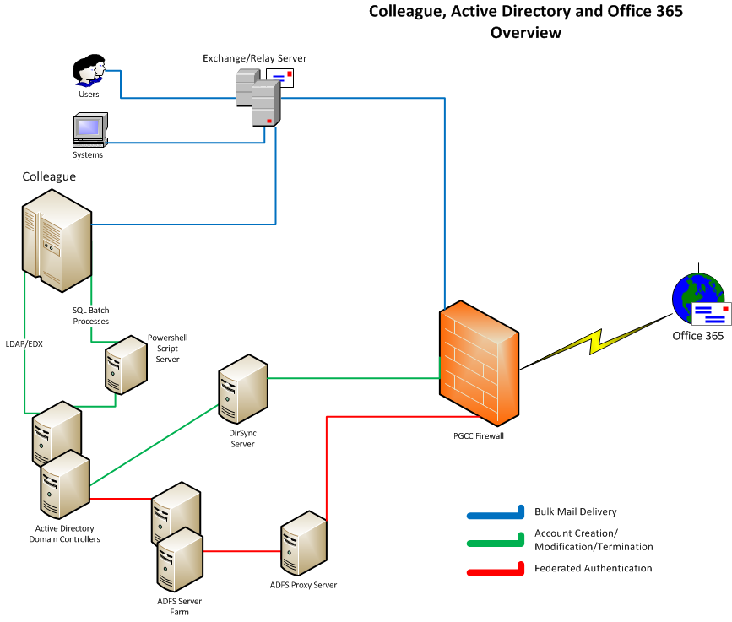

Slide 28
Security Improvements
No email accounts
For Student Employees, Contractors, Volunteers and
Credit/ ConEd Adjuncts “off-the-payroll” 18 months or more
Deletion of email after 3 years
Automatic deletion on a rolling 3 year schedule
Restrictions on Distribution Lists
DLs have a moderator and use is limited to selected employees
Auto-Forwarding to other Email Systems – blocked

Slide 29
Office 365 Academic Plan A2 More features in current release
We implemented:
Exchange plan 1
Subscribed to 5 licenses of Exchange Plan 2 to get
Legal Hold
Can assign the 5 licenses to any 5 email accounts
Also available in Plan A2
SharePoint Plan 1
Lync Plan 1
Office Web Apps

Slide 30
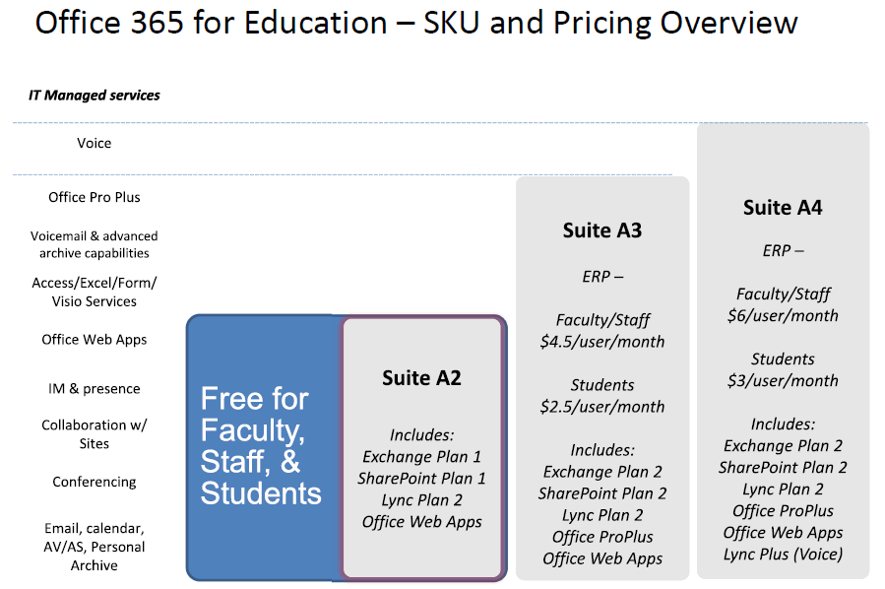

Slide 31
Next Release of Office 365
New Features
New Features
Office on Demand - stream Office to end-points
Site Mailboxes – docs and email sync’d to SharePoint
Data Loss Prevention
eDiscovery Center
Context tracking - what people are working on
Work across Time Zones
Data governance / protection policies in SharePoint
Lync Meeting – HD video, VOIP, IM, desktop & doc sharing using the browser-based Lync web app
More details here…
www.microsoft.com/office/preview/en/office-365-enterprise

Slide 32
Our Conclusion
Good Decisions
Replace GroupWise with Outlook / Exchange
Office 365 in the Cloud
Users like it, IT likes it
IT looking for additional Cloud opportunities

Slide 33
Your Questions, Observations, etc.
Thank you
jrossmeier@pgcc.edu
rgould@pgcc.edu

