Slide 1

How to Pack 3 PB into a 1 PB bag.
4
Brian Viscuso
Matt Lawson
Mid-Atlantic Educause 2013
Baltimore, MD

Slide 2
Matt Lawson
I have spent 15 years in IT.
Dad of 6 Daughters | Principle IT Consultant | Dev Team Lead
DBA | Developer | System Architect
Vice President for Information Technology | Java Guy | IT Director

Slide 3
Brian Viscuso
I have spent 20 years in IT.
Father of Twin Boys | Environmental Geologist | 12 Years in Higher Ed
Director of System Engineering | Data Center/Facility Manager | Lead of Systems Engineering Team

Slide 4
You know you have Big Data when…
… you get a call from the utility company asking you not to run ‘that brownout query’ again. (@aristippus303)
… your IT spends more time purchasing storage capacity than making sure the business has the data they need (@judyiko)

Slide 5
You know you have Big Data when…
… EMC name a new product after you (@aristippus303)
… it piles up so high that it disappears into the clouds (@evertlammerts)

Slide 6
You know you have Big Data when…
… the SAN undergoes gravitational collapse and you get cited by OSHA for an unlicensed singularity. (@datamartist)
… your datacenter manager divides time between installing a new NAS in the kitchen and googling for vacant aircraft hangars. (@alanjharrison)

Slide 7

90% of world’s data was created in last 2 years
80% is unstructured
Source: IBM - http://t.co/WVJSlEfa

Slide 8
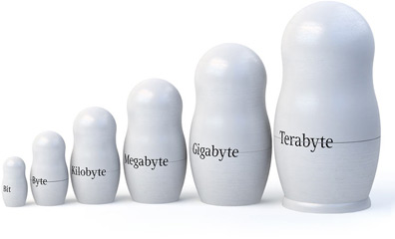
Mankind created data
150 exabytes in 2005 (exabyte is a billion gigabytes)
1,200 exabytes in 2010
35,000 exabytes in 2020 (expected by IBM)
Img: http://i.imgur.com/49xGw.jpg
Source: http://csrc.nist.gov/groups/SMA/forum/documents/june2012presentations/fcsm_june2012_cooper_mell.pdf

Slide 9
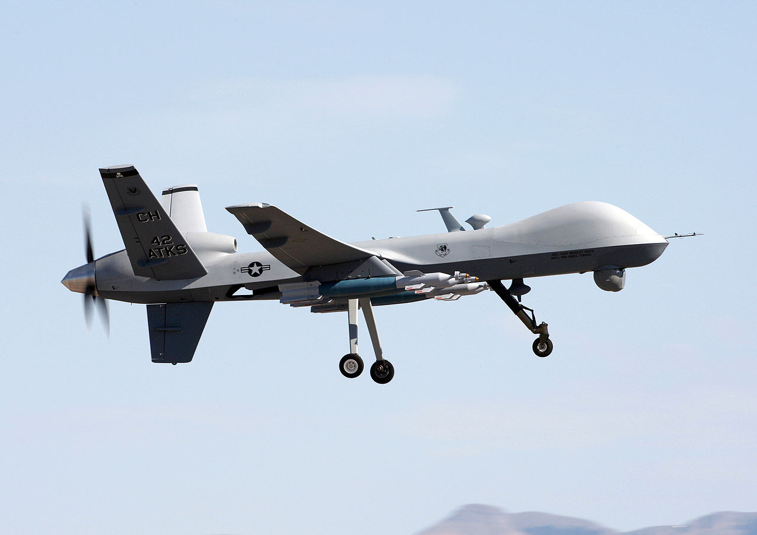
24 years of video in 2009
Img: http://en.wikipedia.org/wiki/File:MQ-9_Reaper_-_090609-F-0000M-777.JPG

Slide 10
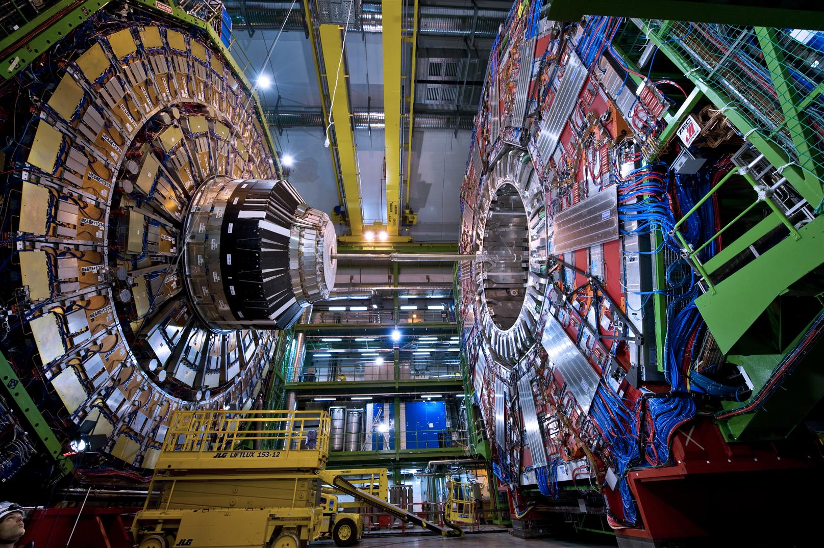
40 terabytes/second
Img: http://newsroom.unl.edu/releases/downloadables/photo/20110822cms.jpg

Slide 11

5,106 tweets/second
Img: http://a.abcnews.com/images/Blotter/gty_osama_bin_laden_jef_111209_wg.jpg

Slide 12
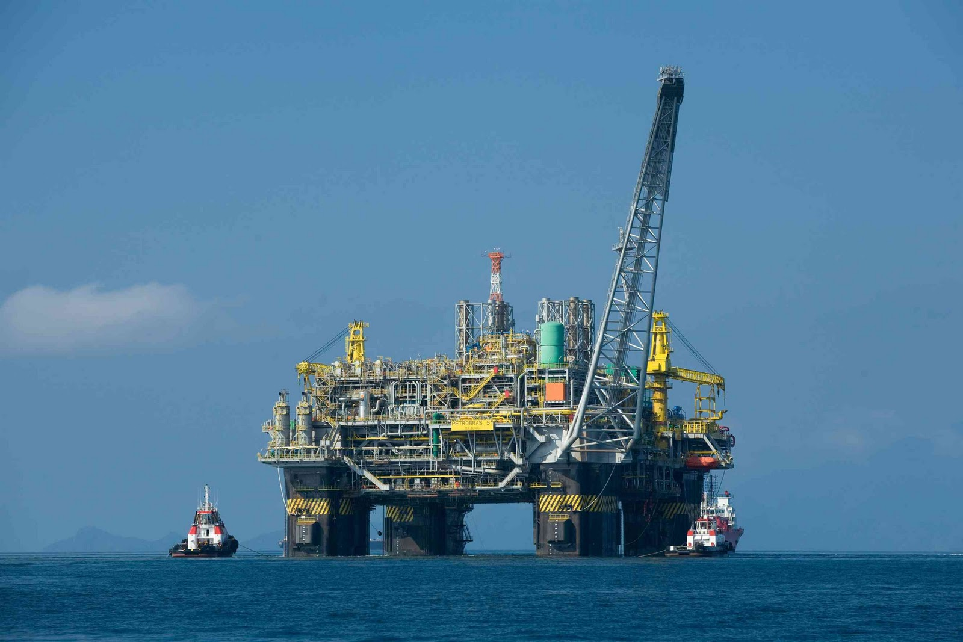
40,000 sensors
Img: http://1.bp.blogspot.com/-ofPym_0YWfI/Tx1x0-LwVQI/AAAAAAAAGLc/yIuaYrW8Lqw/s1600/offshore-oil-drilling-brazil.jpg

Slide 13
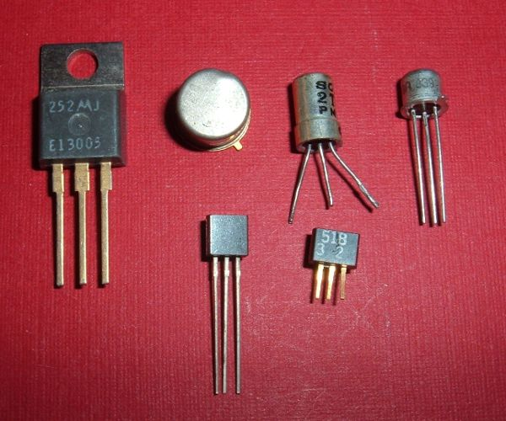
1 Billion per human
Img: http://i1-news.softpedia-static.com/images/news2/Computer-Network-to-Research-Transistor-Miniaturization-2.jpg

Slide 14
Formal Definition of BigData
3 V’s
  Volume, Variety, and Velocity
4 V’s
  Volume, Velocity, Variety, and Variability
4 V’s
  Volume, Variety, and Velocity, Value
O’Reilly Radar
  when the size of the data itself becomes part of the problem

Slide 15


by the Numbers

Slide 16
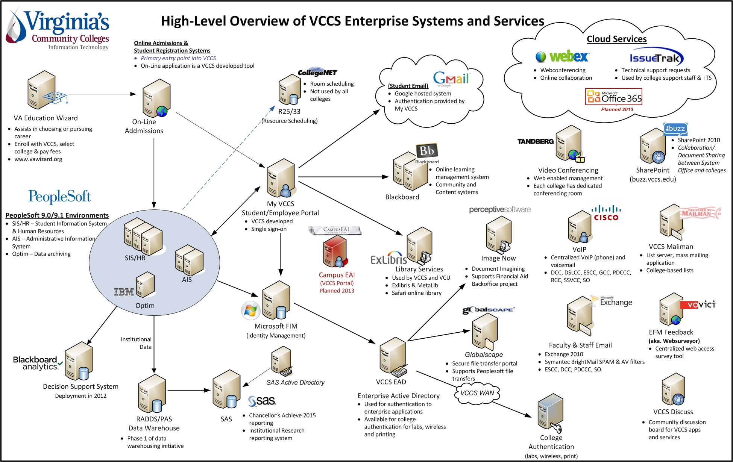

Slide 17

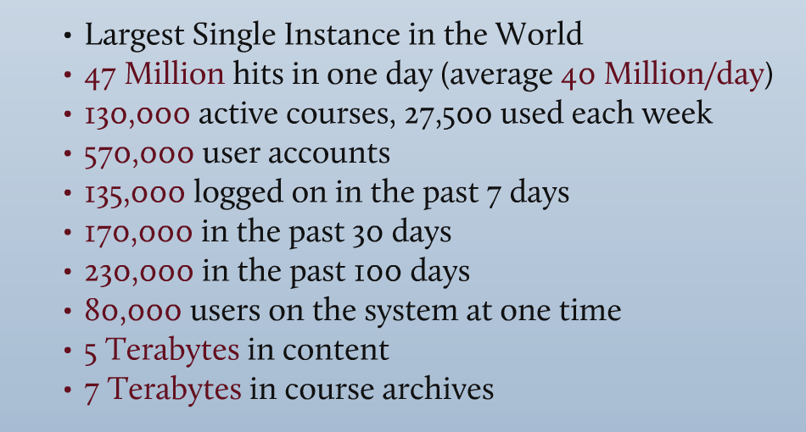
by the Numbers

Slide 18

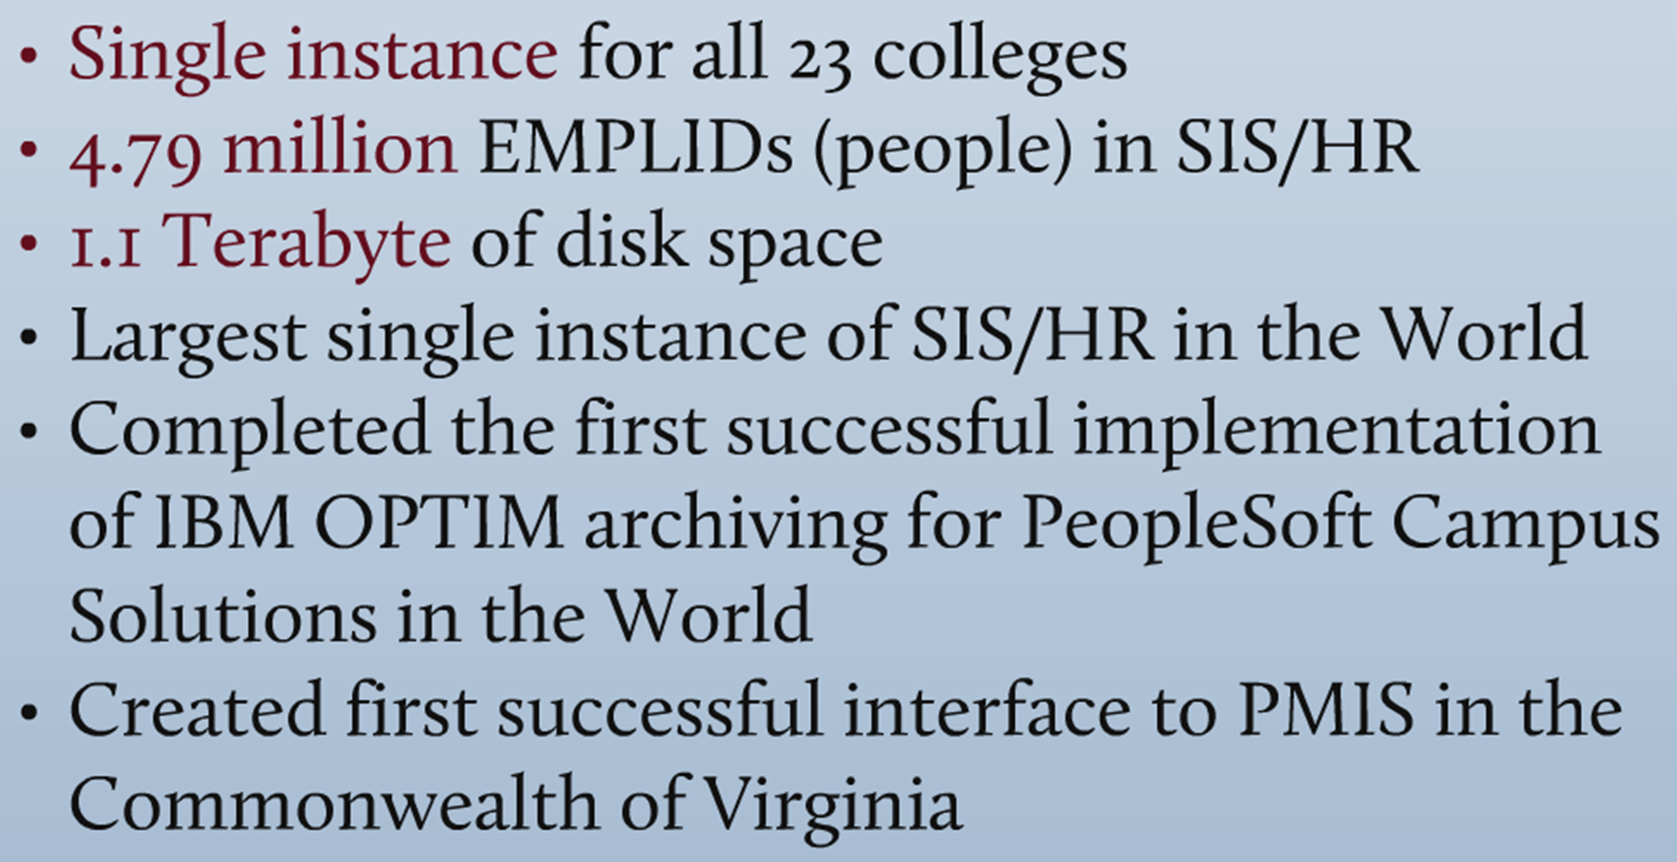
by the Numbers

Slide 19
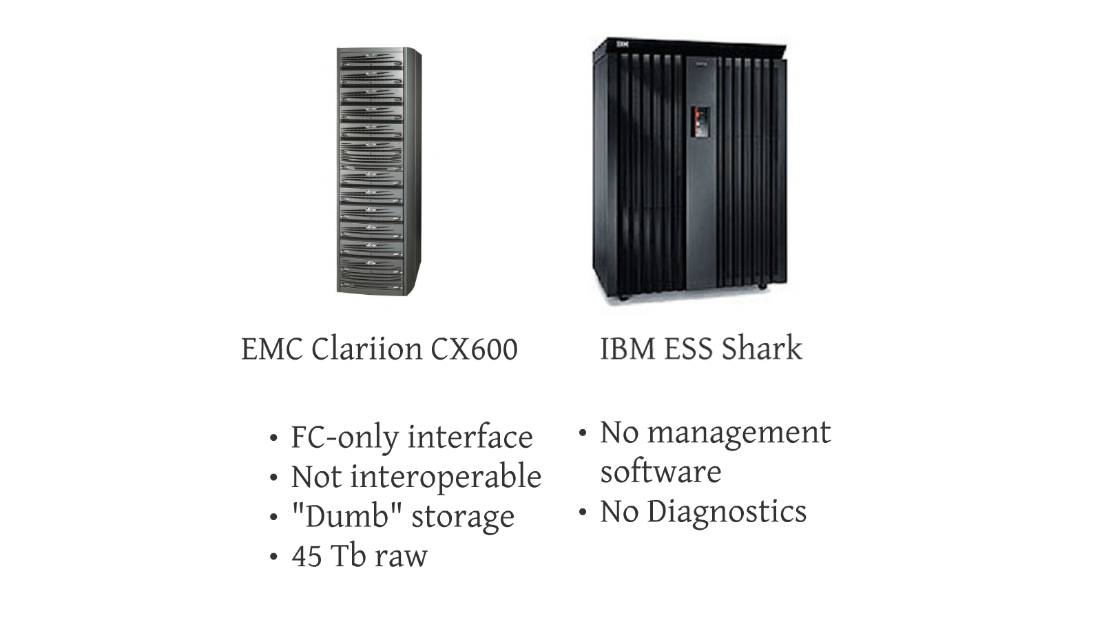
VCCS Historical Data Challenges

Slide 20
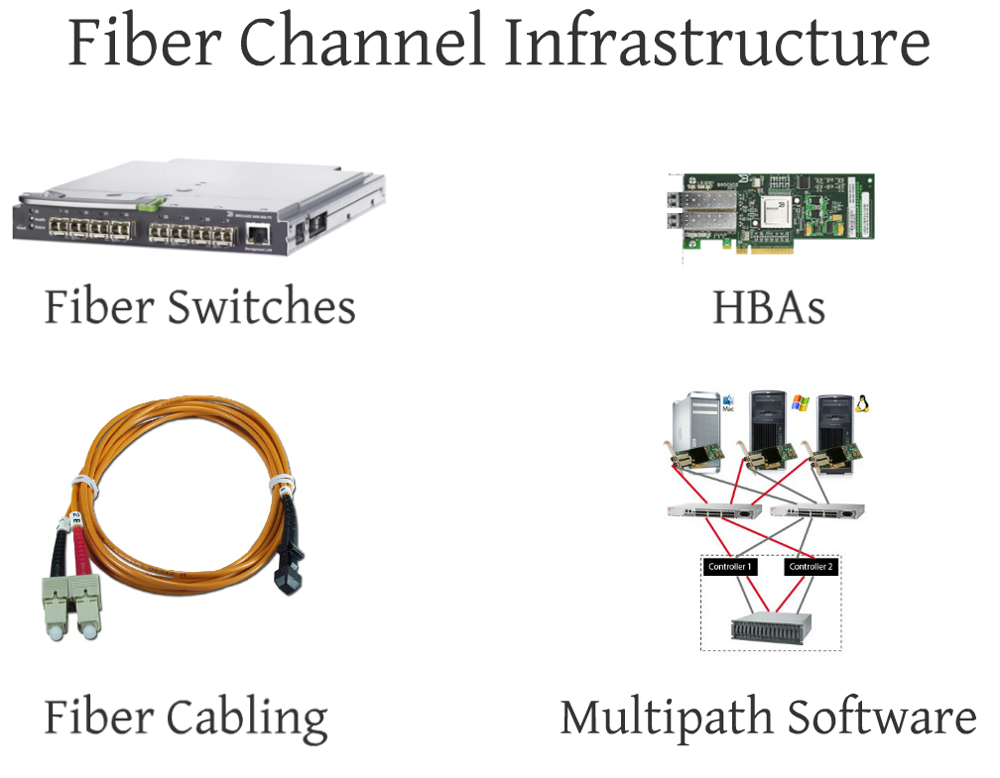

Slide 21
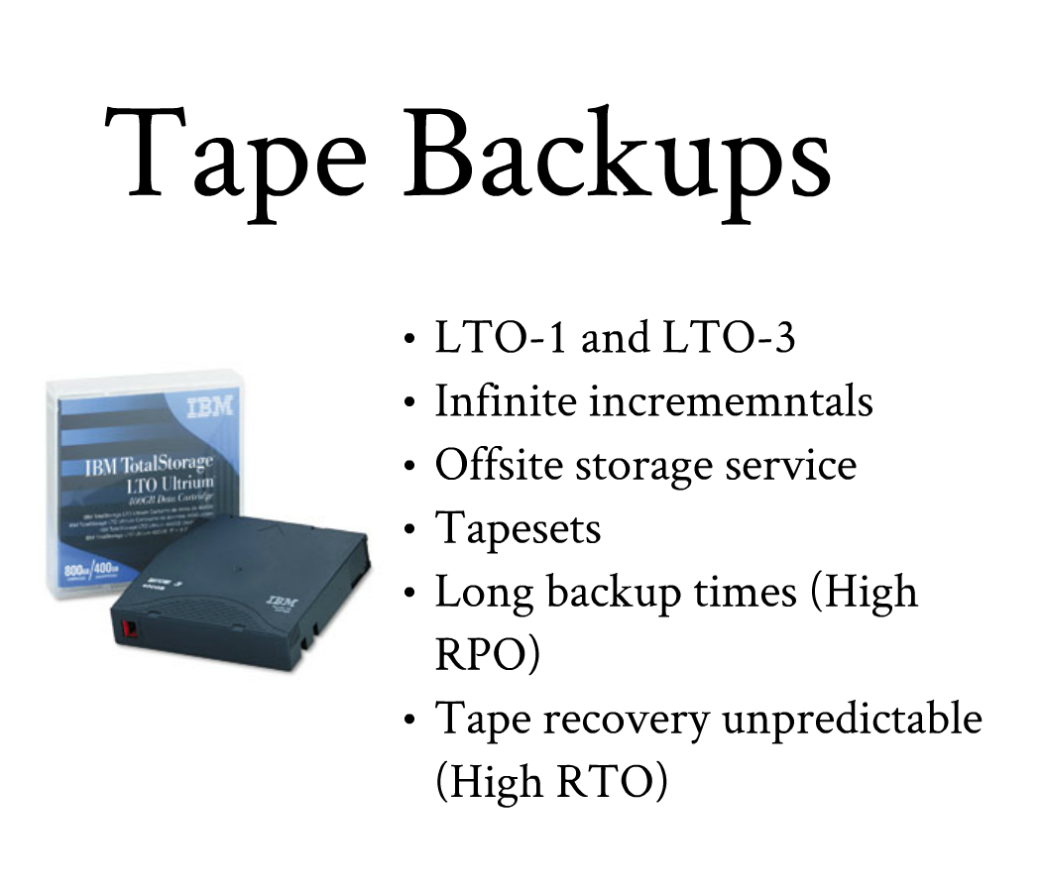

Slide 22
Other Challenges
New Storage needs required deleting something first.
No practical way to do offsite disaster recovery with a reasonable RPO and RTO.
Out of data center floor space.

Slide 23
VCCS Storage Architecture
Disclaimer and other fine print…
Humble beginnings… (2007)
  Three filers
  42TB raw storage
  36TB usable
Current State (2013)
  14 Filers
  ~900TB raw storage
  680TB usable

Slide 25
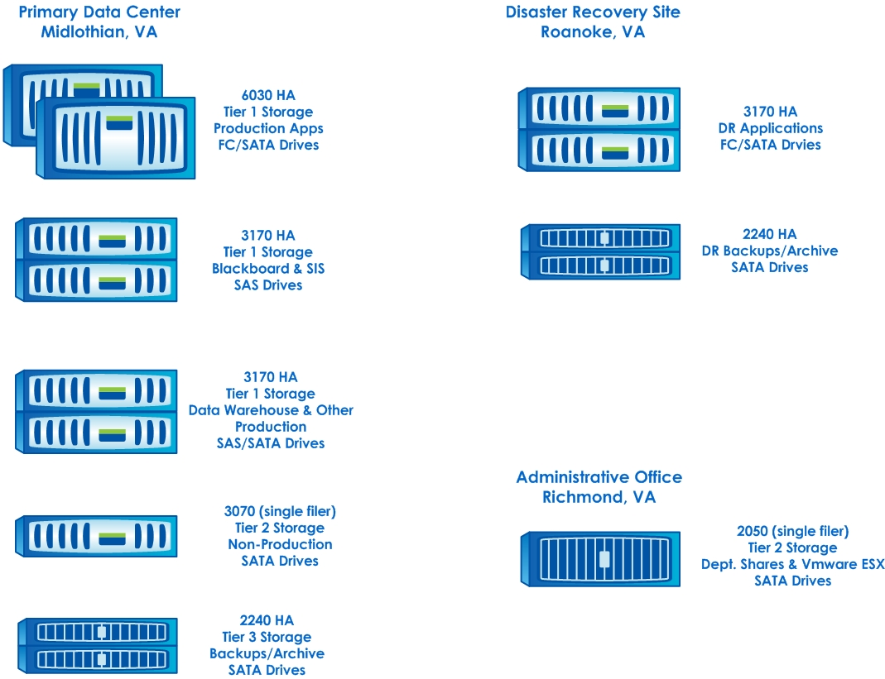

Slide 26
Production Site Details
Network attached only, no fiber channel.
Dedicated 10Gb network for storage.
Redundant core routers.
150Mb network connection to DR location.
  Use of Silver Peak WAN optimizers, allows us to push as much as 850Mb over the 150Mb pipe to our remote facility.
All Production and other critical data volumes are auto-replicated via SnapMirror to our DR facility daily*.
*Schedule is based on established VCCS SOPs for backups.

Slide 27
Value-add Technologies
Snapshots
Unique feature of the NetApp’s storage virtualization technology that is part of their standard OS.
A Snapshot copy is a point-in-time file system image that uses pointers versus actual data copies or writes.
Snapshot creates a “frozen” read-only view of the volume.
Can takes seconds to create versus minutes. (e.g. VCCS Primary Student Information System database ~1.5TB in size takes 128 seconds to snapshot.)
*Limitation of 255 Snapshots can be taken of a volume.
Notes:
WAFL® (Write Anywhere File Layout)

Slide 28
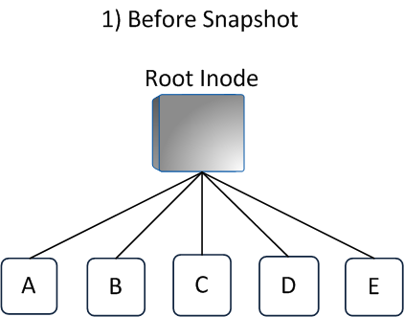
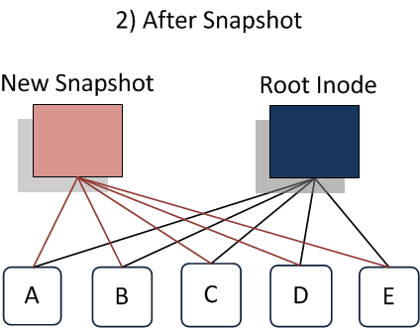
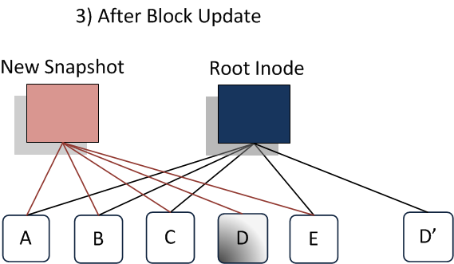

Slide 29
Value-add Technologies
SnapMirror®
Provides fast, efficient data replication and disaster recovery (volume level).
Only sends changed blocks over the network to reduce traffic
Automatically takes checkpoints during data transfers. If your system goes down, the transfer restarts from the most recent checkpoint.
Replicated data is mountable at your DR or secondary location making for quicker DR and/or data validation.
Gives us flexibility to choose the level of RPO based on business needs, using synchronous, asynchronous, or semi-synchronous replication.

Slide 30
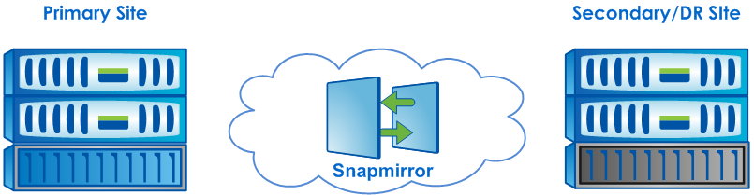
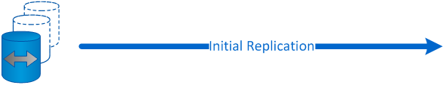


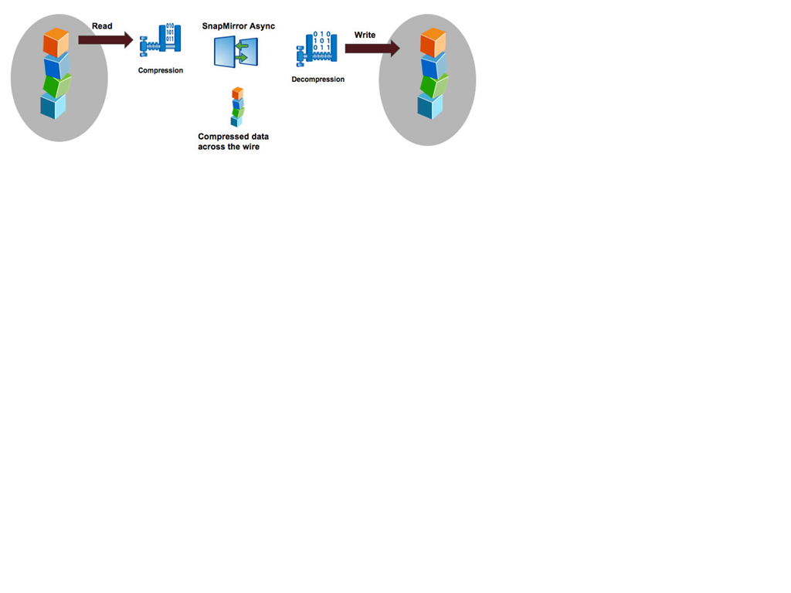

Slide 31
Value-add Technologies = Tapeless Backups
Made our conversion from tape-based backups to disk-to-disk approximate three years ago.
Previously had IBM tape robots for backup. One large 120 tape (DLT1/3) and two 20 tape (DLT3) robots.
Storage arrays are virtual tape libraries. These are then replicated to DR site automatically via SnapMirror.
Approximately 6TB currently consumed in bare metal backups via Symantec NetBackup and various in-house backup scripts (i.e. AIX “mksysb”)
All application data backups are handled via various NetApp Snapshot products.
Notes:
- Management became a full time job
- Could only get the most critical tapes off-site (past three days for primary production databases)
- Backups taking longer than a 24-hour window
1 day to backup
1 day to copy off
1 day tape and offsite.
(3day RPO)
- Stopped taking full backups and had several continuous incremental/append-based backups that would have taken a long time to restore.
Bb Content restore took 2 weeks (~3TB or 200 courses)
More files than could be restored (inode issue)
- The few times we had to go to tape, our success rate was not that good.
Hardware level backups only, all data backups are handled natively via various NetApp Snapshot products (i.e SMO, SMS, SME, etc.).

Slide 32
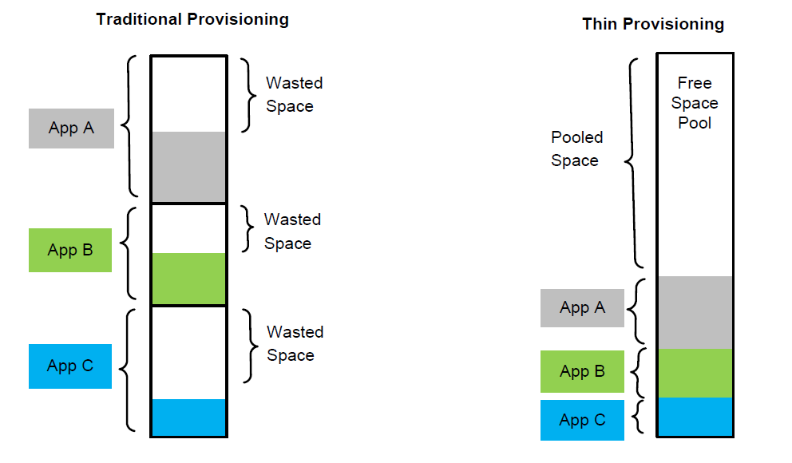
Value-add... Virtualization
Thin Provisioning - Separates the logical representation of storage from the underlying physical disk arrays, making it possible to allocate more storage capacity to applications than is physically installed.
  You can grow or shrink volumes nondisruptively, on the fly, without taking them offline
  Size your volumes to your data sets
  Allocate only the space you need
Notes:
Addresses the problem created from allocating/dedicating storage space to a particular volume or LUN at the time of its creation. Such as:
Once a volume is created on physical storage, its size is extremely difficult to change, and
Once storage is allocated to a particular application, it is not available for another use.
Typically over allocated because it is difficult to know exactly how much space you will need for a particular application or service.

Slide 33
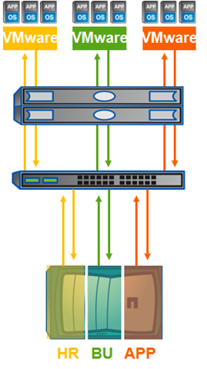
Virtual Filers - The ability to create separate and completely private logical partitions in filer network and storage resources.
Absolute separation and security of shared storage and network resources.
Useful for us as we have multiple Active Directory domains. With vFilers we are able to commit storage resource needs to each domain.
Helpful for Charge Back or “Show Back”.

Slide 34
FlexClones® - Instant ‘writable’ replication of data files, LUNs, and volumes without requiring additional storage space at the time of creation.
Cloned volume: a transparent writable layer in front of Snapshot.
Instant logical copy.
100% space efficient.
Usage:
  Test and development copies
  Database simulations
  VCCS uses for Query instances and DR testing

Slide 35
Value-add… Data Protection
RAID-DP®
Dual parity RAID 6.
Double striping with two dedicated parity disks.
Can withstand a double disk failure in an disk group or aggregate.
Minimal performance hit <2%

Slide 36
Highly Available (HA) Pairs
An HA pair is two storage systems (nodes) whose controllers are connected to each other either other through an adapter or interconnect.
Each node continually monitors its partner, mirroring the data for each other’s nonvolatile memory.
Automatic fail-over if a controller or “head” goes down.
Allows for non-disruptive OS and firmware upgrades.

Slide 37
More Value-add…
Deduplication & Compression
Deduplication - Provided via Advanced Single Instance Storage (A-SIS), divides newly store data objects into small blocks. Each block has a digital “signature,” which is compared to all other signatures in the data volume. If an exact block match exists, the duplicate block is discarded and its disk space is reclaimed.

Slide 38
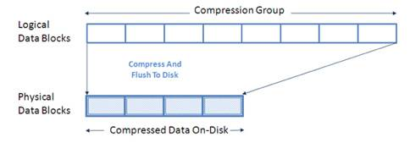
Compression - Algorithm divides a file into chunks of data called “compression groups.” Compression groups are a maximum of 32KB in size.
Can apply to volumes, regular files, virtual local disks, and LUNs
Won’t write data if it isn’t at least 25% compressible to save resource overhead.
Can also be done inline or postprocess via scheduling like deduplication.

Slide 39
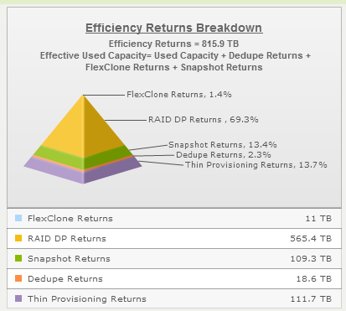
Value-add Technologies… Add Up

Slide 40
Say… Where is that 3TB you were talking about?
Overall storage efficiencies = 816TB
Snapshot hydration* = 3.26PB
So really we are talking closer to 4PB… nice
*13,976 Snapshots over 1,260 Volumes totaling 334TB of prod data. Using an estimate of 10 FULL COPY SNAPSHOTS of that 334TB on Disk, that would require 3.26PB of TAPE if you tried to do the same thing.

Slide 41
So What?
No more fiber channel, Ethernet only
Multiple Protocol Support
  NFS
  iSCSI
  CIFS
Ultra-efficient storage
No more tapes
  Snapshots
  Fast backups (low rpo and rto)
  SnapMirror replication to DR
Operational Efficiencies
  SnapManager Products
  Instance Refreshes (Flexclone)
  Hardware moves and lifecycle management
  Management software and diagnostic capabilities

Slide 42
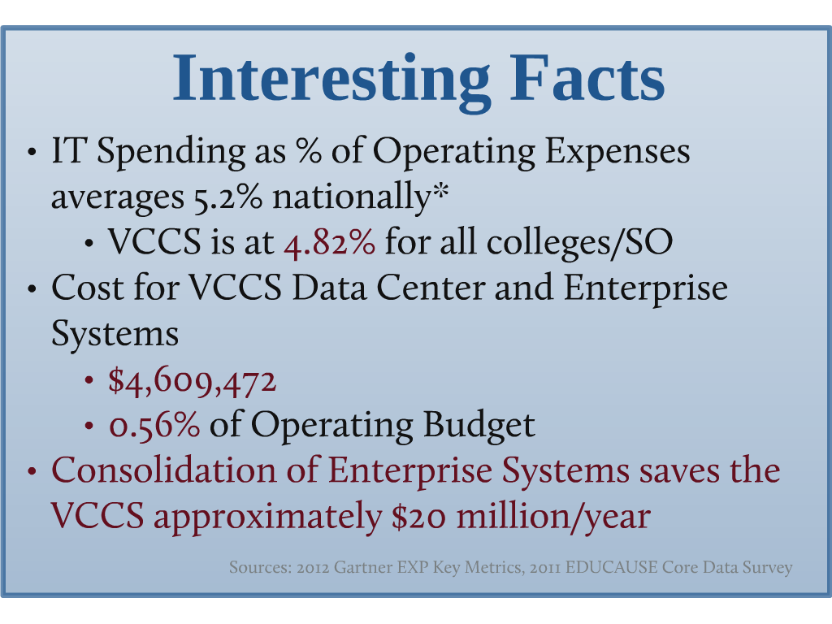

Slide 43
So What?
Saving over $20M/year
Equalizing the quality of service across the Commonwealth, smaller have access to services that they normally would not be able to provide
Agility/Elasticity/Scalability, both technically and from a business perspective

Slide 44

SaaS & IaaS Clouds
Further business process consolidation
Eternal Storage
Data Mining and Analytics
Img: http://3.bp.blogspot.com/_L4pUrlGW7j0/TU6pNahEbEI/AAAAAAAAAG8/5AulSaV3T8E/s1600/future-ahead.jpg

Slide 45

Matt Lawson Brian Viscuso
mlawson@vccs.edu bviscuso@vccs.edu

