Slide 1
Washington University School of Medicine
Bringing Decentralized IT Service Management
Together in the Cloud
Diane Gentile
Customer Services Director
Washington University School of Medicine
diane.gentile@wustl.edu
January 18, 2013

Slide 2
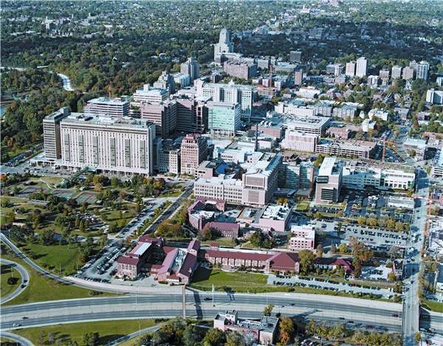
Washington University Medical Center
Washington University School of Medicine
is co-located with Barnes-Jewish Hospital and St. Louis Children’s Hospital in the Central West End of St. Louis. Clinicians are also located at Barnes-Jewish West County, Missouri Baptist Medical Center, Barnes-Jewish St. Peters and other clinics throughout the area.
The main campus covers 155 acres in 50 buildings and our departments are intermixed throughout the Medical Center Campus.
Consistently ranked in the top 5 Medical Schools in the country.
Approximately 1100 students (medical, OT and PT) and 8000 faculty and staff.
$449,470,281 in National Institute of Health (NIH) awarded research grants.

Slide 3
The IT Problem to be Solved…….
Eight(+) different IT departments
Eight unique:
  customer groups
  processes
  customer service philosophies
  trouble ticket systems
  email systems, active directories, etc.
Varying levels of engagement/interest in project
Notes:
How many of you have De-Centralized IT within your organization? Do you need consensus to make changes?

Slide 4
More on the Problem
Outdated ticketing systems
  No ITIL or Service Management capabilities
Cross-department challenges
  Services provided to each other
  Unable to exchange tickets across departments
  Communication issues
  Multiple places to request services from each other
Notes:
We have this crazy environment, but also issues with current system. Talk about how we attempted to replace systems 2 other times, and why the timing was right this time.

Slide 5
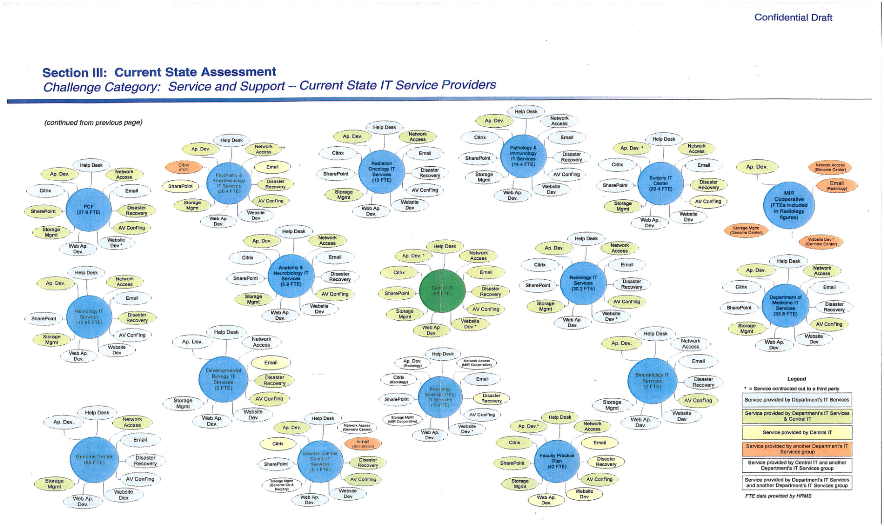
How Decentralized Are We?
Notes:
Not important to be able to read, but demonstrate how we each provide services to each other.

Slide 6

The Agreement
New system badly needed
Departments have similar requirements
We all agree, or the deal is off…
Notes:
All must agree to move to the new system, or the deal is off. Solving the communication and working together problems were key.

Slide 7

The Project
Initiated standard PM process
  Requirements gathering
  Submitted RFP’s
  Brought in vendors for demos

Slide 8
Vendor Focus - IT Perspective
Does it meet most of our requirements?
Is it ITIL-centric?
More importantly-
  Which vendor best meets
  individuality criteria?
  Does it fit our unique environment?
Learned more about each other…..
Notes:
One focus of the demos was to determine what we needed to share versus what could be unique to each department. This was key to success

Slide 9

Vendor Chosen by IT

Slide 10
Will the Business Units Agree?
What’s in it for us?
  Tracking & reporting IT problems
  Department user requirements – what are their needs?
Monetary commitment
  Is the business unit from each department on board?
  Individual conversations with every department
  Buy-in prior to requesting implementation funds

Slide 11
All On-Board
Agreement within IT
Buy-in from business units
Implementation funds secured

Slide 12

Where to Begin?
Discussed desired outcome with implementation partner
Solicited their recommendations on the best way to proceed
Initiated process workshops

Slide 13

Let the Workshops Begin
First order of business:
  Introduction to ITIL
    For all IT staff in participating departments
    Concepts & terms foreign to many IT staff
Now that we’re speaking the same lingo…

Slide 14

Vendor Leads discussions
Process Workshops
  Heads down in a room together
  Initial configuration decisions made
  Objective expert to guide decisions
Notes:
Vendor leading the workshop, and asking questions along the way.
I wanted students to use the self service, but other depts had no plans to use it

Slide 15
Vendor Leads discussions
Process Workshops
    ITIL-centric process discussions
      Incident Management
      Problem Management
      Service Request Management
      Change Management
    Walked through each process individually

Slide 16
Can We All Agree on….?
Decisions on common components
  Most forms including:
    Incident form – mandatory fields, categories, naming conventions, etc.
    General request form
    Change form
    Knowledge form
  Categories for Knowledge & News
  Approval process for Knowledge articles

Slide 17
But My Needs Are Different…..
Where can we be unique?
  Notifications – User & Technician
  SLA parameters
  Service catalog pages
  Employee self-service
  Reports

Slide 18
Beyond Workshops
Identify ongoing team members
Meet weekly to
  Continue decision making during implementation
  Develop customer communication plan
  Address any new issues that arise
  Plan rollout
  Identify training needs
Notes:
-identify team to decrease total team members from the large number of workshop attendees

Slide 19

Project Communication Components
Steering committee
  Director level
Team meetings
  Team members - Help Desk Managers
Vendor Discussions
  Project Manager to Project Manager

Slide 20
Ready? Set? Train!
High level ITIL terminology
  At onset of workshop week
ITIL Certification training for techs
  During configuration/implementation phase
Tool & process training for techs
  Just prior to “Go-Live”
Tool training for admins
  Post implementation

Slide 21

Implementation
Rollout date identified
Complete cut-over in one day for:
  8 departments
  200 IT Technicians
  Faculty, staff and students Self-Service

Slide 22
Support After “Go-Live”
Centrally supported
2 half FTE’s
  Gatekeepers for changes
  Core functionality
  Shared components
  Release updates
  Vendor relationship

Slide 23
Support After “Go-Live”
Departments to support locally
Small percentage of FTE responsible for:
  Notifications
  SLA’s
  Customer satisfaction surveys
  Service catalog
  Knowledgebase
  Reports

Slide 24
End Result!
Common methodology for prioritizing incidents
“Problem” process created (ITIL)
  Used to bring issues from all groups into one document – easily managed from there
  Departments tie their Incidents to a single Problem document
Service catalog!!! Users can:
  Report Issues
  Make Requests
  Choose from standard request types

Slide 25
End Result, continued
“Knowledge” sharing
  KB used to share documents with everyone or subset
Common whiteboard used to alert IT personnel of issues
Process flow documentation
  Workflow diagrams for Incident, Problem, Change, Request

Slide 26
Lessons Learned
Not fully understanding some department specific requirements
  My customers won’t login that way…..
Ongoing issues with support model
Communications within IT groups
  Steering committee to working team & Vice-Versa
Did we include everyone necessary?

Slide 27

Questions?

