Slide 1
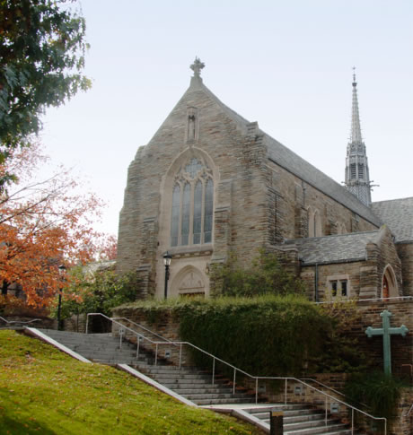
Loyola University Maryland
Louise Finn - CIO
4 year private Catholic, Jesuit University
3,500 undergraduate and 2,600 graduate students
Students represent 34 states and 20 countries
84% of our undergraduates reside on campus
305 full-time faculty members, 85% of which hold terminal degrees
The average class size is 25
The student-to-faculty ratio is 12:1
Approximately 65% of the student body receives some form of financial aid

Slide 2
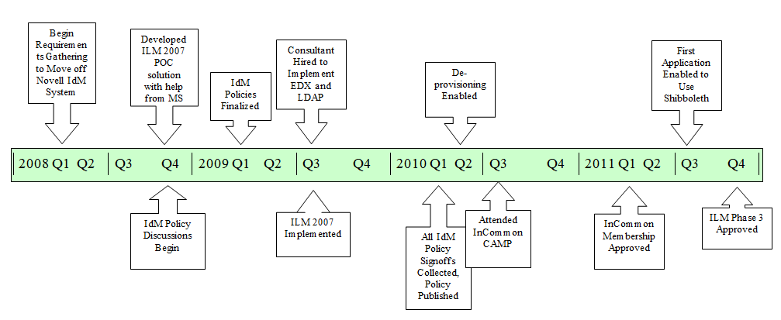
IdM Timeline @ Loyola

Slide 3
IdM Benefits
Decreased processing time for user accounts from a 24 hour to a 2 hour cycle
Improved security by automatically disabling accounts
Provided users with account / resource access guidelines
Increased ease of populating internal and external systems
Moved into a position where federated “cloud” services were possible

Slide 4
Federated Access
The following applications now use Shibboleth for authentication. This allows for the use of Loyola credentials for login.
Educause
Lynda.com
e2Campus
VoiceThread
DreamSpark
Data Cookbook

