Slide 1
The Competing Values of Data Oriented vs Service Oriented Architectures
Presenter:
Dr. Dan Hayden
Illinois State University
Copyright Dan Hayden, 2009. This work is the intellectual property of the author. Permission is granted for this material to be shared for non-commercial, educational purposes, provided that this copyright statement appears on the reproduced materials and notice is given that the copying is by permission of the author. To disseminate otherwise or to republish requires written permission from the author."
Notes:
Good Afternoon, My name is Dan Hayden and I’m the Assistant Vice President for Administrative Information Systems at Illinois State University.
Over the last 15 to 18 months we have been preparing to adopt a Service Oriented Architecture for our enterprise applications. Most of that time was spent updating the technical infrastructure on our mainframe so that we could deploy web services instead of green screens.
While the technical part of this effort was not trivial by any stretch of the imagination, the most challenging part of this initiative was not about the technology … but rather it was getting IT people like you and I to change the way we think about things.

Slide 2

Overview
This presentation is NOT about the underlying technology of a Service Oriented Architecture
Notes:
In keeping with this value statement espoused by Educause, My presentation today is not about how to create or use WSDL files …
It’s not about creating and using an Enterprise Service Bus …
It’s not about the role of the hypertext transfer protocol in presenting information …
It’s not about XML …
It’s not about SOAP objects …
It’s not about the value of re-usable web services …
This technology centric view of a Service Oriented Architecure misses the mark. The real value in a SOA comes from improving the business processes … and that’s where we need to focus our attention!
The real value of SOA is only 20% about the technology and 80% about improving business processes.

Slide 3
Overview
It IS about diagnosing your IT organization’s culture
Assessing the culture embedded in a SOA
About “FIT”
Notes:
This presentation is about the kind of social, organizational, and cultural changes that come into play when an IT organization tries to change their architecture from one that is (and probably always has been) centered on “data” to one that is focused on “services”.
It is about finding out what an IT organization really believes in … what they value about their current systems and development processes so we can be prepared to deal with some of the obstacles we might encounter as we start moving towards a Service Oriented Architecture.
This presentation is about comparing and contrasting the underlying values, beliefs, and assumptions … the culture … that is embedded within a SOA to those that comprise an organization’s culture.
In a nutshell, this presentation is about diagnosing and … if necessary … changing our IT organization’s culture so we can successfully implement a Service Oriented Architecture.
So what is a “culture” and what does it have to do with the kind of Architecture an IT organization wants to use?

Slide 4
Definition of Culture
“A pattern of shared basic assumptions that the group learned as it solved its problems of external adaptation and internal integration, that has worked well enough to be considered valid and therefore, to be taught to new members as the correct way to perceive, think, and feel in relation to those problems.” (Schein, 1992).
Notes:
First, let’s take a minute to define the term “culture” and then we will talk about how it relates to an IT Architecture.
This definition pretty much says it all. It is a pattern of shared basic assumptions about how a group has learned to solve their problems. Specifically, problems related to internal integration and external adaptation. These assumptions are accepted by the collective group because they have worked in the past and there is little reason for people to think they won’t work in the future.
When a new person joins the organization he/she is taught how to perceive things, how to think, and how to feel about the organization’s problems. If there are differences between how the new person has learned to perceive, think, and feel at his previous organization and those in the new organization, one of three things will happen: (1) He/she will change … and adapt and accept the new organization’s culture. (2) He/she will try to change the new organization to be more like his/her preferred organization. Or (3) he/she will find that they just don’t “fit”, and look for another job elsewhere. Culture is something that is learned and like a golf swing, it is often much more difficult to un-learn one than it is to adopt a new one.

Slide 5
Reality
Culture is a “social construction”
  It is what you “think” it is…
  and what you think it is, you have learned from others through social interactions
  There is no “ideal” culture … no “right” or “wrong” or “good” or “bad” culture. Just differences in cultures.
Notes:
Have you ever heard of “Socially Constructed Reality”? The idea is that we know the world as we perceive it and our perceptions are based on what we have learned from others in social interactions. What is real to one person may not be real to another but who is to say which perception is right?
Assessing a culture is not a way to find the “good” or “bad” cultures because there really aren’t any good or bad cultures. They are just different.

Slide 6
FIT
The way things are today …
The way we want things to be tomorrow …
The way things need to be for a SOA …
Notes:
The reason we need to know how to assess cultures is because we need to be able to compare :
The way things are in our organizations today …
how we would like things to be tomorrow …
Against - the way things need to be for a successful implementation of a Service Oriented Architecture.
I hope that you will leave here today with a framework for making these comparisons and that this framework is a useful perspective to help you understand of the kinds of social, and cultural problems you might face as you start moving down the road to a new architecture.
With a better understanding of the problems you can be better prepared to deal with them as they come up.
For those of you who are still trying to decide if you want to start down this road … I hope this framework gives you some information you can use to assess the risks and make a more rational decision about whether SOA is right for your organization and … or possibly more important … if your organization is ready for SOA.

Slide 7
Assessing Culture
(Schein, 1992)
Artifacts
Espoused Values
Basic Underlying Assumptions
Notes:
There are at least three ways to assess an organization’s culture. One is to look at the things they have created … their “artifacts” … and try to draw some conclusions about what seemed to be important to them. Archeologists do this a lot, they look at the things they excavate from the earth and try to make sense of it.
I read a book once about some archeologists in the year 3020 who uncovered a 2005 city still pretty much in tact. As they examined the homes and the things they found in the homes they concluded that a television must have had some religious significance because based on the arrangement of the furniture and it’s placement in the homes it looked like people must have been worshiping the TV. The point is that artifacts are hard to decipher and not always the best way to assess an organization’s culture,
Another way to assess an organization’s culture is to look at their published policies, rules, guidelines, vision and mission statements. The values espoused in these documents describe how the organization believes they should operate and how they want others to see them as an organization.
The Educause statement on the signs you see around here say “It’s not the information or the technology … it’s what we do with it that counts”. That is an espoused value … it is a cultural statement about what is important. In Higher Education we have all heard about “shared governance” and “academic freedom”… those are also examples of Espoused values or statements about what we believe in. However, they may not actually be a true reflection of the organization’s culture but rather a reflection of what they want people to think about them.
The best way to access an organization’s culture is to expose the underlying beliefs, values and assumptions that ultimately determine behavior. The big question then is how do we do that? How do we expose what people really think about “the way things are” and “the way things should be” … and do it in a way that allows us to make distinctions between one culture and another?
To do that, we need to know the dimensions of culture and we need an instrument to “measure” it along those dimensions. If culture had a length, a width, and a height, we could just use a ruler to measure it along these dimensions and we could easily tell if one culture is longer or higher than another. But obviously it doesn’t.

Slide 8
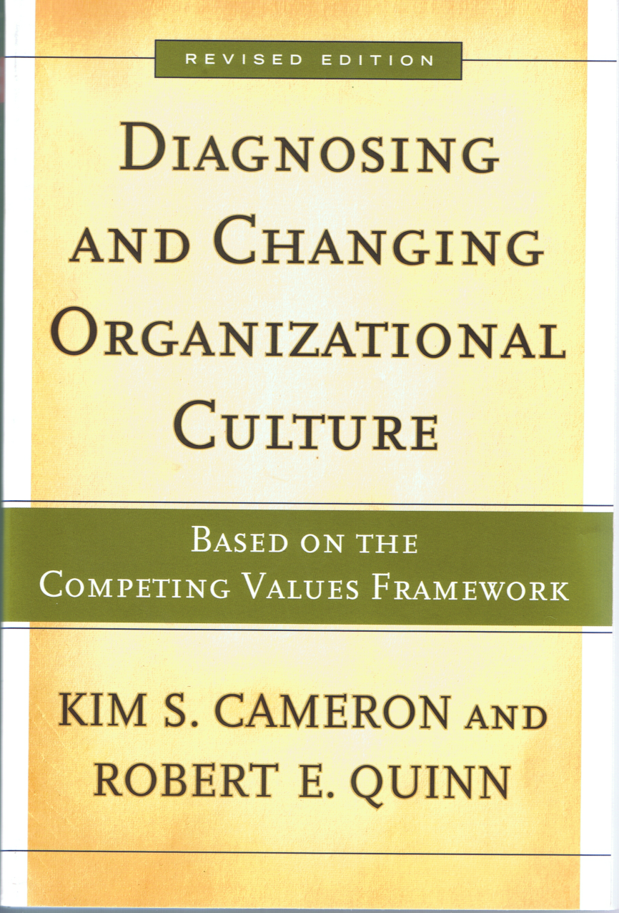
Notes:
Cameron and Quinn, in this book, offered both a framework and an instrument for measuring culture. The framework they used is called the “Competing Values Framework” and their instrument, called the “Organizational Culture Assessment Instrument” or OCAI measures how internally or externally focused an organization is and it also measures how much value an organization places on stability and control via integration versus the flexibility and discretion that facilitates adaptation.
This framework provides a simple way to map the dimensions suggested in Schein’s definition of how people have learned to solve problems and his two dimensions of “internal integration” and “external adaptation”

Slide 9
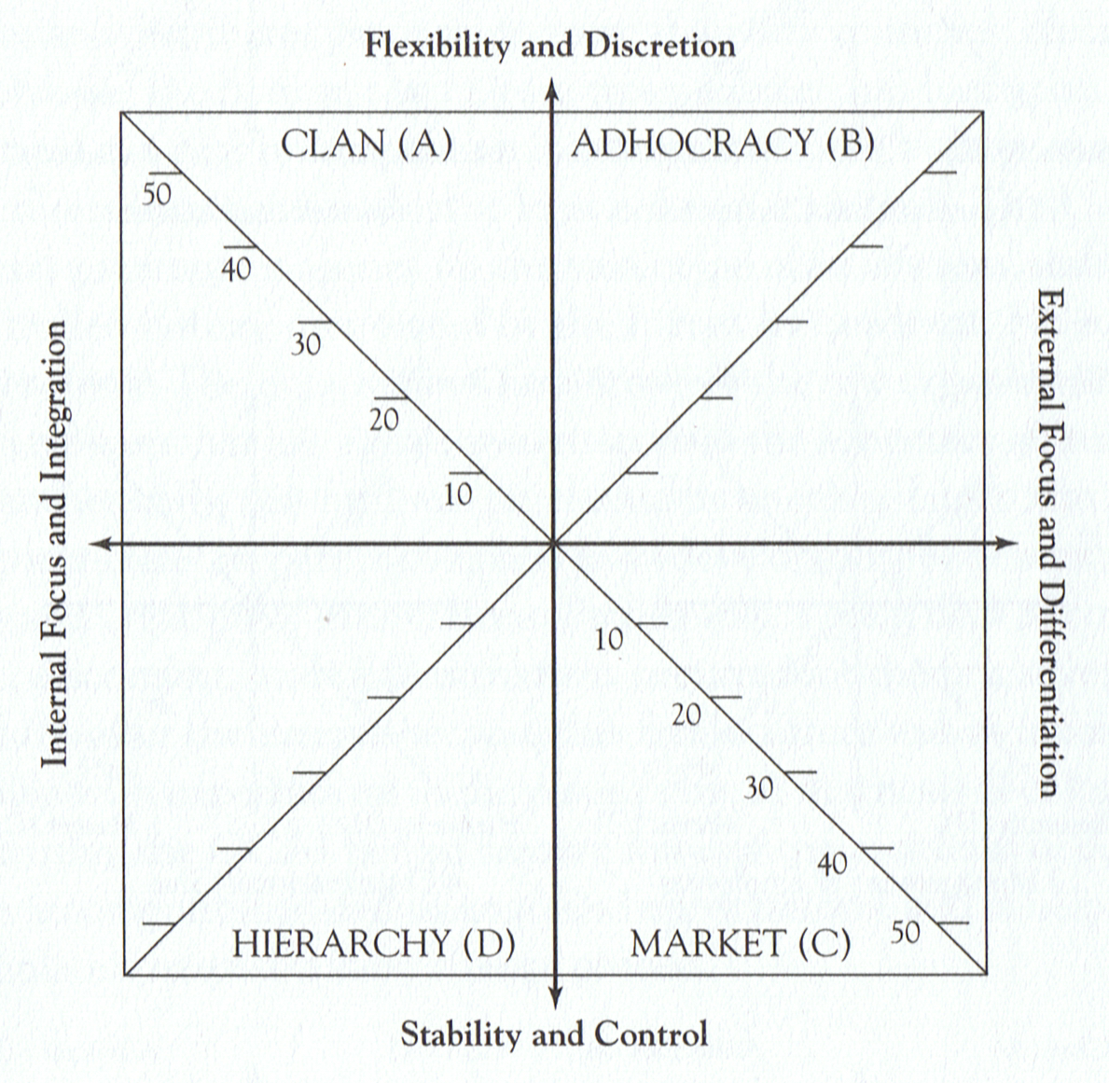
The Competing Values Framework
FOCUS
Notes:
The “Competing Values Framework” was first used as a way to assess organizational ‘effectiveness’. Researchers put together a list of indicators that had an impact on whether an organization was considered effective or not. As they studied these indicators, they discovered that each of them had a “focus” component … that is, they found that they could classify each indicator according to how internally or externally focused it was.

Slide 10
The Competing Values Framework
Control
Notes:
They also determined that each of these effectiveness indicators had a a “control” component … that each indicator could be assessed according to the value the organization placed on “flexibility and discretion” at one end and on “stability and control” at the other.
The extremes of these two dimensions are “competing” in the sense that moving towards one end requires moving away from the other end. That is, “internal” competes with “external” and flexibility competes with control. The more “value” we place on one end, the less we have available for the other end.
So how can this framework, which was originally designed to assess effectiveness, help us assess an organization’s culture? Well, we just have to ask a different set of questions. Rather than asking questions about effectiveness we ask questions about “the way we do things around here”. That is, we ask questions related to “culture”.
In some situations an organization might be totally focused on an internal problems and they may be totally flexible in how they solve those problems (top left quadrant). It is extremely unlikely however that any organization would be at the extremes of either dimension 100% of the time. In reality, over an extended period of time and under a variety of situations and circumstances any one of these things could be assigned more value than the other three.
Ok … so now we know the dimensions … What do we use as a measuring instrument? Cameron & Quinn proposed an “Organizational Culture Assessment Instrument” as the ruler.

Slide 11
“Organizational Culture Assessment Instrument”
Assesses 6 different aspects of culture along the dimensions of the CVF:
  1. Dominant Characteristics,
  2. Organizational Leadership,
  3. Management of Employees,
  4. Organization Glue,
  5. Strategic Emphasis, and
  6. Criteria of Success.
Notes:
The instrument (or ruler) has only 6 questions. Each question is designed to measure a different aspect of an organization’s culture: The “Dominant Characteristics” of the organization, their “Organizational Leadership”, how they “Manage Employees”, the “Glue that holds their Organization Together”, how they do their strategic planning, and what it takes to be successful in their organization.
Here’s an example of Question number 6 about the “Criteria for Success”

Slide 12
OCAI Question 6
6 Criteria of Success |  | NOW
A | The organization defines success on the basis of the development of human resources, teamwork, employee commitment, and concern for people. | 40
B | The organization defines success on the basis of having the most unique or newest products. It is a product leader and innovator. | 20
C | The organization defines success on the basis of winning in the marketplace and outpacing the competition. Competitive market leadership is key. | 10
D | The organization defines success on the basis of efficiency. Dependable delivery, smooth scheduling, and low-cost production are critical | 30
Notes:
Participants are asked to divide 100 points among the four descriptions according to how much their organization is like each description. In the example shown, the respondent says that 40% of the “criteria for success” is about “developing human resources, teamwork, employee commitment, and concern for people”; 20% is about “having the most unique or newest products”; only 10% is about “winning in the marketplace and outpacing the competition”; and 30% is about “efficiency, dependability, smooth scheduling, and low cost production”.
The participants can score each description anywhere from zero to 100 but they are asked to make sure that for each of the 6 questions the sum of the 4 scores adds up to 100.

Slide 13
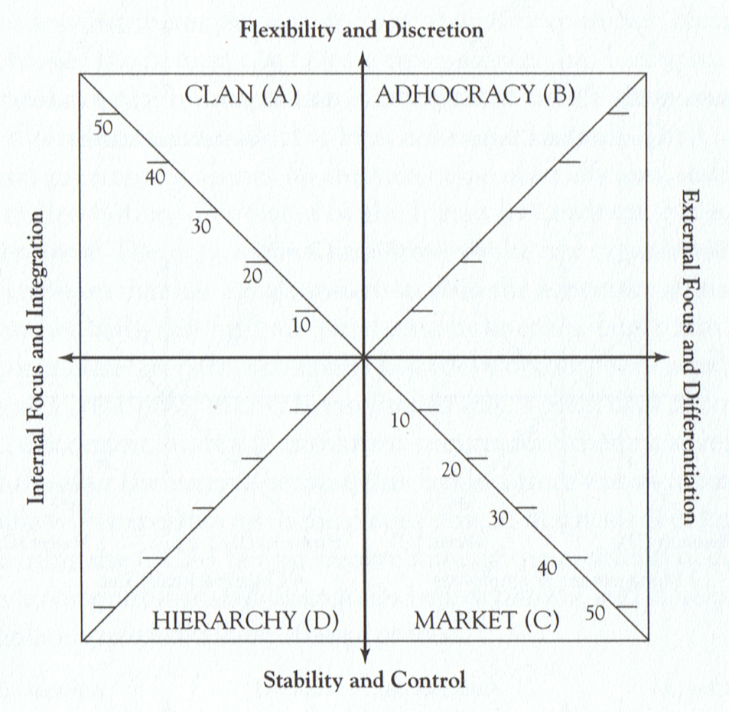
Mapping the OCAI Results to the Competing Values Framework
OCAI Question
6 Criteria of Success |  | NOW
A | The organization defines success on the basis of the development of human resources, teamwork, employee commitment, and concern for people. | 40
B | The organization defines success on the basis of having the most unique or newest products. It is a product leader and innovator. | 20
C | The organization defines success on the basis of winning in the marketplace and outpacing the competition. Competitive market leadership is key. | 10
D | The organization defines success on the basis of efficiency. Dependable delivery, smooth scheduling, and low-cost production are critical | 30
Notes:
We already know which quadrant each answer goes with, so now all we have to do is take the average of all of the “A” scores for the 6 questions and plot them onto the upper left quadrant of the CVF. Then average of all the “B” scores and plot the point in the upper right quadrant and continue with the “C” and “D” scores. Then connect the dots to create a profile of the organization’s culture.
Since every organization may have a slightly different profile, we can use these profiles to make some very fine distinctions between one organization’s culture and another.

Slide 14
So What does this mean?
Current
Culture
Preferred
Culture
Notes:
The current culture profile in this example tells us that the organization is much more focused on solving internal problems than they are with external problems and it looks like it values “flexibility and discretion” just a little more than “stability and control”.
If we were to ask the same 6 questions again, but this time instead of scoring the four descriptions according to how much their organization is like the description we ask them to score the four descriptions according to how they would like for things to be in their organization, we would get a profile of their “preferred” culture. The difference between these two profiles (the “current culture” and the “preferred culture”) suggests both a magnitude and a direction for the kinds of social or cultural changes they would like to see in their organization.
In this example, it is clear that the preferred culture is one that is much more externally focused … and you could infer that this organization would resist any course of action that provokes more “internal” focus and would be receptive to changes that result in more “external” focus.
We know that IT systems provoke change in an organization and if we can predict the kind of changes a specific IT system will provoke and compare it to the kind of changes the organization wants (i.e., the difference between the current culture and the preferred culture), then we can predict the relative level of resistance to the implementation of that specific type of IT.
For example: One of the differences between the values embedded in a Data Oriented Architecture and a Service Oriented Architecture is that SOA does have a much more “external” focus. In the organization shown on this slide, you would expect that this organization would be receptive to a SOA because they would “prefer” a more externally focused culture and SOA would be seen as an application of IT that would help them become more externally focused.

Slide 15
Culture / IT System Archetypes
Human Relations
Open Systems
Internal Process
Rational Goal
Notes:
You may have noticed that the CVF has names on each quadrant to make them easier to talk about: Clan, Adhocracy, Market, and Hierarchy are each “cultural archetypes”
But if we use this framework to assess applications of IT, we would use a different set of names that mean something when we are talking about IT systems. For example, the Clan type culture has the same focus and control characteristics as a Human Resource type IT system because both are focused on internal problems and both allow flexibiliyt and discretion in how the organization deals with problems. The Adhocracy culture is like “Open Systems” type IT; the Market type culture is similar to a “Rational Goal” type IT, and the Hierarchy type culture is much like an IT system to solve “Internal Process” types of problems.
Remember, this framework is about where the focus of attention is with regard to solving problems and about how much flexibility and control is allowed in the way those problems are solved.

Slide 16
Human Relations Systems
System Capability Characteristics
  Computer Aided Instructing
  Interpersonal Communicating & Conferencing
  Group Decision supporting
System Technical Characteristics
  Humorous Output
  User-controllable Systems
  Personalized Systems
  Convenient To Use
  Good Feedback Provided
  Imagery, Graphics, Sound In/Output
  Private Information
Notes:
Of course, the criteria we use to decide if something goes in one quadrant or another must also change. This slide shows the technical and capability characteristics for an application of IT that would go in the top left quadrant and we have named that type of IT a Human Relations System.

Slide 17
Open Systems
System Capability Characteristics
  Environmental Scanning & Filtering
  Inter-oganization Linking
  Doubt and Argument Promoting
System Technical Characteristics
  Multiple Languages/Cues
  Adaptive, Flexible Systems
  Ad hoc Information Content
  Ad hoc System Usage
  Systems Differentiated Among Users
  General Systems, Wide External Scope
  Aggregated Information
  Allows Frequent System Access
Notes:
Here’s the capability and technical characteristics of an IT system that would be mapped to the top right quadrant. And we will call those types of IT Open Systems

Slide 18
Rational Goal
System Capability Characteristics
  Modelling
  Forcasting
  Sensitivity Analyzing
System Technical Characteristics
  Integrated Systems
  Systems With Wide Internal Scope
  Concise, Terse Input and Output
  Efficient Use of Technology
  Accurate Information
  Timely Information
  Quantified Information
  Objective Information
Notes:
Here’s the capability and technical characteristics of an IT system that would be mapped to the bottom right quadrant and we will call these types of IT Rational Goal systems.

Slide 19
Internal Process
System Capability Characteristics
  Internal Monitoring
  Internal Controlling
  Record Keeping
System Technical Characteristics
  Precise, Detailed Information
  Reliable, Failsafe Systems
  Formalized systems
  Stable Systems
  Routinized, Scheduled, periodic Systems
  Standardized Systems
  Structured Systems
Notes:
Here’s the capability and technical characteristics of an IT system that would be mapped to the bottom left quadrant. It is focused on internal processes so that’s what we will call it.
Similar to the way Cameron and Quinn used the “Organizational Culture Assessment Instrument” (OCAI) … I’ve created an instrument to assess the IT along these same dimensions of focus and control.
The IT questionnaire has 12 questions, 3 that relate to each of the 4 quadrants and it is scored and mapped in much the same way as the OCAI.

Slide 20
IT Culture Questionnaire
Provides support for creative thinking. (A)
Enhances control processes within the organization in order to link better with the external world. (D)
Enhances dialog between our enterprise and external business partners, vendors, and customers. (B)
Provides flexibility to work outside of a standard optimization approach. (A)
Allow freedom from conceptual models of customer behavior (A)
Supports group decision making within the organization. (D)
Notes:
Participants are asked to rate an IT application according to its “capability” on a scale of 0 to 5 with 0 being “Not Applicable” and 5 being “Very High” capability rating.
The letter in parenthesis after each question indicates which quadrant each question would be mapped to. (A) = top right or “Human Relations”; (B) = top left or “Open System”; (C) = bottom right or “Rational Goal System”; and (D) = bottom left or “Internal Process” system.
To map the results onto the CVF we sum the three ratings for each quadrant and plot them on the CVF. For example, we would sum the ratings for questions 1, 4, and 5 and plot them on the “A” or top left quadrant.

Slide 21
IT Culture Questionnaire (cont.)
Increases internal monitoring of processes, performance, and/or production.. (D)
Helps optimize processes and procedures by identifying where the company’s resources are not being used effectively. (C)
Provides for extra-organizational scanning needed for effective internal decisions.. (B)
Analyzes how an external event can impact the outcome of an internal process. (C)
Generates conceptual ways to look at the market and/or customers. (B)
Provoking different interpretations so that meaningful debate and creative thinking can occur for how to deal with external issues. (C)
Notes:
Here are the last 6 questions.

Slide 22
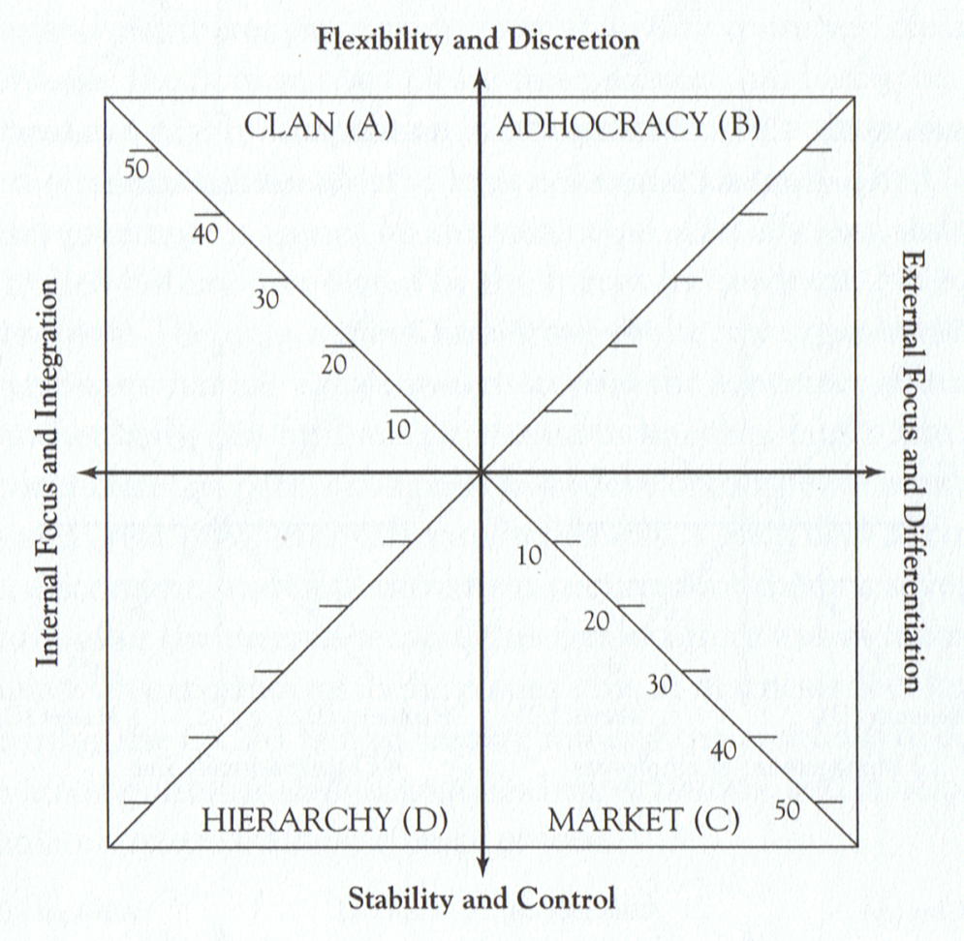
Organization vs Data Warehouse
Bank, Retailer, Insurance
Data Warehouse
Notes:
If we look at a specific application of IT, like a data warehouse for example, we can make some assumptions about the kinds of problems a data warehouse addresses and about how much flexibility or control it allows in solving those problems.
In a study about the cultural impact of Data Warehouses, the researchers found that the values, beliefs, and assumptions embedded in the idea of a Data Warehouse would provoke changes in an organization’s culture that make them more externally focused and more flexible in the way they go about solving problems.
On the left is the culture profile of a typical Bank, Retailer, and Insurance company that was assessed using the OCAI and on the right is the profile of a Data Warehouse assessed with the IT Culture Questionnaire.

Slide 23
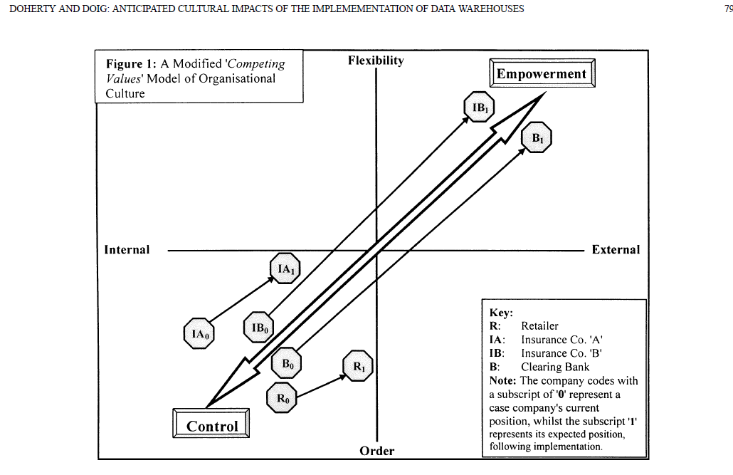
Cultural Impact of Data Warehouse
Notes:
While they chose to show a single point that represents the dominant characteristics of the organization rather than their profile, I think you can still get the idea … the Retailer, the two insurance companies, and a bank all moved up and to the right when they implemented a Data Warehouse. Some moved much more than others but they all moved in the same general direction because of Data Warehouses.

Slide 24
Data vs Service Architectures
Data Oriented
Service Oriented
Notes:
Using this same technique for comparing two kinds of IT Architectures we can see the difference between a Data Oriented and a Service Oriented Architecture.
The difference is that the Data Oriented Architecture is much more internally focused than the Service Oriented Architecture. Data Oriented architectures a focused internally on the data and the IT development while Service Oriented architectures are focused externally on the business processes. Remember when we talked about the dimensions of culture being “Where the organization (or IT system) focuses it’s problem solving attention and the degree of Flexibility vs. Control they allow in solving those problems? This is what that really means.
SOA provokes the IT organization to change it’s focus from internal to external and if this change in focus isn’t compatible with the organization’s “preferred culture”, that is, if the kinds of cultural change the organization is looking for is much more internally focused rather than more externally focused, then we can expect some significant problems and resistance. We may be able to realize 20% of the benefit of SOA that is technical but we will miss the other 80% of the capability completely.

Slide 25
The Paradox
We adopt an IT because we want to change something about the way we do things.
Applications of IT reflect the culture of the people who create and use them.
Adopting a new or different IT provokes a cultural change in the adopting organizations.
… IT systems are produced by the same social structures they seek to transform (Robey and Boudreau, 1999).
Notes:
In the same way it influences the design of buildings, culture influences the design of an IT Architecture. In fact, culture influences the design of just about everything from chairs to referigerators to automobiles … just about everything. The designers embed their own values, beliefs, and assumptions about what these products should do and how they should do it into the design whether they know it or not.
An IT architecture is a cultural “artifact”. It reflects the cultures of the people who designed and used them.
Furthermore, applications of IT have the capability to provoke changes in the culture of the people who use them. It is a paradox that people design IT based on their deep underlying beliefs and assumptions about the kinds of problems that need to be solved and the best way to solve them and at the same time, these applications of IT provoke new and different ways of doing things thus changing the culture.
Hooijberg, R. and F. Petrock (1993). "On Cultural-Change - Using the Competing-Values-Framework to Help Leaders Execute a Transformational Strategy." Human Resource Management 32(1): 29-50.

Slide 26
The Paradox:
Organizations don’t like to change
IT systems provoke changes
Yet … Organizations like IT systems
Notes:
A simple version of this phenomenon is show here.

Slide 27
We like IT that …
Provokes the kinds of changes we believe we need in the organization.
Doesn’t destroy our important social meanings.
That we can change
Notes:
Here are some of the reasons why an organization might want to implement a application of IT that will provoke change. The last one, may create more problems than it solves, particularly in an ERP implementation where the organization tries to change the ERP rather than the way they do things.

Slide 28
SOA is a form of “Technological Seduction”
The deliberate, managed introductions of specific technologies for the sake of seducing organization members into new behavior, which will in turn require then to re-examine their present assumptions and possibly adopt new values, beliefs, and assumptions. (Schein, 1992)
The risk is that you may get behavior changes you don’t want .
Notes:
Besides the obvious “technical” reasons for implementing a change to our IT architecuture, we should be aware of the power of a “Technological Seduction”. I’ll admit that part of the reason I wanted to do it was to “seduce” our development staff into a different kind of behavior. But you have to be aware of the risks because you may not get the results you expect.

Slide 29
Summary
Culture helps explain many organizational [and IT] Phenomena
  Nothing exists in organizations [or IT] except culture, and one “encounters culture any time one rubs up against any organizational [or IT] phenomena” (Cameron and Quinn 1999, [Hayden, 2009])
Notes:
If culture is truly a combination of where people focus their problems solving attention and how they go about solving those problems, then we can substitute “IT” in these statement and they still make sense.

Slide 30
Suggestions:
Before we begin moving towards SOA we need to be honest with ourselves about why we want to do it.
We need to be aware of exactly how we expect SOA to change our way of doing things and determine if we are ready for those kinds of changes.
Changing culture takes time. Don’t expect immediate results.
Notes:
Before we start down the path to SOA we have to be honest with ourselves about why we want to do it. If it is only for the technical benefit, we can only achieve 20% of the benefit. 80% of the benefit is in the “Technological Seduction”.

