Slide 1
Improving a Digital Image Collection for Discovery
Improve + Share Metadata
Create New Access Method: Browsing Subjects
Create Human-Readable Usage Policies

Slide 2
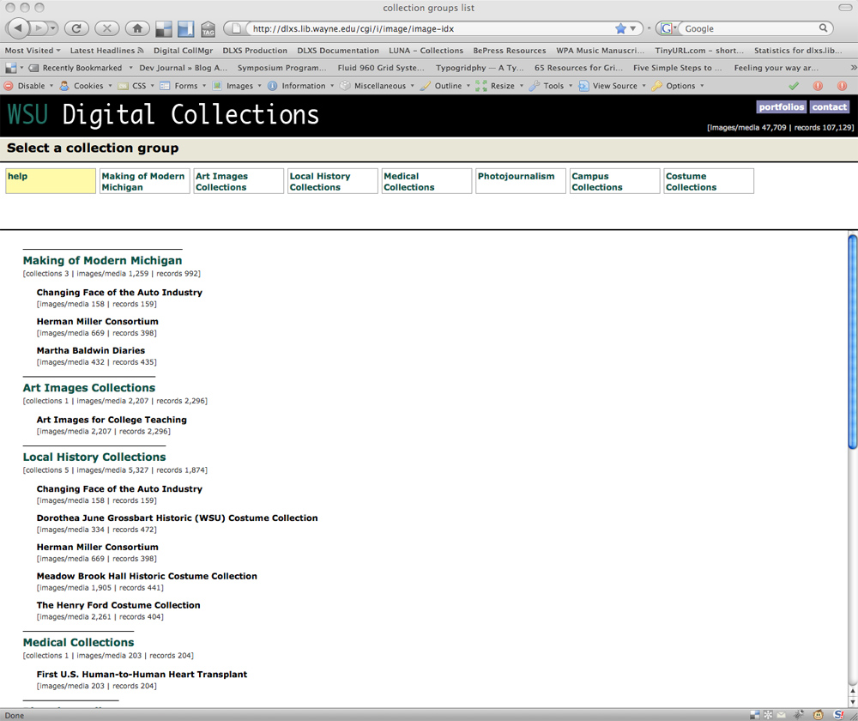

Slide 3
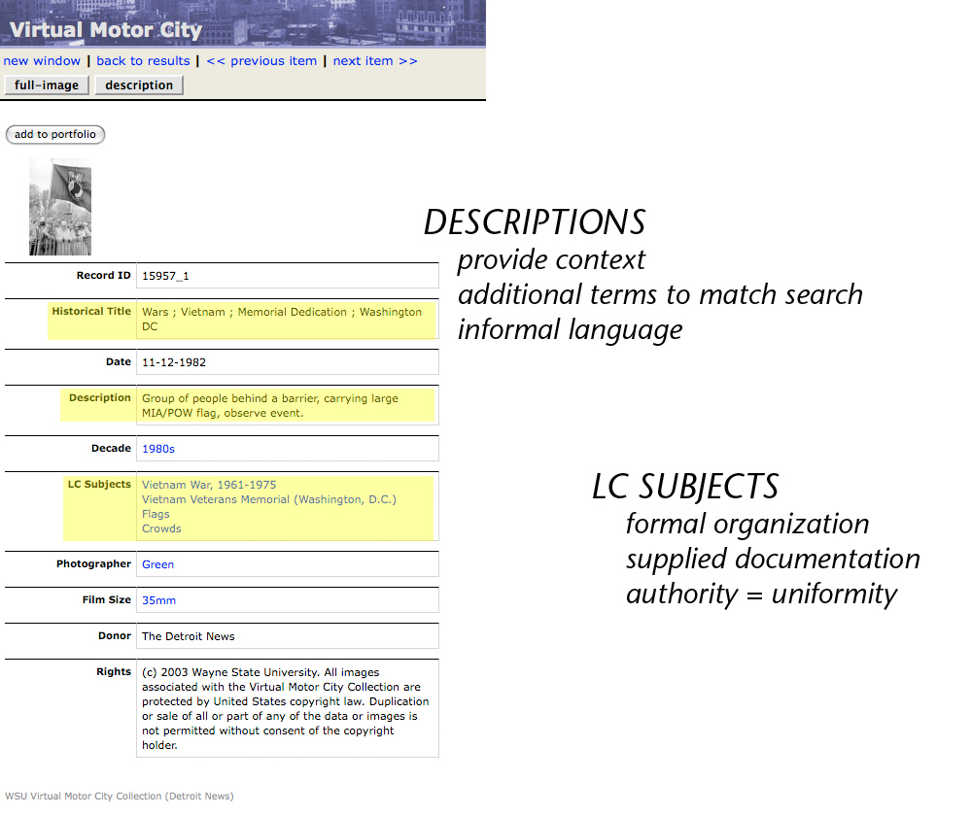

Slide 4
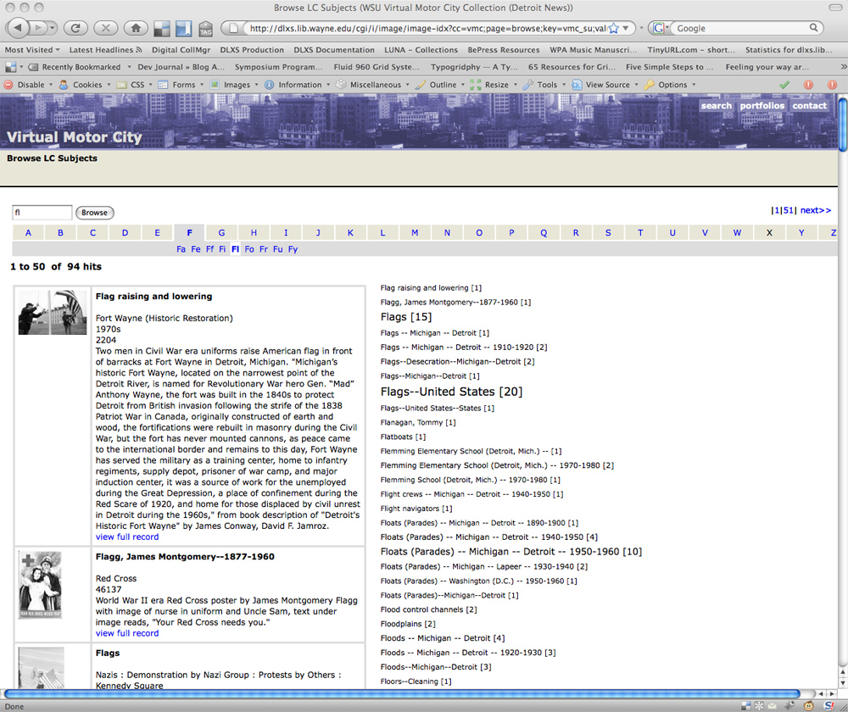

Slide 5
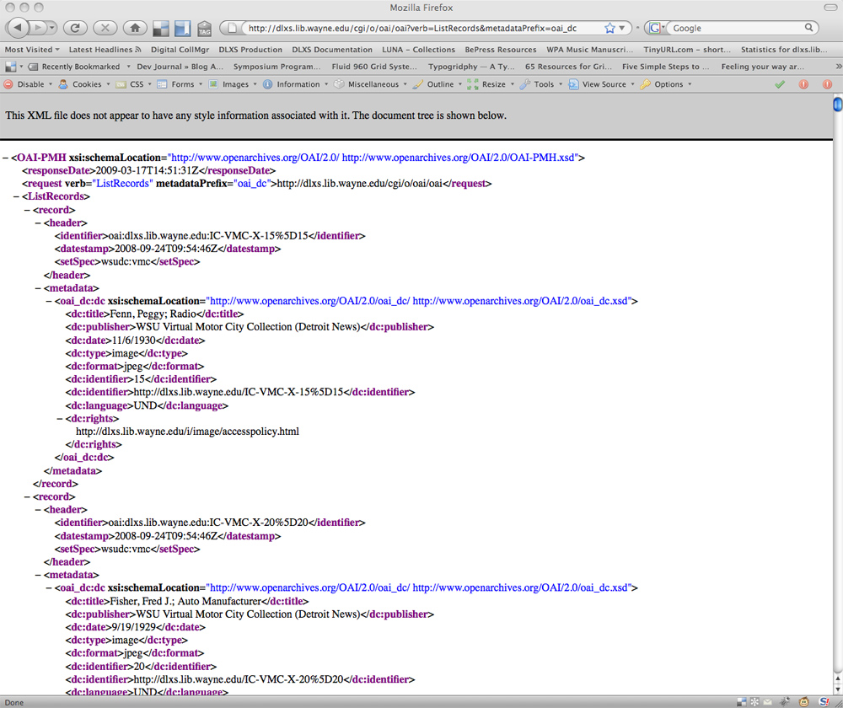

Slide 6
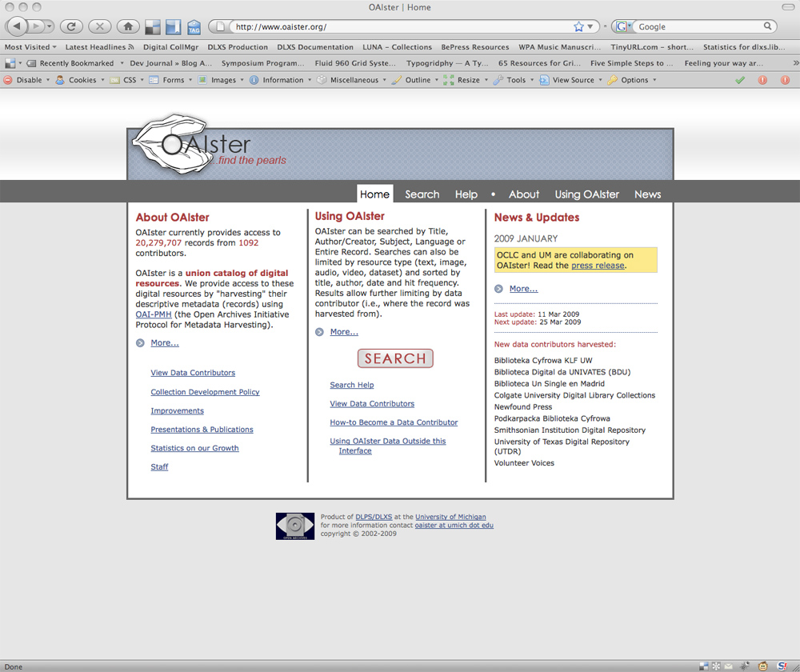
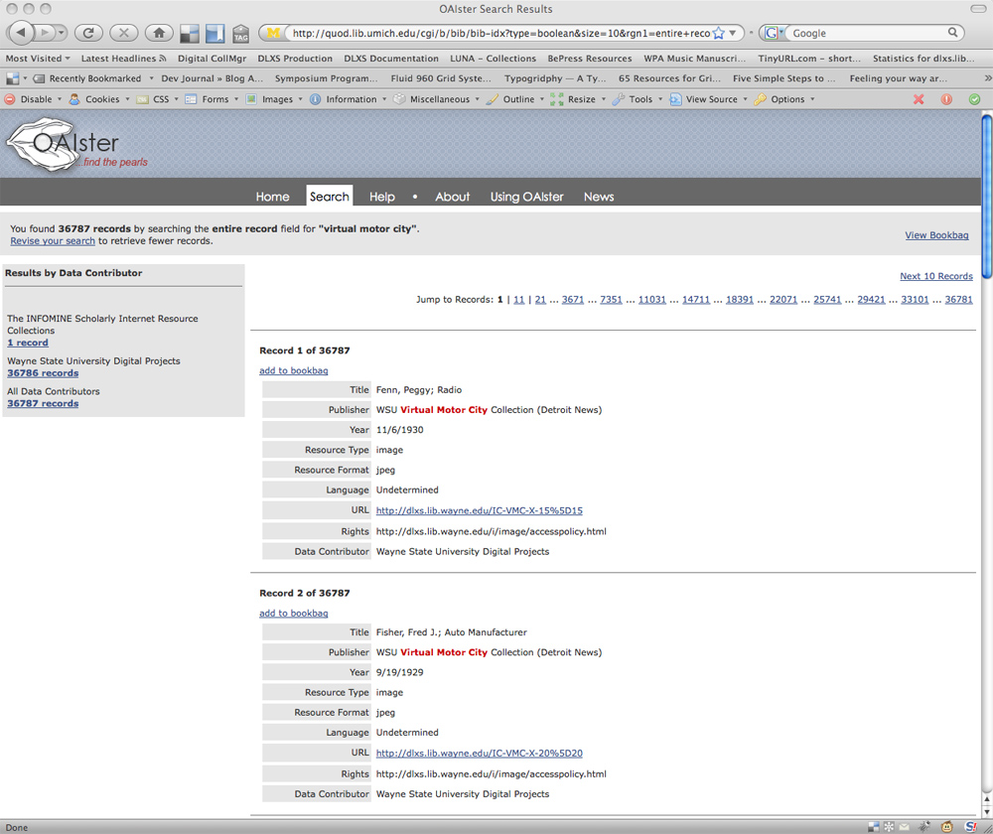

Slide 7
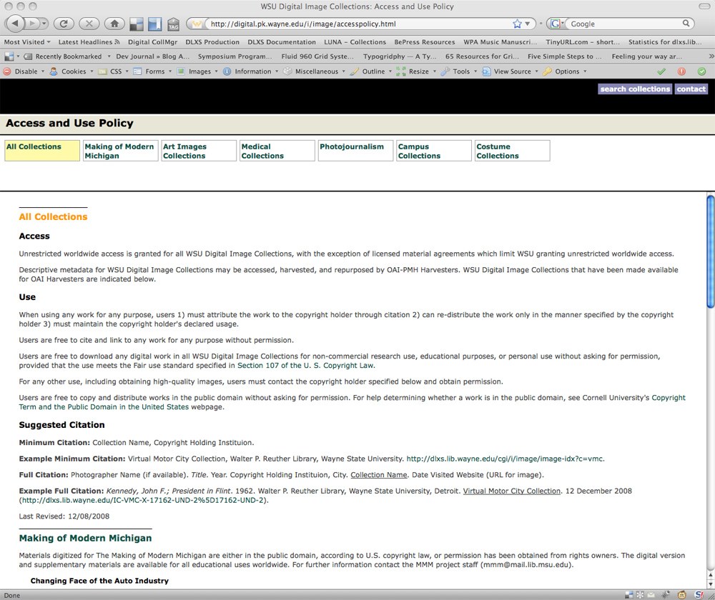

Slide 8
Use Image Collections to Create Digital Learning Objects (DLOs)
Create your portfolio of images from Virtual Motor City
Download the portfolio into a powerpoint or keynote presentation
Add Introductions, objectives, descriptions, explanations, feedback, summary
Change formatting as needed

Slide 9
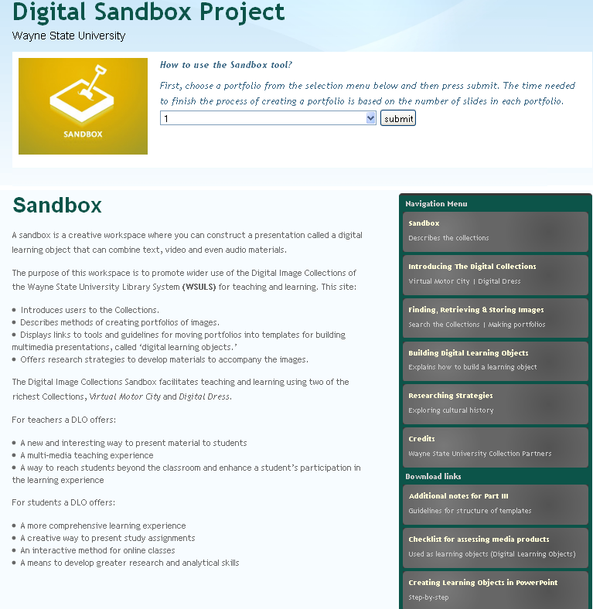

Slide 10
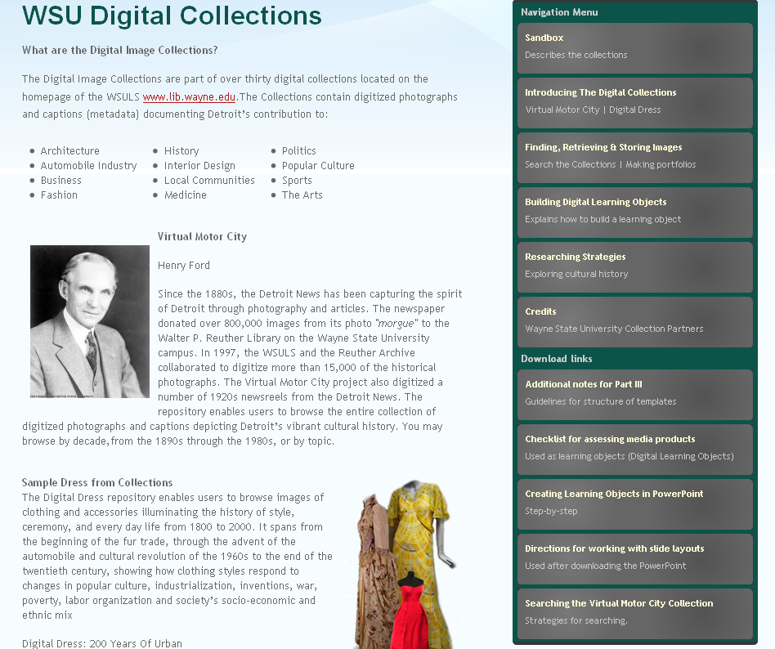

Slide 11
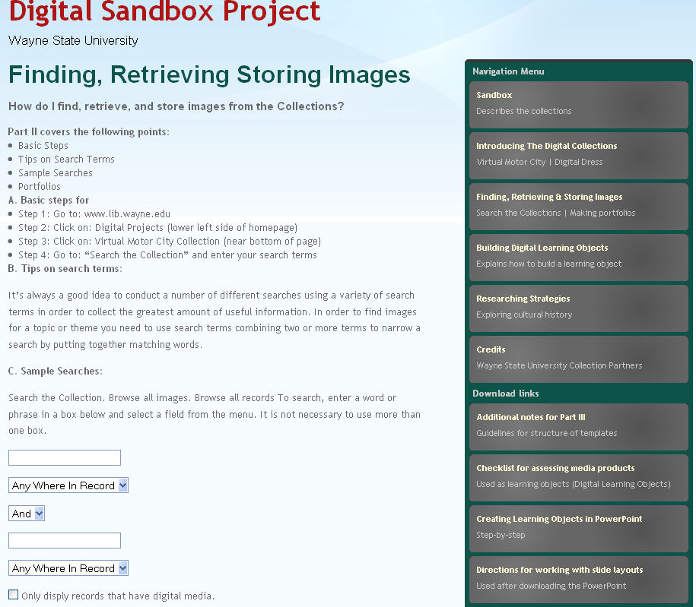

Slide 12
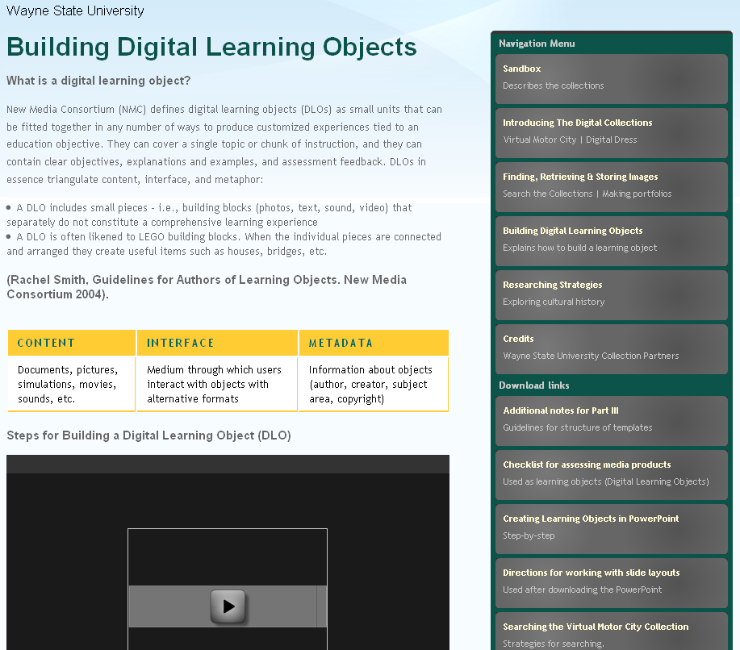

Slide 13
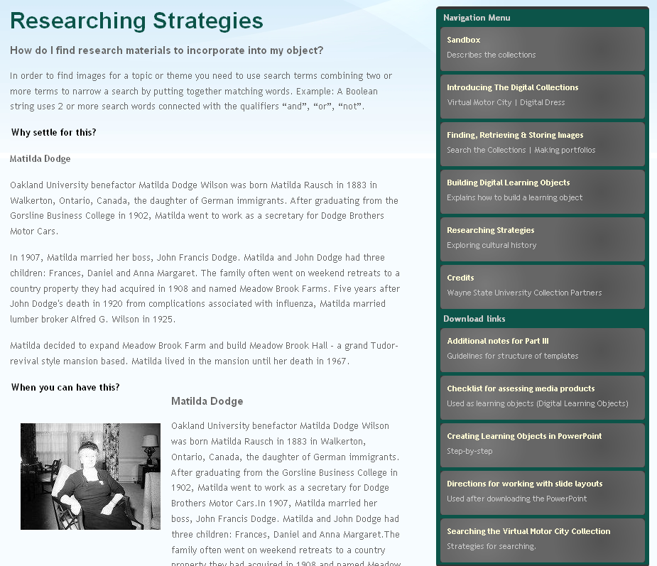

Slide 14
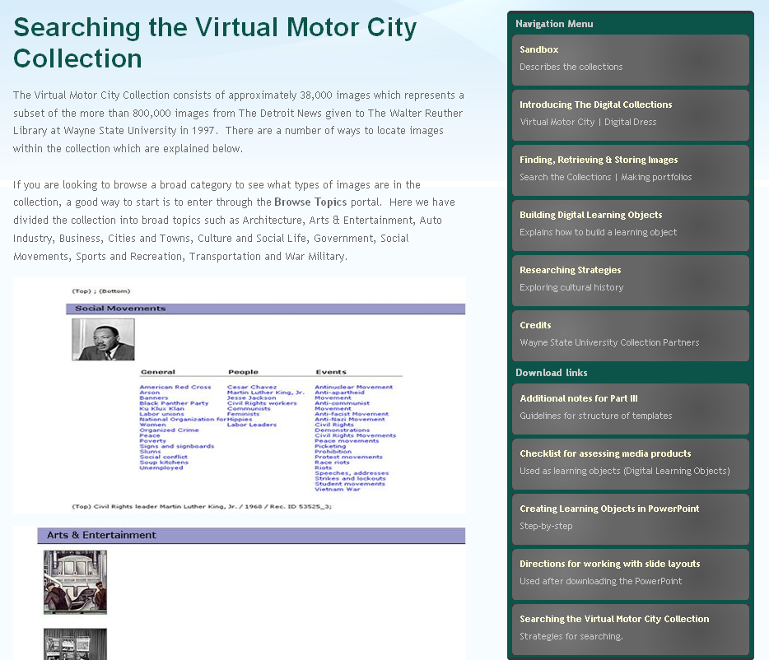

Slide 15
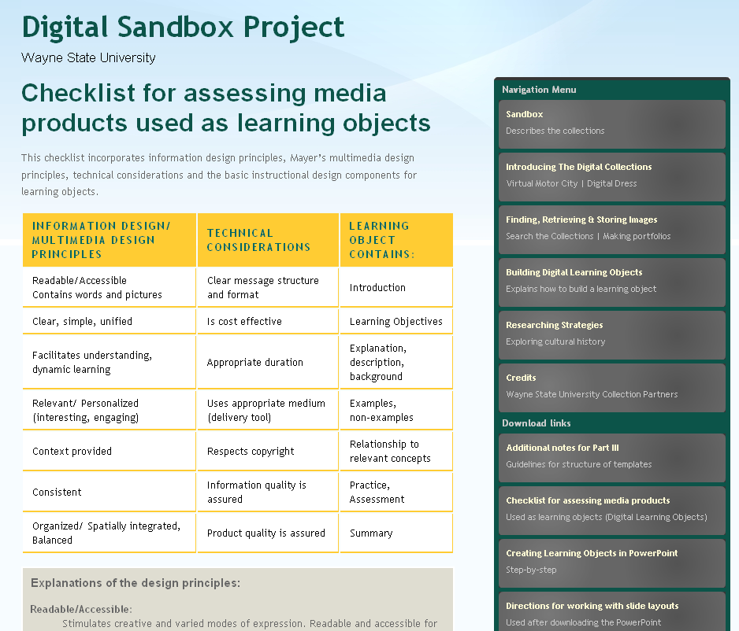

Slide 16
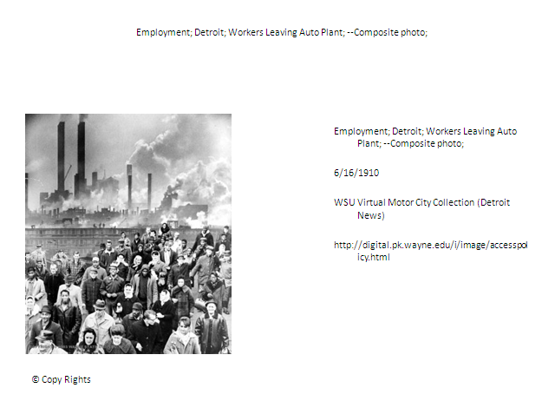
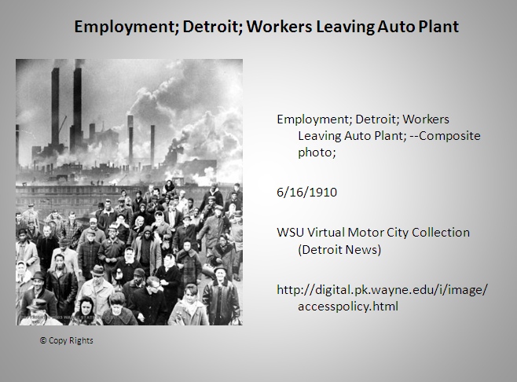
Using the Sandbox Tool
Download into Powerpoint
Improve the “look and feel”
Add Introductions, Explanations, Examples, Assessment, Feedback, as needed.

Slide 17
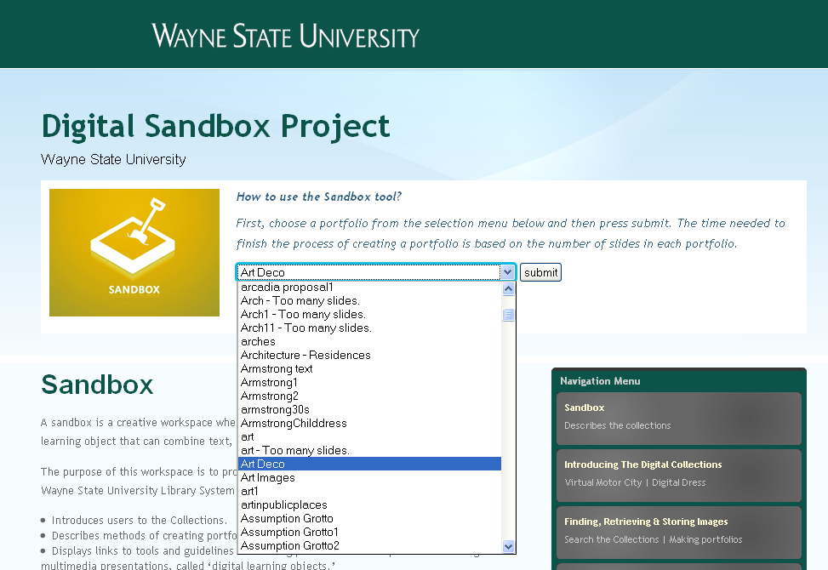
Find your portfolio from list

Slide 18
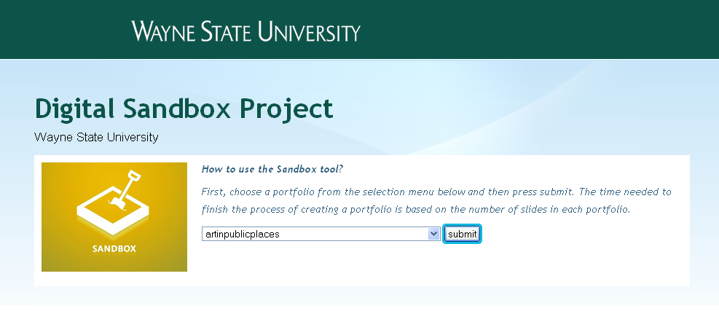
Choose “submit”

Slide 19
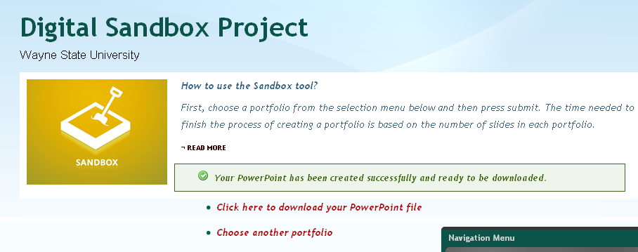
Once message appears, click to download into powerpoint.

Slide 20
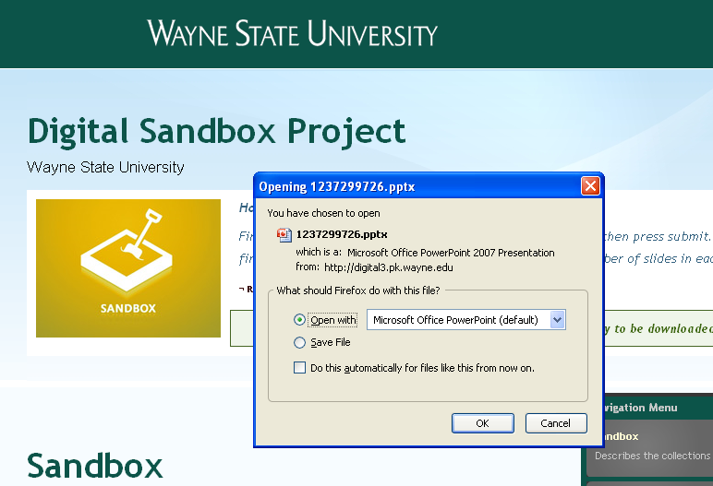
Choose “Open with Microsoft Office PowerPoint” and then

Slide 21
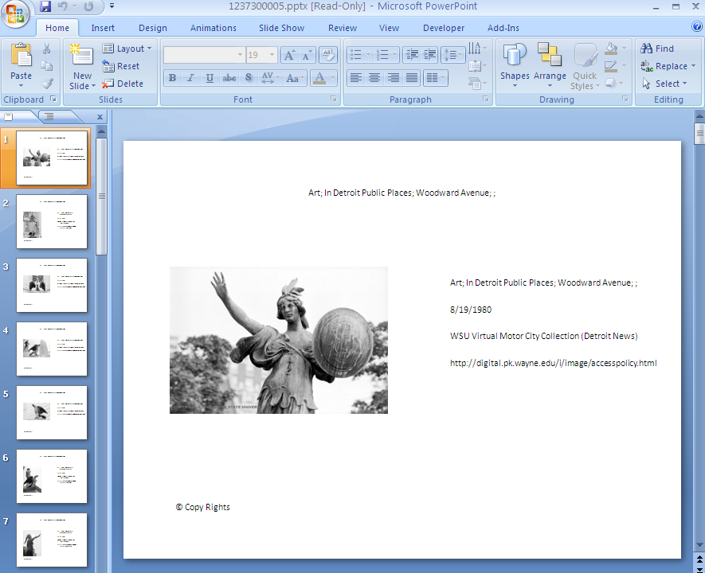
Use instructions to change the “look and feel” in powerpoint.

Slide 22
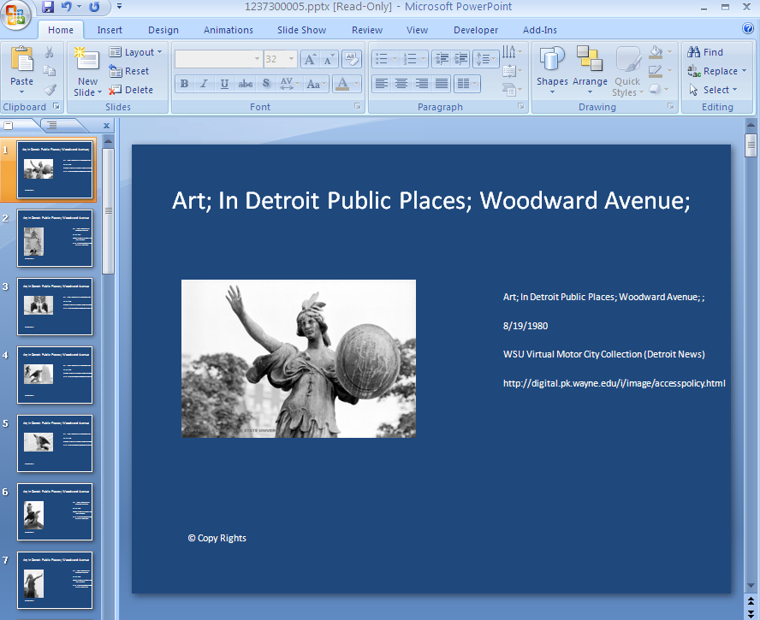
Add more slides for introductions, summaries, examples, explanations, assessment, feedback, . . .

Slide 23

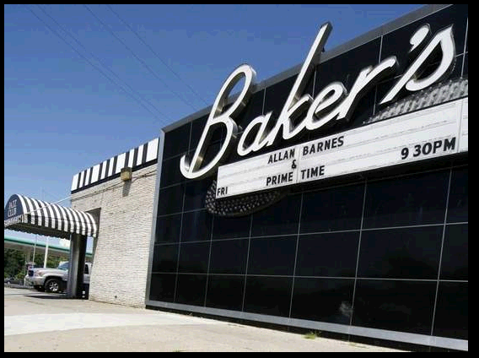
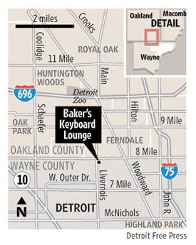
Importance of Preservation
Notes:
“The club became a fixture on the national scene beginning in the 1950s under the leadership of former owner Clarence Baker. Jazz greats like John Coltrane, Oscar Peterson, Dizzy Gillespie, Dave Brubeck and Ella Fitzgerald were regulars, and performing at Baker's has long been a rite of passage for local musicians.”

Slide 24
Questions and Discussion
Digital Learning Objects Sandbox Project
Wayne State University
Julie Thompson Klein
Anne-Marie Armstrong
Jonathan McGlone

