Slide 1
Maintaining a Secure and Usable Wireless Network
Craig Pluchinsky – Systems Analyst at Indiana University of Pennsylvania
Tuesday, March 16, 2010

Slide 2

Company:
  Headquartered in Denver
  Domain Expertise in Wireless & 802.1X
  www.cloudpath.net
Focus:
  Simplify Adoption of Standards-based Network Security in University Environments
Benefits of Working With Cloudpath:
  University Calendar
  Responsive & Proactive Support
  Shared Knowledge

Slide 3
Why WPA2/WPA Enterprise?
IEEE Standard
  Built into infrastructure and most client devices.
  Building block; future standards will build upon.
Wireless Security
      Over-the-air encryption
      User Authentication
      Optional: Network Authentication (Rogues)
      Optional: User-based VLAN &/or ACL assignment to isolate groups
User Experience
          Open laptop & associate w/ cached creds
          Captive portal & VPN fatigue

Slide 4
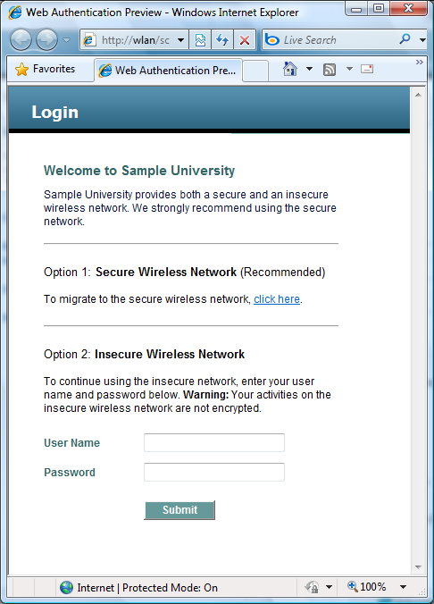

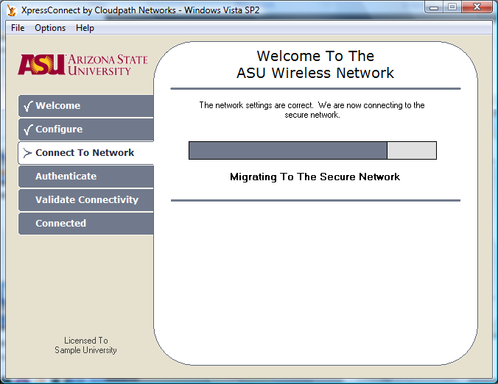
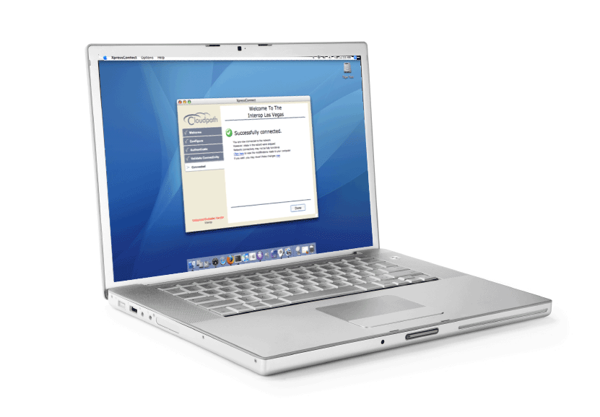
Student Experience – Day 1
univ
univ-secure
1
3
2

Slide 5
Student Experience – Day 2+
univ
univ-secure
1

Slide 6
XpressConnect™ Customer Stages
Upgrading to WPA/WPA2/802.1X
  Increase value of WLAN investment
  Reduce learning curve
  Easy cutover
Increasing Voluntary Adoption
      Make secure network more attractive
      Inverse adoption rates
Stabilizing Existing Network
          Reduce support costs
          Improve user experience
          Tighten security configuration
          Position for future changes

Slide 7








XpressConnect™ Capabilities
Wireless & Wired 802.1X Networks
Cross-Platform Support
Comprehensive On-Ramping
  Resolve Software Conflicts Affecting Wireless
  Install Network-Related Software (SecureW2) and Hotfixes (WPA2)
  Bootstrap Pharos, AV, NAC Agents
Built for the University Environments
  Lightweight, uses OS Components
  Zero Dependency Approach

Slide 8
XpressConnect™ Benefactors
Students, Faculty & Staff
  Quick & easy access to secure network
  No need for call or visit to IT
Support Desk
      Fewer support calls
      Defined criteria for escalation
Network Engineers
          Set it & forget it
          More flexibility to make network changes

Slide 9
Maintaining a Secure and Usable Wireless Network
Craig Pluchinsky – Systems Analyst at Indiana University of Pennsylvania
Tuesday, March 16, 2010

Slide 10
Background Information
Indiana University of Pennsylvania
  ~60 Miles northeast of Pittsburgh
  ~14,000 Students and ~2,000 Faculty and Staff
IT Services
  ~50 Employees
  4 Groups

Slide 11
Wireless Infrastructure
Cisco Hardware
  Wireless LAN Controllers
    4402, 4404 and 5508
  Access Points
    ~600 APs
    1231, 1142, 1242 and 1252
SSIDs
  WEP with Pre Shared Key
    VPN
  WPA-Enterprise and WPA2-Enterprise
    IAS

Slide 12
Wireless Usage
Fall 2006 < 250 users
Fall 2007 < 500 users
Fall 2008 < 1000 users
Fall 2009 > 2000 users
  Implemented XpressConnect in Summer 2009

Slide 13
Today’s Topics
Client Setups
Password Problems
Guest Accounts
XpressConnect Demo

Slide 14
Client Setups

Slide 15
Too many steps and it is difficult
Educate support staff
Have good documentation
Use GPOs where you can
  Computer authentication with user re-authentication
That’s the way it is
Have to be willing to troubleshoot

Slide 16
Drivers
Verify newest version
Firmware updates
  Add functionality and features

Slide 17
Third party utilities
Updates
Remove or disable unless really needed

Slide 18
Operating system issues
Patches
  Windows XP KB917021
  Service Packs
Verify the date and time
Different operating systems
Different languages

Slide 19
Hardware problems
Some wireless adapters won’t work
Don’t support at least WPA

Slide 20
Password Problems
Resets/Changes
  Cached password
  Locking Active Directory accounts out
  Self service change

Slide 21
Guest Accounts
How to request a guest account
Unencrypted SSID
  Why or why not

Slide 22
XpressConnect
Greatly reduced time at our support center
Made their lives easier
Works on a variety of platforms
  Windows, Mac and Linux (Ubuntu)
Demo

Slide 23
THANK YOU

