Slide 1
COLLABORATION IN BUILDING A VIRTUAL TEACHING CENTER
Jean Bryan (DePaul University)
Jodi Cressman (Dominican University)
Todd Diemer (DePaul University)
March 16th, 2010

Slide 2
Today’s Agenda
Part 1 – Assessment of Resources
Part 2 – Building
Notes:
Quick assessment. Ask the audience: 1. Who already has a virtual center 2. Who is thinking about making a center 3. Who is developing a center.

Slide 3
Objectives
  Determine audience
  Assess needed resources including institutional investment
  Identify institutional resources that can address needs
  Develop a process for collaboration
  Consider metrics for assessing success
  Ask: What next?
Notes:
Objectives for today. By the end of this session you should be able to:

Slide 4
Part 1 – Assessment of Resources
What spaces can we develop?
Who are we trying to reach?
What resources do we have?
Why we chose a virtual space.
Developing a virtual space.
Notes:
PART 1
Today’s Agenda
This talk will hopefully bring you towards an argument for the “Why” develop a virtual space.

Slide 5
Who are we trying to reach?
INTERNAL
Faculty members
Faculty development staff
Administration
EXTERNAL
Potential employees
Other universities
Notes:
Who are the stake holders that may use or support the site?

Slide 6
What spaces can we develop?
Organizational space
Physical space
Virtual space
Notes:
Knowing which space you want to develop will make a difference in who you need to collaborate with.
The focus of this presentation is on the virtual space.

Slide 7
What resources do we have?
Set up time
Continued investment
People
  Content experts
  Technical experts
  Enthusiasts
  Administrative leaders

Slide 8





Resource considerations
Short set up time
High long-term investment
Content experts
Technical experts
Enthusiasts
Support from upper administration
Sources: (Sherer, 2003)
Notes:
Short set up time: In terms of planning, designing, and developing a virtual space.
High long term investment: In reference to the buy in and support you have from faculty development offices/faculty members.
Content experts: Pedagogy experts
Technical experts: Web developers or computer scientists
Enthusiasts: Supporters/cheerleaders/word-of-mouth people/advertisers of the site
Support from upper administration: Buy in from the people who can give you web hosting space, domain names, structural support, incentive for groups to collaborate.
User icon from Wikimedia Commons:
http://commons.wikimedia.org/wiki/File:Crystal_Clear_app_personal.png

Slide 9
Why we chose a virtual space
Notes:
Briefly, our “Why” of an online presence.
DePaul had many different groups working on faculty development, but they were spread out, physically, on the WWW, and in particulars of their mission.
Faculty said, “I don’t know where to go for what. I just want to go to one place for help.”

Slide 10
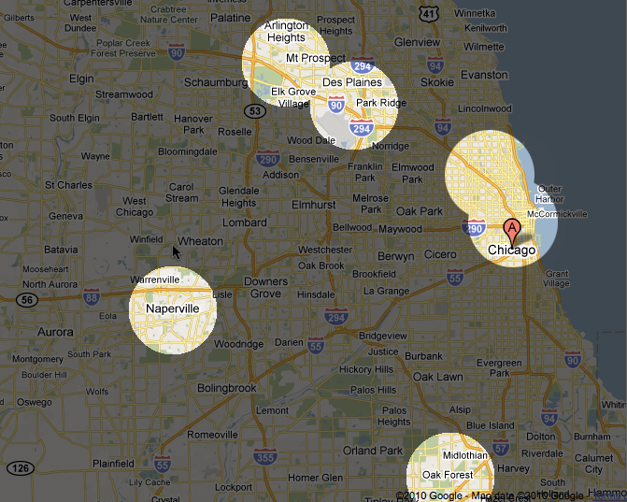
Notes:
Map of Chicago area showing physical distance between two main campuses and suburban campuses.
Loop, Lincoln Park
Naperville, Oak Forest, O’Hare, Rolling Meadows

Slide 11



Notes:
Just some of the faculty development offices at DePaul.

Slide 12
Why we chose a virtual space
Two main campuses
Four suburban campuses
Encourage collaboration among groups
Lack of funding for a physical center
Reach adjuncts
DePaul 2012 strategic plan
Notes:
Briefly, our “Why” of an online presence.
DePaul had many different groups working on faculty development, but they were spread out, physically, on the WWW, and in particulars of their mission.
Faculty said, “I don’t know where to go for what. I just want to go to one place for help.”

Slide 13
Developing a virtual space
“What do we want to build?
Who will contribute?
Where will it live?”

Slide 14
Developing a virtual space –
Social media
Short set up time
High long-term investment
Content experts
Technical experts
Enthusiasts
Support from upper administration
Notes:
Content experts nice to have, but not a requirement. Try to see what others are doing in teaching and learning and spread the word.

Slide 15
Notes:
Example of a social media account, DePaul Teaching Commons on Facebook.
If you are going to use multiple accounts, make sure they all link together, and complement one another. You can flow from one to the other.

Slide 16
Notes:
Example of a social media account, DePaul Teaching Commons on Twitter.
If you are going to use multiple accounts, make sure they all link together, and complement one another. You can flow from one to the other.

Slide 17
Notes:
Example of a social media account, DePaul Teaching Commons on Blogger
If you are going to use multiple accounts, make sure they all link together, and complement one another. You can flow from one to the other.

Slide 18
Developing a virtual space –
Wikis
Short set up time
High long-term investment
Content experts
Technical experts
Enthusiasts
Support from upper administration

Slide 19
Notes:
Example of a Wiki site, WikiPODia.

Slide 20
Developing a virtual space –
Basic website link farm
Short set up time
High long-term investment
Content experts
Technical experts
Enthusiasts
Support from upper administration
Notes:
Link farm website that directs people to other resources on the web.
Now is when you must take into consideration web-space hosted by your university and branding pages to be in line with brand standards.

Slide 21
Developing a virtual space –
Basic website with local content
Short set up time
High long-term investment
Content experts
Technical experts
Enthusiasts
Support from upper administration
Notes:
Website more like the Teaching Commons. Basic static website that contains information from our institution.

Slide 22
Notes:
Example of a standard webpage, DePaul Teaching Commons
Main homepage

Slide 23
Notes:
Example of static web page, DePaul Teaching Commons.
How to: Identify Materials at DePaul

Slide 24
Developing a virtual space –
Interactive locally driven website
Short set up time
High long-term investment
Content experts
Technical experts
Enthusiasts
Support from upper administration
Notes:
Online modules. Interactivity.

Slide 25
Notes:
Carnegie Mellon’s “Solve a Problem” has a sense of interactivity by guiding users through a set of questions to come to a common set of answers.

Slide 26
Notes:
IUPUI on diversity includes detailed lesson plans from the school’s own faculty.

Slide 27
Assessing your own needs
Using the worksheet:
  Take 5 minutes to: Reflect on your own needs and challenges.
  Take 5 minutes to: Discuss your results with those at your table.
Notes:
Group activity... Have audience members assess their own needs, identify what solutions might be useful.

Slide 28
Part 2 - Building
When to create and when to connect
Contributor skill sets
Collaboratively creating new content
Assessing the success of the center
Next steps: Is a virtual space enough?
Notes:
PART 2
Continued agenda

Slide 29
When to create and when to connect
CREATE
Can’t find anything else
Distinctive tone
Apply to your institution
“Ownership”
CONNECT
No time
No content expert
Better resource exists
Notes:
CREATE
If no adequate resource exists and/or you want to contextualize resources for your own institution.
CONNECT
Something better is out there that works for your purposes.

Slide 30

When connecting remember…
Rubrics can help clarify an assignment's goals and greatly reduce the time spent grading and responding to student work.
  Grading Rubrics
Rubrics can help clarify an assignment's goals and greatly reduce the time spent grading and responding to student work.
  This site provides a starter guide to creating grading rubrics.
Sources: (U.S. Department of Health & Human Services, 2006)
Notes:
Give your reader context for the links you are providing as valuable resources. This can often come as a simple description as seen in the right hand image.

Slide 31
Contributors
Diplomat
Orchestral Conductor
Outfitter
Pedagogy Expert
Institutional Anthropologist
Writer/Editor
Web Developer
Enthusiast
Sources: (Shea, T., Sherer, P., & Kristensen, E., 2002)
Notes:
Ideal set of types of people who can contribute. Any one person could, and hopefully will, be more than just one of these types.
Diplomat: forge the collaborations necessary to implement an institutional teaching and learning portal
Orchestral conductor: Coordinating and managing a number of services from different offices on campus would require
Outfitter: Thinking about the elements needed in an institutional teaching and learning portal

Slide 32
Collaboration process
Identify audience
Define tone/voice
Research needs
Organize sources
Write for intended audience
Evaluate with the intended audience (if possible!)
Do it again...
Notes:
This process follows a mindset of iterative design. You should always take a minute to refer back to your user and try to assess whether or not your materials will address their needs.

Slide 33
Notes:
The results of a collaborative process can lead to pages that more effectively speak to what information you want to push out to faculty.
Here we focus on demonstrating the assessment process, not only in large bold imagery, but also in “writing to learn” examples.

Slide 34
Assessing the successes
Faculty feedback
Number of inquiries/support requests
Involvement in university wide projects
Site statistics (local and global)
Notes:
Faculty feedback: Word of mouth support.
Number of inquires/support requests: We’ve gotten a couple each month... Not a large amount, but expectations are growing.
Involvement in university wide projects: Online Teaching Evaluations, Reading Task Force, Learning Management System review process
Site statistics. Easily the most quantifiable. Free solutions out there like Google Analytics. Inform you of who and when users come, what they do, but not why they do it. Qualitative measures are always a help when trying to make sense of statistical data.

Slide 35
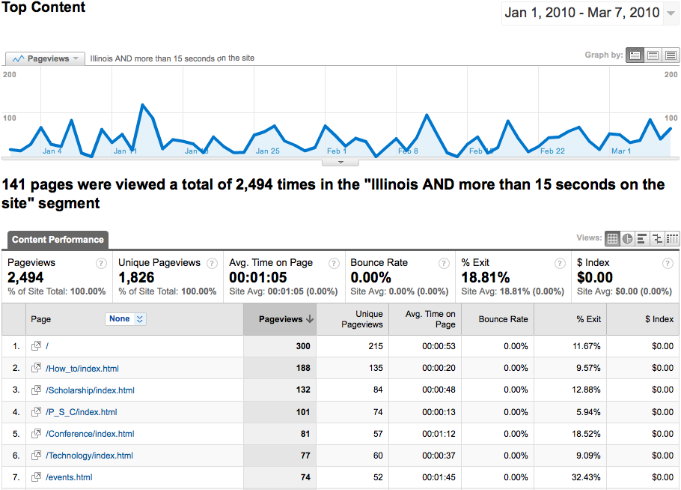
Notes:
Here we are using Google Analytics to filter down to users from Illinois who spent more than 15 seconds on the site from Jan 1 – Mar 7. We can use this to look at what pages are being hit the most, and being sure to optimize navigation and content on these pages first.

Slide 36
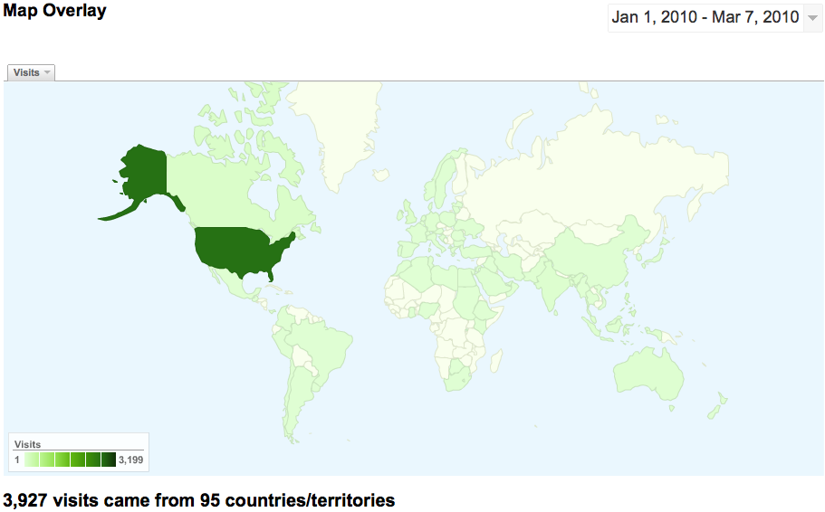
Notes:
If one of your goals was to reach a global audience/outside faculty members, this is certainly one way to assess that success.

Slide 37
Next steps:
Is the virtual center enough?
Notes:
Is a virtual center enough? We said no because:
Still a number of faculty who could/want to attend live workshops.
There is only so much you can convey online, some things like context of a course are often too difficult to work through online.
Online good for the general, offline better for the interpersonal.
Desire to get DePaul specific content up on the Teaching Commons. Run workshops to get local content, and put it back up on the Teaching Commons.

Slide 38
Notes:
Example of live workshop that fed back into the website. Slowly but surely make content local.
There is tons of good content out there, why reinvent the wheel? “We once were the people pushing out global information, our challenge now is to make the global local.”

Slide 39
Notes:
Example of live workshop that fed back into the website. Slowly but surely make content local.
There is tons of good content out there, why reinvent the wheel? “We once were the people pushing out global information, our challenge now is to make the global local.”

Slide 40
THANK YOU
Please remember to fill out the session evaluation form.
Notes:
Q&A time.

Slide 41
References
Shea, T., Sherer, P., & Kristensen, E. (2002). Harnessing the potential of online faculty development: Challenges and opportunities. In D. Lieberman (Ed.), To improve the academy, 20, (pp. 162–179). Bolton, MA: Anker.
Sherer, Pamela D. (2003). "Online communities of practice: A catalyst for faculty development". Innovative higher education (0742-5627), 27 (3), p. 183.
U.S. Department of Health & Human Services. (2006). Research-Based Web Design & Usability Guidelines. Washington, DC: U.S. Government Printing Office. Retrieved http://www.usability.gov/guidelines/

