Slide 1
Using Video to
Engage Students Without Stress
Alison Sommer
Academic Information Associate for
Languages and Fine Arts

Slide 2



The Problem with…
DVDs in the Classroom

Slide 3

Solution #1

Slide 4
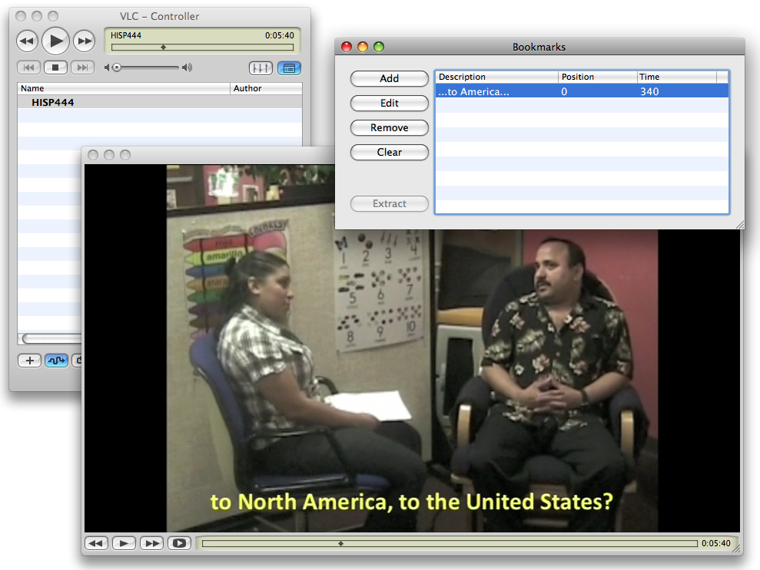
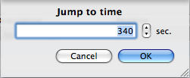

Slide 5


Solution #2
+

Slide 6
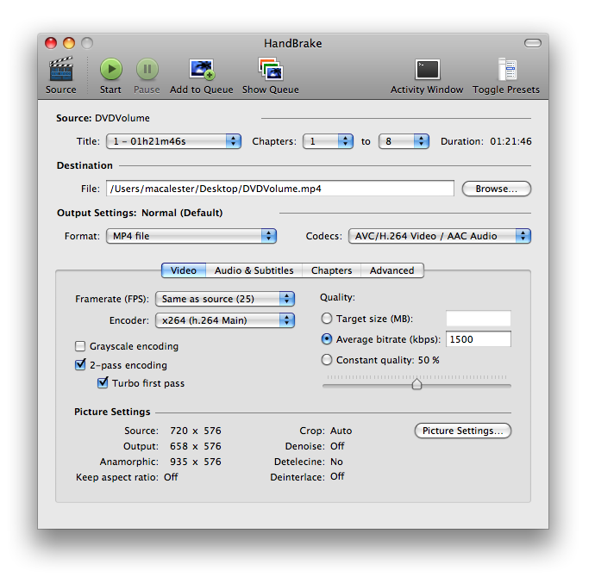

Slide 7
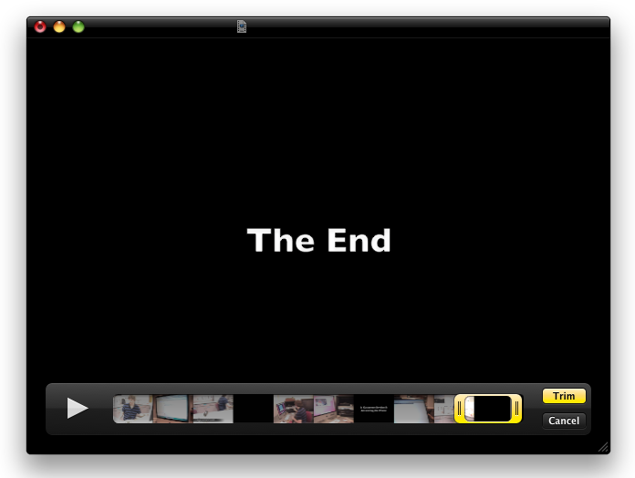
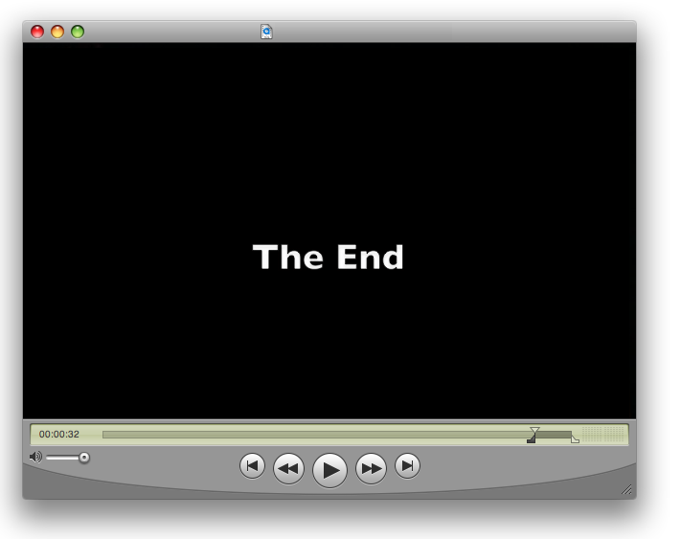

QuickTime 10
QuickTime Pro

Slide 8




Opens up other possibilities…

Slide 9

…solves other problems…

Slide 10

… and raises other questions.

