Slide 1
Updating the Value Proposition:
Using Services to Define Your IT Organization
Mark Askren – CIO, University of Nebraska – Lincoln
Kimberly Harper – Director of Finance & Portfolio Management,
University of Nebraska – Central Administration

Slide 2

The Impetus – Budget Crisis
Experiencing pressure from both sides:
Demand for IT services grows, while resources stay the same or decrease (“new normal”)
Challenge is how to:
Further cut already reduced
budgets
Continue to produce core
mission services and innovation
to meet increasing demand

Slide 3
Re-evaluation
Our Goals
Create a better understanding of our IT organizations (including within our organizations)
Validate that our priorities are aligned and funding justified
Identify efficiency & collaborative opportunities
Improve strategic planning & decision-making, and invest accordingly
Weather the storm
Identify opportunities for improvement

Slide 4
An Approach: Services Inventory
Scope
Identify all services provided to both internal and external customers.
Identify all assets that support each service
(e.g., software, applications, operating systems, hardware maintenance, connectivity charges, materials, contract charges, personnel).
Identify customers who utilize each service.
Identify total cost of all assets associated with each service.

Slide 5
An Approach: Services Inventory
Methodology
Consultant-led staff interviews
Development of service offering categories, descriptions and characteristics
Development of financial cost model

Slide 6
An Approach: Services Inventory
Outcome – Identified Service Offerings
CSN
UNL
Data Management & Analytics
E-Mail, Communication & Collaboration
Hardware & Software Support
Data Management & Analytics
E-Mail, Communication & Collaboration
Hardware, Hosting & Storage
Internet & Network Connectivity
IT Governance & Service Management
User Access & Security
Internet, Phone & Network Communications
IT Governance & Service Management
User Access & Security
User Training & Community
User Training & Community
Enterprise Information Systems
Printing, Forms & Output Management
Web Development Support
Classroom, Lab & Instructional Resources
Consulting & Project Management
Development, Integration & Support
Technology Innovation Support
Technology Sales & Repairs

Slide 7
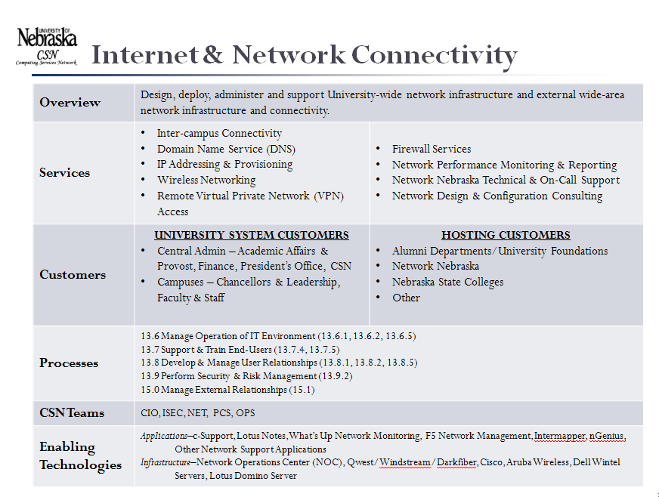
An Approach: Services Inventory
Outcome – Define Service Offering Attributes

Slide 8
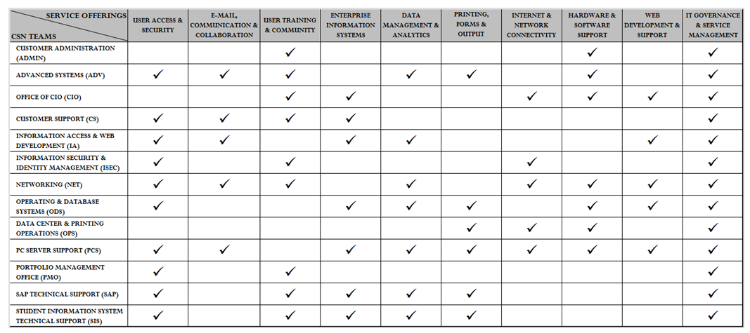
An Approach: Services Inventory
Teams that Provide Services
Services require cross functional contributions (break out of “silo” thinking)

Slide 9
The Key Lessons Learned
Using IT services as the value definition is more effective than the traditional organization structure and major projects view
Traditional IT becomes Service Oriented
Technology focus |  | Process focus
“Fire-fighting” |  | Preventative
Reactive |  | Proactive
Users |  | Customers
Centralized, done in-house |  | Distributed, sourced
Isolated, silos |  | Integrated, enterprise-wide
“One off”, ad hoc |  | Repeatable, accountable
Informal processes |  | Formal best practices
IT internal perspective |  | Business perspective
Operational specific |  | Service orientation

Slide 10
The Key Lessons Learned
Decisions to continue, discontinue or develop new services have wide-spread implications
Services inventorying and management is a long-term commitment
Challenges:
  Moving from team-focus to service-focus
  Resource-facing vs. Customer-facing services
  Not getting trapped by what you know
  Drawing lines in the sand
  Staff buy-in

Slide 11
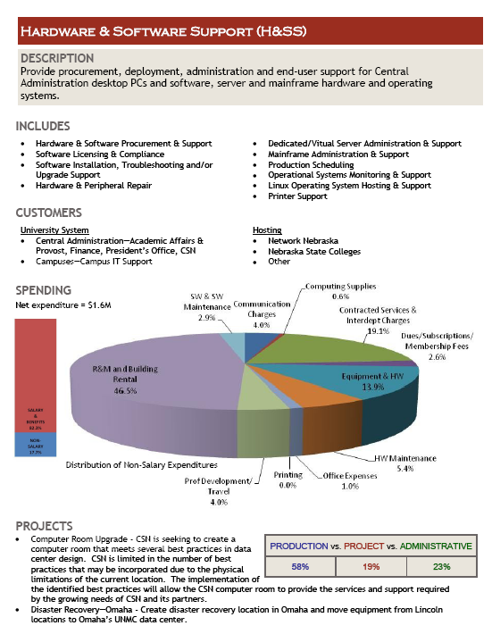
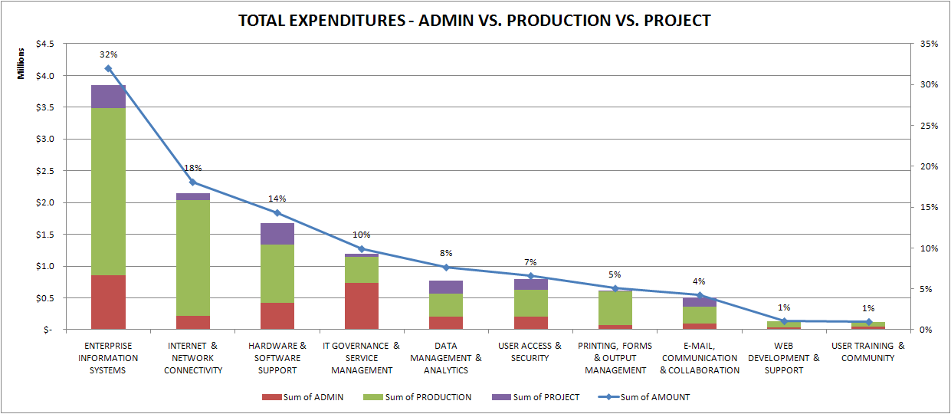
Positive Outcomes
Improve
communication
and understanding:
For Executive Leadership

Slide 12
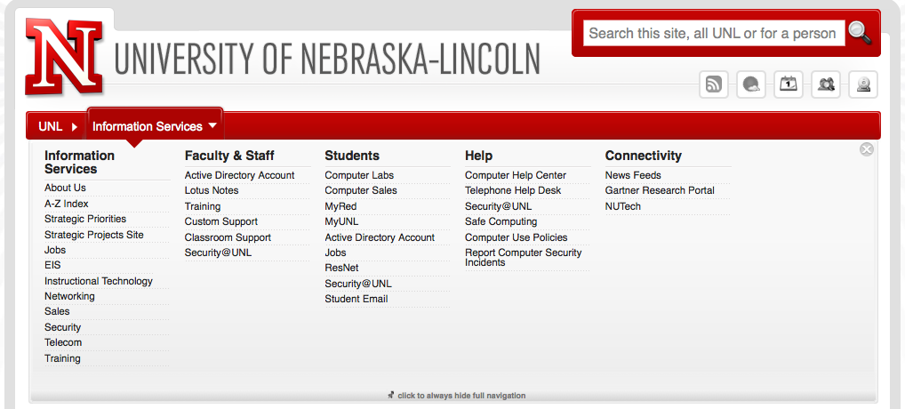
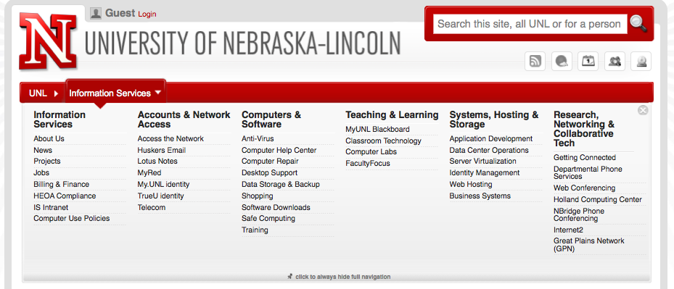
Positive Outcomes
Improve communication and understanding:
For Customers
Key services provide the
framework for redesigning
UNL’s web site

Slide 13
Practical Outcomes
Enable Efficiency and Collaboration
Services are helping redefine campus-wide IT resources allocation & assess cost savings and greater efficiencies
Framework is key to looking at system-wide collaboration opportunities and community projects with Higher Ed IT organizations in the BigTen CIC, and on a national basis.

Slide 14
Practical Outcomes
Strategic Planning & Decision Making
Enables evaluation of how each service is aligned and supports overarching University initiatives.
Enables understanding of how changes in IT services impact the University
(e.g., what functionality is affected, which customers are affected, does it have a global impact or is it focused to a small community)
Enables more accurate and timely analysis of alternatives
Re-evaluation of service offerings
(create new, retire existing, combine, branch, etc.)

Slide 15
Practical Outcomes
Continual Improvement
Identifying and managing to performance metrics
Establishing Service Level Agreements (setting and managing expectations)
Developing Service Catalog and Request Processes
Implement ongoing customer feedback process
Evaluation of services and definitions is never finished

Slide 16
Contact Information
Mark Askren
maskren2@unl.edu
Kimberly Harper
kkharper@nebraska.edu

