Slide 1
“They Really Need to See Me!”
The Realities of Teaching Faculty to Teach Online
Midwest Educause 2011
Kelly Wilkinson
Director, Center for Instruction Research & Technology
Indiana State University
Edward R. Kinley (AWOL)
Assoc. VP for Academic Affairs & CIO
Indiana State University

Slide 2




Why do students select online courses?

Slide 3

What do students expect when they participate in an online course?
?

Slide 4

What do faculty expect from experiences of teaching an online course?

Slide 5
What makes a good learning experience?

Slide 6
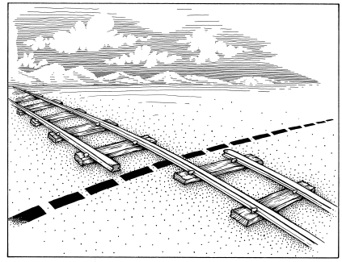
We’ve Gotta Problem Here?
Shifting the faculty and student mindsets to bring experiences into alignment.

Slide 7
Top 10 Reasons Faculty are Unsuccessful when it comes to the Online Environment
Students want to see me.
It’s too much work.
I don’t want to change.
Lecture is important for my discipline.
I’m not comfortable doing new things.
It works in my “required” classes.
I don’t know how to use the tools.
I know it works because I use it.
It’s what I know.
I’ve been doing it this way for years.

Slide 8
ISU Survey of Distance Education Faculty
The majority of the faculty stated that the most limiting thing about online teaching is the leanness of the communication media.
“Direct interaction with students to guarantee that skills are being learned effectively.”
“There are no “Ah-Hah” moments in online teaching because this comes with a live classroom environment where students are interacting with each other and the instructor.”

Slide 9
I need for them to see me!
Voyager
Completing It’s Mission

Slide 10


V’Ger
Spock explained: “V’Ger is…evolving, learning, searching, instinctively needing… It knows only that it needs, Commander. But like so many of us, it does not know what”;

Slide 11

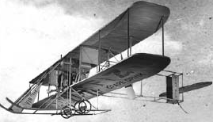
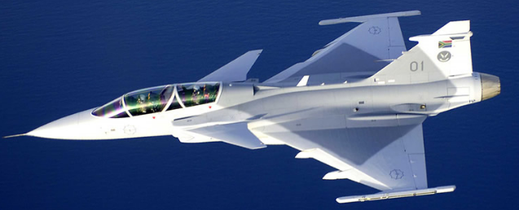

Translate Our Knowledge of Learning
Effective Engagement
Operationalize

Slide 12
Faculty is the Center of Strength
Faculty Orientation
Face-to-Face
Student Orientation
Distance Education
PAIR-A-DOX
Personality
Content
Present
Shift
Interaction
Facilitation
Process
Method
Content Discipline
Engage
Discipline
Discipline

Slide 13
What does this mean?
Pedagogy of Interaction
    Student centered
    Multiple communication channels
    Immersive feedback

Slide 14
Solution
Good teaching and learning… Online
Partnerships between…
Foundational Studies
Distance Education
CIRT
Faculty Senate
Instruction
Mentoring
Assessment
3 Components:
Based on National Standards for Quality Online Teaching (NACOL)

Slide 15

Questions?

Slide 16

THANK YOU!

