Slide 2
Get Creative!
Enhance Your Campus Portal with Existing Collaborative IT Solutions

Slide 3
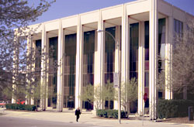
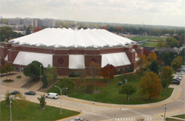
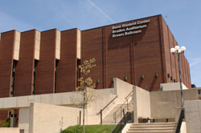
Who We Are…
Total students: 20,856
  Undergraduates: 18,344
  Graduates: 2,512
1,100 faculty members
1,300 staff members

Slide 4
Topics
User expectations
Then to now
  Where we were
  Where we are headed
Stakeholders and Collaboration
Anticipating and planning for usage
Alleviating stress
Server architecture

Slide 5
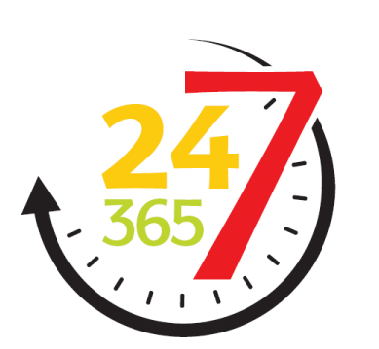
User Expectations - Availability
24 / 7 / 365
  College students today expect, and rightfully so, the ability to see and change information from anywhere at any time.

Slide 6
User Expectations - Availability

Slide 7
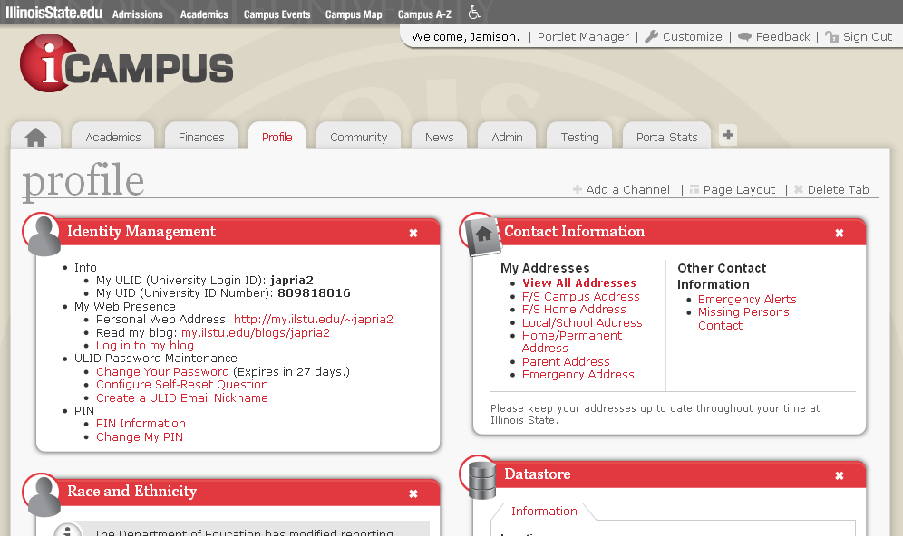
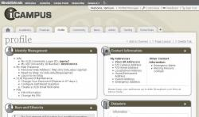
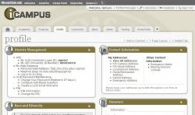
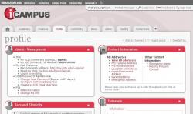
User Expectations - Accessibility
Color blindness simulation results for a typical portal page in iCampus showing expected output for users with Protanopia, Deuteranopia, and Tritanopia.
http://www.etre.com/tools/colourblindsimulator/

Slide 8
User Expectations – Accessibility
Research Resources:
  Section 508 (http://www.access-board.gov/508.htm)
  W3C (http://www.w3.org/TR/?WCAG/)
  iCITA HTML Best Practices (http://html.cita.illinois.edu)
  Illinois Information Technology Accessibility Act (http://www.dhs.state.il.ud/page.aspx?item=32765)
Tools
  JAWS for Windows (http://www.freedomscientific.com)
  Firefox Accessibility Extension (http://firefox.cita.uiuc.edu/)
  Lynx Text Browser (http://lynx.isc.org)

Slide 9





User Expectations - Usability
The user should not have to learn to use your web interface.
Everything should work as the user expects.
Reuse controls and elements that are familiar to users.

Slide 10
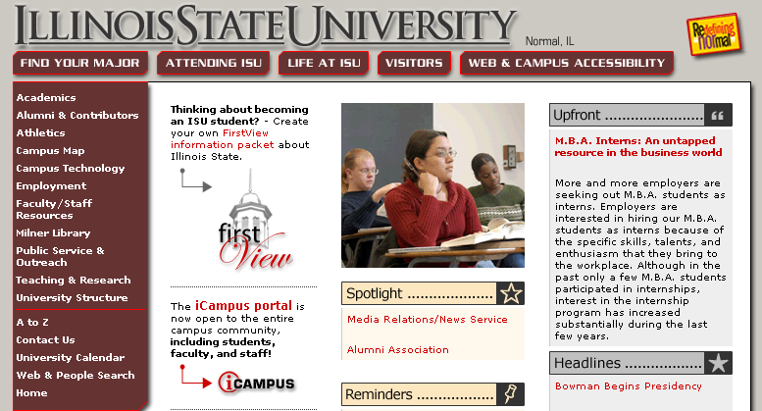
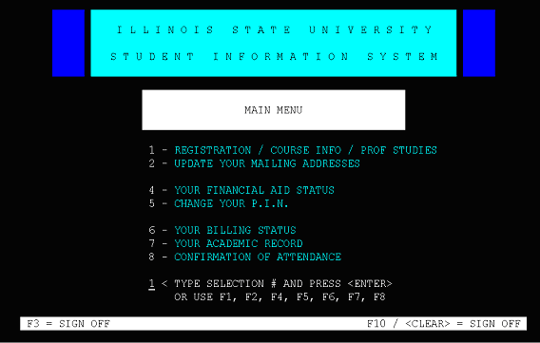
Where We Were - 1999

Slide 11

Where We Were – Spring 2000
Building a technology friendly campus
Extend student services to the web
Provide support for:
  Admission
  Registration
  Academic planning
  Career advising
  Student placing
  News and events

Slide 12
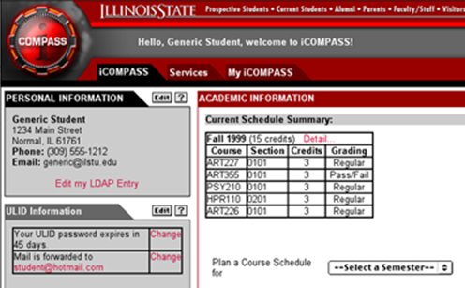
Where We Were – 2001-2002
Portal and Academic Web Services group (PAWS)
  Established in Spring 2001
  Determined priorities for web-enabling University services
PAWS group endorsed uPortal Project (2002)
  Services primarily for students
  IBS/UNICON partnership
  iCompass prototype
An early mock-up of the University Portal, originally named iCOMPASS

Slide 13
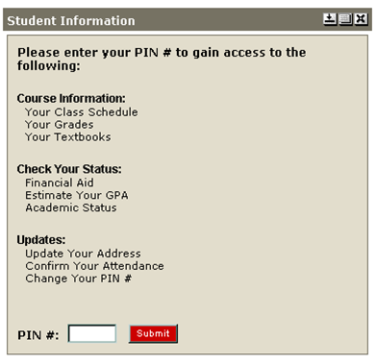
iCampus Launch – Fall 2002
Originally launched with limited services:
  Email
  Class Schedule
  Grades
  Textbooks
  Address
  Financial Aid
  Academic Status

Slide 14
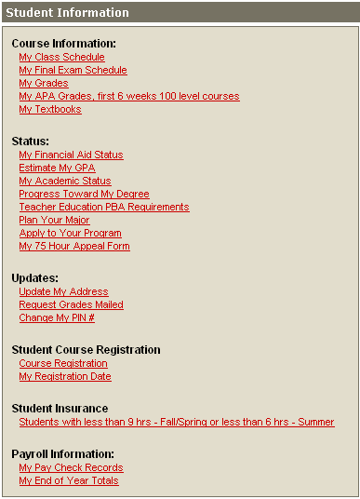
Post-Launch Results – 2003-2008
Be careful what you wish for
  Growth in number of services = cluttered screens
  Everyone wanted their data on prime real estate
  Portal blamed for anything and everything
New services, new challenges
  Information overload
  Real time data with confusing messages
  Streamlining complex processes

Slide 15
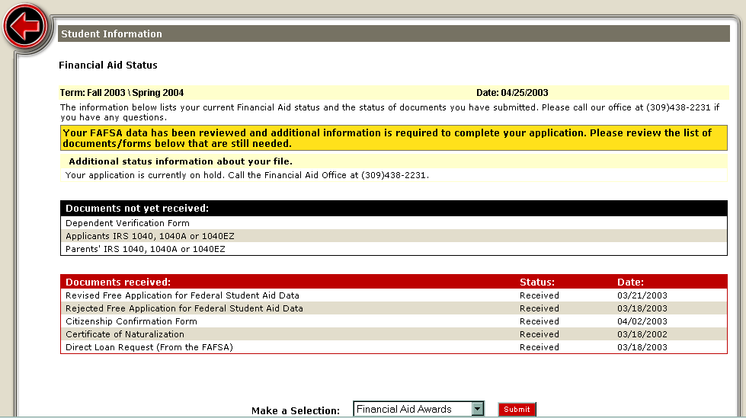
Design Pitfalls

Slide 16
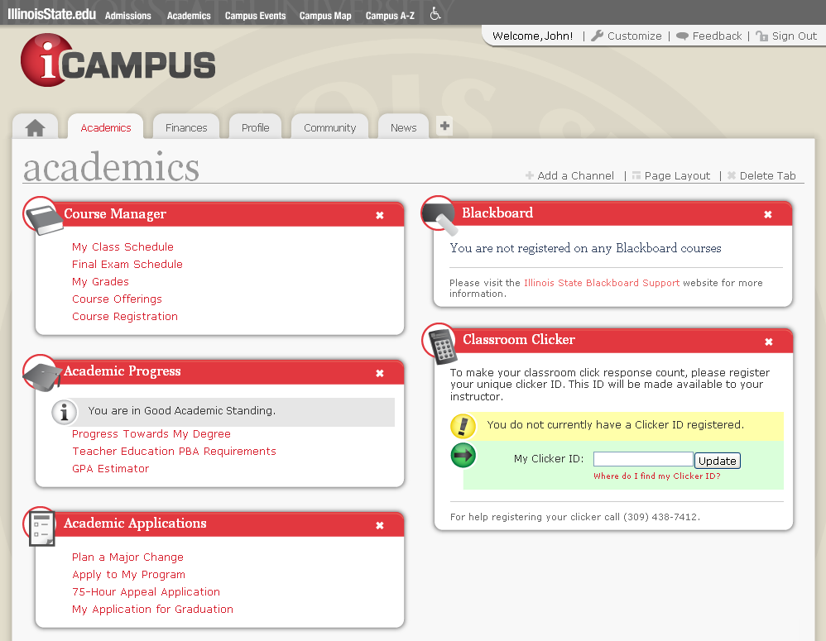
Where We Are Now – May 2010 Upgrade

Slide 17
iCampus Oversight Committee
Examine features and services
Manage the competing priorities
Identifies areas for improvement
Provides recommendations for new content
A platform to discuss the future of the portal
Members from diverse offices around campus:
  Registrar
  IT Staff
  Faculty
  Disability Concerns
  Student Accounts
  Student Advising

Slide 18
Decentralized Organization
Illinois State University has numerous independent IT offices, ranging from desktop support to application development, to server maintenance.
The campus portal is an extremely far-reaching project that receives information from, provides information to, or in some way impacts almost every one of these organizations.

Slide 19
Collaboration
Designate cross-unit project teams early on
  Should meet regularly
  Include all stakeholders
Write and revise timelines with approval from each group that has a deliverable, no matter how small

Slide 20
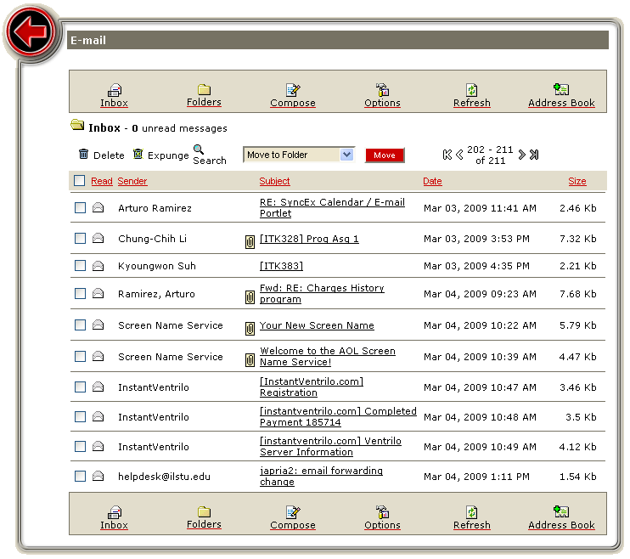
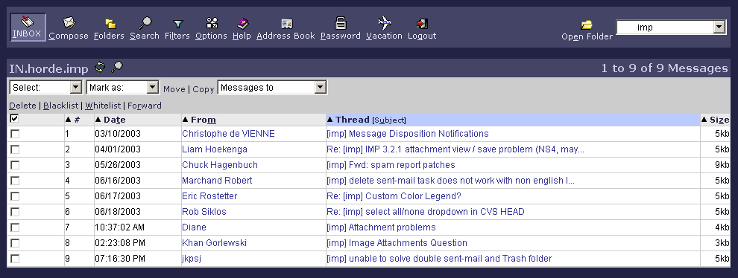
Utilizing Existing Resources
iCampus E-mail Portlet
ISU WebMail

Slide 21
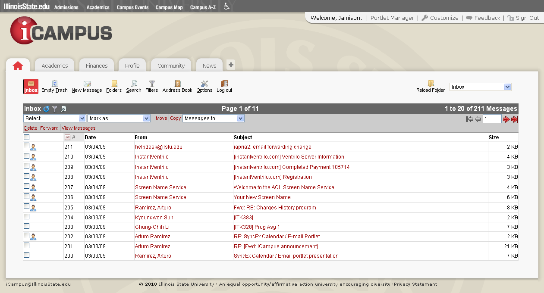
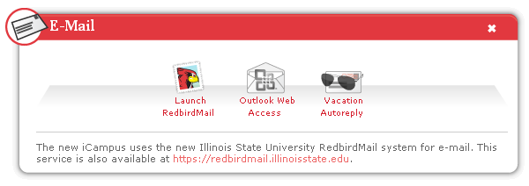
Utilizing Existing Resources

Slide 22
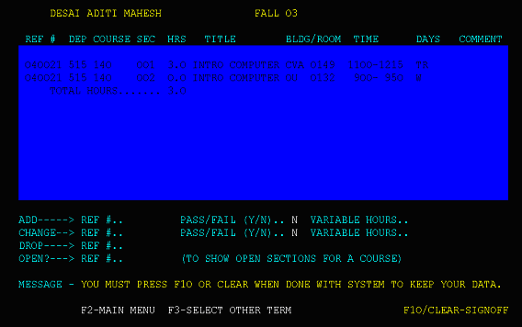
Expect Increased Use
As users become more comfortable using your systems, usage will increase.

Slide 23
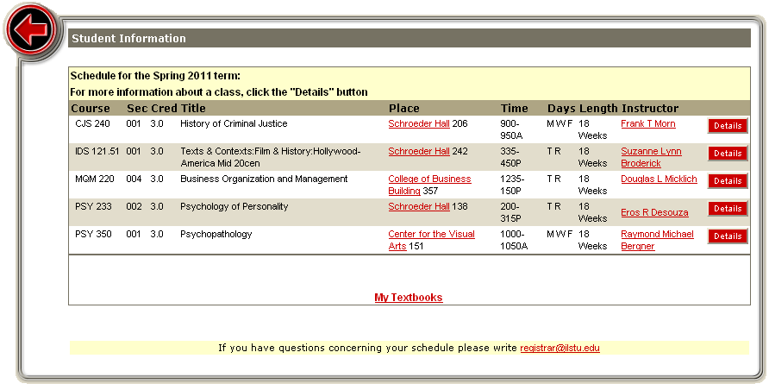
Expect Increased Use
As users become more comfortable using your systems, usage will increase.

Slide 24
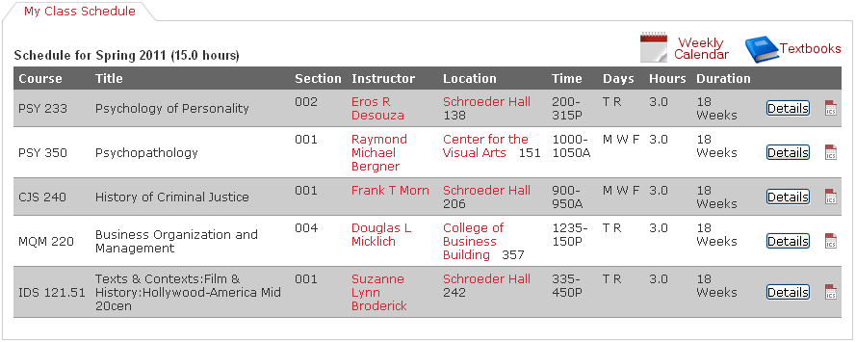
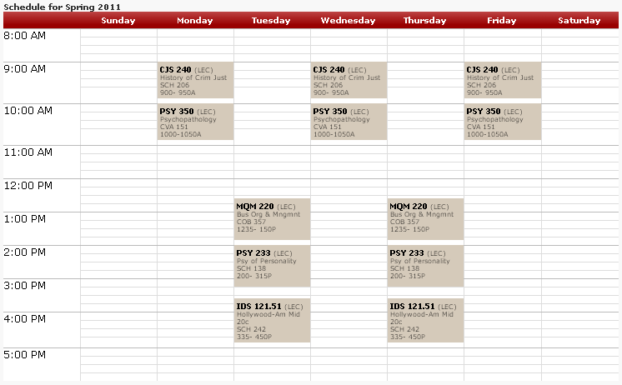
Expect Increased Use
As users become more comfortable using your systems, usage will increase.

Slide 25
Planning for Critical Mass
Always plan for peak load times:
  First day of registration
    Highest daily volume (steady throughout)
    Increased calls to expensive mainframe services
  Grade Release
    Highest instantaneous volume (busy for roughly one hour)
    High numbers of simultaneous logins causes concerns with initial data load
  Opening of Housing / Dining contracts
    Close to grade release in instantaneous volume
    Most used system that impacts our payment gateway (TouchNet)

Slide 26
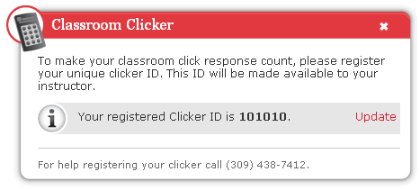
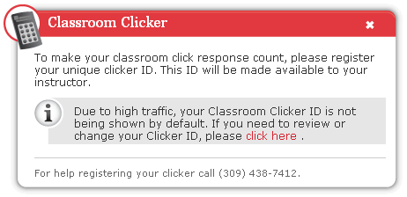
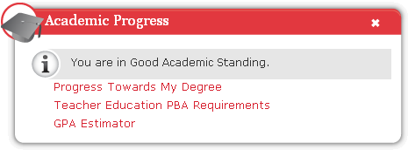
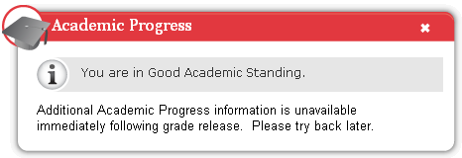
Alleviating Stress - Portal
Normal Traffic Day
Grade Release Day

Slide 27
Alleviating Stress – Supporting Services
Check all database queries and index tables properly
Index fields on LDAP for any filters used regularly by portal applications
Review and refactor any code that was repurposed for web application use
Review scalability for all supporting applications with plans for future traffic expectations.

Slide 28
Alleviating Stress - Systems
Standard Day: 20 instances
Heavy Volume: 24 or more instances
Proactive load testing against the main uPortal servers and every supporting service to identify bottlenecks
Monitoring all aspects at all times
Solaris Operating System Tuning

Slide 29
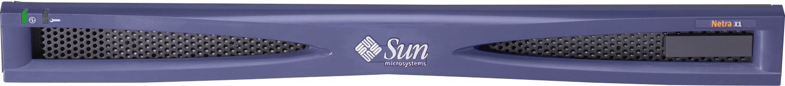
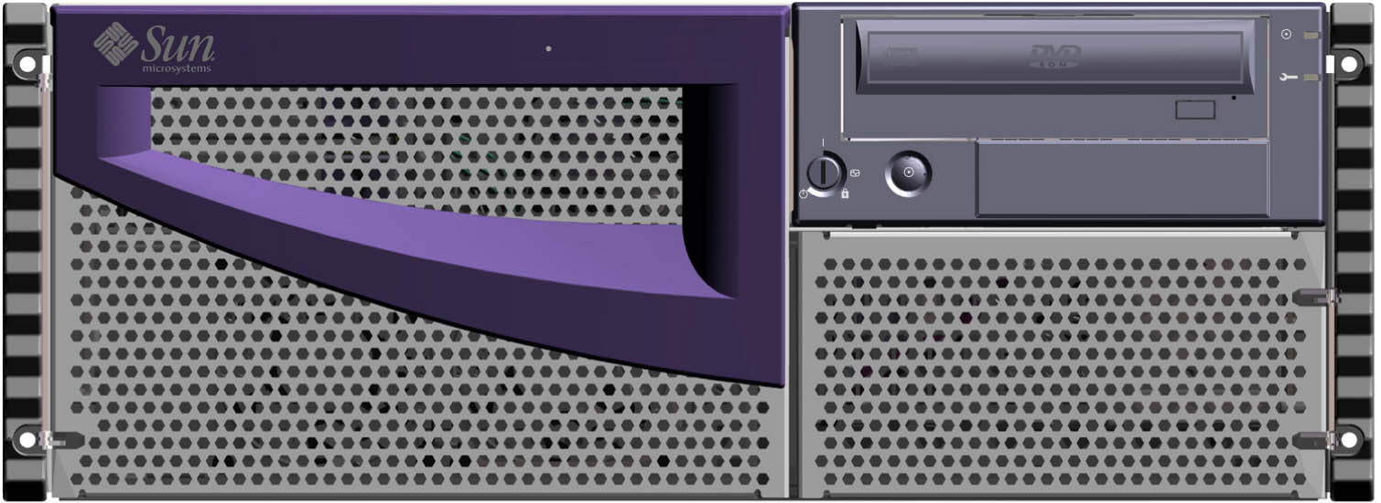

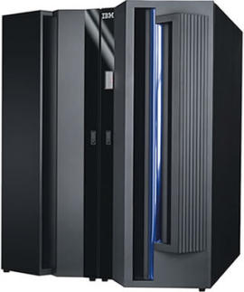
Initial (2002)
Architecture
Stevenson Hall
Data Center
Julian Hall
Data Center
Cisco Content Switches (CSS) were used for load balancing
1 load balancer in each datacenter doing separate load balancing
Complex networking was required to split traffic across both load balancers
Health probes were based on tomcat TCP port checks

Slide 30
Initial (2002)
Architecture
Stevenson Hall
Data Center
Julian Hall
Data Center
Web server hardware were SUN Netra X1 (Pizza boxes)
Each server having:
1 x 500mhz SPARC CPU
1gb memory
Each server used 2 Ethernet ports and 1 power outlet
Consumed 52 Ethernet ports and 26 power outlets in the datacenter
Process of adding capacity was very involved

Slide 31
Initial (2002)
Architecture
Stevenson Hall
Data Center
Julian Hall
Data Center
LDAP and Database layer
Both of these systems only existed in a single datacenter and were single points of failure.
We were lucky enough not to have any hardware failures during the times these SPOF systems were in use.

Slide 32
Initial (2002)
Architecture
Stevenson Hall
Data Center
Julian Hall
Data Center
Mainframe Layer
Houses student information
Eagle was used as a bridge to obtain information in xml from the mainframe COBOL programs.
There is only one mainframe.

Slide 33

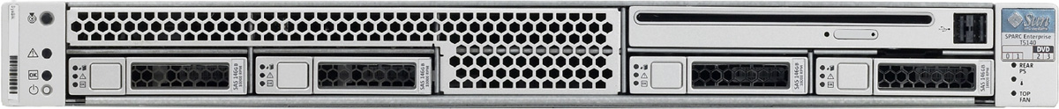
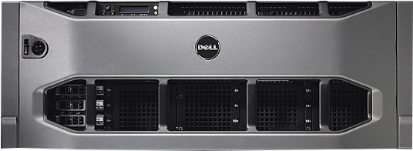
Current
Architecture
Stevenson Hall
Data Center
Julian Hall
Data Center
Cisco Ace modules are now used as Load Balancers
2 Ace modules in an Active/Passive configuration
Round-Robin Load balancing algorithm is used with successful distribution of load
Health probes are much more intelligent with application level checks

Slide 34
Current
Architecture
Stevenson Hall
Data Center
Julian Hall
Data Center
Web server hardware now consist of 4 components
2 x Sun T1000
2 x Sun T5140
Now only consuming 8 Ethernet ports and 8 power outlets in the datacenters
Actual web servers are virtualized using Solaris Logical Domains (LDOMs)
Adding more capacity is very simple and quick

Slide 35
Current
Architecture
Stevenson Hall
Data Center
Julian Hall
Data Center
T5140: 128 cpus/threads and up to 128 GB RAM available
- Gives us 32 quad core servers with 4GB RAM per 5140
T1000: 32 cpus/threads and up to 32GB RAM
Gives us 8 quad core servers with 4GB RAM per T1000
We have plenty of room for production, development and QA growth

Slide 36
Logical Domains
Portal Logical Domain / Guest OS
SPARC Solaris 10
Apache HTTPD 2.2
Apache Tomcat 6.0.29
Sun Java 1.6
uPortal 3.1.1
Samba 3.5.6

Slide 37
Current
Architecture
Stevenson Hall
Data Center
Julian Hall
Data Center
Supporting LDAP and MSSQL servers are no longer single points of failure.
2 LDAP servers sit behind a VIP more for availability than load balancing.
MS SQL is in a failover cluster using Microsoft’s HyperV Features.

Slide 38
Managing Costs
Virtualize hardware environment
- Reduced needed rack space, network, and power
- heavily increased computing capacity
Take advantage of open source software solutions
Avoid expensive consultant cost
Integrate existing applications

Slide 39
Closing
Check out our demonstration portal on laptops around the room
  http://icampusdemo.illinoisstate.edu
Evaluations Reminder
Thank You

Slide 40
Any Questions?
Majeed Abu-Qulbain
Lead Unix Administrator
mabuqu@IllinoisState.edu
Jamison Prianos
Portal Application Developer
japria2@IllinoisState.edu
Julie Prianos
Director, Web Support
japrian@IllinoisState.edu
Arturo Ramirez
Lead Portal Developer
aramir@IllinoisState.edu
Demo the iCampus Portal or download this presentation at http://icampusdemo.illinoisstate.edu

