Slide 1
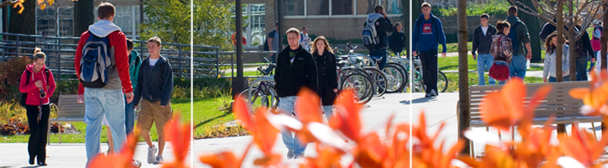
University of Wisconsin-Whitewater:
Transforming How Future Teachers View and Use Technology in the Classroom
Katy Heyning, Dean, College of Education and Professional Studies

Slide 2
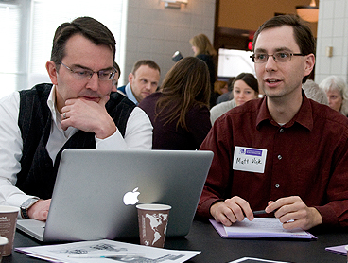
A case study of:
How Wisconsin Technology Initiative (WTI) sparked a retooling of the way future teachers are prepared.
Planning and using our new Active Collaboration Lab (ACL)
Moving faculty, staff and students into new ways of thinking and doing in collaboration with PK12 schools

Slide 3
University of Wisconsin-Whitewater
Four-year, coeducational, residential campus
Located between Madison, Milwaukee and Chicago
Enrollment: 11,615
Undergraduates: 10,230
Graduates: 1,385
Employees: 1,286
Faculty: 356
Academic staff: 503

Slide 4

College of Education & Professional Studies
One of 5 colleges on campus
Eight departments
About 2200 majors
About 110 faculty and many academic staff
Recommend about 400 people for teaching licenses per year
Place about 1200 students in schools at any one time

Slide 5
Changes began in 2009
New dean
New associate dean
New assistant dean
New department chairs
Strategic planning
New provost

Slide 6
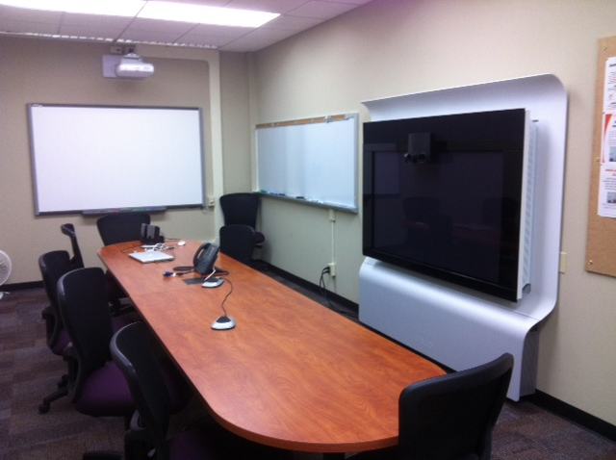
But it really began with this:

Slide 7
Unusual investment for teacher education
Talked about plans with our campus rep
Put me in touch with others in the area doing innovative things in education

Slide 8
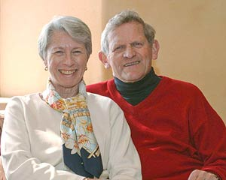

Wisconsin Technology Initiative
Funded in 2010 with donation by John & Tashia Morgridge
Advance use of technology in learning environments in Wisconsin
2011 applied for and received funding

Slide 9
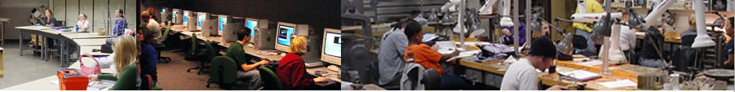
Simple three part plan:
Invest in faculty
Invest in students
Invest in equipment

Slide 10
Faculty Development – TECHNOLOGY FELLOWS PROGRAM
Many wanted to do more but didn’t know where to begin
Created Technology Fellows Program
4 faculty per term
.25 buyout from teaching duties
$500 travel money
Handheld device of their choice
Research requirement
Visit exemplars in the schools
Collaborative sharing
Give-back to college following term

Slide 11
Student Development – T-TUG
Teachers & Technology Users Group
Highly motivated cadre of shared interest
Lead the College and assist in planning
Fall “stuff the bus” trip to Flipped Classroom conference
Recruitment for Winterim course
Inaugural meeting on March 22nd
Plans to hire students using student help money

Slide 12
Invest in equipment – ACTIVE COLLABORATION LAB (ACL)
Build on the momentum of the Telepresence co-lab
Create interactive learning/teaching collaborative space
Create a technology sandbox for students to practice in
SMART board
Promethean board
LCD gaming space
Student Response Systems for checkout
Flexible classroom “pod” work
Use Cisco technology to enable two-way videoconferencing, recording of exemplar lessons and remote supervision

Slide 13
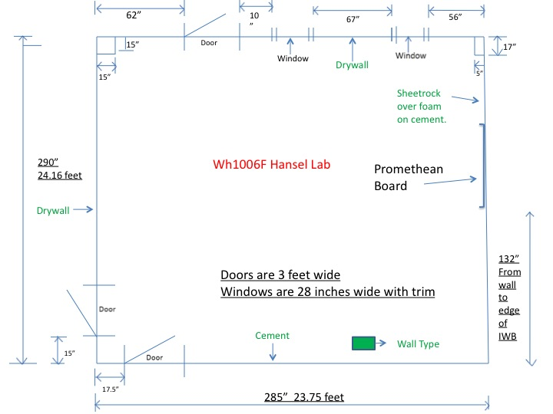
White Board/Gaming Area
White Board
Flexible seating (chairs/tables, etc.
Promethean Board
Workstation
Computer
SMART Board

Slide 14
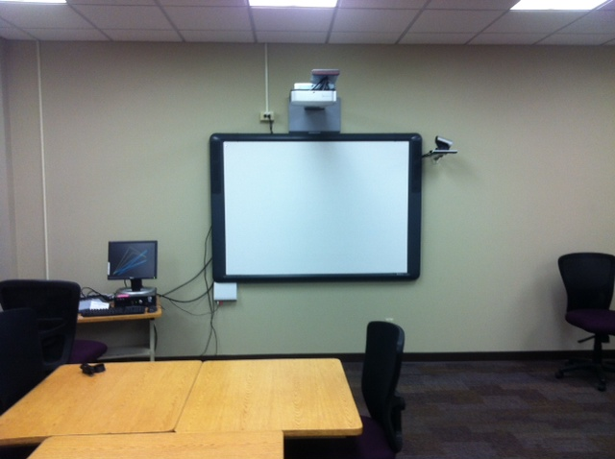
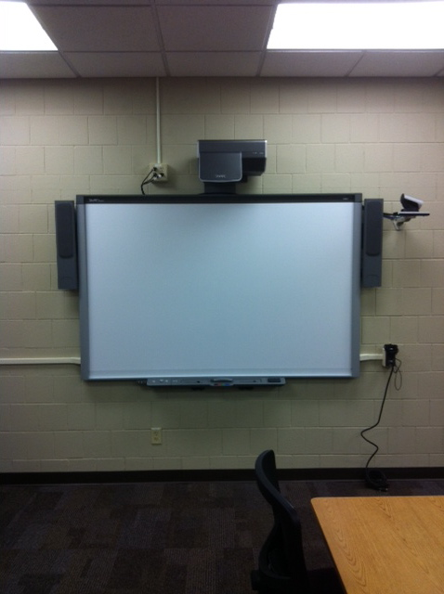
SMART board, camera & connections
Promethean board, camera & connections

Slide 15
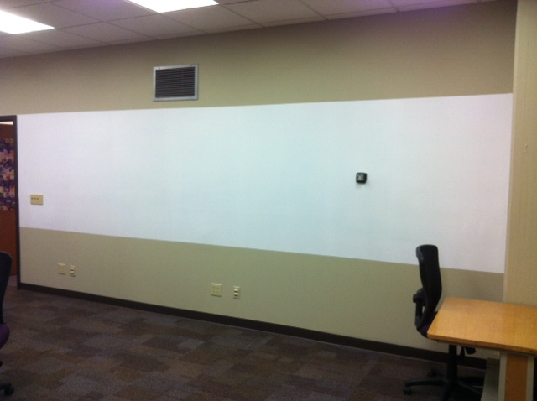
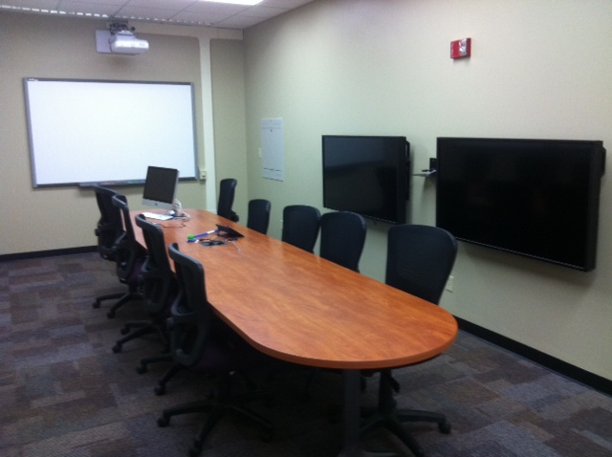
Room to write – whiteboard paint
New updated co-lab next to Telepresence co-lab

Slide 16
Yet to do:
Finalize furniture – (T-TUG student group designing)
Finalize hookup of Codec and recording features
Order gaming LCD screens and create center
Testing open house event

Slide 17
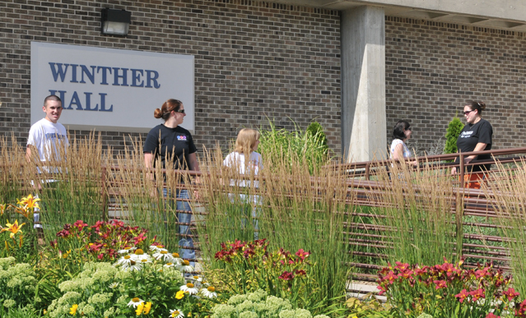
Where are we going with all of this?
“It doesn’t matter where you are –
you are nowhere compared to where you can go.”
– Bob Proctor

Slide 18
A few things this has already sparked:
Spring 2012 - Pilot online WebEx student teaching seminar for students in high-tech classrooms linking three districts
Fall 2012 – Faculty “give-back” on Technology Fellows research
Fall 2012 – Begin recording “exemplar” lessons and PK12/IHE sharing & professional development
Spring 2013 – Pilot virtual supervision of student teachers in select programs
Spring 2013 – work with rural Wisconsin schools to broaden placement footprint

Slide 19

Comments?
Questions?

