Slide 1
Understanding Student Use of Digital Learning Resources
Glenda Morgan Chuck Dziuban
Patsy Moskal Flora McMartin
Alan Wolf Josh Morrill

Slide 2
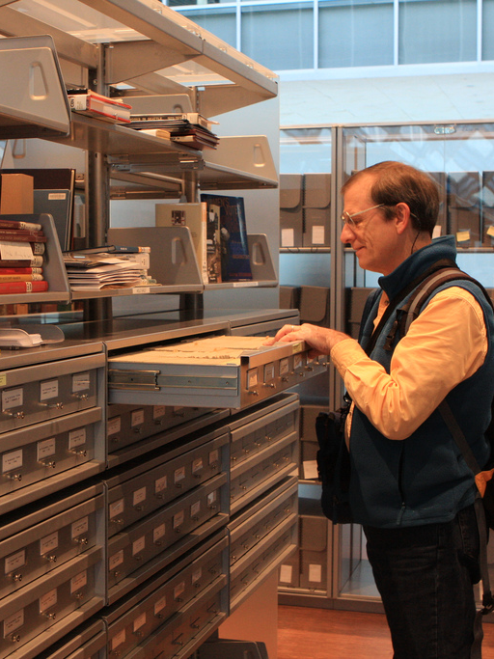
Why Study Use of Digital Resources
How people interact with scholarly content is changing
Roots in NSDL and other digital library initiatives
People had only studied how faculty used specific collections
No one knew how faculty found & used materials
Notes:
Brewbooks http://www.flickr.com/photos/brewbooks/4464892154

Slide 3
We Started Out Looking at Faculty Use of Digital Resources
2006 – 2009 – National survey of STEM instructors regarding their use of digital resources in teaching (n=4,439)
2009 – Large international survey of Physics instructors (n=9,275)
2011 – National study of Social Science faculty (n=1,037)

Slide 4
Research Questions - Faculty
What do faculty members do with the online digital resources they find at digital libraries, online collections, etc.?
Do faculty value digital resources?
How do faculty use digital resources for teaching purposes?
What are the barriers to their use of resources and digital libraries/collections?

Slide 5
How different are faculty from one another?
When we look at traditionally identified faculty populations, we saw few differences.
The type of institution where they serve
The amount of time that they have been teaching
Even discipline was less a factor than expected
As far as these traditional groups go, we have a homogenous population

Slide 6
Types of Digital Resources
Type of Resource | % Use Very Frequently
Digital images - visual | 42
Animations | 11
Data Sets | 22
Teaching, Learning Exercises | 28
Online scholarly resources | 49
Notes:
What is the relationship between how people value resources and how they use them?
I would argue that it is the frequency of use is not a proxy for quality of use, which is much harder to measure. So we do not know whether there is a contradiction between how faculty value the resources and their frequency of use.

Slide 7
Digital Resources – other findings
Google favorite starting point
Iterative process (satisficing)
Most are not authors of DRs
Tend to use DRs developed by others ‘as is’

Slide 8
Motivations
Strong Agreement
Top – Improve student learning
Stay abreast of professional developments
Keep material fresh
Help students learn difficult concepts
Agreement
Incorporating DR’s in class is fun
*Saves time

Slide 9
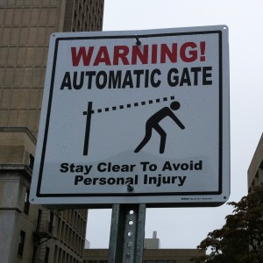
Barriers to use
Agreement
*More time
More useful DR available
More/better training in
Ambivalent
Institutional rewards for use
Disagreement
Access to dependable technology
Greater priority to institution
Photo Credit: Brandon
Notes:
http://www.mura.org/2010/10/gotta-watch-those-sneaky-gate-arms/

Slide 10
Conclusions about Faculty
Instructors are changing more slowly than the educational landscape
Need activation to overcome barriers and encourage adoption
Intrinsic motivation is a powerful force (but people do not have limitless reservoirs)
Still, students are a powerful extrinsic motivator

Slide 11
How do students use digital resources in their learning?

Slide 12
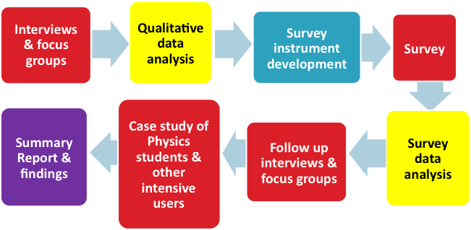
Research Questions - Students
What are the circumstances that motivate students to look for DRs?
Where to students start searching?
What criteria to students use to assess DRs?
What barriers to students face in finding & using DRs?
What kinds of DRs do students prefer?
Do students value “collections”?

Slide 13
Student Study – 2011 - 2013
Qualitative data analysis
Interviews & focus groups
Survey instrument development
Survey
Summary Report & findings
Case study of Physics students & other intensive users
Survey data analysis
Follow up interviews & focus groups

Slide 14
Qualitative Findings
Students making far more independent use of DRs than anticipated
Students desire content that is well organized and that teachers teach it to them
They seek information/explanation when teachers are doing a poor job of it.
Students seek video, but it is unclear if they prefer it
Differences between recordings of full lectures vs. chunks.
Students may be turning to new or different content providers faster than we discover them e.g. YouTube channels
Students may value collections more than their propensity to turn to Google may indicate, especially when directed to ‘authoritative’ sources

Slide 15
How and Why Students Use Digital Resources

Slide 16
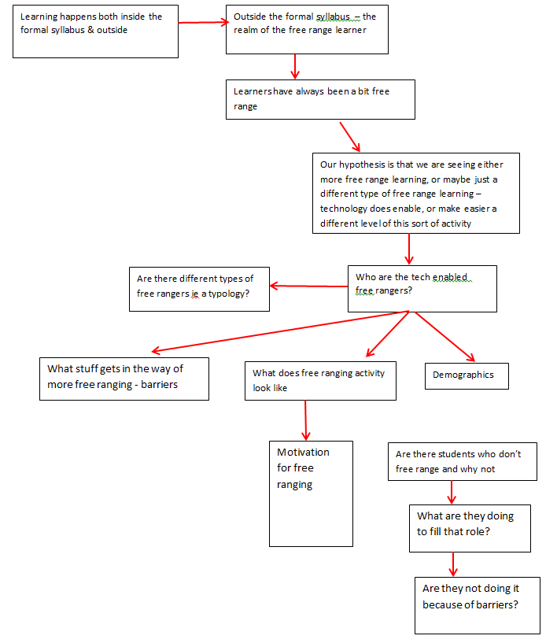

Slide 17
Formal Syllabus
Learning happens both inside and outside
Learners have always been a bit “free range”
Hypothesis
That we are seeing more free range learning – or a different type of free range learning
Who are the free rangers?
Free Rangers
Outside is the realm of the “free range learner”
Are there different types of free ranger?
Non Free Rangers
Demographics
Motivation
Barriers
Are there students who don’t free range, and why not?
What are they doing to fill that role

Slide 18
Survey strategy

Slide 19
Student Survey Lines of Inquiry
Where do students turn when they run into problems with schoolwork
Where do students turn when they are interested in a topic
General motivations for studying and academic work
Use of digital resources in class and students preferences

Slide 20
Pilot Survey
Online survey
Conducting pilot
2 faculty at UCF advertised to their classes
~50 responses
Asked students for feedback regarding questions that were confusing

Slide 21
Survey Strategy
Using survey administration company
Maintain large database of people
Can pre-screen on demographics
National sample
Removes researcher pressure on participants
Sample size of 40,000-60,000
Plan on 5% response rate

Slide 22
Survey Comparisons
The nature of this sample is providing us with three comparison groups:
Full & Part-time Students**
Former Students
Never Been / Not Currently Students

Slide 23
Survey Follow Ups
Our Motto is: “Explore BIG – Focused Refinement”
Possible Follow Ups:
Physics Students
UW-Madison / IL Students
Others?

Slide 24
Questions
Glenda Morgan gmorgan@illinois.edu
Joshua Morrill joshua@morrillsolutions.com
Alan Wolf alanwolf@wisc.edu
Co-Conspirators
Flora McMartin
Patsy Moskal
Chuck Dziuban

