Slide 1
Making a Difference on Campus and Beyond
Richard J. Bazile
David Dodd
Douglas Ruschman
Melissa Woo
March 26, 2012

Slide 2

Mentoring
www.educause.edu/mentoring
Notes:
Mentoring is often mentioned as one of the most important components of professional development.
Some things to remember about mentoring:
Mentoring can be either formal or informal
A mentor doesn’t have to be from the same field of work. In fact, you can broaden your knowledge considerably by looking outside your own field. For example, if you know IT, perhaps you might seek a mentor with finance expertise.
A mentor doesn’t necessarily have to be in a “higher” position than yours. Peer mentors can be equally as important as part of your professional development.
If you’ve benefitted from having a mentor, remember to pay it forward by mentoring someone else!
For additional information on mentoring, see the EDUCAUSE Mentoring Information Kit at http://www.educause.edu/mentoring

Slide 3
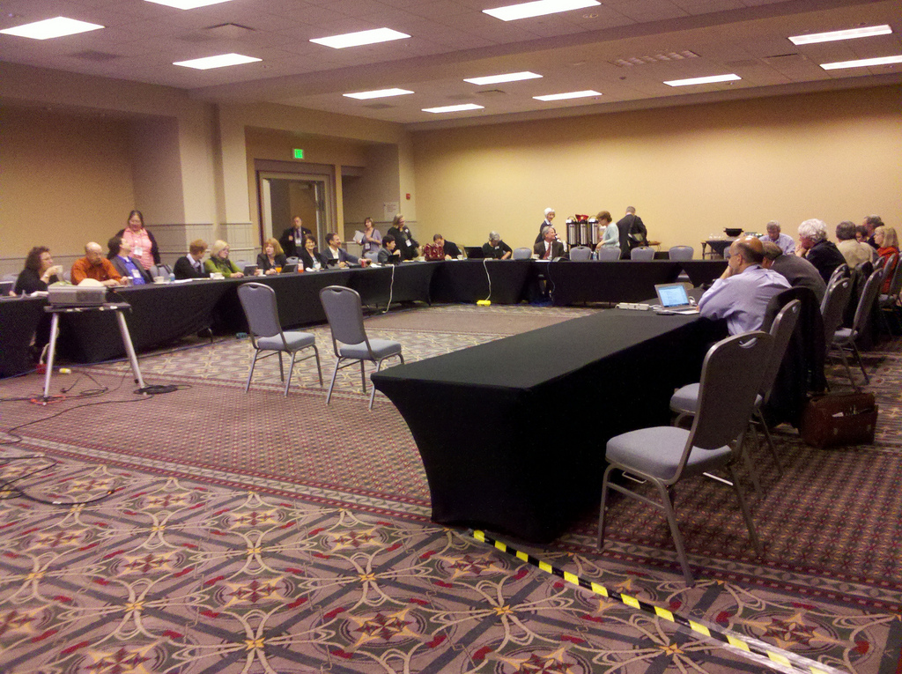
Service
www.educause.edu/pd
Notes:
A great way to further your professional development as well as provide service to the professional community is to volunteer with a professional society. This talk will focus on EDUCAUSE-related opportunities, but other professional societies will offer similar opportunities.
The EDUCAUSE Professional Development web site is located at http://www.educause.edu/pd – you can find links to many of the professional development opportunities offered through EDUCAUSE, including the EDUCAUSE Institutes and conferences.
Make sure you check out the EDUCAUSE Professional Development Opportunities grid at http://www.educause.edu/PDOpportunities . It serves as a “wayfinder” to help you locate opportunities ranging from low to high cost, and from early through advanced career stages.
I’ve been fortunate to have been offered many opportunities to volunteer time to EDUCAUSE, including:
EDUCAUSE 2012 Program Committee member; chair of the Infrastructure, Information Security, and Identity Management domain
Professional Development Advisory Committee (2009-2011); 2010 committee chair
2008 Midwest Regional EDUCAUSE Conference Program Committee member
I started volunteering with EDUCAUSE by convening conference sessions. A convener introduces the session and speakers, gets help if there are room or A/V issues, and ensures that the session starts and ends on time. EDUCAUSE conferences generally have links on their web sites that allow you to volunteer to convene specific sessions.
The other way that I started out volunteering with EDUCAUSE was by being a reviewer for conference presentation proposals. Presentation reviewers are recruited through a variety of methods. EDUCAUSE tends to keep lists of past reviewers who are often asked if they are willing to volunteer again. Conference session track/domain chairs will also reach out through their professional networks to seek volunteers as well. Finally, EDUCAUSE keeps lists of people who have indicated that they are interested in helping out with future conferences.
To register for more formal volunteer opportunities with EDUCAUSE, such as serving on an advisory committee or a conference program committee, visit http://net.educause.edu/VolunteerOpportunities/861 to complete a Volunteer Interest Form. Please keep in mind that many, many people indicated interest in volunteering for EDUCAUSE activities, so don’t be discouraged if you aren’t offered the opportunity of your interest the first time; keep trying!
Other ways that you can contribute to the professional community include:
Conference sessions (presentations, discussion facilitation) – do you have knowledge/skills/abilities to share with others? Consider submitting conference presentation proposals.
Consider writing articles for publication in professional journals.
Get involved in social networks with other like-minded professionals.
Suggest a new and different way to contribute to the community!
(By the way, in case anyone is wondering about the photo, it’s of the EDUCAUSE 2012 Program Committee meeting that was held during the EDUCAUSE 2011 Conference in Philadelphia.)

Slide 4

Networking
For introverts:
The power of introverts - Susan Cain – TED 2012 Talk
http://www.ted.com/talks/lang/en/susan_cain_the_power_of_introverts.html
The Introvert’s Guide to Success in Business and Leadership – Lisa Petrilli - ebook
http://www.lisapetrilli.com/the-introverts-guide/
Notes:
You’ve probably heard this over and over again, but networking is genuinely extremely important to your professional development and career advancement. Period.
Networking can help you find other positions if you’re actively seeking (and sometimes when you’re not!). This is particularly true for senior-level positions, such as CIO/Library Director/etc., types of positions. Yes it’s cliché, but it’s often all about who you know.
Networking can help you gain information and knowledge you need to perform your current job better. Make sure to reach out to your peers and exchange information, challenges, etc. – you’ll be pleasantly surprised at how important a network of peers can be if you are facing a challenge and need help!
I realize that networking is often not a very comfortable thought to many people, particularly those who are more introverted than extraverted. I’ve listed a couple of sources that some introverted colleagues of mine have found useful. The TED Talk by Susan Cain is inspiring because it celebrates the strengths that introverts bring to society. The ebook by Lisa Petrilli offers tips for introverts who know they need to network but dread it. The Petrilli book also contains a short chapter near the end that provides advice for extraverts who manage introverts.

Slide 5
UNDERSTAND KEY TERMS AND MAKE SURE YOUR STAFF DOES TOO
Enrollment
  Inquiry
  Applicant (Stealth)
  Accepted
  Deposited
  Enrolled
Fundraising
  Donor (3 T’s)
  LYBNT
University
  Mission
  Vision
  Values
  Strategic Goals
  Departmental Goals

Slide 6
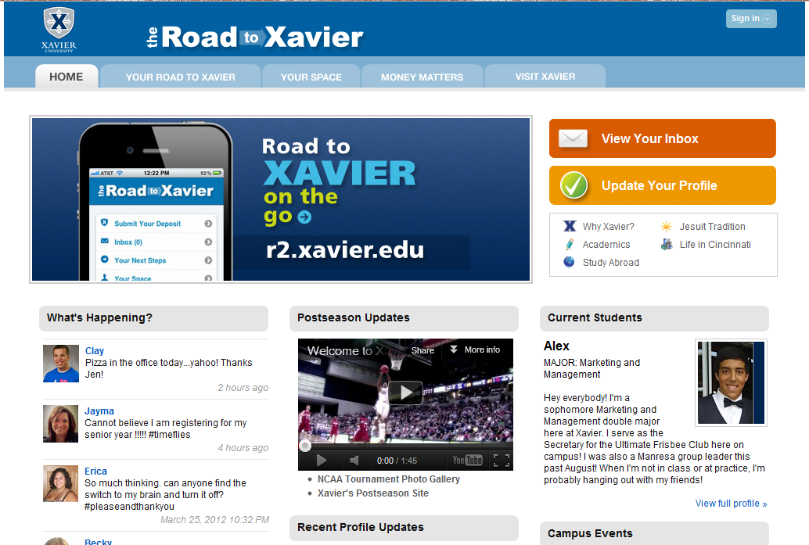
Align with university strategic goals

Slide 7
DEVELOP YOUR TEAM
Good leaders are measured on the success of their entire organization not just themselves
Make your team better:
  Bring in a speaker once a month
  Invite your staff to make presentations… to your team, senior administrators, Trustees
  Encourage professional development
  Develop positive PR for your organization
  Hold informal sessions about learning topics
  Hold a day, then weekly time afterward

Slide 8
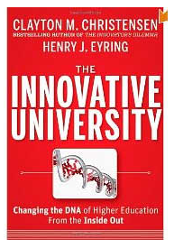

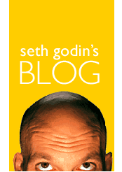
READ
Can Higher Education Be Fixed, Forbes
The Cluetrain Manifesto
The Future of the Library, Seth Godin
Read the Chronicle

Slide 9
Richard J. Bazile
David Dodd
Douglas Ruschman
Melissa Woo
EVALUATION www.educause.edu/MWRC12/Program/SESS32

